Slide 1
Chapter 5
Protein Function

Slide 2
1. Functions of globular proteins
Storage of ions and molecules
myoglobin, ferritin
Transport of ions and molecules
hemoglobin, serotonin transporter
Defense against pathogens
antibodies, cytokines
Muscle contraction
actin, myosin
Biological catalysis
chymotrypsin, lysozyme

Slide 3
2. Interaction with other molecules
The function of many proteins involve the reversible binding with other molecules
A molecule bound reversibly by a protein is called a ligand (typically a small molecule)
A region in the protein where the ligand binds is called the binding site
Ligand binds via noncovalent interactions, which enables the interactions to be transient
Ligand binding is often coupled to conformational changes (induced fit)
In multisubunit proteins, conformational changes in one subunit can affect the others (cooperativity)

Slide 4
Binding: quantitative description
Consider a process in which a ligand (L)
binds reversibly to a site in the protein (P)
The kinetics of such a process is described by: the association rate k_{a}
the dissociation rate k_{d}
After some time, the process will reach the equilibrium where the association rate and the dissociation rates are equal
The equilibrium composition is characterized by the association constant K_{a}
k_{a}
+
L
P
k_{d}
PL

Slide 5
Binding: analysis in terms of the bound fraction
In practice, we can often determine the fraction of occupied binding sites
Substituting [PL] with K_{a}[L][P], we’ll eliminate [PL]
Eliminating [P] and rearranging gives the result in terms of association constant
In terms of the more commonly used dissociation constant K_{d}:

Slide 6
Binding: graphical analysis
The fraction of bound sites depends on the free ligand concentration and K_{d}
In a typical experiment, ligand concentration is the known independent variable
K_{d} can be determined graphically
[L] ≈ [L]_{total}

Slide 7
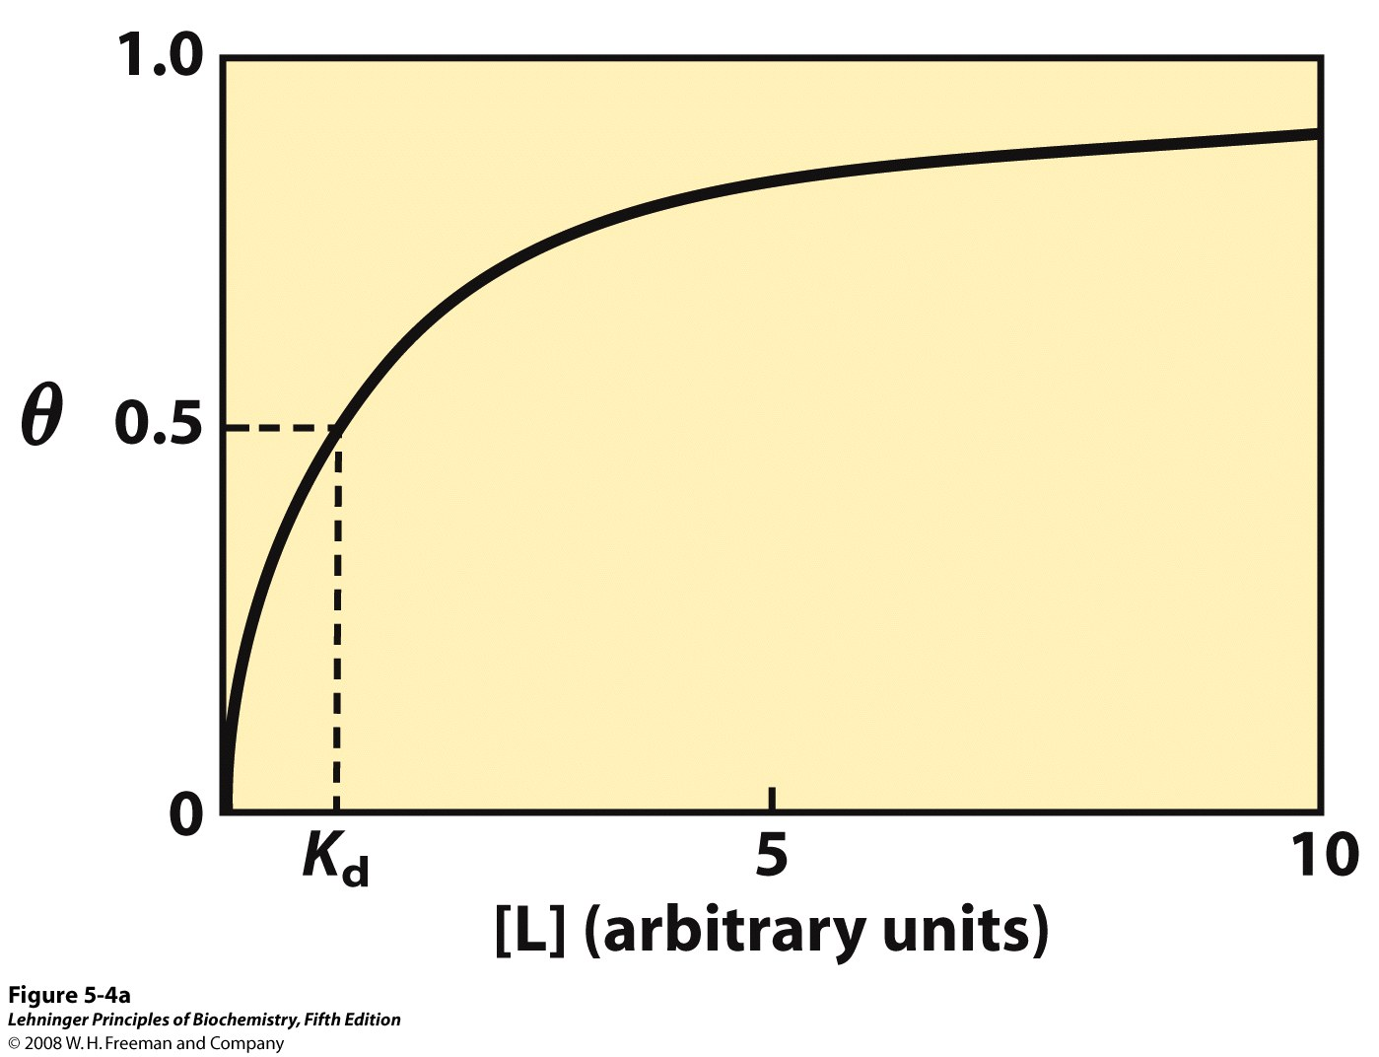
The [L] at which half of the available ligand-binding sites are occupied is equivalent to 1/K_{a}, or K_{d}
Graphical representation of ligand binding
Notes:
FIGURE 5-4a Graphical representations of ligand binding.

Slide 8
Graphical representation of ligand binding
(rectangular hyperbola - 矩形双曲线)
horizontal asymptote (水平渐近线) at θ = 1
vertical asymptote (垂直渐近线) at [L] = - K_{d}
Notes:
FIGURE 5-4a Graphical representations of ligand binding.

Slide 9
Binding: thermodynamic connections
Interaction strength can be expressed as:
association (binding) constant K_{a}, units M⁻¹
dissociation constant K_{d}, units M, K_{d} = 1/K_{a}
interaction (binding) free energy ΔGº, units: kJ/mol
Definitions:
K_{a} = [PL]/[P][L] K_{d}=[P][L]/[PL]
In practice, K_{d} is used much more often than K_{a} to express the affinity of a protein for a ligand
Magnitudes
Strong binding: K_{d} < 10 nM
Weak binding: K_{d} > 10 μM

Slide 10
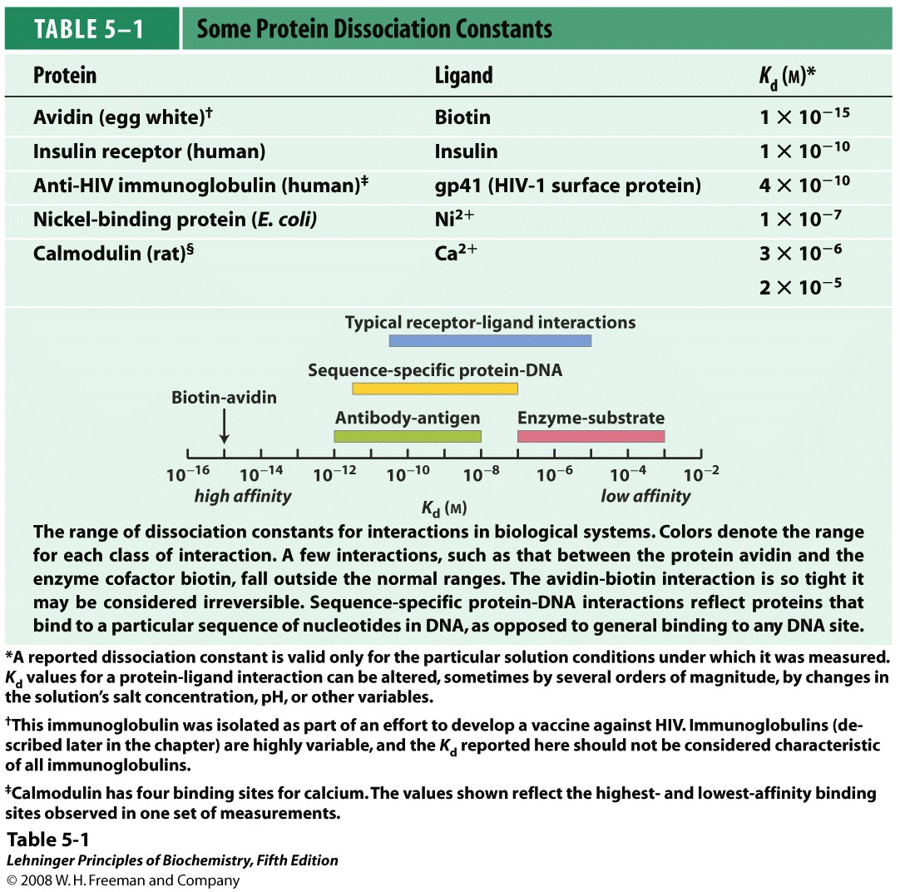

Slide 11
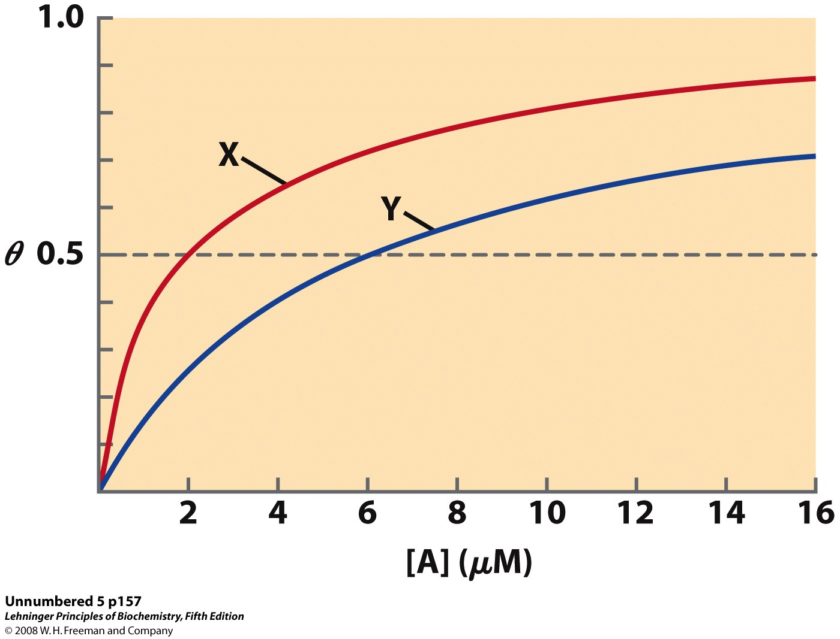
Examples of binding strength
Which protein has a greater affinity for ligand A?

Slide 12
Binding specificity: Lock and Key Model
Proteins typically have high specificity: only certain ligands bind
High specificity can be explained by the complementarity in size, shape, charge or hydrophobic/hydrophilic character between the binding site and the ligand
“Lock and Key” model by Emil Fisher (1894) assumes that complementary surfaces are preformed
+

Slide 13
Binding specificity: Induced Fit Model
Conformational changes may occur upon ligand binding (proposed by Daniel Koshland in 1958)
This adaptation is called the induced fit
Induced fit allows for tighter binding of the ligand
Induced fit can increase the affinity of the protein for a second ligand
Both the ligand and the protein can change their conformations
+

Slide 14
3. Function of myoglobin
O₂ is poorly soluble in aqueous solution
Protein side-chains lack affinity for O₂
Some transition metals bind O₂ well but would generate free radicals if free in solution
Organometallic compounds such as heme are more suitable but Fe²⁺ in free heme could be oxidized to Fe³⁺ if two heme molecules share an oxygen molecule
Solution: capture the oxygen molecule with heme that is sequestered inside the protein
Myoglobin is the main oxygen storage protein in muscle, particularly abundant in the muscles of diving marine animals such as seals and whales

Slide 15
Structure of heme
The heme group is present in myoglobin, hemoglobin, and many other proteins, designated heme proteins
Heme consists of a complex organic ring structure, protoporphyrin IX, with a bound iron atom in its ferrous (Fe²⁺) state
The iron atom of heme has six coordination bonds: four in the plane of, and bonded to, the flat porphyrin ring system, and the other two perpendicular to it
Iron in the Fe²⁺ state binds O₂ reversibly

Slide 16
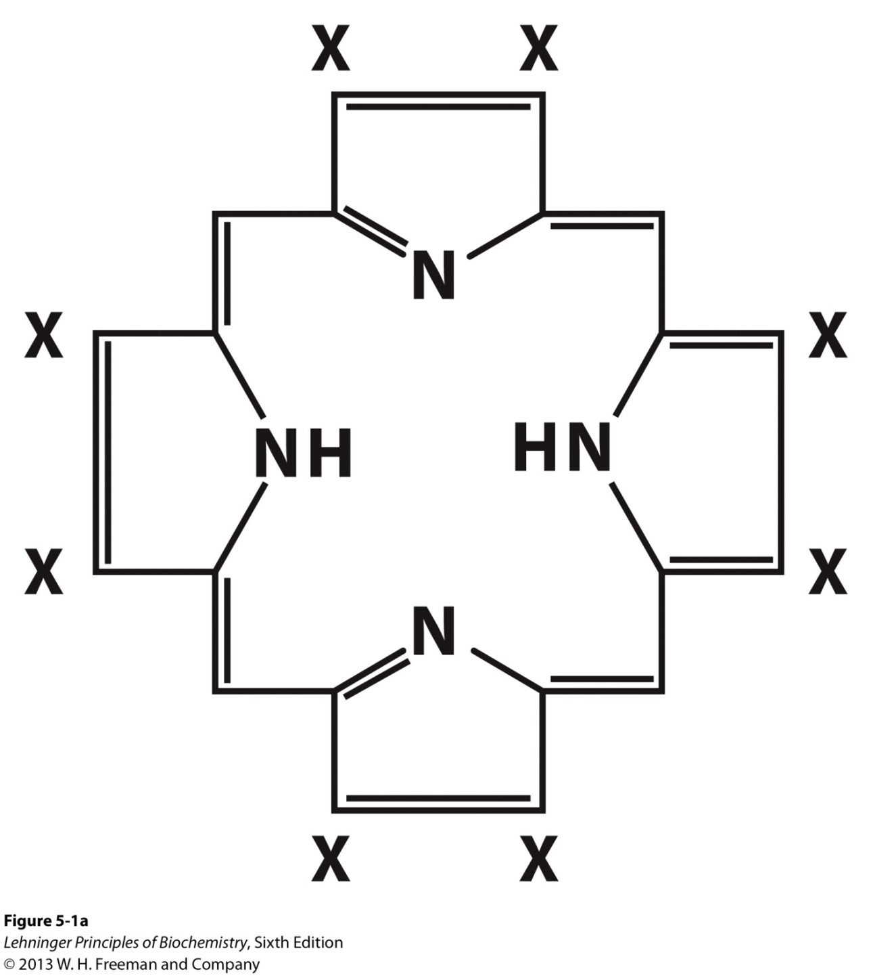
Porphyrins consist of four pyrrole rings linked by methene bridges

Slide 17
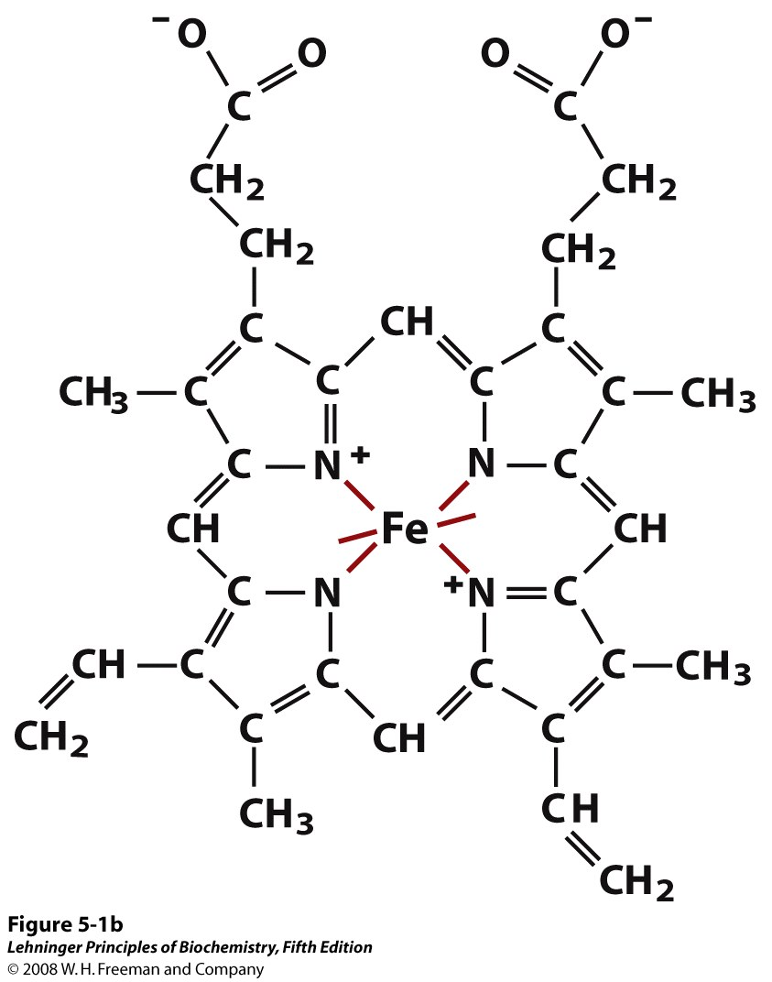
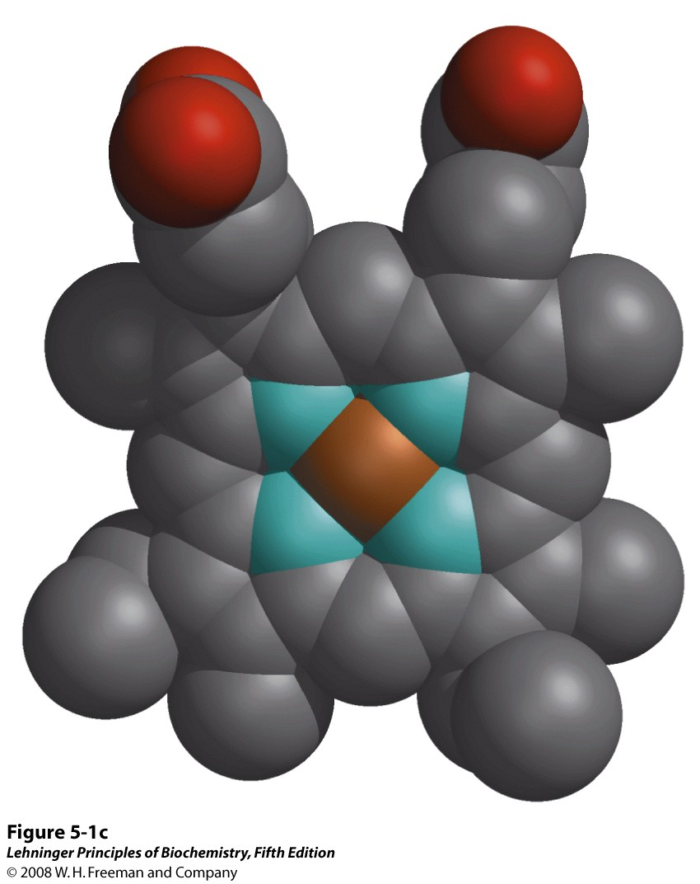
The heme group
Notes:
FIGURE 5-1b Heme. (b, c) Two representations of heme (derived from PDB ID 1CCR). The iron atom of heme has six coordination bonds: four in the plane of, and bonded to, the flat porphyrin ring system, and (d) two perpendicular to it.

Slide 18
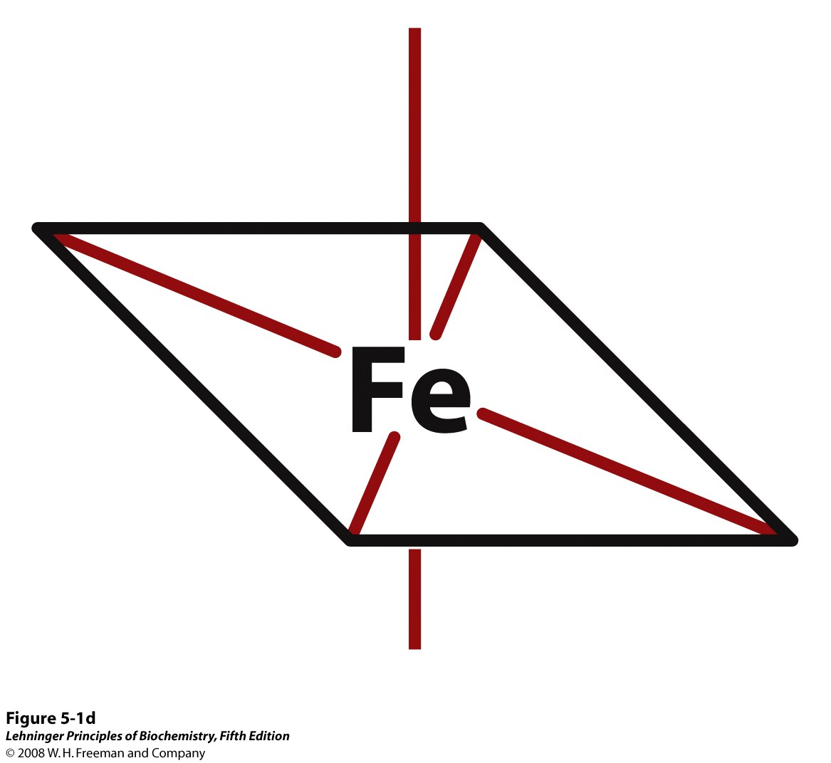
The iron atom of heme has six coordination bonds: four in the plane of, and bonded to, the flat porphyrin ring system, and two perpendicular to it.
Notes:
FIGURE 5-1d Heme.

Slide 19
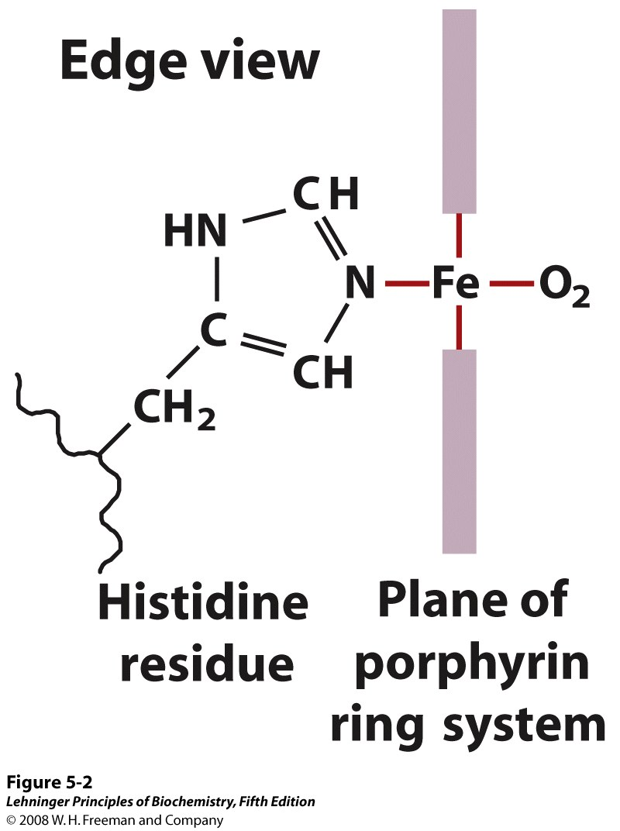
(His F8, proximal His)
The heme group viewed from the side
Notes:
FIGURE 5-2 The heme group viewed from the side. This view shows the two coordination bonds to Fe²⁺ that are perpendicular to the porphyrin ring system. One is occupied by a His residue, sometimes called the proximal His; the other is the binding site for oxygen. The remaining four coordination bonds are in the plane of, and bonded to, the flat porphyrin ring system.

Slide 20
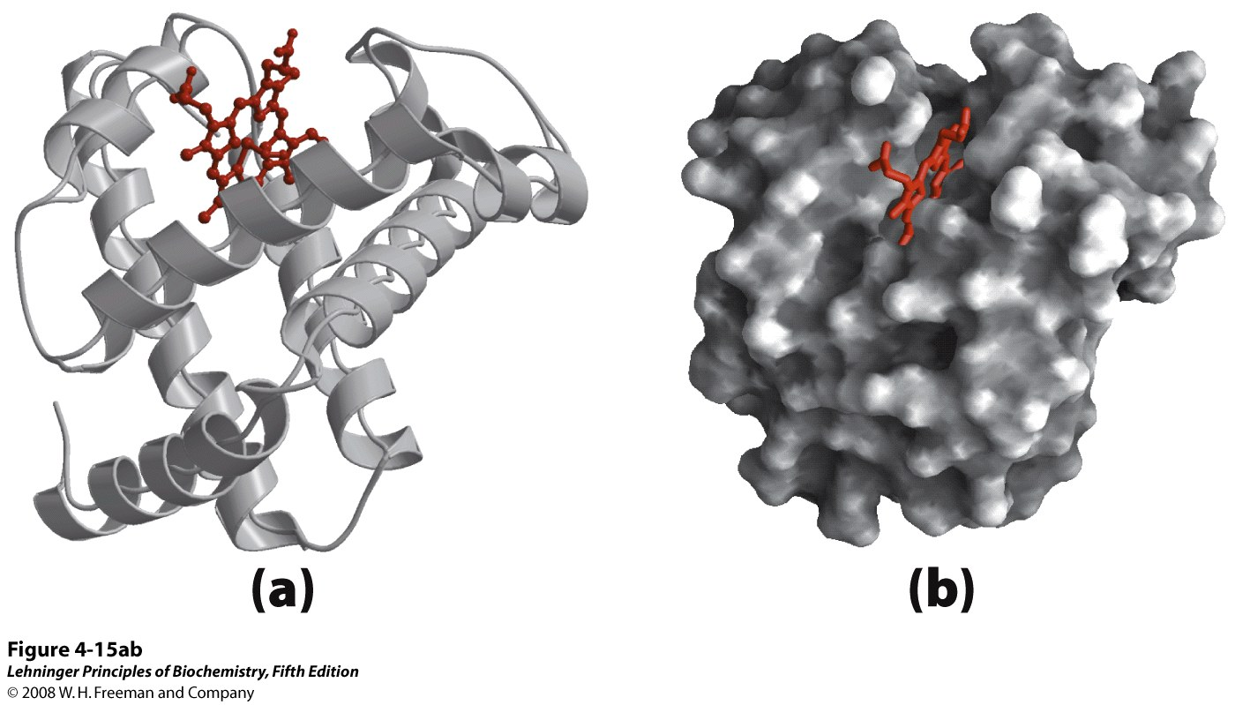
Heme
Tertiary structure of sperm whale myoglobin
Single polypeptide chain, 153 amino acids, M_{r} 16,700
70% main chain folded into 8 α-helices (right-handed)
Notes:
FIGURE 4-15a,b (PDB ID 1MBO) Orientation of the protein is similar in (a) through (d); the heme group is shown in red. In addition to illustrating the myoglobin structure, this figure provides examples of several different ways to display protein structure. (a) The polypeptide backbone in a ribbon representation of a type introduced by Jane Richardson, which highlights regions of secondary structure. The α-helical regions are evident. (b) Surface contour image; this is useful for visualizing pockets in the protein where other molecules might bind. (c) Ribbon representation including side chains (blue) for the hydrophobic residues Leu, Ile, Val, and Phe. (d) Space-filling model with all amino acid side chains. Each atom is represented by a sphere encompassing its van der Waals radius. The hydrophobic residues are again shown in blue; most are buried in the interior of the protein and thus not visible.

Slide 21
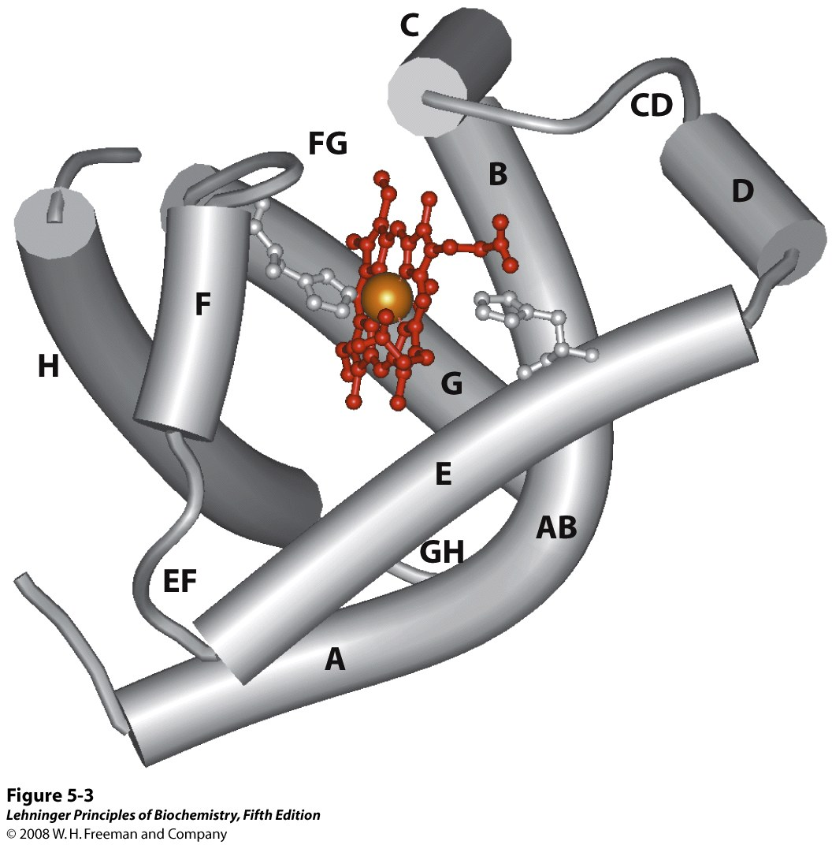
heme
The eight α-helical segments (shown here as cylinders) are labeled A through H.
Nonhelical residues in the bends that connect them are labeled AB, CD, EF, and
so forth, indicating the segments they interconnect. The heme is bound in a
pocket made up largely of the E and F helices, although amino acid
residues from other segments of the protein also participate.
Notes:
FIGURE 5-3. (PDB ID 1MBO) The eight α-helical segments (shown here as cylinders) are labeled A through H. Nonhelical residues in the bends that connect them are labeled AB, CD, EF, and so forth, indicating the segments they interconnect. A few bends, including BC and DE, are abrupt and do not contain any residues; these are not normally labeled. (The short segment visible between D and E is an artifact of the computer representation.) The heme is bound in a pocket made up largely of the E and F helices, although amino acid residues from other segments of the protein also participate.

Slide 22
Spectroscopic detection of oxygen binding to myoglobin
The heme group is a strong chromophore that absorbs both in ultraviolet and visible range
Ferrous form (Fe²⁺ ) without oxygen has an intense Soret band at 429 nm
Oxygen binding alters the electronic properties of the heme, and shifts the position of the Soret band to 414 nm
Binding of oxygen can be monitored by UV-Vis spectrophotometry

Slide 23
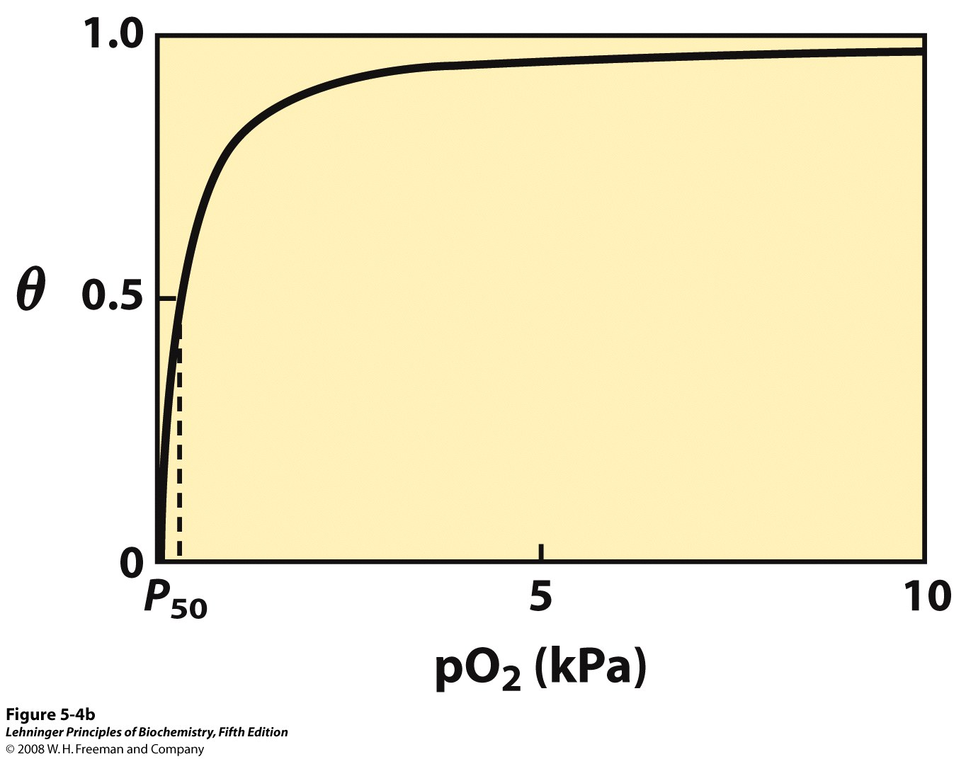
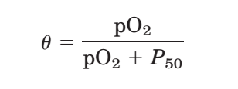
Binding of oxygen to myoglobin
The partial pressure of O₂ in the air above the solution is
expressed in kilopascals (kPa). Oxygen binds tightly
to myoglobin, with a P₅₀ of only 0.26 kPa.
The fraction of binding sites occupied by O₂ is a
hyperbolic function of pO₂.
Notes:
FIGURE 5-4 Graphical representations of ligand binding.

Slide 24
Binding of carbon monoxide
CO has similar size and shape to O₂; it can fit to the same binding site
The K_{d} for CO binding to free heme is 20,000 times lower than that for O₂, but CO binds to the heme in myoglobin only about 200 times better than oxygen due to steric hindrance
CO is highly toxic as it competes with O₂. It blocks the function of myoglobin, hemoglobin, and mitochondrial cytochromes that are involved in oxidative phosphorylation

Slide 25
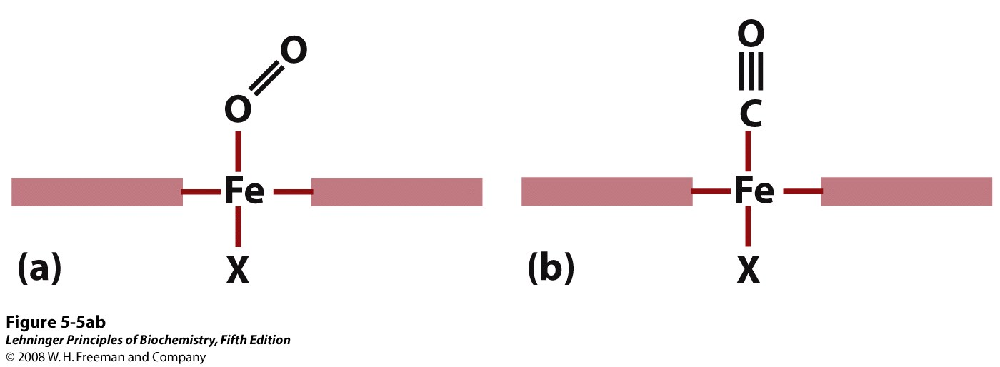
Oxygen binds to heme with the O₂ axis at an angle, a binding conformation readily accommodated by myoglobin. Carbon monoxide binds to free heme with the CO axis perpendicular to the plane of the porphyrin ring. When binding to the heme in myoglobin, CO is forced to adopt a slight angle because the perpendicular arrangement is sterically blocked by His E7, the distal His. This effect weakens the binding of CO to myoglobin.

Slide 26
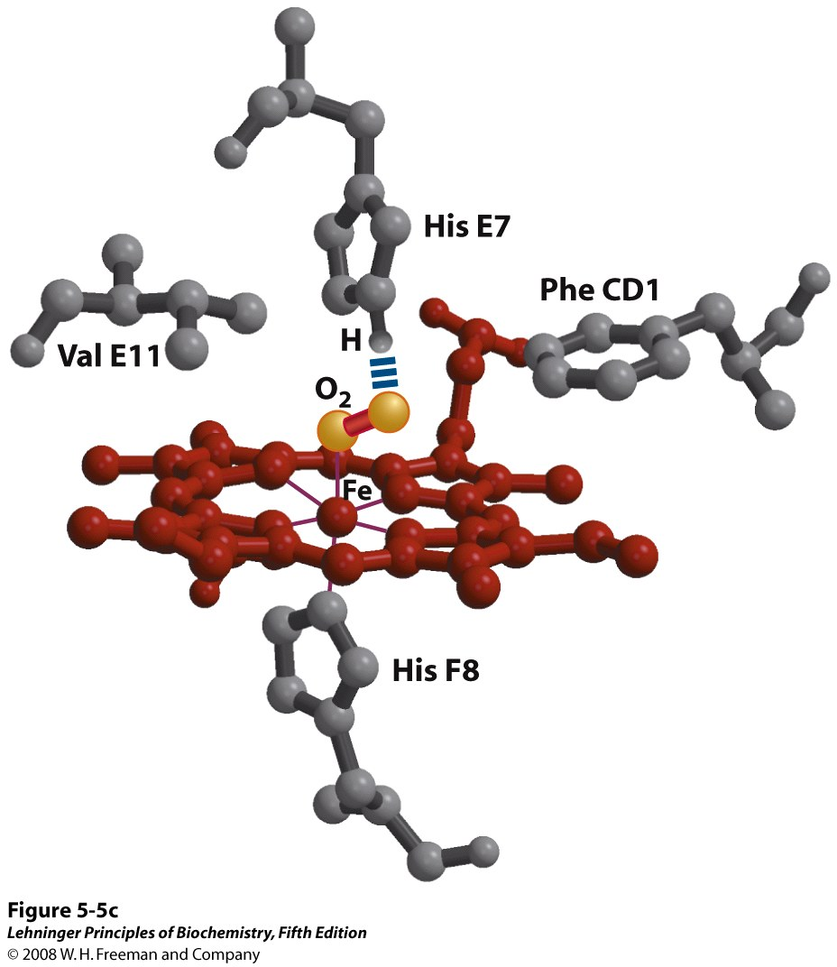
(distal His)
The bound O₂ is hydrogen-bonded to the distal His, His E7 (His⁶⁴), further facilitating the binding of O₂.
(proximal His)
Steric effects caused by ligand binding to the heme of myoglobin
Notes:
FIGURE 5-5c Steric effects caused by ligand binding to the heme of myoglobin.

Slide 27
Could myoglobin work as a good O₂ transporter?
Oxygen binds tightly to myoglobin, with a P₅₀ of only 0.26 kPa.
pO₂ in lungs is about 13 kPa: it binds oxygen well.
pO₂ in tissues is about 4 kPa: it will not release it!
Would lowering the affinity (P₅₀) of myoglobin to oxygen help?
For effective transport affinity must vary with pO₂.

Slide 28
How can affinity to oxygen change
Must be a protein with multiple binding sites
Binding sites must be able to interact with each other
This phenomenon is called cooperativity
positive cooperativity: first binding event increases affinity at remaining sites
negative cooperativity: first binding event reduces affinity at remaining sites

Slide 29
4. Function of hemoglobin
Carries all the O₂ required by cells from the lungs to the tissues
Also carries two end products of cellular metabolism (CO₂ and H⁺) from the tissues to the lungs and the kidneys for excretion (about 40% H⁺ and 15-20% CO₂)
The binding of H⁺ and CO₂ is inversely related to the binding of O₂

Slide 30
Structure of hemoglobin
Hemoglobin (Hb) is a tetramer of two subunits (α₂β₂), M_{r} 64,500
Each subunit contains a heme prosthetic group and is capable of binding one molecule of O₂
The three-dimensional structure of α and β subunits are very similar to that of myoglobin
Noncovalent interactions play important roles in stabilizing the quaternary structure
The strongest subunit interactions occur between unlike subunits, such as α₁β₁ and α₂β₂
Two major conformations: R (relax) and T (tense) state
O₂ binding promotes transition to the R state

Slide 31
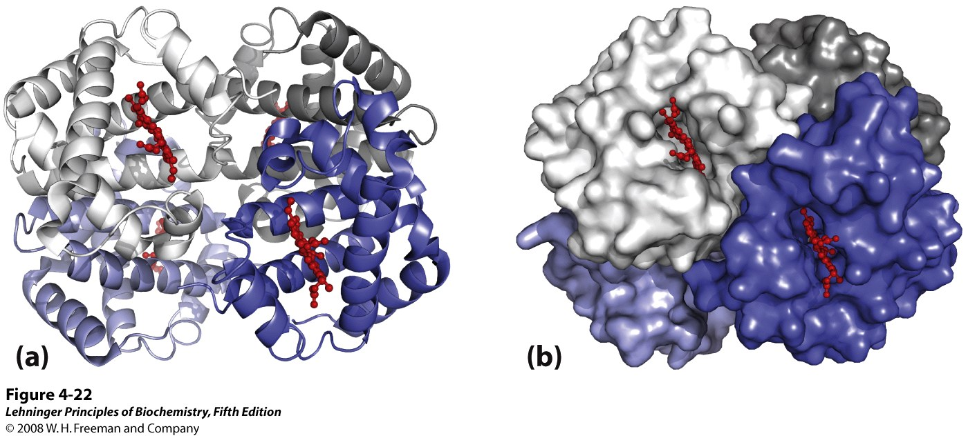
Quaternary structure of deoxyhemoglobin
The structure of the two identical α subunits (grey) is similar to, but not identical with that of the two identical β subunits (blue). The molecule contains four heme groups (red).
Notes:
FIGURE 4-22 (PDB ID 2HHB) X-ray diffraction analysis of deoxyhemoglobin (hemoglobin without oxygen molecules bound to the heme groups) shows how the four polypeptide subunits are packed together. (a) A ribbon representation. (b) A surface contour model. The α subunits are shown in shades of gray; the β subunits in shades of blue. Note that the heme groups (red) are relatively far apart.

Slide 32
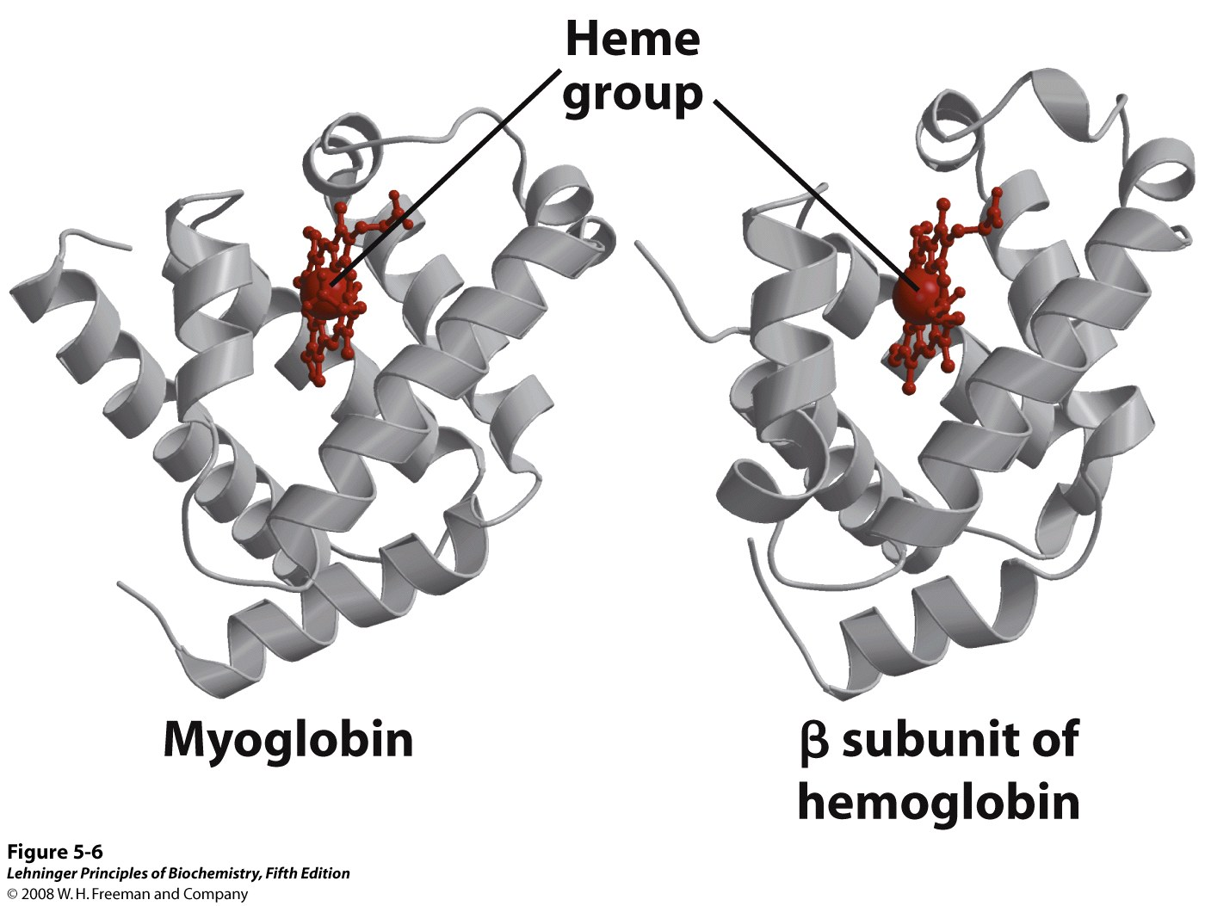
Comparison of the structures of myoglobin and the β subunit of hemoglobin
Notes:
FIGURE 5-6 Comparison of the structures of myoglobin (PDB ID 1MBO) and the β subunit of hemoglobin (derived from PDB ID 1HGA).

Slide 33
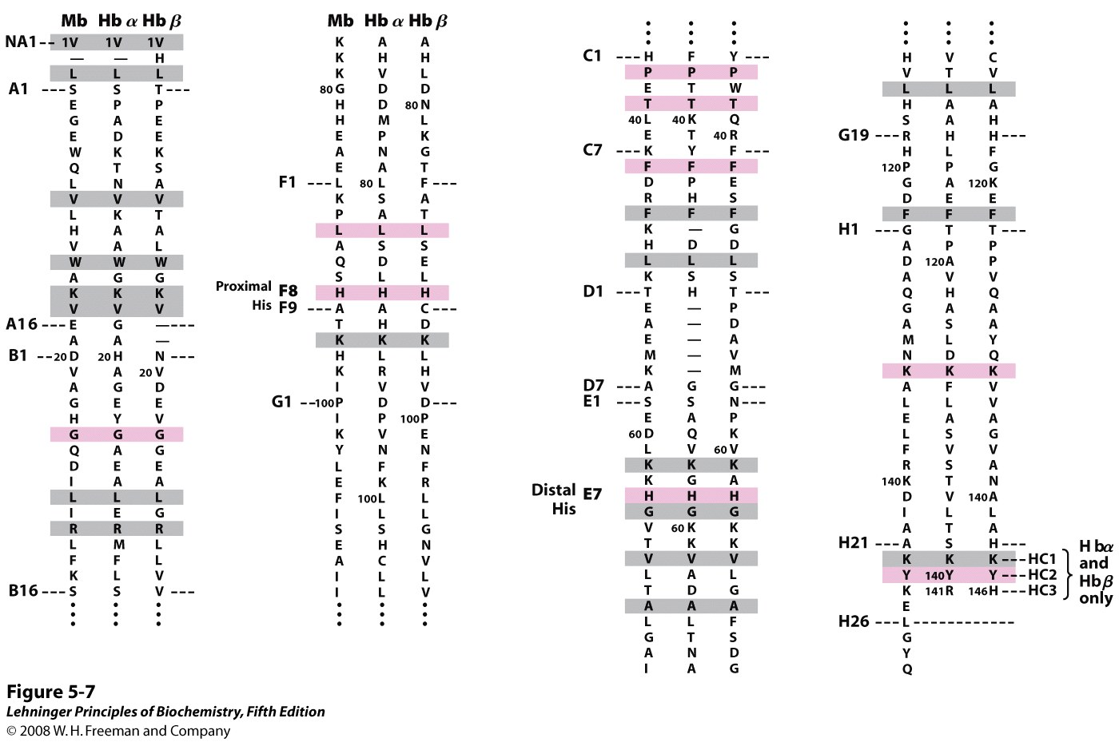
The amino acid sequences of whale myoglobin and
the α and β chains of human hemoglobin
Notes:
FIGURE 5-7 Dashed lines mark helix boundaries. To align the sequences optimally, short gaps must be introduced into both Hb sequences where a few amino acids are present in the other, compared sequences. With the exception of the missing D helix in Hbα, this alignment permits the use of the helix lettering convention that emphasizes the common positioning of amino acid residues that are identical in all three structures (shaded). Residues shaded in pink are conserved in all known globins. Note that the common helix-letter-and- number designation for amino acids does not necessarily correspond to a common position in the linear sequence of amino acids in the polypeptides. For example, the distal His residue is His E7 in all three structures, but corresponds to His⁶⁴, His⁵⁸, and His⁶³ in the linear sequences of Mb, Hbα, and Hbβ, respectively. Nonhelical residues at the amino and carboxyl termini, beyond the first (A) and last (H) α-helical segments, are labeled NA and HC, respectively.

Slide 34
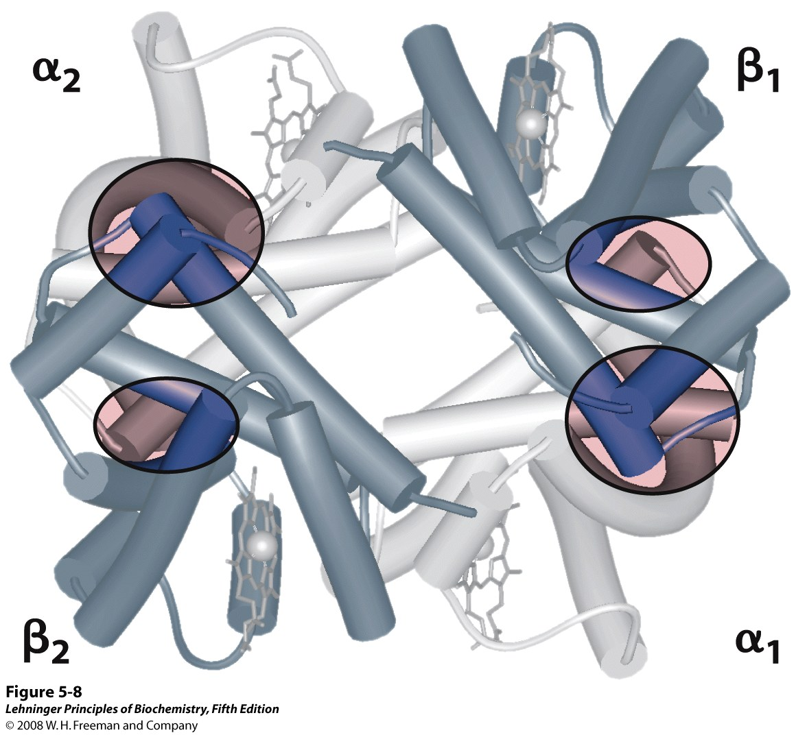
Dominant interactions between hemoglobin subunits
In this representation, α subunits are light and β subunits are dark.
The strongest subunit interactions (highlighted) occur between unlike
subunits. When oxygen binds, the α₁β₁ contact changes little, but there
is a large change at the α₁β₂ contact, with several ion pairs broken.
Notes:
FIGURE 5-8 Dominant interactions between hemoglobin subunits. In this representation, α subunits are light and β subunits are dark. The strongest subunit interactions (highlighted) occur between unlike subunits. When oxygen binds, the α₁β₁ contact changes little, but there is a large change at the α₁β₂ contact, with several ion pairs broken (PDB ID 1HGA).

Slide 35
R and T states of hemoglobin
T = Tense state, O₂ binding triggers a T R conformational change
R = Relaxed state, this state has higher affinity for O₂ than the T state
Deoxyhemoglobin subunits are more stable in the T state
Conformational change from the T state to the R state involves breaking ion pairs between the α₁β₂ (and α₂β₁) interface

Slide 36
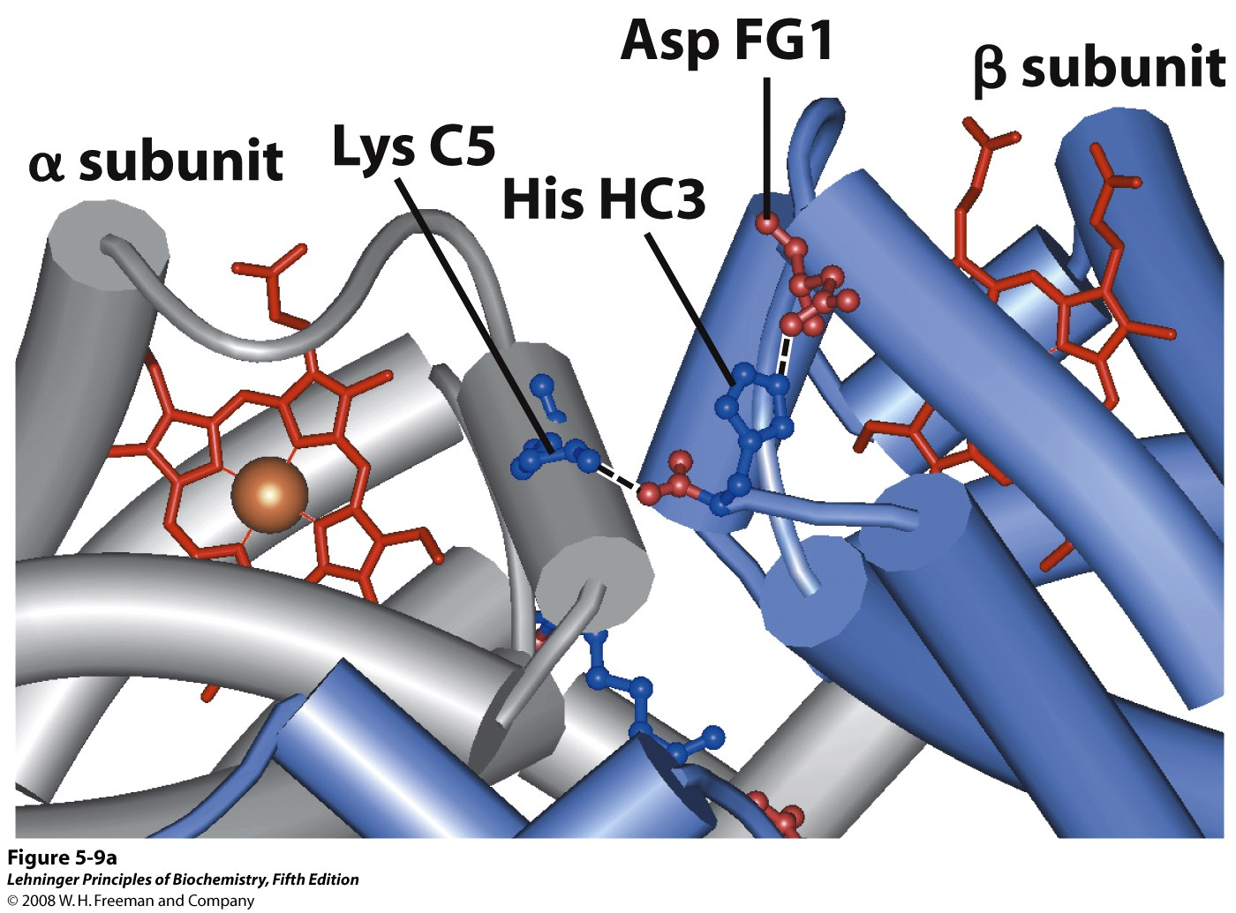
Some ion pairs that stabilize the T state of deoxyhemoglobin
Notes:
FIGURE 5-9a

Slide 37
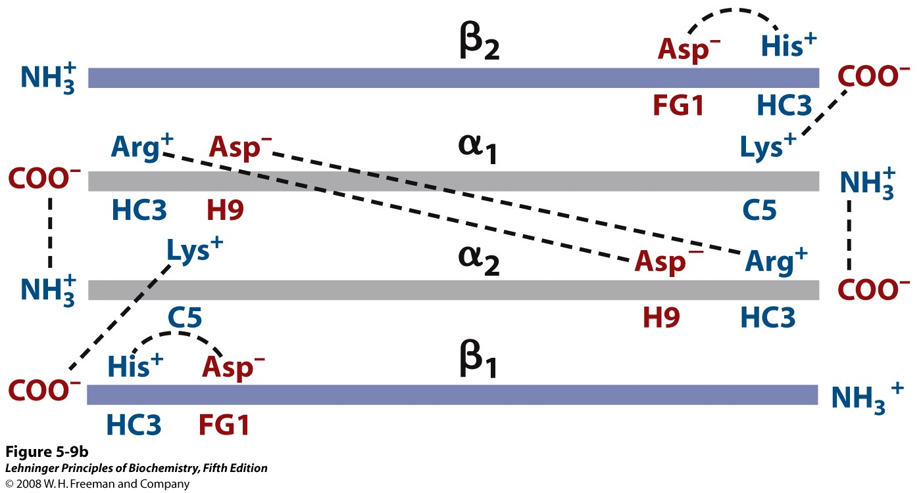
Interactions between the ion pairs
that stabilize the T state of deoxyhemoglobin
Notes:
FIGURE 5-9b Some ion pairs that stabilize the T state of deoxyhemoglobin. (b) Interactions between these ion pairs, and between others not shown in (a), are schematized in this representation of the extended polypeptide chains of hemoglobin.

Slide 38
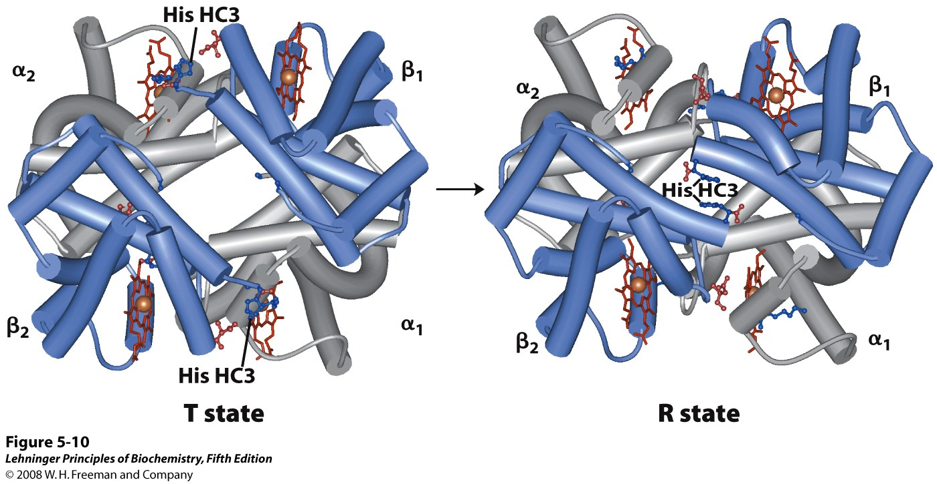
The T → R transition
The transition from the T state to the R state shifts the subunit pairs substantially, affecting certain ion pairs. Most noticeably, the His HC3 residues at the carboxyl termini of the β subunits, which are involved in ion pairs in the
T state, rotate in the R state toward the center of the molecule, where they are
no longer in ion pairs. Another dramatic result of the T → R transition is a narrowing of the pocket between the β subunits.
Notes:
FIGURE 5-10. (PDB ID 1HGA and 1BBB) In these depictions of deoxyhemoglobin, as in Figure 5-9, the α subunits are blue and the β subunits are gray. Positively charged side chains and chain termini involved in ion pairs are shown in blue, their negatively charged partners in red. The Lys C5 of each α subunit and Asp FG1 of each β subunit are visible but not labeled (compare Figure 5-9a). Note that the molecule is oriented slightly differently than in Figure 5-9. The transition from the T state to the R state shifts the subunit pairs substantially, affecting certain ion pairs. Most noticeably, the His HC3 residues at the carboxyl termini of the β subunits, which are involved in ion pairs in the T state, rotate in the R state toward the center of the molecule, where they are no longer in ion pairs. Another dramatic result of the T → R transition is a narrowing of the pocket between the β subunits.

Slide 39
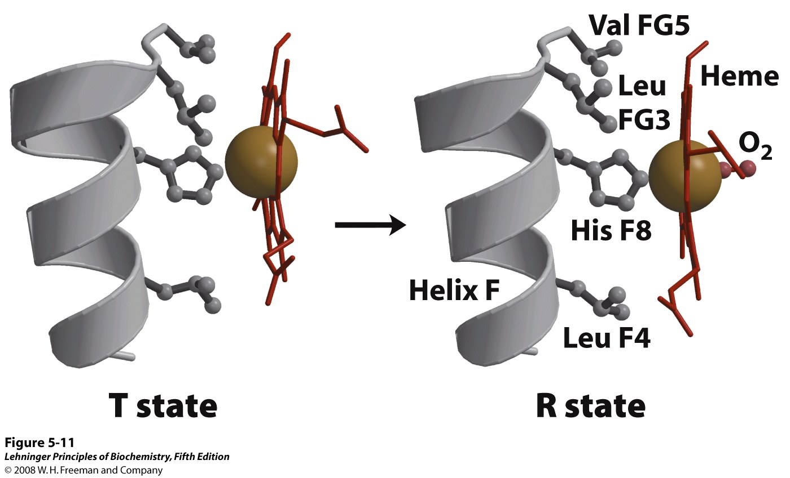
Changes in conformation near heme
on O₂ binding to deoxyhemoglobin
The shift in the position of helix F when heme binds O₂ is thought to be one of the adjustments that triggers the T → R transition.
Notes:
FIGURE 5-11 Changes in conformation near heme on O₂ binding to deoxyhemoglobin. (Derived from PDB ID 1HGA and 1BBB) The shift in the position of helix F when heme binds O₂ is thought to be one of the adjustments that triggers the T → R transition.

Slide 40
Hemoglobin binds O₂ cooperatively
Hemoglobin must bind O₂ efficiently in the lungs and release O₂ in the tissues
O₂ binding promotes transition from the T state to the R state
O₂ binding to individual subunit can alter the affinity for O₂ in adjacent subunits
Conformational changes between the T and R states, mediated by subunit-subunit interactions, result in cooperative binding --- sigmoid binding curve
Two models to explain --- the concerted model or the sequential model

Slide 41
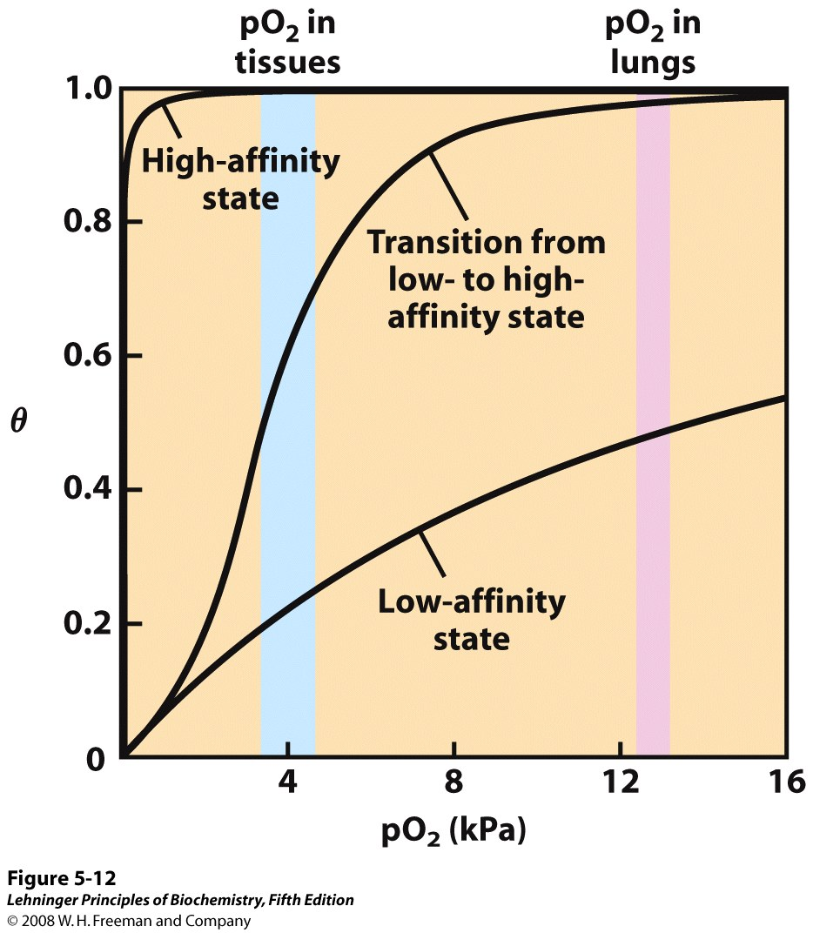
A sigmoid (cooperative) binding curve
A sigmoid binding curve can be viewed as a hybrid curve reflecting a transition from a low-
affinity to a high-affinity state. Because of its cooperative binding, hemoglobin is more sensitive to
the small differences in O₂ concentration between the tissues and the lungs, allowing it to
bind oxygen in the lungs (where pO₂ is high) and release it in the tissues (where pO₂ is low).
Notes:
FIGURE 5-12 A sigmoid (cooperative) binding curve. A sigmoid binding curve can be viewed as a hybrid curve reflecting a transition from a low-affinity to a high-affinity state. Because of its cooperative binding, as manifested by a sigmoid binding curve, hemoglobin is more sensitive to the small differences in O₂ concentration between the tissues and the lungs, allowing it to bind oxygen in the lungs (where pO₂ is high) and release it in the tissues (where pO₂ is low).

Slide 42
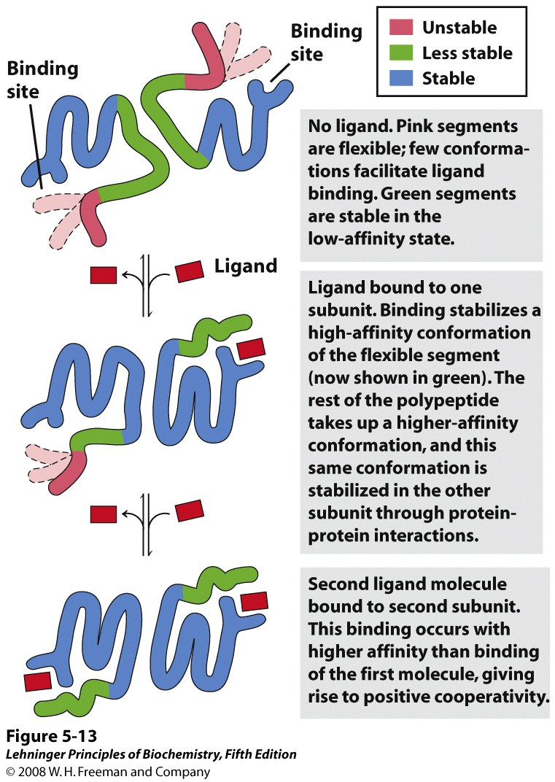
Structural changes in a multisubunit protein undergoing cooperative binding to ligand
Notes:
FIGURE 5-13

Slide 43
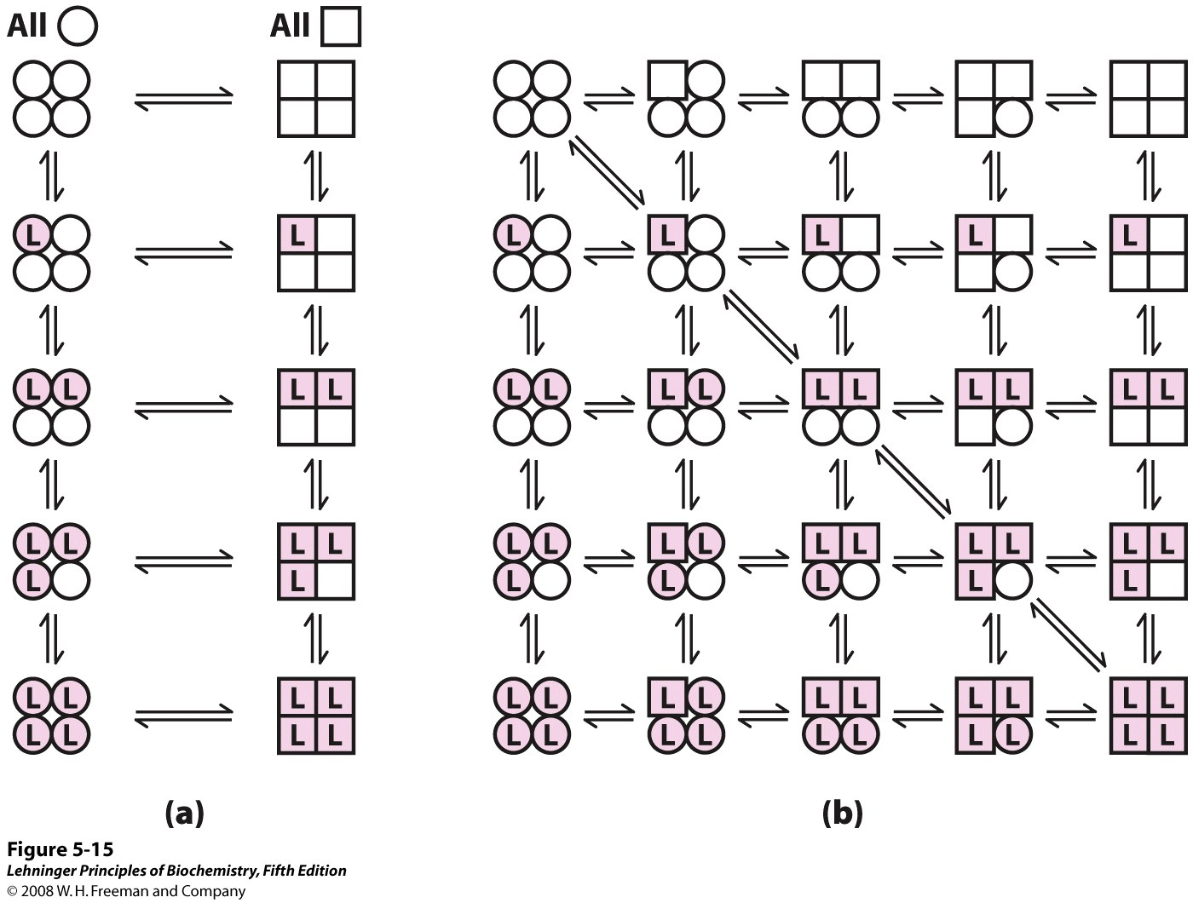
Concerted model
(all-or-none)
Sequential model
Two general models for the interconversion of inactive
and active forms of a protein during cooperative ligand binding
Notes:
FIGURE 5-15 Two general models for the interconversion of inactive and active forms of a protein during cooperative ligand binding. Although the models may be applied to any protein—including any enzyme (Chapter 6)—that exhibits cooperative binding, we show here four subunits because the model was originally proposed for hemoglobin. (a) In the concerted, or all-or-none, model (MWC model), all subunits are postulated to be in the same conformation, either all circles (low affinity or inactive) or all squares (high affinity or active). Depending on the equilibrium, K₁, between circles and squares forms, the binding of one or more ligand molecules (L) will pull the equilibrium toward the square form. Subunits with bound L are shaded. (b) In the sequential model, each individual subunit can be in either the or form. A very large number of conformations is thus possible.

Slide 44
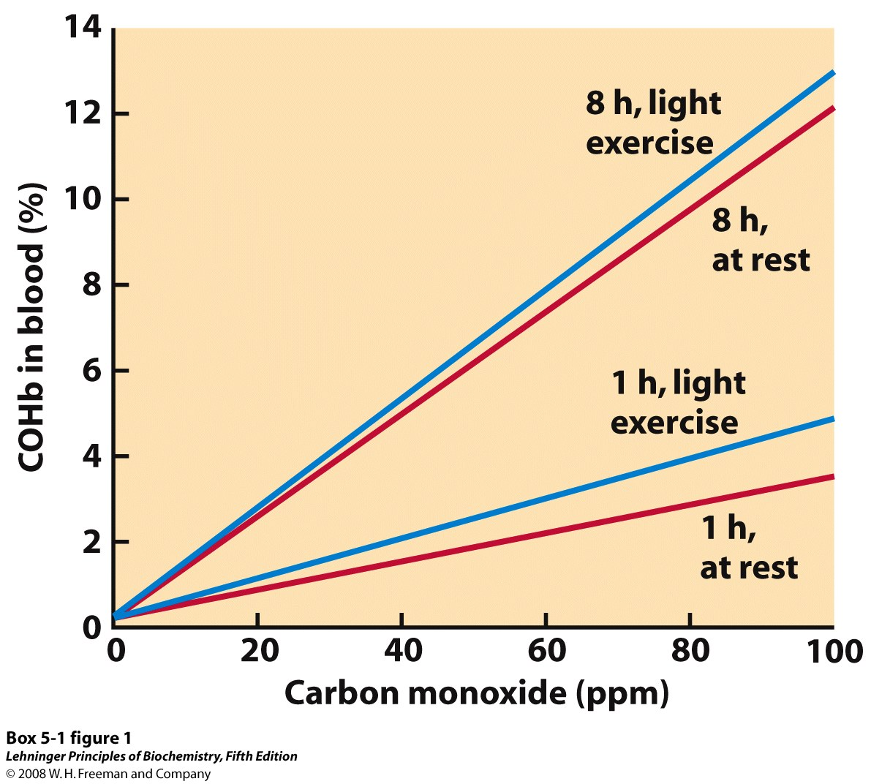
In an average, healthy
individual, 1% or less
of the total hemoglobin
is complexed with
COHb. Death normally
occurs when COHb
rises to 60%.
Relationship between levels of COHb (carboxyhemoglobin)
in blood and concentration of CO in the surrounding air
Notes:
BOX 5-1 FIGURE 1 Relationship between levels of COHb in blood and concentration of CO in the surrounding air. Four different conditions of exposure are shown, comparing the effects of short versus extended exposure, and exposure at rest versus exposure during light exercise.

Slide 45
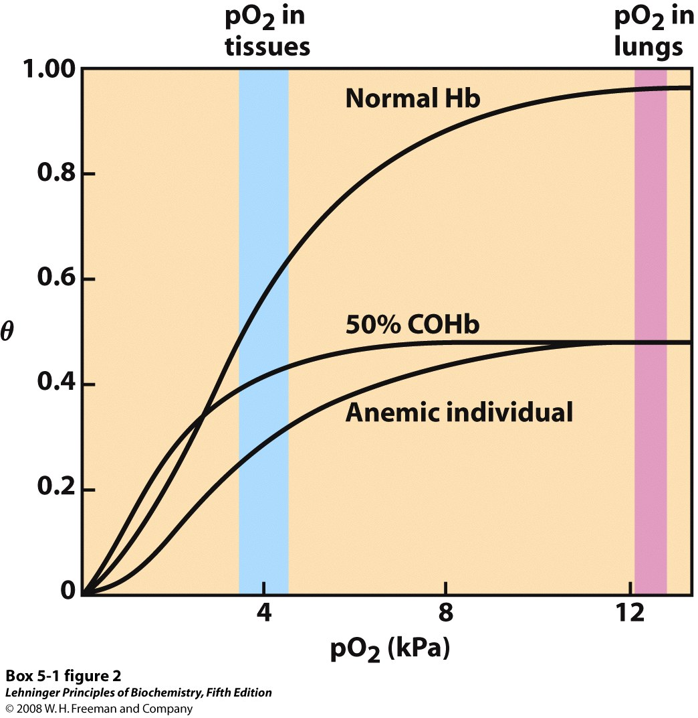
CO has an approximately
250 fold greater affinity for
hemoglobin than O₂.
Oxygen-binding curves for normal hemoglobin, hemoglobin
from an anemic individual with only 50% of her hemoglobin
functional, and hemoglobin from an individual with 50% of
his hemoglobin subunits complexed with CO
Notes:
BOX 5-1 FIGURE 2 Several oxygen-binding curves: for normal hemoglobin, hemoglobin from an anemic individual with only 50% of her hemoglobin functional, and hemoglobin from an individual with 50% of his hemoglobin subunits complexed with CO. The pO₂ in human lungs and tissues is indicated.

Slide 46
The effect of pH on O₂ binding to hemoglobin
H⁺ binds to a number of amino acid residues in hemoglobin (for example, His HC3, which then forms a salt bridge with Asp⁹⁴) and stabilizes the T state
Blood in lungs has higher pH than blood in capillaries of metabolic tissues
Affinity for oxygen depends on the pH
- Oxygen binds well at higher pH
- Oxygen is released at lower pH
The pH difference between lungs and metabolic tissues increases the O₂ transfer efficiency
This is known as the Bohr effect

Slide 47
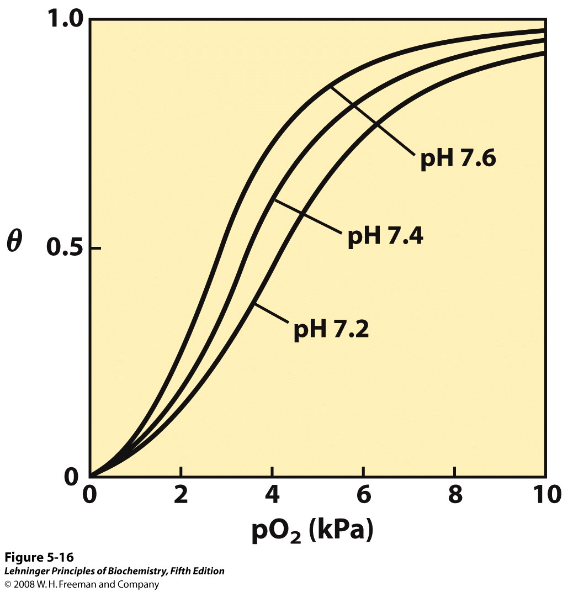
The pH of blood is 7.6 in the lungs and 7.2 in the tissues. Experimental measurements on hemoglobin binding are often performed at pH 7.4.
Effect of pH on oxygen binding to hemoglobin
Notes:
FIGURE 5-16

Slide 48
Hemoglobin and CO₂ export
CO₂ is produced by metabolism in tissues and must be exported
Some CO₂ is exported as dissolved bicarbonate in the blood
Some CO₂ is exported in the form of a carbamate on the amino terminal residues of each of the polypeptide subunits of hemoglobin
The formation of a carbamate yields a proton which can bind to hemoglobin and promote oxygen dissociation
CO₂ both directly and indirectly affect the affinity of hemoglobin to bind O₂

Slide 49
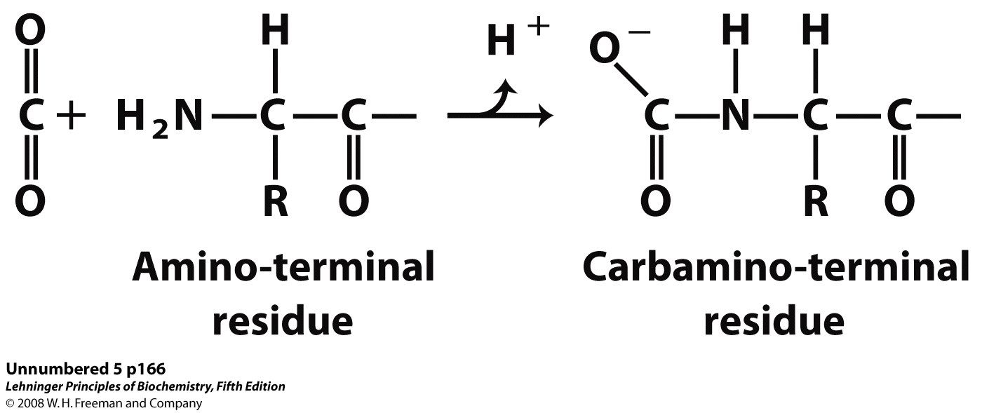
Some CO₂ is exported in the form of a carbamate on the amino terminal residues of each of the polypeptide subunits of hemoglobin. The binding of CO₂ forms additional ion pairs, which stabilize the deoxy form of hemoglobin.

Slide 50
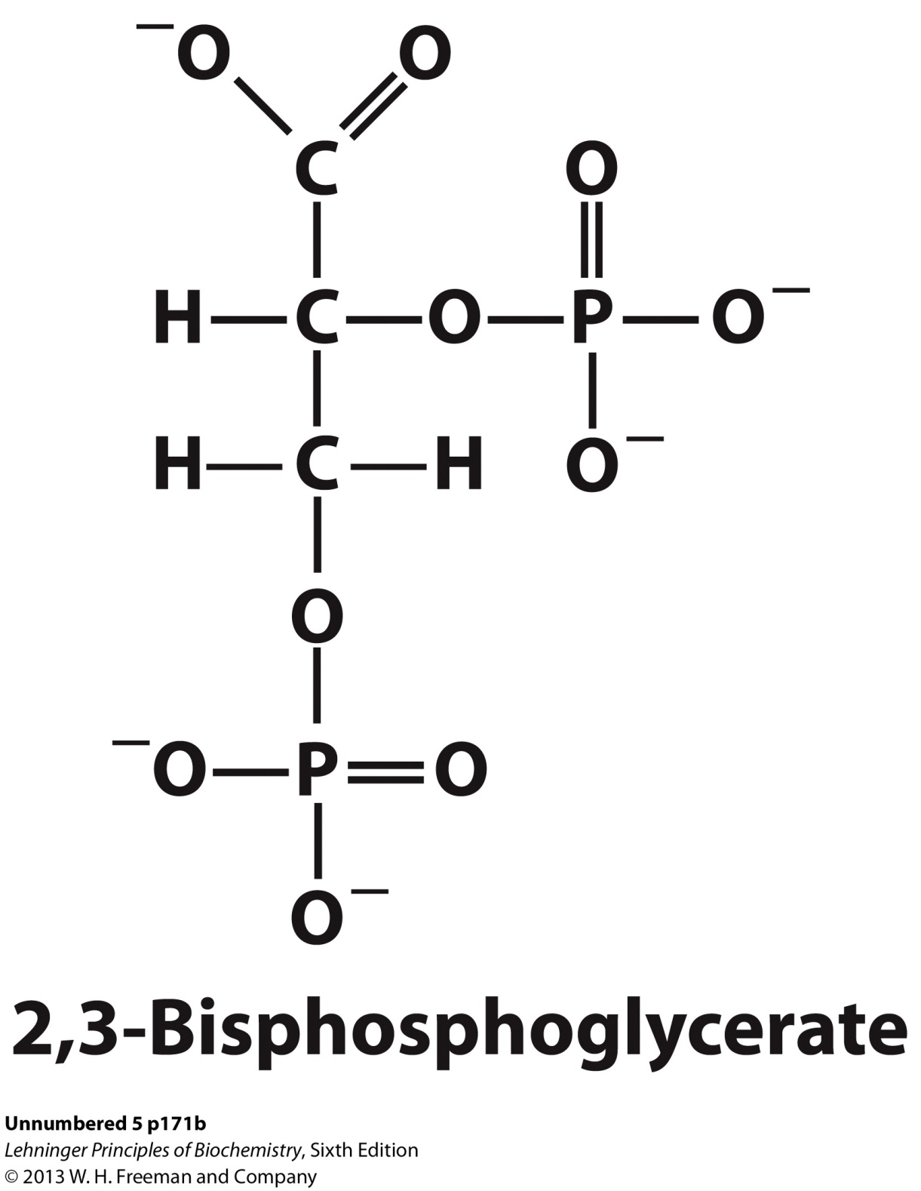

Slide 51
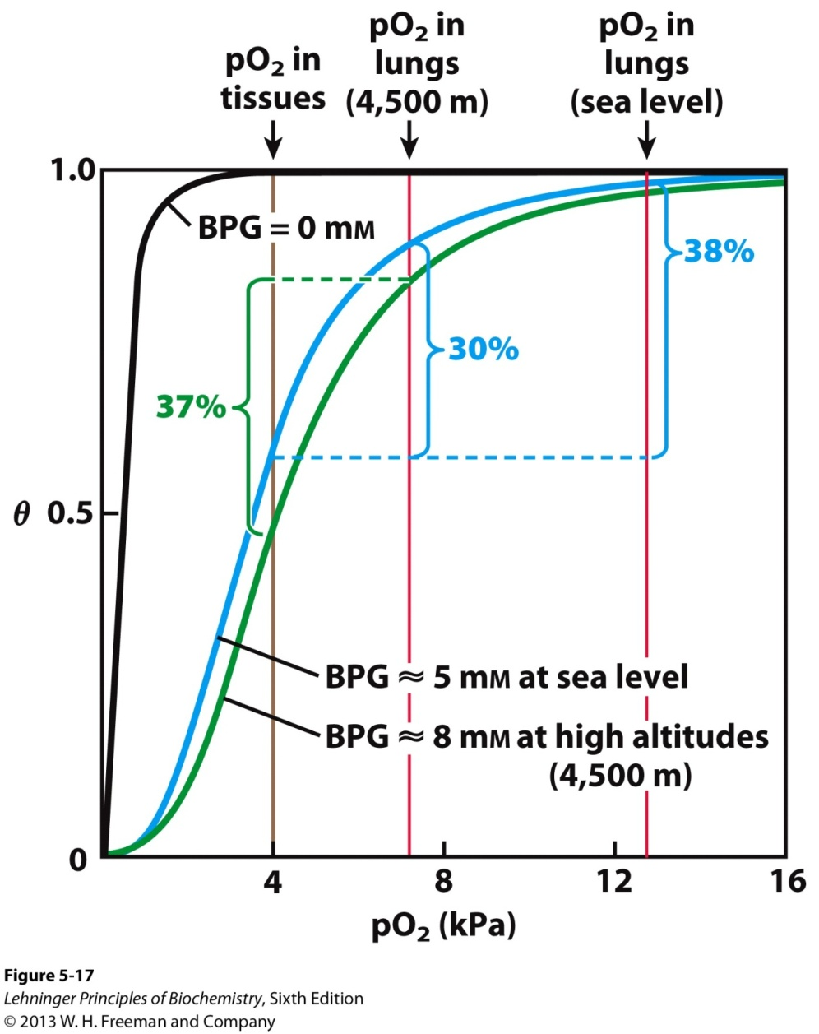
2,3-bisphosphoglycerate
(BPG) binds in the central
cavity between the four
subunits by interactions
between negatively charged
groups on BPG and positively
charged amino acid residues
that line the central cavity.
and stabilizes the deoxy form
of hemoglobin.
2,3-BPG allows for O₂ release
in the tissues and adaptation
to changes in altitude.
Effect of BPG on oxygen binding to hemoglobin
The BPG concentration in normal human blood is about 5 mM at sea level and about 8 mM
at high altitudes. At sea level, hemoglobin is nearly saturated with O₂ in the lungs, but just
over 60% saturated in the tissues. At high altitudes, O₂ delivery declines by about one-fourth.
An increase in BPG concentration decreases the affinity of hemoglobin for O₂, so approximately
37% of what can be carried is again delivered to the tissues.
Notes:
FIGURE 5-17 Effect of BPG on oxygen binding to hemoglobin. The BPG concentration in normal human blood is about 5 mM at sea level and about 8 mM at high altitudes. Note that hemoglobin binds to oxygen quite tightly when BPG is entirely absent, and the binding curve seems to be hyperbolic. In reality, the measured Hill coefficient for O₂-binding cooperativity decreases only slightly (from 3 to about 2.5) when BPG is removed from hemoglobin, but the rising part of the sigmoid curve is confined to a very small region close to the origin. At sea level, hemoglobin is nearly saturated with O₂ in the lungs, but just over 60% saturated in the tissues, so the amount of O₂ released in the tissues is about 38% of the maximum that can be carried in the blood. At high altitudes, O₂ delivery declines by about one-fourth, to 30% of maximum. An increase in BPG concentration, however, decreases the affinity of hemoglobin for O₂, so approximately 37% of what can be carried is again delivered to the tissues.

Slide 52
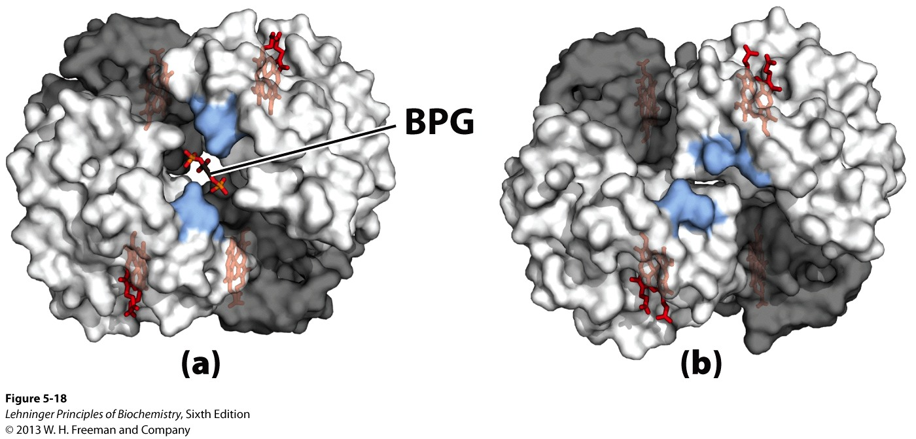
The binding pocket for BPG
disappears on oxygenation,
following transition to
the R state
Binding of BPG to deoxyhemoglobin

Slide 53
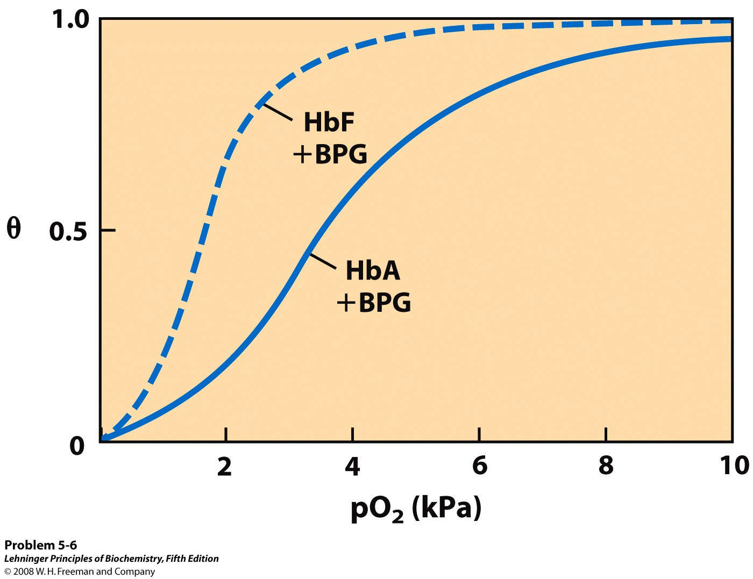
α₂γ₂
Comparison of fetal and maternal hemoglobin
Fetal hemoglobin has a much lower affinity for BPG than adult hemoglobin, and a correspondingly higher affinity for O₂.

Slide 54
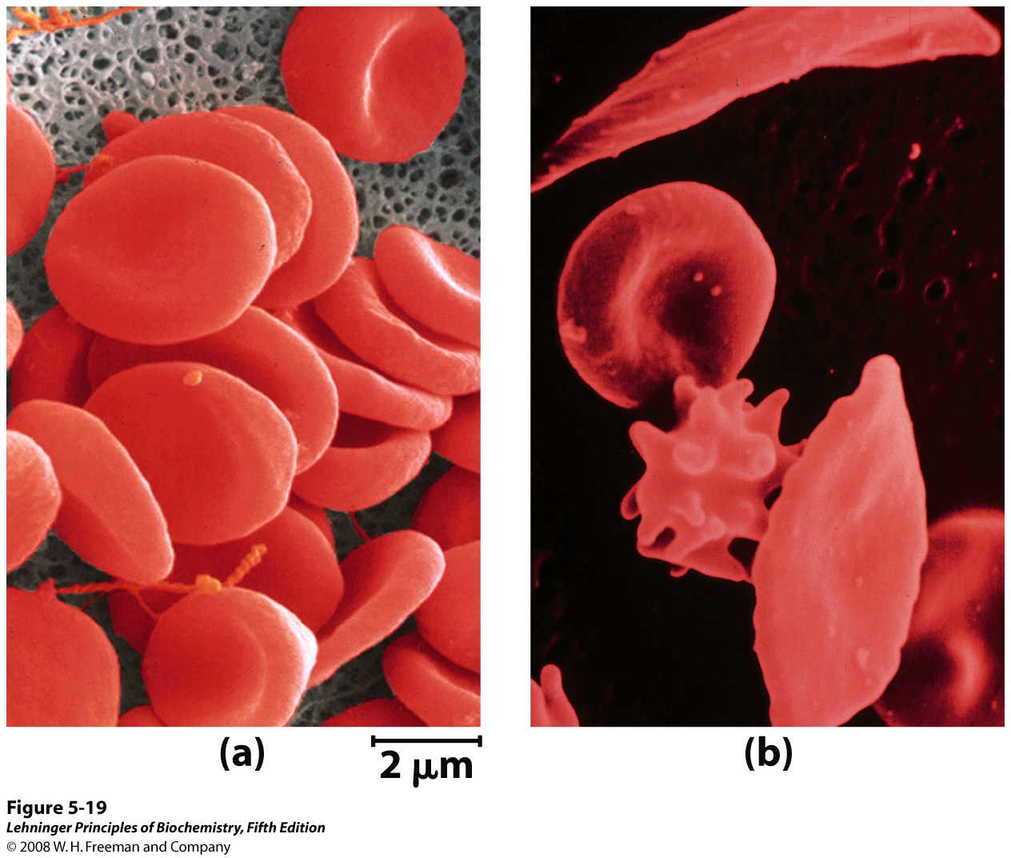
A comparison of (a) uniform, cup-shaped, normal erythrocytes with
(b) the variably shaped erythrocytes seen in sickle-cell anemia,
which range from normal to spiny or sickle-shaped.
Notes:
FIGURE 5-19 A comparison of (a) uniform, cup-shaped, normal erythrocytes with (b) the variably shaped erythrocytes seen in sickle-cell anemia, which range from normal to spiny or sickle-shaped.

Slide 55
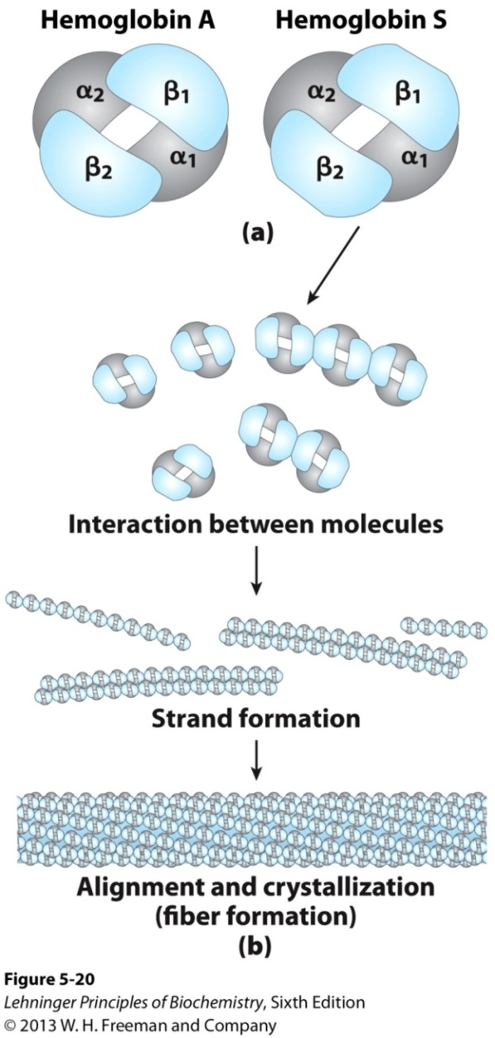
Glu to Val change at
position 6 in β subunit
Normal and sickle-cell hemoglobin
Deoxyhemoglobin S has a hydrophobic patch on its surface, which causes the molecules to aggregate into strands that align into insoluble fibers.

Slide 56
Effects of ligand-binding on the affinity of O₂ to hemoglobin*****
Ligand | Binding site | Effect on affinity
CO | Same as O₂ | increase
CO₂ | N-terminal end of hemoglobin | decrease
H⁺ | His HC3 and other amino acids | decrease
BPG | Central cavity | decrease

Slide 57
5. Two types of the immune systems
Cellular immune system
targets host cells that have been infected
also destroys virus particles and infecting bacteria
key players: macrophages, killer T cells (T_{c}),
and inflammatory T cells (TH₁)
Humoral “fluid” immune system
targets extracellular pathogens
can also recognize foreign proteins
makes soluble antibodies
keeps “memory” of past infections
key players: B-lymphocytes and helper T-cells (TH₂)

Slide 58
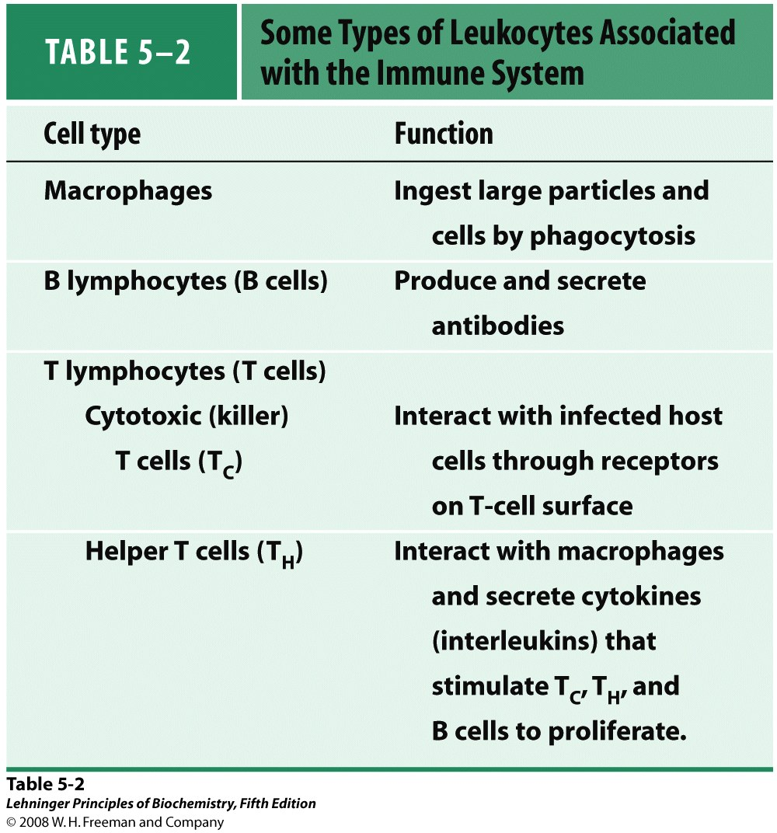

Slide 59
Cellular immune system
Many infected cells display fragments of infectious particles on their surface
Phagocytes: specialized cells that eat invaders
Macrophages: large phagocytes that ingest bacteria

Slide 60
Humoral immune system
Vertebrates fight infections with soluble antibodies that
specifically bind antigens
-Antigens are substances that stimulate production of antibodies
Typically macromolecular in nature
Recognized as foreign by the immune system
Coat proteins of bacteria and viruses
Surface carbohydrates of cells or viruses
-Antibodies are proteins that are produced by B cells and
specifically bind to antigens
Binding will mark the antigen for destruction or interfere with its function
A given antibody will bind to a small region (epitope) of the antigen
One antigen can have several epitopes

Slide 61
Antibody
Antibody (Immunoglobulin, Ig): a protein synthesized by an animal in response to a foreign substance, called an antigen, to protect the animal from infection
Antibodies have specific and high affinity for the antigens that elicited their synthesis
Proteins, polysaccharides, and nucleic acids can be effective antigens
Five classes: IgA, IgD, IgE, IgG and IgM

Slide 62
Antibody
An antibody recognizes a specific group or cluster of amino acids on a large molecule called an antigenic determinant, or epitope
Small foreign molecules, such as synthetic peptides, also can elicit antibodies, provided that the small molecule contains a recognized epitope and is attached to a macromolecular carrier
Polyclonal antibody: a mixture of antibodies, each recognizing a different part of the same antigen, generated by different B cells
Monoclonal antibody: recognize only one epitope on an antigen, generated by identical B cells

Slide 63
Immunoglobulin G
The major class of antibody
One of the most abundant proteins in the blood serum
4 polypeptide chains (2 heavy chain and 2 light chains) linked by noncovalent and disulfide bonds --- Y shape
Cleavage with papain generates Fc and Fab fragments
Two antigen-binding sites are formed by the combination of variable domains from one light (V_{L}) and one heavy (V_{H}) chain
The binding specificity of an antibody is determined by the amino acid residues in the variable domains of its heavy and light chains

Slide 64
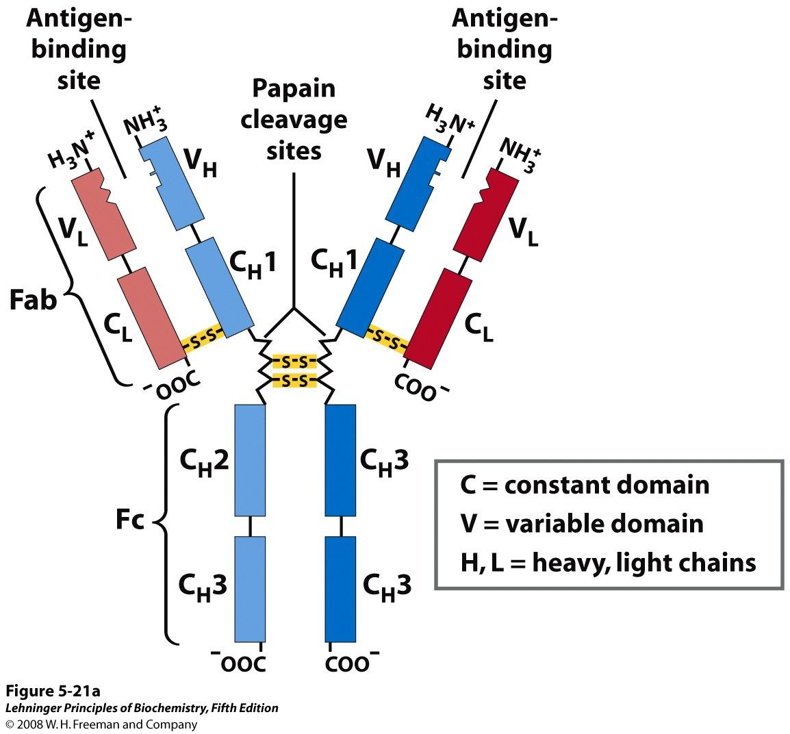
Structure of immunoglobulin G
Pairs of heavy and light chains combine to form a Y-shaped molecule. Two antigen-binding sites are formed by the combination of variable domains from one light (V_{L}) and one heavy (V_{H}) chain. Cleavage with papain separates the Fab and Fc portions of the protein in the hinge region. The Fc portion of the molecule also contains bound carbohydrate.
Notes:
FIGURE 5-21a Immunoglobulin G. (a) Pairs of heavy and light chains combine to form a Y-shaped molecule. Two antigen-binding sites are formed by the combination of variable domains from one light (V_{L}) and one heavy (V_{H}) chain. Cleavage with papain separates the Fab and Fc portions of the protein in the hinge region. The Fc portion of the molecule also contains bound carbohydrate (shown in (b)).

Slide 65
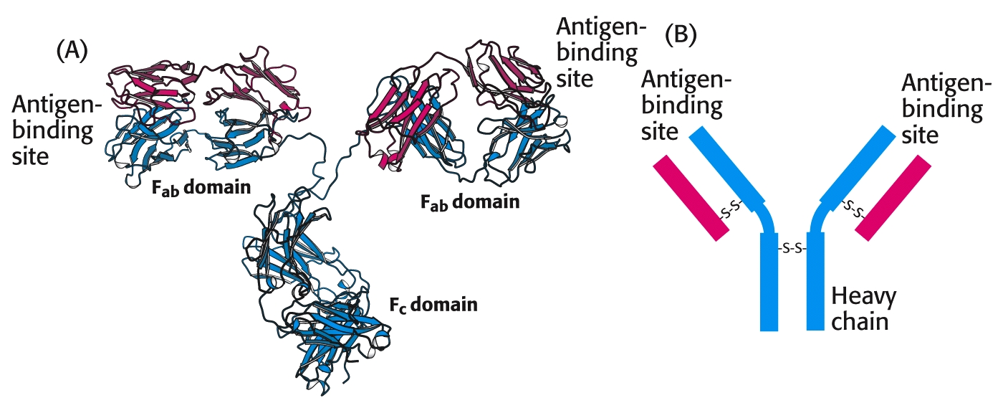
(A) IgG antibodies consist of four chains, two heavy chains (blue) and two light chains (red), linked by disulfide bonds. The heavy and light chains come together to form F_{ab} domains, which have the antigen-binding sites at the ends. The two heavy chains form the F_{c} domain by flexible linkers. (B) A more schematic representation of an IgG molecule.

Slide 66
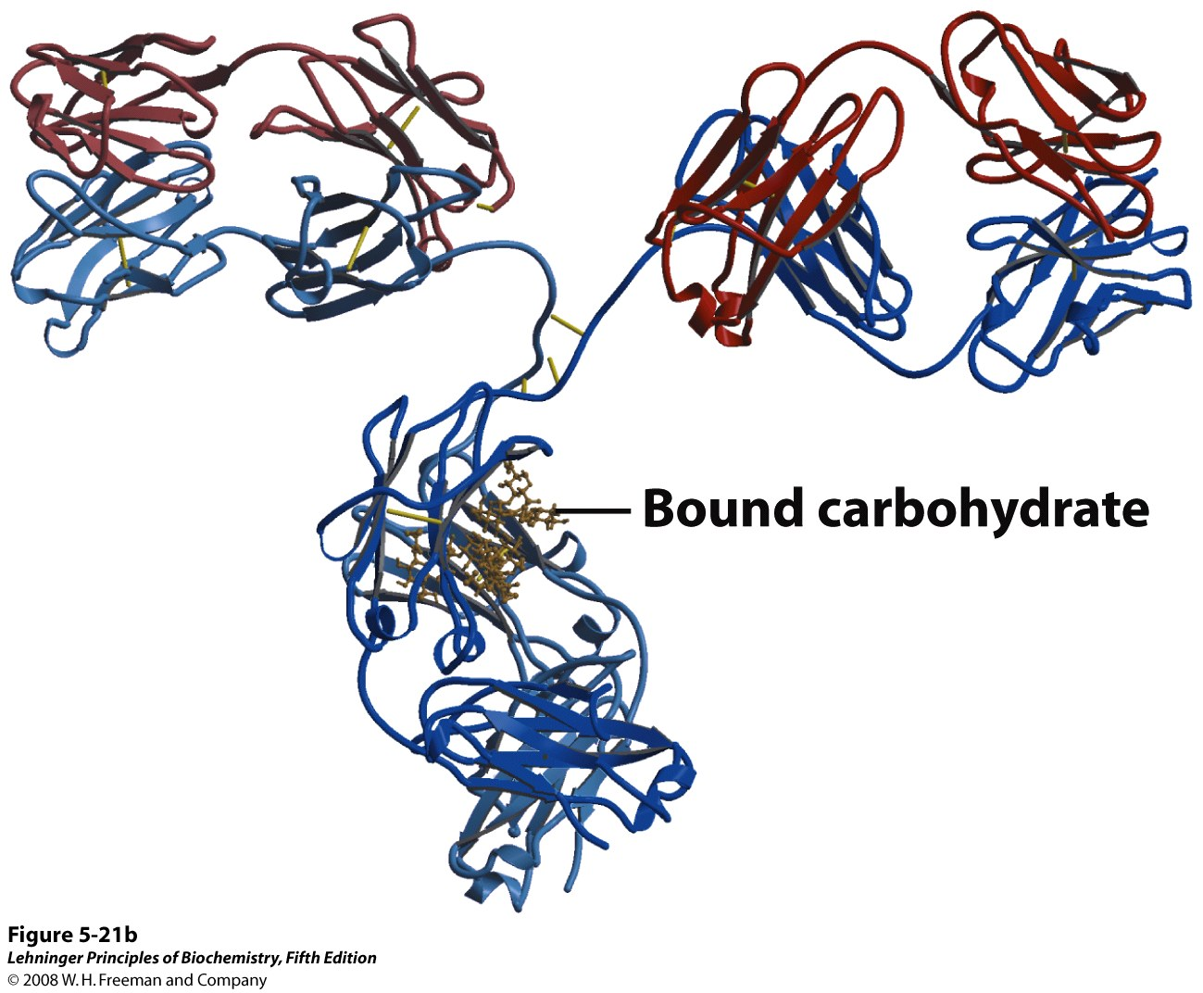
A ribbon model of the first complete IgG molecule to be
crystallized and structurally analyzed
Notes:
FIGURE 5-21b Immunoglobulin G. (b) A ribbon model of the first complete IgG molecule to be crystallized and structurally analyzed (PDB ID 1IGT). Although the molecule has two identical heavy chains (two shades of blue) and two identical light chains (two shades of red), it crystallized in the asymmetric conformation shown here. Conformational flexibility may be important to the function of immunoglobulins.

Slide 67
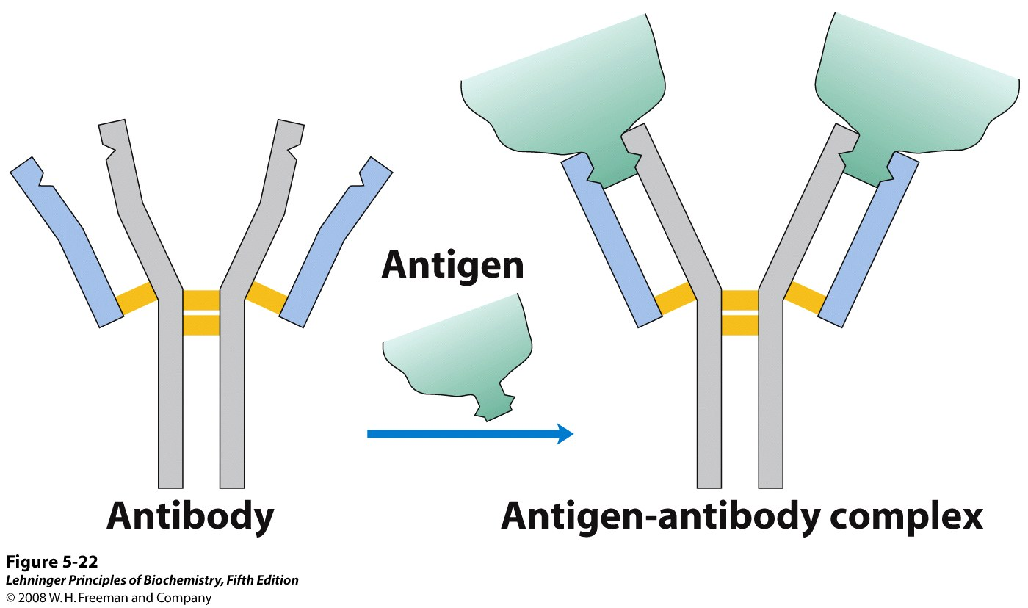
Binding of IgG to an antigen
To generate an optimal fit for the antigen, the binding sites
of IgG often undergo slight conformational changes.
Such induced fit is common to many protein-ligand interactions.
Notes:
FIGURE 5-22 Binding of IgG to an antigen. To generate an optimal fit for the antigen, the binding sites of IgG often undergo slight conformational changes. Such induced fit is common to many protein-ligand interactions.

Slide 68
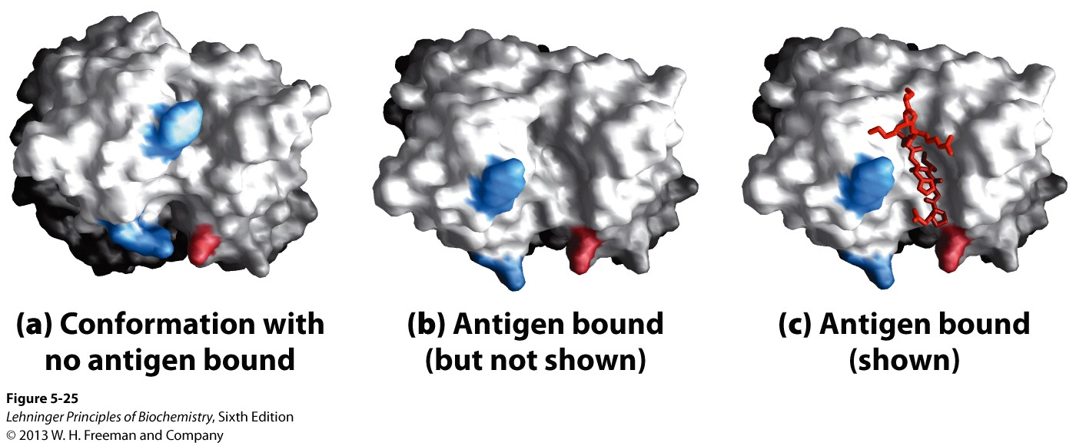
Induced fit in the binding of an antigen to IgG
Notes:
FIGURE 5-25 Induced fit in the binding of an antigen to IgG. The molecule here, shown in surface contour, is the Fab fragment of an IgG. The antigen is a small peptide derived from HIV. Two residues in the heavy chain (blue) and one in the light chain (pink) are colored to provide visual points of reference. (a) View of the Fab fragment in the absence of antigen, looking down on the antigen-binding site (PDB ID 1GGC). (b) The same view, but with the Fab fragment in the “bound” conformation (PDB ID 1GGI); the antigen is omitted to provide an unobstructed view of the altered binding site. Note how the binding cavity has enlarged and several groups have shifted position. (c) The same view as (b), but with the antigen in the binding site, pictured as a red stick structure.

Slide 69
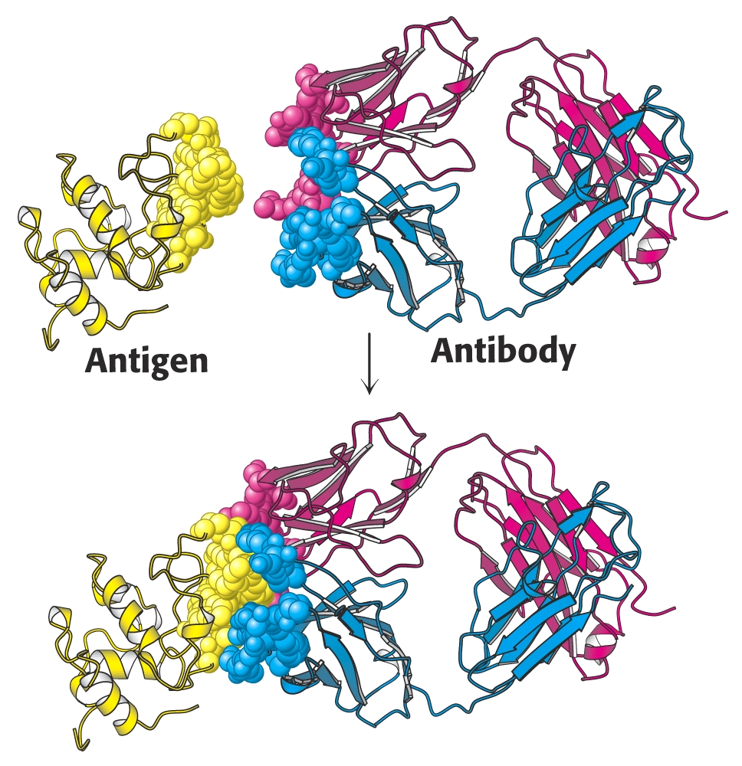
A protein antigen, in this case lysozyme, binds to the end of an F_{ab} domain from an antibody.
The end of the antibody and the antigen have complementary shapes, allowing a large amount of surface to be buried on binding.

Slide 70
Limitation of polyclonal antibodies
Heterogeneity (a pool of antibodies recognizing different epitopes): PAb often fails to detect the phosphorylation state of proteins, or distinguish between closely-related members of a protein family
Low concentration and purity level in the PAb preparation: concentration of the specific antibody in the polyclonal sera is only 1%-5% of the total concentration of IgG

Slide 71
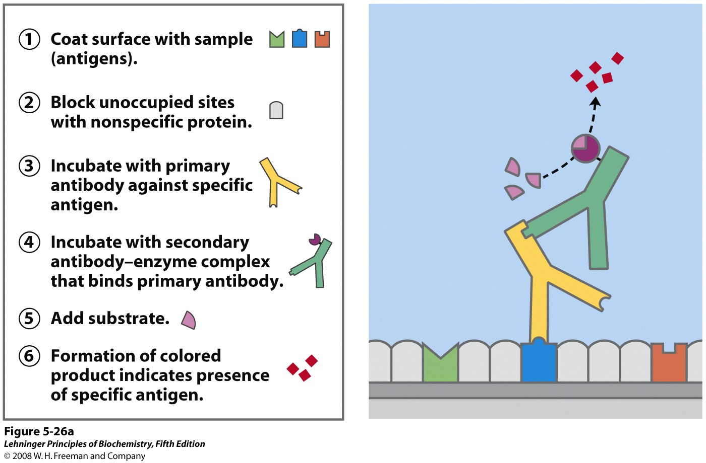
The specific reaction of an antibody with its antigen is the
basis of several techniques that identify and quantify
a specific protein in a complex sample.
Notes:
FIGURE 5-26a

Slide 72
General procedure of western blotting
1. Separate sample proteins by SDS-PAGE
2. Transfer the proteins from the gel to the
membrane
3. Expose the membrane to a solution
containing antibody (primary antibody)
that recognizes the protein of interest
4. Treat the membrane with secondary
antibody, which is conjugated to a group
that enables detection

Slide 73
Detection methods of western blotting
The secondary detection conjugate catalyzes reactions that produce products that are either:
---chemiluminescent, producing light at the site of the target protein which can be detected by exposing the membrane to photographic film
---chromogenic, forming a colored precipitate on the membrane at the site of the target protein

Slide 74
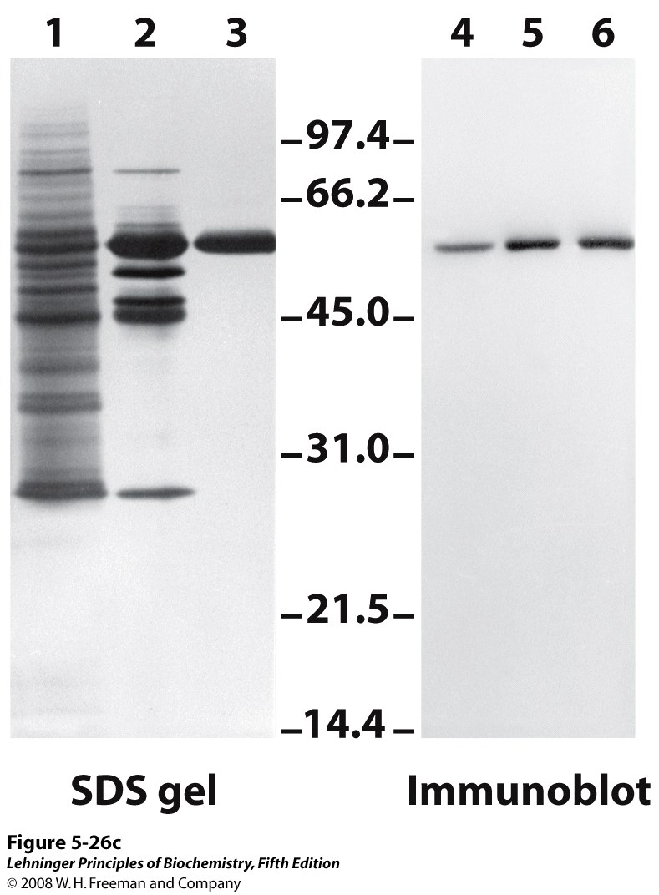
Western blotting permits the detection
of proteins separated by gel electrophoresis
Notes:
FIGURE 5-26c Antibody techniques. (c) An immunoblot. Lanes 1 to 3 are from an SDS gel; samples from successive stages in the purification of a protein kinase were separated and stained with Coomassie blue. Lanes 4 to 6 show the same samples, but these were electrophoretically transferred to a nitrocellulose membrane after separation on an SDS gel. The membrane was then “probed” with antibody against the protein kinase. The numbers between the SDS gel and the immunoblot indicate M_{r} in thousands.

Slide 75
ELISA
Enzyme-Linked Immunosorbent Assay
In ELISA, antibodies can be used to quantify the amount of the antigen (sandwich ELISA) or antibody (indirect ELISA)
ELISA is sensitive: can detect less than a nanogram (ng) of a protein

Slide 76
Indirect ELISA
In indirect ELISA, the production of color indicates the amount of an antibody to a specific antigen.

Slide 77
Sandwich ELISA
In sandwich ELISA, the production of color indicates the quantity of antigen.

Slide 78
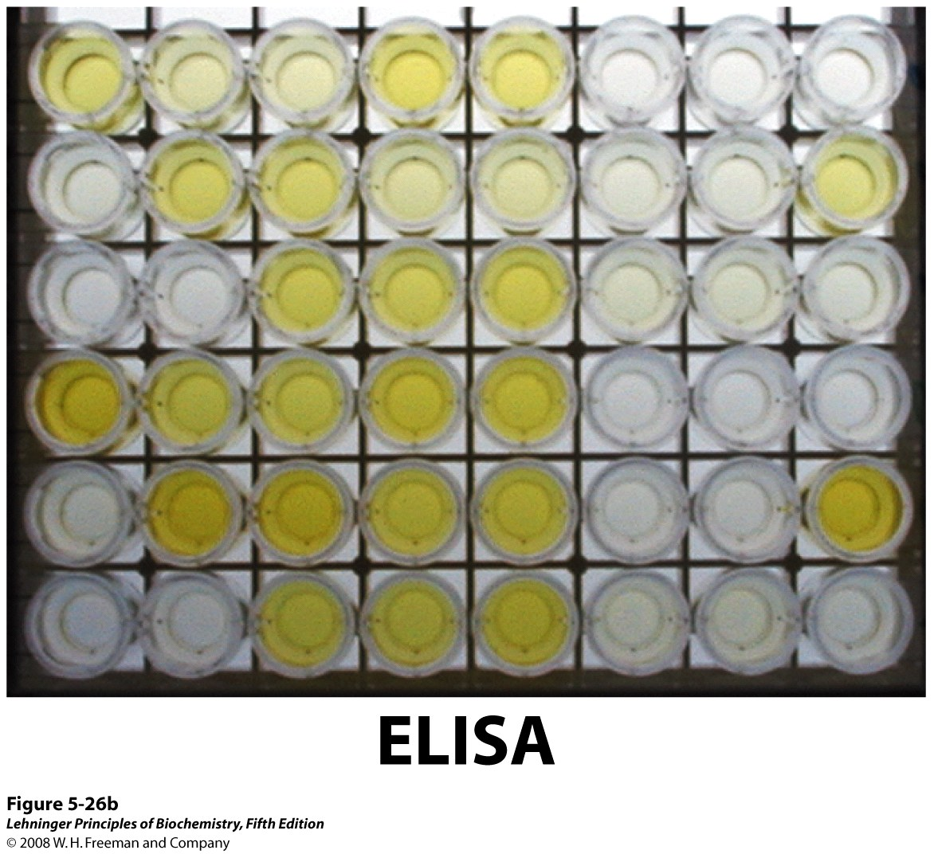
Notes:
FIGURE 5-26b Antibody techniques. (b) An ELISA to test for the presence of herpes simplex virus (HSV) antibodies in blood samples. Wells were coated with an HSV antigen, to which antibodies against HSV will bind. The second antibody is anti–human IgG linked to horseradish peroxidase. Following completion of the steps shown in (a), blood samples with greater amounts of HSV antibody turn brighter yellow.

Slide 79
Other techniques using antibodies
Immunocytochemistry
Immunohistochemistry
Immunoprecipitation
Flow cytometry and FACS

Slide 80
Keywords
myoglobin--- stores O₂
hemoglobin---
transports O₂, H⁺, and CO₂
antibody
antigen
conformational change

Slide 81
Words of the week
reversible
transient
specific
cooperative
complementary

Slide 82
Textbook-reading of the week
Summary 5.1
Summary 5.2
Hemoglobin undergoes a structural
change on binding oxygen
Carbon monoxide: a stealthy killer
(Box 5-1)

Slide 83
Summary
The ligand-binding site on the protein is complementary to the ligand in size, charge, shape, or hydrophobic/hydrophilic character.
Myoglobin is a protein with a heme prosthetic group that binds oxygen reversibly.
Hemoglobin displays positive cooperativity with respect to its oxygen binding.
Conformational changes between the T state and the R state of hemoglobin, mediated by subunit-subunit interactions, result in cooperative binding, which can be described by a sigmoid binding curve.

Slide 84
Binding of H⁺, CO₂ or 2,3-BPG decreases the affinity of hemoglobin for O₂.
The capacity to communicate ligand-binding information from one subunit to the others makes the hemoglobin molecule adapted to integrating the transport of O₂ , H⁺, and CO₂ by erythrocytes.
The binding specificity of an antibody is determined by the amino acid residues in the variable domains of its heavy and light chains.

