Slide 1
Chapter 13 Bioenergetics and biochemical reaction types

Slide 2
1. Cells need energy to do all their work
To generate and maintain its highly ordered structure (biosynthesis of macromolecules)
To generate all kinds of movement
To generate concentration and electrical gradients across cell membranes
To maintain a body temperature
To generate light in some animals
The “energy industry”(production, storage and use) is central to the economy of the cell society!

Slide 3
Living organisms use energy extracted from nutrients or sunlight
Potential energy
Energy transductions accomplish work
Nutrients in environment (complex molecules such as sugars, fats)
Sunlight
Chemical synthesis
Mechanical work
Osmotic and electrical gradients
Light production
Genetic information transfer

Slide 4
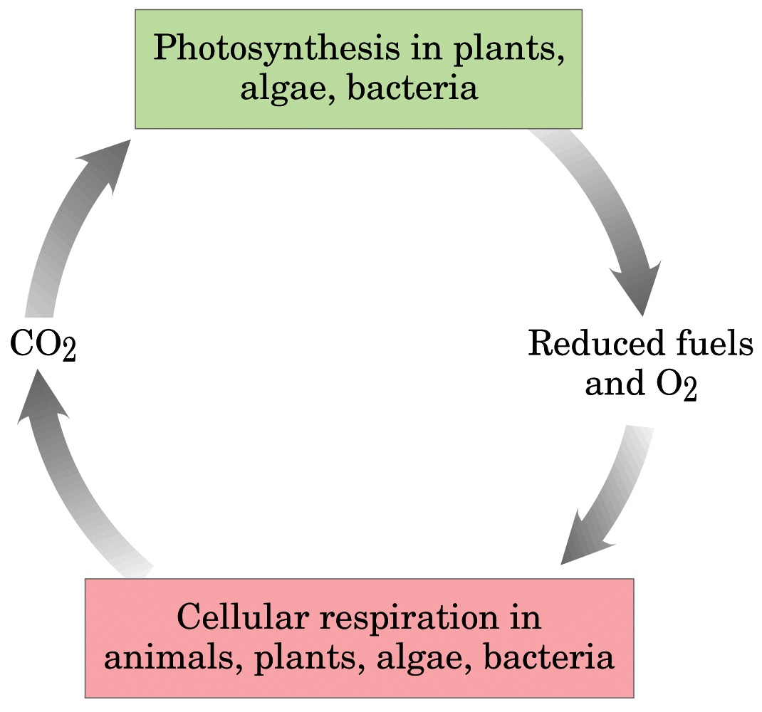
The energy needs of virtually all organisms are
provided, directly or indirectly, by solar energy

Slide 5
Bioenergetics (生物能学): the quantitative study of the energy transductions in living cells and of the nature and function of the chemical processes underlying these transductions.

Slide 6
Biological energy transformations obey the two basic laws of thermodynamics.
1st law: energy can neither be created nor be destroyed (but conserved).
2nd law: in all natural processes, the entropy of the universe increases.

Slide 7
2. Cells have to use chemical energy to do all their work
Antoine Lavoisier’s insight on animal respiration in the 18th century: it is nothing but a slow combustion of carbon and hydrogen (the same nature as a lighting candle).
Living cells are generally held at constant temperature and pressure: chemical energy (free energy) has to be used by living organisms, neither thermal energy nor mechanical energy is available to do work in cells.

Slide 8
The energy that cells can and must use is free energy.
The free energy concept of thermodynamics is more important to biochemists than to chemists (who can always increase the temperature and pressure to make a reaction to occur!).

Slide 9
3. Application of the free energy (G) concept to biochemical reactions
Free energy (G): the amount of energy available to do work during a reaction at a constant temperature and pressure; change, not absolute value, can be measured.
Free energy change (ΔG): The free energy difference between the products and the reactants.
ΔG = ΔH –TΔS

Slide 10
ΔG = ΔH –TΔS
H: enthalpy (焓)---the heat content of a system
S: entropy (熵)---the extent of randomness or disorder in a system

Slide 11
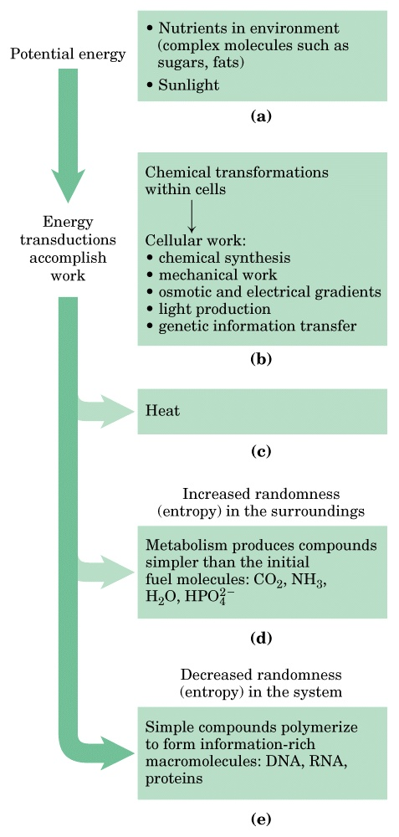
Figure 1-25
(Chapter 1)
Some energy interconversion in living organisms

Slide 12
Gibbs observation: under constant temperature and pressure, all systems change in such a way that free energy is minimized (products should have less free energy than reactants for a reaction to occur spontaneously, i.e., ΔG has a negative value ).
Spontaneity has nothing to do with rate! (determined by ΔG)
Enzymes only speed up thermodynamically favorable reactions (having a negative ΔG) !

Slide 13
Standard free energy change in biochemistry (ΔG'º): value of the change in free energy under conditions of 298 K (25ºC), 1 atm pressure, pH 7.0 (chemists use pH 0, i.e., the concentration of H⁺ they use is 1M, not 10⁻⁷ M as biochemists use here) and initial concentrations of 1 M for all reactants and products (except H⁺).

Slide 14
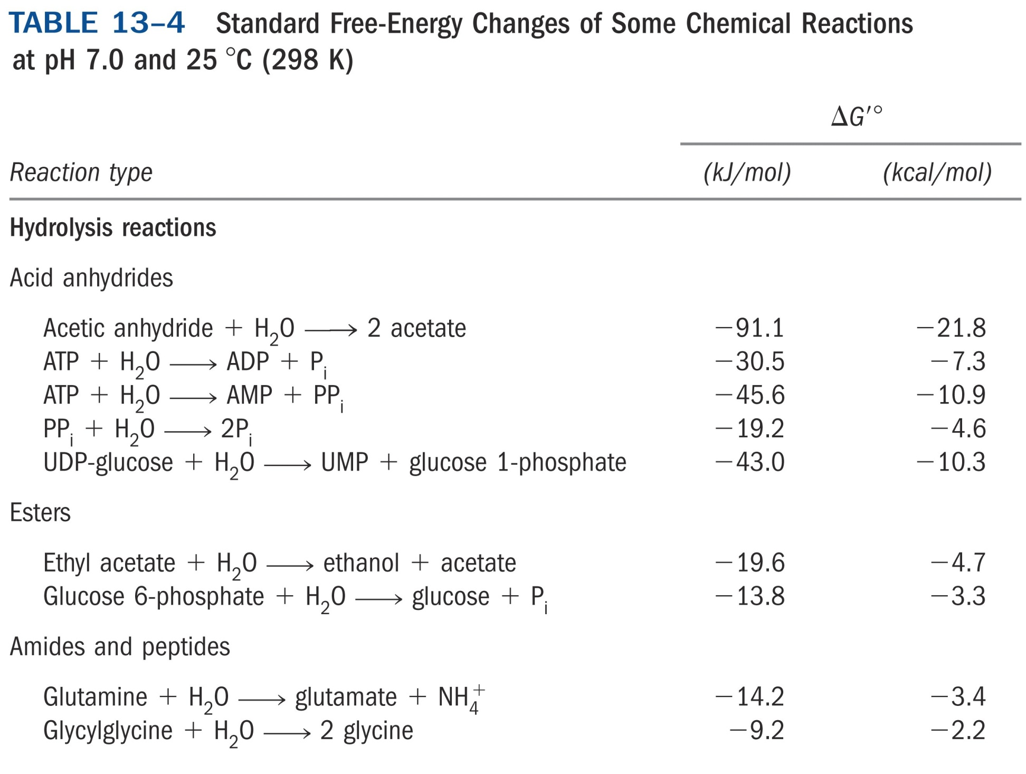

Slide 15
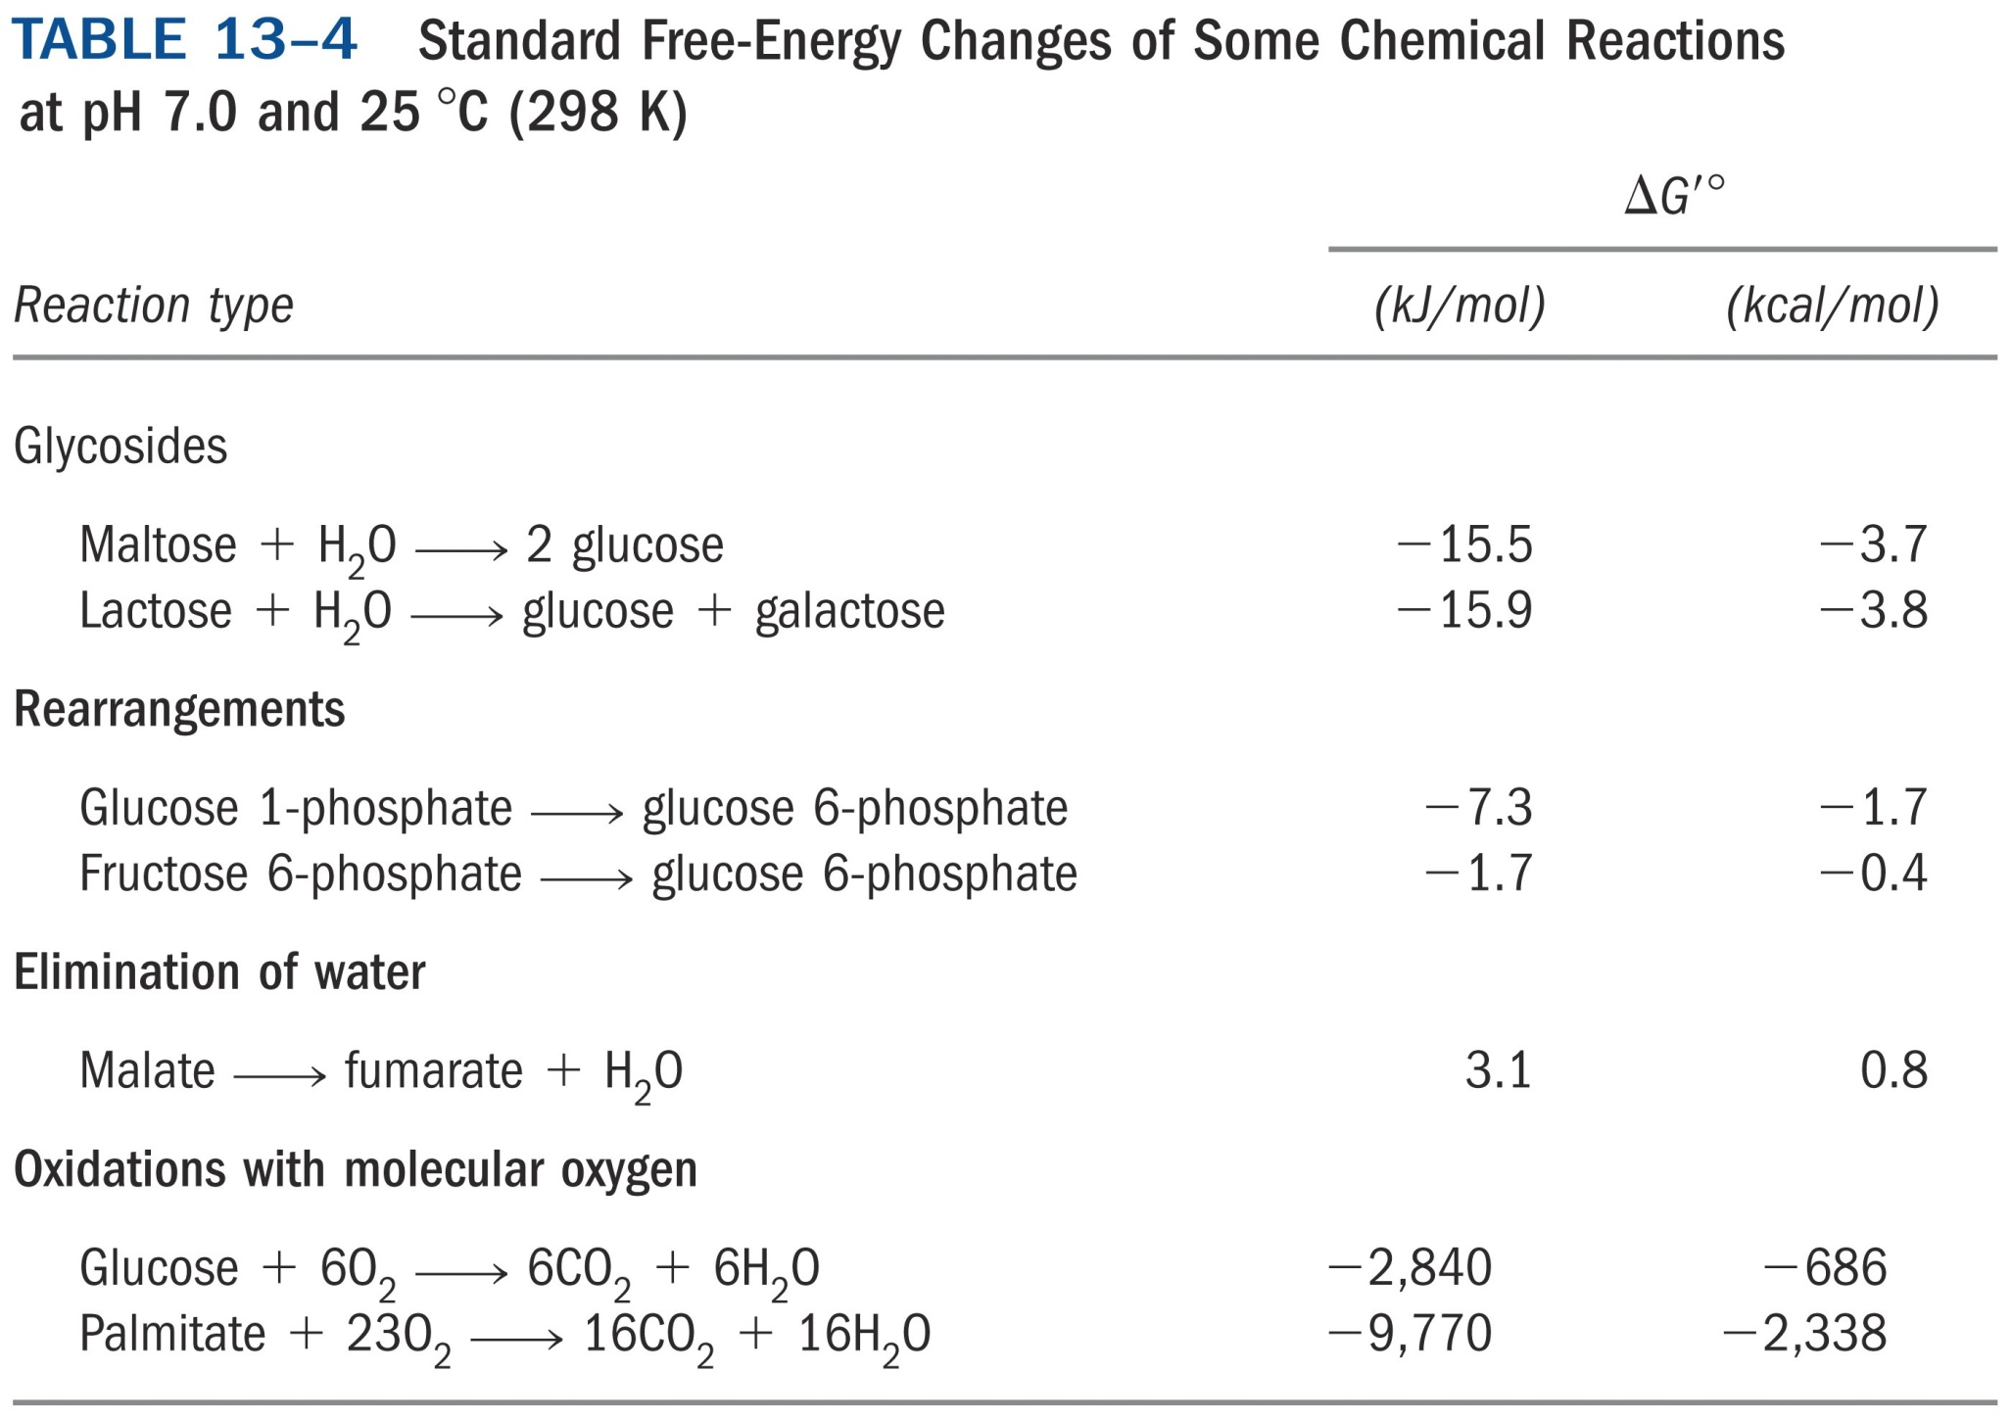

Slide 16
The actual free energy change (ΔG ) depends on ΔG'º, temperature, ratio of product and reactant concentrations (Q):
ΔG = ΔG'º + RT ln Q
For the reaction aA + bB cC + dD:
ΔG'º is related to the equilibrium constant K'_{eq} (the prime again indicates its biochemical transformation):
at equilibrium, ΔG = 0, Q = K'_{eq} , thus
ΔG'º = -RT ln K'_{eq}

Slide 17
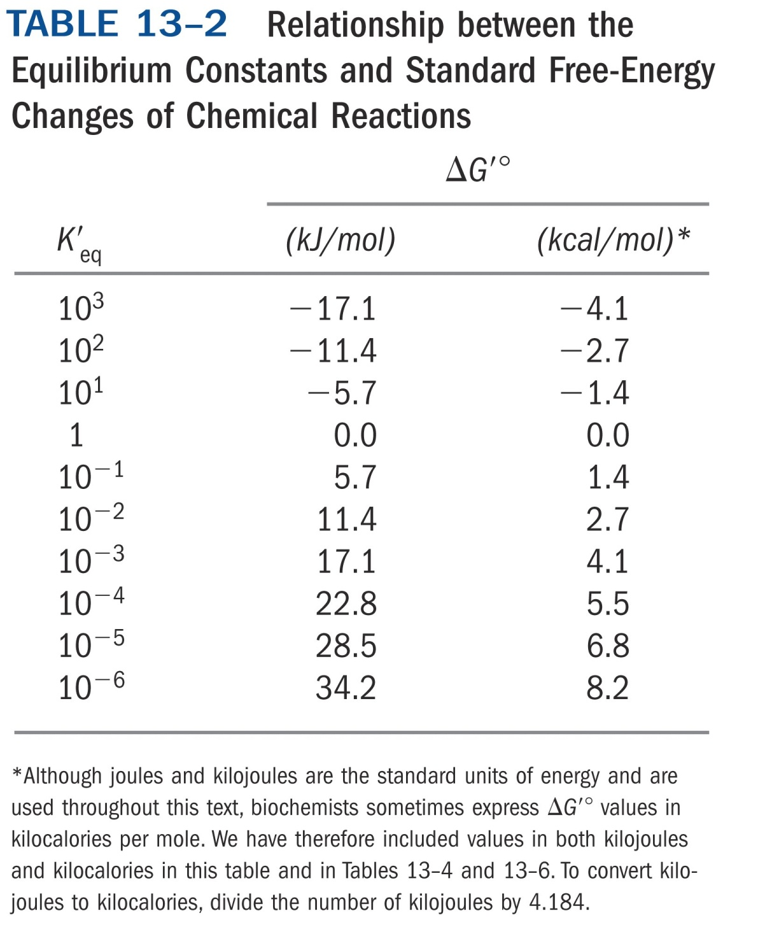

Slide 18
*****
Exergonic
Endergonic
Δ G' º = -RT ln K'eq

Slide 19
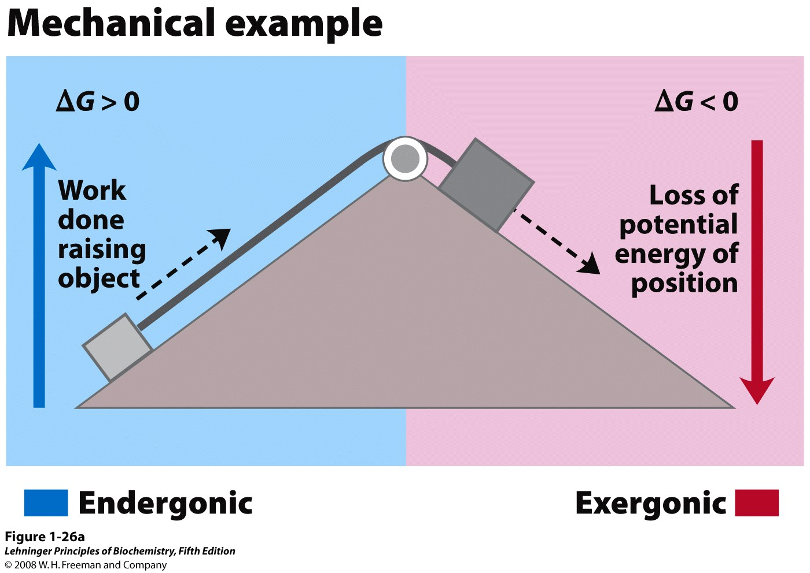
Energy coupling in mechanical processes
Notes:
FIGURE 1–26a Energy coupling in mechanical and chemical processes. (a) The downward motion of an object releases potential energy that can do mechanical work. The potential energy made available by spontaneous downward motion, an exergonic process (pink), can be coupled to the endergonic upward movement of another object (blue).

Slide 20
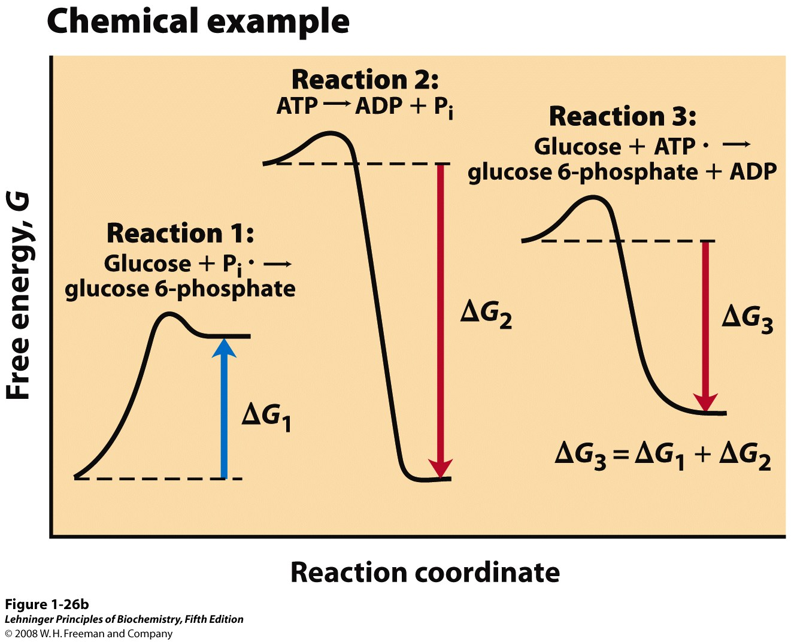
Energy coupling in chemical processes
Notes:
FIGURE 1–26b E (b) In reaction 1, the formation of glucose 6-phosphate from glucose and inorganic phosphate (P_{i}) yields a product of higher energy than the two reactants. For this endergonic reaction, ΔG is positive. In reaction 2, the exergonic breakdown of adenosine triphosphate (ATP) has a large, negative free-energy change (ΔG₂). The third reaction is the sum of reactions 1 and 2, and the free-energy change, ΔG₃, is the arithmetic sum of ΔG₁ and ΔG₂. Because ΔG₃ is negative, the overall reaction is exergonic and proceeds spontaneously.

Slide 21
ΔG'º
^{(kJ/mol)}
Glucose + Pi G-6-P + H₂O +13.8
ATP + H₂O ADP + P_{i} -30.5
Sum: ATP + glucose G-6-P + ADP -16.7

Slide 22
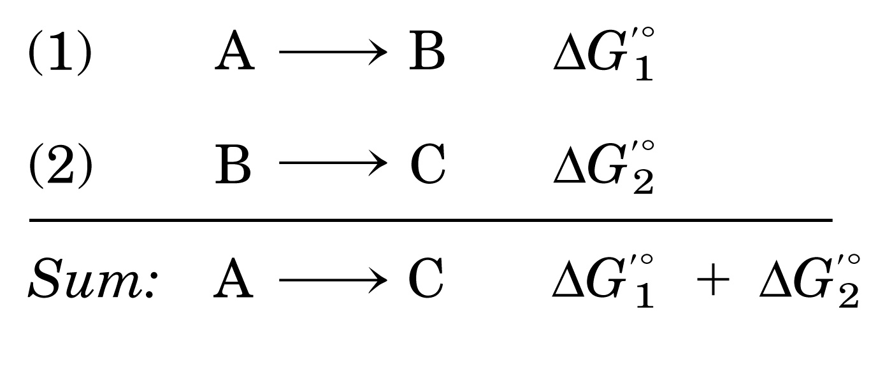
A thermodynamically unfavorable (endergonic) reaction can be driven in the forward direction by coupling it to a highly exergonic reaction through a common intermediate.

Slide 23
The ΔG and ΔG'º values are additive when reactions are coupled (i.e., sharing common intermediates), thus a thermodynamically unfavorable reaction can be driven by a favorable one.
The overall K'eq is multiplicative (the product of two, 两值相乘), although ΔG'º is additive (the algebraic sum of two, 两值相加).
The free energy change for a reaction is independent of the pathway by which the reaction occurs.

Slide 24
Five main reaction classes of biochemistry
Oxidation-reductions--dehydrogenations
Reactions that make or break
carbon-carbon bonds
Internal rearrangements, isomerizations and eliminations
Group transfers
Free radical reactions

Slide 25
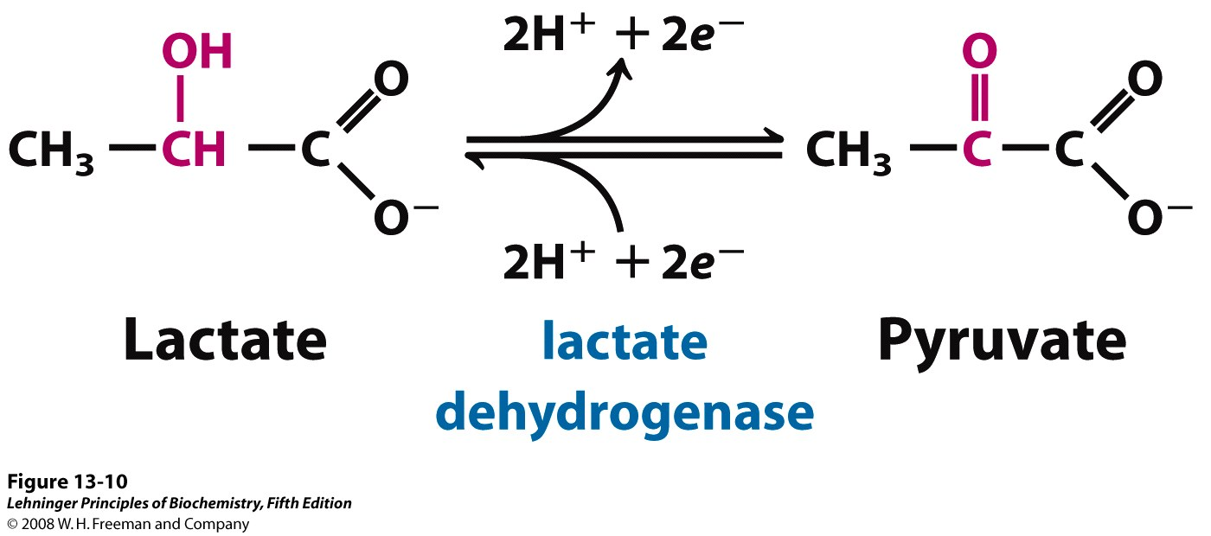
An oxidation-reduction reaction
Notes:
FIGURE 13-10 An oxidation-reduction reaction. Shown here is the oxidation of lactate to pyruvate. In this dehydrogenation, two electrons and two hydrogen ions (the equivalent of two hydrogen atoms) are removed from C-2 of lactate, an alcohol, to form pyruvate, a ketone. In cells the reaction is catalyzed by lactate dehydrogenase and the electrons are transferred to the cofactor nicotinamide adenine dinucleotide (NAD). This reaction is fully reversible; pyruvate can be reduced by electrons transferred from the cofactor.

Slide 26
4. ATP is the universal energy currency in all living cells
This was first perceived by Fritz Lipmann and Herman Kalckar in 1941 when studying glycolysis.
Hydrolysis of the two phosphoanhydride (磷酸酐键) bonds in ATP generate more stable products, releasing large amount of free energy (ΔG'º is
-30.5 kJ/mol; ΔG in cells is -50 to -65 kJ/mol).
The ATP molecule is kinetically stable at pH 7 (i.e., it has a high activation energy) and enzyme catalysis is needed for its hydrolysis.

Slide 27
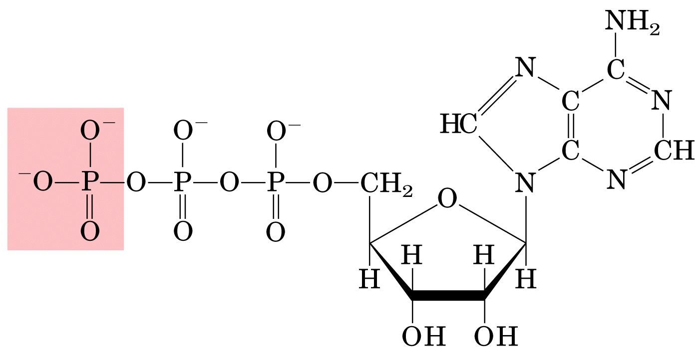
Adenosine triphosphate (ATP)

Slide 28
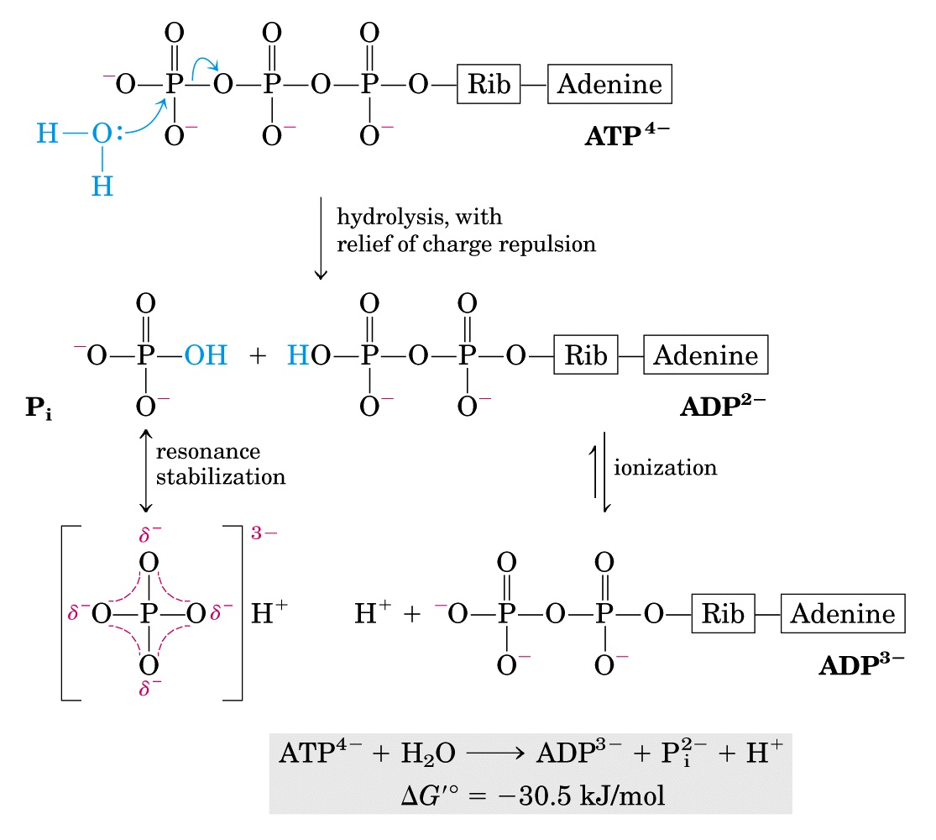
Chemical basis for the large free-energy change
associated with ATP hydrolysis

Slide 29
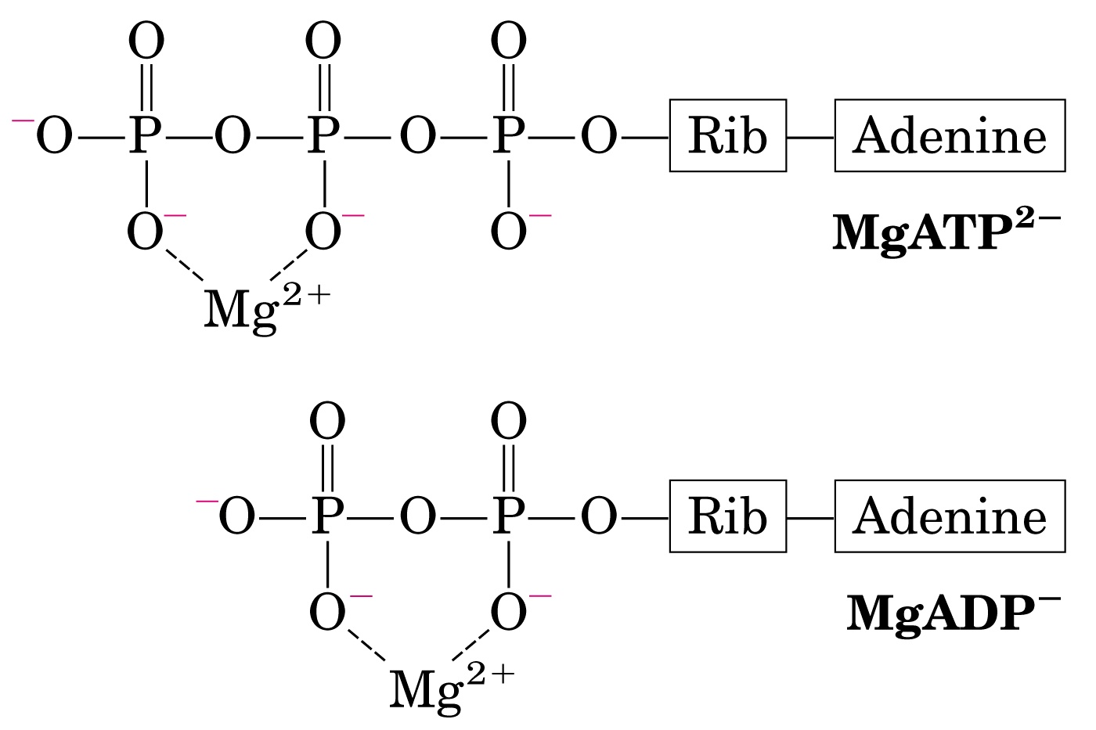
For most enzymatic reactions that involve ATP as
phosphoryl group donor, the true substrate is MgATP²⁻

Slide 30
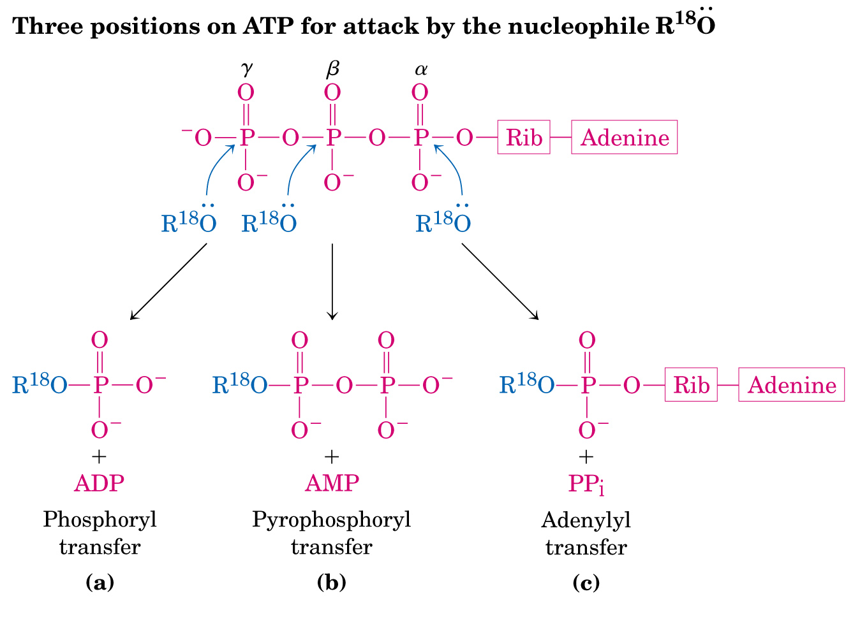
ATP can transfer a P_{i}, PP_{i} or AMP to a reactant

Slide 31
ATP is not a long-term storage form of free energy in living cells, being consumed within a minute following its formation (phosphocreatine, 磷酸肌酸, act as a energy storage form for longer term).
The concentration of ATP remains constant, because the rate of ATP consumption equals its rate of synthesis.
A resting human consumes about 40 kg of ATP in 24 hours!

Slide 32
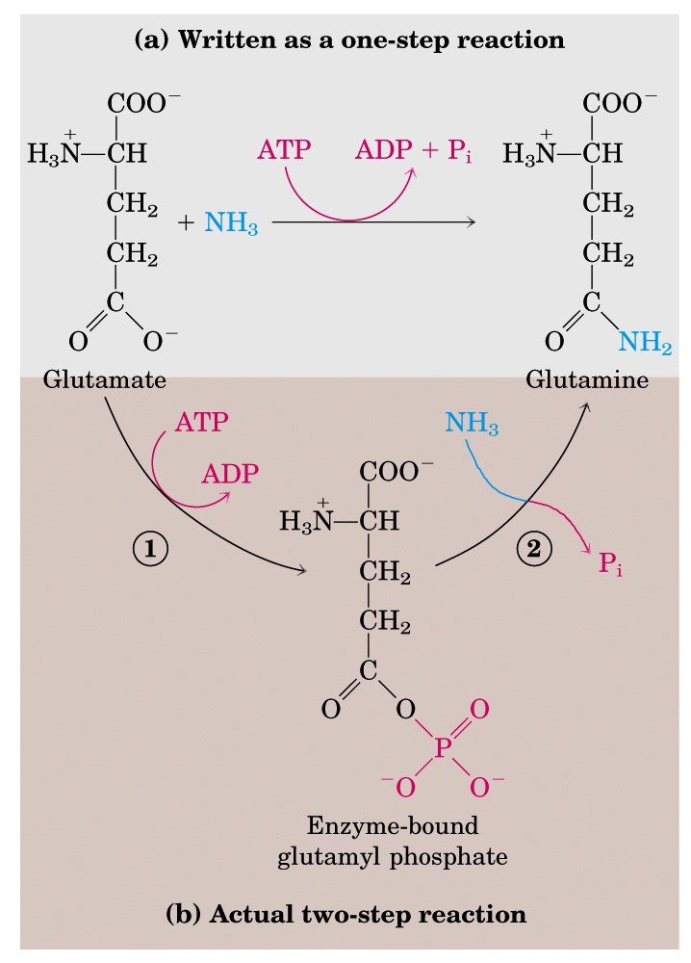
ATP provides energy by
group transfer (donating a
Pi, PPi or AMP to form
covalent intermediates),
not by simple hydrolysis
(a two-step reaction)
Glutamine
synthetase

Slide 33
Other phosphorylated compounds also have large free energies of hydrolysis.
ATP has an intermediate phosphoryl group transfer potential, thus ADP can accept and ATP can donate phosphoryl groups.
ATP can carry energy from high-energy phosphate compounds produced by catabolism to low-energy ones, converting them into more reactive species, therefore, coupling endergonic processes to exergonic ones.

Slide 34
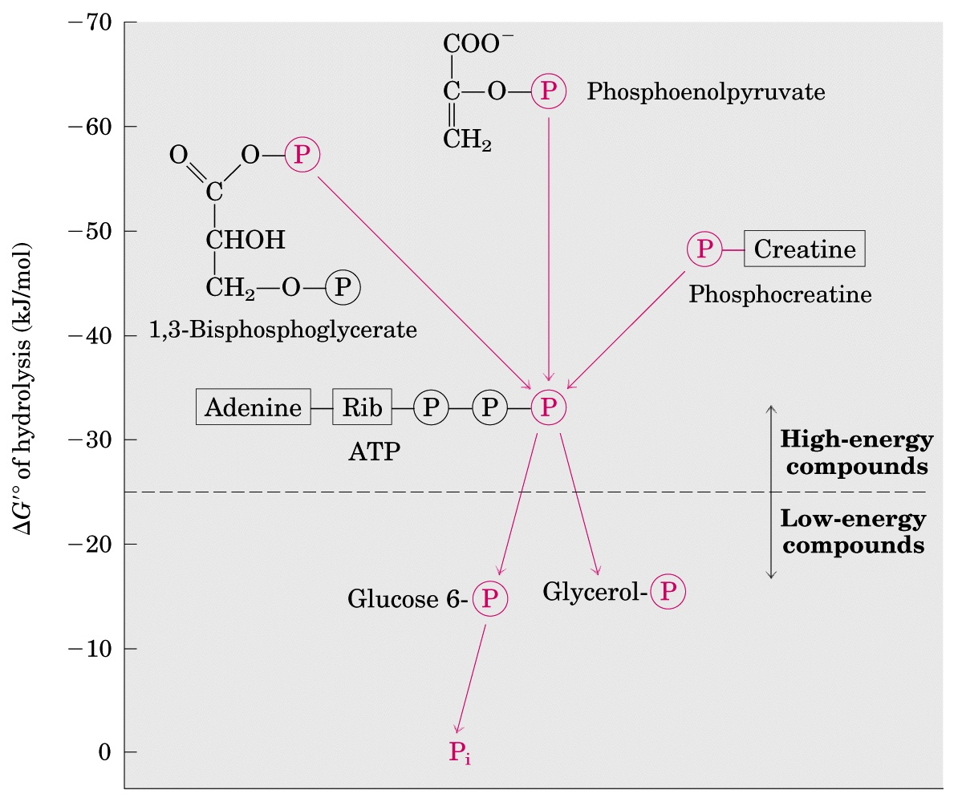
（PEP）
ATP has an intermediate phosphoryl group transfer potential

Slide 35
ΔG'º
^{(kJ/mol)}
PEP + H₂O pyruvate + P_{i} -61.9
ADP + P_{i} ATP + H₂O +30.5
Sum: PEP + ADP pyruvate + ATP -31.4

Slide 36
ΔG'º
^{(kJ/mol)}
Glucose + Pi G-6-P + H₂O +13.8
ATP + H₂O ADP + P_{i} -30.5
Sum: ATP + glucose G-6-P + ADP -16.7

Slide 37
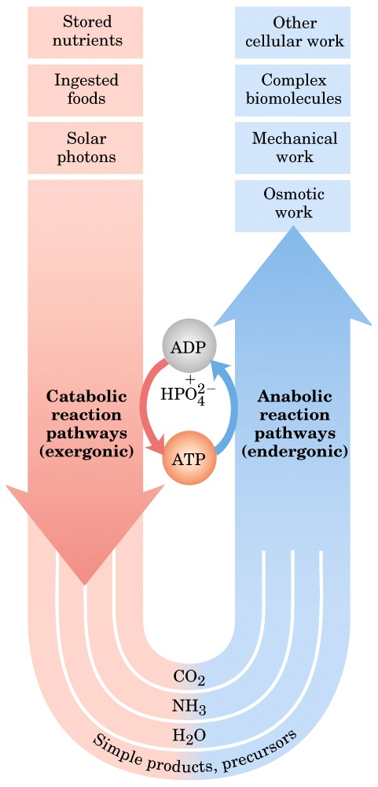
ATP serves as the
universal energy
currency in all
living cells

Slide 38
ATP energizes active transport and muscle contraction (by ATP hydrolysis).
Assembly of informational macromolecules requires energy.
In the firefly, ATP is used in a set of reactions
that convert chemical energy into light energy.
In the lab, as little as a few picomoles (10⁻¹² mol) of ATP can be measured using firefly luciferin and luciferase (荧光素酶), using spectroscopic methods.

Slide 39
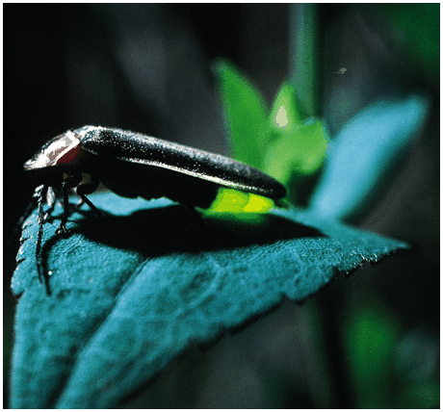
In the firefly, ATP is used in a set of reactions
that convert chemical energy into light energy

Slide 40
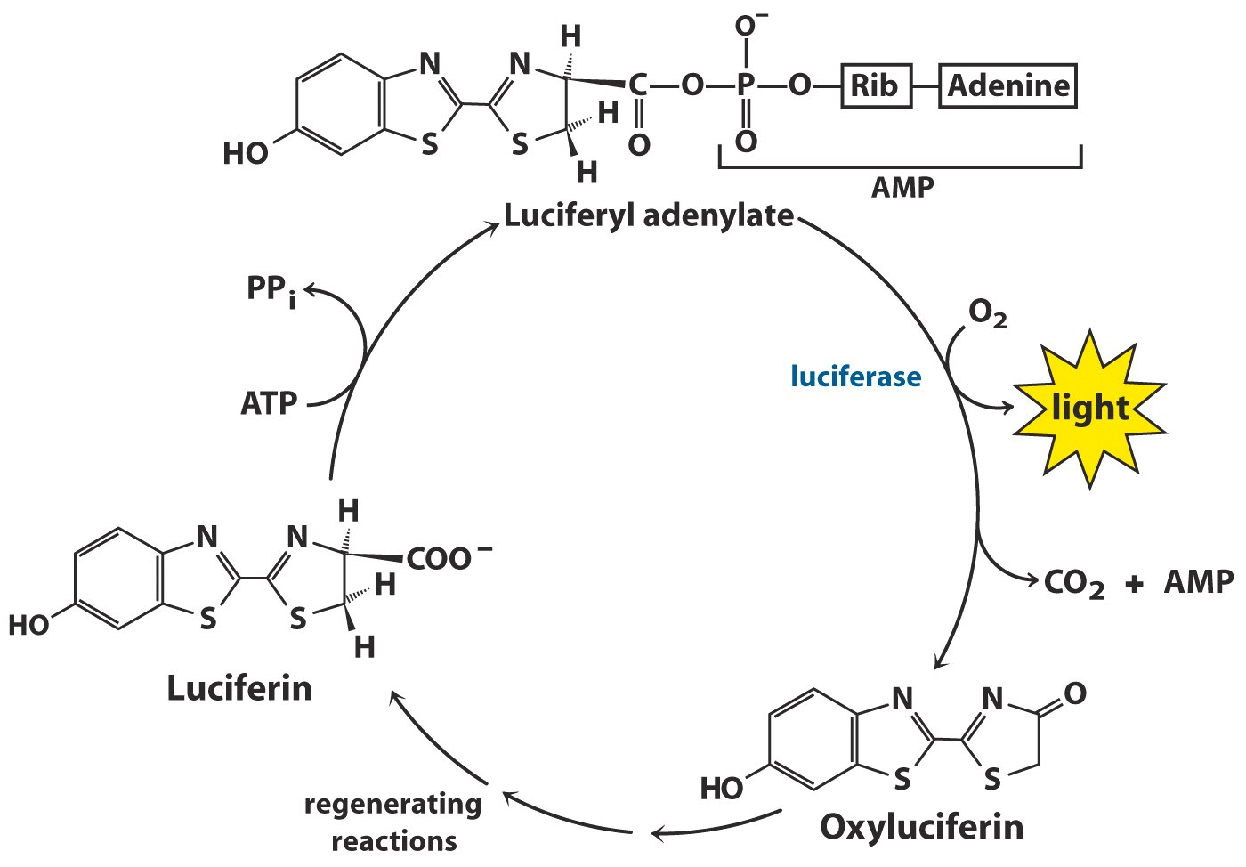
Picomoles (10⁻¹² mol) of ATP can be
measured using luciferase

Slide 41
5. Electron transfer via reduction-oxidation (redox) reactions generates biological energy
When electrons flow from a low affinity carrier (reductant) to a high affinity carrier (oxidant), either in an electric battery or in a living cell, energy is released and work can be done.

Slide 42
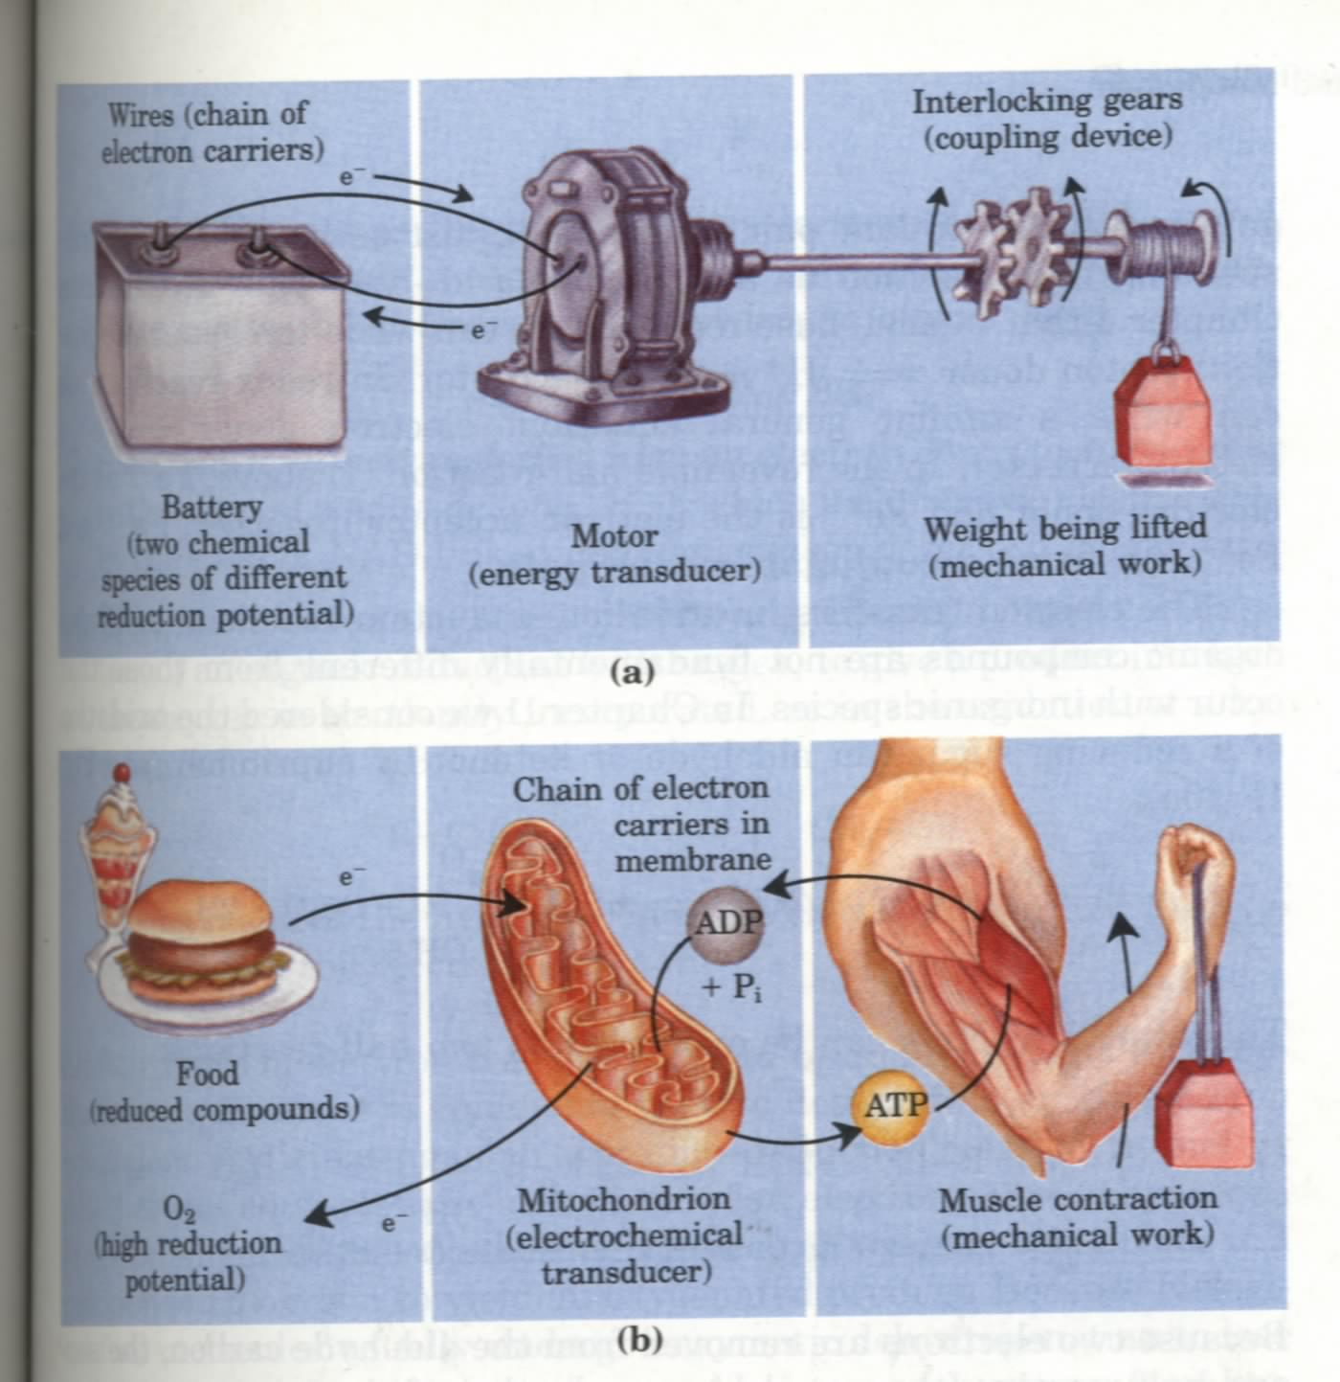
Energy is
“generated” via
electron flow
both in a battery
and in a cell!

Slide 43
Oxidation of energy-rich biological fuels often means dehydrogenation (catalyzed by dehydrogenases, 脱氢酶) from carbons having various oxidation states.
The affinity for electrons of a compound (in its oxidized form) is indicated by its reduction potential (E).

Slide 44
Standard reduction potential (E'º) of each oxidant is measured by connecting a half-cell having the oxidized and reduced species of the redox pair each at 1 M, or 1 atm for gases, pH 7 to a reference half-cell having 1 M H⁺ and 1 atm H₂, whose E'º is arbitrarily assigned as 0.00 V.

Slide 45
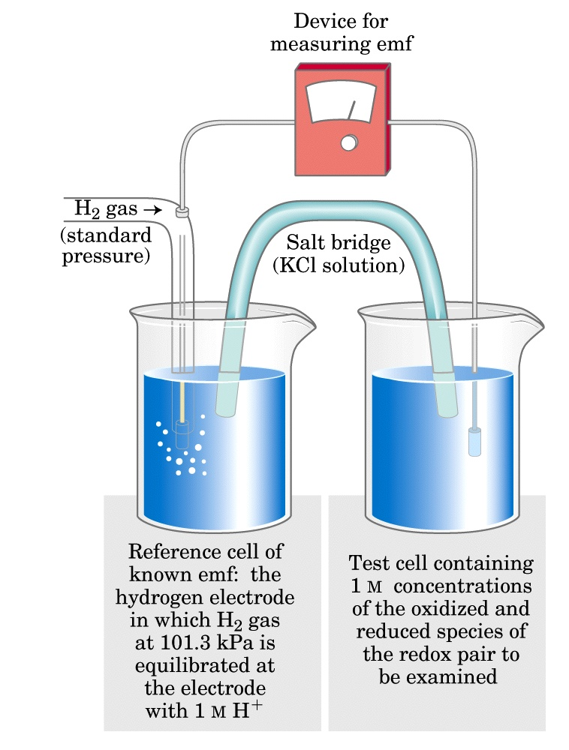
The standard reduction
potential (E'º) of a
conjugate redox pair
is measured by
connecting the sample
half cell to the H⁺/H₂
reference half cell.

Slide 46
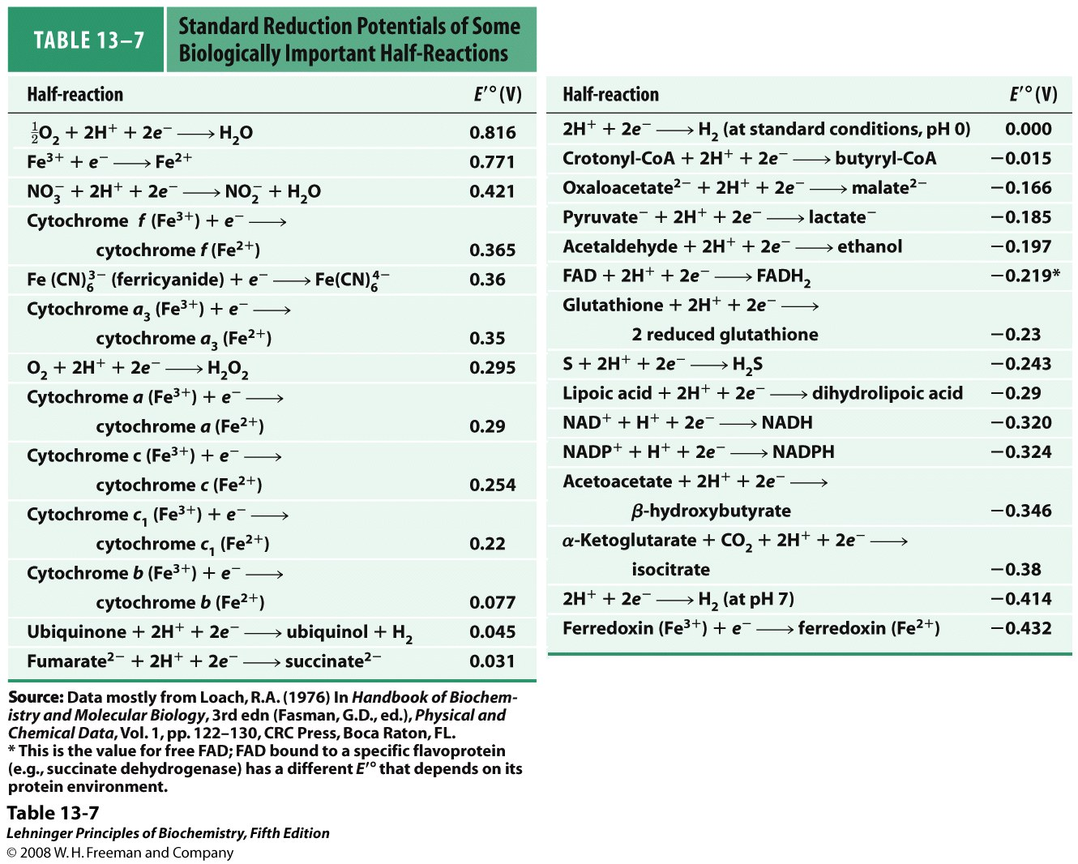

Slide 47
A positive value of E'º indicates a tendency to acquire electron from the reference half cell (with 1M H⁺/1atm H₂).
In the living cells, electrons are transferred directly as electrons (between metal ions), as hydrogen atoms (H⁺+e⁻), or as a hydride ion (:H⁻ or H⁺+2e⁻).

Slide 48
The actual reduction potential (E) depends on electrons transferred per molecule, temperature and ratio of
[electron acceptor]/[electron donor]:
ΔG'º of a redox reaction can be calculated from the ΔE'º of the two redox pairs:

Slide 49
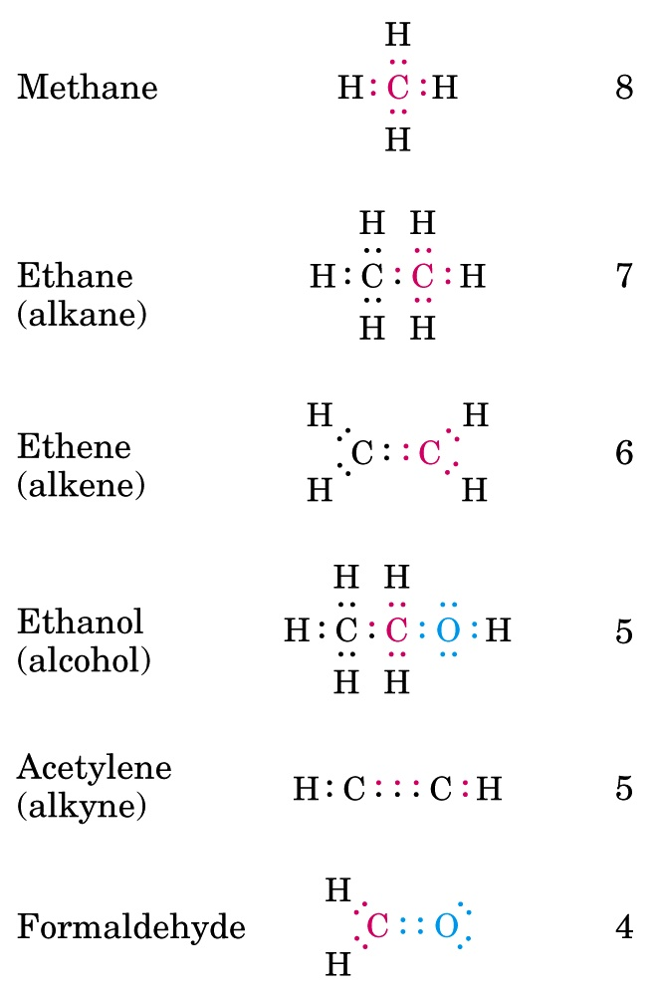
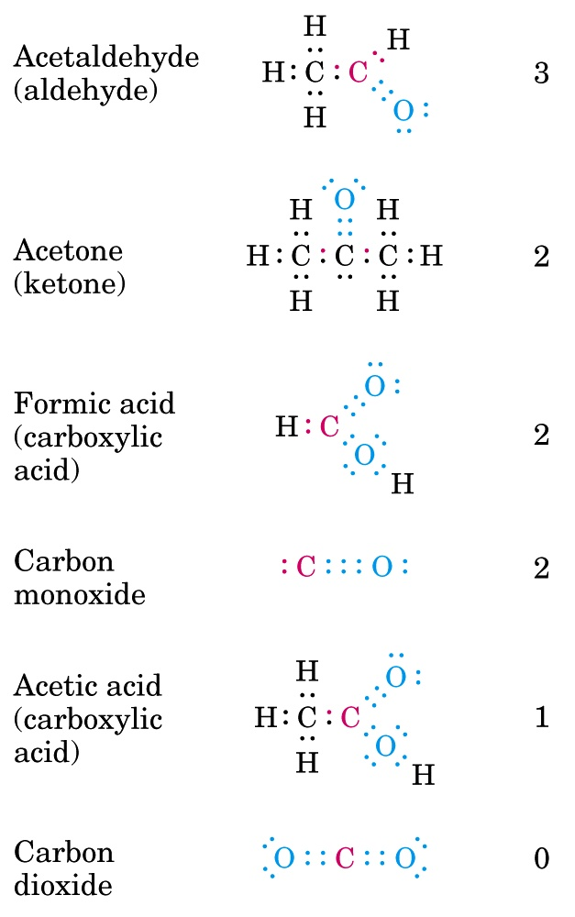
The carbon atom may “own” different number of electrons in
different compounds, thus having different oxidation states

Slide 50
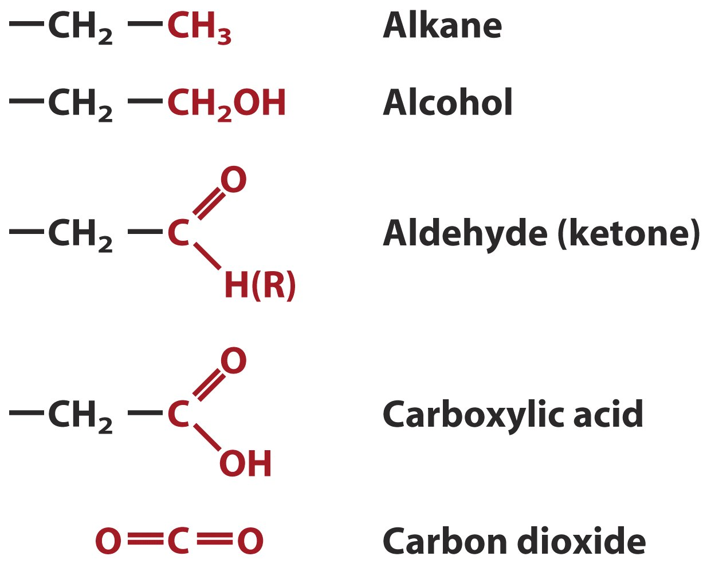
Carbons have various oxidation states, with hydrocarbon being
the most reduced and CO₂ being the most oxidized.

Slide 51
6. A few universal carriers (as coenzymes) collect electrons from the oxidation of various substrates
NAD⁺, NADP⁺, FMN and FAD are the commonly used electron carriers.
NAD and NADP are dinucleotides able to accept/donate a hydride ion (thus with 2e⁻) for each round of reduction/oxidation.

Slide 52
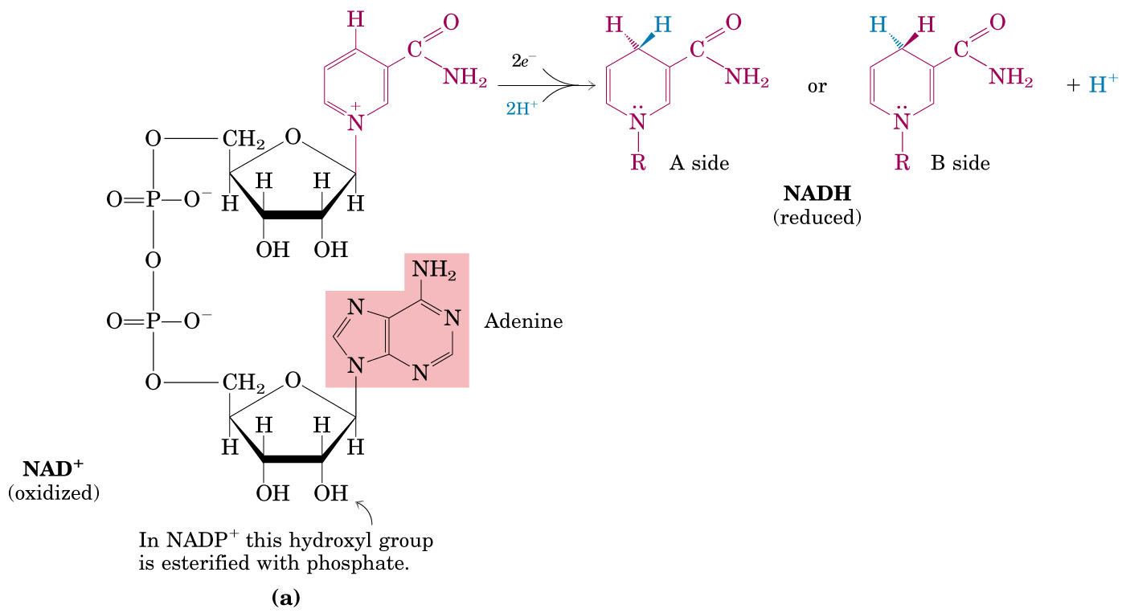
Nicotinamide
NAD: Nicotinamide Adenine Dinucleotide
NADP: Nicotinamide Adenine Dinucleotide Phosphate

Slide 53
In each specific NAD- or NADP-containing dehydrogenase, the hydride ion is added/taken stereospecifically from one side (A or B) of the nicotinamide (烟碱) ring.
NAD and NADP can easily diffuse out of the enzymes.
NAD⁺ generally functions in catabolic reactions, whereas NADPH is always part of an anabolic reaction.
Dietary deficiency of niacin, the vitamin form of NAD and NADP, causes pellagra (糙皮病).

Slide 54
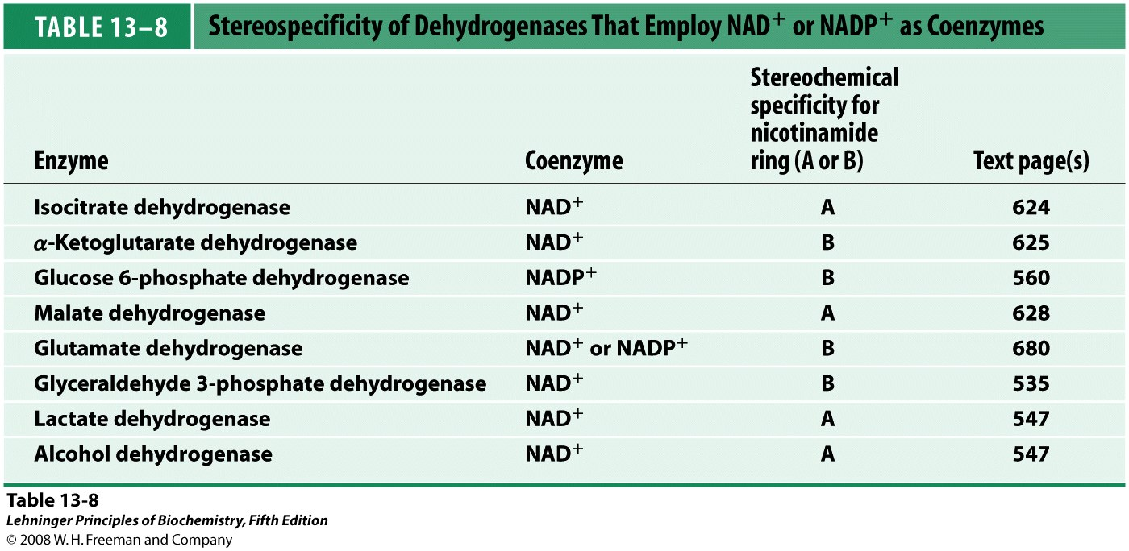

Slide 55
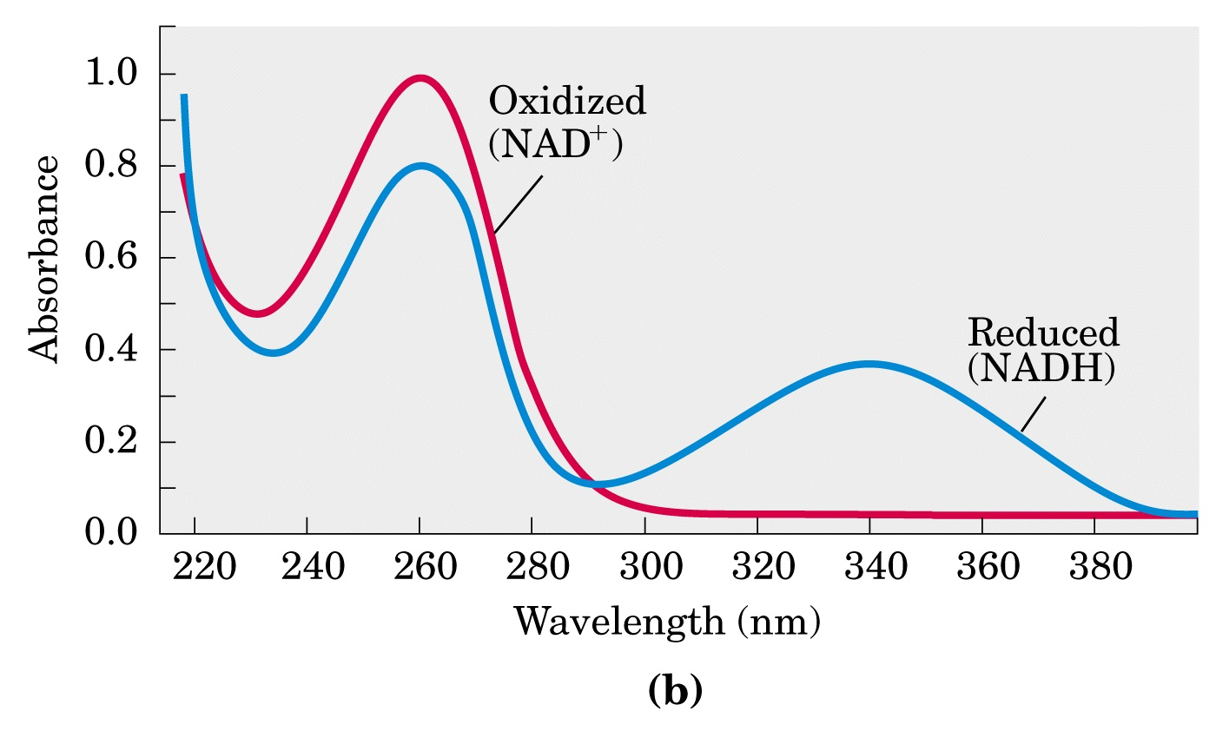
Reduction of NAD⁺ and NADP⁺ can be easily
followed by spectroscopy (at 340 nm)

Slide 56
Glyceraldehyde 3-phosphate + NAD⁺
3-phosphoglycerate + NADH + H⁺
Acetaldehyde + NADH + H⁺
ethanol + NAD⁺
Sum: Glyceraldehyde 3-phosphate + acetaldehyde
3-phosphoglycerate + ethanol
The coenzymes function catalytically and are
recycled repeatedly without a net change in
the concentration of NAD⁺ + NADH

Slide 57
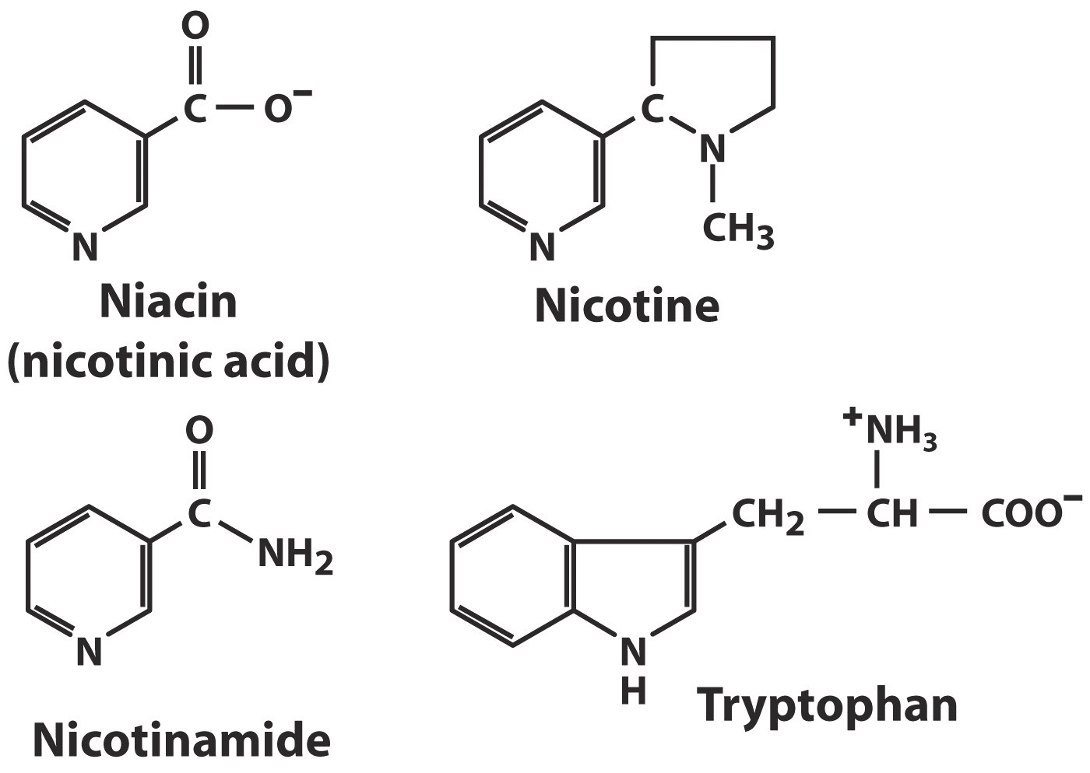
(B vitamin)
(Precursor)
Structures of niacin and its derivative nicotinamide
Dietary deficiency of niacin, the vitamin form of NAD
and NADP, causes pellagra (糙皮病).

Slide 58
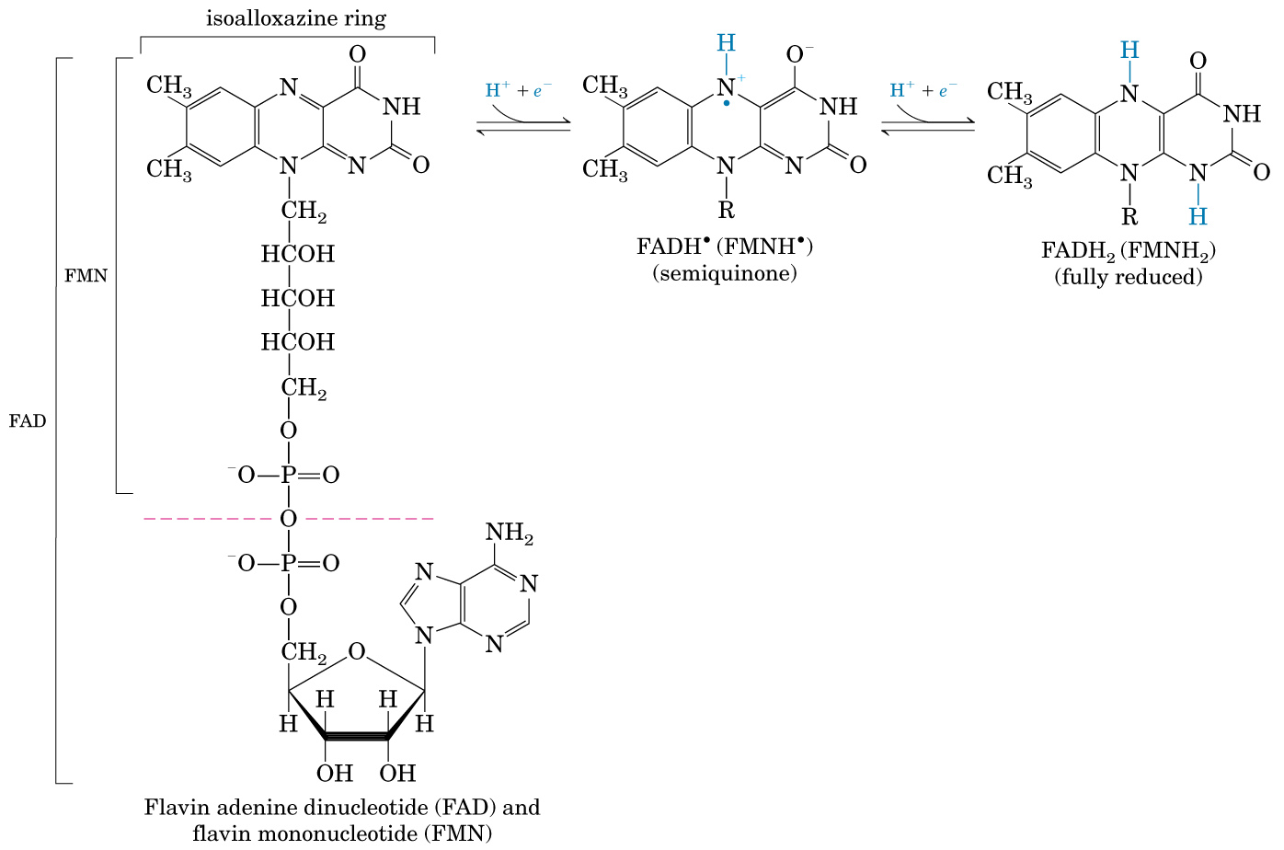
Reactive sites
FMN: Flavin mononucleotide
FAD: Flavin adenine dinucleotide
(derived from the vitamin riboflavin)

Slide 59
Flavoproteins are enzymes that catalyze oxidation-reduction reactions using either FMN or FAD as coenzymes.
FMN and FAD are tightly bound to the enzymes as prosthetic groups (辅基).
FMN or FAD is able to accept/donate one or two electrons (as hydrogen atom), with absorption maximum shifts from 570 nm to 450nm.

Slide 60
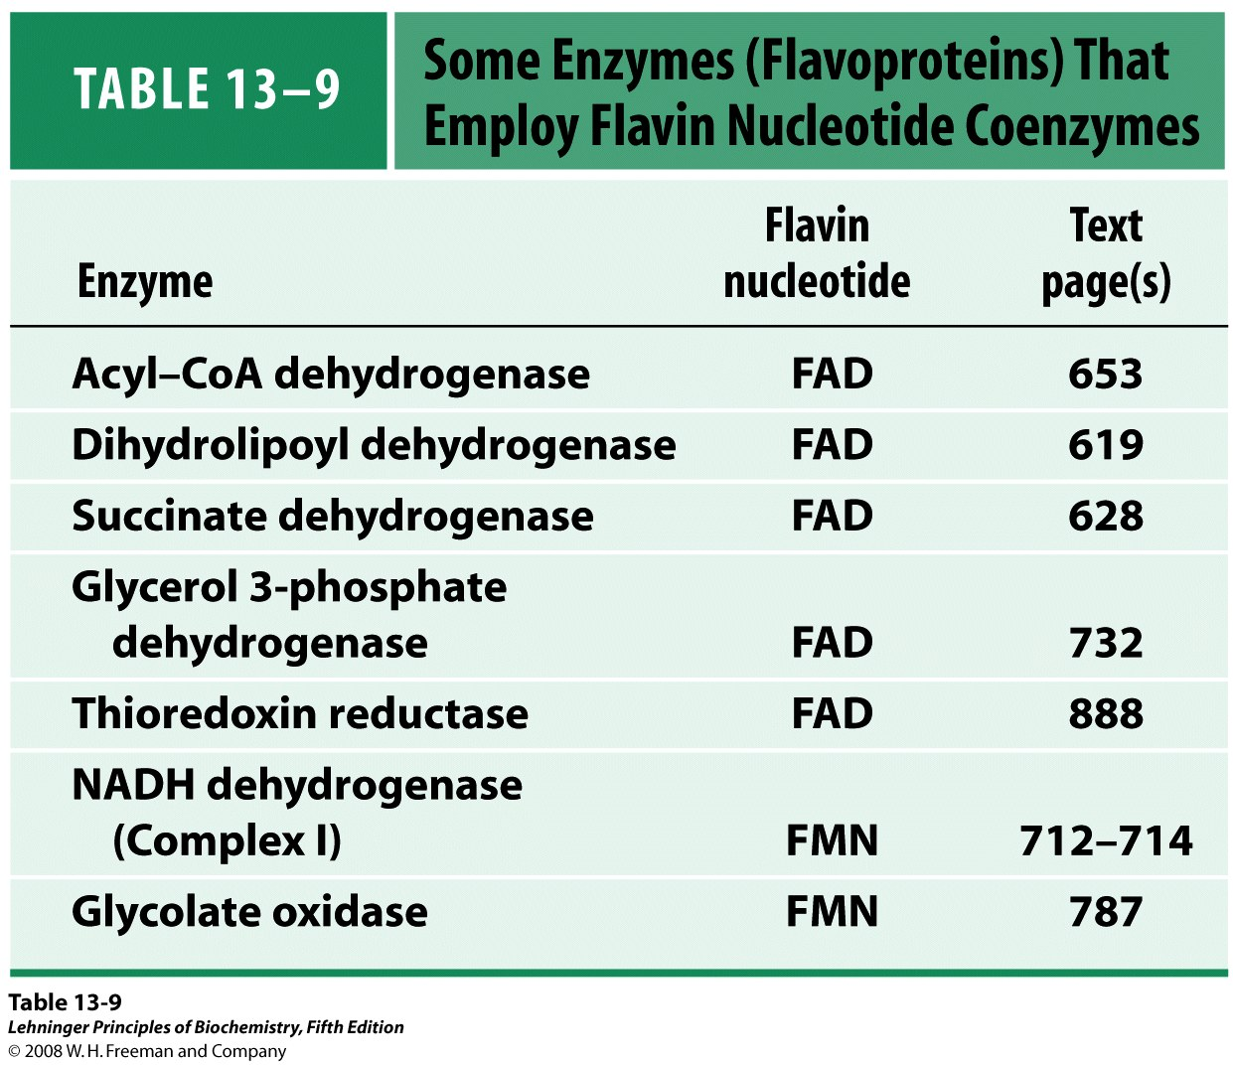

Slide 61
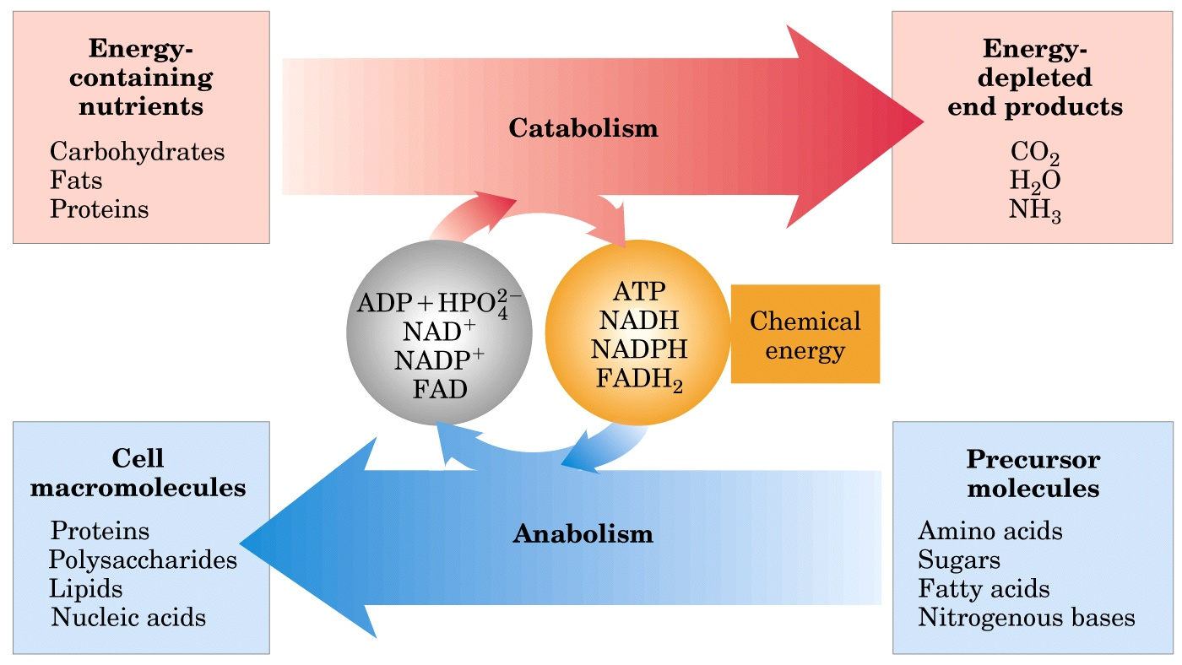
Energy relationships between catabolic and anabolic pathways

Slide 62
NADH and FADH₂ will be further oxidized via the respiratory chain on the inner membrane of mitochondria or plasma membrane of bacteria for energy generation (To be discussed in Chapter 19).

Slide 63
Keywords
ΔG
ΔE
ATP
NAD, NADP
FMN, FAD

Slide 64
Words of the week
catabolism (分解代谢) vs. anabolism (合成代谢)
oxidation (氧化) vs. reduction (还原)
exergonic (放能) vs. endergonic (吸能)
autotroph (自养生物) vs. heterotroph (异养生物)

Slide 65
Textbook-reading of the week
Summary 13.1
Summary 13.2
Summary 13.3
Summary 13.4
p532-537 (6th Edition)

Slide 66
Summary
Bioenergy is chemical energy, studied in terms of free energy and free energy change (ΔG).
ATP acts as the free energy carrier in cells.
Bioenergy is mainly produced via stepwise electron flow (redox reactions) through a series of electron carriers having increasing levels of reduction potential (E).
Electrons released from the oxidation of nutrient fuels are initially channeled to a few universal electron carriers (such as NAD⁺ and FAD).

