Slide 1
Chapter 16 The Citric Acid Cycle
The common pathway leading to the
complete oxidation of carbohydrates,
fatty acids, and amino acids to CO₂
A pathway providing many precursors
for biosynthetic reactions

Slide 2
Citric Acid Cycle (三羧酸循环)
Also called the tricarboxylic acid cycle (TCA) or the Krebs cycle
Pyruvate completely oxidized to CO₂ and H₂O in the presence of O₂---cellular respiration
Occurs in eight steps in mitochondria
Energy efficiently conserved
A hub in metabolism, serving in both catabolic and anabolic processes

Slide 3
1. The cellular respiration (complete oxidation of fuels) can be divided into three stages
Stage I All the fuel molecules are oxidized to generate a common two-carbon unit, acetyl-CoA.
Stage II Acetyl-CoA is completely oxidized to CO₂, with electrons collected by NAD and FAD via the citric acid cycle.
Stage III Electrons of NADH and FADH₂ are transferred to O₂ via a series of carriers, producing H₂O and a H⁺ gradient, which will promote ATP formation.

Slide 4
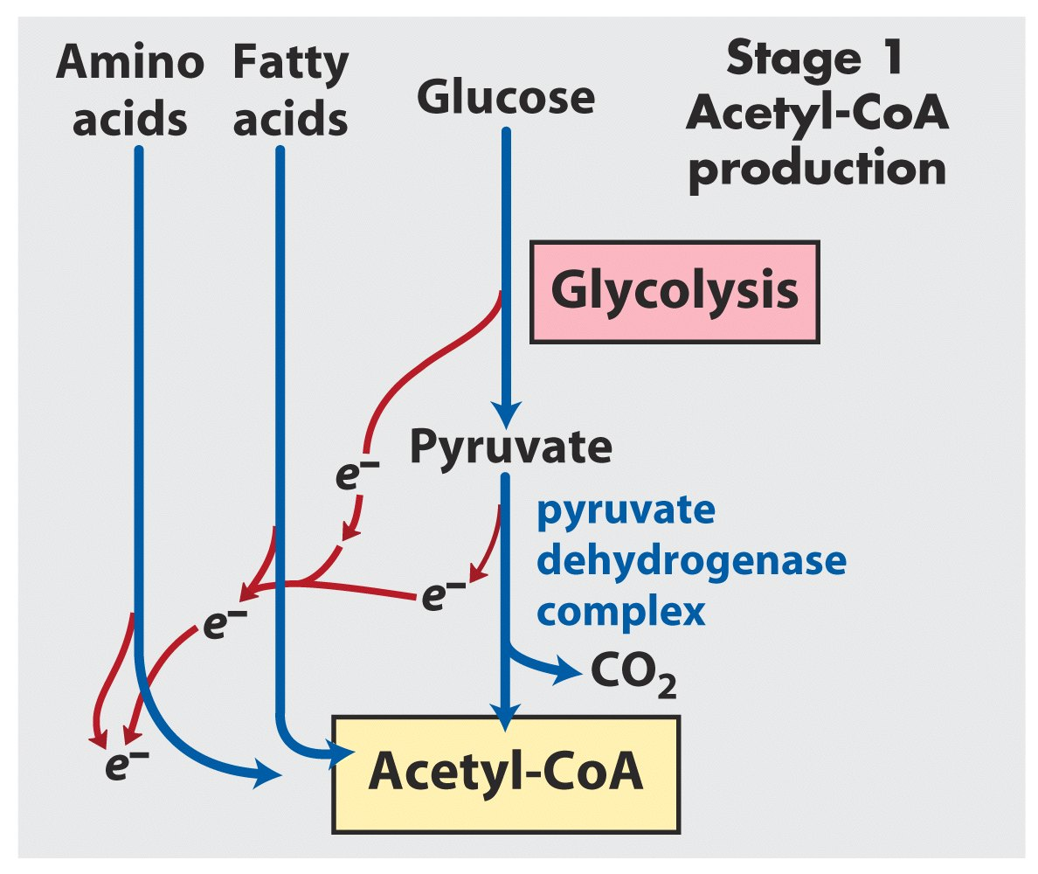

Slide 5
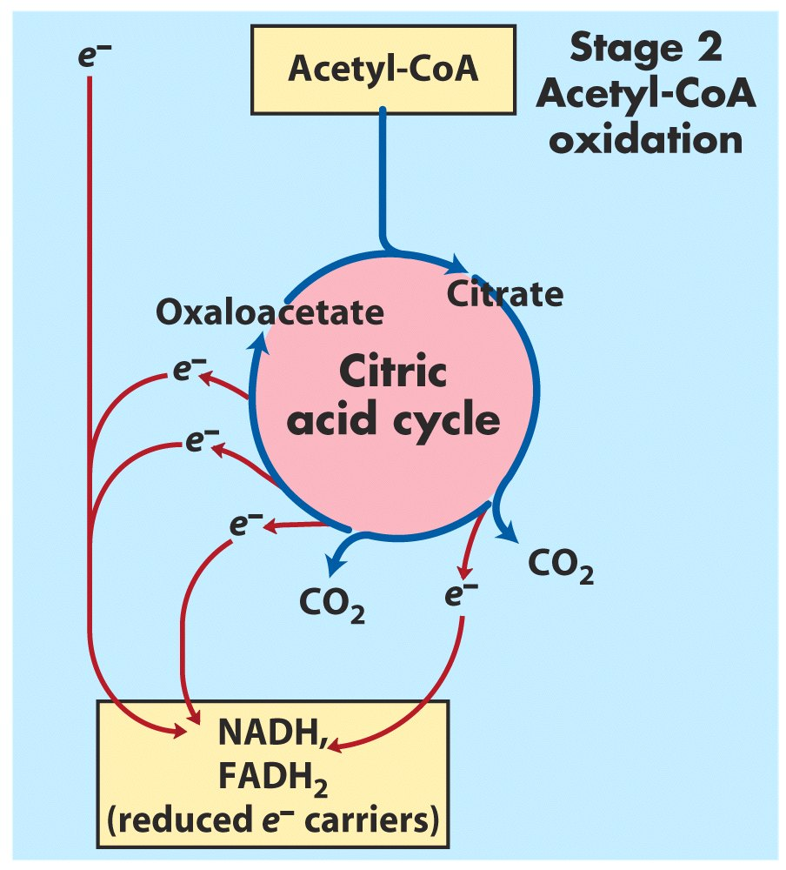

Slide 6
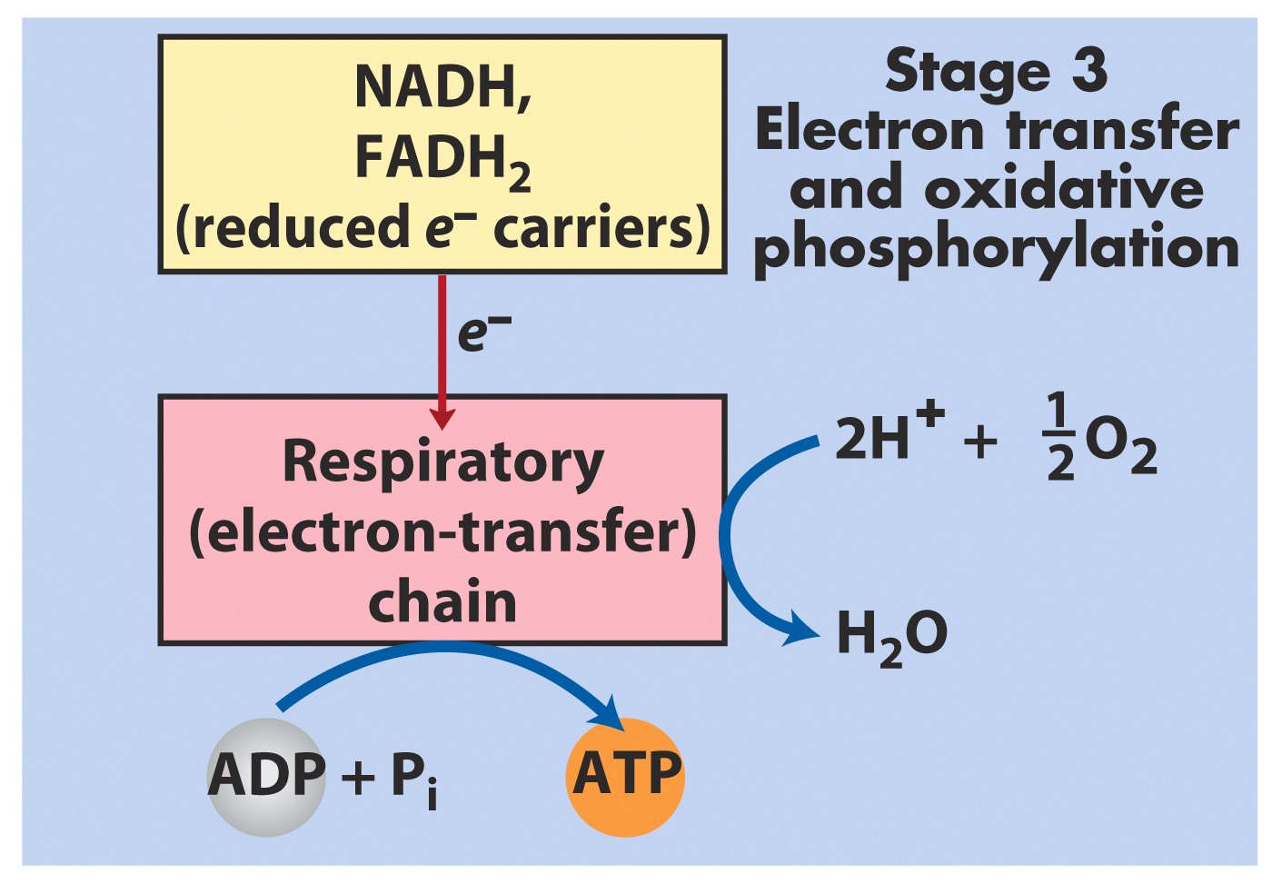

Slide 7
2. Pyruvate is oxidized to acetyl-CoA by the pyruvate dehydrogenase complex
Pyruvate is first transported into mitochondria via a specific transporter on the inner membrane.
Pyruvate is converted to acetyl-CoA and CO₂ by oxidative decarboxylation.
The pyruvate dehydrogenase (PDH) complex is a huge multimeric assembly of three kinds of enzymes, having 60 subunits in bacteria and more in mammals.

Slide 8
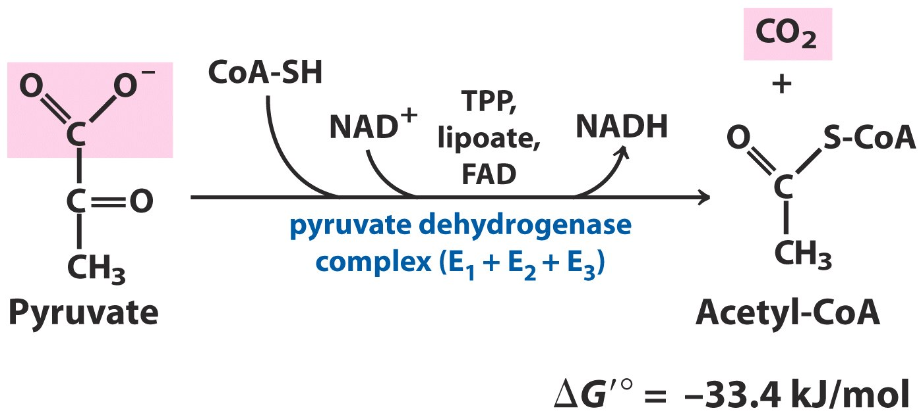
Production of acetyl-CoA
irreversible
Oxidative decarboxylation

Slide 9
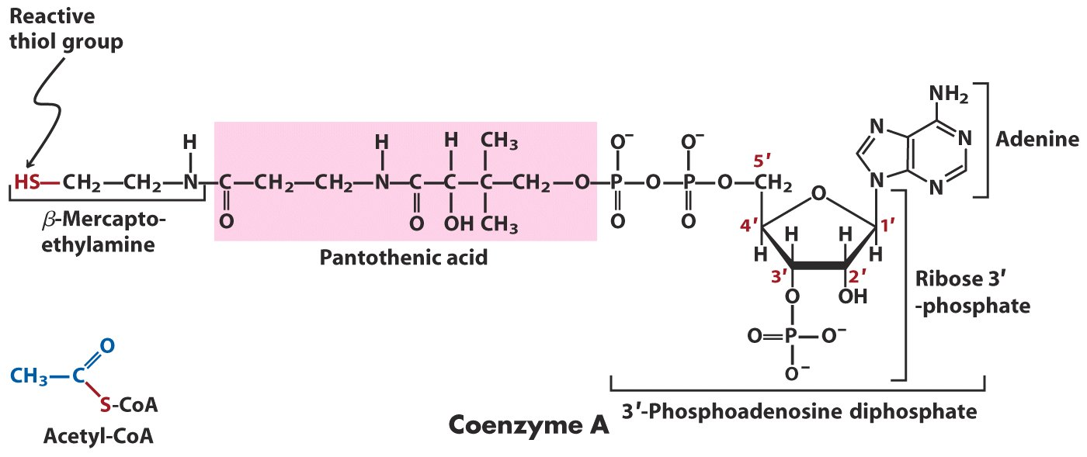
Critical to its role
as an acyl carrier
in a number of
metabolic reactions

Slide 10
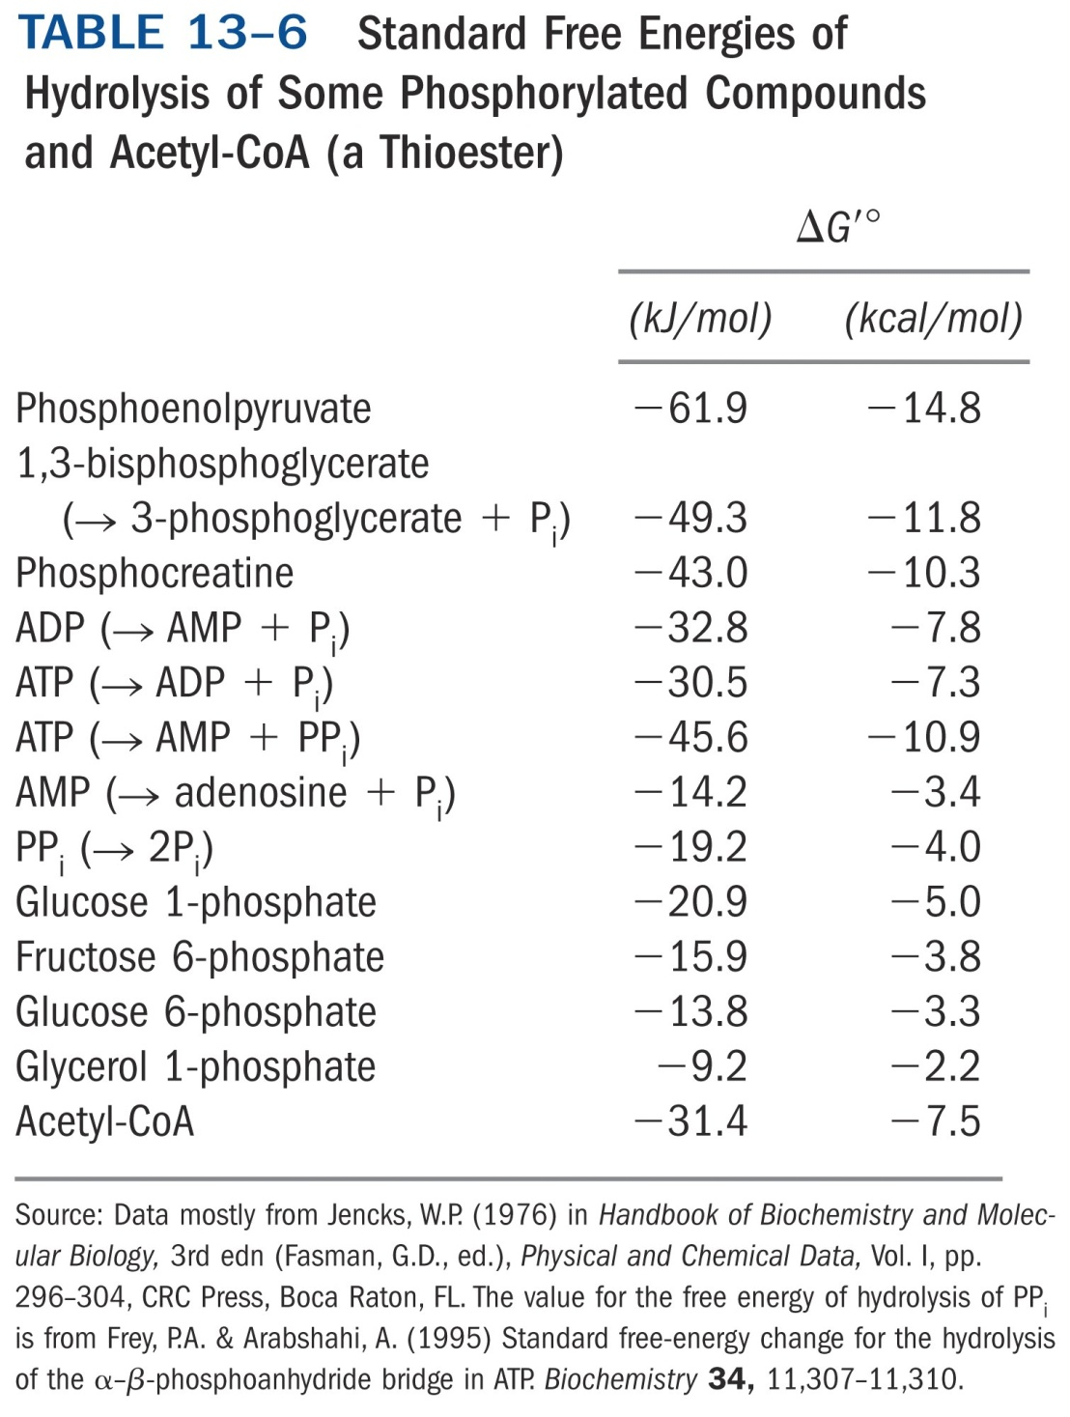
(thioester)

Slide 11
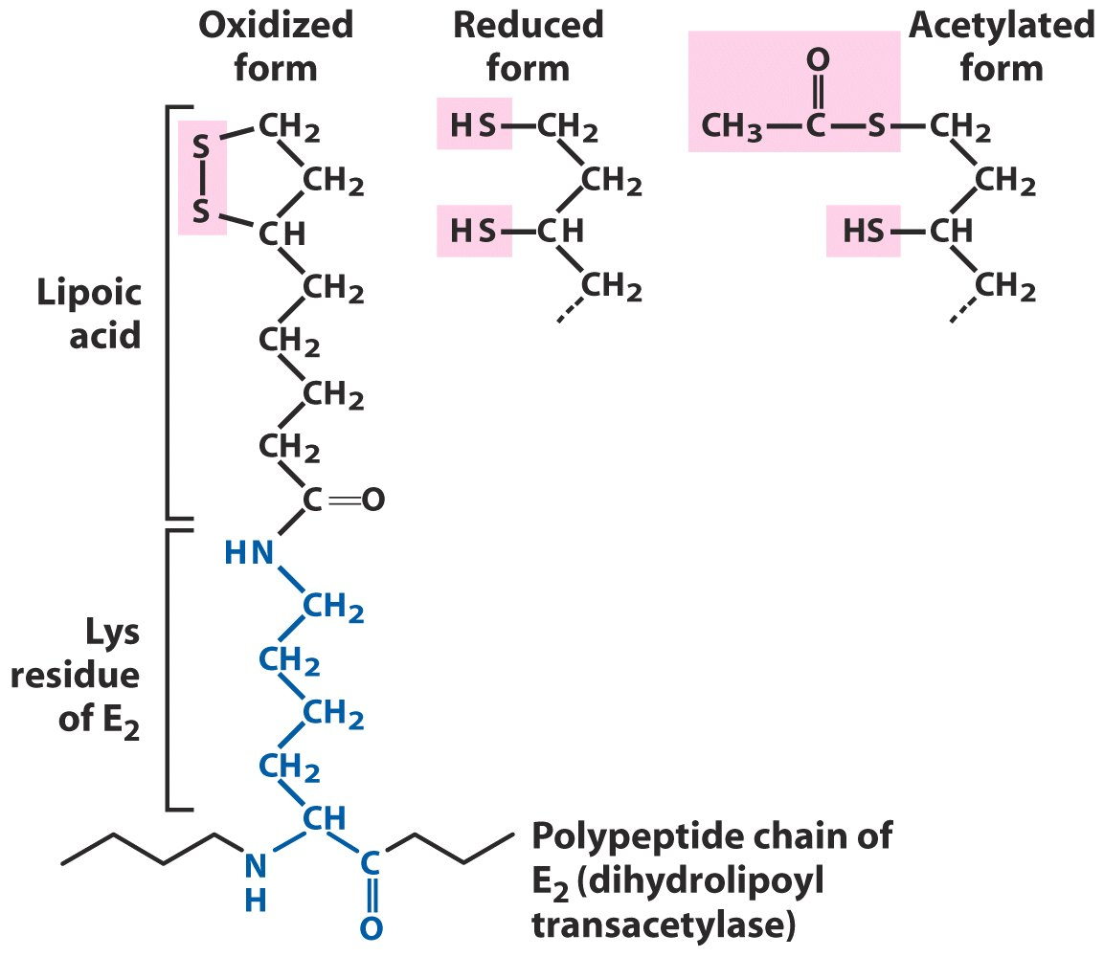
Lipoate can act as
a carrier of both
hydrogen and
an acetyl group

Slide 12
Pyruvate dehydrogenase complex (PDH)
Three-enzyme complex
E₁: pyruvate dehydrogenase (TPP)
E₂: dihydrolipoyl transacetylase (lipoate)--core
E₃: dihydrolipoyl dehydrogenase (FAD)
Plus 2 regulatory proteins (a protein kinase
and a phosphoprotein phosphatase)

Slide 13
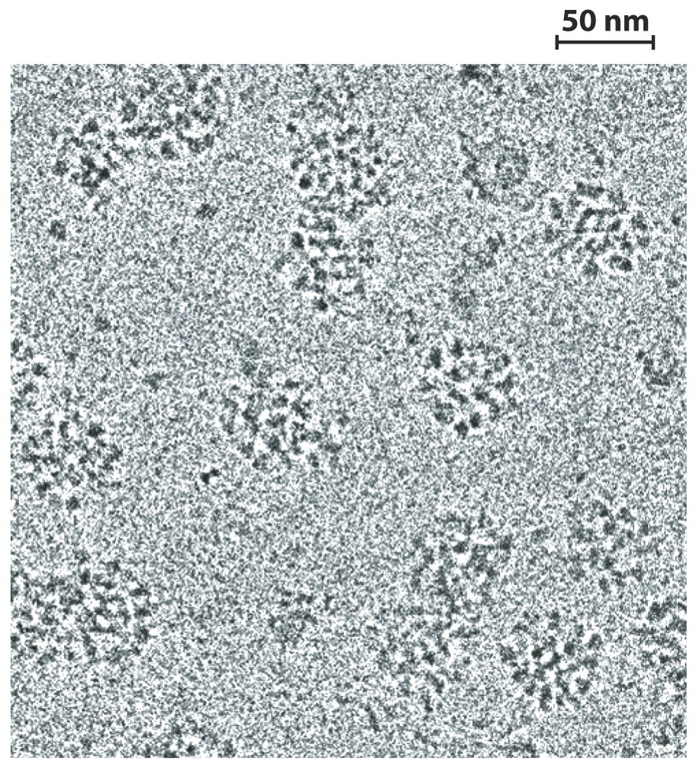
Cryoelectron
micrograph of PDH
complexes isolated
from bovine kidney

Slide 14
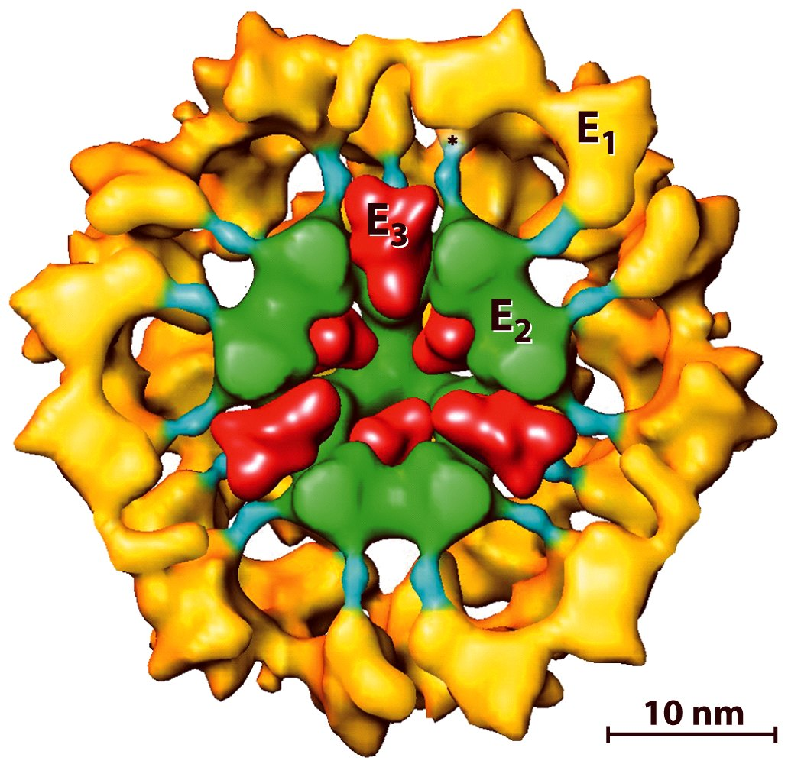
Three-dimensional image of the PDH complex

Slide 15
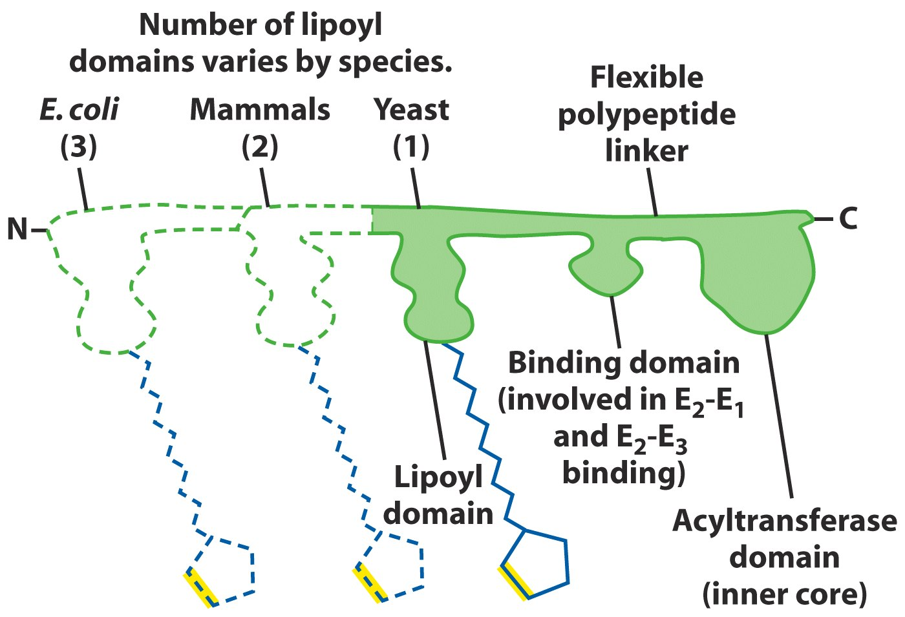
E₂ consists of three types of domains linked
by short polypeptide linkers

Slide 16
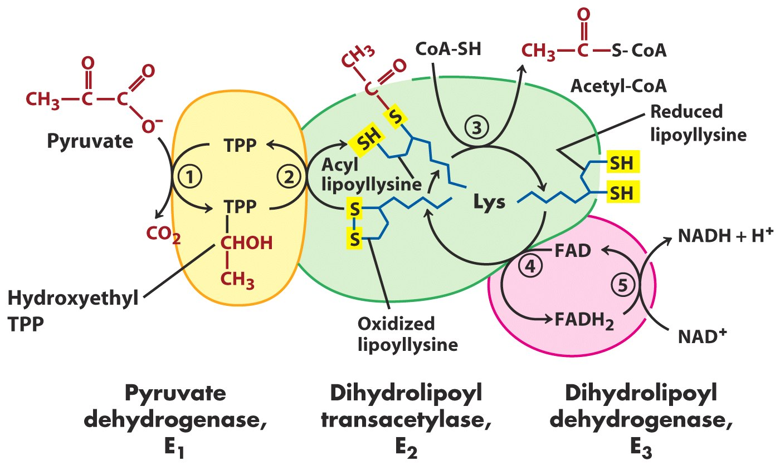
Oxidative decarboxylation of pyruvate to
acetyl-CoA by the PDH complex

Slide 17
Substrates of the five reactions catalyzed by the pyruvate dehydrogenase complex are efficiently channeled---substrate channeling
The long lipoyllysine arm of E₂ swings from the active site of E₁ to E₂ to E₃, tethering the intermediates to the enzyme complex to allow substrate channeling.
The multienzyme complexes catalyzing the oxidative decarboxylation of a few different kinds of α-keto acids, including pyruvate dehydrogenase complex, α-ketoglutarate dehydrogenase complex and branched-chain α-keto acid dehydrogenase complex, show remarkable structure and function similarities (all have identical E₃, similar E₁ and E₂).

Slide 18
3. The complete oxidation of pyruvate in animal tissues was proposed to undergo via a cyclic pathway
O₂ consumption and pyruvate oxidation in minced muscle tissues were found to be stimulated by some four-carbon dicarboxylic acids (fumarate, succinate, malate and oxaloacetate), five-carbon dicarboxylic acid (α-ketoglutarate ), or six-carbon tricarboxylic acids (citrate, isocitrate, cis-aconitate).
A small amount of any of these organic acids stimulates many folds of pyruvate oxidation!

Slide 19
Malonate inhibits pyruvate oxidation regardless of which active organic acid is added!
Hans Krebs proposed the “citric acid cycle” for the complete oxidation of pyruvate in animal tissues in 1937.
The citric acid cycle was confirmed to be universal in cells by in vitro studies with purified enzymes and in vivo studies with radio isotopes (“radio isotope tracer experiments”).
Krebs was awarded the Nobel Prize in medicine in 1953 for revealing the citric acid cycle (thus also called the Krebs cycle).

Slide 21
4. The acetyl group (carried by CoA) is completely oxidized to CO₂ via the citric acid cycle
The 4-carbon oxaloacetate (草酰乙酸) acts as the “carrier” for the oxidation.
The two carbons released as 2 CO₂ in the first cycle of oxidation are not from the acetyl-CoA just joined.
The 8 electrons released are collected by three NAD⁺ and one FAD.
One molecule of ATP (or GTP) is produced per cycle by substrate-level phosphorylation.

Slide 22
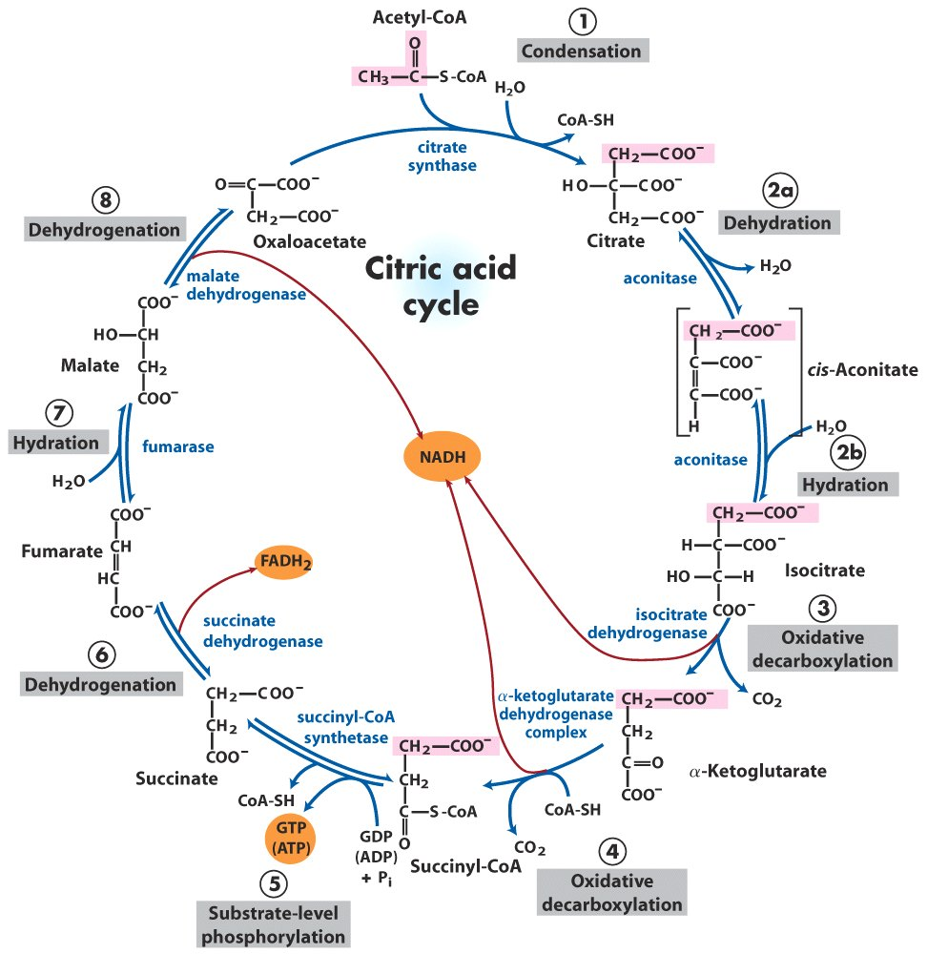
Reactions of the citric acid cycle

Slide 23
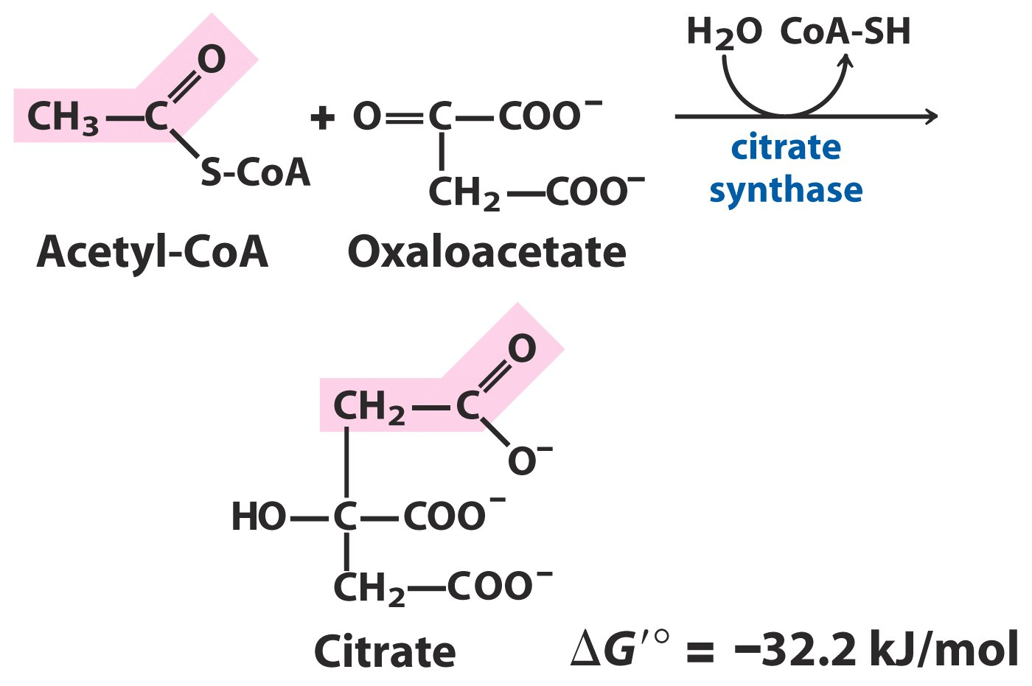
Step 1: condensation
irreversible

Slide 24
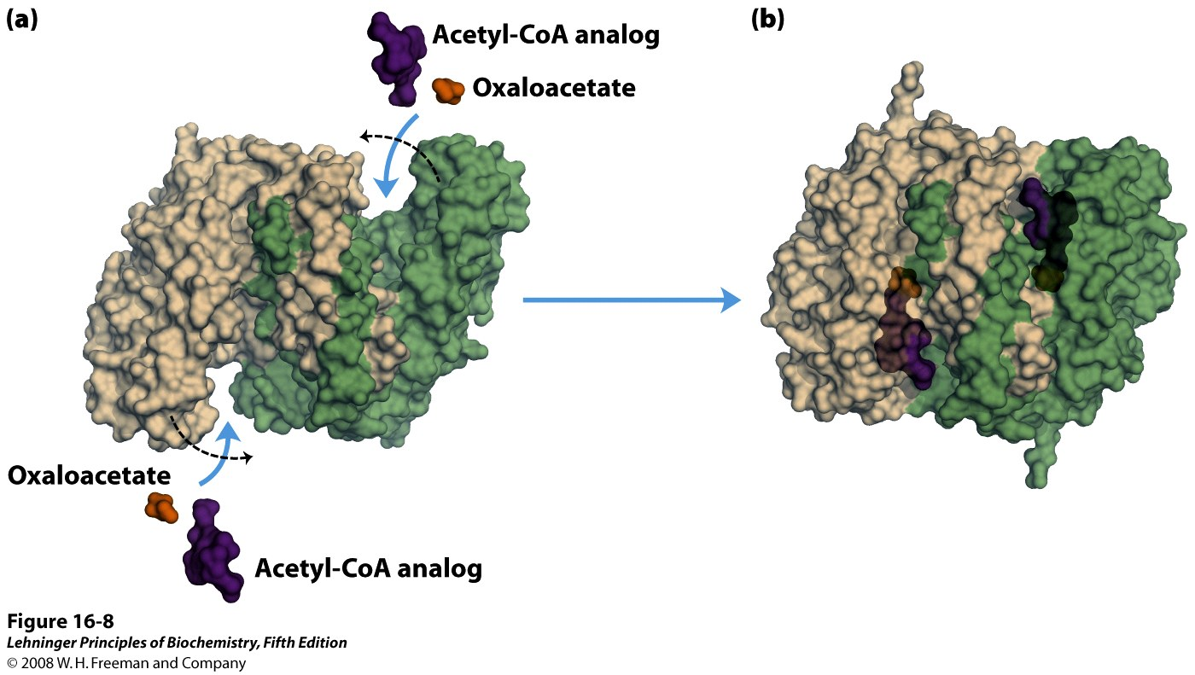
Structure of citrate synthase
Notes:
FIGURE 16-8 Structure of citrate synthase. The flexible domain of each subunit undergoes a large conformational change on binding oxaloacetate, creating a binding site for acetyl-CoA. (a) Open form of the enzyme alone (PDB ID 5CSC); (b) closed form with bound oxaloacetate and a stable analog of acetyl-CoA (carboxymethyl-CoA) (derived from PDB ID 5CTS). In these representations one subunit is colored tan and one green.

Slide 25
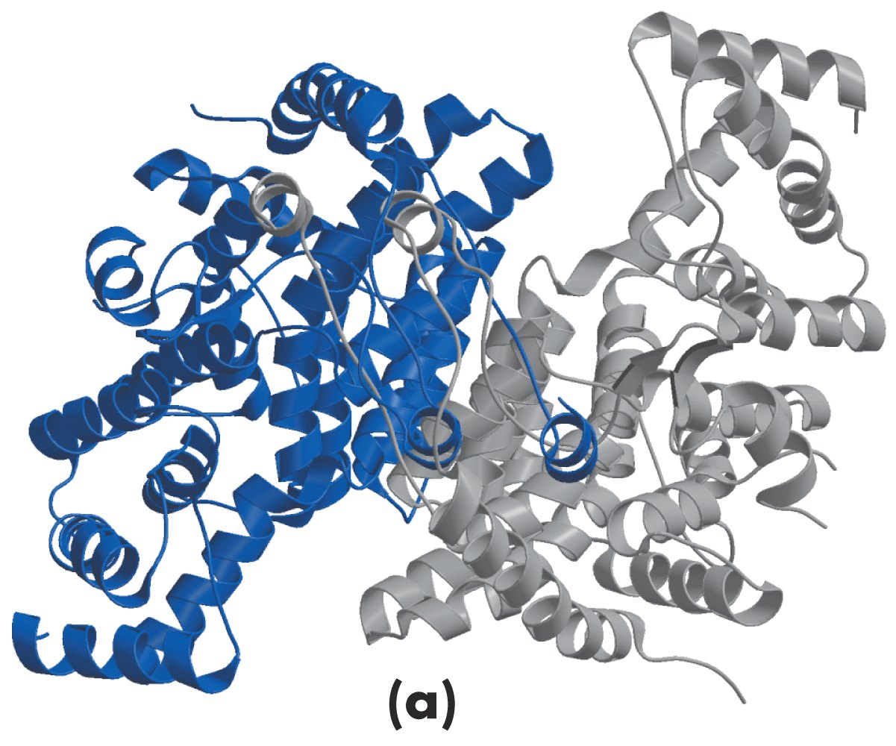
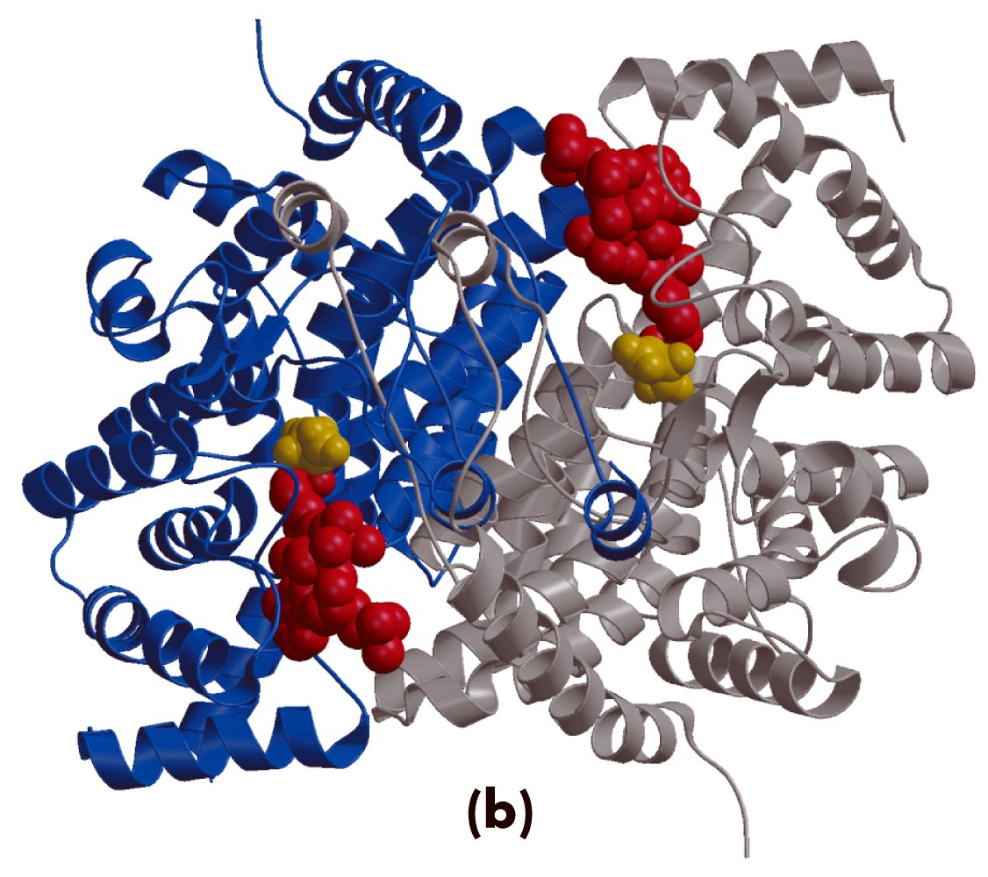
Citrate synthase
---induced fit

Slide 26
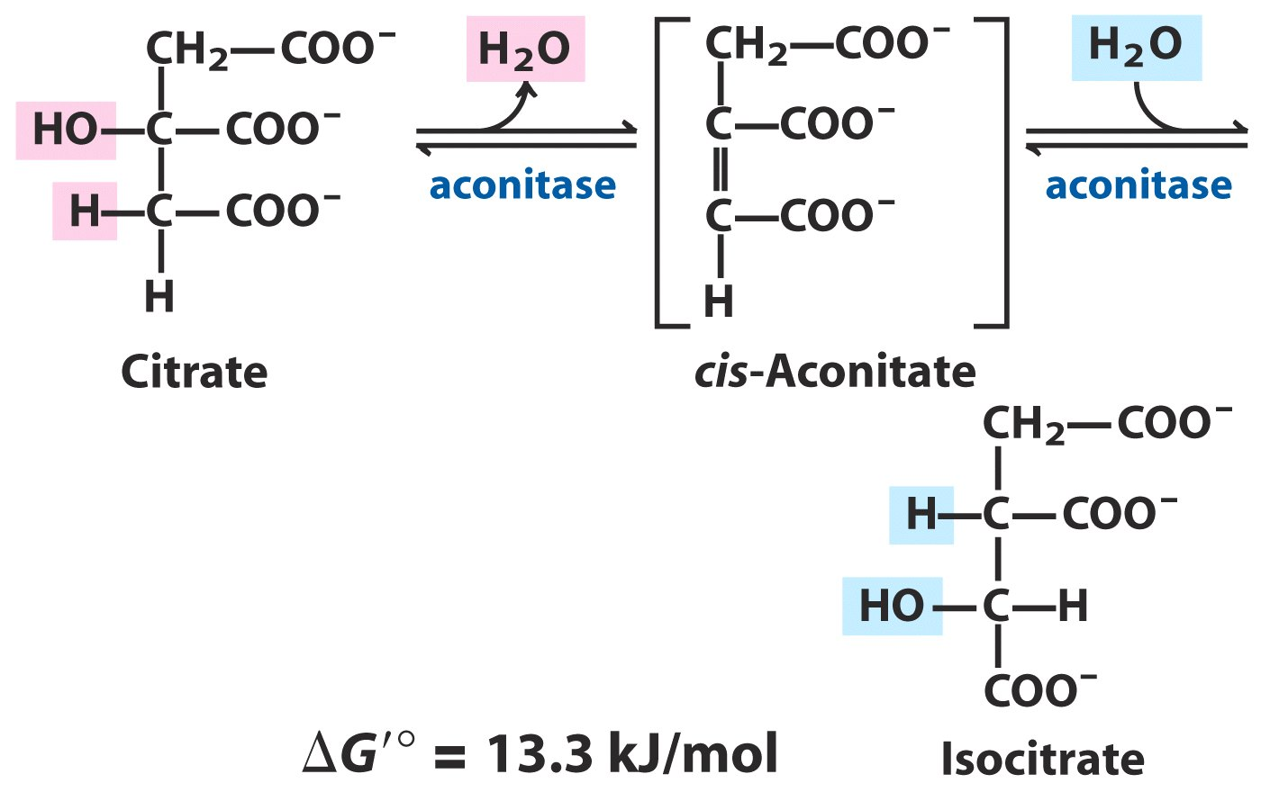
Step 2: dehydration & hydration

Slide 27
Step 3 oxidative decarboxylation
irreversible
Two isozymes

Slide 28
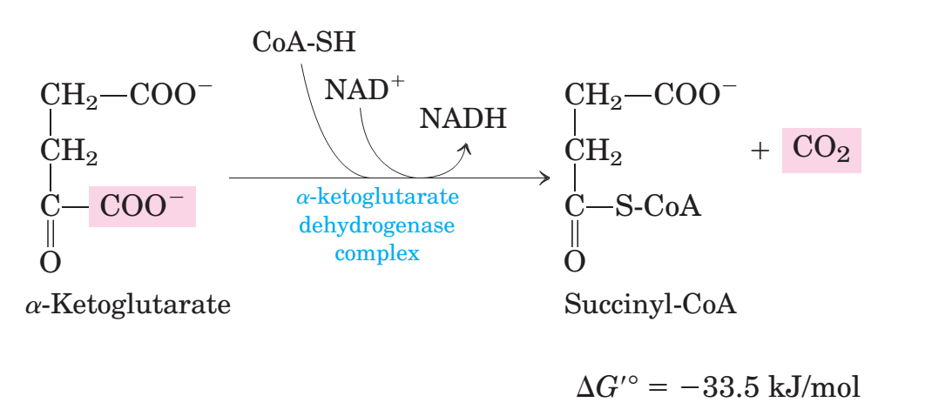
Step 4 oxidative decarboxylation
irreversible
Similar to pyruvate dehydrogenase complex

Slide 29
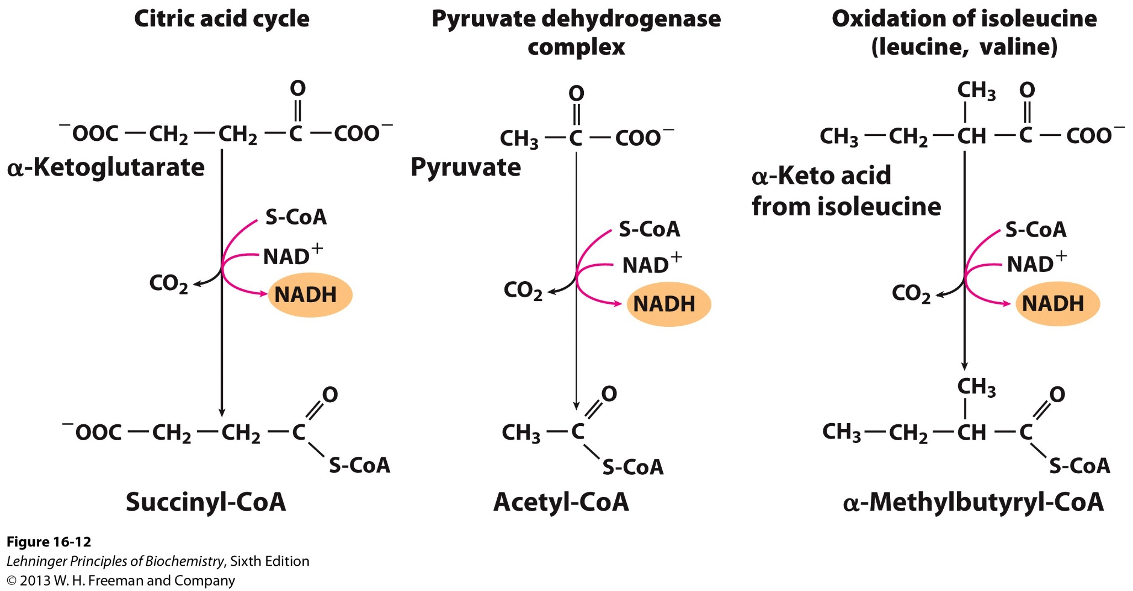
A conserved mechanism for oxidative decarboxylation

Slide 30
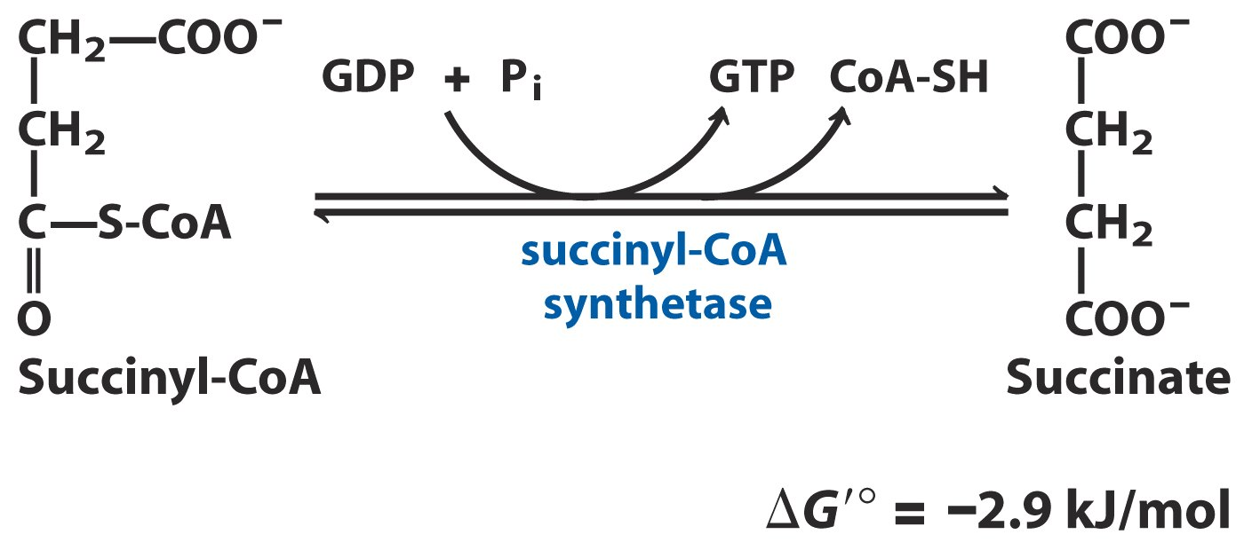
Step 5 substrate-level phosphorylation
(Two isozymes, one for
GDP, the other for ADP)

Slide 31
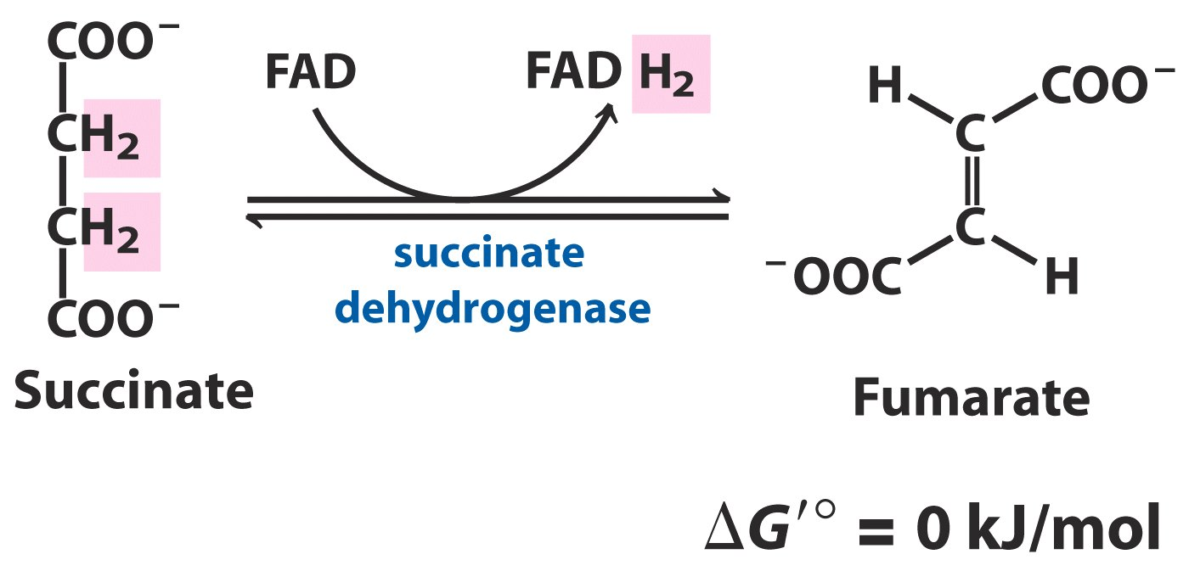
Step 6 dehydrogenation
(Membrane-bound)

Slide 32
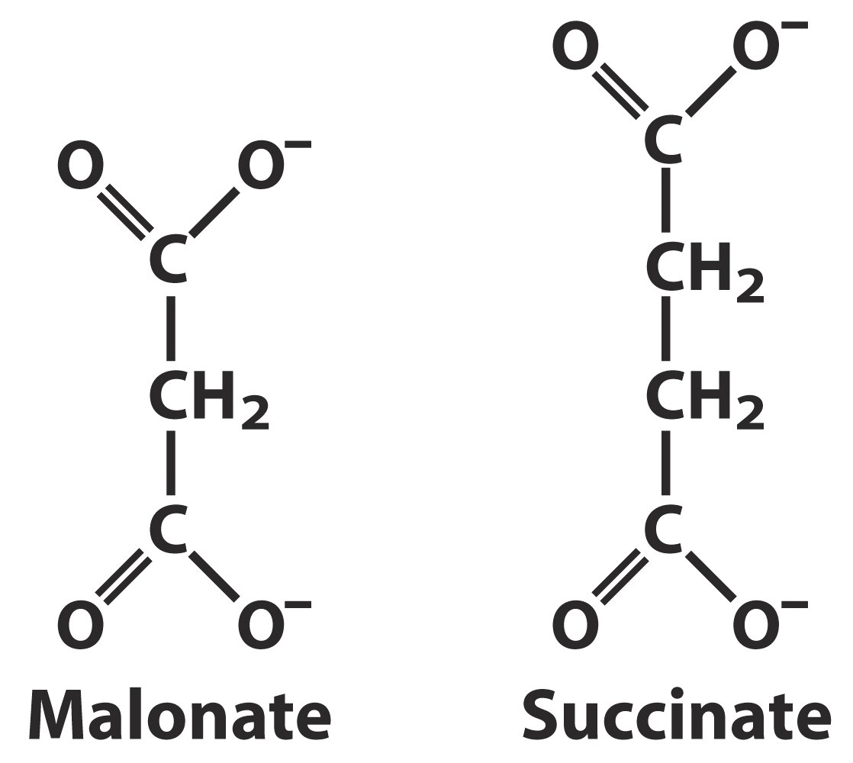
Competitive Inhibitor

Slide 33
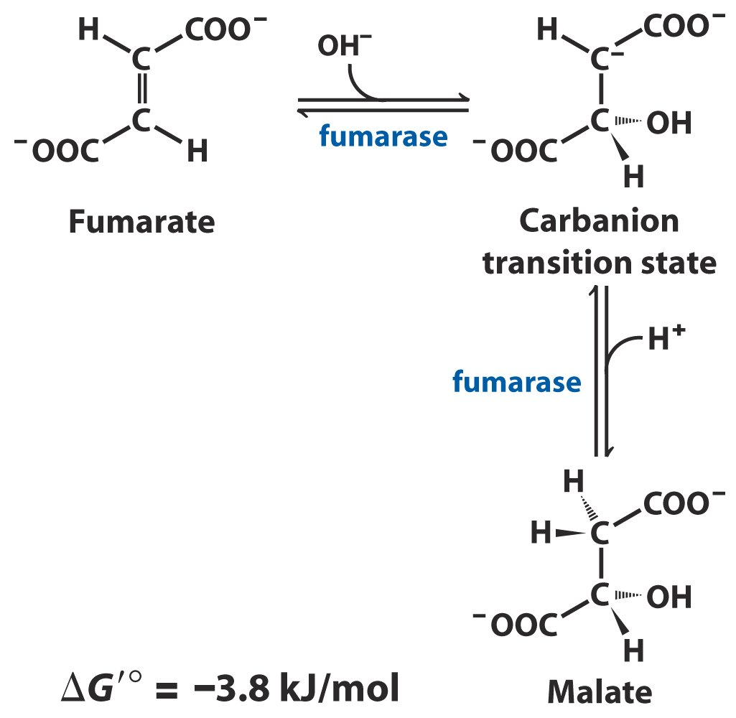
Step 7
hydration
Stereospecific

Slide 34
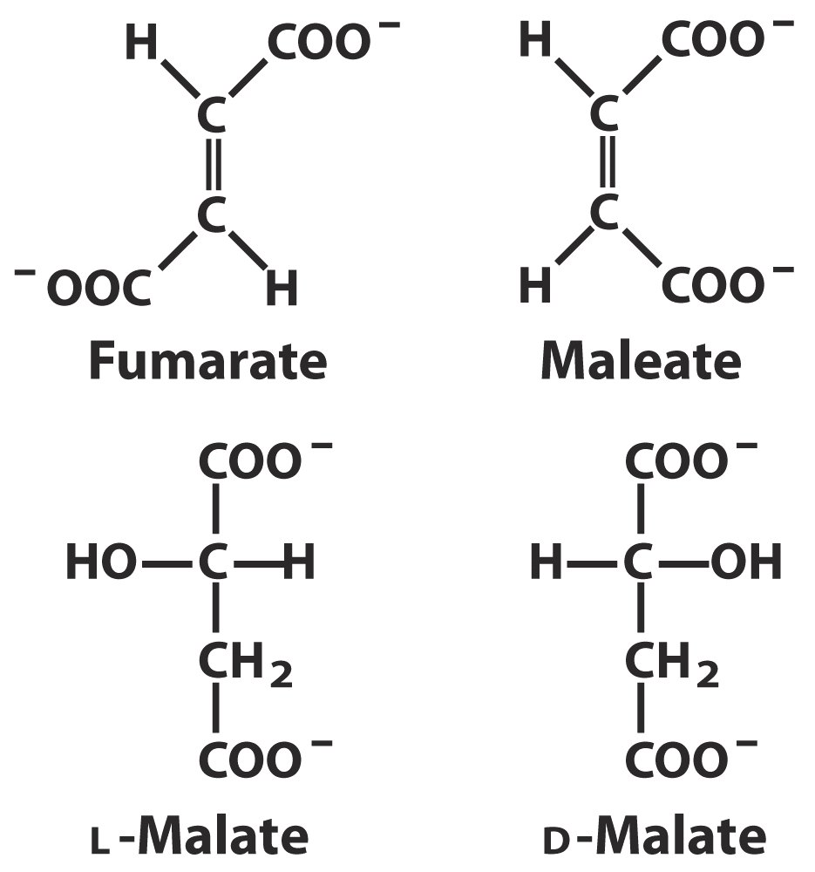
(trans)
(cis)

Slide 35
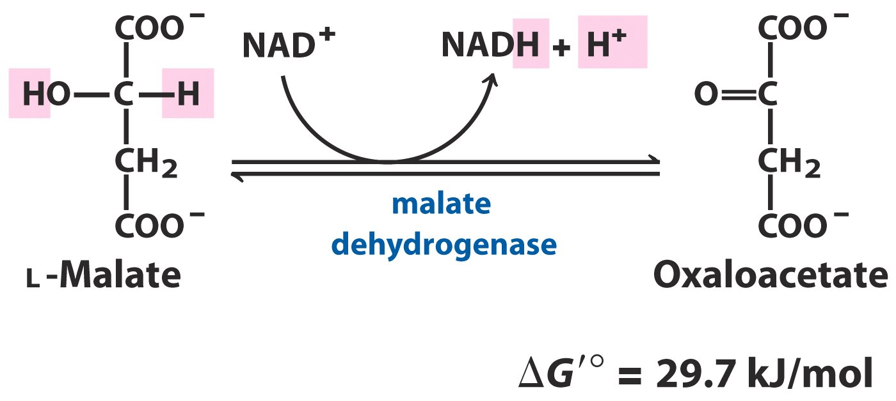
Step 8 dehydrogenation

Slide 36
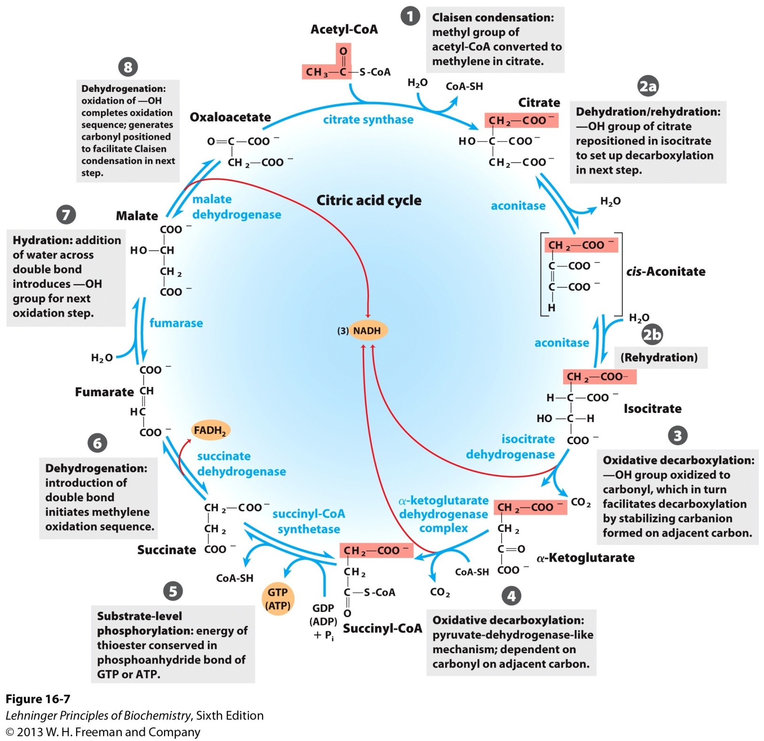
Reactions of the citric acid cycle

Slide 37
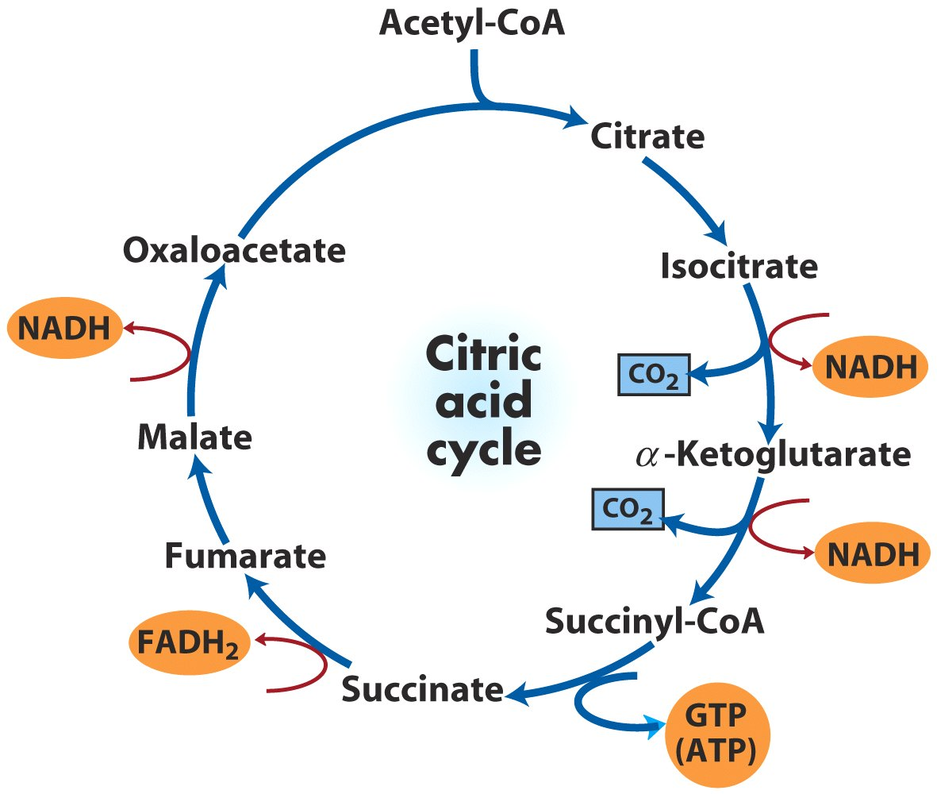
Products of one turn of the citric acid cycle

Slide 38
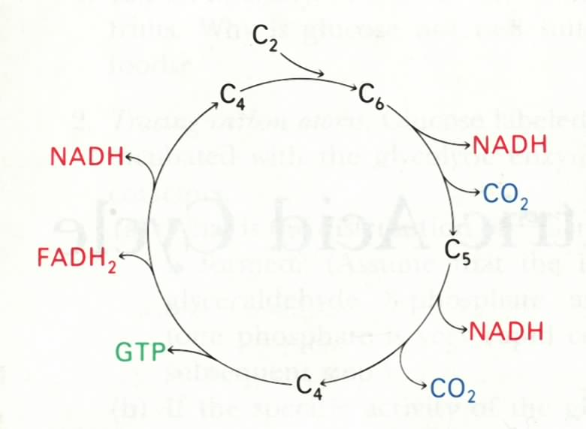
Products of one turn of the citric acid cycle

Slide 39
irreversible
Reactions of the citric acid cycle

Slide 40
The citric acid cycle
Acetyl-CoA + 3NAD⁺ + FAD + GDP + P_{i} + 2H₂O
2CO₂ + 3NADH + FADH₂ + GTP + 3H⁺ + CoA

Slide 41
5. The complete oxidation of one glucose may yield as many as 32 ATP
All the NADH and FADH₂ will eventually pass their electrons to O₂ after being transferred through a series of electron carriers.
The complete oxidation of each NADH molecule leads to the generation of about 2.5 ATP, and FADH₂ of about 1.5 ATP.
The overall efficiency of energy conservation is about 34% using the free energy changes under standard conditions and about 65% using actual free energy changes in cells.

Slide 42
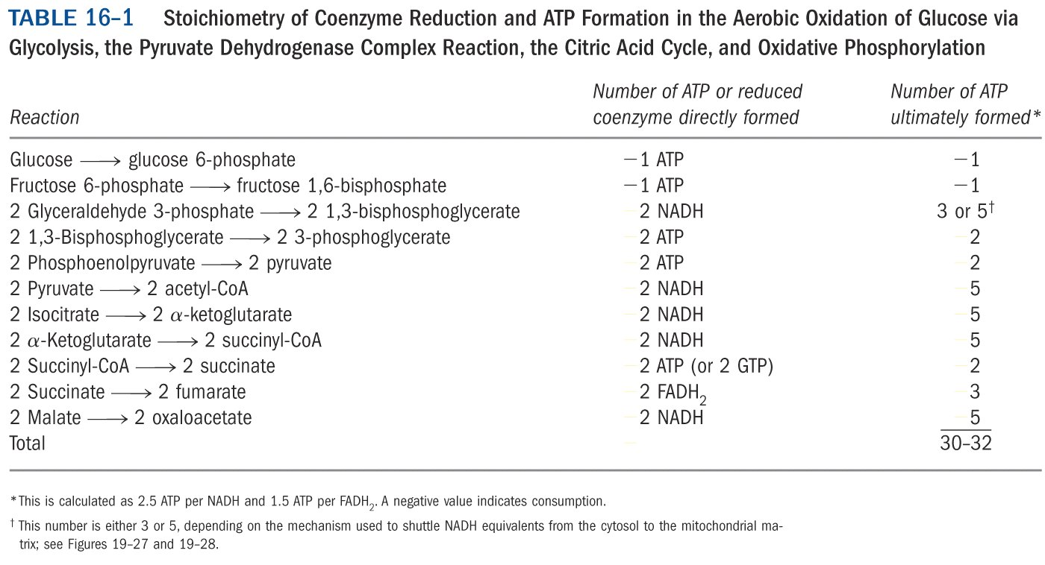
*****

Slide 43
6. The intermediates of the citric acid cycle are important sources for biosynthetic precursors
The citric acid cycle is the hub of intermediary metabolism serving both the catabolic and anabolic processes (thus an amphibolic pathway).
Any compounds that give rise to four- or five- carbon intermediates of the cycle can be oxidized by the cycle.
It provides precursors for the biosynthesis of glucose, amino acids, nucleotides, fatty acids, heme groups, etc.

Slide 44
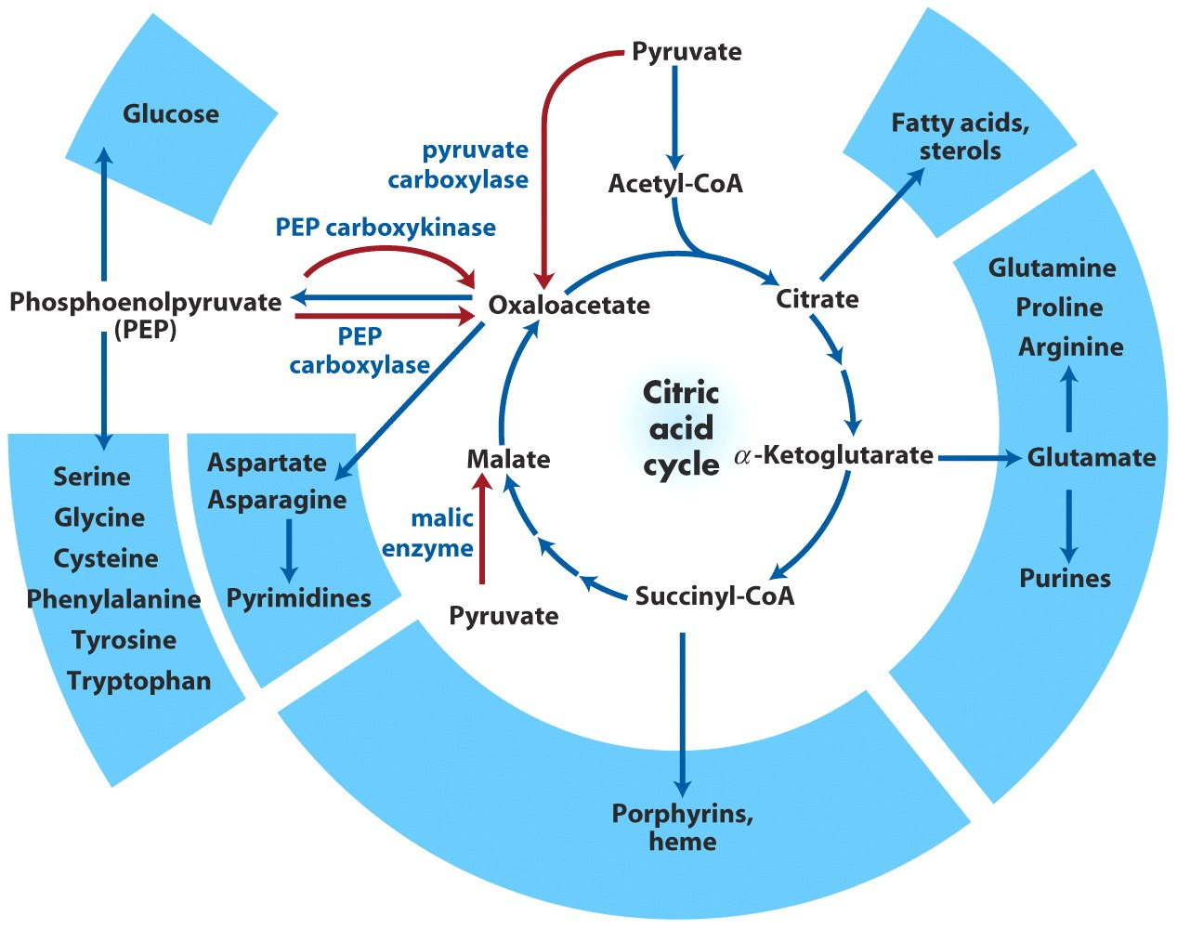
Citric acid cycle provides precursors for many biosynthetic pathways

Slide 45
Intermediates of the citric acid cycle get replenished by anaplerotic reactions when consumed by biosynthesis.
The most common anaplerotic reactions covert either pyruvate or phosphoenolpyruvate to oxaloacetate or malate.

Slide 46
Pyruvate carboxylase catalyzes the carboxylation of pyruvate using covalently bound biotin (a vitamin) as the coenzyme.
The long flexible arm of biotin switches between two active site of the pyruvate carboxylase (one for attaching a HCO₃⁻ to biotin and the other for transferring the carboxyl group to pyruvate).
Acetyl-CoA is a positive allosteric modulator for pyruvate carboxylase.

Slide 47
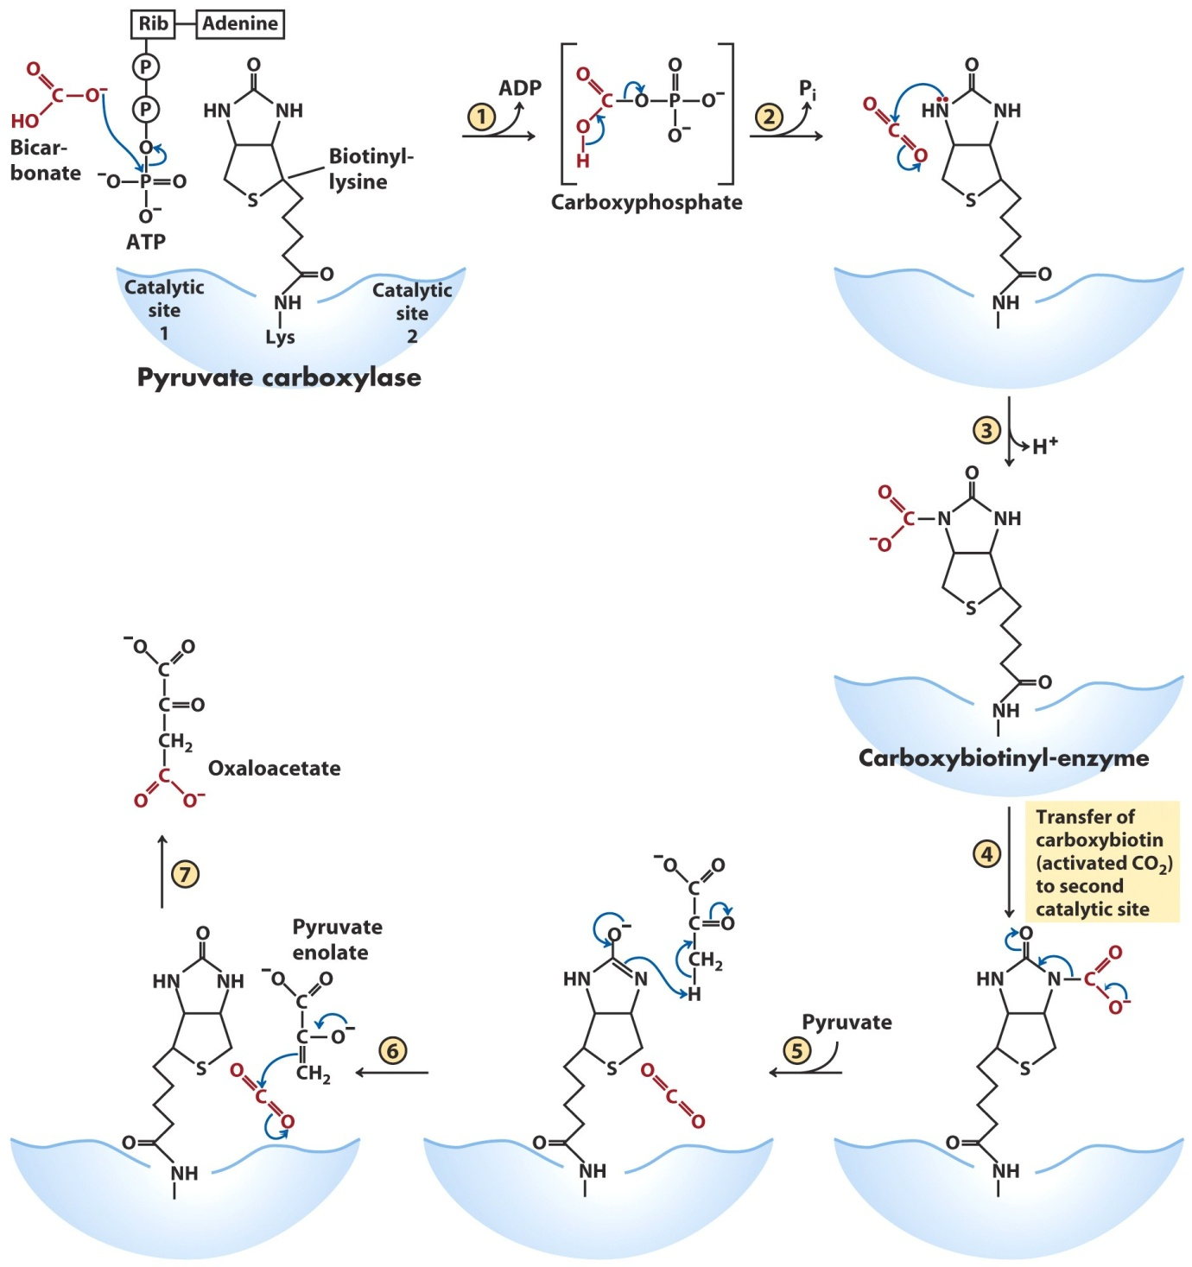
Biotin (a vitamin)
plays a key role in
the carboxylation
reaction---
specialized
carrier of
one-carbon groups

Slide 48
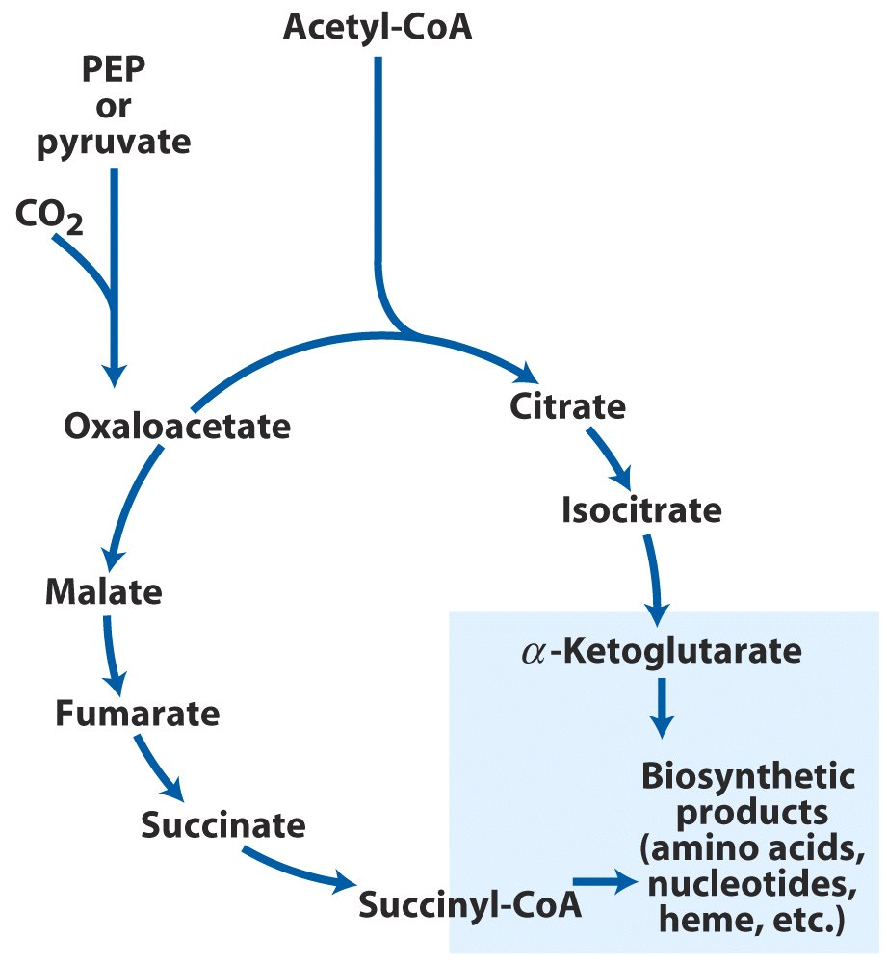
Some anaerobic bacteria,
lacking α-ketoglutarate
dehydrogenase, make
biosynthetic precursors
via the incomplete citric acid
cycle, which could be an
early evolution stage of
the citric acid cycle.

Slide 49
Regulation of the citric acid cycle
Regulatory enzymes:
Pyruvate dehydrogenase complex
Citrate synthase
Isocitrate dehydrogenase
α-ketoglutarate dehydrogenase

Slide 50
7. The pyruvate dehydrogenase complex in vertebrates is regulated allosterically and covalently
The formation of acetyl-CoA from pyruvate is a key irreversible step in animals because they are unable to convert acetyl-CoA to glucose.
The complex (in all organisms) is allosterically inhibited by signaling molecules indicating a rich source of energy, e.g., ATP, acetyl-CoA, NADH, long chain fatty acids; activated by molecules indicating a lack (or demand) of energy, e.g., AMP, CoA, NAD⁺, Ca²⁺.

Slide 51
The activity of the complex (in vertebrates, probably also in plants, but not in E. coli) is also regulated by reversible phosphorylation of one of the enzymes, E₁, in the complex: phosphorylation of a specific Ser residue inhibits and dephosphorylation activates the complex.
The kinase and phosphatase is also part of the enzyme complex.
E₁ (unphosphorylated)---active
E₁ (phosphorylated)---inactive
Kinase involved is activated by ATP, but inhibited by a drug called dichloroacetate.

Slide 52
8. The rate of the citric acid cycle is controlled at three exergonic irreversible steps
Regulatory enzymes: citrate synthase, isocitrate dehydrogenase and α-ketoglutarate dehydrogenase
Inhibited by product feedback (citrate, succinyl-CoA) and high energy charge (ATP, NADH)
Activated by a low energy charge (ADP) or a signal for energy requirement (Ca²⁺).

Slide 53
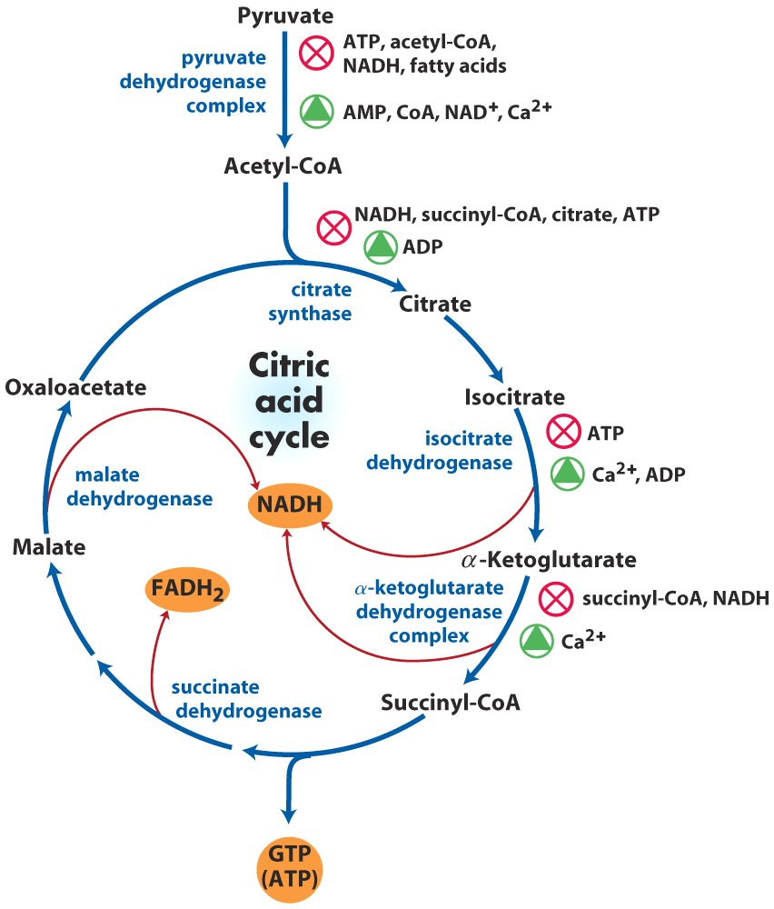
Regulation of the citric acid cycle
*****

Slide 54
9. Net conversion of acetate to carbohydrates is achieved via the glyoxylate cycle
In vertebrates there is no net conversion of acetate (also from fatty acids and amino acids) to any of the citric acid cycle intermediate, thus neither to carbohydrates.
Net conversion of acetate to four-carbon citric acid cycle intermediates occurs via the glyoxylate cycle, found in plants, certain invertebrates, and some microorganisms (including E. coli and yeast).

Slide 55
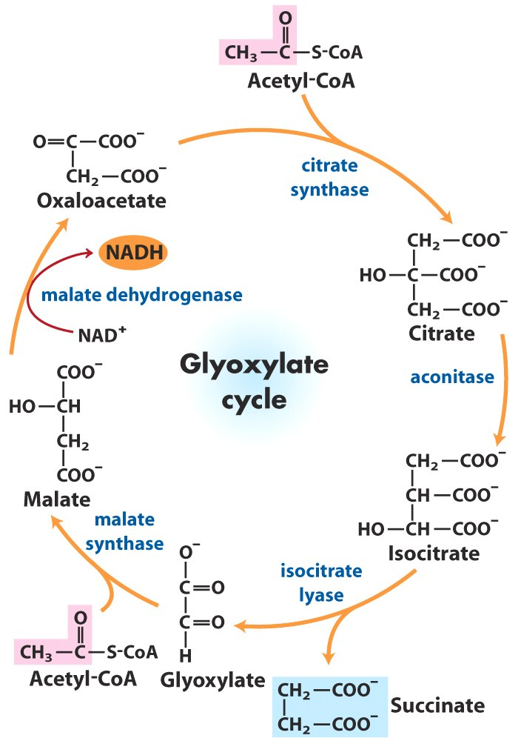
The glyoxylate cycle

Slide 56
The glyoxylate cycle shares three steps and bypasses the rest, including the two decarboxylation steps, of the citric acid cycle.
Two acetyl-CoA molecules enter each glyoxylate cycle with a net production of one succinate.
Isocitrate lyase and malate synthase are the two bypassing enzymes, converting isocitrate to malate via the glyoxylate intermediate, releasing a succinate on the way.

Slide 57
The glyoxylate cycle
Convert acetate to carbohydrate in plants, certain invertebrates and some microorganisms
2 Acetyl-CoA + NAD⁺ + 2H₂O
Succinate + 2CoA + NADH + H⁺

Slide 58
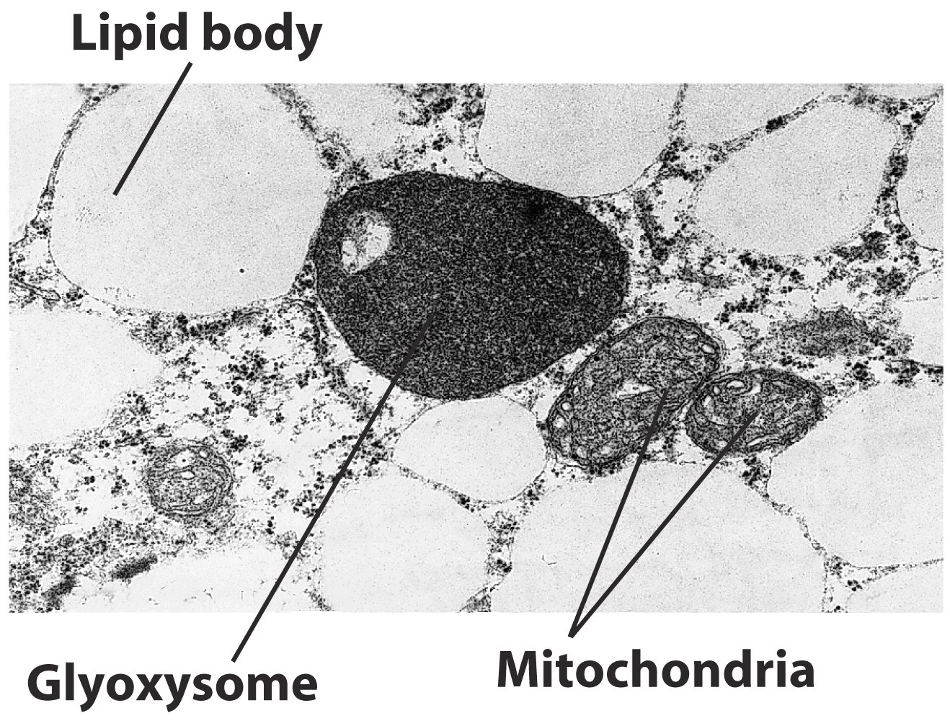
Electron micrograph of a germinating cucumber seed

Slide 59
10. Conversion of fatty acids to glucose (in germinating seeds) occurs in three intracellular compartments
Fatty acids are first converted to acetyl-CoA, which is in turn converted to succinate via the glyoxylate cycle in glyoxysomes.
Succinate is transported to mitochondria and converted to malate via the citric acid cycle.
Malate is then transported out of mitochondria and is converted to glucose in the cytosol.

Slide 60
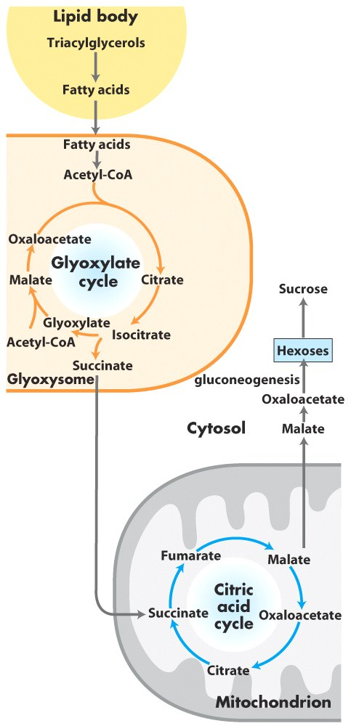
Relationship between the citric acid cycle and the glyoxylate cycle

Slide 61
11. The partitioning of isocitrate between the citric acid cycle and the glyoxylate cycle is coordinately regulated
The activity of the E. coli isocitrate dehydrogenase is inhibited when phosphorylated by a specific kinase and activated when dephosphorylated by a specific phosphatase.

Slide 62
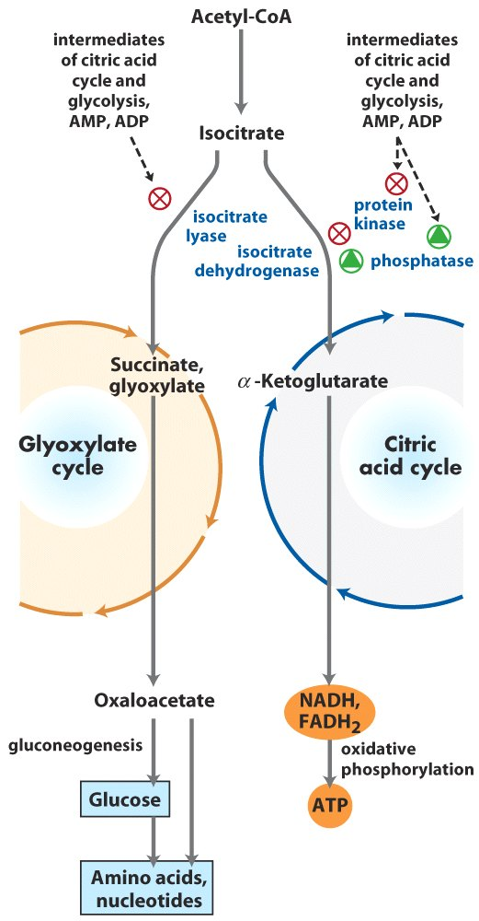
The citric acid
and glyoxylate
cycles are
coordinately
regulated

Slide 63
The kinase and phosphatase activities are located in two domains of the same polypeptide and are reciprocally regulated: the kinase is allosterically inhibited (while the phosphatase activated) by molecules indicating an energy depletion, e.g., accumulation of intermediates of glycolysis and the citric acid cycle.
The allosteric inhibitors of the kinase also act as inhibitors for the isocitrate lyase: i.e., they activate the dehydrogenase while simultaneously inhibit the lyase.

Slide 64
Keywords
Pyruvate dehydrogenase complex--reaction, regulation
The citric acid cycle--reaction, regulation
The glyoxylate cycle--products

Slide 65
Words of the week
kinase vs. phosphatase
phosphorylation vs. dephosphorylation
phosphorylated vs. unphosphorylated
activated vs. inactivated
synthase vs. synthetase

Slide 66
Text-book reading of the week
Summary 16.1 (p637)
Summary 16.2 (p653)
Summary 16.3 (p656)
Summary 16.4 (p659)
p648 (Box 16-3)
p653-655 (regulation of the citric acid cycle)

Slide 67
Summary
Pyruvate, the product of glycolysis, is converted to acetyl-CoA, the starting material of the citric acid cycle, by the pyruvate dehydrogenase (PDH) complex.
The PDH complex is composed of multiple copies of three enzymes and five different coenzymes.
The citric acid cycle is a nearly universal central catabolic pathway in which compounds derived from the breakdown of carbohydrates, fats and proteins are oxidized to CO₂, with most of the energy of oxidation temporarily held in the electron carriers NADH and FADH₂.

Slide 68
For each acetyl-CoA oxidized by the citric acid cycle, the energy gain consists of three molecules of NADH, one FADH_{2,} and one ATP or GTP.
The overall rate of the citric acid cycle is controlled by the rate of conversion of pyruvate to acetyl-CoA and by the flux through citrate synthase, isocitrate dehydrogenase, and α-ketoglutarate dehydrogenase.
The PDH complex is inhibited allosterically by metabolites that signal a sufficiency of metabolic energy (ATP, acetyl-CoA, NADH and fatty acids) and stimulated by metabolites that indicate a reduced energy supply (AMP, NAD⁺ and CoA).

Slide 69
The glyoxylate cycle is active in the germinating seeds of some plants and in certain microorganisms that can live on acetate as the sole carbon source.
In the glyoxylate cycle, the bypassing of the two decarboxylation steps of the citric acid cycle makes possible of the net formation of succinate.
Vertebrates lack the glyoxylate cycle and cannot synthesize glucose from acetate or the fatty acids that give rise to acetyl-CoA.
The partitioning of isocitrate between the citrate acid cycle and the glyoxylate cycle is controlled at the level of isocitrate dehydrogenase, which is regulated by reversible phosphorylation.

