Slide 1
Chapter 18 Amino Acid Oxidation and the Production of Urea

Slide 2
1. The surplus amino acids in animals can be completely oxidized or converted to other storable fuels
Amino acids in excess (from diet, protein turnover) can neither be stored, nor excreted, but oxidized to release energy or converted to fatty acids or glucose.
Animals also utilize amino acid for energy generation during starvation or in diabetes mellitus (糖尿病).
Microorganisms can also use amino acids as an energy source when the supply is in excess.
Plants almost never use amino acids as an energy source (neither fatty acids).

Slide 3
2. Dietary proteins are digested into amino acids in the gastrointestinal tract
Pepsin cleaves polypeptides into smaller peptides in stomach (N-terminal side of Phe, Trp and Tyr residues).
Trypsin (C-terminal side of Arg and Lys) and chymotrypsin (C-terminal side of Phe, Trp and Tyr) further cleave the peptides in small intestine.
Carboxypeptidase and aminopeptidase cleave the small peptides into amino acids, which are then absorbed and eventually delivered to liver.

Slide 4
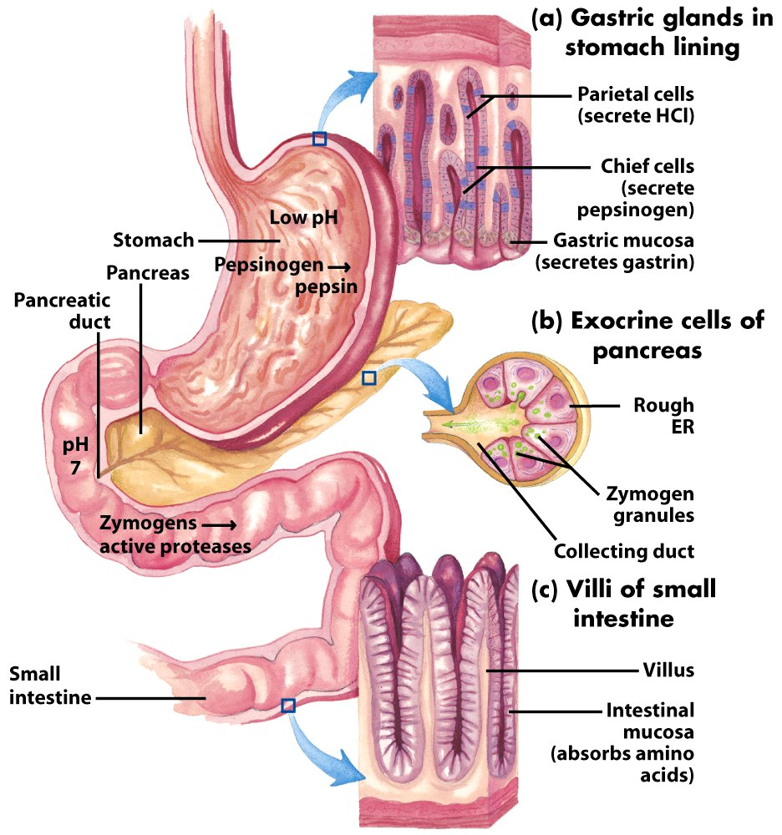
Part of the human digestive (gastrointestinal) tract

Slide 5
3. The amino groups and the carbon skeletons of amino acids take separate but interconnected pathways
The amino group is reused or excreted, as ammonia, urea (via the urea cycle) or uric acid.
The carbon skeletons (α-keto acids) generally find their way to the citric acid cycle for further oxidation or conversion.
The degradation of the carbon skeletons may be very complicated but similar to that of fatty acids in some cases.

Slide 6
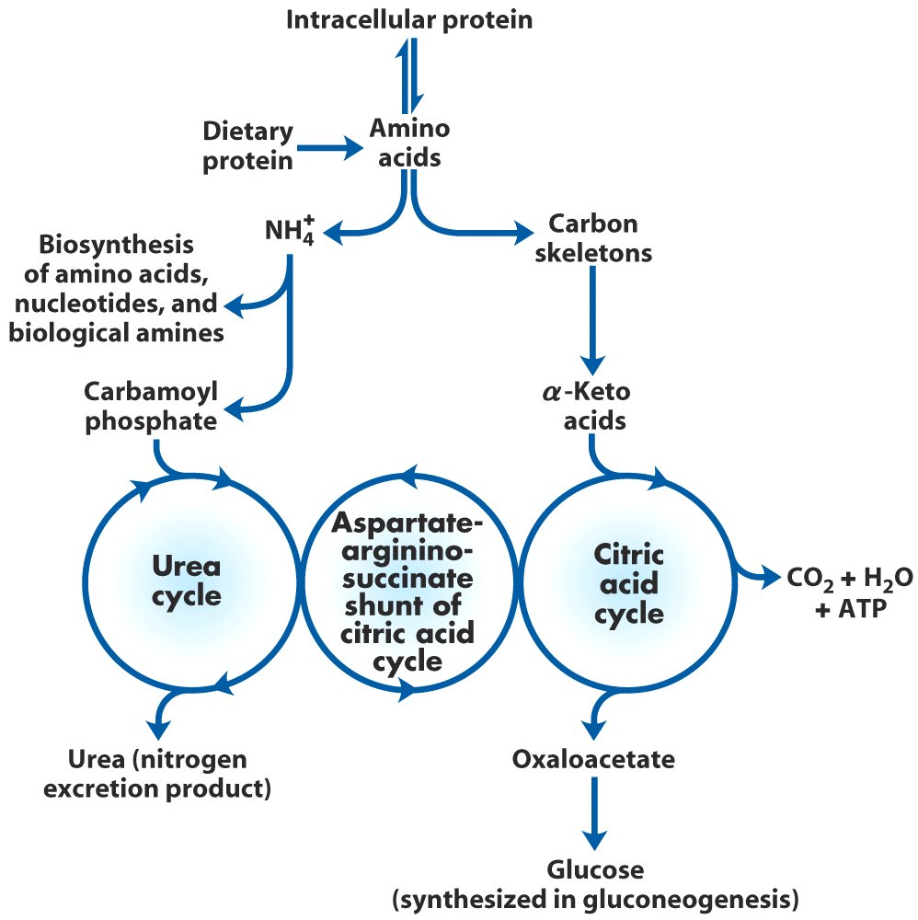
Overview of amino acid catabolism in mammals

Slide 7
4. Liver is the major site of amino acid degradation in vertebrates
Glutamate, α-ketoglutarate and pyruvate collects amino groups (in forms of Gln, Glu and Ala) to liver mitochondria for further processing.
The excess NH₄⁺ is excreted directly in bony fishes, or as urea in most terrestrial vertebrates, or as uric acid in birds and terrestrial reptiles.
The carbons in both urea and uric acid are highly oxidized (with most of the energy extracted).

Slide 8
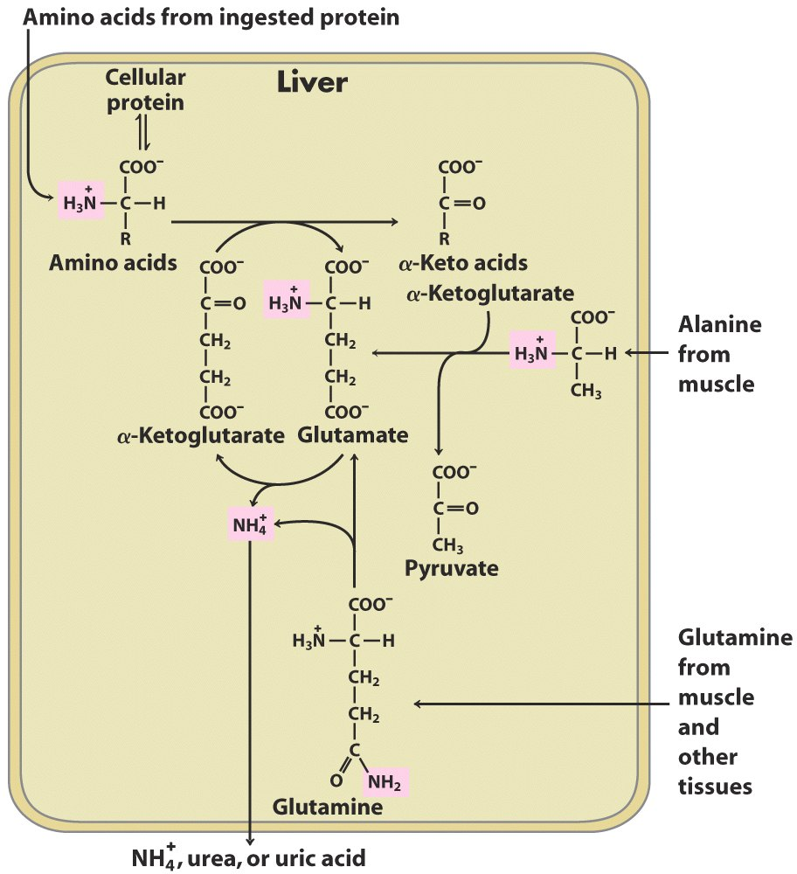
Overview of catabolism of amino groups in vertebrate liver*****

Slide 9
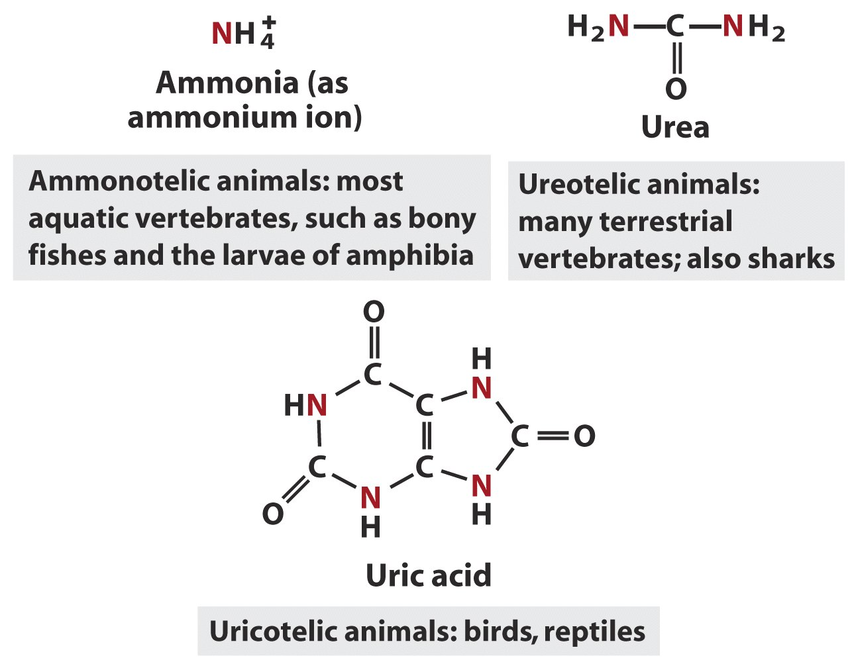
Excretory form of nitrogen

Slide 10
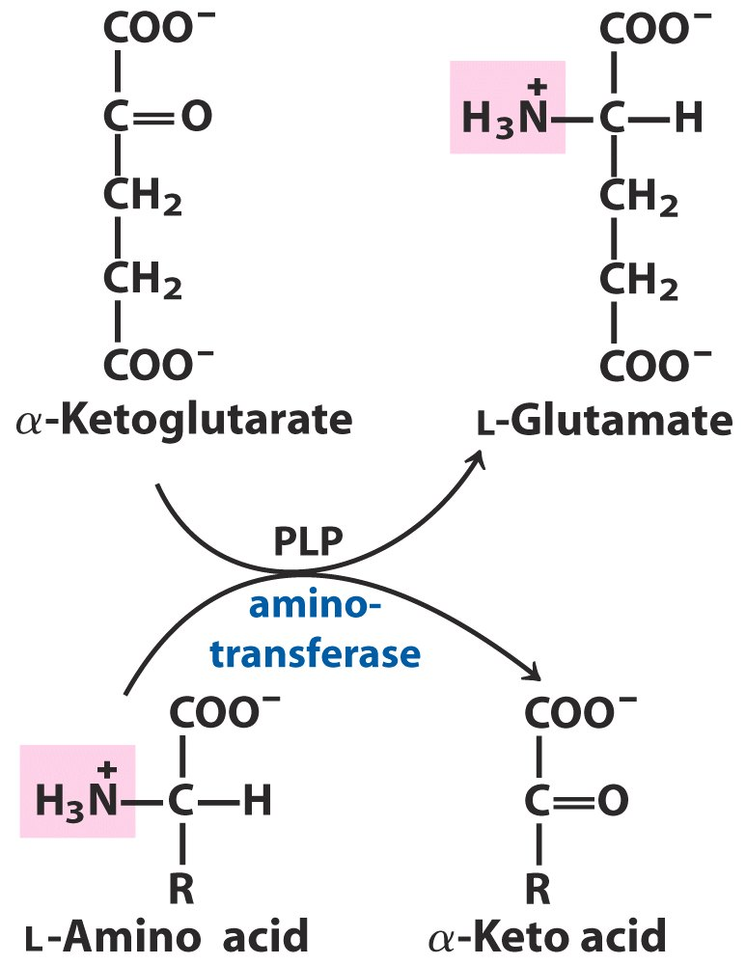
Different aminotransferases catalyze the transfer of
the amino group from an amino acid to
α−ketoglutarate to form Glu and a α-keto acid

Slide 11
5. PLP facilitates the transamination and other transformations of amino acids
Pyridoxal phosphate (PLP), being derived from vitamin B₆ (i.e., pyridoxine) and the prosthetic group for all the aminotransferases, acts as a temporary carrier of the amino groups.
PLP is bound covalently to the active sites of aminotransferases via structural determination.
PLP accepts and then donates an amino group by forming a Schiff base with the amino-donating amino acid and amino-accepting α-keto acid (being α-ketoglutarate in many cases).

Slide 12
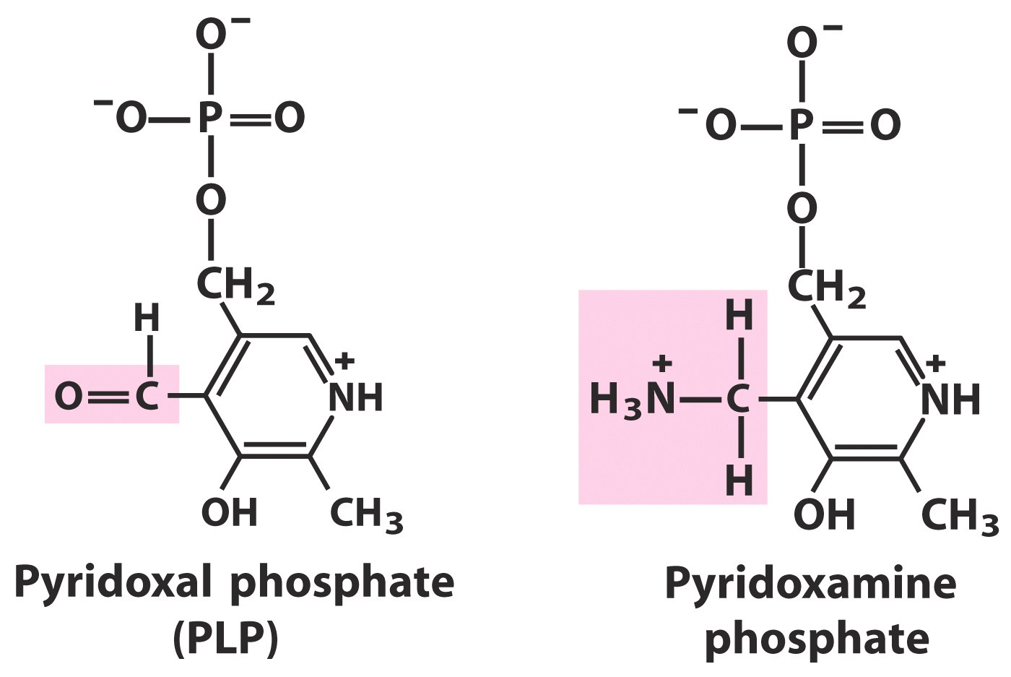

Slide 13
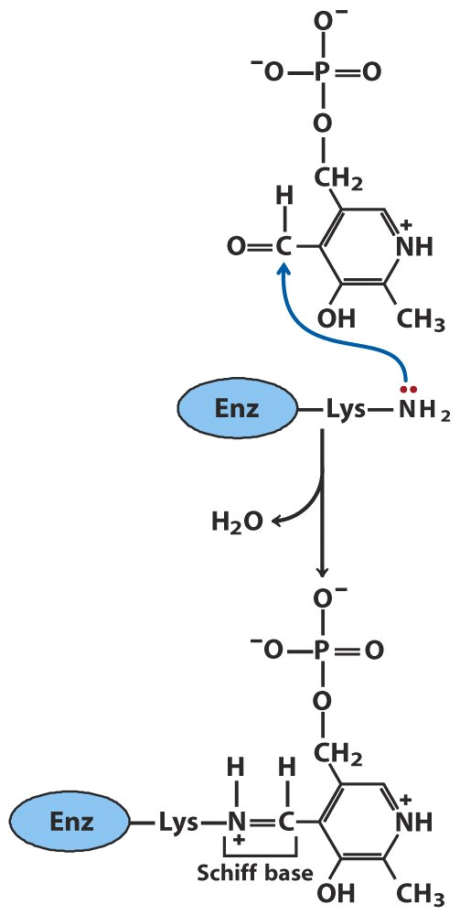
PLP is bound
covalently to the
active sites of
aminotransferases
through Schiff-base
linkage.

Slide 14
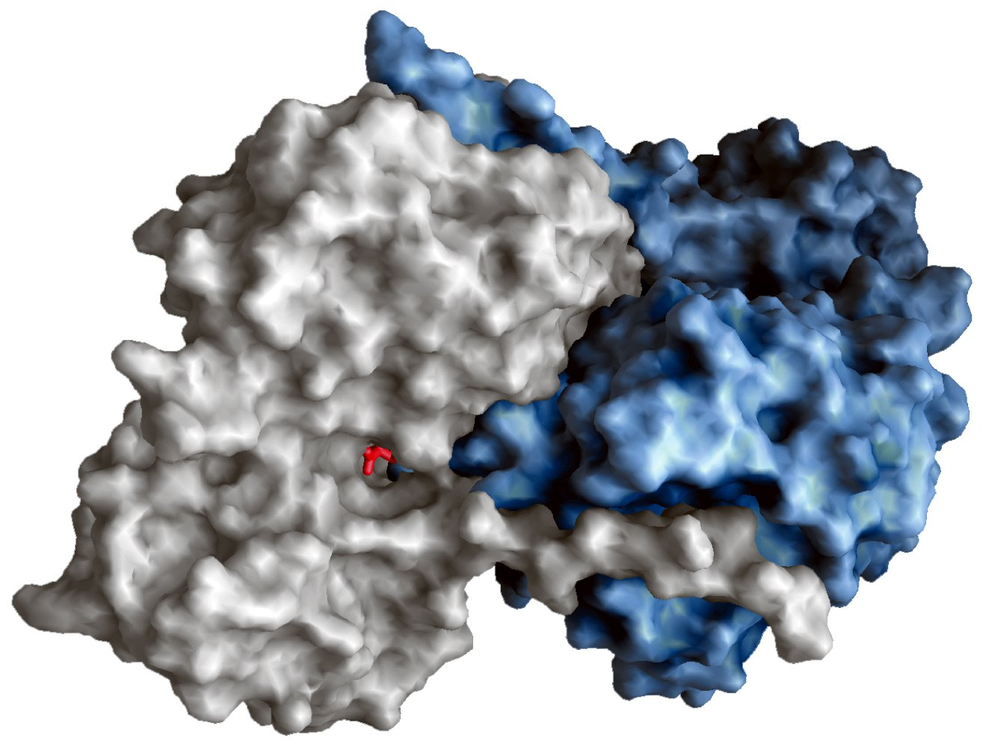
PLP bound to aspartate aminotransferase

Slide 15
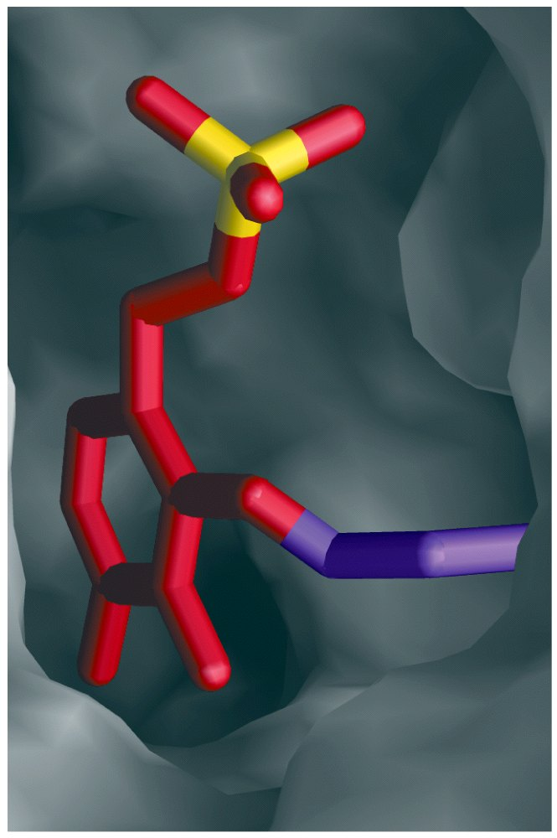
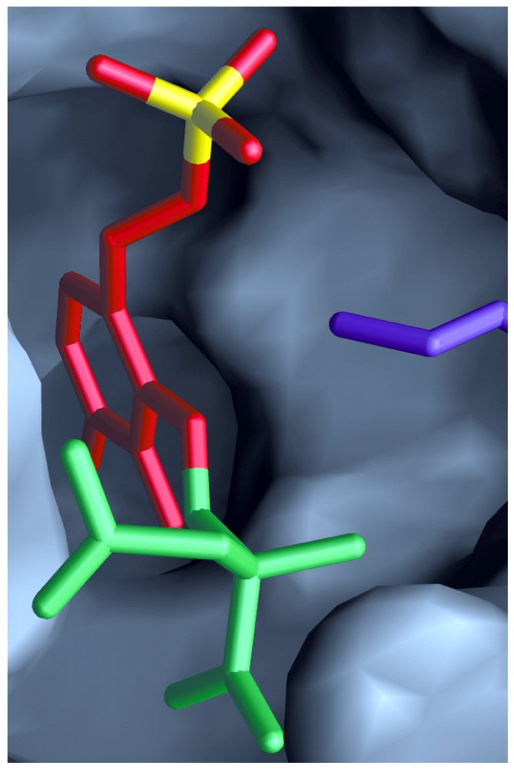
Active site of aspartate aminotransferase

Slide 16
The reaction occurs via a typical ping-pong mechanism: the first product leaves before the second substrate enters.
An interconversion between an aldimine (醛亚胺) and a ketimine (酮亚胺) is proposed to occur via a quinonoid (醌型的) intermediate during the transamination reaction.
PLP act in a variety of other reactions at the α, β, and γ carbons of amino acids, including racemizations, decarboxylations at the α carbon, elimination and replacement reactions at the β and γ carbons.

Slide 17
6. Glutamate collects and delivers free ammonia to the liver
Free ammonia is produced in tissues (e.g., by the direct deamination of Ser and Thr, deamination of nucleotides) and is toxic to animals, thus need to be transported to the liver by first converting to a nontoxic compound, Gln.
Glutamine synthetase catalyzes the two-step addition of ammonia to Glu to yield Gln, with ATP consumed to activate the γ-COOH.
This reaction also represents how fixed nitrogen in bacteria enter biomolecules; Gln is the source of amino groups in a variety of biosynthetic reactions.

Slide 18
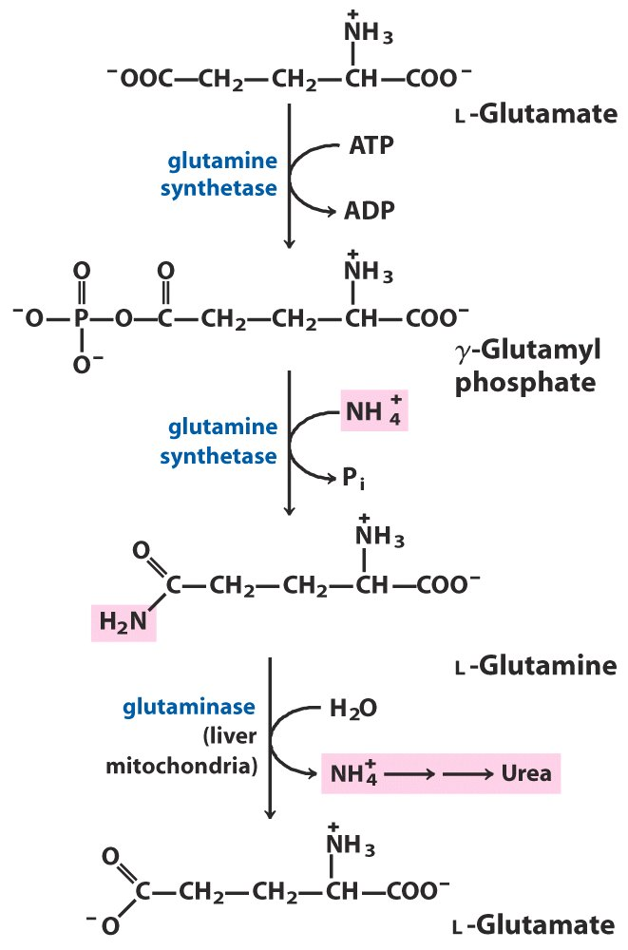
Ammonia transport in the form of glutamine

Slide 19
7. Alanine transports ammonia from muscle to the liver
Pyruvate is an abundant product from muscle glycolysis and can take an amino group (from Glu) to form Ala (alternatively, be reduced to lactate).
Alanine, once gets to liver, will transfer its amino group to α-ketoglutarate or oxaloacetate to reform pyruvate.
Pyruvate is reconverted to glucose in liver via the gluconeogenesis pathway, which will be transported back to muscle for energy supply.
This is called glucose-alanine cycle, complementing the Cori cycle for liver to continuously provide glucose to vigorously contracting skeletal muscles.

Slide 20
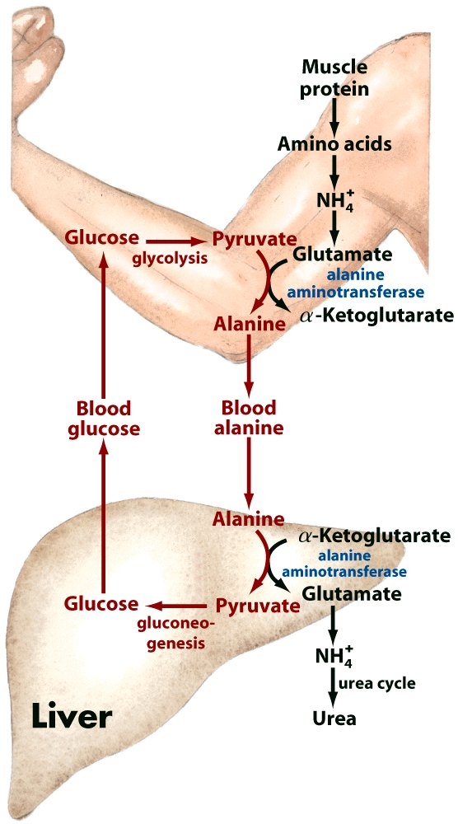
Glucose-alanine cycle

Slide 21
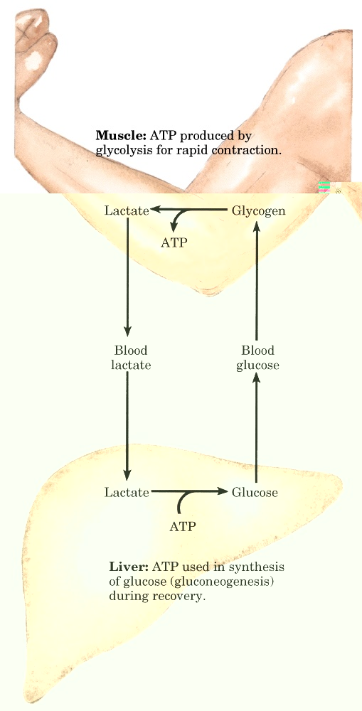
Cori cycle

Slide 22
8. Gln and Glu releases NH₄⁺ in liver mitochondria
The glutaminase in liver mitochondria catalyzes the conversion of Gln to Glu, releasing NH₄⁺ (from the side chain amide of Gln).
The glutamate dehydrogenase (a hexameric allosteric enzyme) there catalyzes the oxidative deamination of Glu, releasing NH₄⁺, with released electrons collected by either NAD⁺ or NADP⁺.
Glutamate dehydrogenase is allosterically activated by ADP and GDP, but inhibited by ATP and GTP, i.e., a lowering of the energy charge accelerates the oxidation of amino acids.

Slide 23
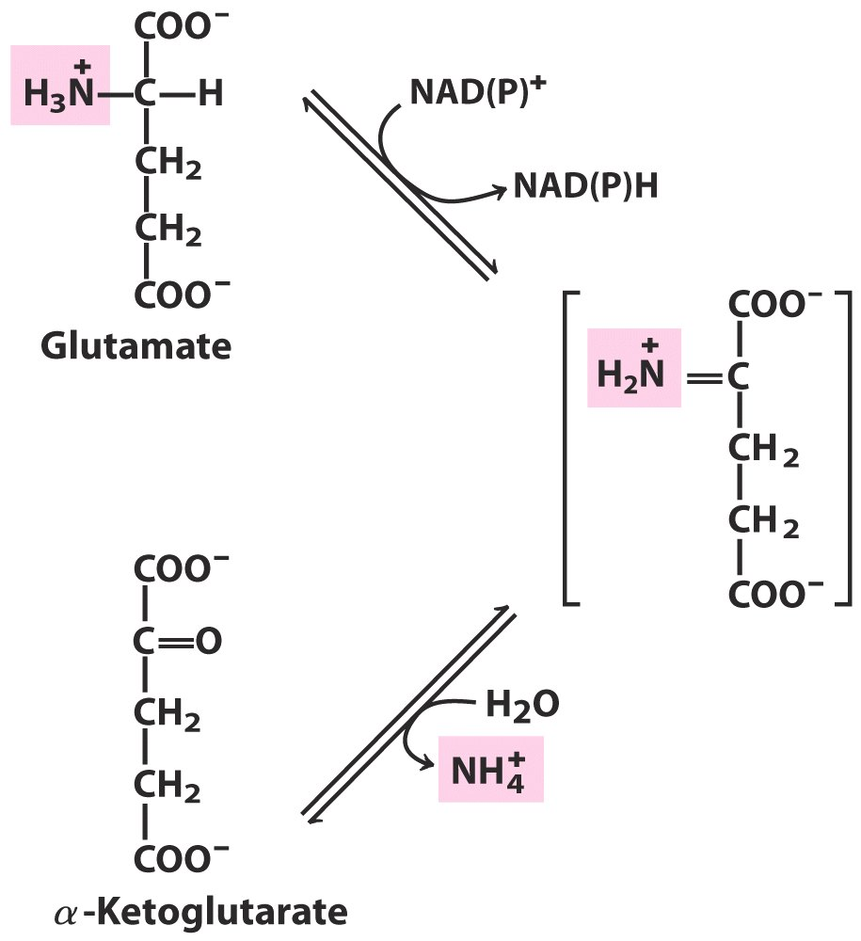
Glutamate dehydrogenase
Oxidative deamination

Slide 24
9. NH₄⁺ in hepatocytes is converted into urea in most terrestrial vertebrates for excretion
Hans Krebs and Kurt Henseleit revealed in 1932 (five years before the citric acid cycle was elucidated) that this conversion is accomplished via a cyclic pathway, called the urea cycle.
The two nitrogen atoms are derived from Asp and NH₄⁺, with the carbon atom coming from CO₂.

Slide 25
Ornithine (鸟氨酸), acting as the carrier of the carbon and nitrogen atoms, has a role similar to that of oxaloacetate in the citric acid cycle.
The urea cycle spans the mitochondria and cytosol.
Four phosphoanhydride bonds (equivalent to four ATP molecules) are hydrolyzed for the production of each urea.
2NH₄⁺ + HCO₃⁻ + 3ATP⁴⁻ + H₂O
Urea + 2ADP³⁻ + 4P_{i}²⁻ + AMP²⁻ + 5H⁺

Slide 26
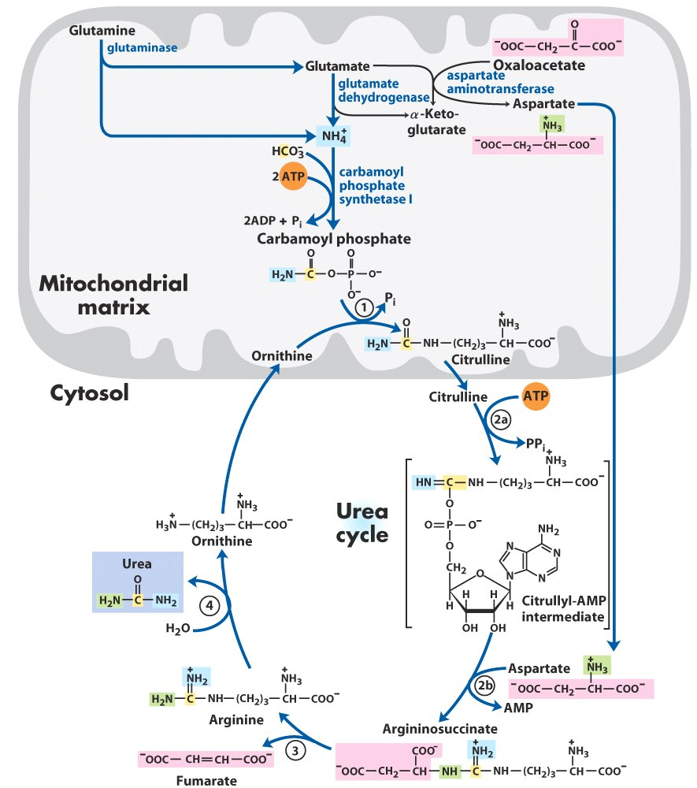
The urea cycle takes place in the mitochondria
and cytosol of liver cells

Slide 27
10. The conversion of ammonia to urea takes five enzymatic steps
First a carbamoyl phosphate (氨基甲酰磷酸, an activated carbamoyl group donor) is produced in the mitochondrial matrix using one NH₄⁺, one HCO₃⁻, and two ATP molecules, with the catalysis of carbamoyl phosphate synthetase I (isozyme II exists in the cytosol, acting in pyrimidine synthesis).

Slide 28
The urea cycle begins in the mitochondrial matrix when a carbamoyl group is transferred to ornithine to form citrulline (瓜氨酸), in a reaction catalyzed by ornithine transcarbamoylase.
Citrulline then moves into the cytosol.
The amino group of one Asp condenses with the ureido group of citrulline to form argininosuccinate, in an ATP-dependent reaction catalyzed by argininosuccinate synthetase, via a citrullyl-AMP intermediate.

Slide 29
The argininosuccinate is then cleaved to form Arg and fumarate, in a reaction catalyzed by argininosuccinate lyase.
Arg is then cleaved to form urea and regenerate ornithine at the same time, catalyzed by arginase.
Fumarate enters mitochondria and is reconverted to Asp: converted to oxaloacetate first via the citric acid cycle (generating one NADH), then take an amino group from Glu via a transamination reaction.

Slide 30
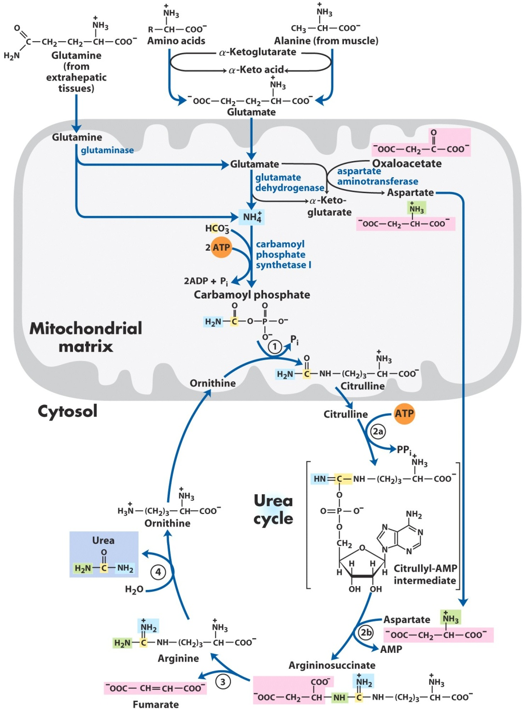
ornithine transcarbamoylase
argininosuccinate synthetase
argininosuccinate lyase
arginase
Urea cycle and reactions that feed amino groups into the cycle

Slide 31
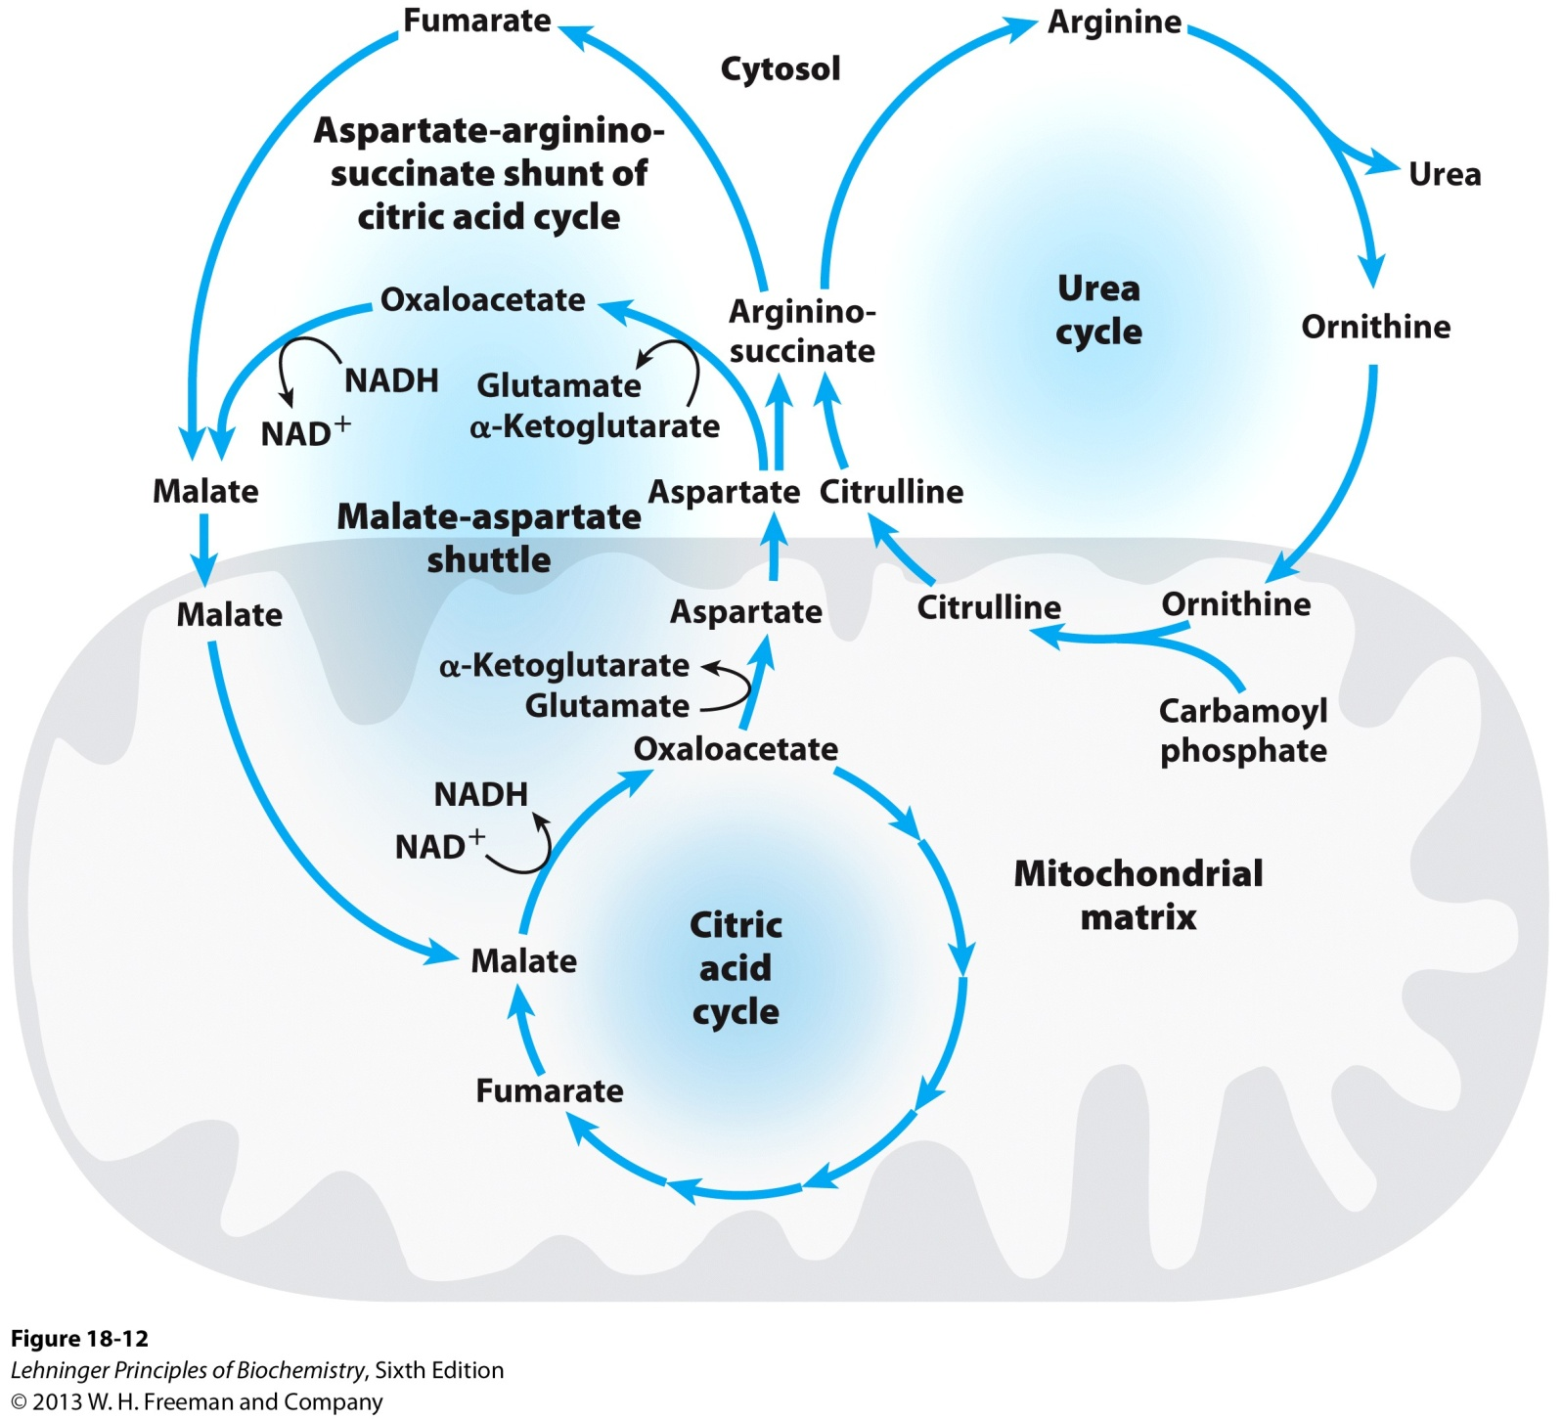
“Krebs bicycle”
The urea cycle and the citric
acid cycle are linked via
the aspartate-arginino-
succinate shunt
Links between the urea cycle and citric acid cycle

Slide 32
11. The rate of urea synthesis is controlled at two levels
Allosteric regulation of enzyme activity (fast): N-acetylglutamate, synthesized from acetyl-CoA and glutamate by the catalysis of N-acetylglutamate synthase, positively regulates carbamoyl phosphate synthetase I activity.
Gene regulation of enzyme amount (slow): syntheses of the five liver enzymes involved in urea synthesis are increased during starvation (when energy has to be obtained from muscle proteins!) or after high protein uptake.

Slide 33
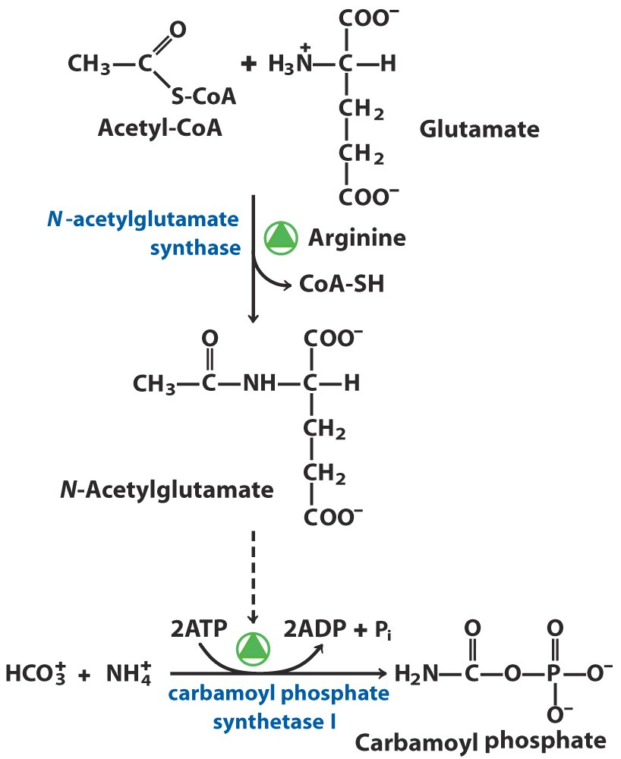
Carbamoyl phosphate
synthetase I is positively
regulated by the enigmatic
N-acetylglutamate

Slide 34
12. Genetic defects of the urea production enzymes lead to hyperammonemia and brain damage
Genetic defects of all five urea cycle enzymes have been revealed.
High levels of ammonia lead to mental disorder or even coma and death.
Ingenious strategies for coping with the deficiencies have been devised based on a thorough understanding of the underlying biochemistry.

Slide 35
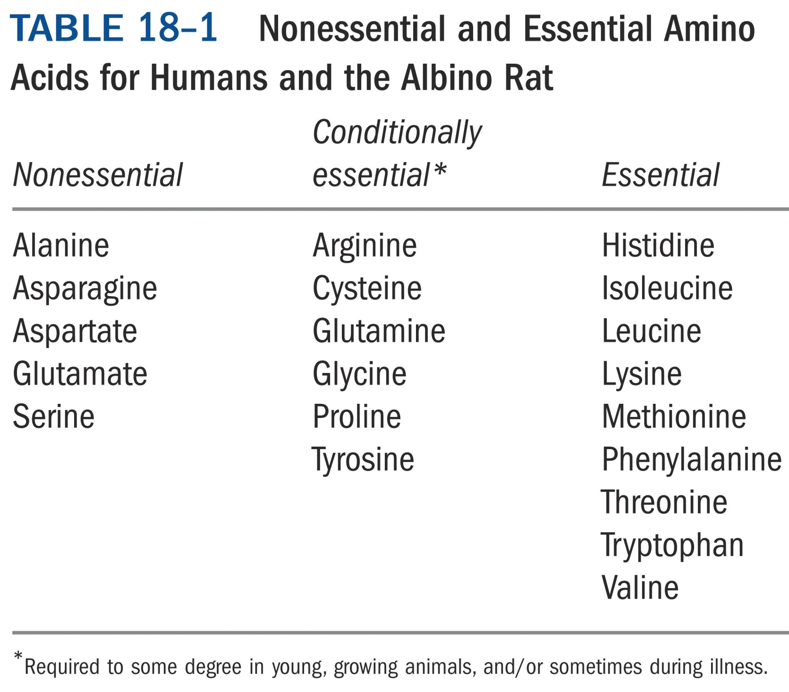

Slide 36
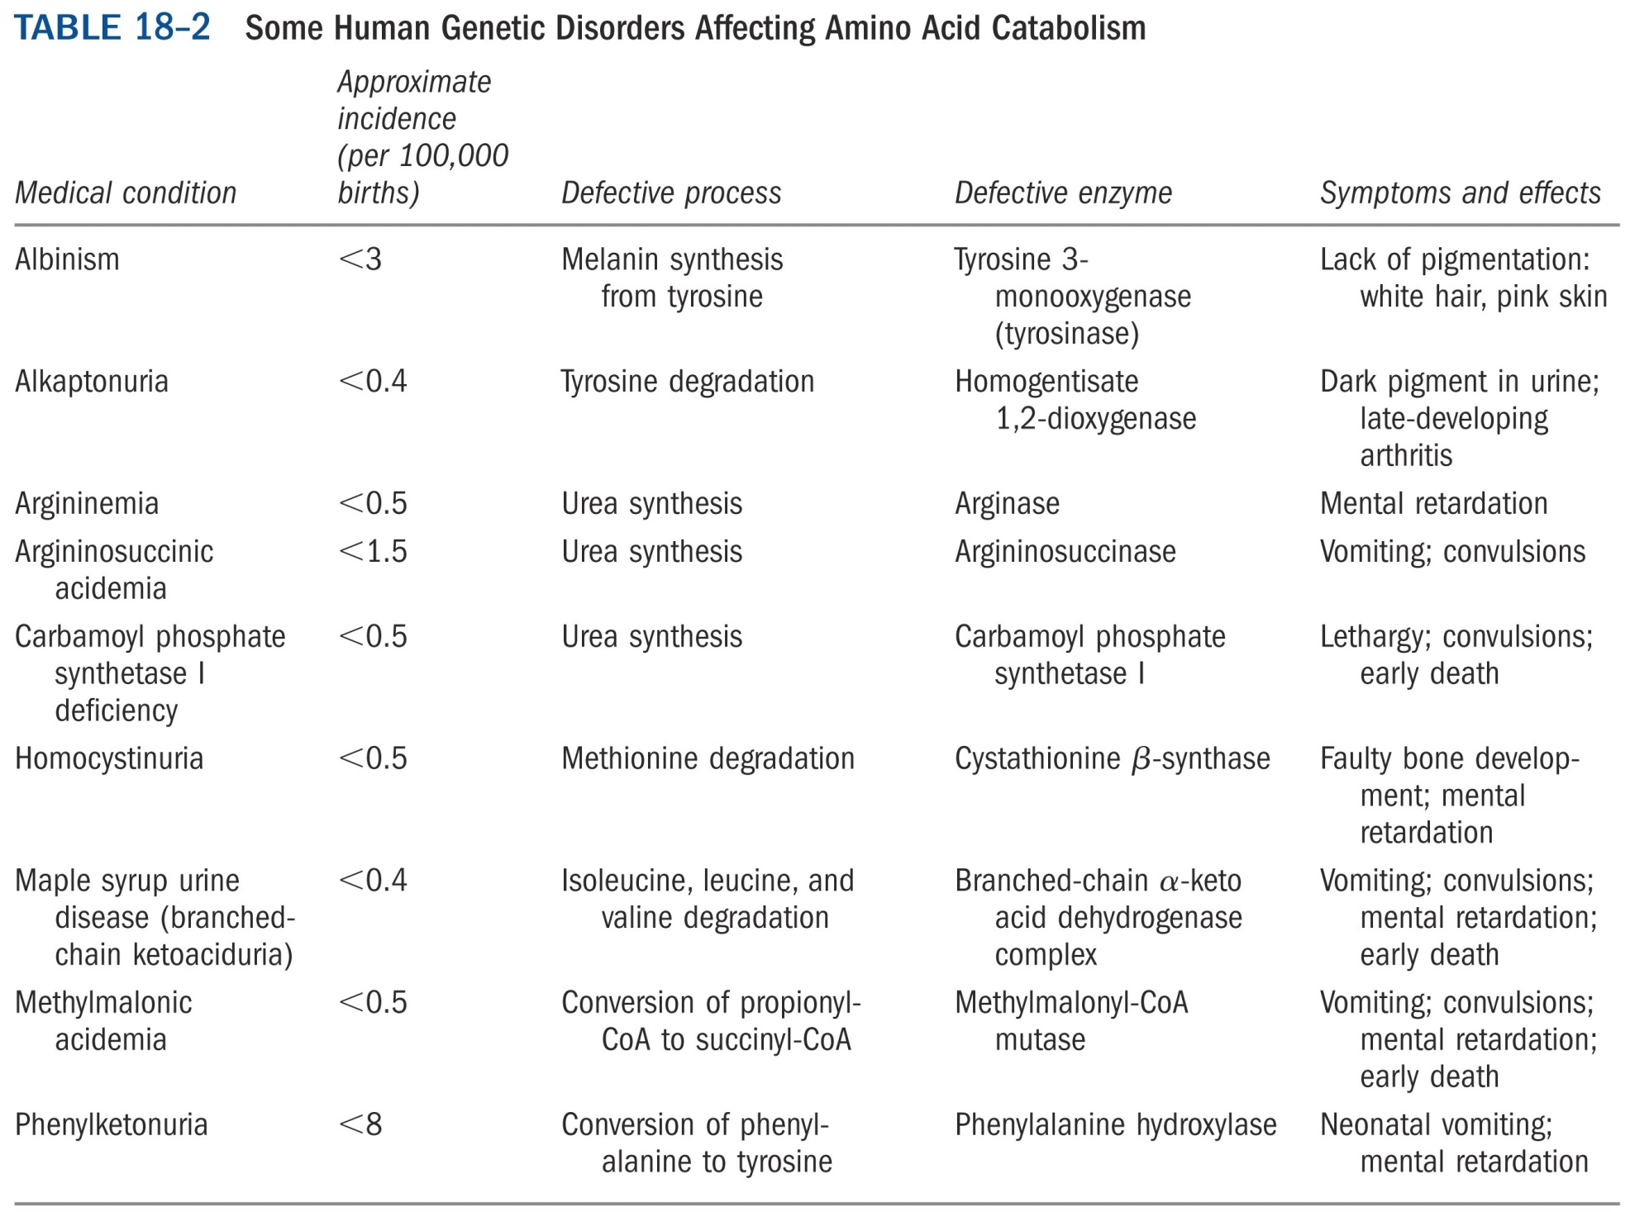

Slide 37
Strategy I: diet control, provide the essential amino acids in their α-keto acid forms.
Strategy II: when argininosuccinate lyase is deficient, ingesting a surplus of Arg will help (ammonia will be carried out of the body in the form of argininosuccinate, instead of urea).
Strategy III: when carbamoyl phosphate synthetase, ornithine transcarbamoylase, or argininosuccinate synthetase are deficient, the ammonia can be eliminated by ingesting compounds (e.g., benzoate or phenylacetate), which will be excreted after accepting ammonia.

Slide 38
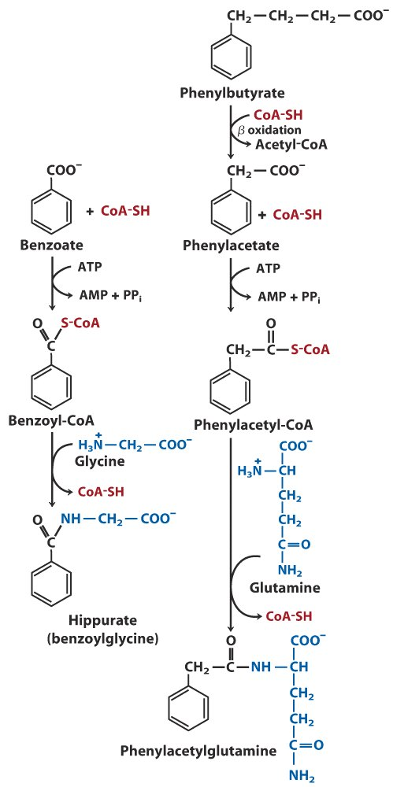
Treatment for deficiencies in urea cycle enzymes

Slide 39
13. The carbon skeletons of the amino acids are converted (funneled) into seven major metabolic intermediates
Intermediates include:
acetoacetyl-CoA, acetyl-CoA (which can be converted to fatty acids and ketone bodies, these amino acids are thus ketogenic)
Pyruvate, α-ketoglutarate, succinyl-CoA, fumarate, oxaloacetate (all can be converted to glucose, these amino acids are thus glucogenic)

Slide 40
Amino acids having long carbon chains often degrade in ways similar to fatty acid oxidation.
Amino acids having short chains often degrade into pyruvate or citric acid intermediates directly.
Some of the conversions are very complicated, using a variety of cofactors.

Slide 41
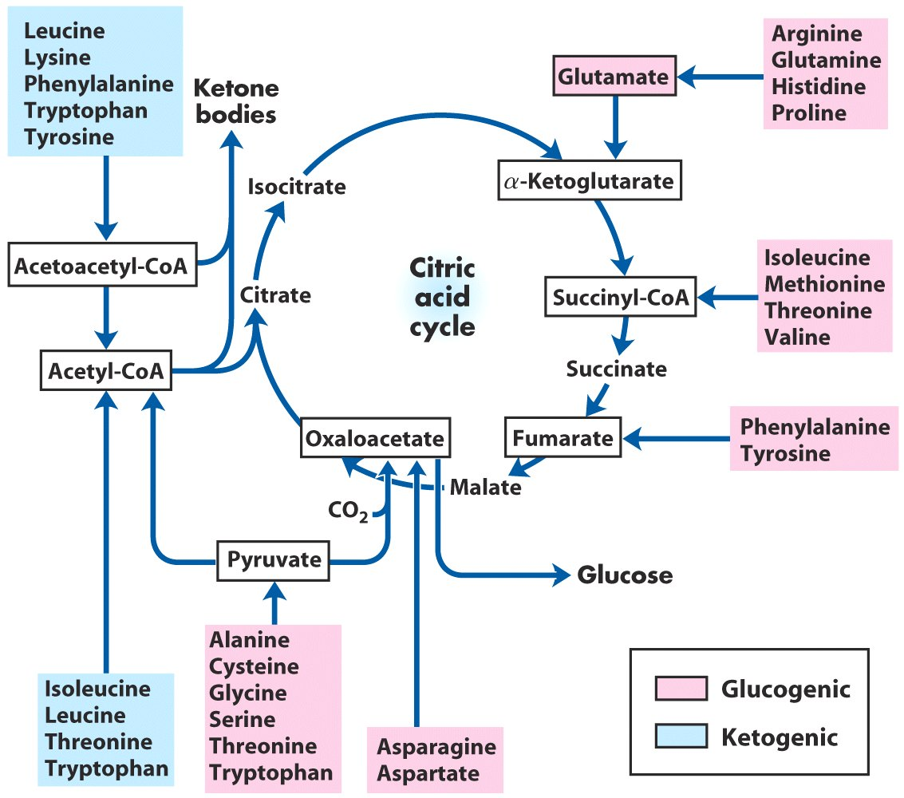
The carbon skeletons of amino acids are oxidized via the citric acid cycle*****

Slide 42
14. Some amino acids are converted to intermediates of citric acid cycle by simple removal of the amino groups
Ala pyruvate
Asp oxaloacetate
Glu α-ketoglutarate
Asn Asp (via a deamination reaction
catalyzed by asparaginase)
Gln Glu (via a deamination reaction
catalyzed by glutaminase)

Slide 43
15. Acetyl-CoA is formed from the degradation of many amino acids
Trp, Ala, Ser, Gly, Thr and Cys are converted to pyruvate first before being converted to acetyl-CoA.
Portions of the carbon skeletons of Trp, Phe, Try, Lys, Leu, and Ile are converted (via acetoacetyl-CoA or directly) to acetyl-CoA.
Some of the final steps in the degradation of Leu, Lys, and Trp resemble steps in fatty acid oxidation.
Tryptophan degradation is the most complex.

Slide 44
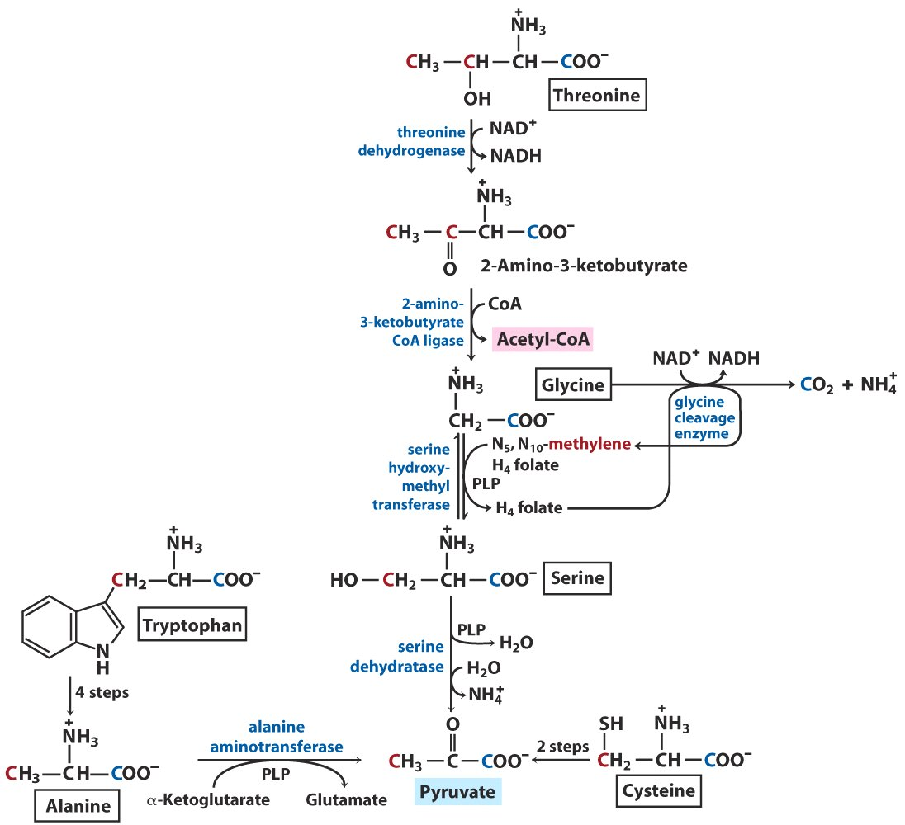
Trp, Thr, Ala, Ser, Gly and Cys
are converted to pyruvate,
before being converted to
acetyl-CoA

Slide 45
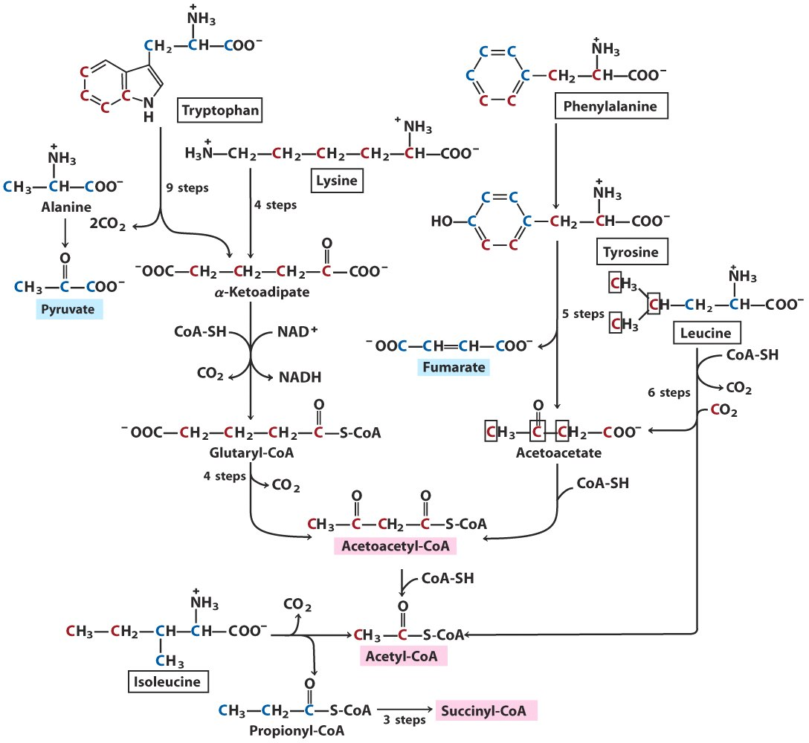
Trp, Phe, Tyr, Lys, Leu,
and Ile are converted
to acetyl-CoA

Slide 46
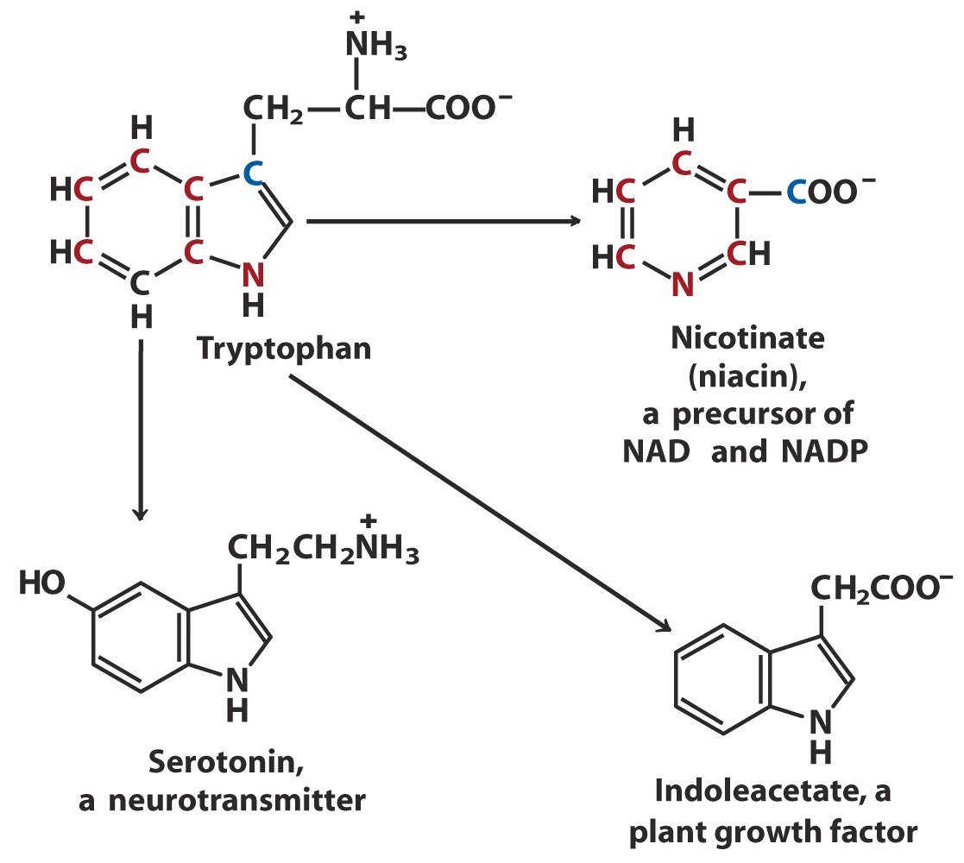
Intermediates of tryptophan
degradation are precursors
for synthesizing other
biomolecules

Slide 47
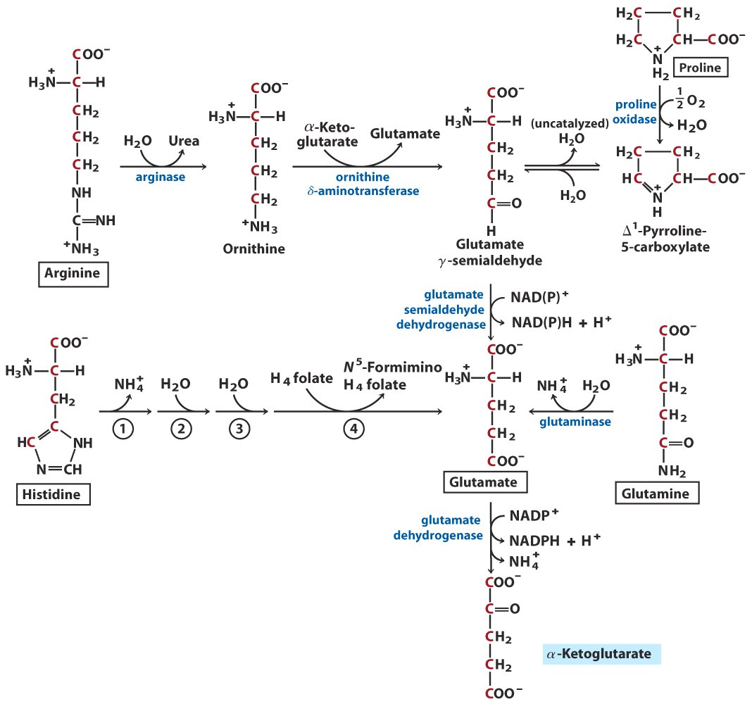
Arg, His, Glu, Gln
and Pro are converted
to α-ketoglutarate

Slide 48
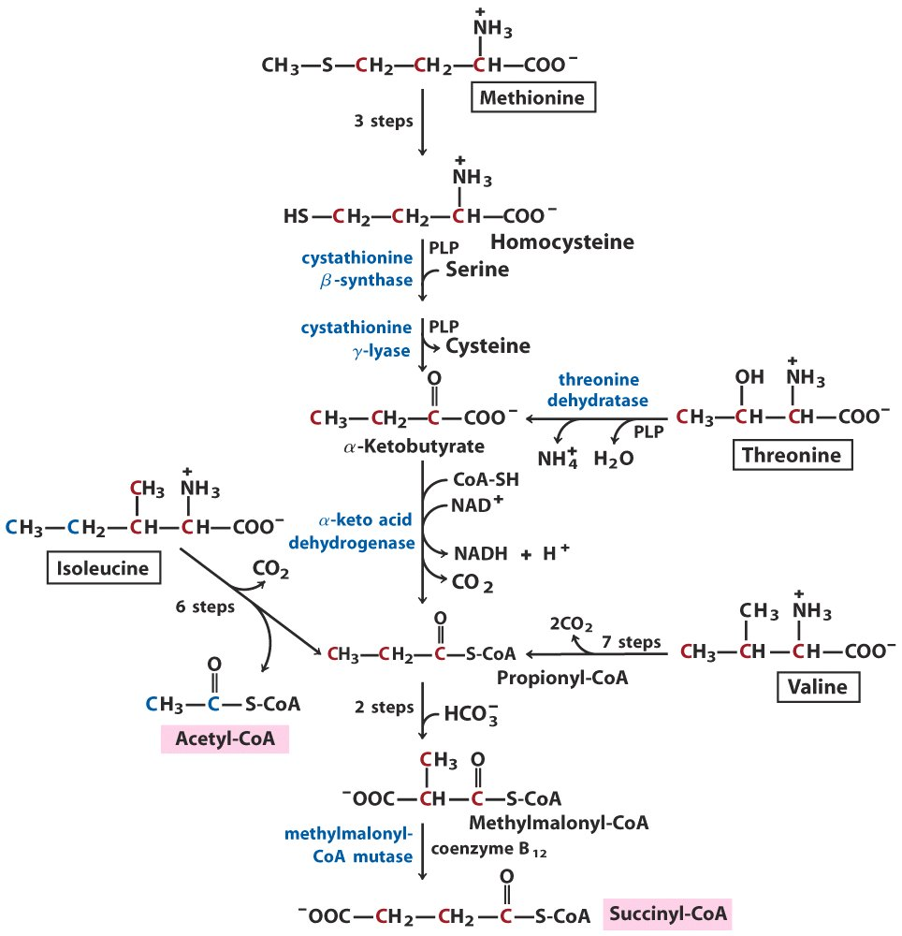
Met, Ile, Thr and
Val are converted
to succinyl-CoA

Slide 49
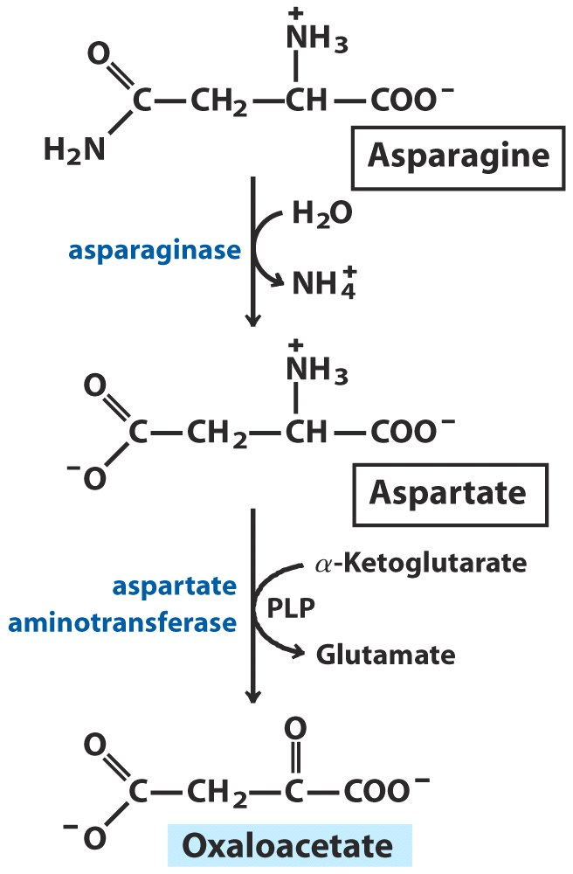
Asp and Asn
are converted to
oxaloacetate

Slide 50
16. Leu, Ile, and Val are degraded via reactions similar to fatty acid oxidation
They are oxidized primarily in muscle, adipose, kidney and brain tissue, not in liver.
The same branched-chain aminotransferase and branched-chain α-keto acid dehydrogenase complex catalyze the first two degradative reactions (transamination and oxidative decarboxylation) of all these three amino acids in extrahepatic tissues.
The α-keto acid dehydrogenase complex has a similar structure and catalyzes essentially the same type of reaction as pyruvate dehydrogenase complex and the α-ketoglutarate dehydrogenase complex.

Slide 51
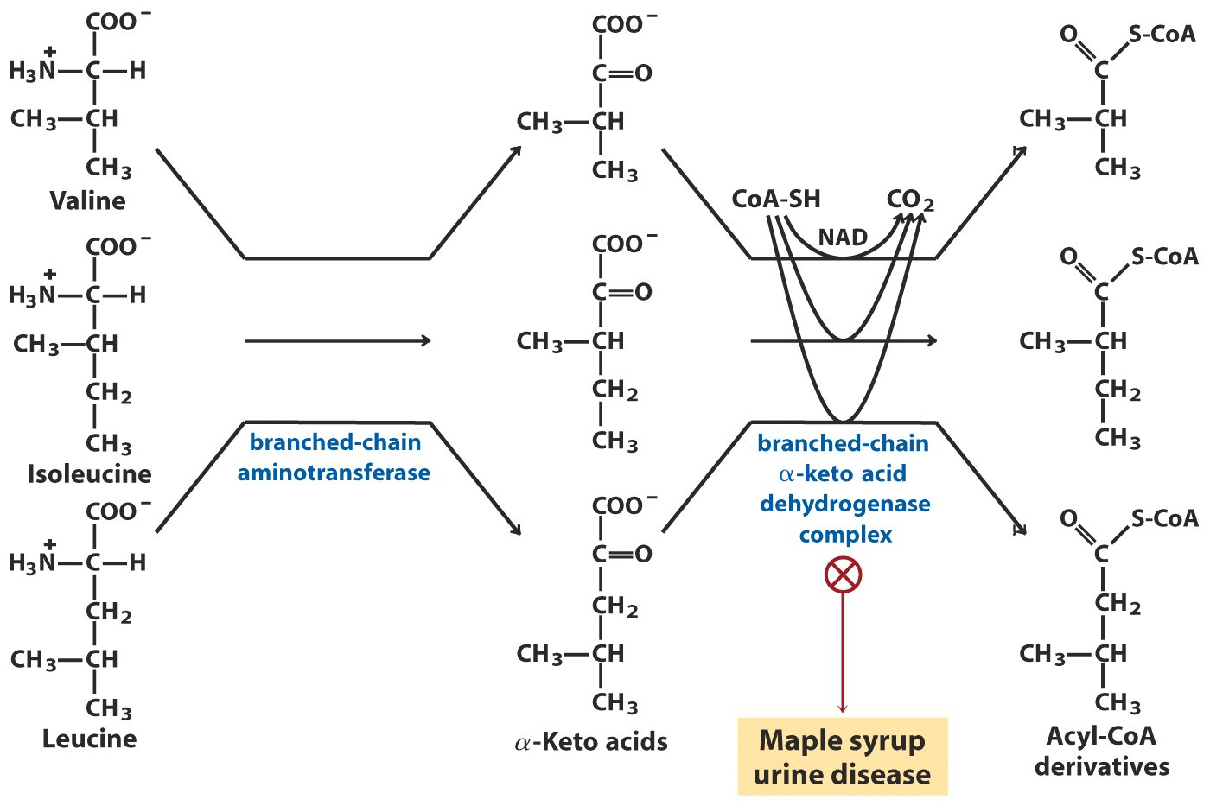
Absent
in liver
Catabolic pathways for Val, Ile and Leu

Slide 52
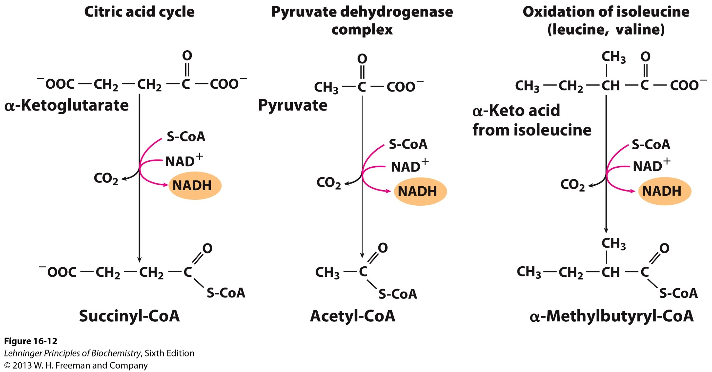
A conserved mechanism for oxidative decarboxylation

Slide 53
17. A few genetic diseases are related to defects in amino acid catabolism
Defects in enzymes of amino acid degradation lead to accumulation of specific intermediates, many of which cause diseases.
Deficiency of phenylalanine hydroxylase causes phenylketonuria (PKU, 苯丙酮尿症), one of the earliest human genetic defects of metabolism (first revealed in 1934 in testing mentally retarded patients, whose urine turned olive-green on addition of FeCl₃) .
The accumulated Phe is converted to phenylpyruvate (via an aminotransferase) which caused the color change of urine.

Slide 54
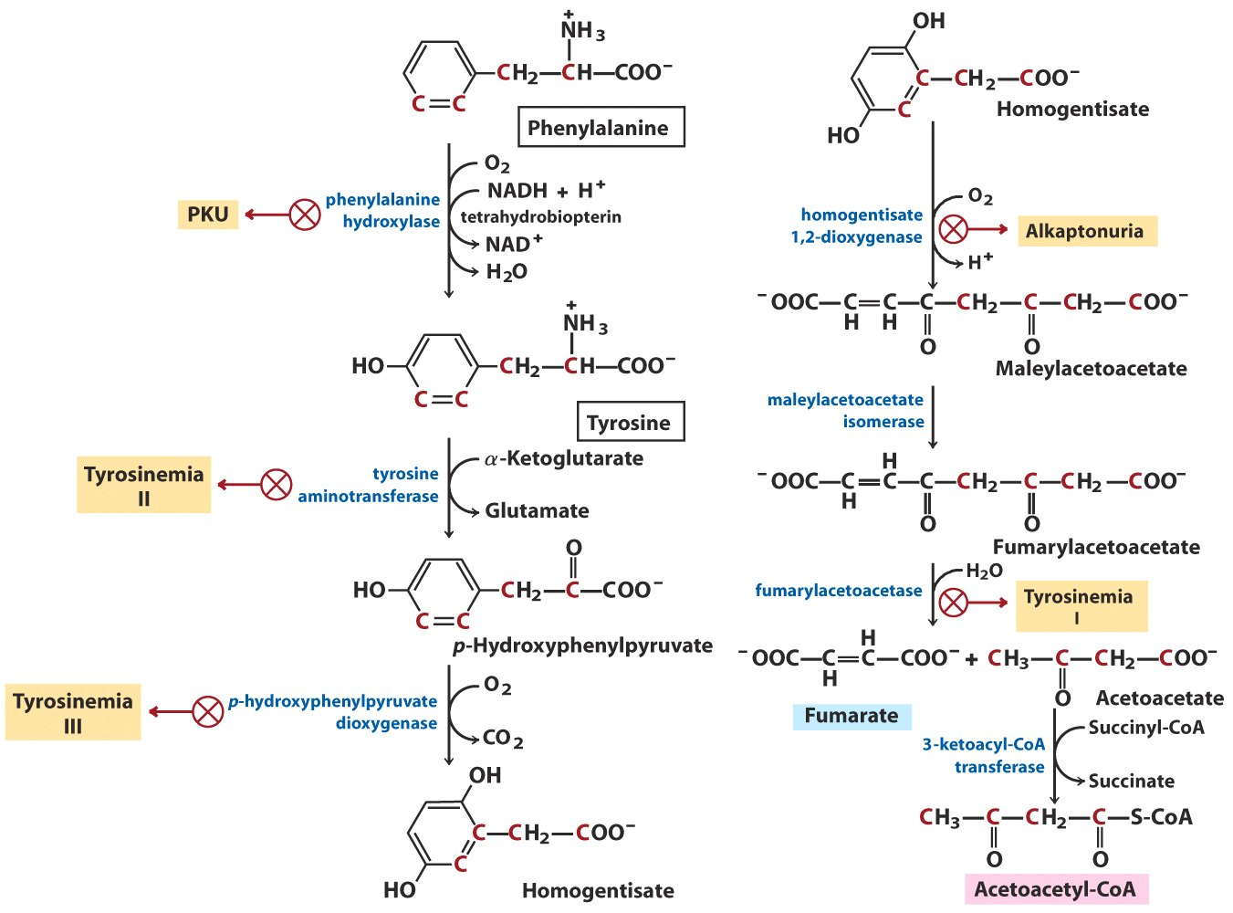
Phe and Tyr are eventually converted
to fumarate and acetoacetyl-CoA

Slide 55
(PKU)
Notes:
55

Slide 56
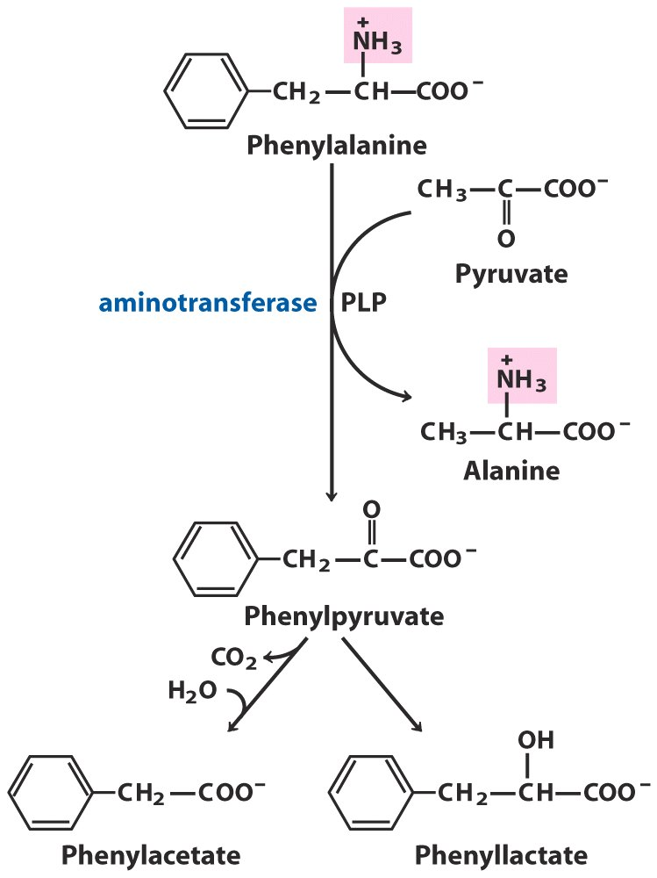
Phenylalanine that is
accumulated in PKU
patients is
converted to other
alternative products.

Slide 57
Another disease related to Phe/Tyr catabolism and of historical interest is alkaptonuria (尿黑酸症).
Archibald Garrod discovered that the condition is transmitted as a single recessive inheritable trait and could be traced to the absence of a single enzyme (in early 1900s), thus hinted the direct relation between genes and enzymes.
Homogentisate dioxygenase was found to be defective in such patients.

Slide 58
Amino acids can be converted to
glucose (glucogenic) or ketone bodies (ketogenic)

Slide 59
Keywords
Transfer of NH₄⁺---Ala, Glu, Gln
Urea cycle---reaction and regulation
Pathways of amino acid degradation
---as groups into TCA

Slide 60
Words of the week
hyper vs. hypo
macro vs. micro
glucogenic vs. ketogenic

Slide 61
Text-book reading of the week
Summary 18.1 (p704)
Summary 18.2 (p710)
Summary 18.3 (p725-726)
p703-704 (Ammonia is toxic to animals)
p708 (Box 18-1)

Slide 62
Summary
Amino acid in excess can neither be stored, nor excreted, but oxidized or converted.
The amino groups and carbon skeletons of amino acids take separate but interconnected pathways.
Liver is the major site of amino acid degradation in vertebrates.
PLP facilitates the transamination and other transformations of amino acids.
Glutamate collects and delivers free ammonia to the liver.
Gln and Glu releases NH₄⁺ in liver mitochondria.

Slide 63
NH₄⁺ in hepatocytes is converted to urea through the urea cycle in most terrestrial vertebrates for excretion.
The conversion of ammonia to urea takes five enzymatic steps.
The rate of urea synthesis is controlled at two levels.
The carbon skeletons of the amino acids are first converted (funneled) into seven major metabolic intermediates.
Some amino acids are converted to intermediates of citric acid cycle by simple removal of the amino groups.

Slide 64
Acetyl-CoA is formed from the degradation of many amino acids.
A few genetic diseases are related to defects in amino acid catabolism.
Leu, Ile, and Val are degraded via reactions similar to fatty acid oxidation.

