Slide 1
Chapter 19 Oxidative phosphorylation and photophosphorylation
Generation of ATP by using a across-membrane proton gradient, which is generated from electron flow through a chain of carriers

Slide 2
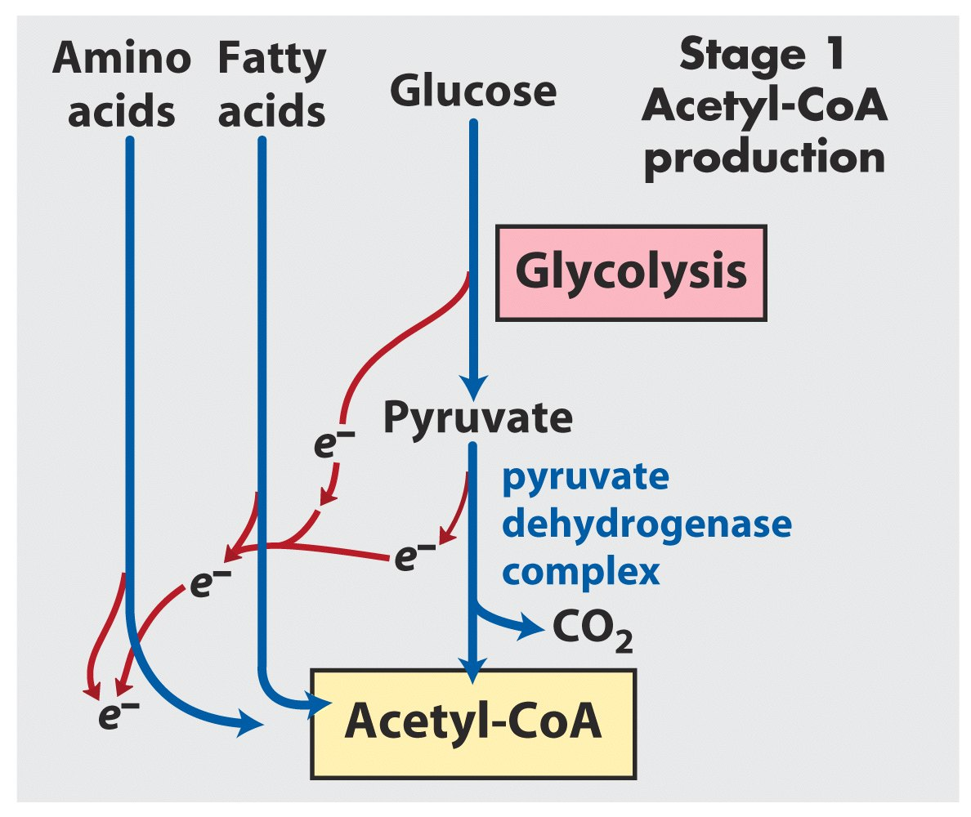
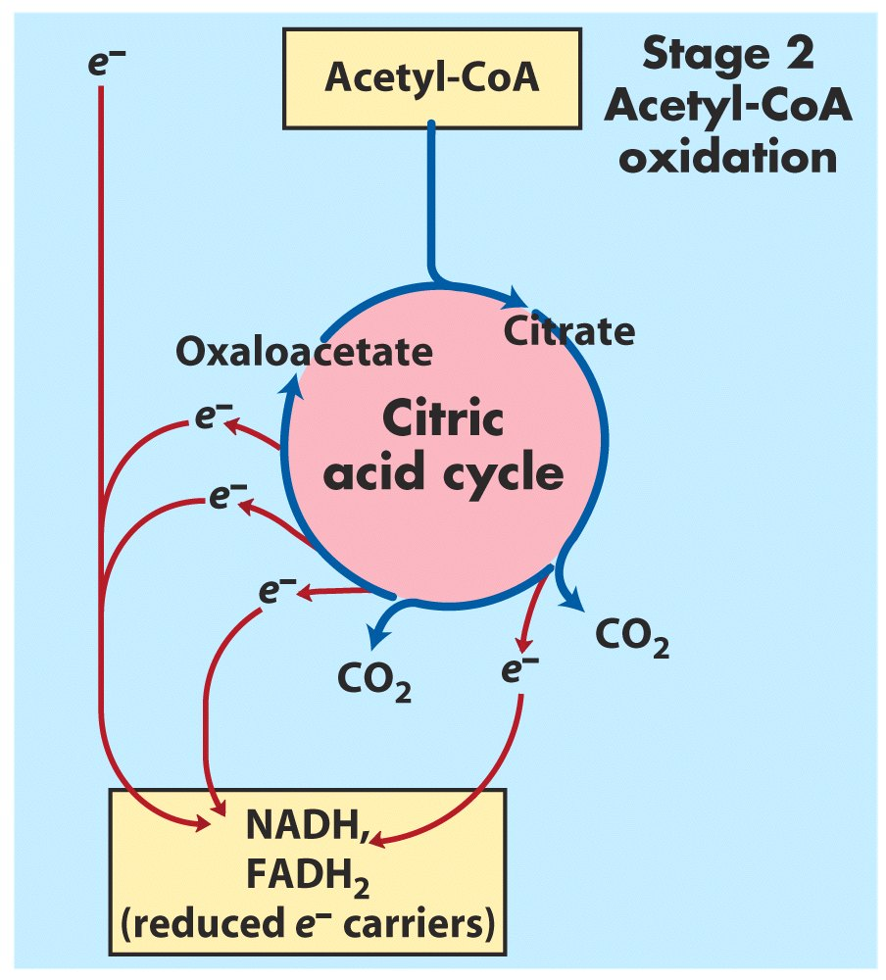
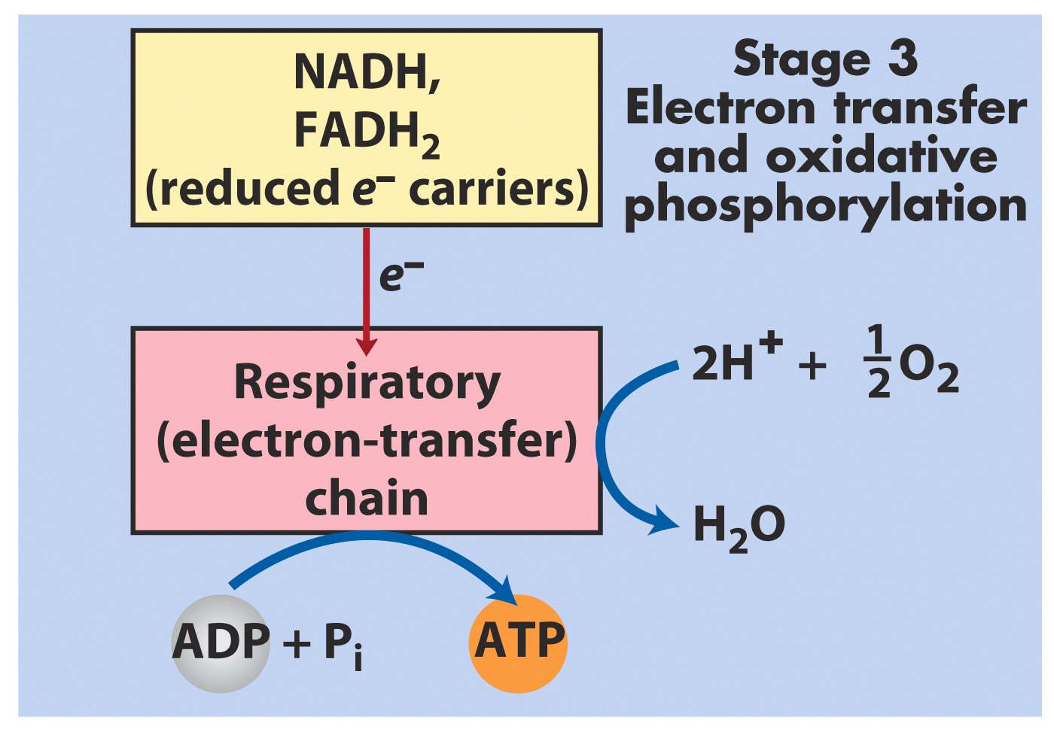

Slide 3
1. ATP is synthesized using the same strategy in oxidative phosphorylation and photophosphorylation
Oxidative phosphorylation is the process in which ATP is generated as a result of electron flow from NADH or FADH₂ to O₂ via a series of membrane-bound electron carriers called the respiratory chain (reducing O₂ to H₂O at the end)----氧化磷酸化
Photophosphorylation is the process in which ATP (and NADPH) is synthesized as a result of electron flow from H₂O to NADP⁺ via a series of membrane-bound electron carriers (oxidizing H₂O to O₂ at the beginning)----光合磷酸化

Slide 4
Oxidative phosphorylation and photophosphorylation are mechanistically similar
1). Both involve the flow of electrons through a chain of membrane-bound carriers.
2). The energy released from “downhill” electron flow is first used for “uphill” pumping of protons (质子) to produce a proton gradient (thus a transmembrane electrochemical potential) across a biomembrane.
3). ATP is then synthesized by a “downhill” transmembrane flow of protons through a specific protein machinery (ATP synthase).

Slide 5
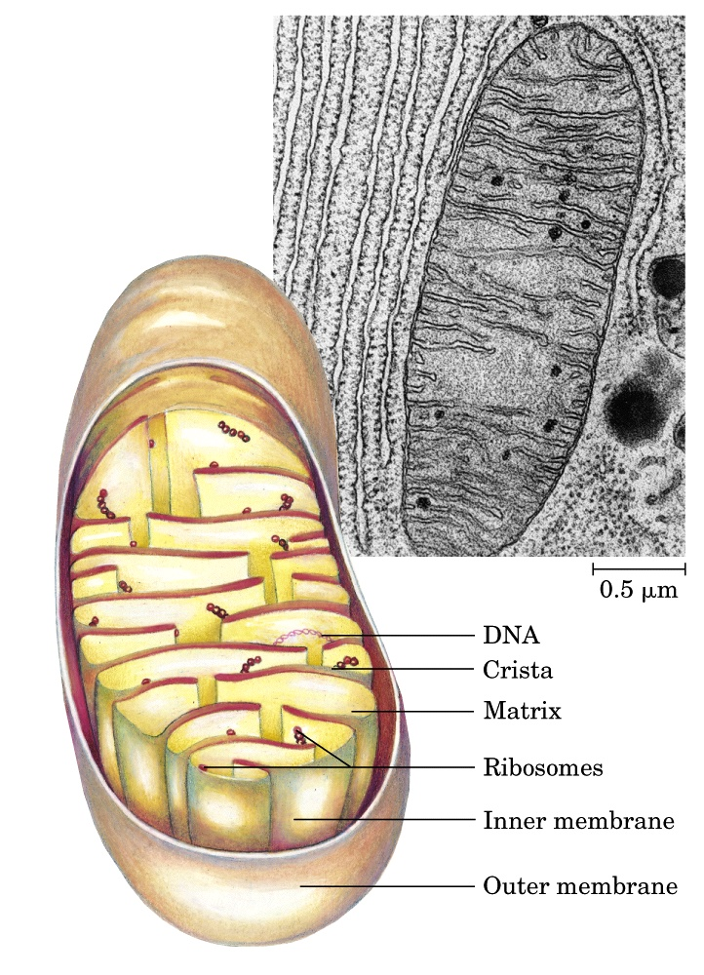
Cristae (the infoldings
of the inner membrane
of mitochondria) is
where the respiratory
chain is located.

Slide 6
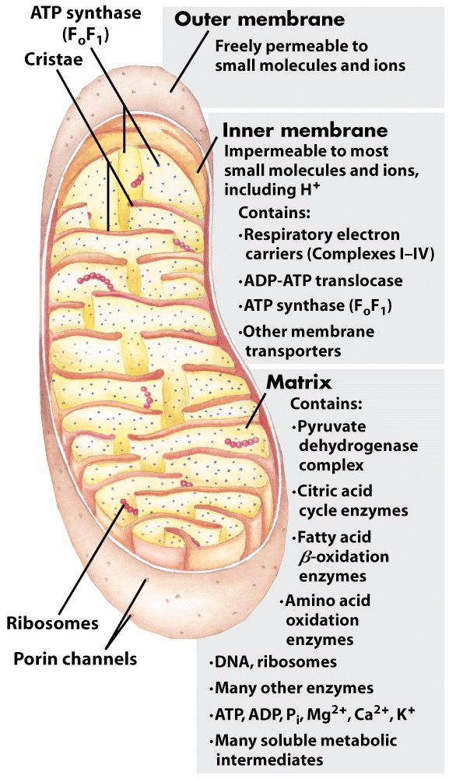
Biochemical anatomy of a mitochondrion*****

Slide 7
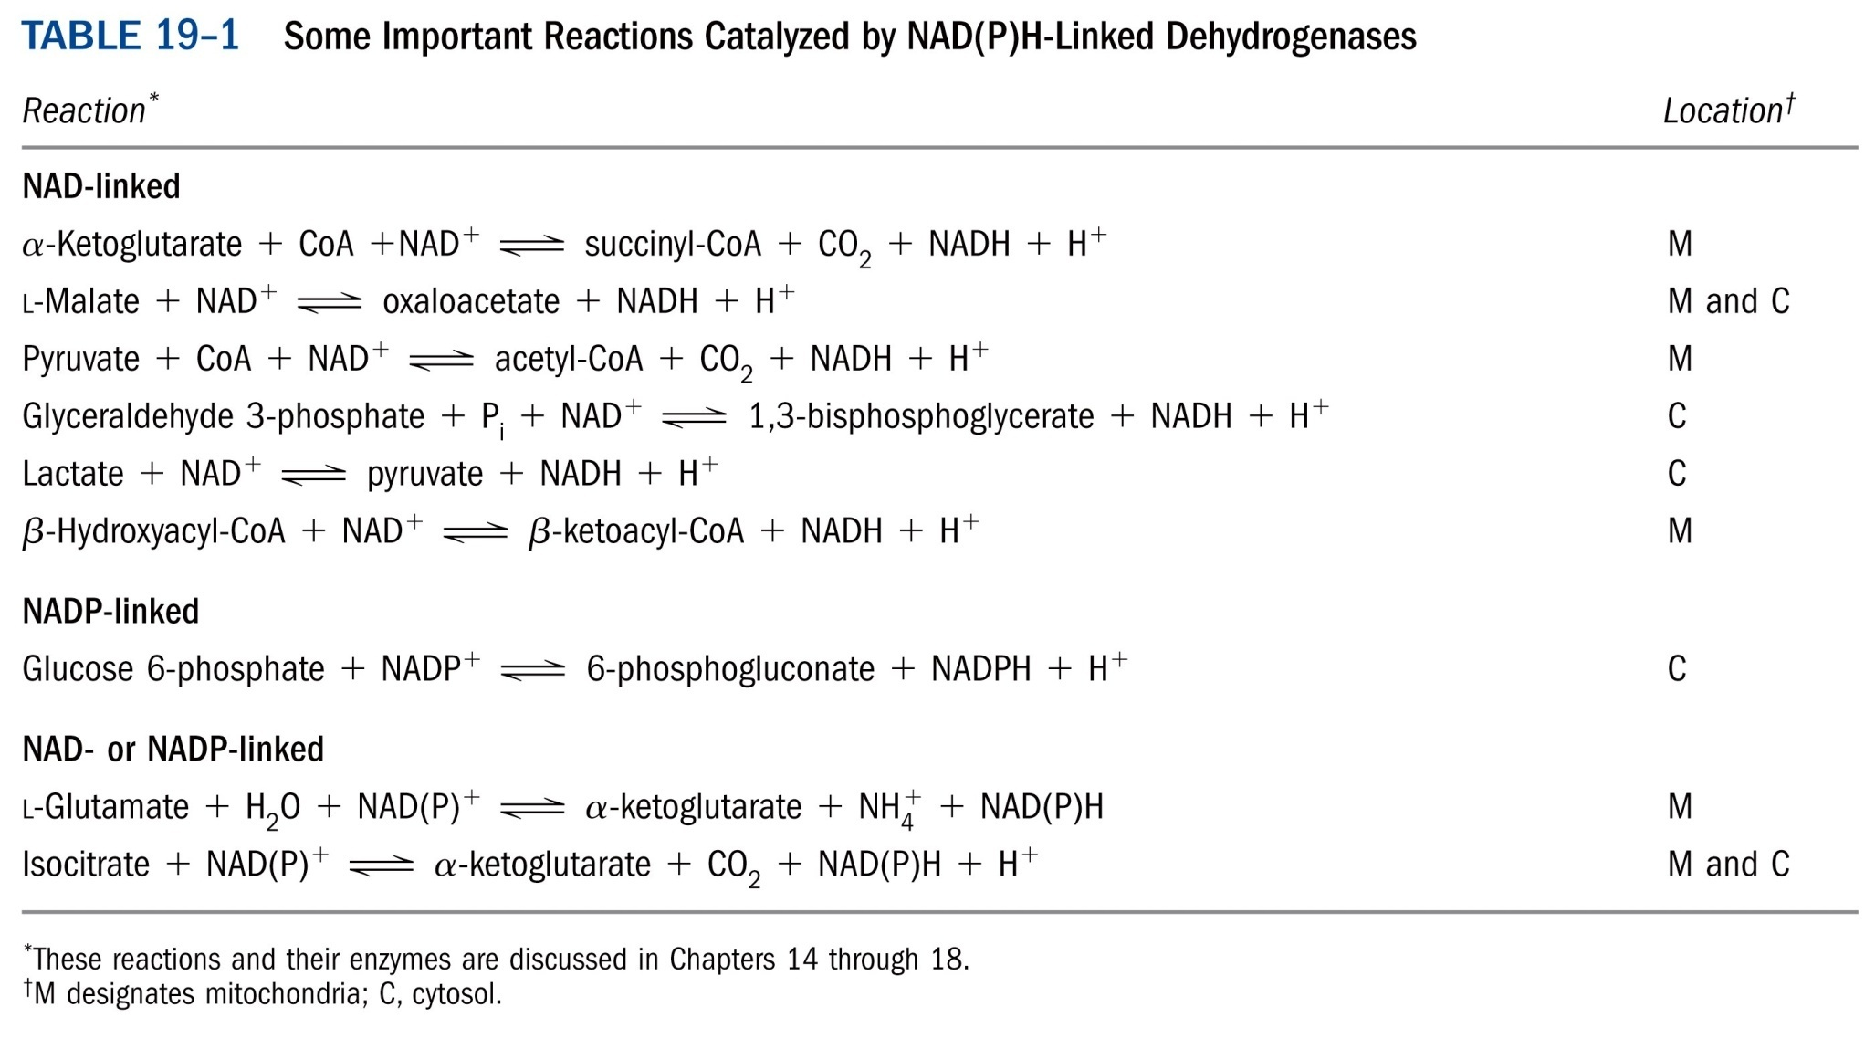
*****

Slide 8
2. Electrons collected in NADH and FADH₂ are released and transported to O₂ via the respiratory chain
The chain is located on the convoluted inner membrane (cristae) of mitochondria in eukaryotic cells (revealed by Eugene Kennedy and Albert Lehninger in 1948) or on the plasma membrane in prokaryotic cells.
A 1.14-volt potential difference (ΔE’⁰) between NADH (-0.320 V) and O₂ (0.816 V) drives electron flow through the chain.

Slide 10
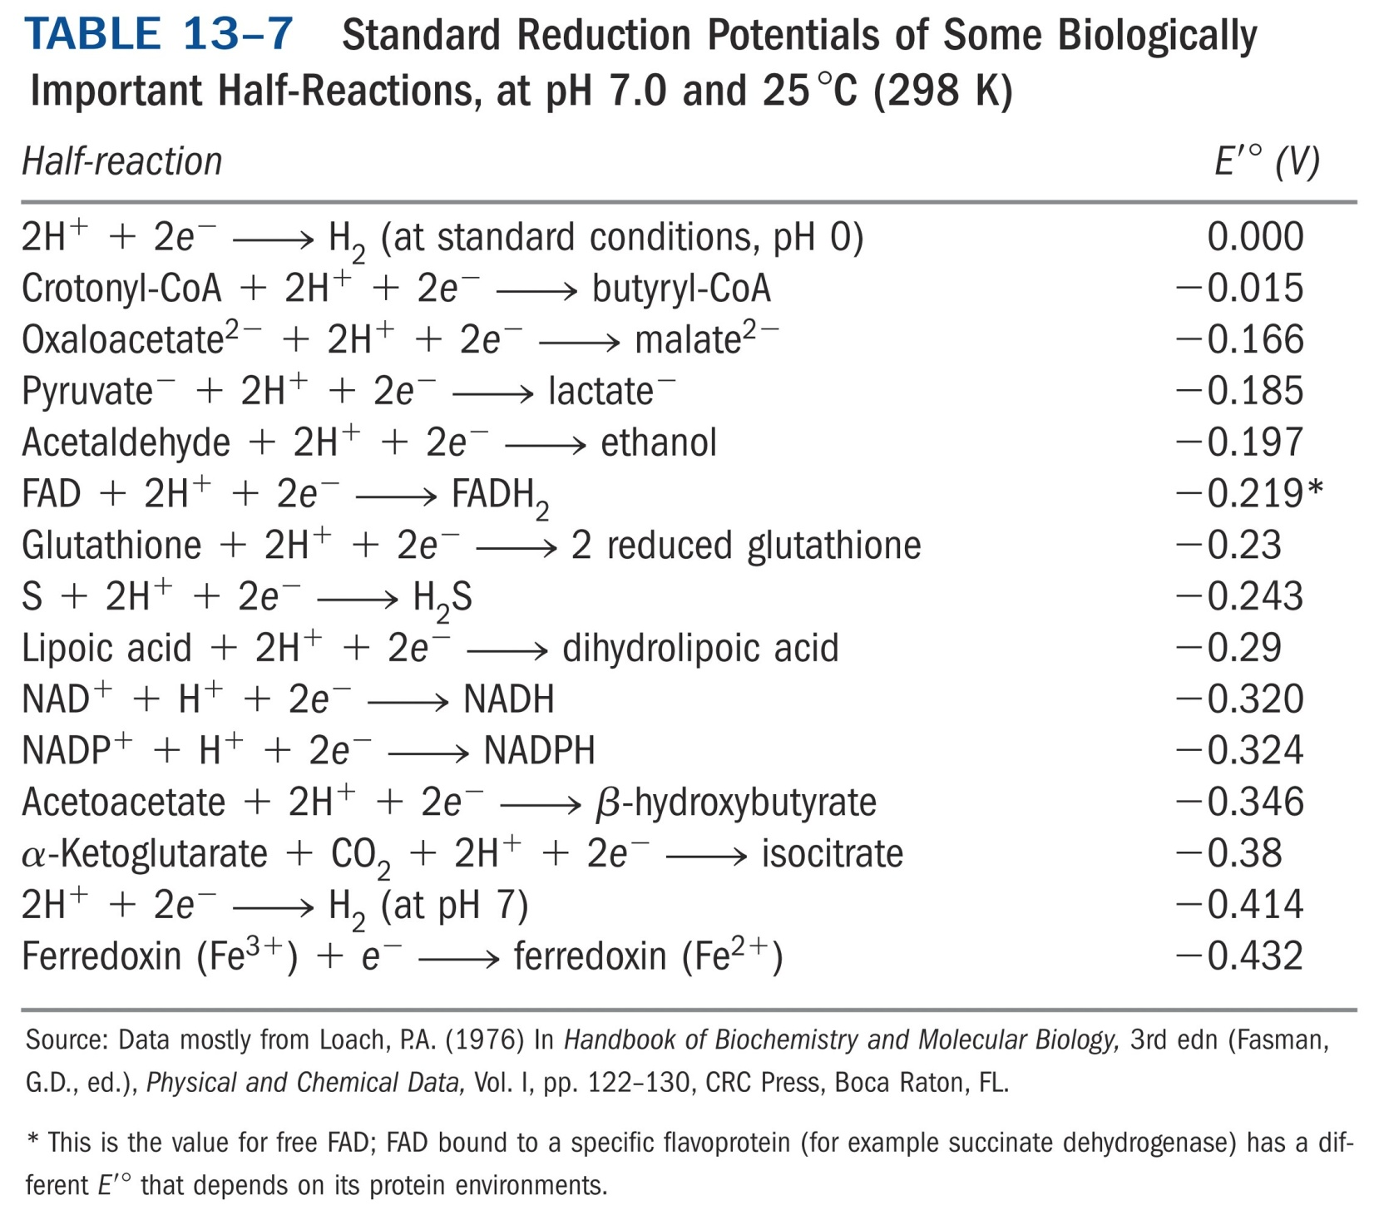

Slide 11
The respiratory chain consists of four large multi-protein complexes (I, II, III, and IV; three being proton pumps) and two mobile electron carriers, ubiquinone (Q or coenzyme Q) (泛醌) and cytochrome c (细胞色素c).
Prosthetic groups acting in the proteins of respiratory chain include flavins (FMN, FAD), hemes (血红素) (heme A, iron protoporphyrin IX, heme C), iron-sulfur clusters (2Fe-2S, 4Fe-4S), and copper (Cu).

Slide 12
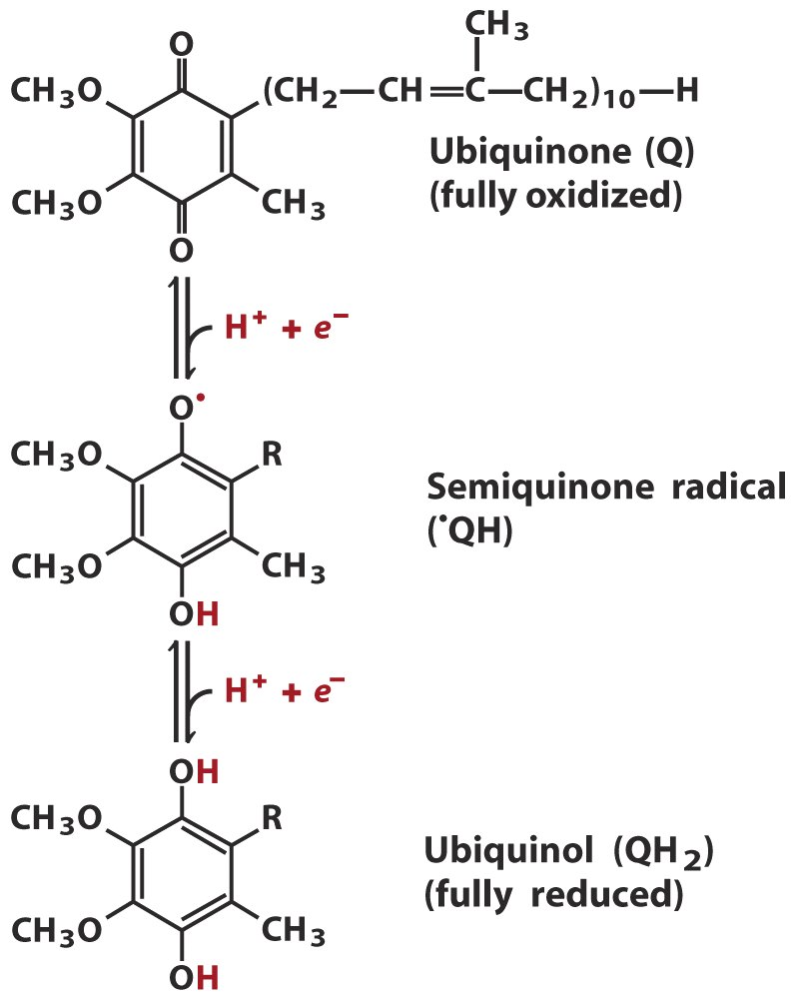
Ubiquinone is a mobile
electron/proton carrier
Coenzyme Q
or Q
Lipid-soluble benzoquinone
with a very long isoprenoid
side chain; can accept one
or two electrons, forming
radical semiquinone or
ubiquinol (QH₂); QH₂
diffuses to the next complex
(III); the only electron
carrier not bound to a
protein.

Slide 13
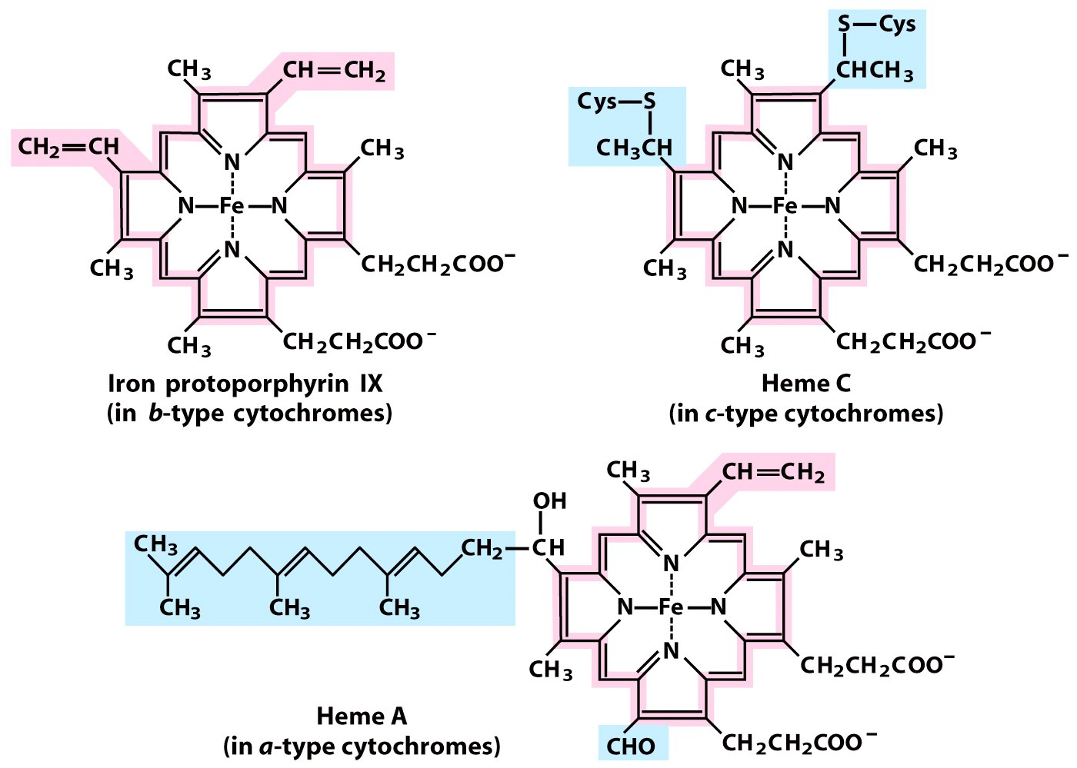
Prosthetic groups of cytochromes

Slide 14
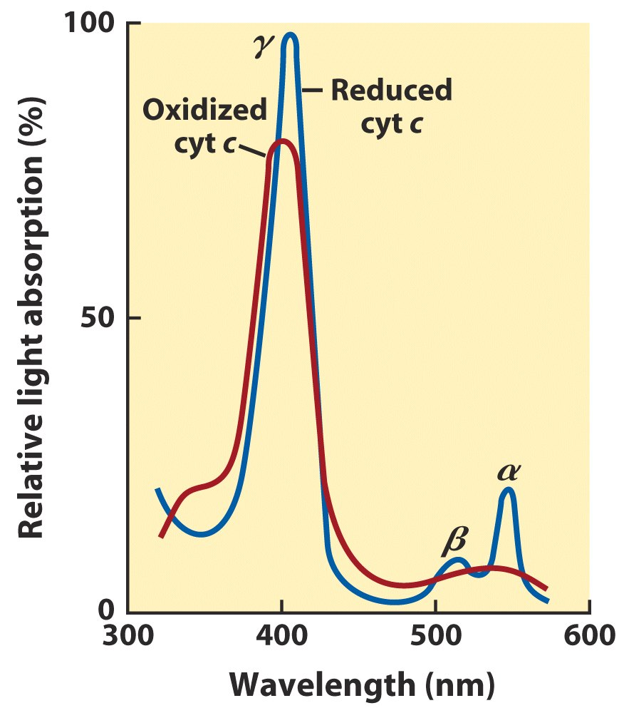
Reduced cytochromes
have three absorption
bands in the visible
wavelengths
Cyt a: ~600 nm
Cyt b: ~560 nm
Cyt c: ~550 nm

Slide 15
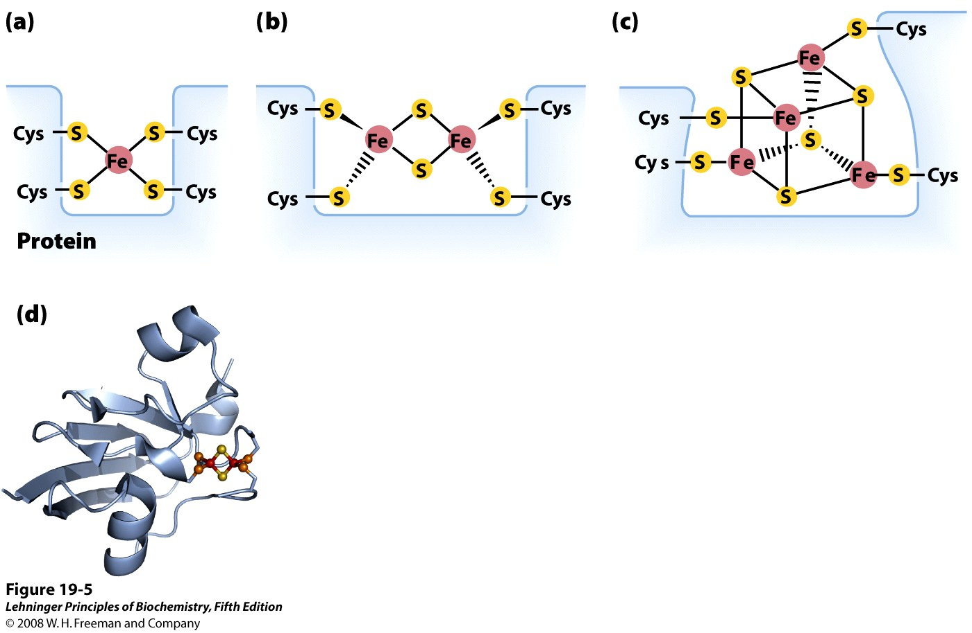
2Fe-2S
4Fe-4S
Different types of
iron-sulfur centers
Iron atoms cycle between Fe²⁺
(reduced) and Fe³⁺(oxidized).
Notes:
FIGURE 19-5 Iron-sulfur centers. The Fe-S centers of iron-sulfur proteins may be as simple as (a), with a single Fe ion surrounded by the S atoms of four Cys residues. Other centers include both inorganic and Cys S atoms, as in (b) 2Fe-2S or (c) 4Fe-4S centers. (d) The ferredoxin of the cyanobacterium Anabaena 7120 has one 2Fe-2S center (PDB ID 1FRD); Fe is red, inorganic S is yellow, and the S of Cys is orange. (Note that in these designations only the inorganic S atoms are counted. For example, in the 2Fe-2S center (b), each Fe ion is actually surrounded by four S atoms.) The exact standard reduction potential of the iron in these centers depends on the type of center and its interaction with the associated protein.

Slide 16
3. The order of the many electron carriers on the respiratory chain have been elucidated via various studies
Method 1: Measurement of the standard reduction potential (E’⁰)
Electrons tend to transfer from low E’⁰ carriers to high E’⁰ carriers (but may deviate from this in real cells).

Slide 17
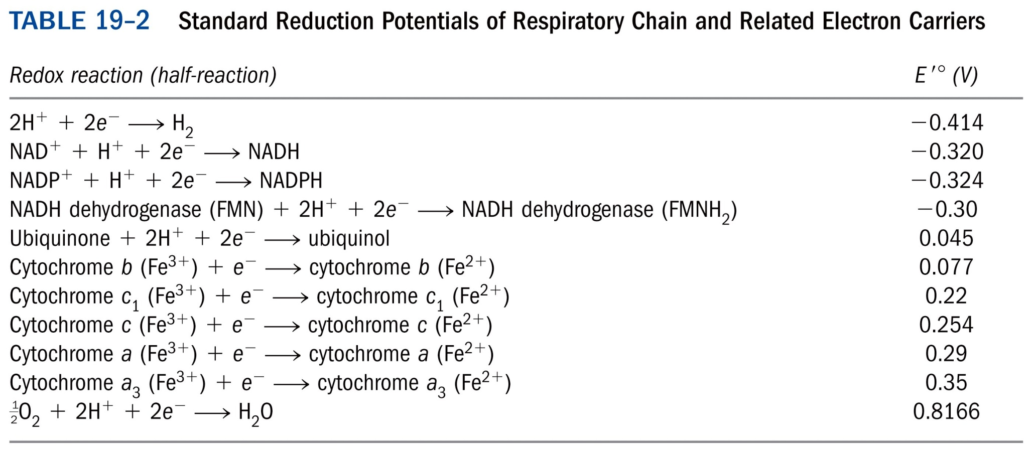
Electron carriers have an order of increasing E’⁰

Slide 18
Method 2: Oxidation kinetics studies
Full reduction followed by sudden O₂ introduction; earlier oxidation, closer to the end of the respiratory chain; using rapid and sensitive spectrophotometric techniques to follow the oxidation of the cytochromes, which have different wavelength of maximal absorption.

Slide 19
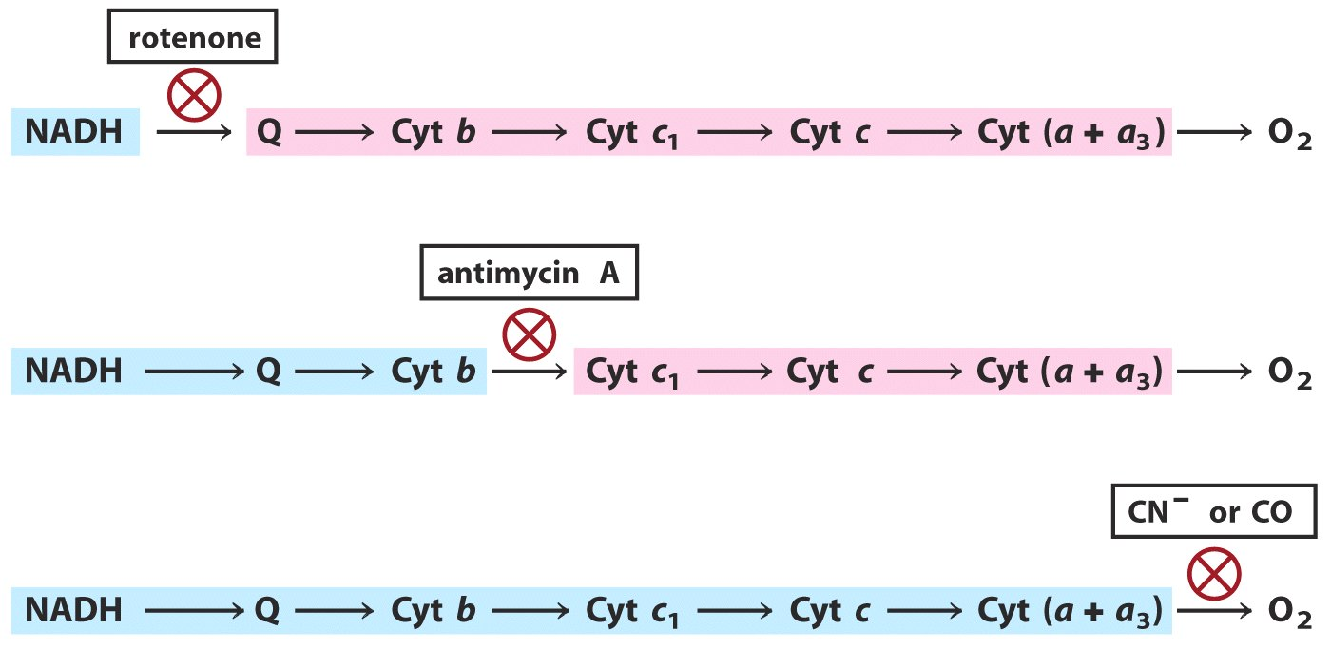
Method 3: Effects of various specific inhibitors those before the blocked step should be reduced and those after should be oxidized.
Reduced
Oxidized
Reduced
Oxidized
Reduced

Slide 20
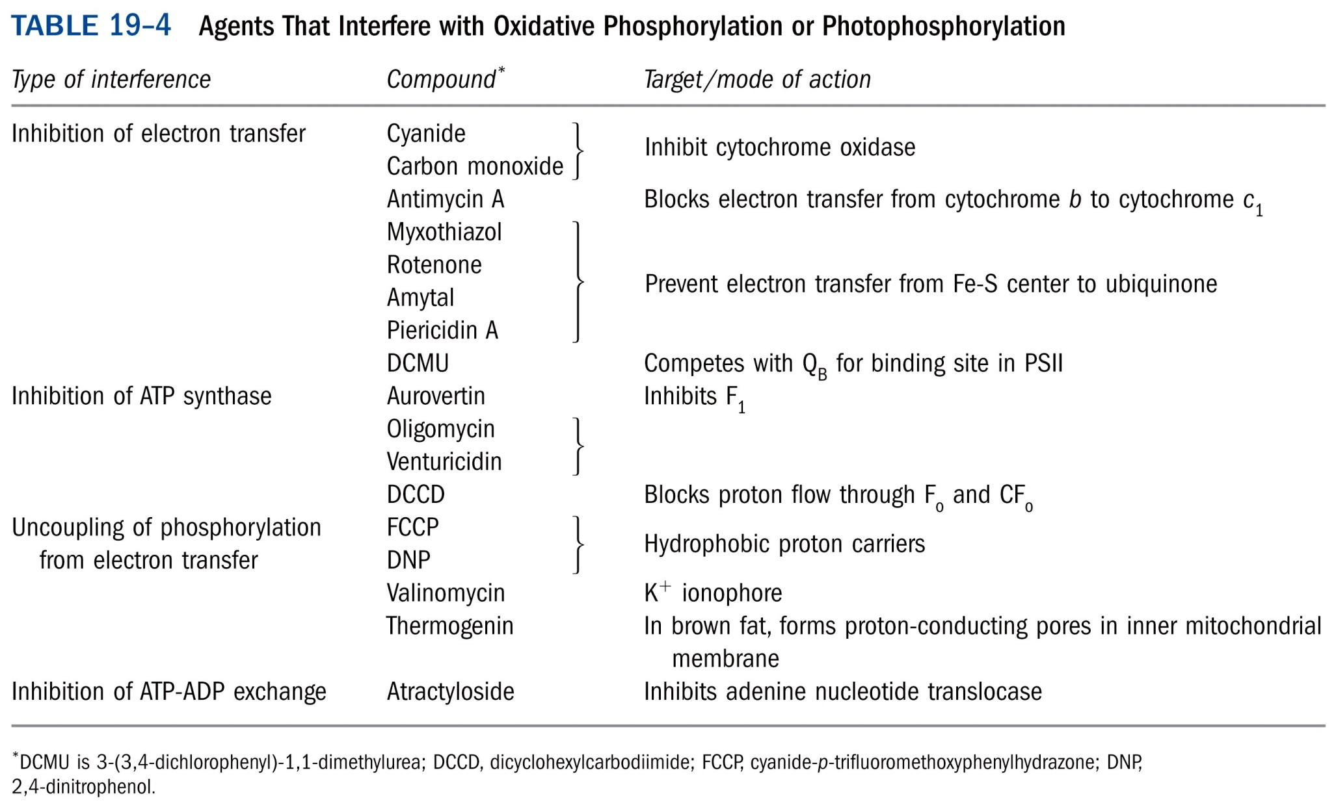
*****
氰化物

Slide 21
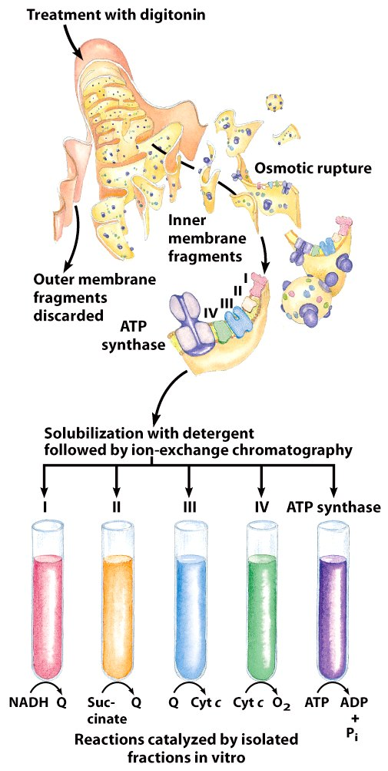
Method 4:
Isolation and characterization
of each of the multiprotein
complexes: specific electron
donors and acceptors can be
determined for portions
of the chain.

Slide 23
4. NADH enters the chain at NADH dehydrogenase (Complex I)
Also named as NADH:ubiquinone oxidoreductase or NADH-Q reductase
A “L” shaped 850 kD multimeric protein complex of 42 different subunits (larger than a ribosome!)
FMN and Fe-S centers act as prosthetic groups.
Final electron acceptor is ubiquinone (coenzyme Q).
Exergonic electron transfer is coupled to endergonic proton pumping (with 4 H⁺ pumped from the matrix side to intermembrane space per electron pair transferred), with mechanism unknown.

Slide 24
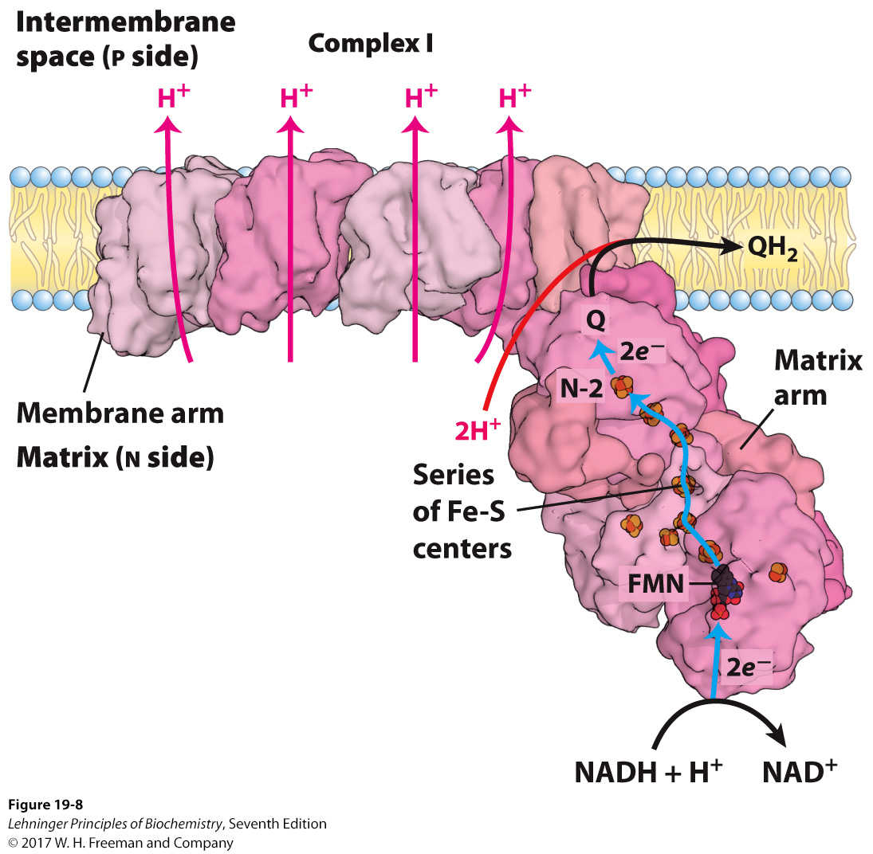
NADH + 5H⁺_{N} + Q
NAD⁺ + QH₂ + 4H⁺_{P}
NADH dehydrogenase
(Complex I)

Slide 25
5. FADH₂ of flavoproteins also transfer their electrons to ubiquinone
Flavoproteins like succinate dehydrogenase (Complex II), fatty acyl-CoA dehydrogenase, and glycerol 3-phosphate dehydrogenase are associated to the inner membrane of mitochondria and transfers their electrons collected on FADH₂ to Q to form QH₂.
The energy released from these electron transfer is not high enough to promote proton pumping.

Slide 26
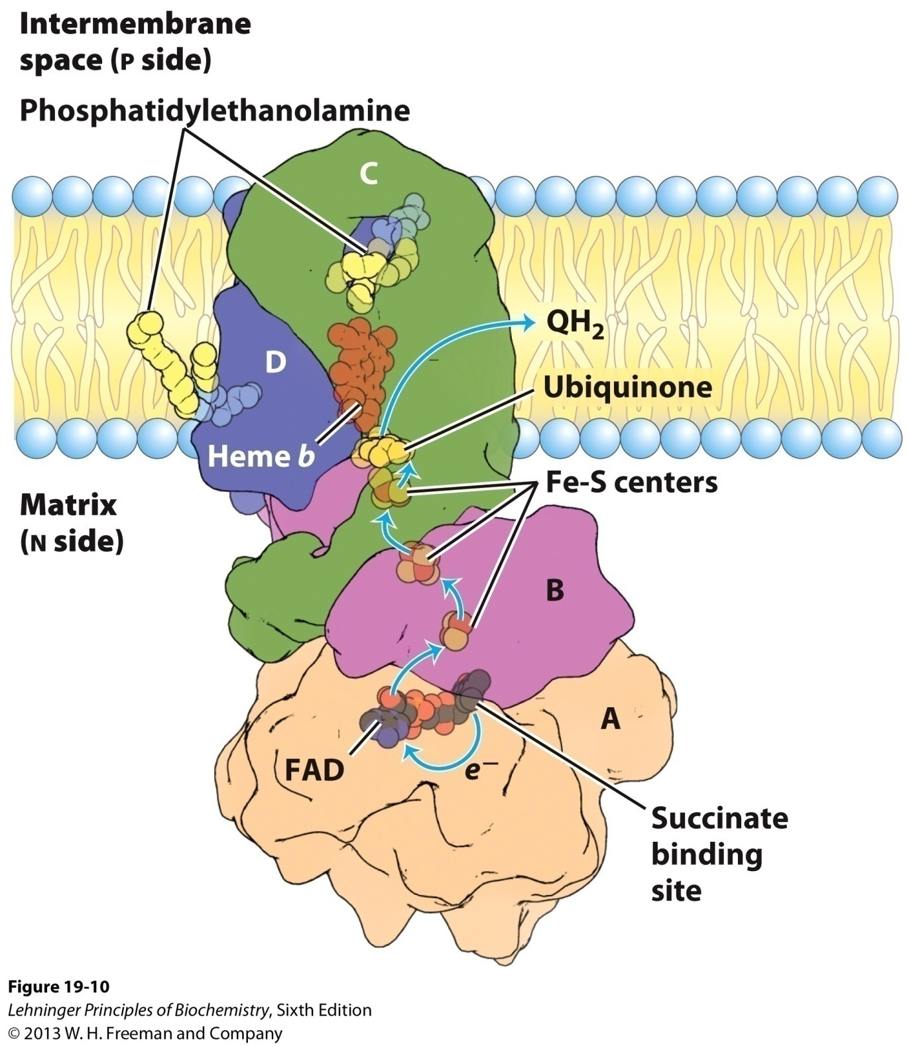
Structure of Complex II
(succinate dehydrogenase)
of E. coli

Slide 27
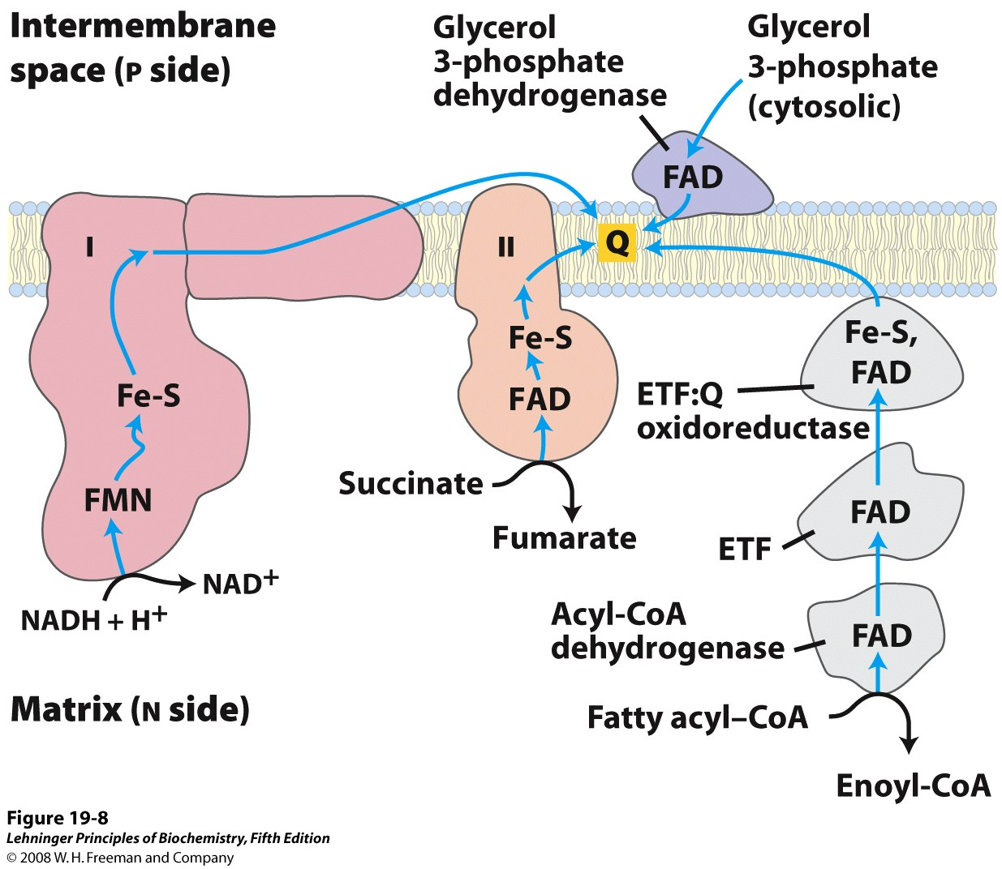
Ubiquinone (Q) accepts electrons from both NADH
and FADH2 in the respiratory chain
Notes:
FIGURE 19-8 Path of electrons from NADH, succinate, fatty acyl–CoA, and glycerol 3-phosphate to ubiquinone. Electrons from NADH pass through a flavoprotein to a series of iron-sulfur proteins (in Complex I) and then to Q. Electrons from succinate pass through a flavoprotein and several Fe-S centers (in Complex II) on the way to Q. Glycerol 3-phosphate donates electrons to a flavoprotein (glycerol 3-phosphate dehydrogenase) on the outer face of the inner mitochondrial membrane, from which they pass to Q. Acyl-CoA dehydrogenase (the first enzyme of β oxidation) transfers electrons to electron-transferring flavoprotein (ETF), from which they pass to Q via ETF:ubiquinone oxidoreductase.

Slide 28
6. Electrons of QH₂ is transferred to cytochrome c via cytochrome bc₁ complex (Complex III)
Also called cytochrome c reductase or
ubiquinone:cytochrome c oxidoreductase
A 250 kD multiprotein complex of 11 subunits
Complete 3-D structure determined in 1997!
The functional core consists of three subunits: cytochrome b (with two hemes, b_{H} and b_{L}); an Fe-S protein; and cytochrome c₁ (with the heme group covalently bound to protein via two thioester bonds).

Slide 29
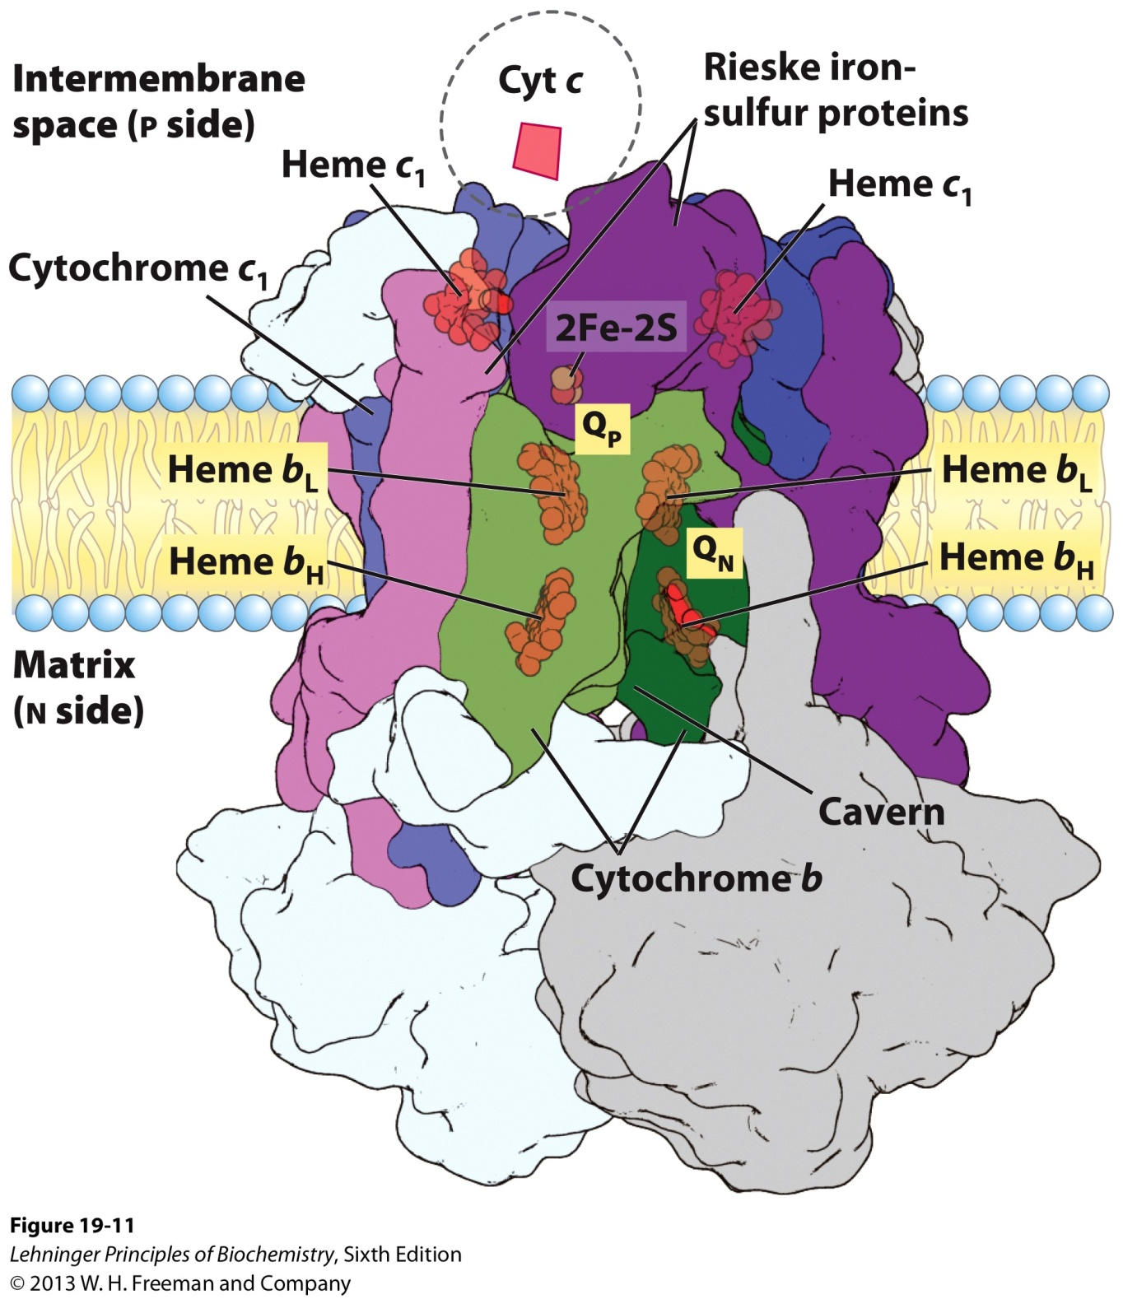
Cytochrome bc₁ complex
(Complex III)

Slide 30
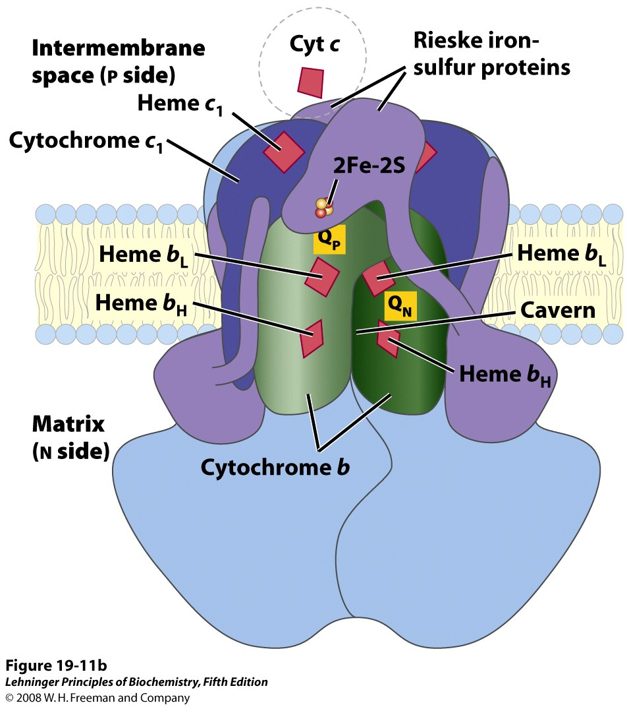
Cytochrome bc₁ complex
(Complex III)
Notes:
FIGURE 19-11b Cytochrome bc₁ complex (Complex III). The complex is a dimer of identical monomers, each with 11 different subunits. (a) The functional core of each monomer is three subunits: cytochrome b (green) with its two hemes (b_{H} and b_{L}); the Rieske iron-sulfur protein (purple) with its 2Fe-2S centers; and cytochrome c₁ (blue) with its heme (PDB ID 1BGY). (b) This cartoon view of the complex shows how cytochrome c₁ and the Rieske iron-sulfur protein project from the P surface and can interact with cytochrome c (not part of the functional complex) in the intermembrane space. The complex has two distinct binding sites for ubiquinone, Q_{N} and Q_{P}, which correspond to the sites of inhibition by two drugs that block oxidative phosphorylation. Antimycin A, which blocks electron flow from heme b_{H} to Q, binds at Q_{N}, close to heme b_{H} on the N (matrix) side of the membrane. Myxothiazol, which prevents electron flow from QH₂ to the Rieske iron-sulfur protein, binds at Q_{P}, near the 2Fe-2S center and heme b_{L} on the P side. The dimeric structure is essential to the function of Complex III. The interface between monomers forms two caverns, each containing a Q_{P} site from one monomer and a Q_{N} site from the other. The ubiquinone intermediates move within these sheltered caverns. Complex III crystallizes in two distinct conformations (not shown). In one, the Rieske Fe-S center is close to its electron acceptor, the heme of cytochrome c₁, but relatively distant from cytochrome b and the QH₂-binding site at which the Rieske Fe-S center receives electrons. In the other, the Fe-S center has moved away from cytochrome c₁ and toward cytochrome b. The Rieske protein is thought to oscillate between these two conformations as it is first reduced, then oxidized.

Slide 31
Two-electron carrier QH₂ passes one electron to the one-electron carrier Fe-S center, then to the heme C group in Cyt c₁, and finally to the heme C group of Cyt c; the other electron to b_{L}, b_{H}, and finally to an Q or Q.⁻ via a so-called “Q cycle”.
Cytochrome c, a soluble protein located in the intermembrane space, will move to Complex IV.
The Q cycle accommodates the switch between the two-electron carrier ubiquinone to the one-electron carriers---cytochrome b and c.
QH₂ + 2 Cyt c₁ (oxidized) + 2H⁺_{N}
Q + 2 Cyt c₁ (reduced) + 4H⁺_{P}

Slide 32
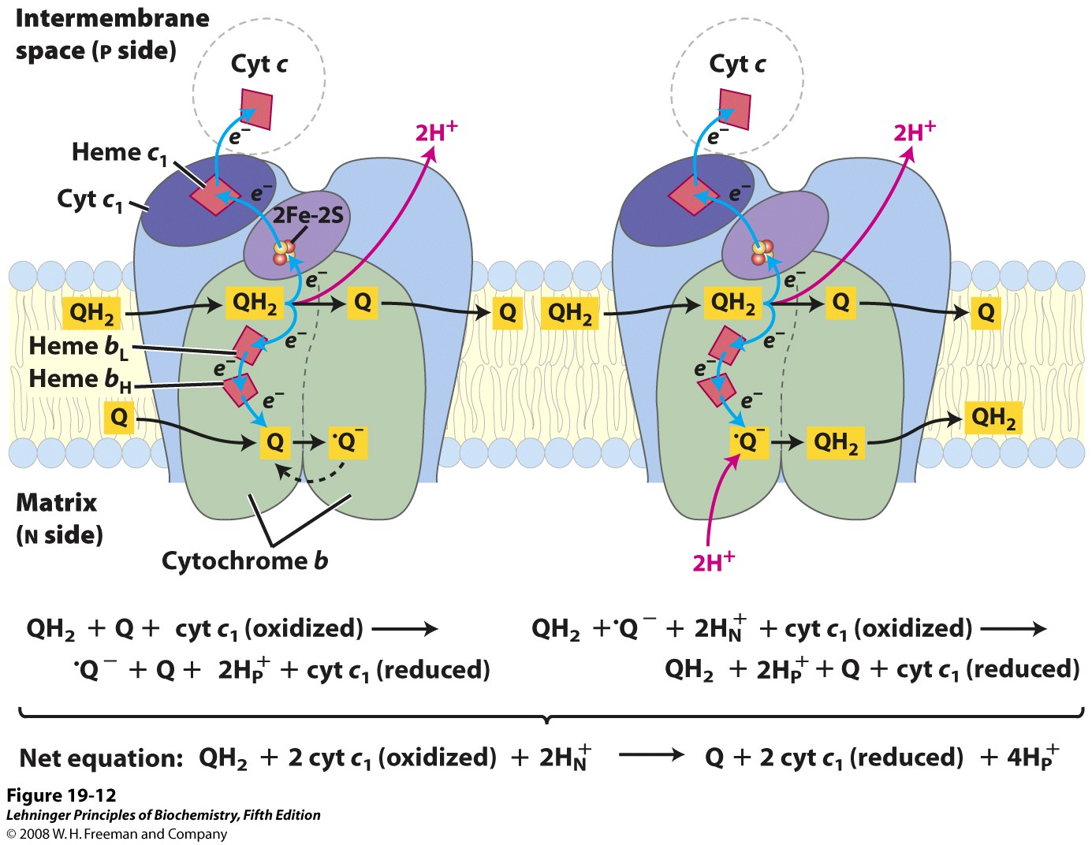
Electron path in Complex III
Notes:
FIGURE 19-12 The Q cycle, shown in two stages. The path of electrons through Complex III is shown by blue arrows. In the first stage (left), Q on the N side is reduced to the semiquinone radical, which in the second stage (right) is converted to QH₂. Meanwhile, on the P side of the membrane, two molecules of QH₂ are oxidized to Q, releasing two protons per Q molecule (four protons in all) into the intermembrane space. Each QH₂ donates one electron (via the Rieske Fe-S center) to cytochrome c₁, and one electron (via cytochrome b) to a molecule of Q near the N side, reducing it in two steps to QH₂. This reduction also uses two protons per Q, which are taken up from the matrix.

Slide 33
7. Electrons of Cyt c are transferred to O₂ on cytochrome oxidase (Complex IV)
A 204 kD 13-subunit protein complex, with structure determined in 1996
Three subunits (I, II and III) are probably critical to the function.
Three copper ions (2 Cu_{A}, 1 Cu_{B}), two heme A groups (a and a₃) act as electron carriers in Complex IV.

Slide 34
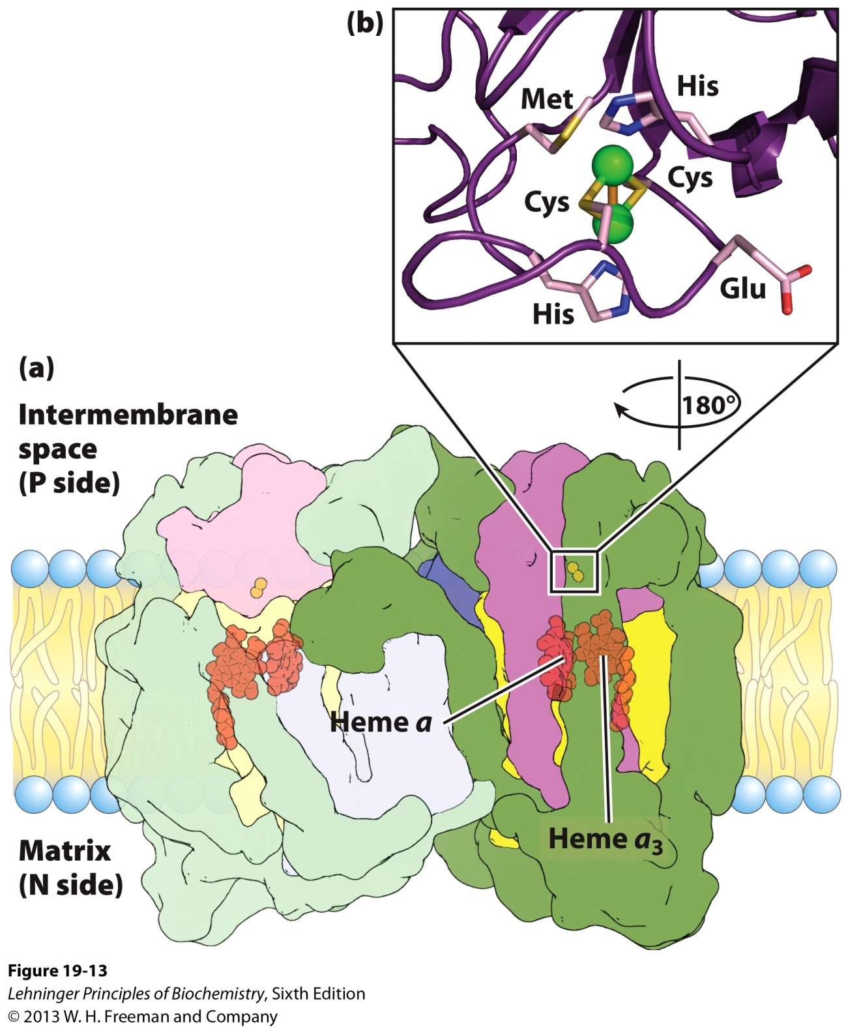
Structure of cytochrome oxidase
(Complex IV)

Slide 35
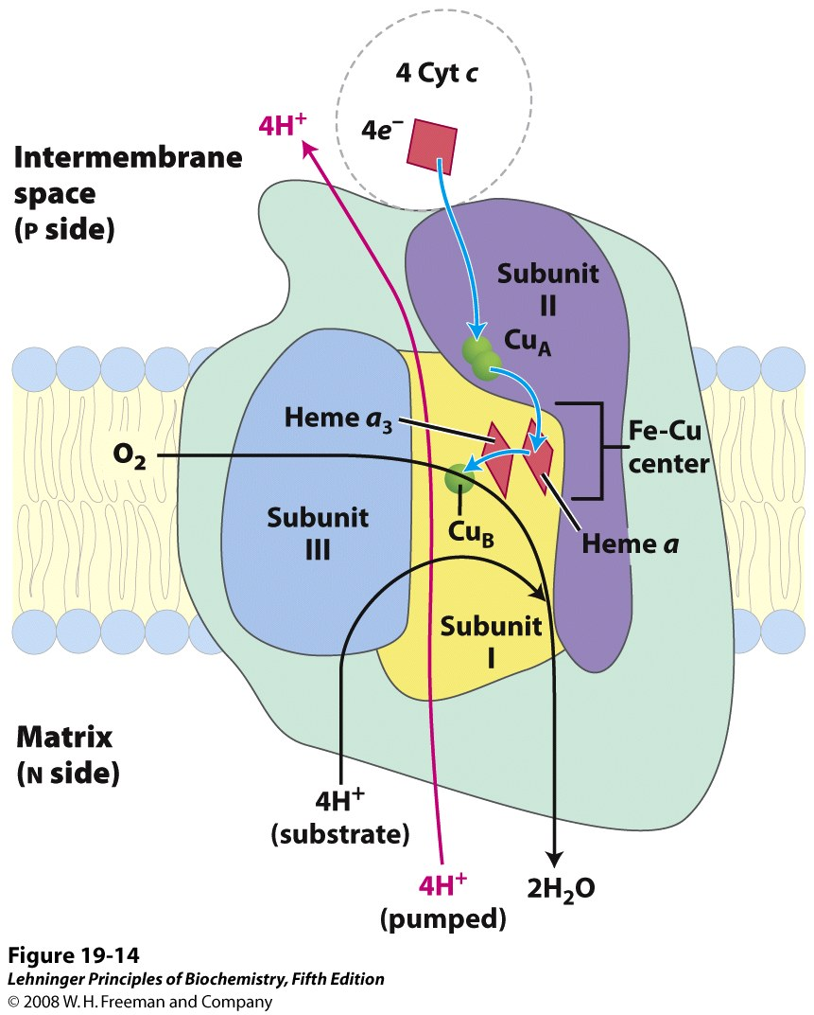
The electron path in
Complex IV
Notes:
FIGURE 19-14 Path of electrons through Complex IV. The three proteins critical to electron flow are subunits I, II, and III. The larger green structure includes the other 10 proteins in the complex. Electron transfer through Complex IV begins with cytochrome c (top). Two molecules of reduced cytochrome c each donate an electron to the binuclear center Cu_{A}. From here electrons pass through heme a to the Fe-Cu center (cytochrome a₃ and Cu_{B}). Oxygen now binds to heme a₃ and is reduced to its peroxy derivative (O₂^{2–}; not shown here) by two electrons from the Fe-Cu center. Delivery of two more electrons from cytochrome c (top, making four electrons in all) converts the O₂^{2–} to two molecules of water, with consumption of four "substrate" protons from the matrix. At the same time, four protons are pumped from the matrix by an as yet unknown mechanism.

Slide 36
Four electrons need to be transferred to reduce one O₂ molecule at the “Fe-Cu_{B} center” of Complex IV to form 2H₂O.
Four “substrate” protons are consumed from the N side for every four electrons transferred to one O₂ molecule.
One proton is pumped out from the N to P side for each electron to be transferred by an as yet undefined mechanism.
4 Cyt c (reduced) + 8 H⁺_{N} + O₂
4 Cyt c (oxidized) + 4 H⁺_{P} + 2H₂O

Slide 37
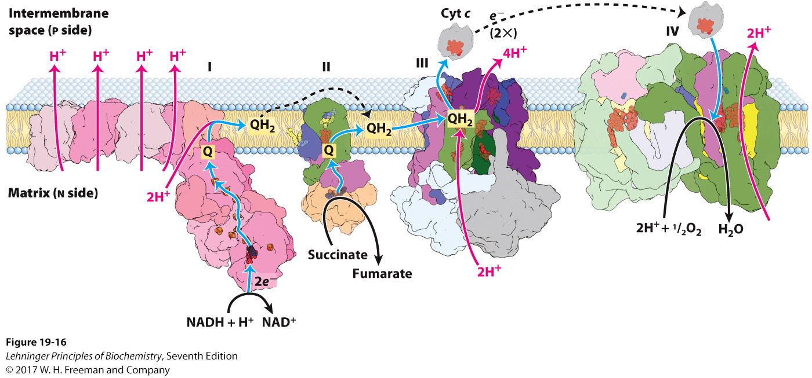
Summary of the flow of electrons and protons
through the four complexes of the respiratory chain*****

Slide 38
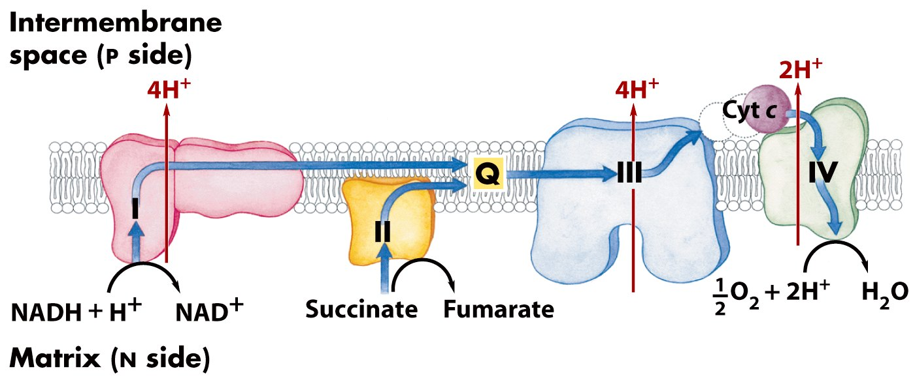
A H⁺ gradient across the inner membrane of
mitochondria (or plasma membrane of bacteria)
is generated by “uphill” H⁺ pumping using energy
released by the “downhill” flow of electrons.

Slide 39
8. A proton gradient across the inner membrane of mitochondria is generated using the electron motive force
An estimate of 10 protons are pumped for oxidizing one NADH and 6 protons for one FADH₂ accompanying the electron flow through Complexes I (II), III and IV.
NADH + H⁺ + ½O₂ NAD⁺ + H₂O
ΔG'º = -220 kJ/mol
FADH₂ + ½ O₂ FAD + H₂O
ΔG'º = -150 kJ/mol

Slide 40
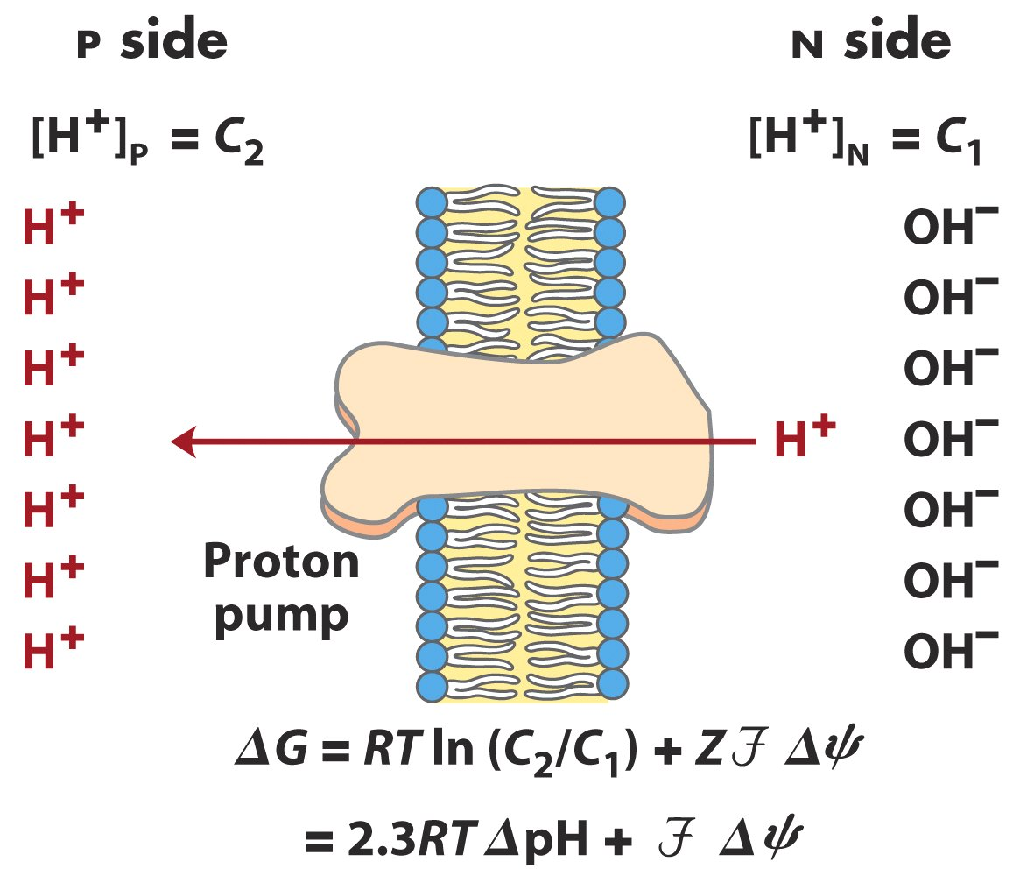
(electrical potential)
Proton-motive force: the free energy change for the creation of an electrochemical gradient by an ion pump

Slide 41
In actively respiring mitochondria, the measured ΔpH is about 0.75 and difference in electrical potential (ΔΨ) is about 0.15-0.2 V.
ΔG = 20 X 10 = 200 (kJ /mol)
The energy of electron transfer is efficiently conserved in a proton gradient.
The energy stored in such an H⁺ gradient can be used to synthesize ATP or to do other work.

Slide 42
9. Electron transfer to O₂ was found to be coupled to ATP synthesis from ADP + P_{i} in isolated mitochondria
ATP would not be synthesized when only ADP and P_{i} are added in isolated mitochondria suspensions.
O₂ consumption, an indication of electron flow, was detected when a reductant (e.g., succinate) is added, accompanied by an increase of ATP synthesis.

Slide 43
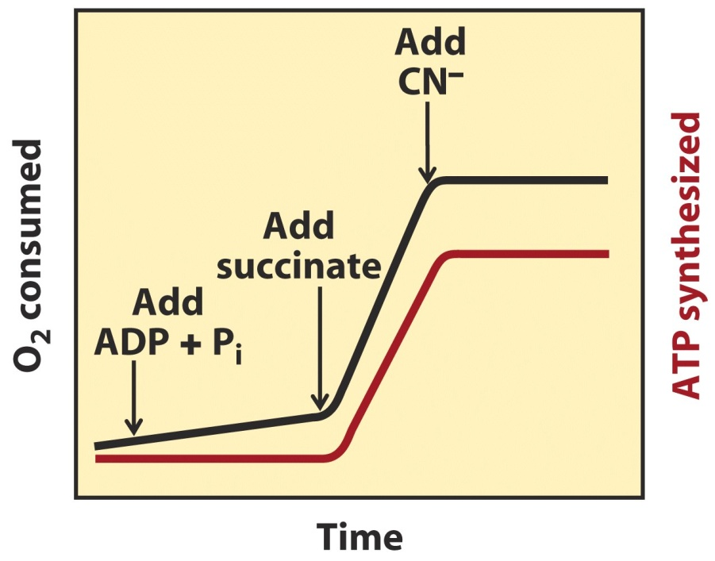
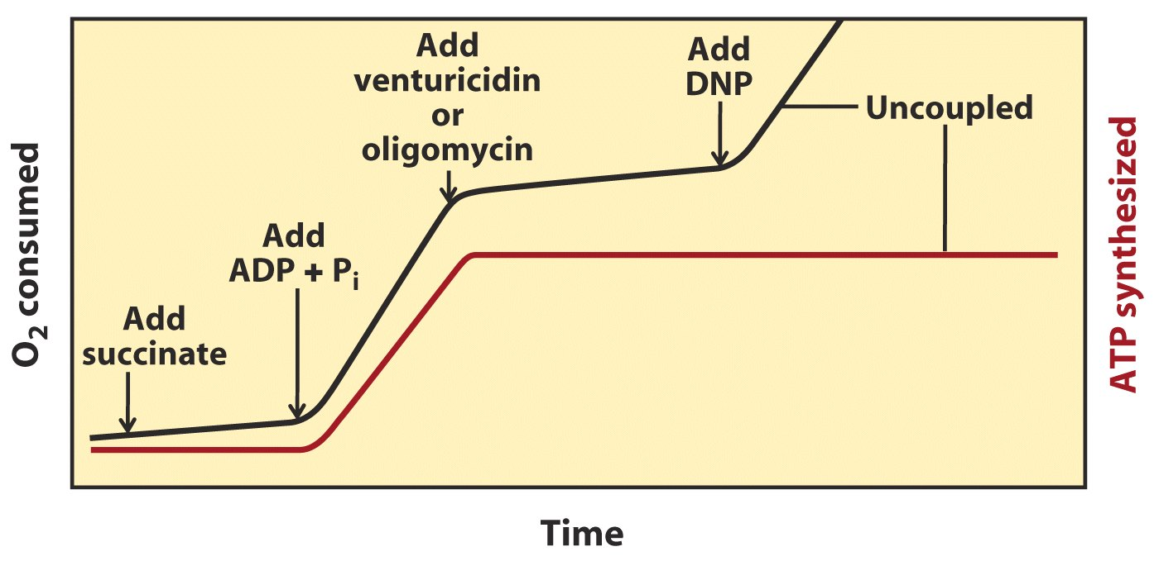
Electron transfer was found to be
obligatorily coupled to ATP Synthesis
in isolated mitochondria suspensions:
neither reaction occurs without the other.

Slide 45
Both O₂ consumption and ATP synthesis were suppressed when inhibitors of respiratory chain (e.g., cyanide, CO, or antimycin A) was added.
ATP synthesis depends on the occurrence of electron flow in mitochondria.
O₂ consumption was not observed if ADP was not added to the suspension, although a reductant is provided.
O₂ consumption was also not observed in the presence of inhibitors of ATP synthase (e.g., oligomycin or venturicidin).
Electron flow also depends on ATP synthesis!

Slide 46
10. The chemiosmotic model was proposed to explain the coupling of electron flow and ATP synthesis
First proposed in 1961 by Peter Mitchell (a British).
---one of the great unifying principles of twentieth century biology!
Energy released from electron transfer is hypothesized to be first used to pump protons from the mitochondrial matrix to the intermembrane space (or from stroma to thylakoid lumen in chloroplasts), thus generating a proton gradient across the inner membrane; such a proton-motive force then drives ATP synthesis by moving protons back into the matrix via the ATP synthase.

Slide 47
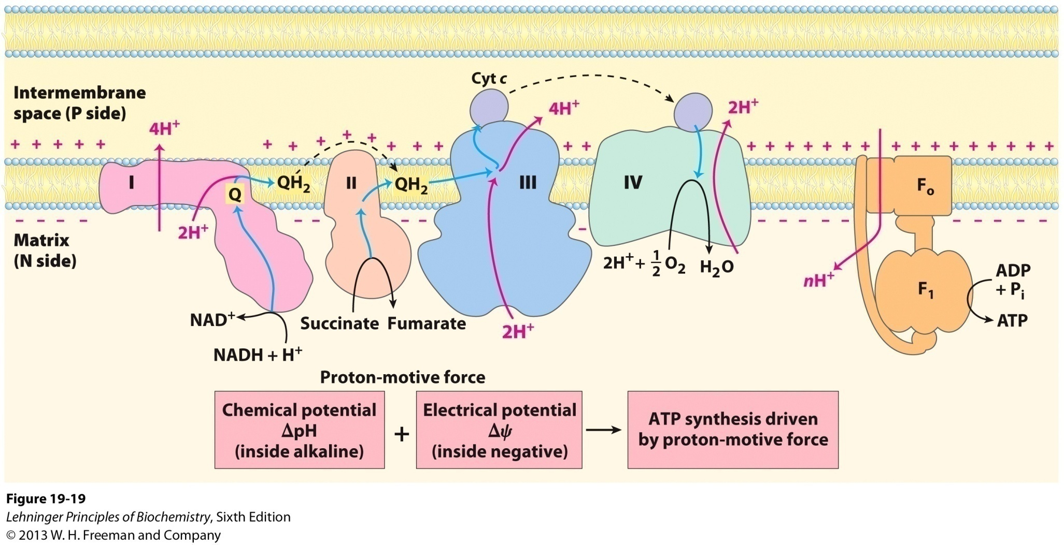
The chemiosmotic model by Mitchell

Slide 48
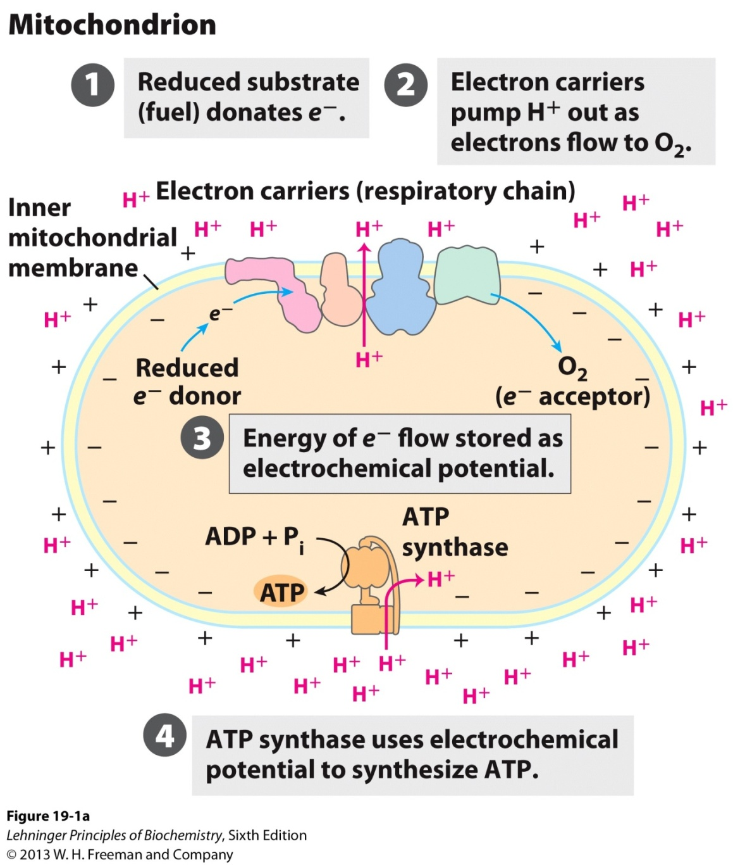
The chemiosmotic mechanism for ATP synthesis

Slide 49
11. The supporting evidences for the chemiosmotic coupling were collected
A closed membrane system is essential for ATP synthesis but not for the electron flow (tested with detergent or physical shearing).
The transmembrane proton pumping has been experimentally detected: pH in the intermembrane space was found to decrease when electron flow occurs (more protons are pumped when NADH, rather than succinate, is utilized as reductant).
Hydrophobic weak acids (DNP and FCCP) and ionophores (valinomycin) were found to be able to uncouple ATP synthesis from electron transfer.

Slide 50
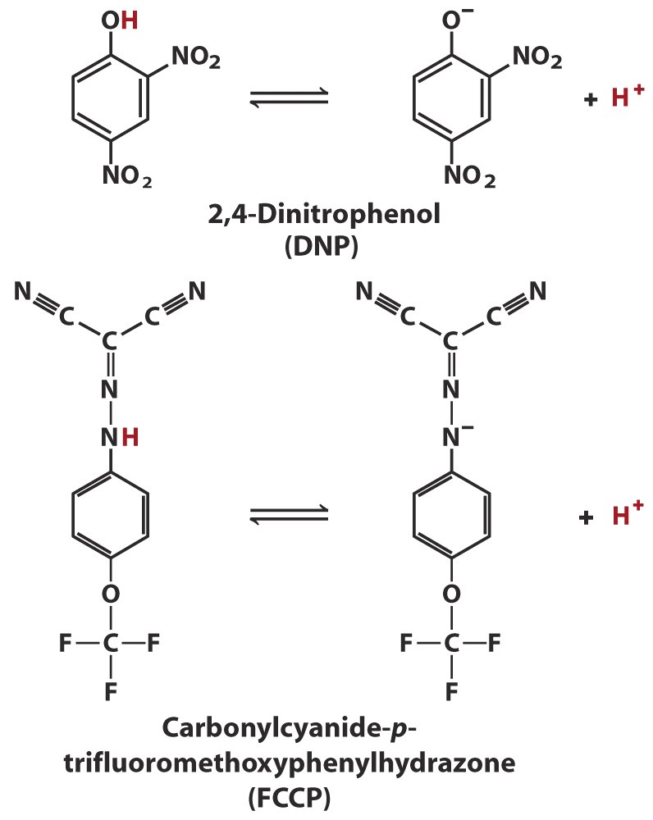
(二硝基苯酚)
DNP and FCCP are able to dissipate the proton gradient, thus uncoupling electron transfer and phosphorylation.

Slide 51
DNP, a hydrophobic weak acid, uncouples
ATP synthesis from electron flow

Slide 52
An artificially imposed electrochemical gradient across the chloroplast thylakoid membrane and inner mitochondrial membrane alone (both were performed using sub-organelle vesicles) were found to drive ATP synthesis (with the ATP synthase present).
The across-membrane proton gradient was thus finally accepted as the driving force for ATP synthesis: the chemiosmotic(化学渗透) model was accepted as a theory!
The chemiosmotic theory unified the apparently disparate energy transduction processes as oxidative phosphorylation, photophosphorylation, active transport across membranes and the motion of bacterial flagella.

Slide 53
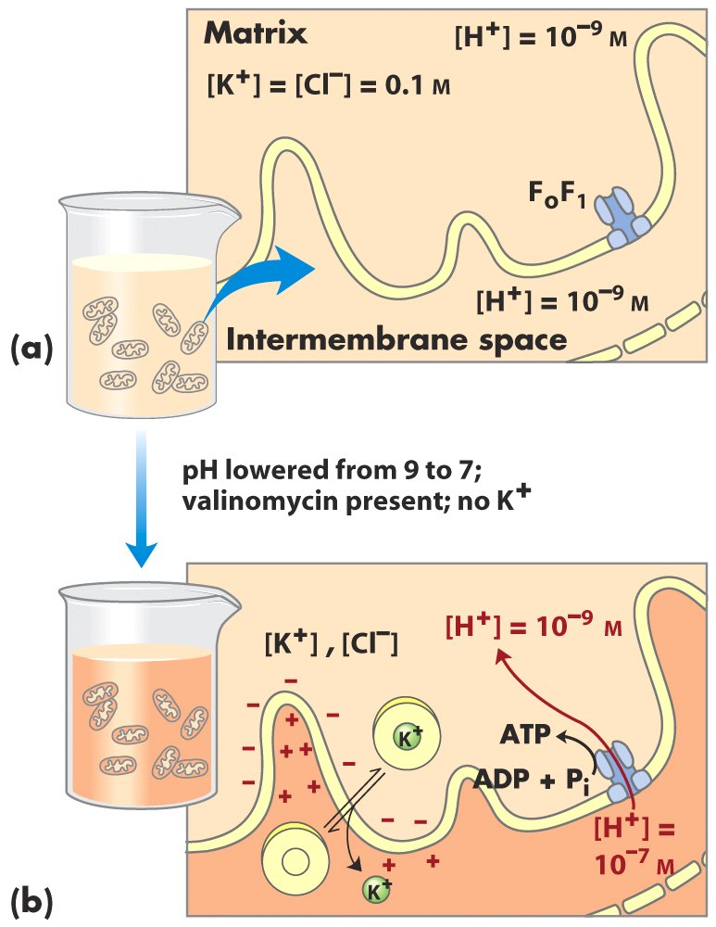
An artificially
imposed proton
gradient can drive
ATP synthesis!

Slide 55
12. ATP synthase was first identified by dissociation and reconstitution studies
Abundant knoblike protruding structures were observed on the matrix side of the inner mitochondrial membrane by EM (by Efraim Racker in 1960).
The inside-out submitochondrial particles with the “knobs” are capable of both electron transfer and ATP synthesis.
When the protruding F₁ part was removed by agitation, electron transfer could still occur, but without proton gradient and ATP synthesis.

Slide 56
ATP synthesis reappeared when F₁ was reconstituted back (the solubilized F₁ alone can catalyze ATP hydrolysis, thus was originally named as F₁ATPase).
F₁ was the first essential factor identified for oxidative phosphorylation.

Slide 57
13. Isotope exchange experiments revealed that the ΔG’⁰ for ATP synthesis on purified F₁ is close to zero!
When solubilized F₁ (act as an ATPase) was incubated with ATP in the presence of ¹⁸O-labeled H₂O, three or four ¹⁸O atoms were incorporated into the P_{i}, indicating that multiple rounds of ATP formation and hydrolysis occurred in the enzyme active site(s).
ATP has much higher affinity to the enzyme.
The proton gradient was proposed to drive the release of ATP from the enzyme surface.

Slide 58
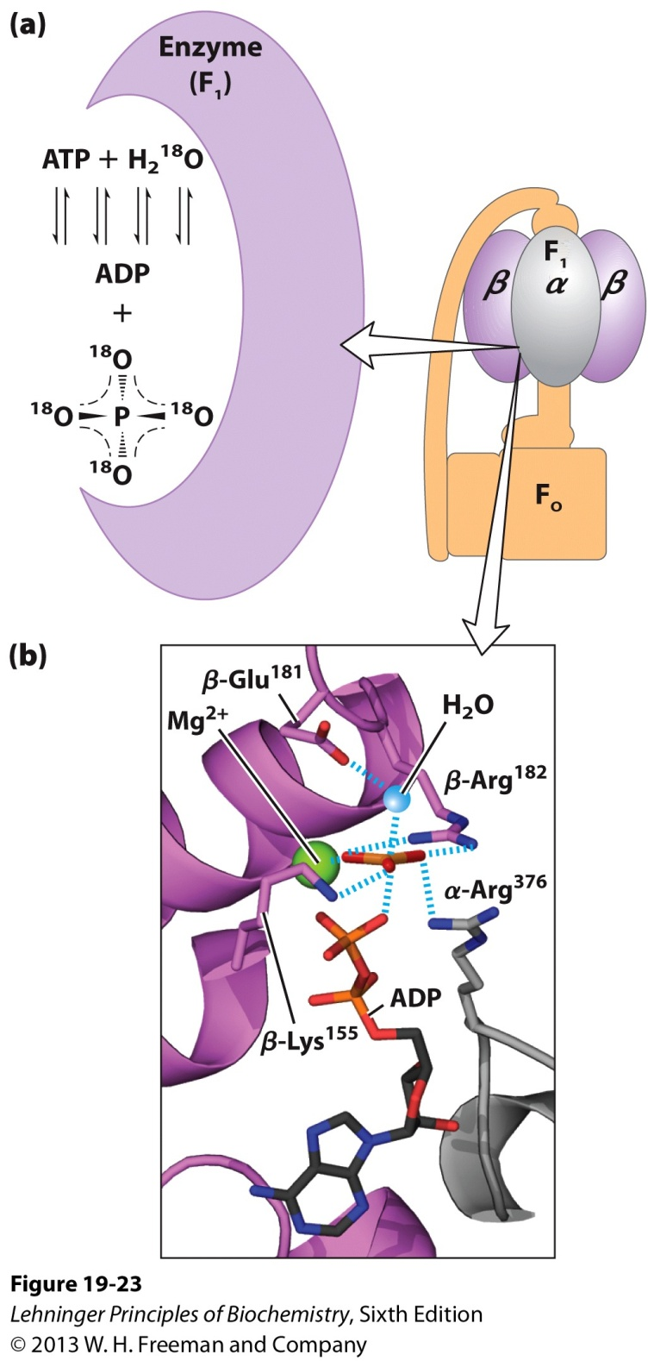
The ¹⁸O experiment:
The ΔG’º for ATP
synthesis on
purified F₁
is close to zero!
(Paul Boyer)
Catalytic mechanism of F₁

Slide 59
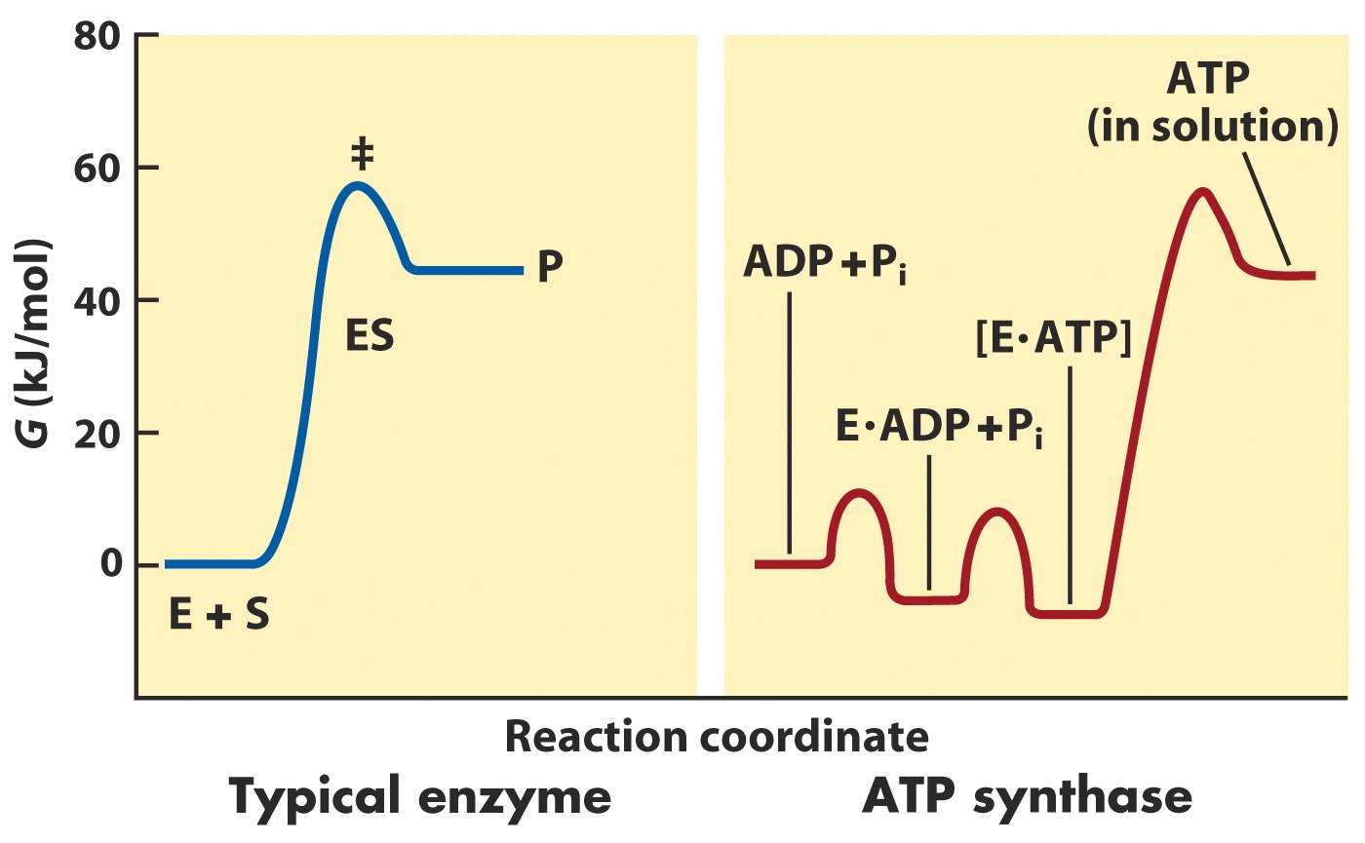
Release of ATP from ATP synthase was proposed to be
the major energy barrier for ATP synthesis

Slide 60
14. ATP synthase comprises a proton channel (F_{o}) and a ATPase (F₁)
The F₁ part consists of nine subunits of five types: α₃β₃γδε.
The knoblike F₁ portion is a hexamer of alternating α and β subunits, which sits atop the single rod-shaped γ subunit.
The F_{o} portion consists of three types of subunits:
ab₂c₁₀₋₁₂.
The c subunits, each forming two transmembrane helices, form a donut-shaped ring in the plane of the membrane.

Slide 61
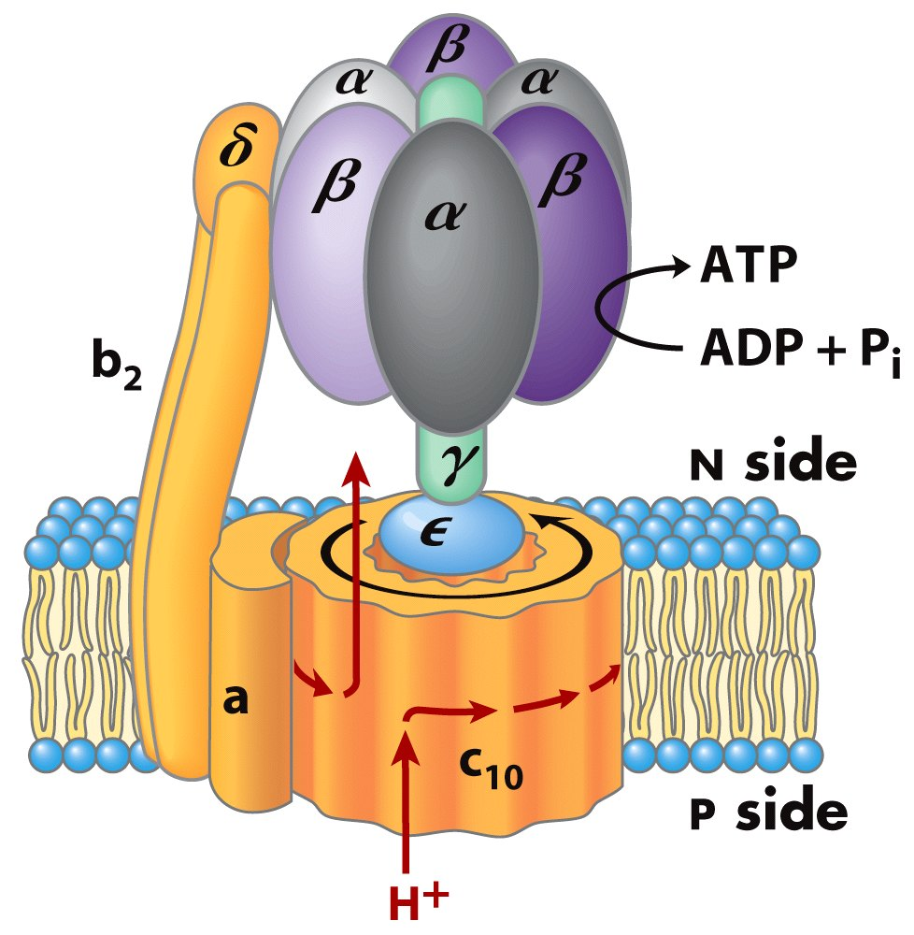
The ATP synthase
comprises a proton
channel (F_{o}) and a
ATPase (F₁)

Slide 62
The leg-and-foot-shaped γε subunits stands firmly on the ring of c subunits.
The two b subunits of F_{o} seem to connect to the αβ hexamer via the δ subunit of F₁.
The proton channel is believed to lie between the a subunit and the ring of c subunits.
X-ray crystallography revealed that the three β subunits of F₁ assumes three different conformations, with bound ADP, ATP analog, or empty respectively.

Slide 63
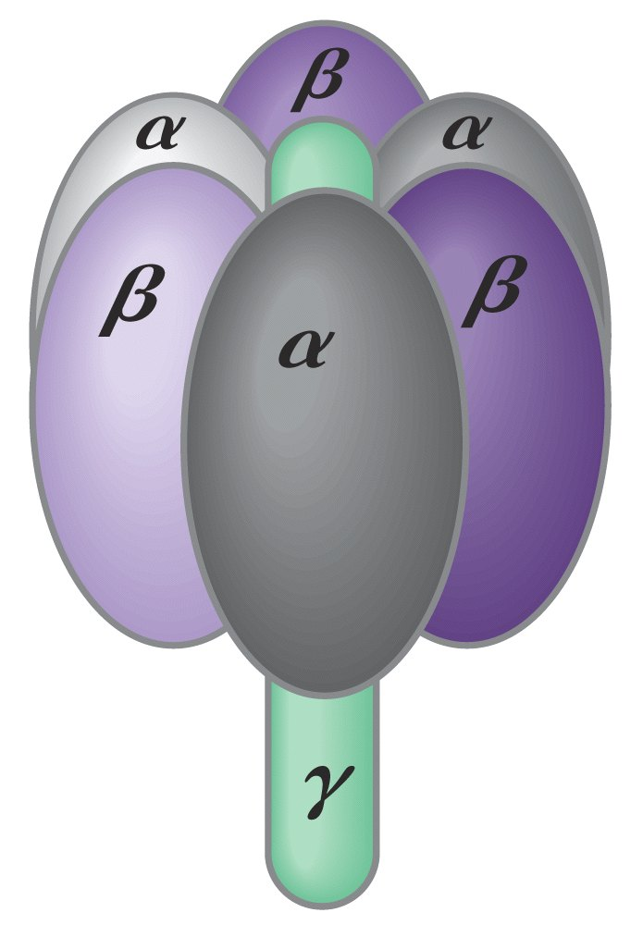
Structure of the F₁ complex

Slide 64
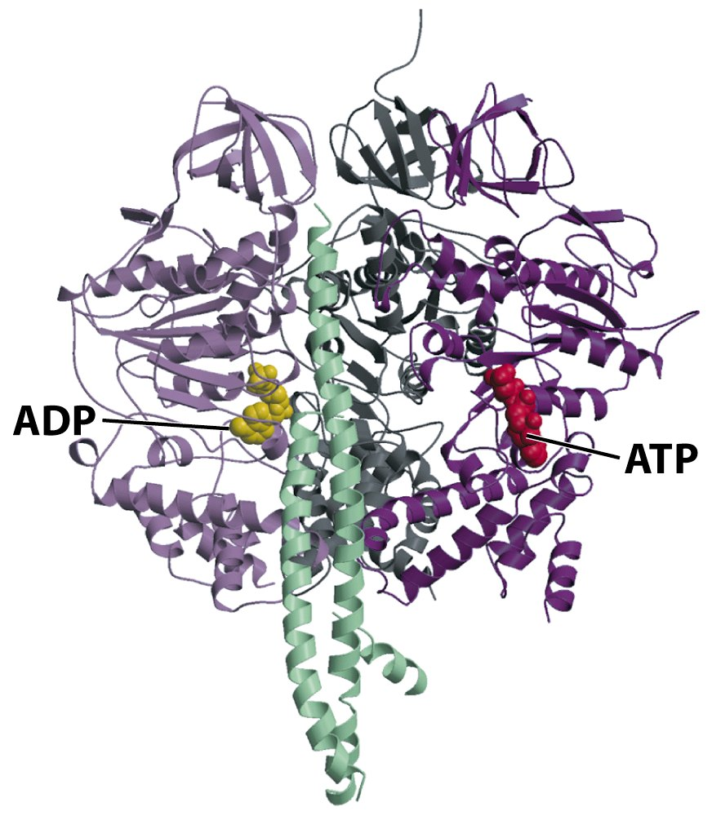
Crystal structure of
bovine F₁ viewed from the side
Rod-shaped γ subunit
(shaft, 旋转轴)

Slide 65
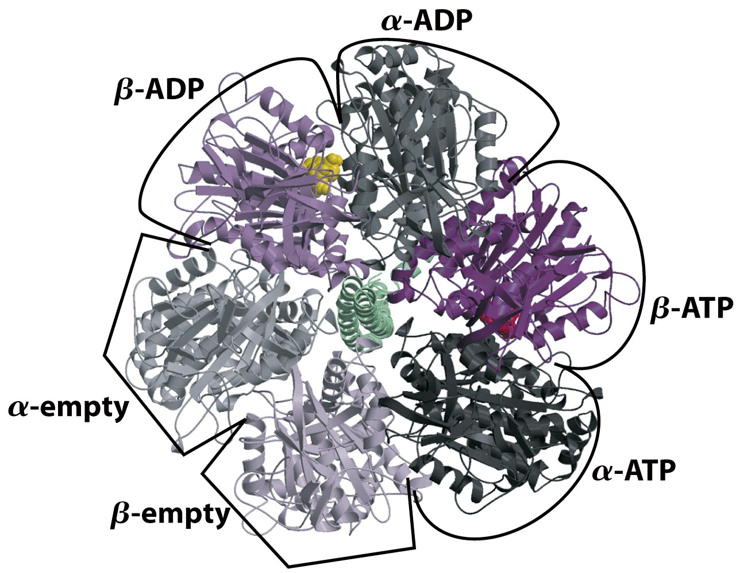
Top view of F₁
Each β subunit of ATP synthase can assume three different conformations

Slide 66
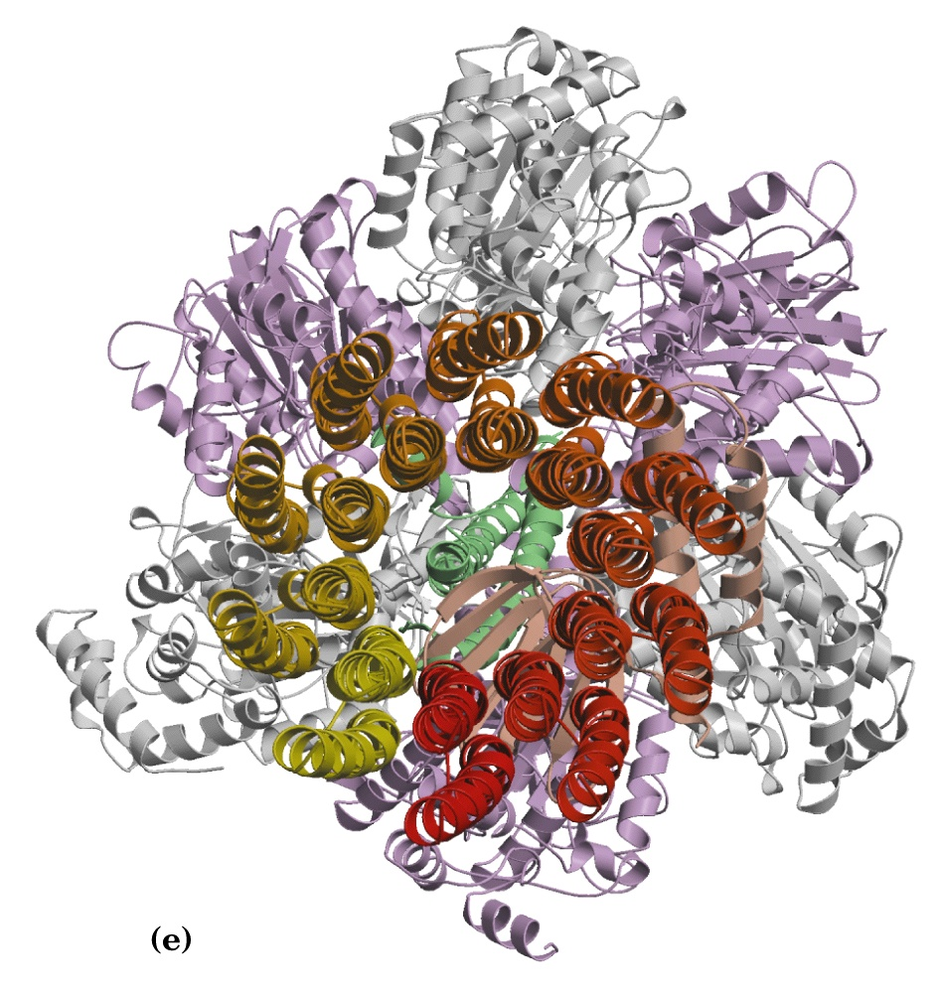
The γ subunit of F₁
α
β
The c subunits of F_{o}
The F_{o}F₁ structure, viewed end-on in the direction P side to N side

Slide 67
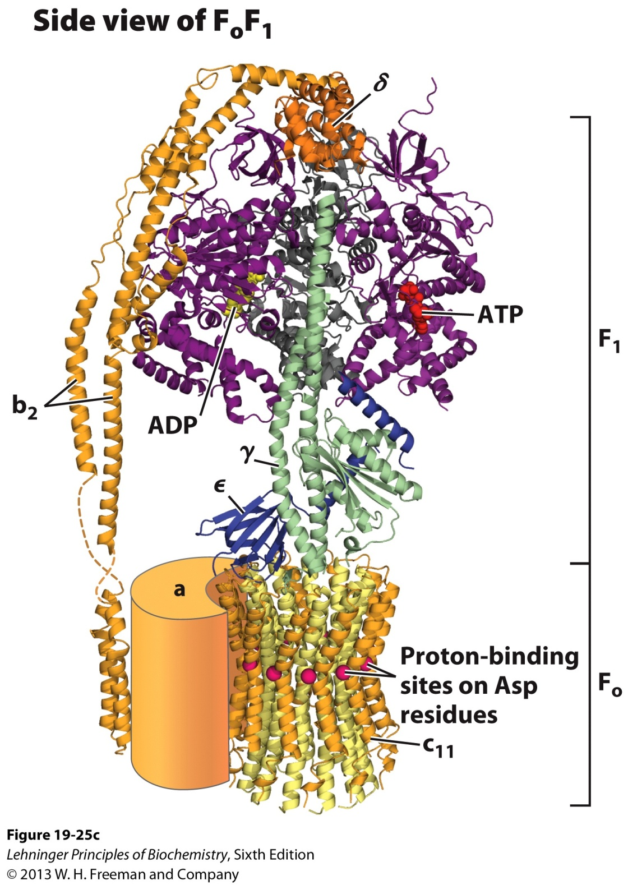

Slide 68
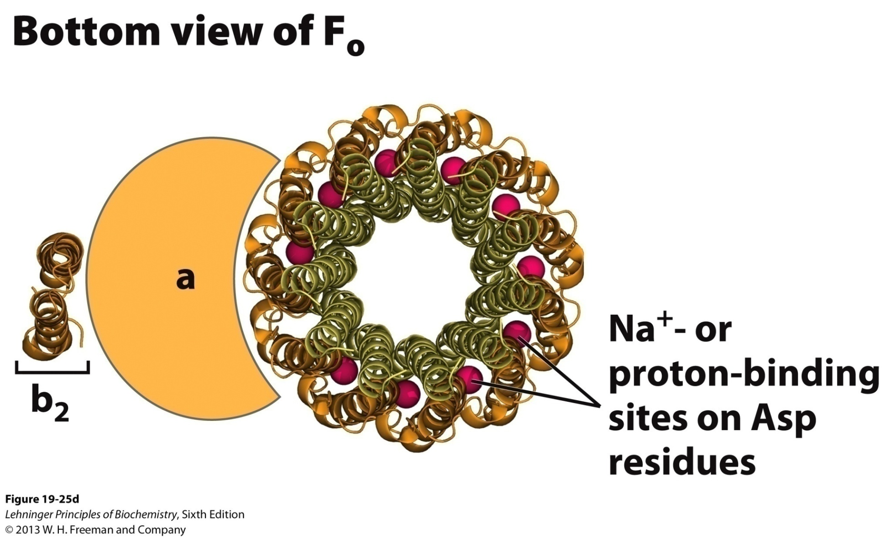
Each of the c subunits in F_{o} has a critical Asp residue near the middle
of the membrane, which undergoes protonation/deprotonation
during the catalytic cycle of the ATP synthase.

Slide 69
15. The binding-change model was proposed to explain the action mechanism of ATP synthase
The model was proposed based on kinetic and binding studies (before the 3-D structure of bovine F₁ or yeast F_{o} F₁ was determined).
Downhill proton movement through F_{o} will drive the rotation of the c-subunit ring and the asymmetrical γ subunits, which will cause each of the three β subunits to interconvert between the three conformations, as a result, each of them take turns to take up ADP + P_{i}, synthesize ATP, and release ATP----rotational catalysis

Slide 70
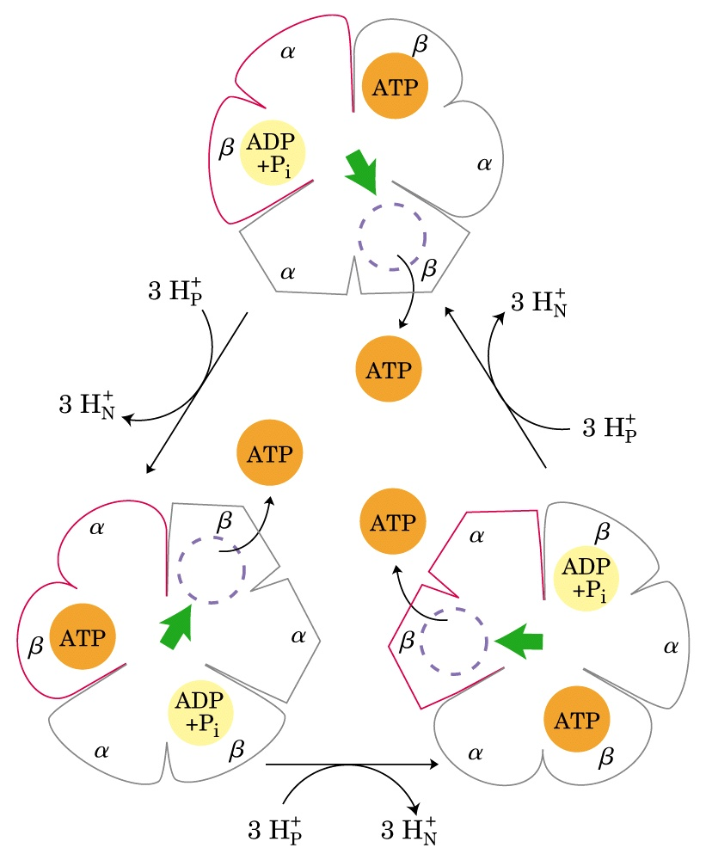
β-ATP
β-empty
β-ADP
Binding-change model for ATP synthase

Slide 71
Rotation of the γ subunit of the F₁ unit in discrete 120º (powered by ATP hydrolysis catalyzed by the β subunits) has been observed using a fluorescence microscope.
The estimation of H⁺ consumption for each ATP formed is 4 (among which one is consumed in transporting ATP, ADP and P_{i}).

Slide 72
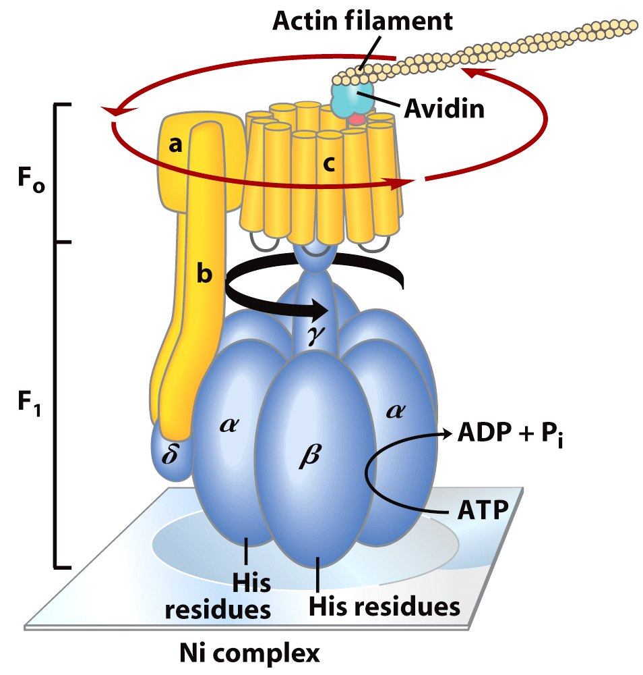
Rotation of the γ
subunit and the
ring of c subunits
in the F₀F₁ complex
was observed by
in vitro studies
using fluorescence
microscopy

Slide 73
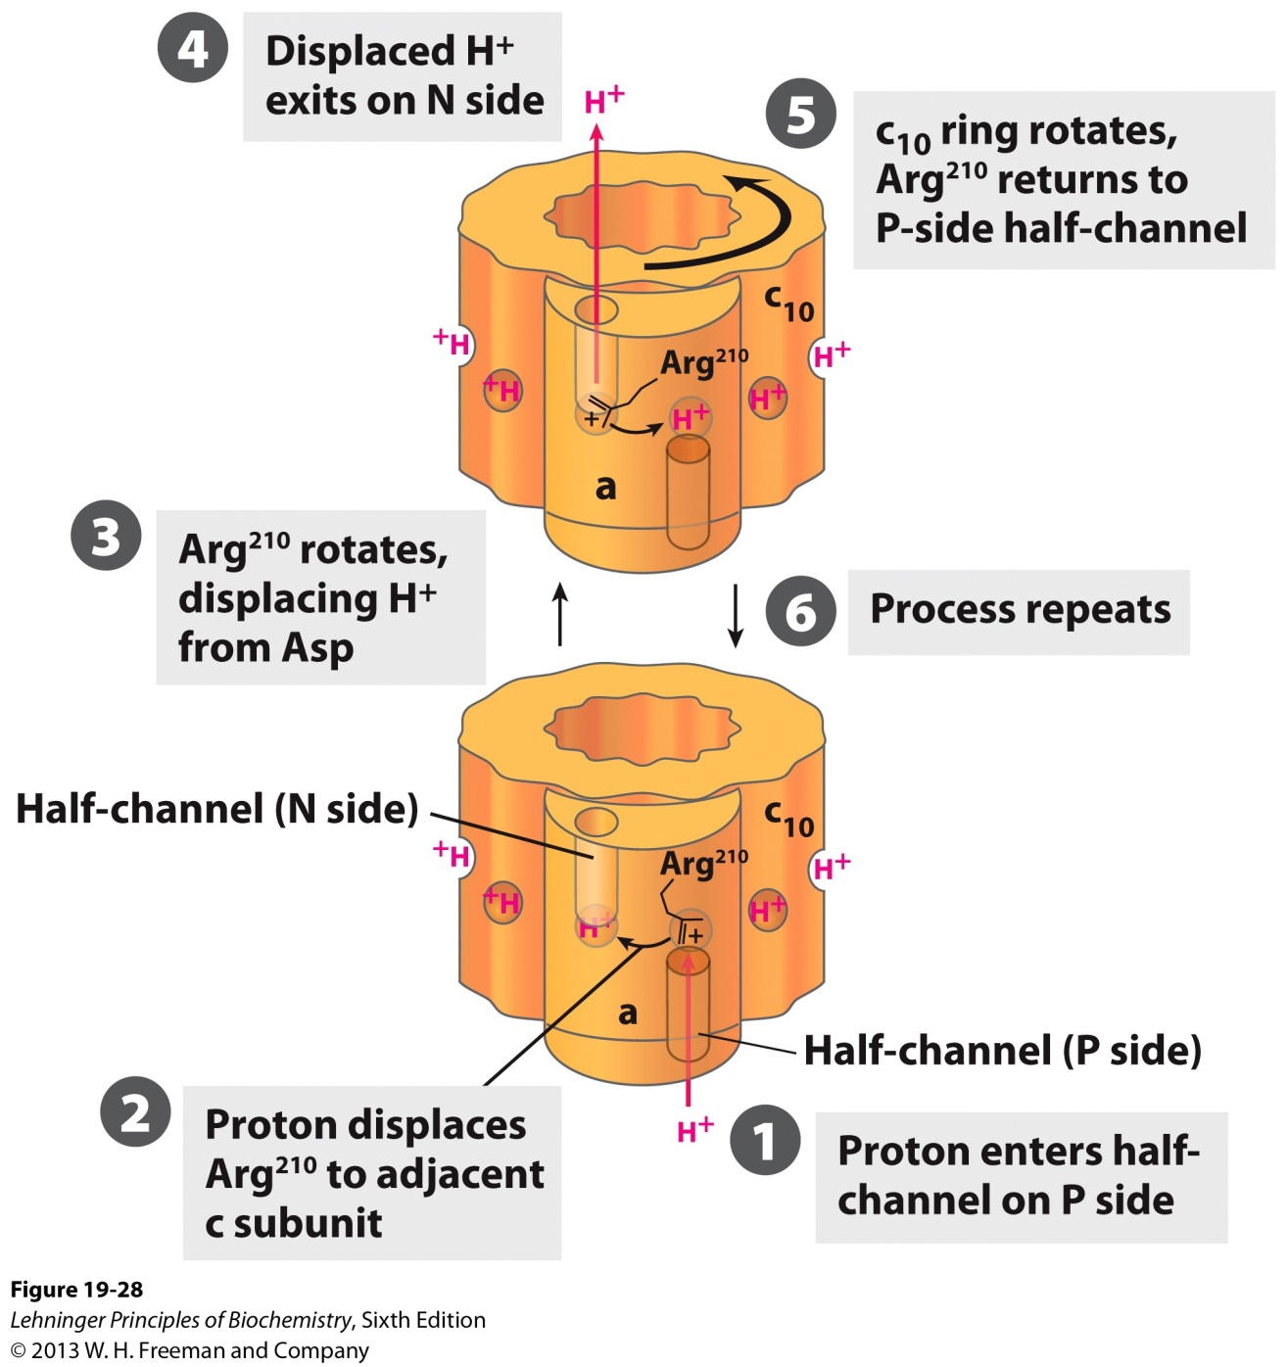
The orientation of the
proton gradient dictates
the direction of proton flow
and makes the rotation of
the c ring essentially
unidirectional.
A model for proton-driven rotation of the c ring

Slide 75
The estimation of H⁺ consumption for each ATP formed is 4 (among which one is consumed in transporting ATP, ADP and P_{i}).
1 NADH 10 protons 2.5 ATP
1 FADH₂ 6 protons 1.5 ATP
PNAS paper:
rotate ~100 times/second, bovine c₈-ring in F-ATPase
8/3 + 1 = 3.7 proton/ATP
NADH: 10/3.7= 2.7 ATP
FADH₂ : 6/3.7= 1.6 ATP

Slide 76
16. The energy stored in the proton gradient can be used to do other work
ADP and P_{i} are believed to be transported into, and ATP out the mitochondrial matrix by using the proton gradient.
The rotary motion of the bacterial flagella is energized directly by the proton gradient across the cytoplasmic membrane.
The thermogenin on the inner mitochondrial membrane of brown fat tissue cells uses the proton-gradient to produce heat to maintain body temperature for hibernating animals, newborn animals and mammals adapted to cold (thermogenesis).

Slide 77
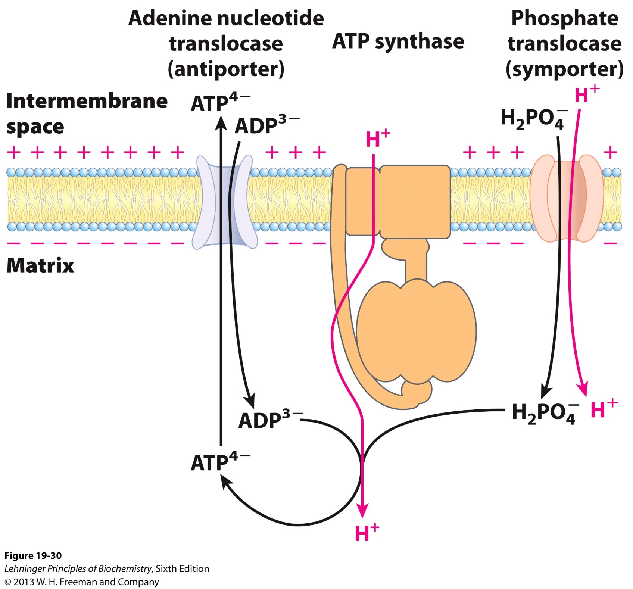
The proton-
motive force
is used for
active transport
through the
inner
membrane of
the mitochondria
Adenine nucleotide and phosphate translocases

Slide 78
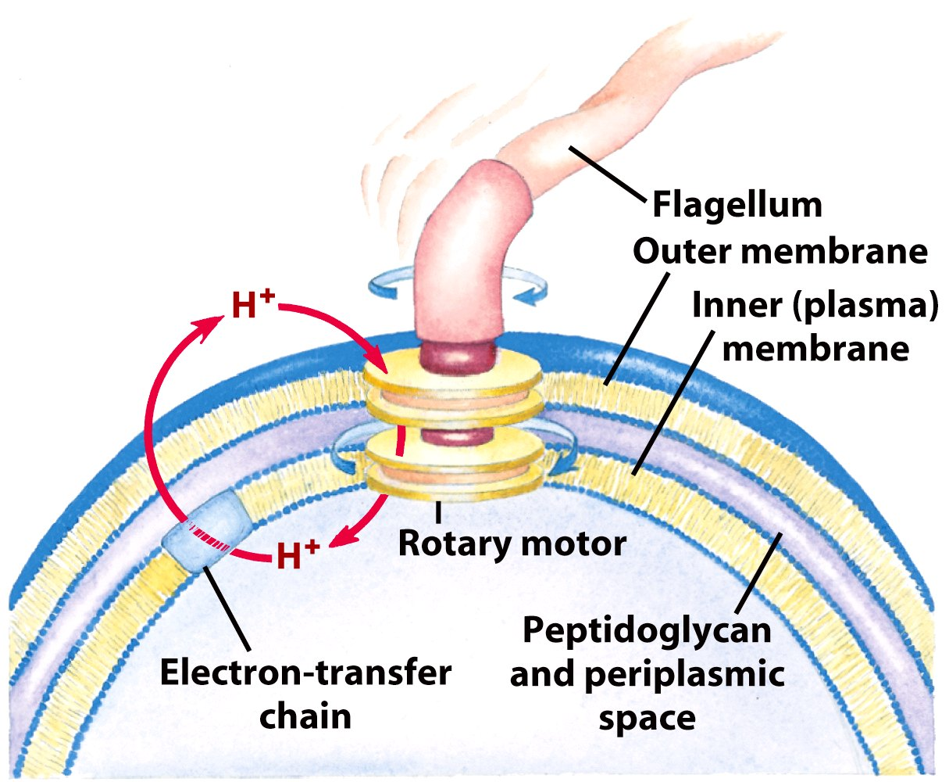
The rotary motion of the bacterial flagella is energized directly by the proton gradient across the cytoplasmic membrane.

Slide 79
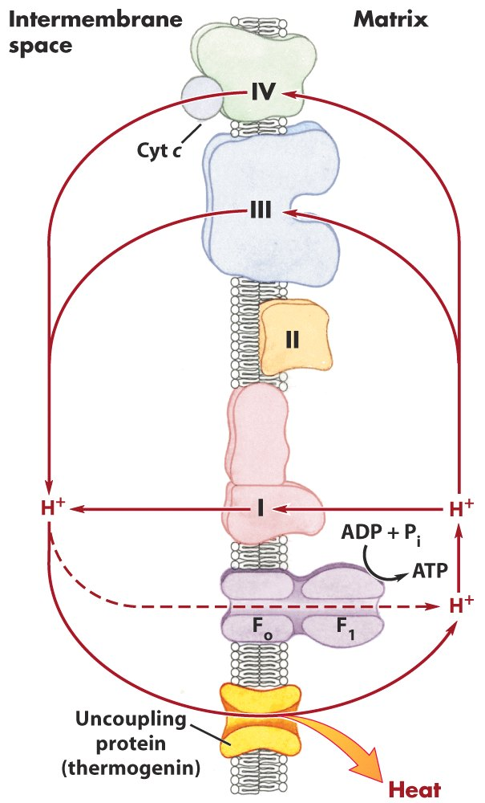
Thermogenin of brown
fat mitochondria causes
the energy conserved by
proton pumping to be
dissipated as heat.

Slide 80
17. Electrons in NADH generated in cytosol is shuttled into mitochondria to enter the respiratory chain
This is usually fulfilled by the malate-aspartate shuttle system in liver, kidney and heart, using the malate-α-ketoglutarate and the glutamate-aspartate transporters.
Electrons of NADH in the cytosol of skeletal muscle and brain are often shuttled into the matrix by using the glycerol 3-phosphate shuttle, which delivers the electrons to Complex III, thus releasing less amount of energy for proton gradient generation.

Slide 81
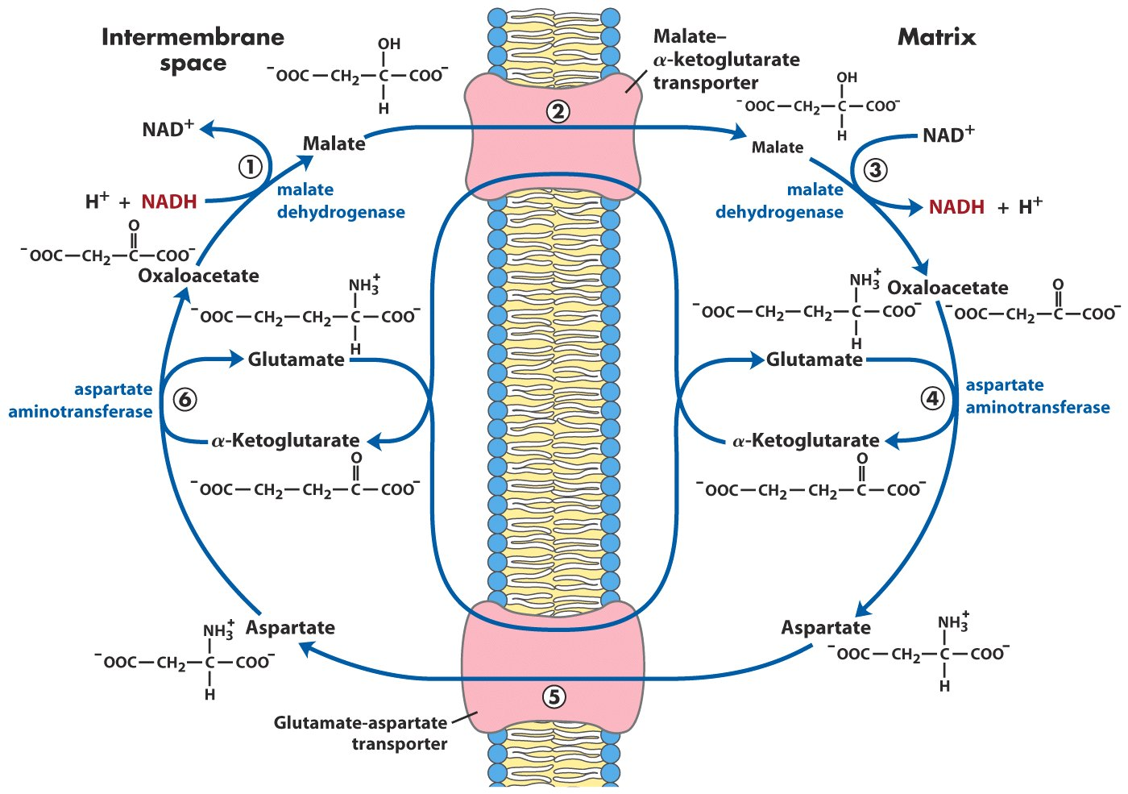
Malate-aspartate shuttle (in liver, kidney and heart)

Slide 82
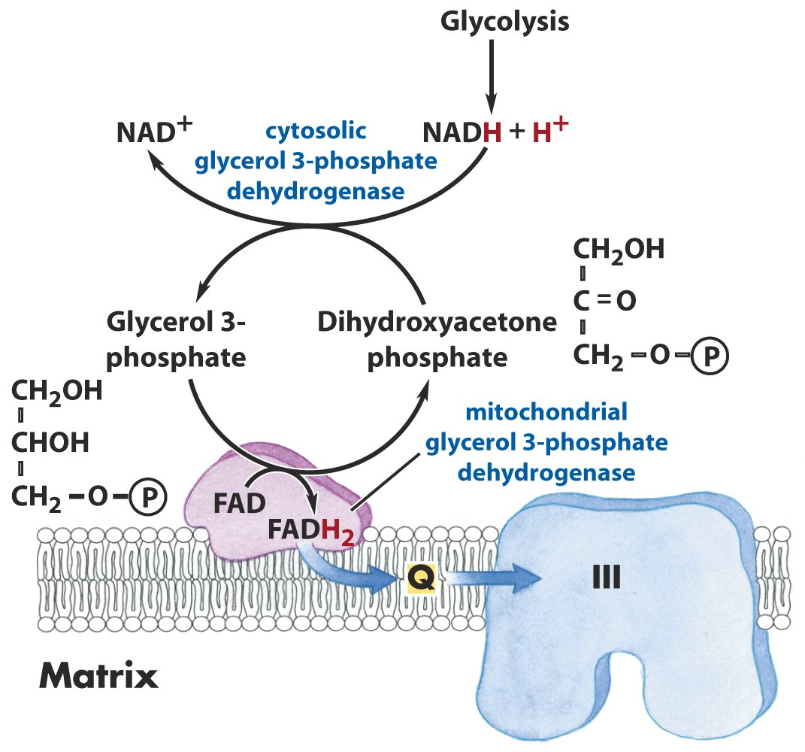
Glycerol 3-phosphate shuttle (in skeletal muscle and brain)

Slide 83
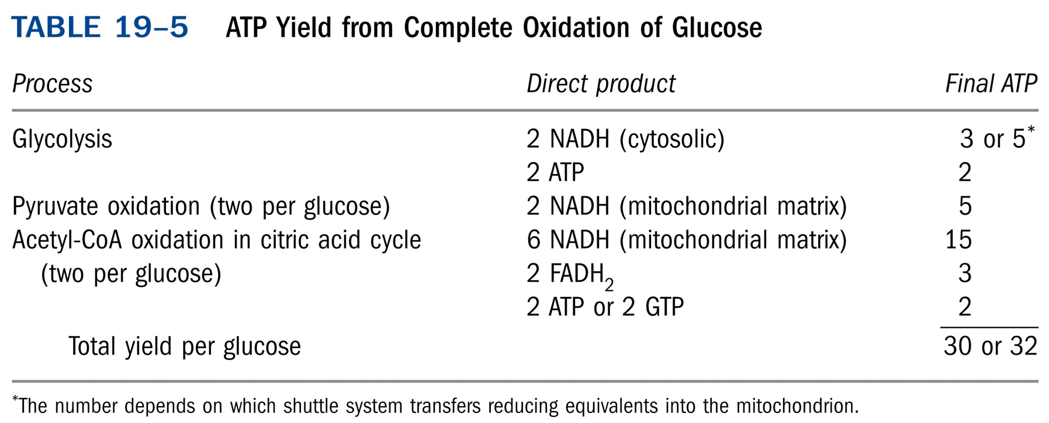

Slide 84
Electrons of NADH generated in plant cytosol enter
the respiratory chain directly with no need of shuttling
due to the presence of an externally oriented NADH
dehydrogenase.

Slide 85
18. The pathways leading to ATP synthesis are coordinately regulated
The rate of the respiration is generally controlled by the availability of ADP, since ADP acts as the acceptor of P_{i}, this way of regulation is thus called “acceptor control”.
ATP, ADP, NADH, or NAD⁺ regulates rate of fuel oxidation at further upstream steps (in stage I and II of fuel oxidation pathway).
The ratio [ATP]/([ADP][P_{i}]) fluctuates only slightly in most tissues due to a coordinated regulation of all the pathways leading to ATP production.

Slide 86
Regulation of the ATP-producing pathways*****

Slide 87
Mitochondrial genes
and mutations
LHON: Leber’s
hereditary
optic neuropathy

Slide 89
Single cells contain many mitochondria
Notes:
FIGURE 19-40 Single cells contain many mitochondria. A typical animal cell has hundreds or thousands of mitochondria, some fraction of which may contain genomes with mutations that affect mitochondrial function. This ovine (sheep) kidney epithelial cell was cultured in the laboratory, fixed, and then stained with fluorescent probes that show mitochondria as gold, microfilaments of actin red, and nuclei green when observed in the fluorescence microscope.

Slide 90
Bacterial respiratory chain

Slide 91
Keywords
Respiratory chain---Complex I, II, III and IV
Proton gradient---the chemiosmotic theory
ATP synthase

Slide 92
Words of the week
outer membrane vs. inner membrane
intermembrane vs. intramembrane
matrix

Slide 93
Text-book reading of the week
Summary 19.1 (p746)
Worked example 19-2 (p757)
Summary 19.2 (p759)
Summary 19.3 (p762)
p759-762 (regulation of oxidative phosphorylation)

Slide 94
Summary
ATP is synthesized using the same strategy in oxidative phosphorylation and photophosphorylation.
Electrons collected in NADH and FADH₂ are released (at different entering points) and transported to O₂ via the respiratory chain, which consists of four multiprotein complexes (I, II, III, and IV) and two mobile electron carriers (ubiquinone and cytochrome c).
A proton gradient across the inner membrane of mitochondria is generated using the electron motive force generated by electron transfer through the respiratory chain.

Slide 95
The order of the many electron carriers on the respiratory chain have been elucidated via various studies, including measurements of the standard reduction potential, oxidation kinetics of the electron carriers, and effects of various respiratory chain inhibitors.
Electron transfer to O₂ was found to be coupled to ATP synthesis from ADP + P_{i} in isolated mitochondria.
The chemiosmotic theory explains the coupling of electron flow and ATP synthesis.

Slide 96
ATP synthase comprises a proton channel (F_{o}) and a ATPase (F₁).
The binding-change model was proposed to explain the action mechanism of ATP synthase.
The energy stored in the proton gradient can be used to do other work.
Electrons in NADH generated in cytosol is shuttled into mitochondria to enter the respiratory chain.
The pathways leading to ATP synthesis is coordinately regulated.

