Slide 1
Chapter 19 Oxidative phosphorylation and photophosphorylation
Generation of ATP by using a across-membrane proton gradient, which is generated from electron flow through a chain of carriers

Slide 2
Photosynthesis (光合作用)
The chemical process by which green plants and other phototrophs synthesize organic compounds from carbon dioxide and water in the presence of sunlight.
light
CO₂ + H₂O （CH₂O） + O₂

Slide 3
19. Photosynthetic organisms generate ATP (and NADPH) via photophosphorylation
The molecular mechanism of photophosphorylation is remarkably similar to that of oxidative phosphorylation: also mediated via a across-membrane proton gradient generated using energy released from stepwise electron flow through a series of electron carriers, located on the thylakoid membranes of chloroplasts or plasma membrane of bacteria.

Slide 4
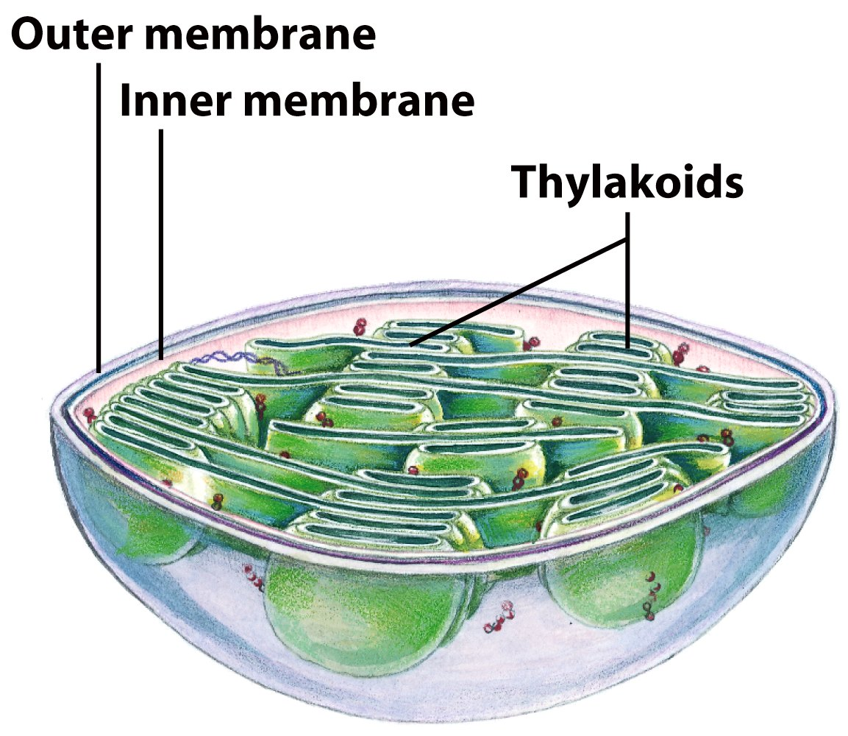
Schematic diagram of a chloroplast

Slide 5
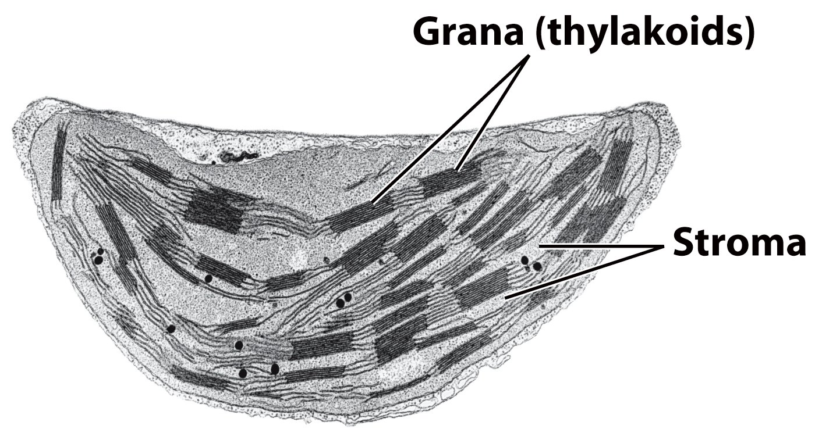
Electron micrograph of a chloroplast

Slide 6
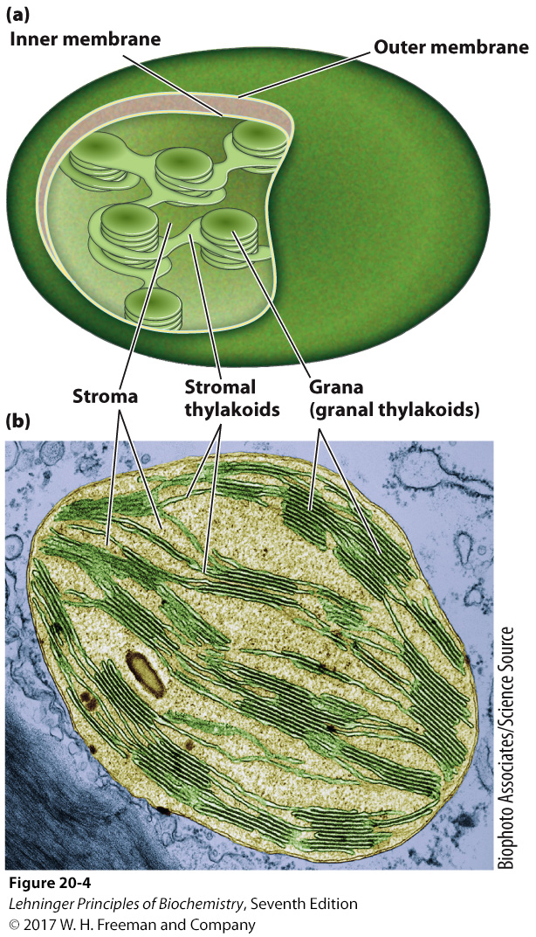
Electron micrograph of a chloroplast

Slide 7
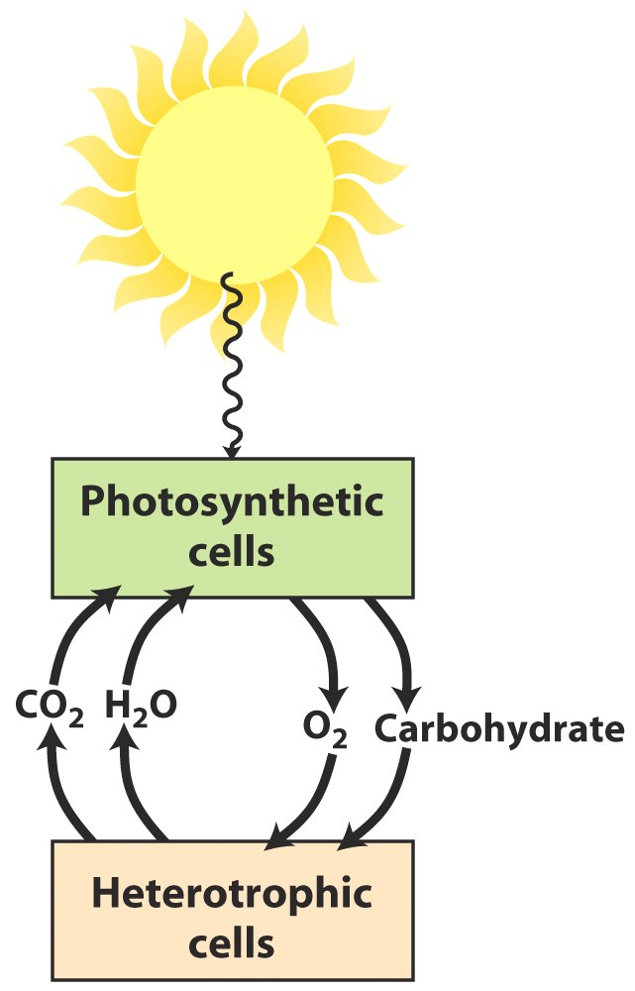
Solar energy as the ultimate source of all biological energy

Slide 8
The electron donor in photophosphorylation, H₂O, is first charged by using light energy to provide electrons of high potential energy.
The excess energy-rich ATP and NADPH generated by photophosphorylation are further stored in stable energy-rich carbohydrates through the carbon-assimilation (fixation) reactions occurring in the stroma of chloroplasts.

Slide 9
Two processes of photosynthesis
1. Light-dependent reactions or light reactions
Produces energy from solar power in the form of ATP and NADPH.
2. Light-independent reactions or carbon-assimilation reactions
Uses energy (ATP and NADPH) from light reaction to make carbohydrates.

Slide 10
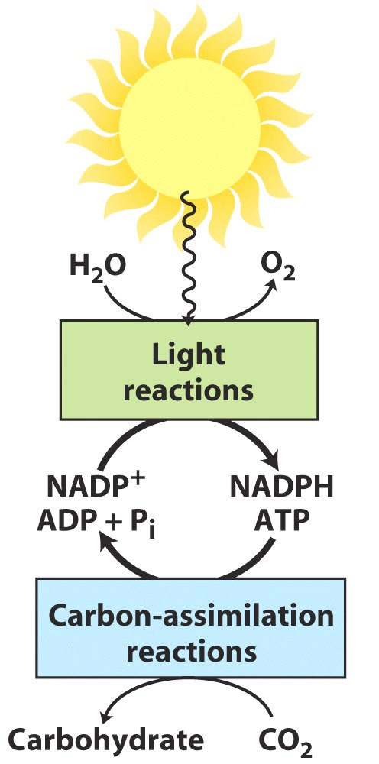
Both ATP and NADPH
are generated by the
light reactions of
photosynthesis
Thylakoid
Stroma

Slide 11
20. It took a long time for human beings to understand the chemical process of photosynthesis
O₂ is produced by plants (1780).
Light is needed for plants to produce O₂ (1786).
CO₂ is taken up by plants (1790s).
H₂O is taken up during CO₂ fixation because the sum of weights of organic matter and O₂ is much more than the weight of CO₂ consumed, water is the only other substance present (1790s).
Plants convert solar energy into chemical free energy (1842).

Slide 12
Experiment with leaf extract containing chloroplasts revealed that absorbed light energy causes electrons to flow from H₂O to an artificial electron acceptor (NADP⁺ was found to be the acceptor in chloroplasts later); CO₂ is not required for this process; therefore O₂ could not be produced from CO₂ (1930s, Hill).
Hill reaction:
2H₂O + 2A 2AH₂ + O₂
Radio isotope tracer experiments revealed that CO₂ is added to ribulose-1,5-bisphosphate in a cyclic pathway before it is used for glucose synthesis (1950s, Calvin).
light

Slide 13
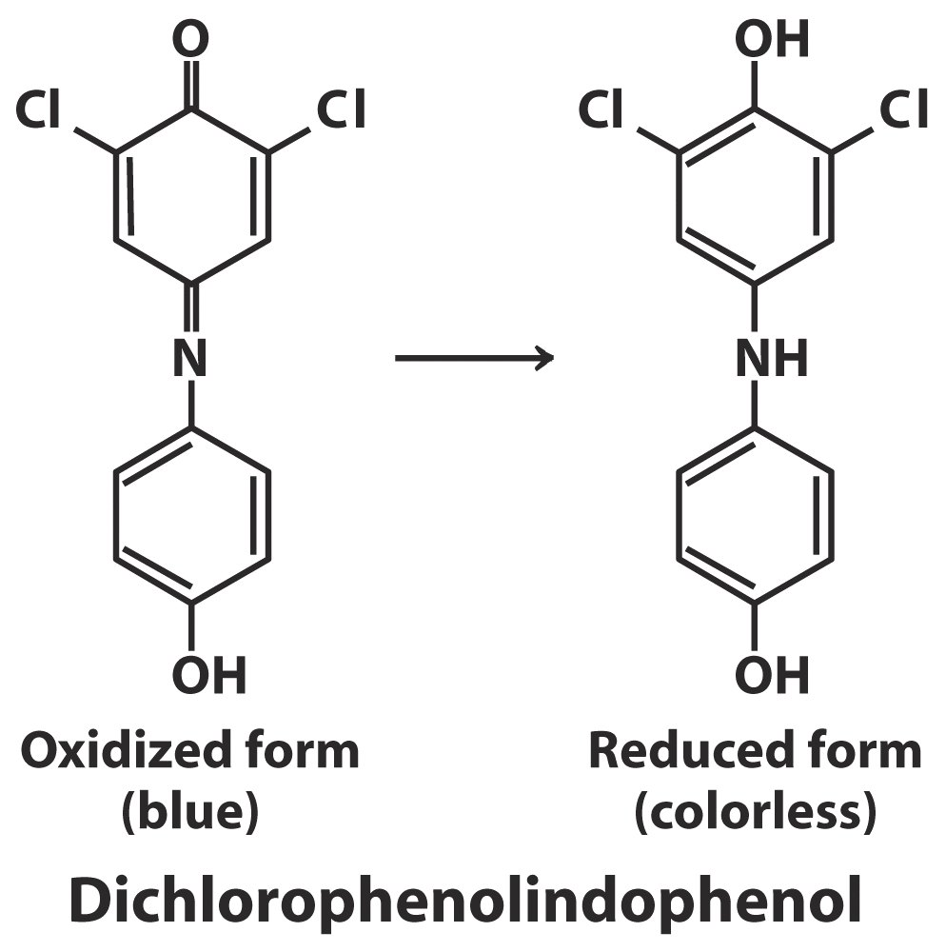

Slide 14
21. The major light absorbing pigments on thylakoid membrane were revealed to be chlorophylls
Chlorophylls (叶绿素)(a and b) were found to resemble the heme group of hemoglobin, being polycyclic planar polytenes, except that the central Fe²⁺ is replaced by a Mg²⁺; a 21-carbon alcohol called phytol is attached to a carboxyl group on the protoporphyrin ring; there exists an extra non-pyrrole ring.
The light absorbing pigments in algae and photosynthetic bacteria (named as bacteriochlorophyll) are very similar to that of higher plants.

Slide 15
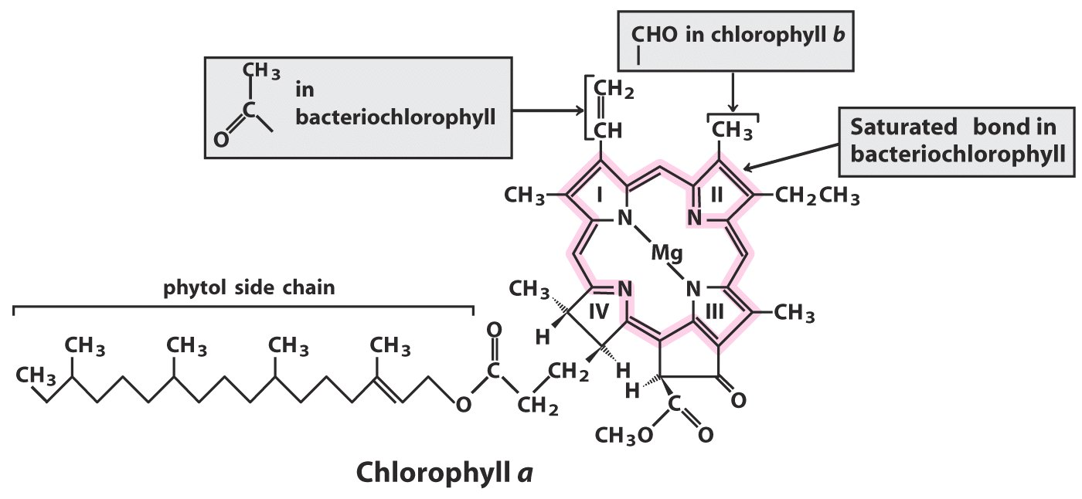
Chlorophyll a and b and bacteriochlorophyll are the primary gatherers of light energy

Slide 17
Chlorophyll is always associated with specific proteins to form light-harvesting complexes (LHCs).
Carotenoids (类胡萝卜素), absorbing light at wavelengths distinct from chlorophylls, act as accessory pigments on thylakoid membranes.
Cyanobacteria and red algae use open-chain tetrapyrroles, called phycobilins, to absorb light at wavelengths between 520-630 nm.
The absorption spectra of chlorophyll a and b overlap with the action spectrum of photosynthesis in chloroplasts.

Slide 18
Carotene and lutein act as accessory pigments in plants
(absorbing light at wavelengths distinct from chlorophyll)

Slide 19
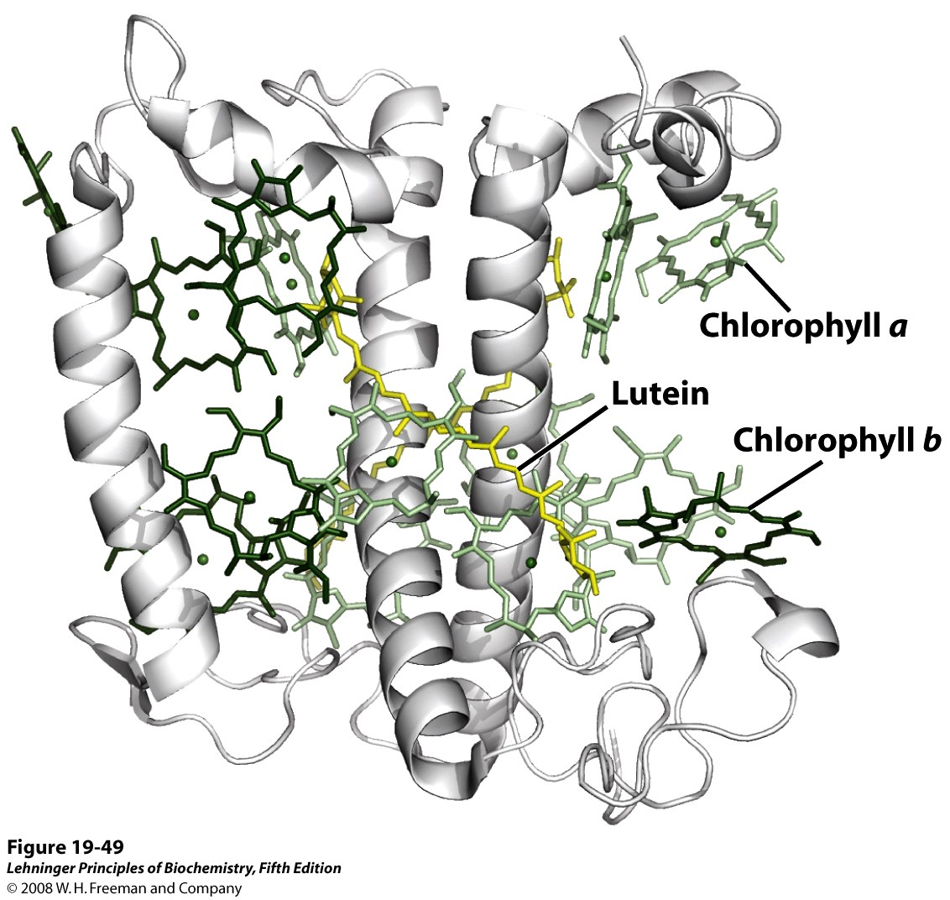
A light-harvesting complex (LHCII)
Notes:
FIGURE 19-49 A light-harvesting complex, LHCII. (PDB ID 2BHW) The functional unit is an LHC trimer, with 36 chlorophyll and 6 lutein molecules. Shown here is a monomer, viewed in the plane of the membrane, with its three transmembrane α-helical segments, seven chlorophyll a molecules (light green), five chlorophyll b molecules (dark green), and two molecules of the accessory pigment lutein (yellow), which form an internal cross-brace.

Slide 20
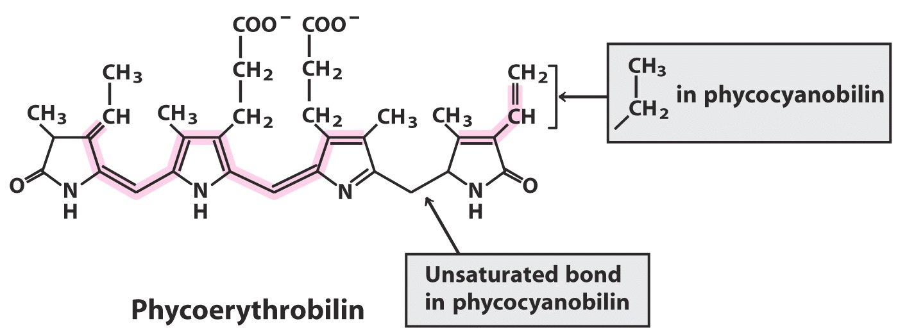
Phycobilins, light absorbing pigments in cyanobacteria and red algae, are open-chain tetraparrole polytenes, absorbing light at wavelengths between 520-630 nm.

Slide 21
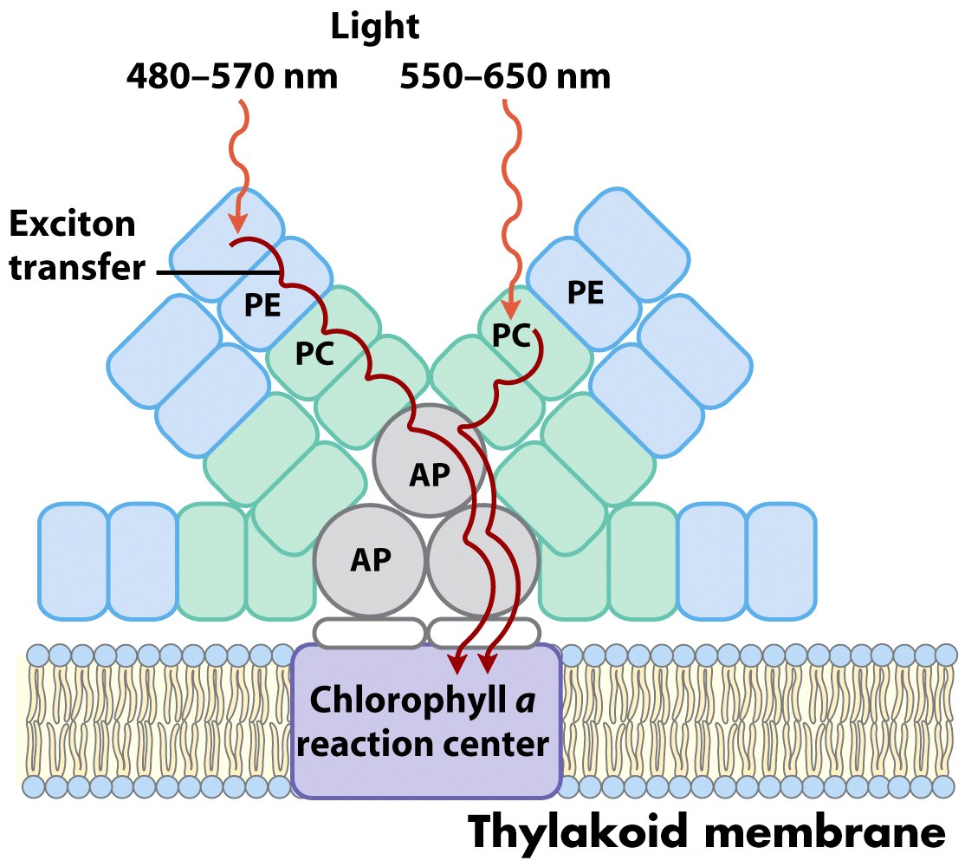
A phycobilisome---the primary light-harvesting structures in cyanobacteria and red algae

Slide 22
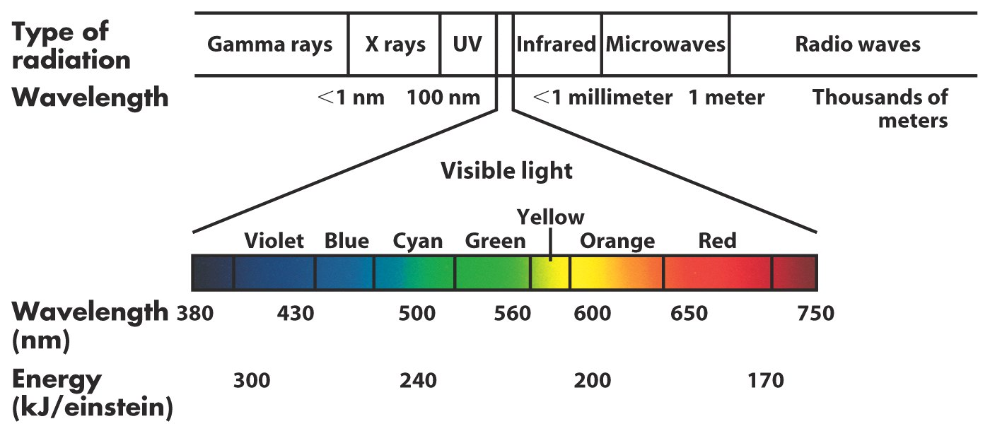
Electromagnetic radiation

Slide 23
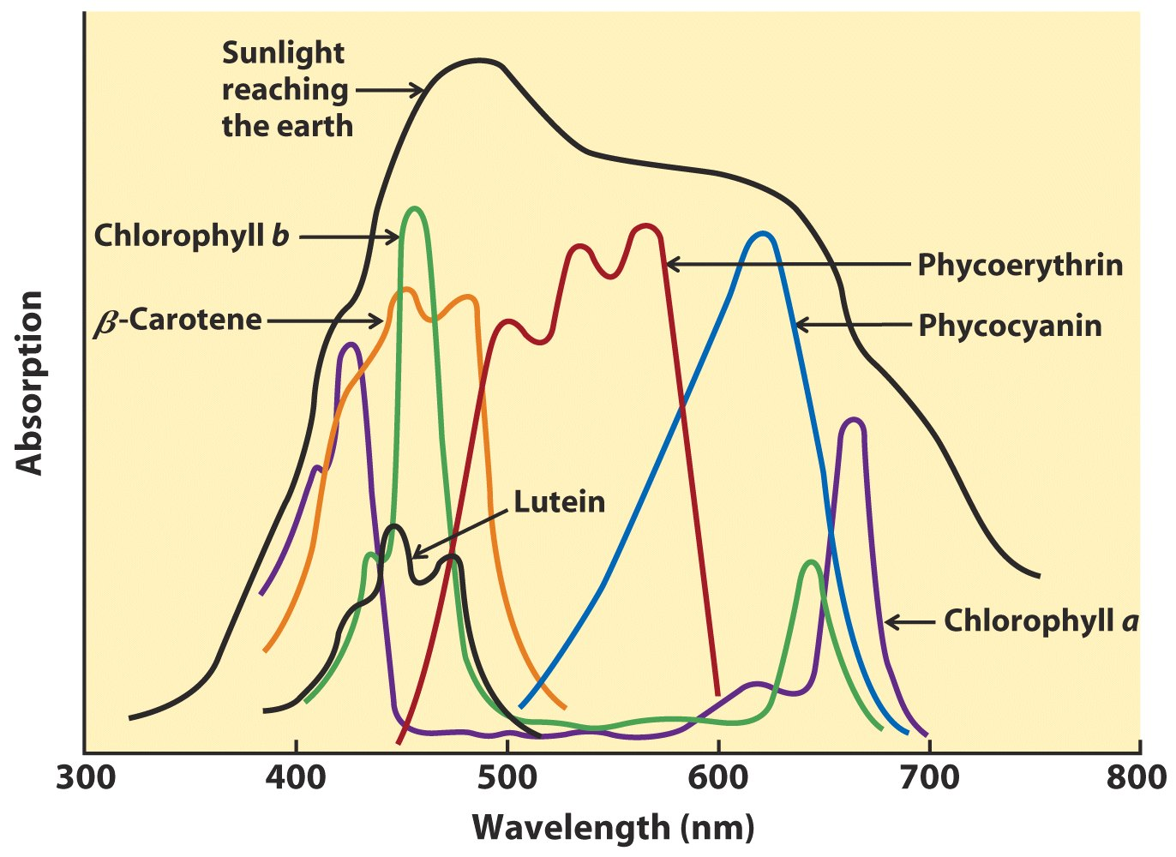
The combination of chlorophylls (a and b) and accessory pigments
enable plants to harvest most of the energy available in sunlight

Slide 24
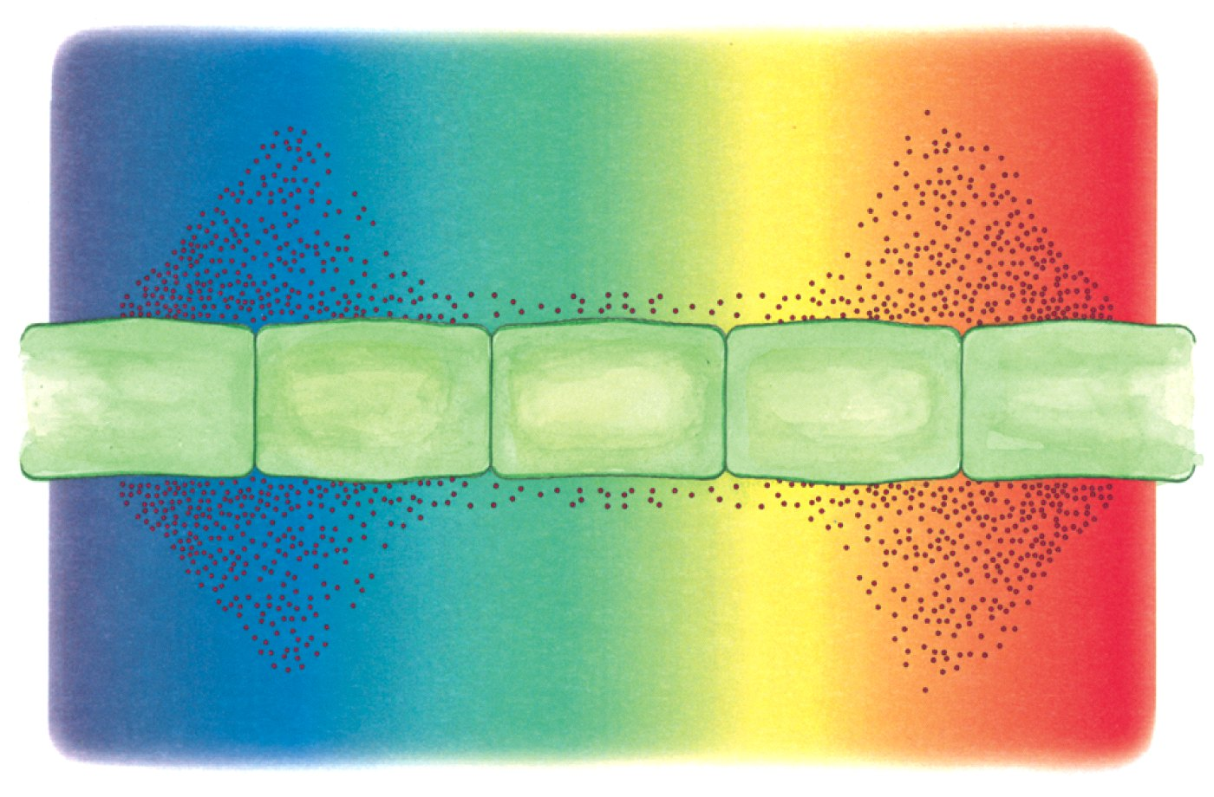
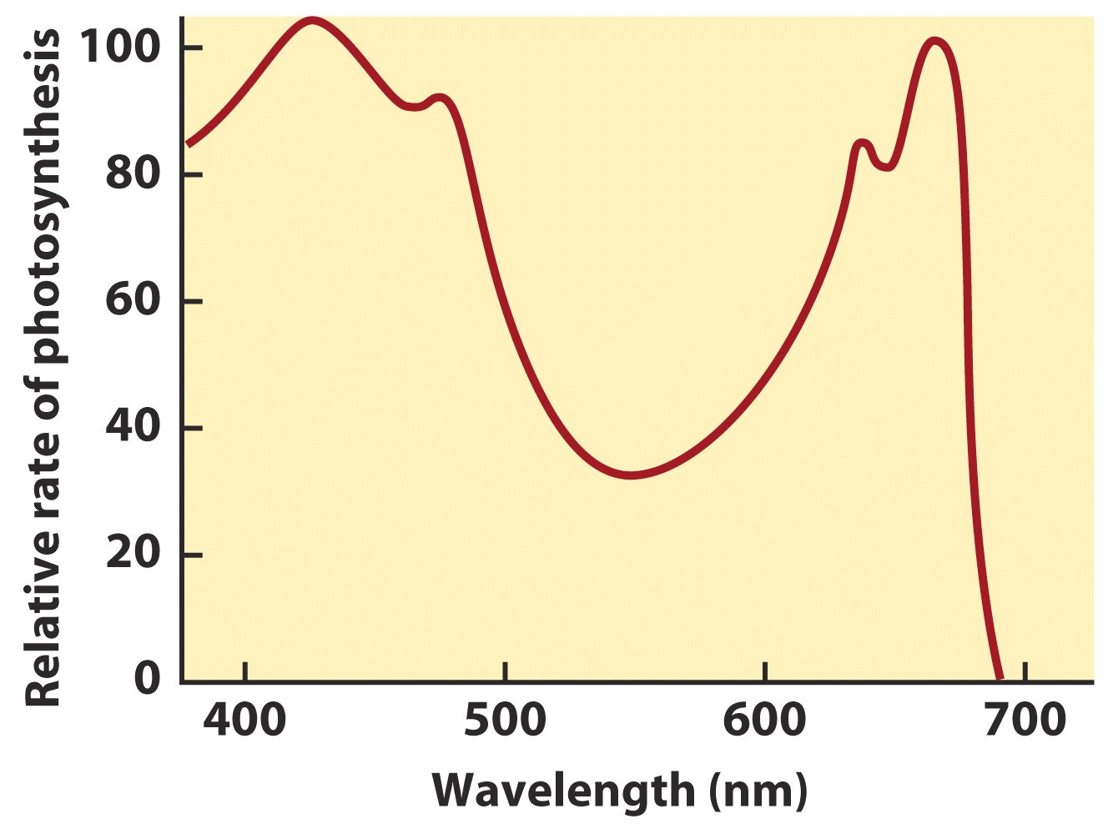
The action spectrum
of photosynthesis in alga
overlaps with the
absorption spectra
of chlorophyll a and b.

Slide 25
22. Photons absorbed by many chlorophylls funnel into one reaction center via exciton transfer
The light-absorbing pigments are arranged in functional arrays called photosystem.
Photons absorbed by many antenna pigments funnel to one reaction center having a specially localized pair of chlorophyll a molecules via exciton transfer.

Slide 26
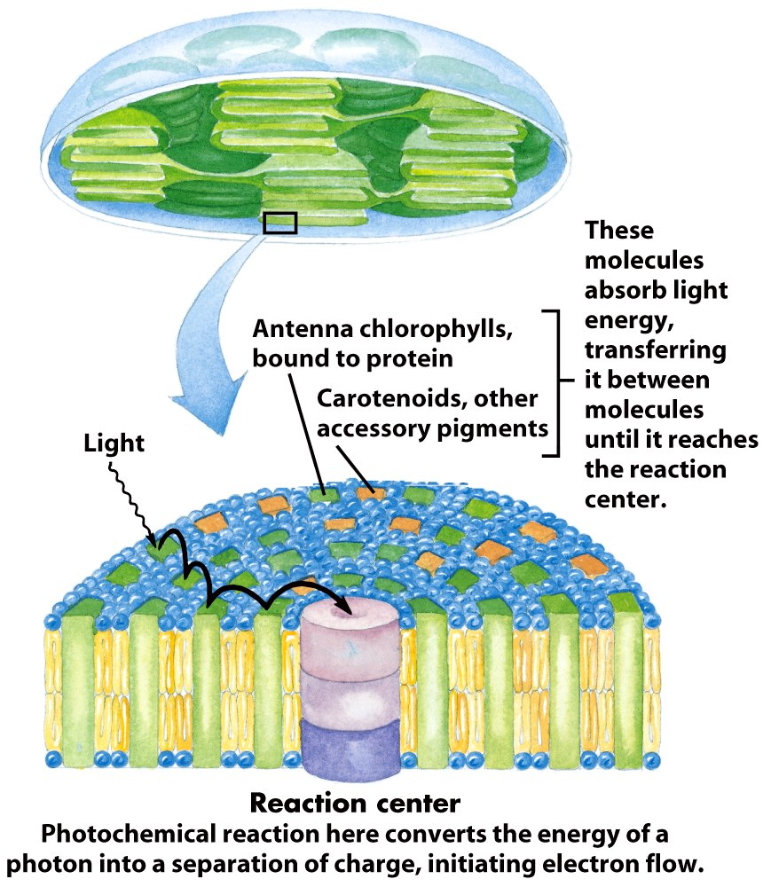
The light-absorbing pigments
of thylakoid or bacterial
membranes are arranged
in functional arrays called
photosystems.

Slide 27
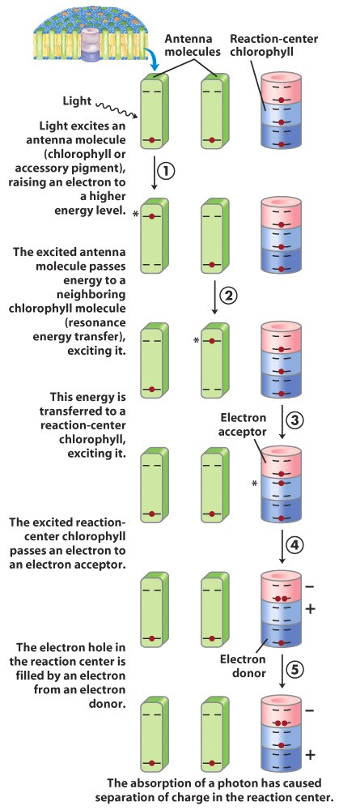
Charge separation at the
reaction center may be
caused by the absorption
of one photon from one
chlorophyll molecule.

Slide 28
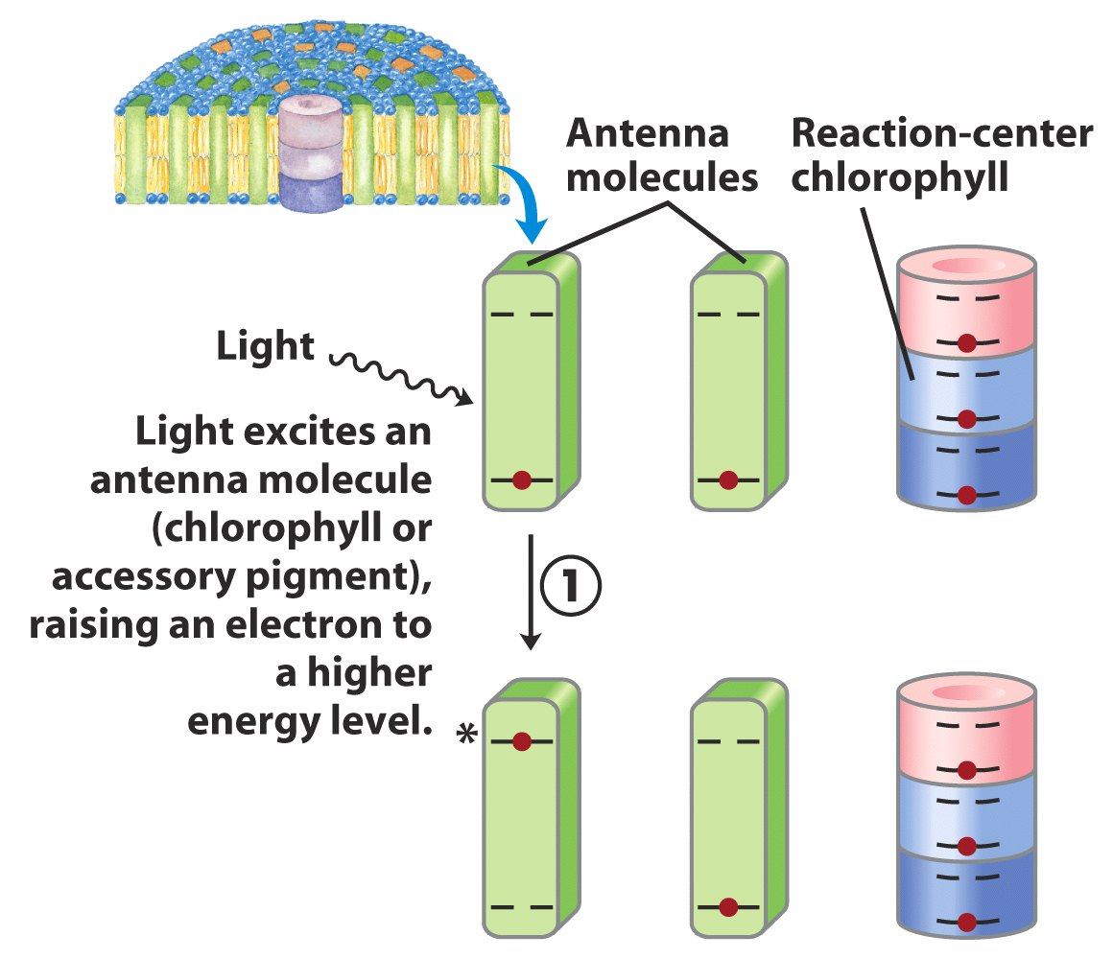

Slide 29
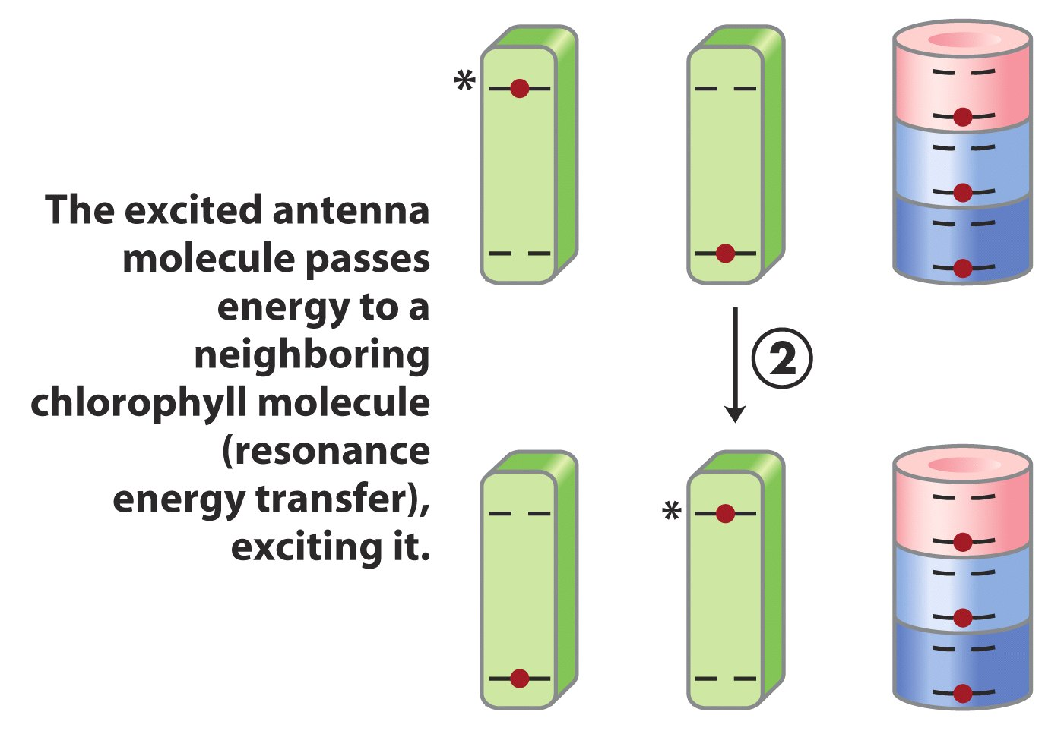

Slide 30
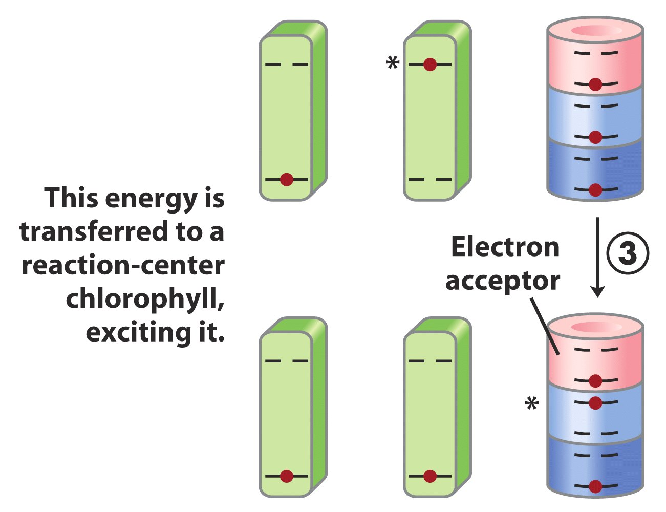

Slide 31
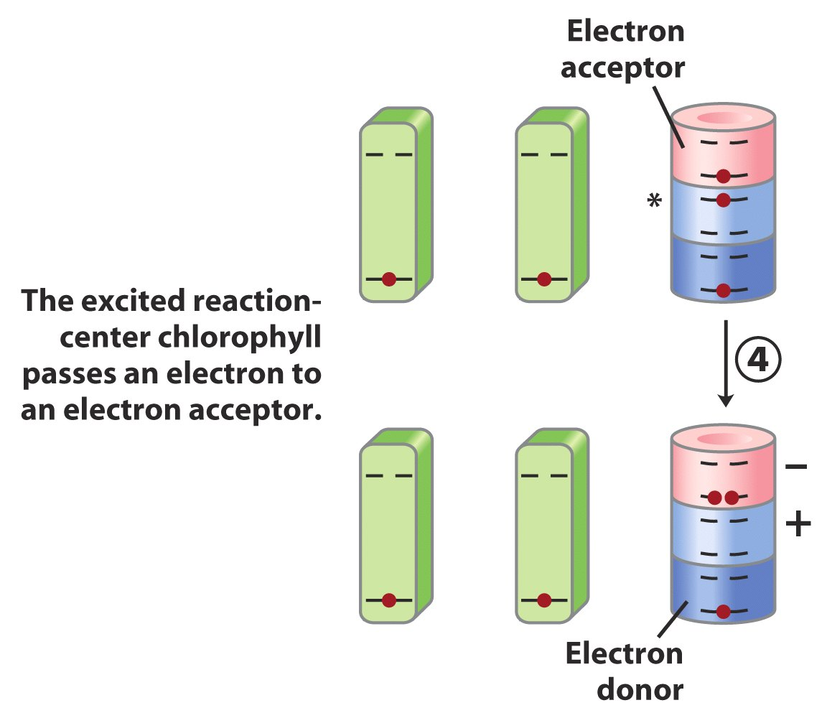

Slide 32
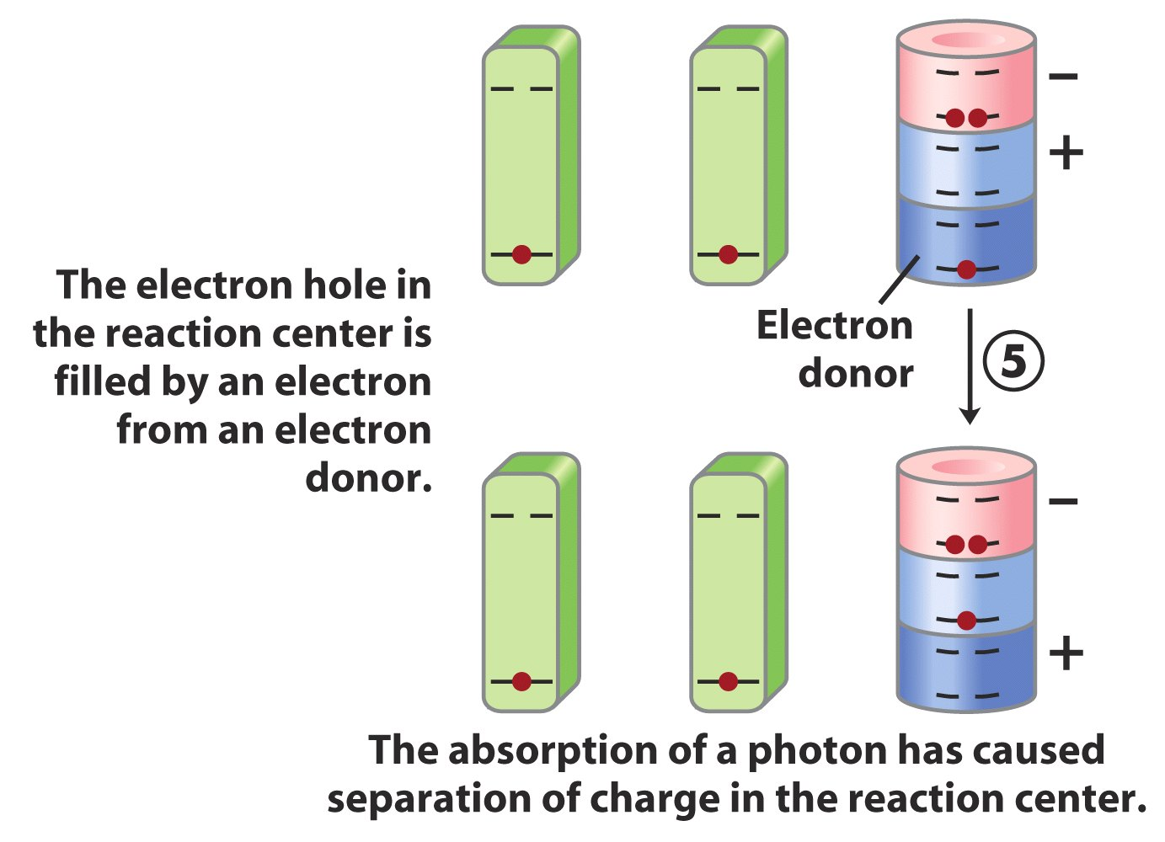

Slide 33
23. Two types of photochemical reaction centers have been revealed in bacteria
Type II in purple bacteria: a cyclic electron flow pathway; electrons activated from the reaction center chlorophylls (P870) are first accepted by pheophytins (chlorophylls lacking the central Mg²⁺) (脱镁叶绿素) causing charge separation; then to a quinone, before being transferred back to P870 via cytochrome bc₁ complex and Cyt c₂.

Slide 34
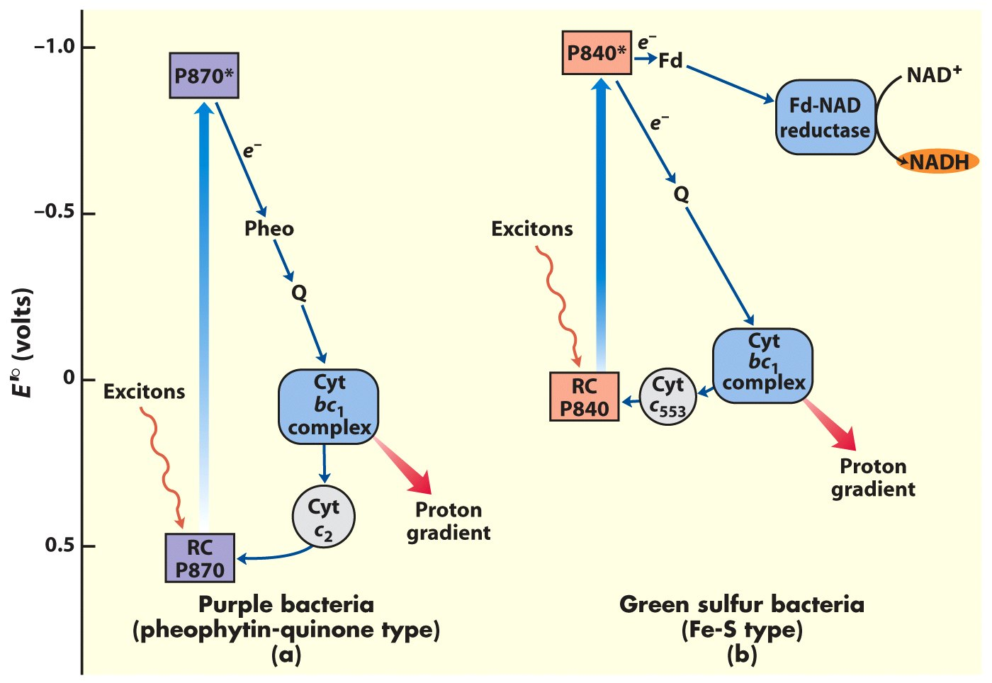
(pheophytin)
The cyclic and noncyclic electron transfer path
found in photosynthetic bacteria

Slide 35
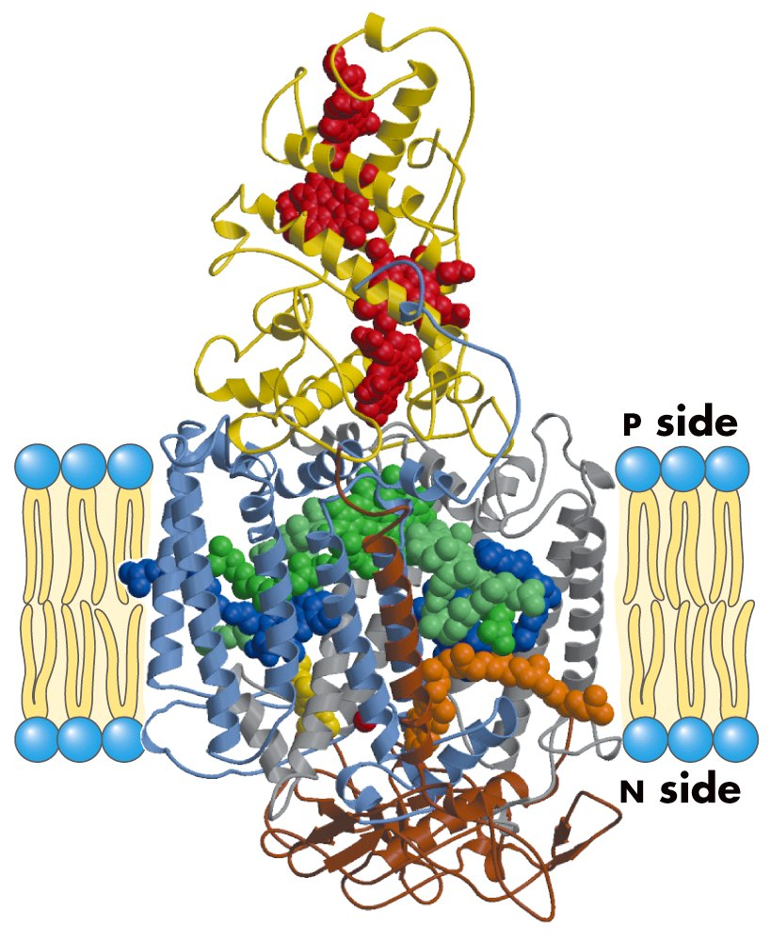
Photoreaction center of the purple bacterium
Rhodopseudomonas viridis

Slide 36
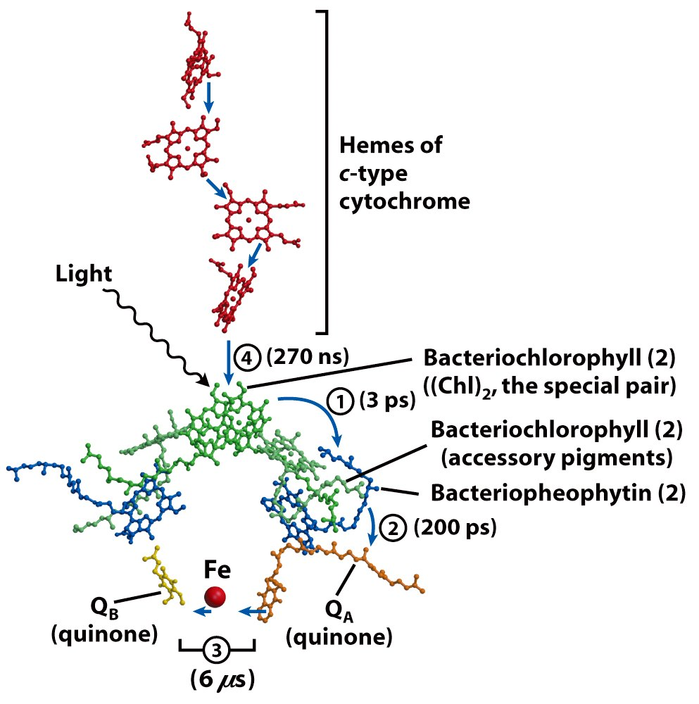
A deduced path of
electron flow on
purple bacterial
plasma membrane

Slide 37
Type I in green sulfur bacteria: both a cyclic electron pathway corresponding to the one in purple bacteria and a linear pathway leading to NADH formation using ferredoxin (a 2Fe-2S) and Fd:NAD reductase.
The cytochrome bc₁ complexes, being similar to the complex III in mitochondria, pumps protons across the plasma membranes.

Slide 38
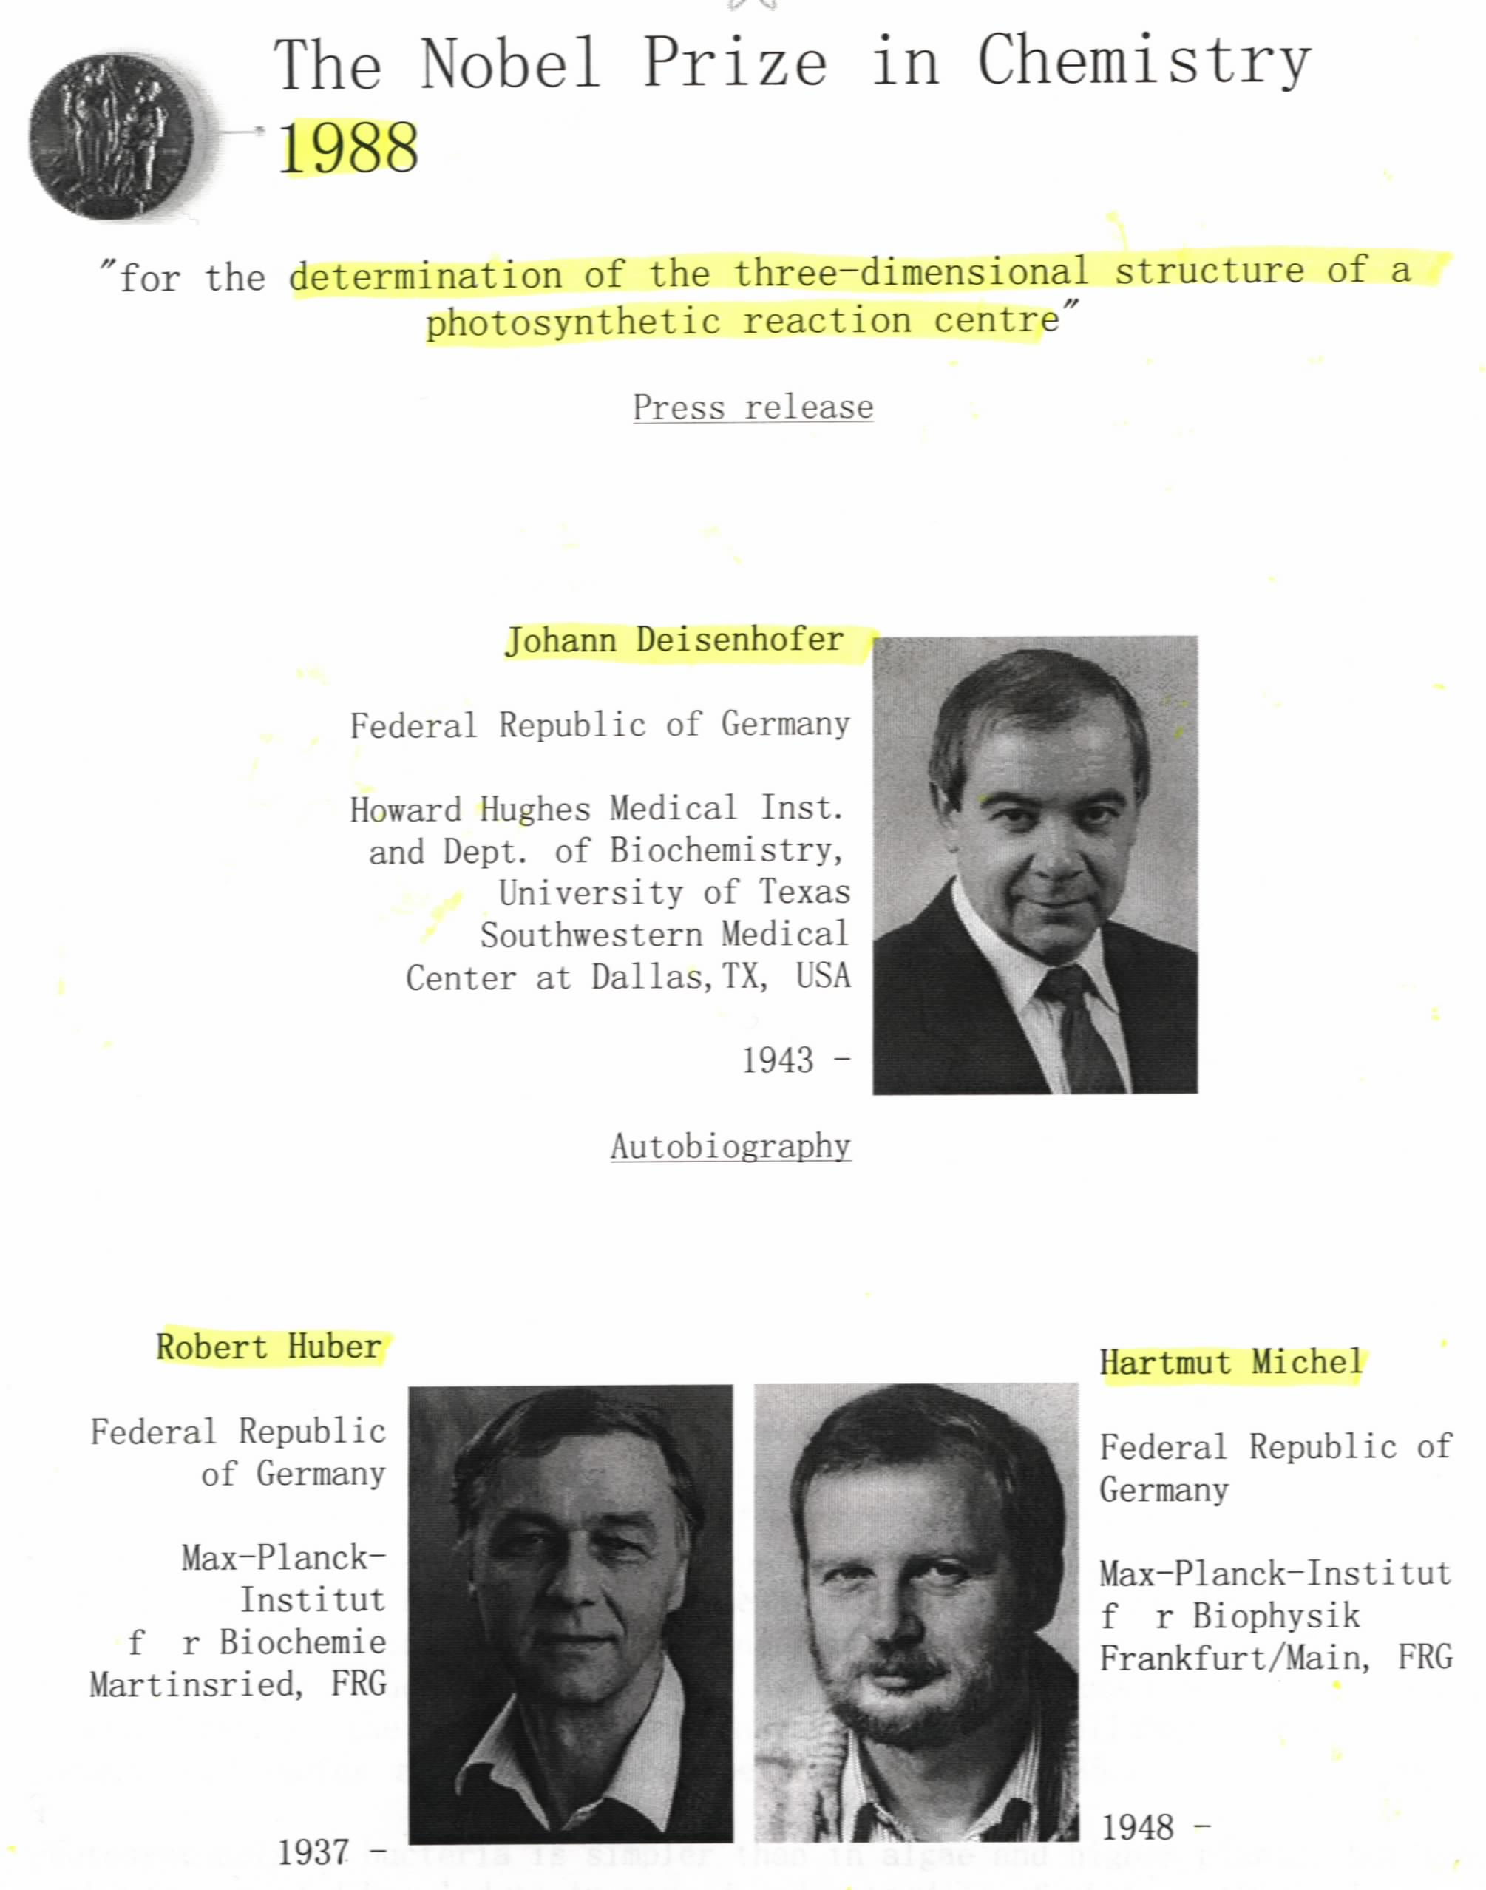

Slide 39
24. Two photosystems (II and I) work in tandem to move electrons from H₂O to NADP⁺ in higher plants
PSI and PSII were revealed by quantum efficiency studies (“red drop” and “enhancement” phenomena for chloroplasts) and bleaching studies (a temporary decrease in absorption of light at a specific wavelength).
The electrons are charged twice (at P680 and P700).

Slide 40
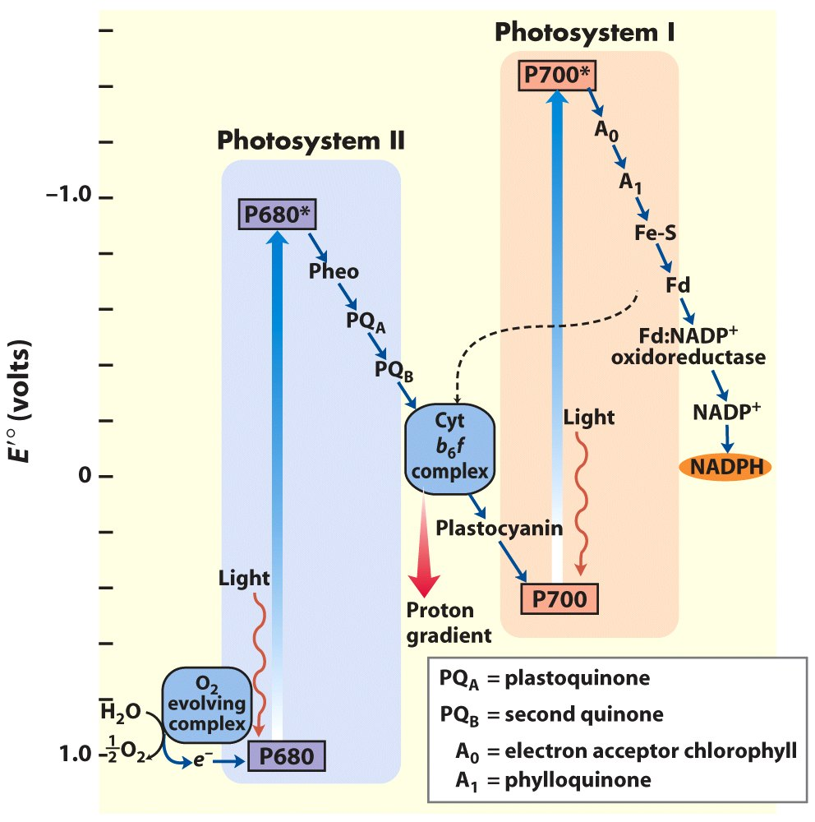
The “ Z scheme”
to show the
electron flow from
PSII to PSI

Slide 41
Pheophytin acts as the first electron acceptor for the excited chlorophyll molecules (the “special pair”) in PSII resulting in charge separation.
Plastoquinone(质体醌), structurally similar to ubiquinone, carries electrons from PSII to cytochrome b₆f complex.
The cytochrome b₆f complex (similar to the cytochrome bc₁ complex for oxidative phosphorylation) pumps H⁺ across the thylakoid membrane.

Slide 42
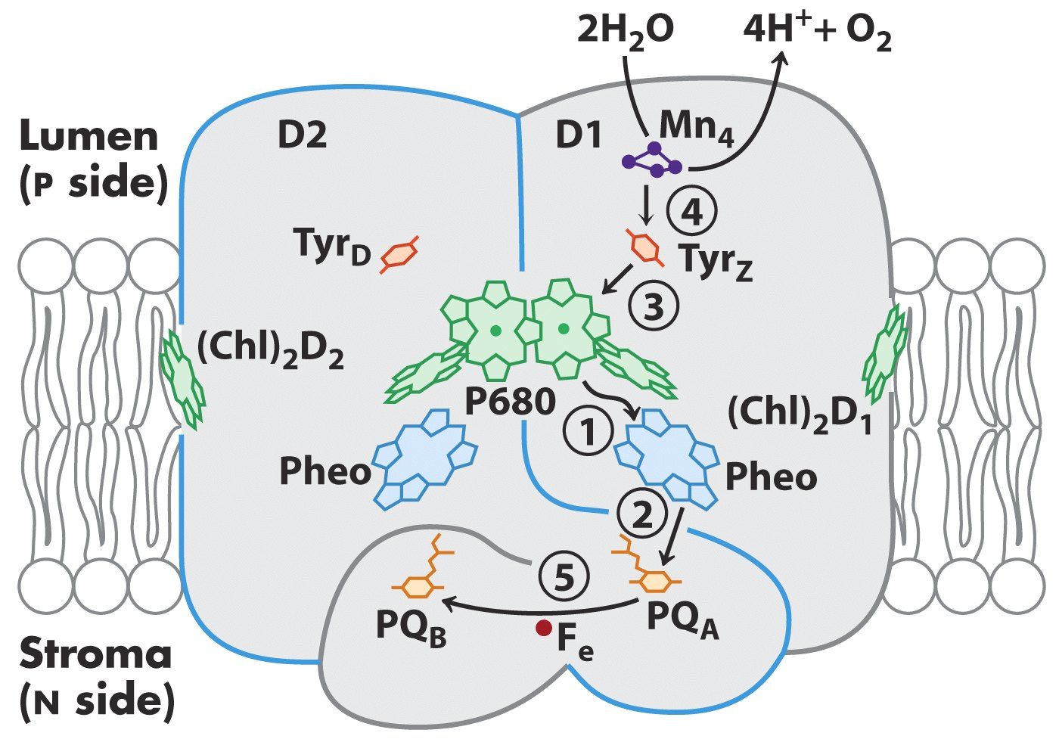
Photosystem II of the cyanobacterium
Synechococcus elongates

Slide 43
Plastocyanin (质体蓝素), a Cu-containing soluble protein, carries electrons from the cytochrome b₆f complex to P700 of PSI (playing a similar role as cytochrome c in oxidative phosphorylation).
PSII are often found only in the stacked regions of the thylakoid membrane, with PSI and ATP synthase often only in the unstacked region.
The cytochrome b₆f complex and cytochrome c₆ act in both oxidative phosphorylation and photophosphorylation in cyanobacteria.

Slide 44
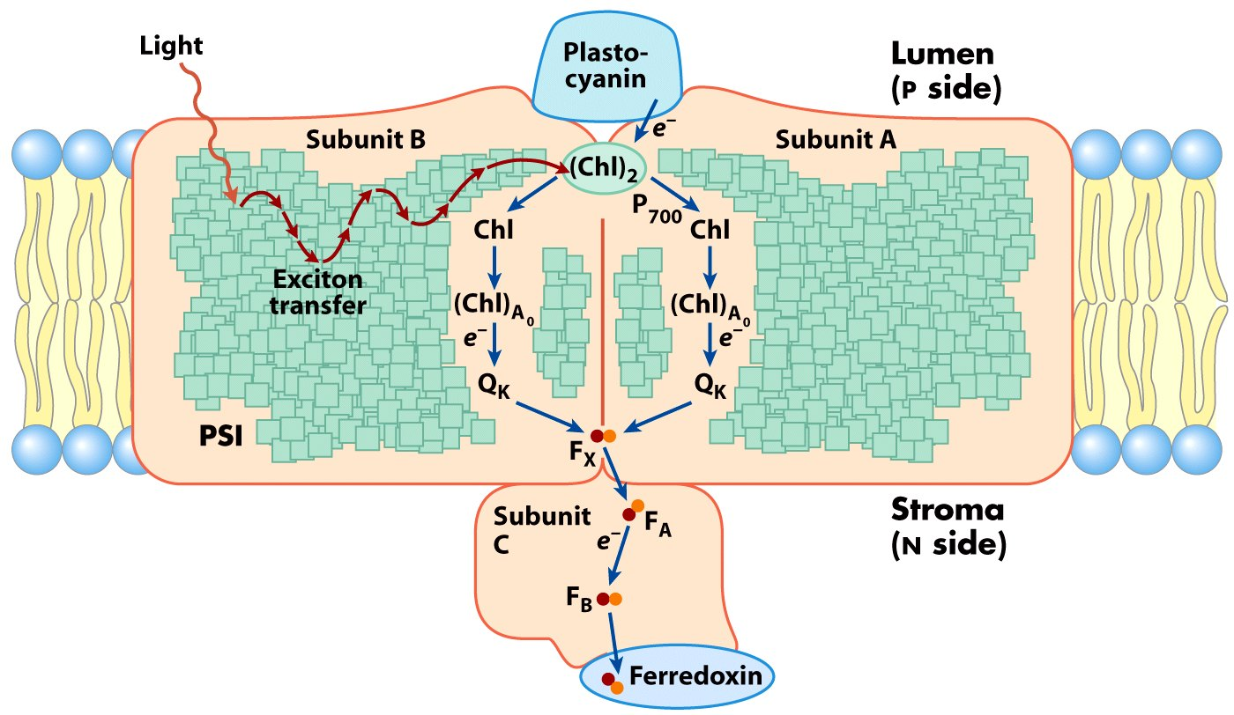
Essential proteins and cofactors in a single unit of PSI

Slide 45
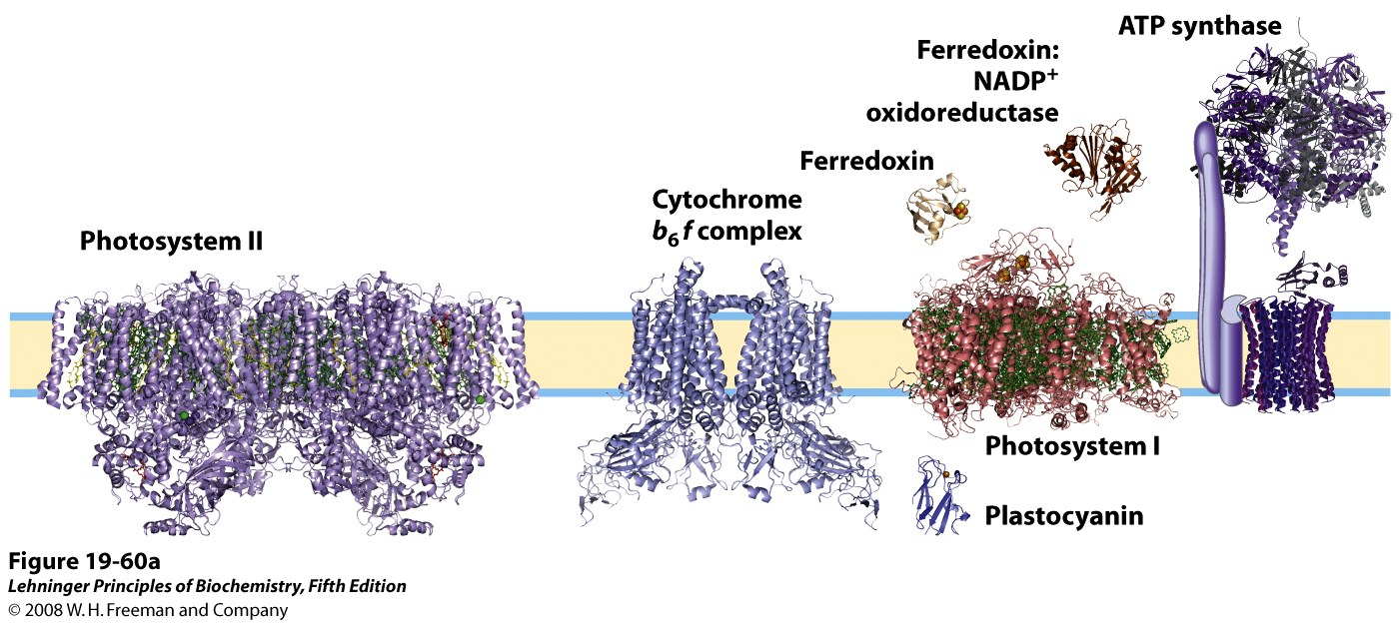
Location of PSI and PSII in thylakoid membranes
Notes:
FIGURE 19-60a Localization of PSI and PSII in thylakoid membranes. (a) The structures of the complexes and soluble proteins of the photosynthetic apparatus of a vascular plant or alga, drawn to the same scale. The PDB ID for the structure of PSII is 2AXT; for PSI, 1QZV; for cytochrome b₆f, 2E74; for plastocyanin, 1AG6; for ferredoxin, 1A70; for ferredoxin:NADP⁺ reductase, 1QG0. The ATP synthase structure shown is a composite of that from yeast mitochondria (PDB ID 1QO1) and bovine mitochondria (PDB ID 1BMF).

Slide 46
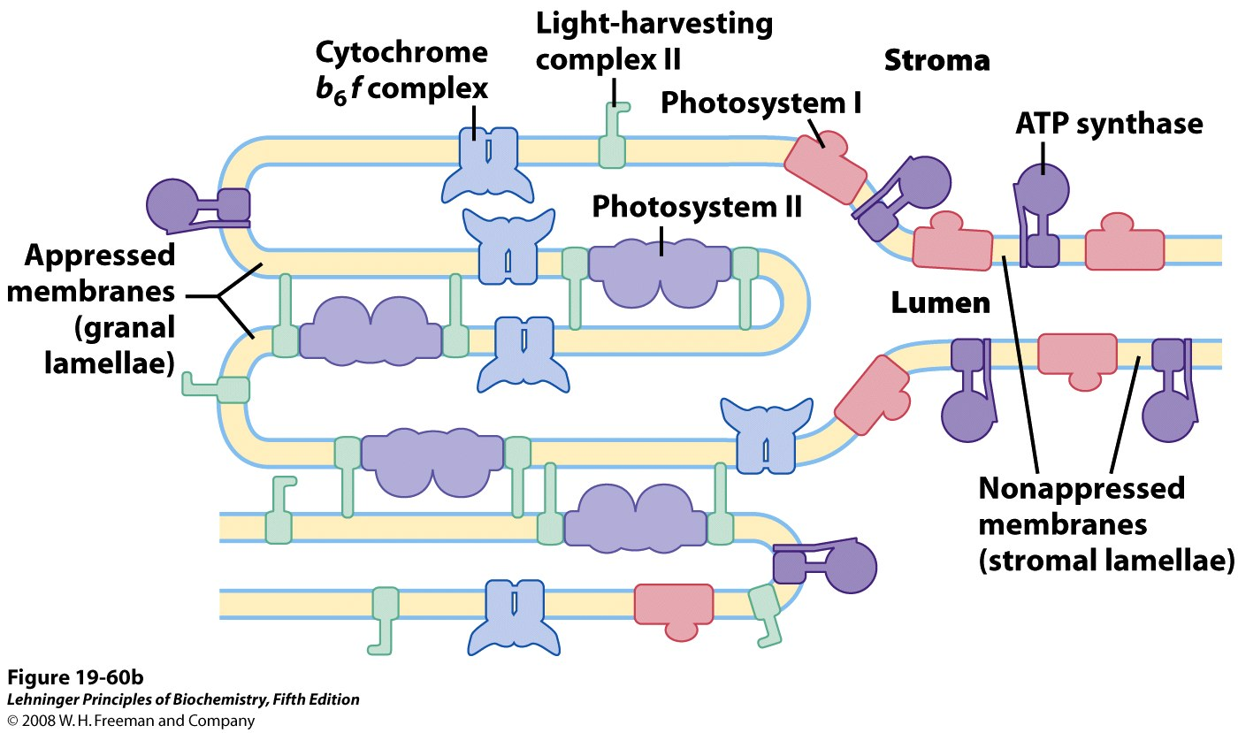
H⁺
Location of PSI and PSII in thylakoid membranes
Notes:
FIGURE 19-60b Localization of PSI and PSII in thylakoid membranes. (b) Light-harvesting complex LHCII and ATP synthase are located both in appressed regions of the thylakoid membrane (granal lamellae, in which several membranes are in contact) and in nonappressed regions (stromal lamellae), and have ready access to ADP and NADP⁺ in the stroma. PSII is present almost exclusively in the appressed regions, and PSI almost exclusively in nonappressed regions, exposed to the stroma. LHCII is the "adhesive" that holds appressed lamellae together (see Figure 19-61).

Slide 47
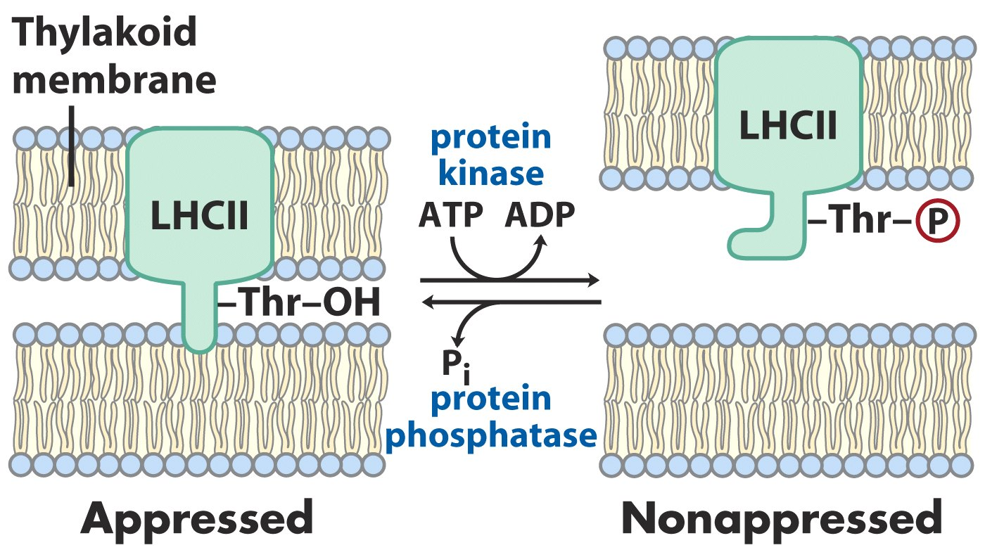
Accumulation of reduced plastoquinone stimulates
the kinase, leading to conversion of stacked to
unstacked membranes

Slide 48
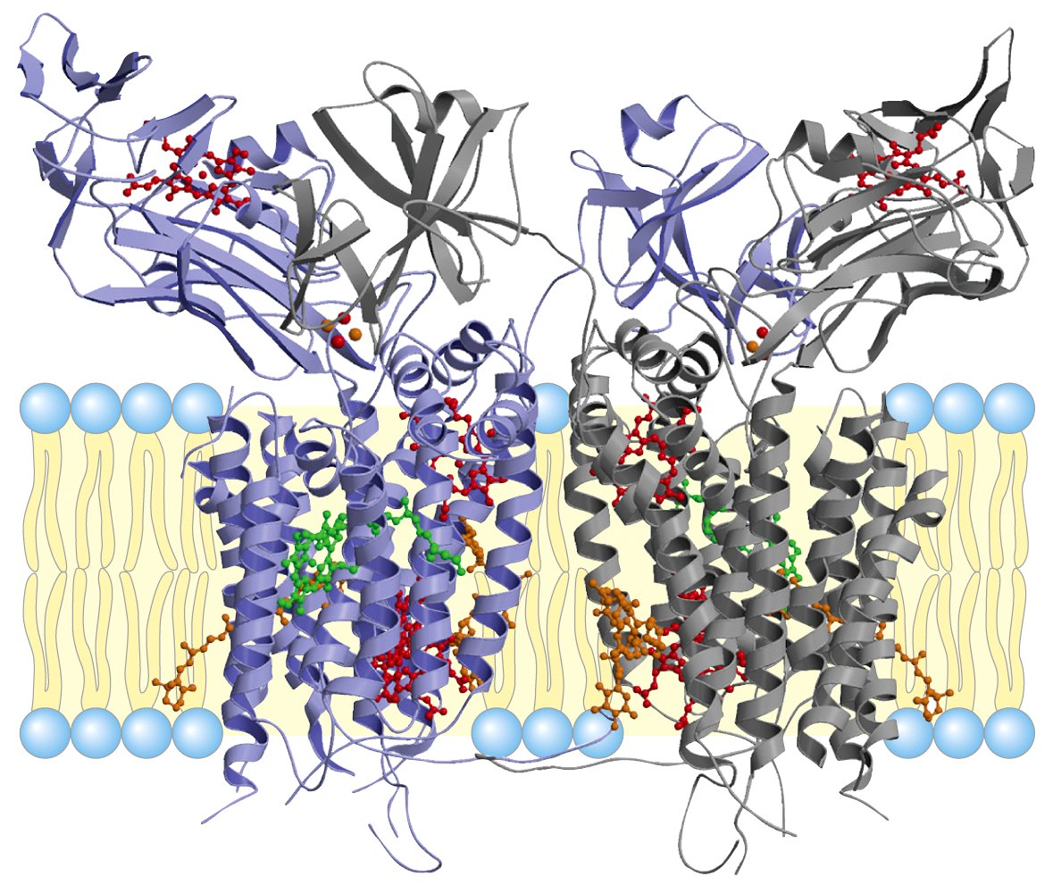
The cytochrome b6f complex

Slide 49
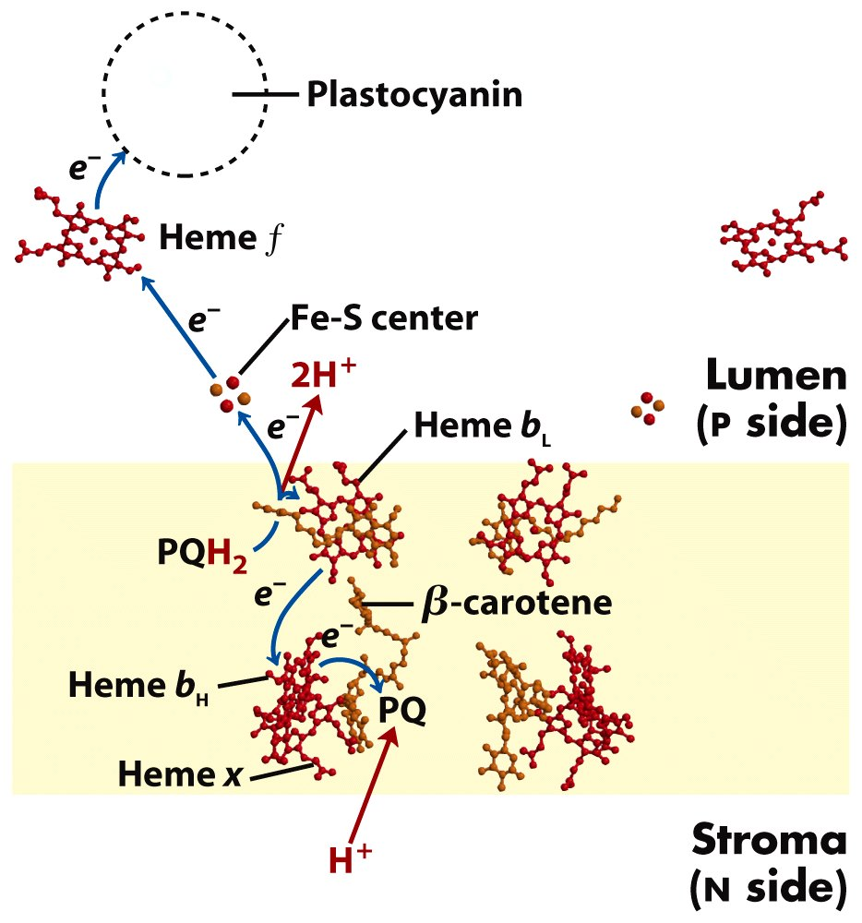
The cofactors of the cytochrome b6f complex
that are involved in electron transfers

Slide 50
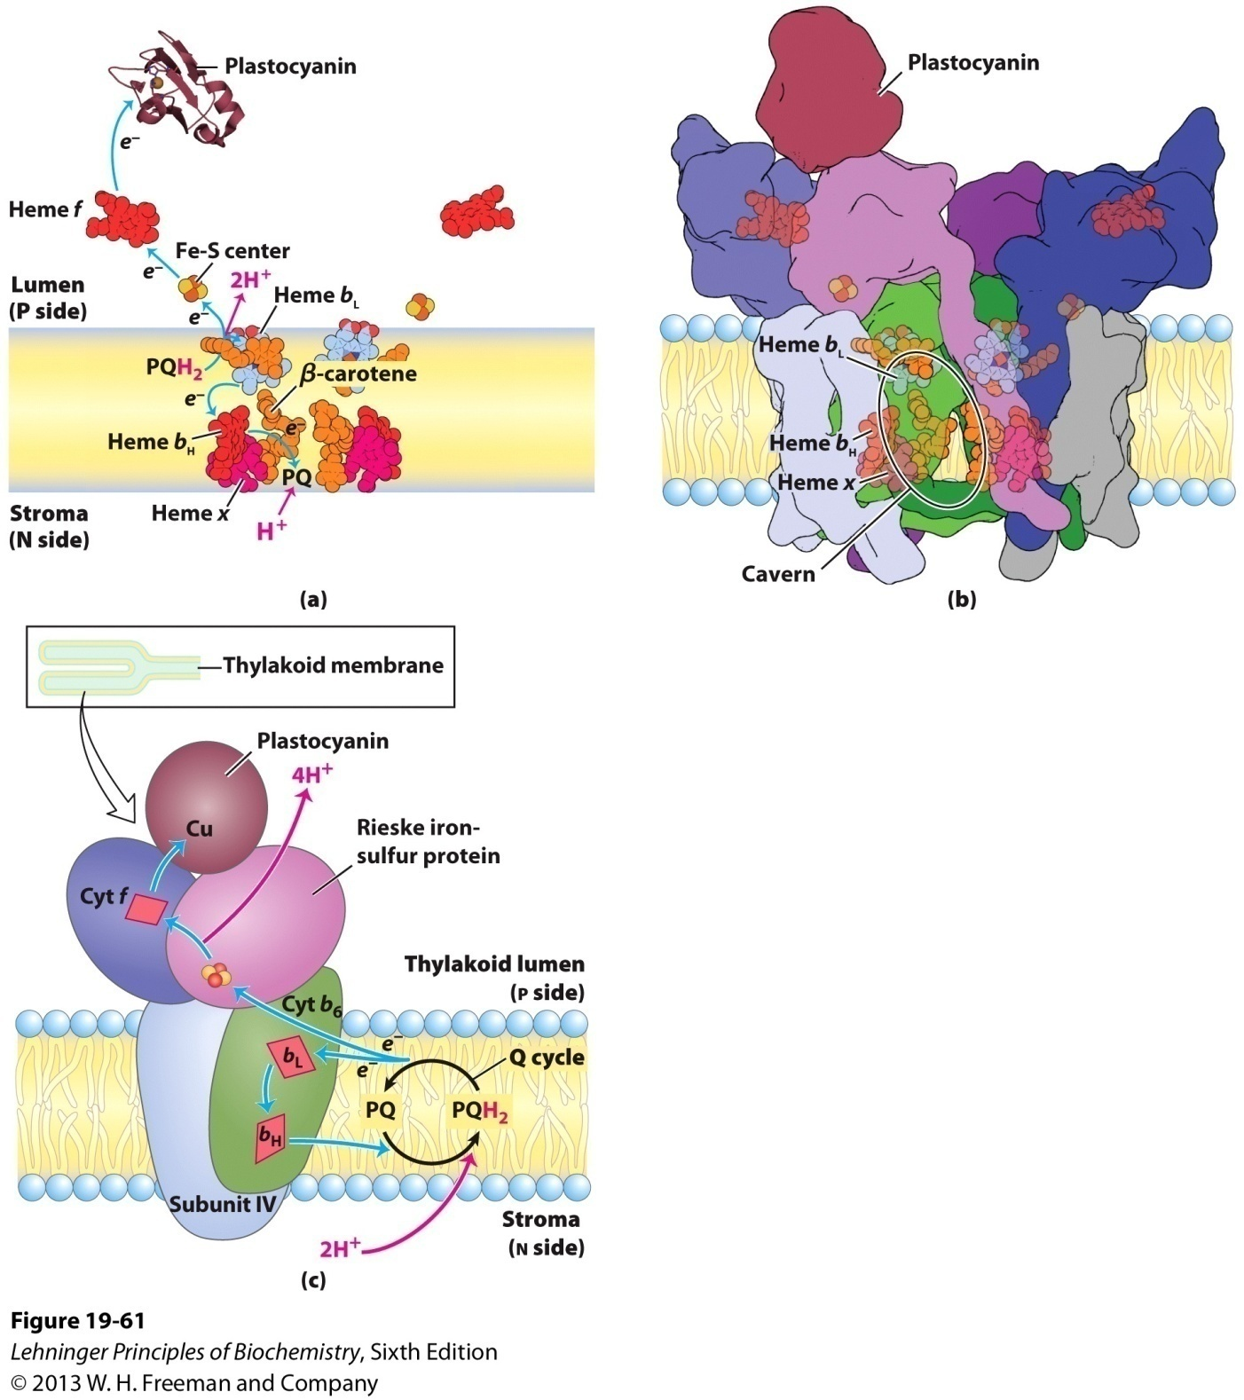
Electron and proton flow through
the cytochrome b6f complex

Slide 51
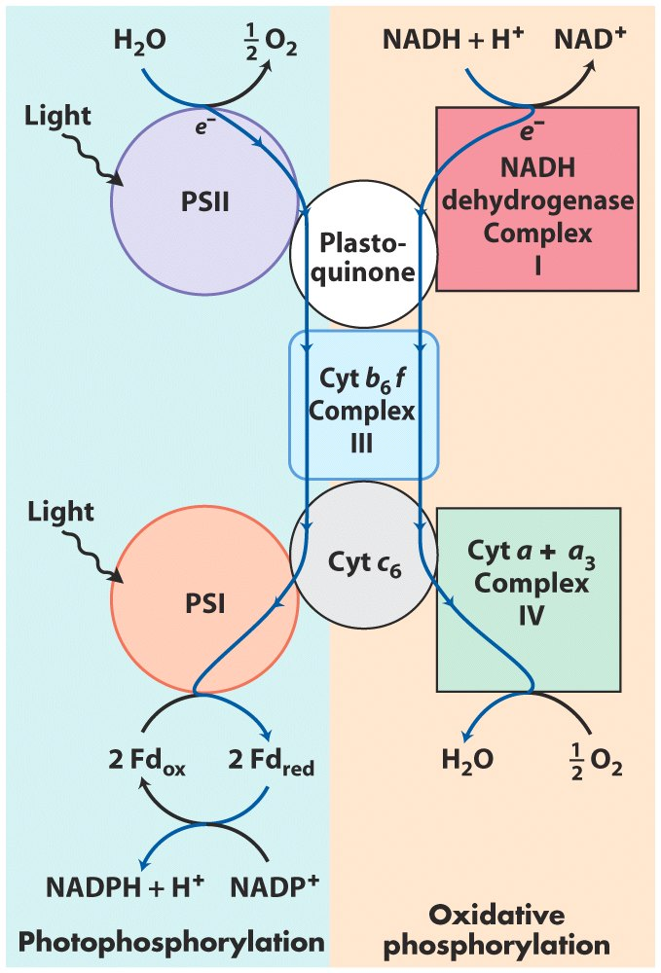
The cytochrome b6f complex
and cytochrome c6 act in both
oxidative phosphorylation
and photophosphorylation in
cyanobacteria.

Slide 52
25. P680⁺ in PSII extracts electrons from H₂O to form O₂ via a Mn-containing oxygen-evolving complex
P680⁺ first accepts electrons from a Tyr residue (often designated as Z) of the D1 subunits of PSII, producing a Tyrosyl radical (Tyr*).
Tyr* then accepts electrons from the Mn complex in the oxygen-evolving complex.
The Mn complex is believe to serve as a charge accumulator that enables O₂ to be formed (from 2 splitting H₂O) without generating hazardous partly reduced intermediates, however with mechanism yet to be elucidated.

Slide 53
The Mn complex releases H⁺ to the thylakoid lumen
while transferring electrons from H2O to Tyr via a
mechanism yet to be revealed

Slide 54
26. Photosynthetic organisms use diverse hydrogen donors
Use H₂O
2H₂O + CO₂ (CH₂O) + O₂
Use H₂S (green sulfur bacteria)
2H₂S + CO₂ (CH₂O) + 2S
Use lactate (some photosynthetic bacteria)
2 Lactate + CO₂ (CH₂O) + 2 pyruvate
General form:
2H₂D + CO₂ (CH₂O) + 2D
light
light
light
light

Slide 55
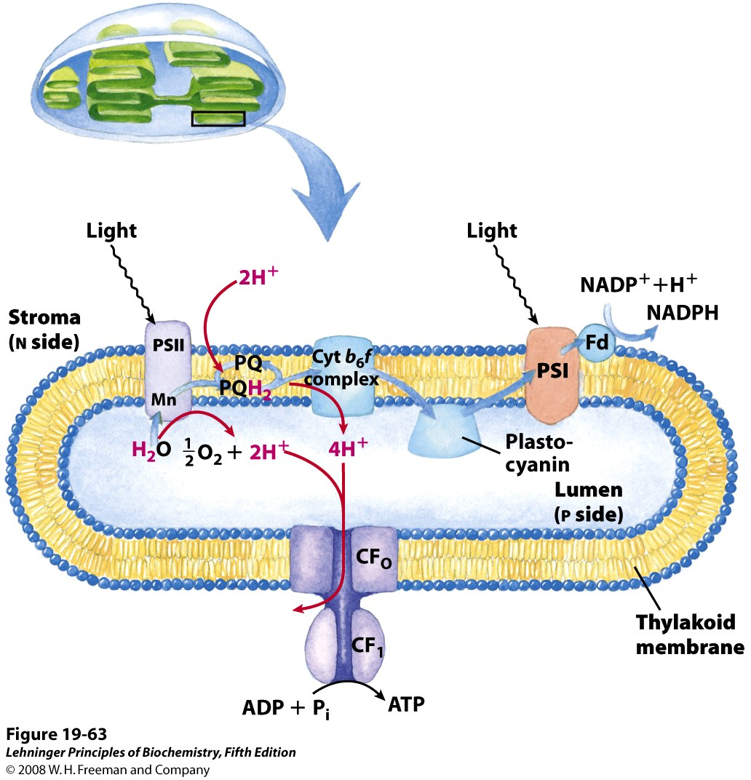
*****
Proton and electron circuits in thylakoids
2H2O + 8 photons + 2NADP⁺ + ~3ADP + ~3Pi
O2 + ~3ATP + 2NADPH

Slide 56
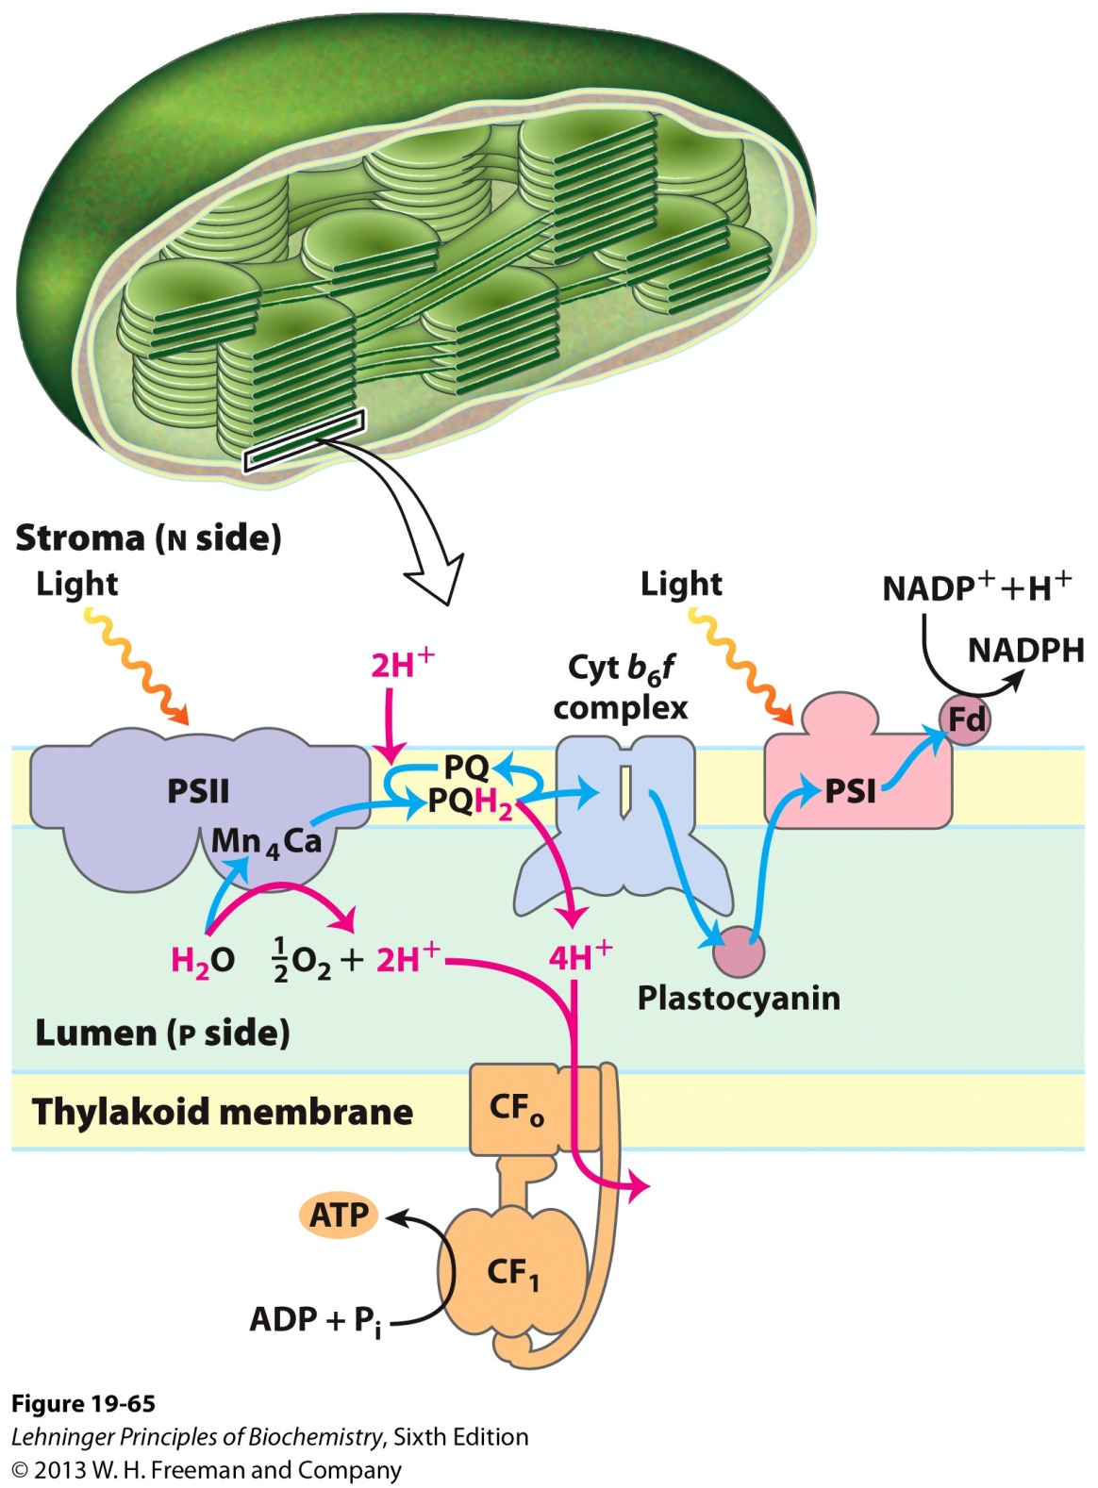
Proton and electron circuits
during photophosphorylation

Slide 57
Cyclic electron flow
is not accompanied
by net formation of
NADPH or evolution
of O2 (involves only
PSI).

Slide 58
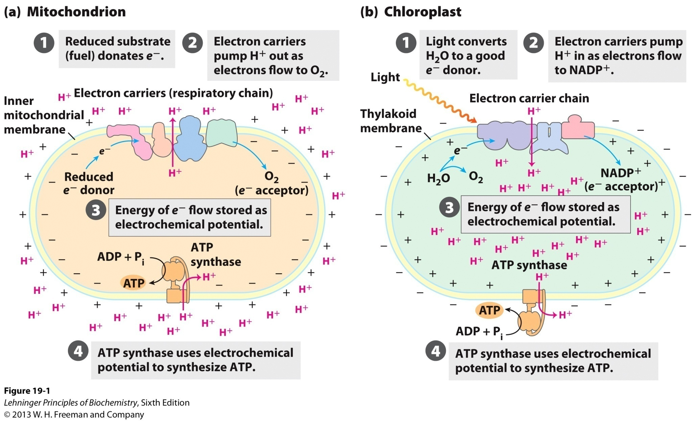
The chemiosmotic mechanism for ATP synthesis

Slide 59
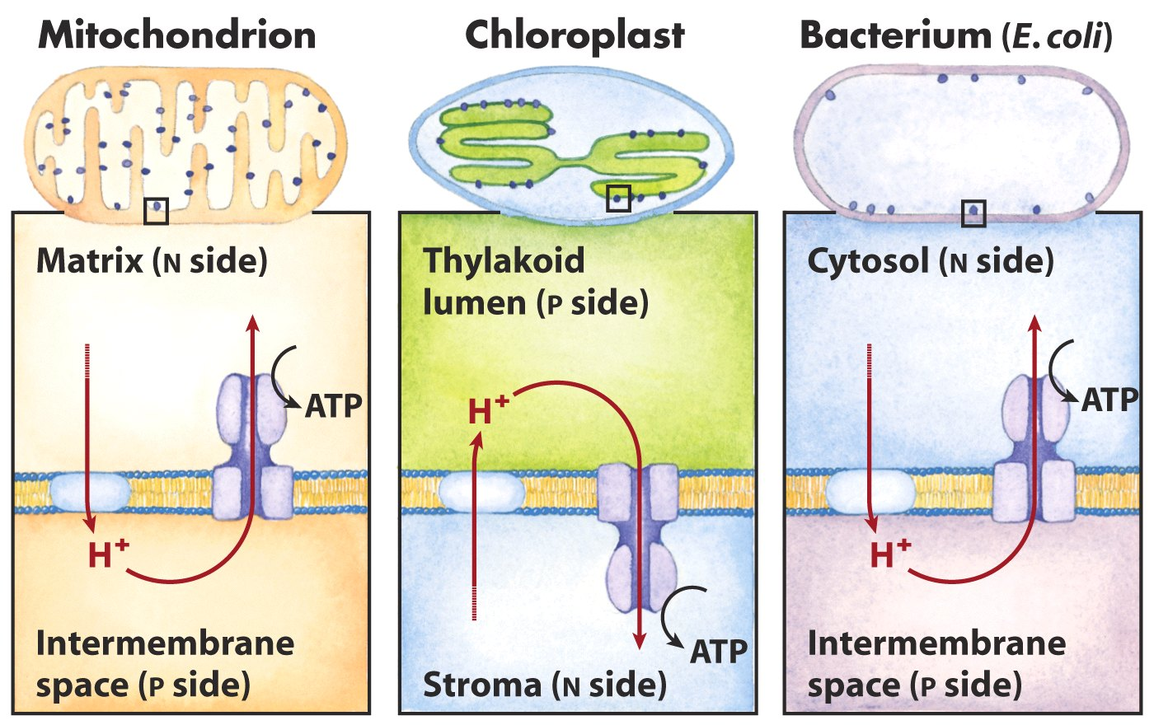
Comparison of the topology of proton movement and
ATP synthase orientation in the membranes of
mitochondria, chloroplasts and bacterium

Slide 60
Oxidative phosphorylation and photophosphorylation are mechanistically similar
1). Both involve the flow of electrons through a chain of membrane-bound carriers.
2). The energy released from “downhill” electron flow is first used for “uphill” pumping of protons to produce a proton gradient (thus a transmembrane electrochemical potential) cross a biomembrane.
3). ATP is then synthesized by a “downhill” transmembrane flow of protons through a specific protein machinery (ATP synthase).

Slide 61
ATP is synthesized using the same strategy in oxidative phosphorylation and photophosphorylation
Oxidative phosphorylation is the process in which ATP is generated as a result of electron flow from NADH or FADH₂ to O₂ via a series of membrane-bound electron carriers called the respiratory chain (reducing O₂ to H₂O at the end)----氧化磷酸化
Photophosphorylation is the process in which ATP (and NADPH) is synthesized as a result of electron flow from H₂O to NADP⁺ via a series of membrane-bound electron carriers (oxidizing H₂O to O₂ at the beginning)----光合磷酸化

Slide 62
Differences
between oxidative phosphorylation and photophosphorylation
1). The organelle in which the process occurs: mitochondrion vs. chloroplast
2). The initial source of electrons:
NADH or FADH₂ vs. H₂O (or H₂S, or organic hydrogen donors)
3). Source of energy for the electron donors:
fuel molecules vs. photons
4). Final electron acceptor: O₂ vs. NADP⁺

Slide 63
Keywords
Photophosphorylation
--- generates both ATP and NADPH
Oxidative phosphorylation and
photophosphorylation
--- similarities and differences

Slide 64
Words of the week
substrate-level phosphorylation
oxidative phosphorylation
photophosphorylation

Slide 65
Text-book reading of the week
Summary 19.6 (p770)
Summary 19.7 (p776)
Summary 19.8 (p786)
Summary 19.9 (p788)
p786-788 (ATP synthesis by photophosphorylation)

Slide 66
Summary
ATP is synthesized using the same strategy in oxidative phosphorylation and photophosphorylation.
Photosynthetic organisms generate ATP (and NADPH) via photophosphorylation.
The major light absorbing pigments on thylakoid membrane are chlorophylls.
Photons absorbed by many chlorophylls funnel into one reaction center via exciton transfer.
Two types of photochemical reaction centers have been revealed in bacteria.
Two photosystems (II and I) work in tandem to move electrons from H₂O to NADP⁺ in higher plants.
P680⁺ in PSII extracts electrons from H₂O to form O₂ via a Mn-containing oxygen-evolving complex.

