Slide 1
Chapter 20
Carbohydrate Biosynthesis
Gluconeogenesis: the universal pathway for synthesis of glucose (Ch14)
Coordinated regulation of glycolysis and gluconeogenesis (Ch15)
Biosynthesis of glycogen, starch, and sucrose (Ch15 & 20)
Coordinated regulation of glycogen breakdown and synthesis (Ch15)
CO₂ fixation in plants (the Calvin Cycle) (Ch20)
Regulation of carbohydrate metabolism
in plants (Ch20)

Slide 2
1. Carbohydrates are synthesized from simple precursors via gluconeogenesis (糖异生)
A few three-carbon compounds (including lactate, pyruvate, glycerol, and 3-phosphoglycerate) serve as the major precursors for carbohydrate (glucose) biosynthesis or gluconeogenesis.
The reactions of gluconeogenesis are essentially the same in different organisms.
The conversion of pyruvate to glucose is the central pathway in gluconeogenesis.

Slide 3
2. The opposing pathways of glycolysis and gluconeogenesis have 3 reactions different and 7 reactions in common
The reversible reactions between pyruvate and glucose are shared by gluconeogenesis and glycolysis, but the irreversible reactions are different (“bypassed” in gluconeogenesis).

Slide 4
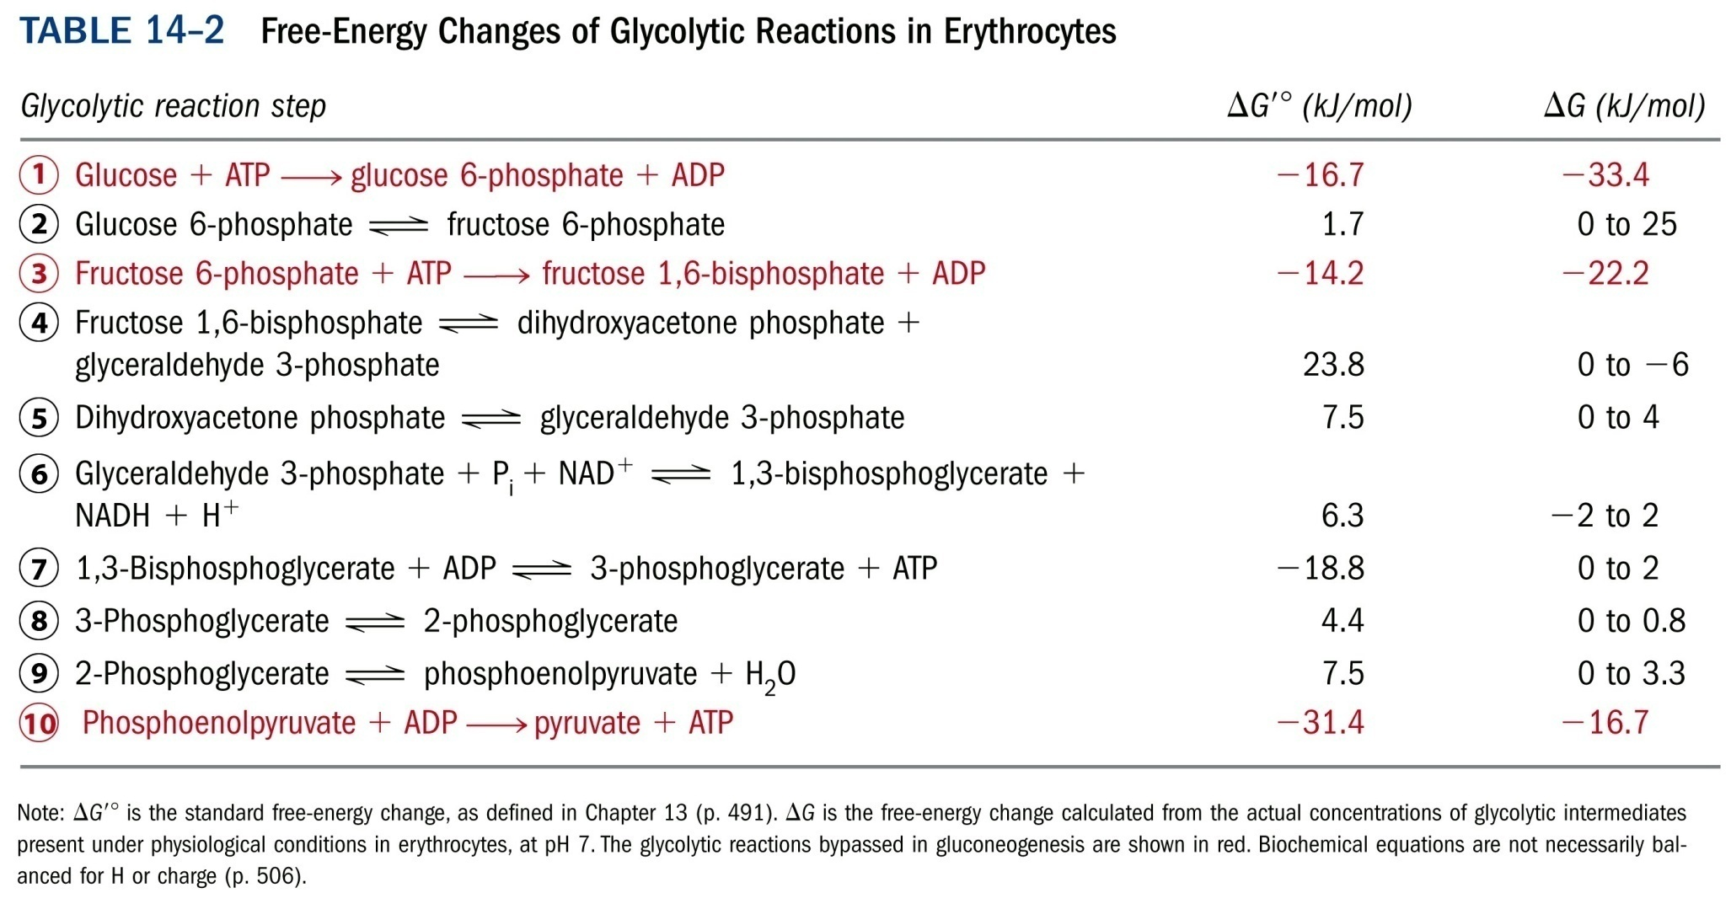

Slide 5
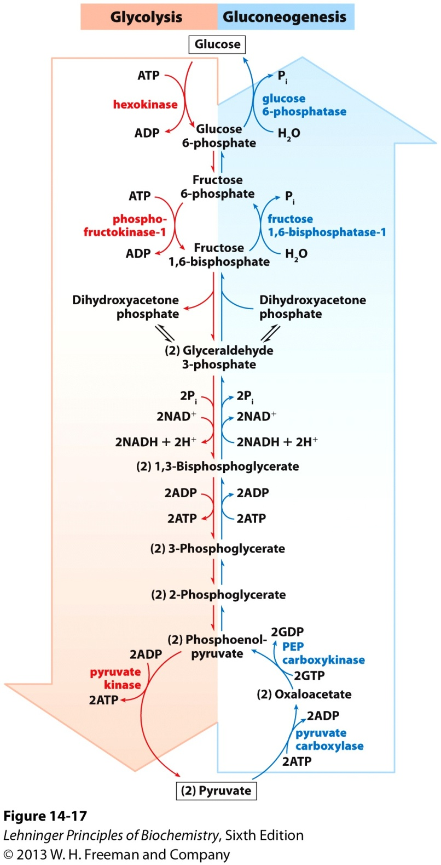
Opposing pathways of
glycolysis and
gluconeogenesis: with 3
different and 7 common
reactions*****

Slide 6
3. Pyruvate is converted to phosphoenolpyruvate (PEP) via two alternative paths
In both paths, pyruvate is converted to oxaloacetate (with the catalysis of pyruvate carboxylase) in mitochondria.
In one path, oxaloacetate is converted directly to PEP in the matrix of mitochondria in a reaction catalyzed by the mitochondrial PEP carboxykinase isozyme, PEP is then transported to the cytosol for further conversion.

Slide 7
In another path (when pyruvate is the precursor), oxaloacetate is first converted to malate in the matrix, which is then transported to the cytosol, where it is converted to oxaloacetate, and then PEP in a reaction catalyzed by cytosolic PEP carboxykinase isozyme.
Both paths involve a carboxylation-decarboxylation sequence, acting as a unique way to activate pyruvate.
Two high-energy phosphate equivalents must be expended to convert one pyruvate to one PEP.

Slide 8
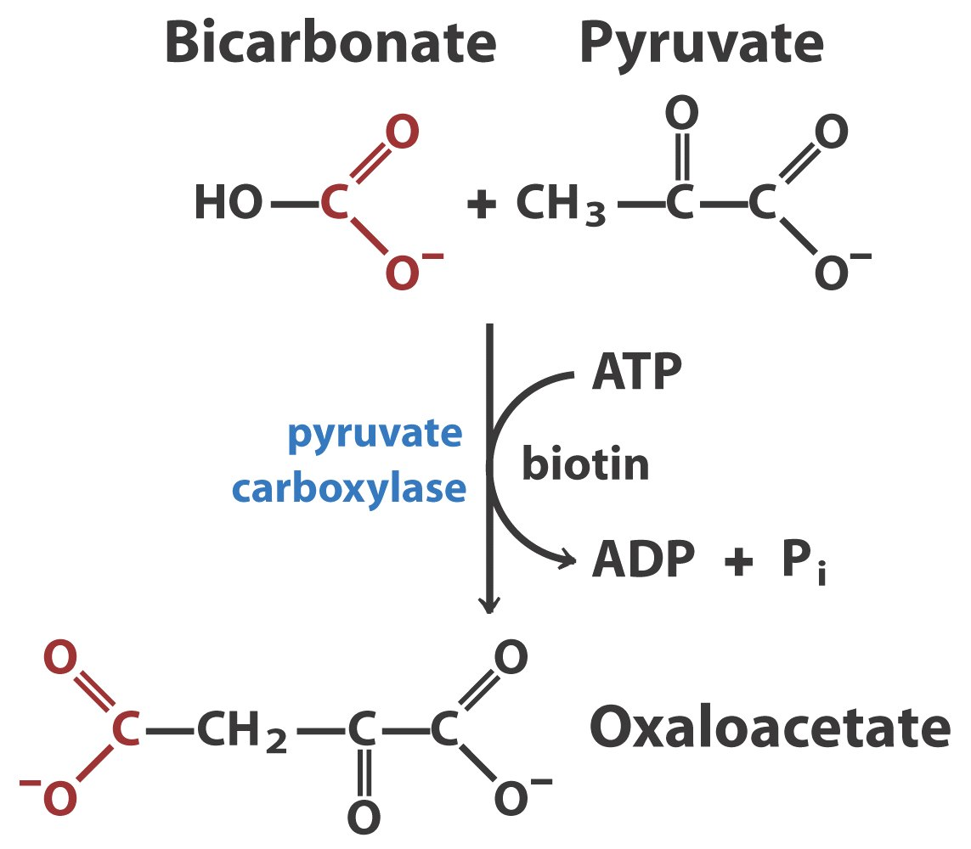
Pyruvate carboxylase: the first regulatory enzyme in
gluconeogenesis, requires acetyl-CoA as a positive effector

Slide 9
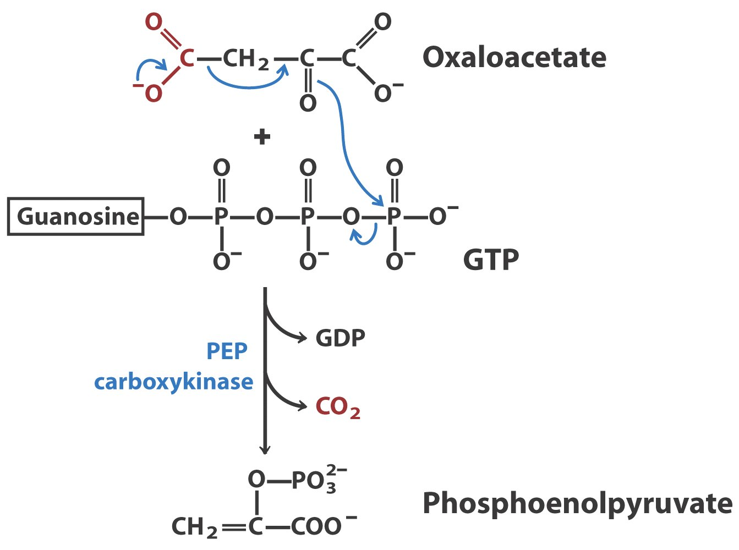

Slide 10
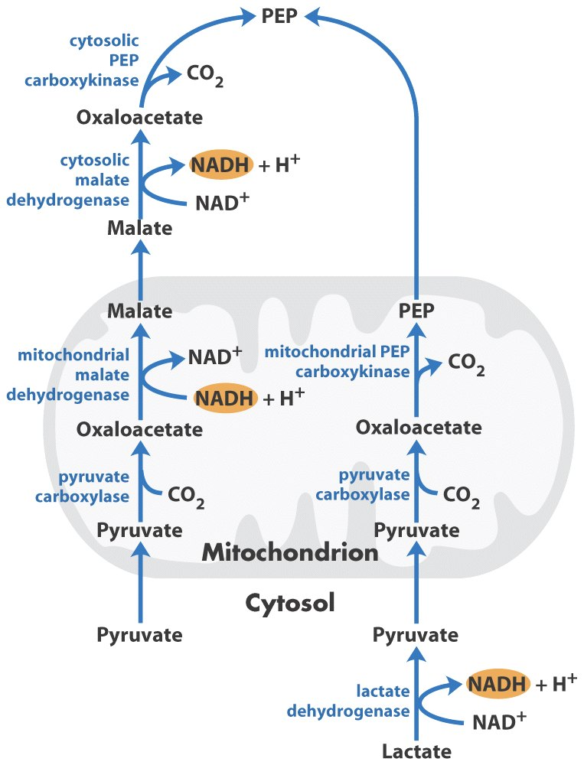
From pyruvate
to PEP: two
alternative paths
Pyruvate + ATP + GTP + HCO3⁻
phosphoenolpyruvate + ADP + GDP + Pi + CO2
ΔG'º = 0.9 kJ/mol

Slide 11
4. Conversion of fructose 1,6-bisphosphate to fructose 6-phosphate is the second bypassing step
The reaction is catalyzed by Mg ²⁺-dependent fructose 1,6-bisphosphatase (instead of phosphofructokinase-1).
Fructose 1,6-bisphosphate + H₂O
fructose 6-phosphate + P_{i}
ΔG'º = -16.3 kJ/mol

Slide 12
5. The conversion of glucose 6-phosphate to glucose is the last bypassing step
The reaction is catalyzed by glucose 6-phosphatase (instead of hexokinase).
The enzyme is present on the lumenal side of the endoplasmic reticulum of hepatocytes and renal cells.
The enzyme is not present in muscle or brain cells, where gluconeogenesis does not occur.
Glucose produced by gluconeogenesis is delivered to muscle or brain through the bloodstream.
Glucose 6-phosphate + H₂O glucose + P_{i}
ΔG'º = -13.8 kJ/mol

Slide 13
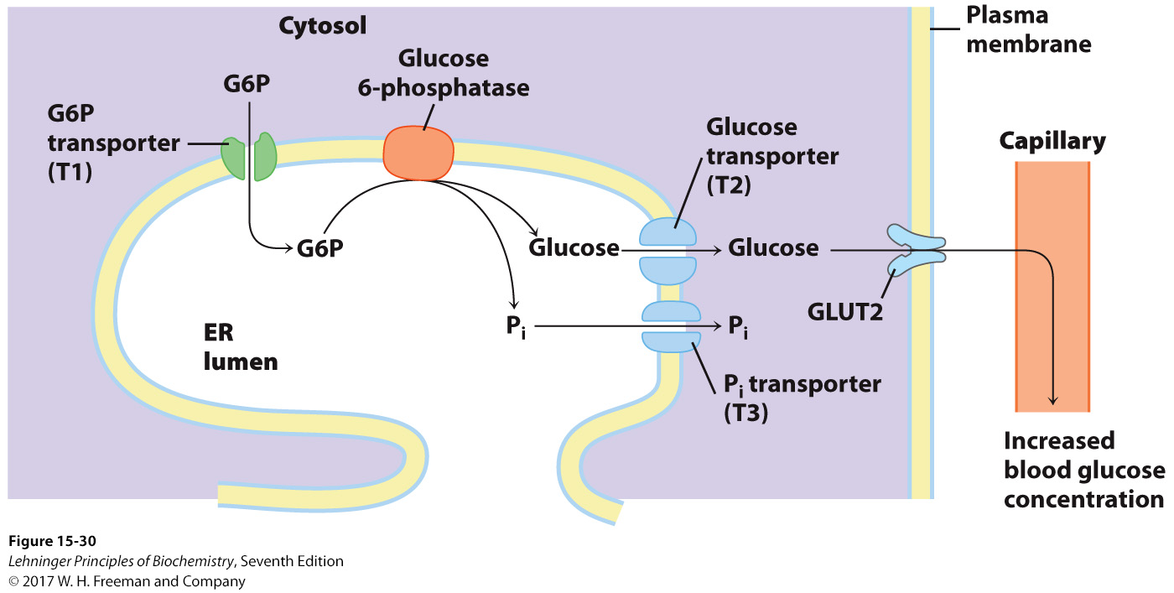
Hydrolysis of glucose 6-phosphate by
glucose 6-phosphatase of the ER
Notes:
FIGURE 15–30 Hydrolysis of glucose 6-phosphate by glucose 6-phosphatase of the ER. The catalytic site of glucose 6-phosphatase faces the lumen of the ER. A glucose 6-phosphate (G6P) transporter (T1) carries the substrate from the cytosol to the lumen, and the products glucose and P_{i} pass to the cytosol on specific transporters (T2 and T3). Glucose leaves the cell via the GLUT2 transporter in the plasma membrane.

Slide 14
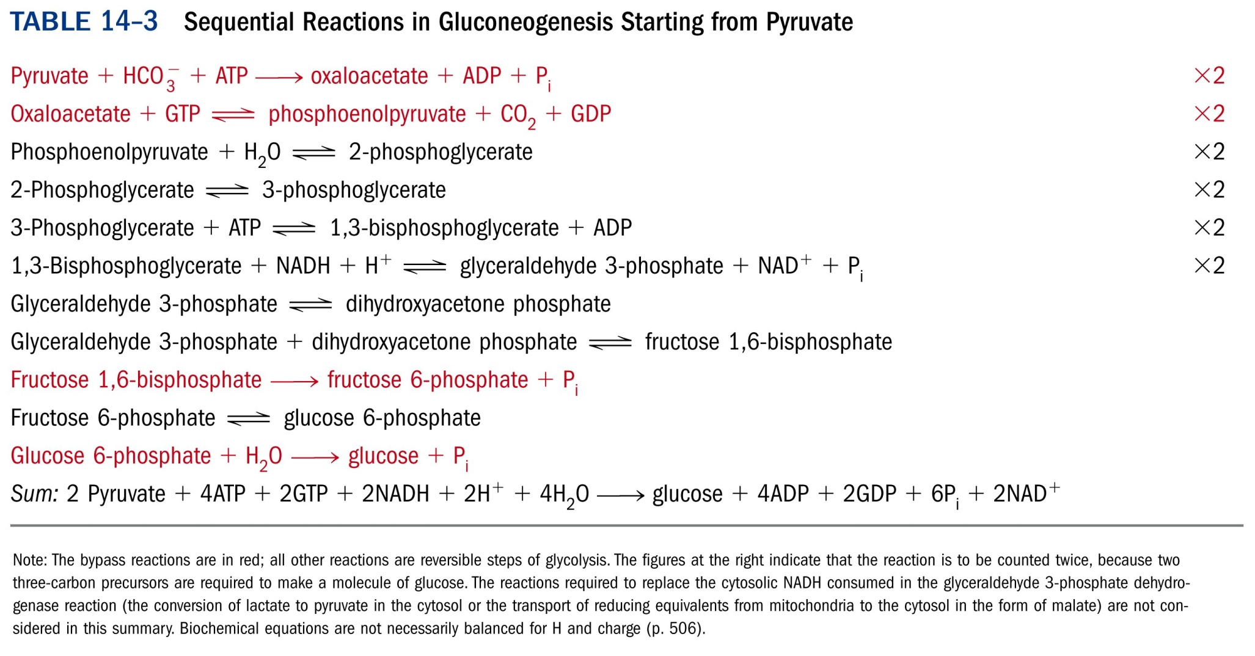
*****

Slide 15
6. More energy is consumed in gluconeogenesis than produced in glycolysis
Six high-energy phosphate groups are required when two molecules of pyruvate are converted to one glucose via gluconeogenesis pathway.
Two molecules of ATP are produced when one glucose molecule is converted to two pyruvate molecules via glycolysis pathway.
The NADH needed for gluconeogenesis is either provided by lactate dehydrogenation in the cytosol or exported from mitochondria matrix via malate during one path for converting pyruvate to PEP.

Slide 16
Both glycolysis and gluconeogenesis are essentially irreversible processes
Gluconeogenesis
2 Pyruvate + 4ATP + 2GTP + 2NADH + 4H₂O
glucose + 4ADP + 2GDP + 6P_{i} + 2NAD⁺ + 2H⁺
ΔG = -16 kJ/mol
Glycolysis
Glucose + 2ADP + 2P_{i} + 2NAD⁺
2 Pyruvate + 2ATP + 2NADH + 2H⁺ +2H₂O
ΔG = -63 kJ/mol

Slide 17
7. Many amino acids but not fatty acids are glucogenic in mammals
The amino acids that can be converted to pyruvate or citric acid cycle intermediates are glucogenic.
Net conversion of acetyl-CoA to pyruvate (the oxidative decarboxylation of pyruvate is irreversible) or oxaloacetate does not occur in mammals, thus neither Lys nor Leu nor even-numbered fatty acids are glucogenic in mammals; but net conversion of acetyl-CoA to oxaloacetate occurs in organisms like plants and bacteria that have the glyoxylate cycle.
Fatty acid oxidation provide an important energy source for gluconeogenesis.

Slide 18
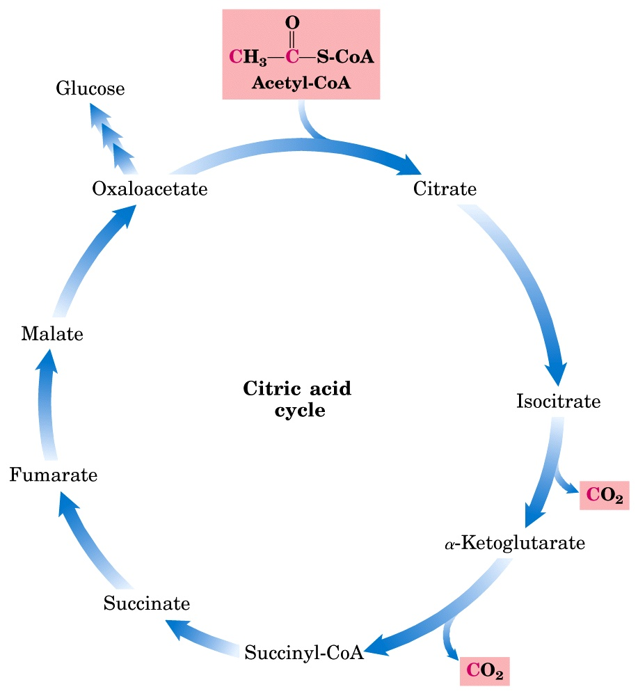
Glucose can also be synthesized from intermediates
of the citric acid cycle

Slide 19
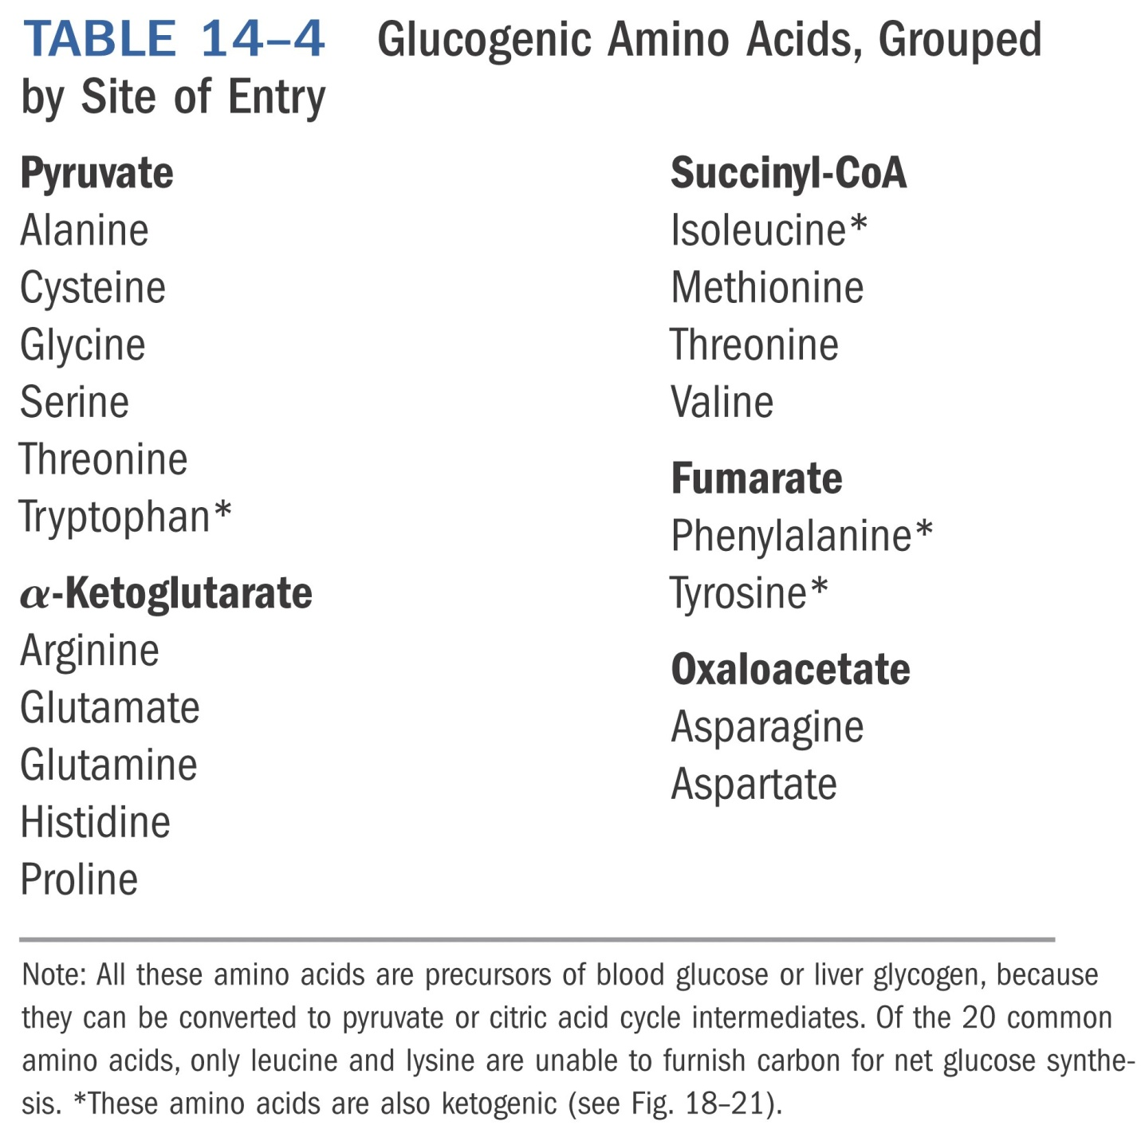
*****

Slide 20
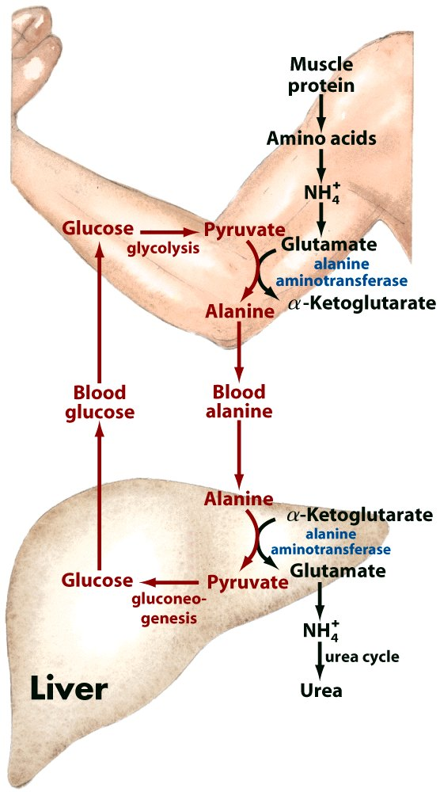
Glucose-alanine cycle

Slide 21
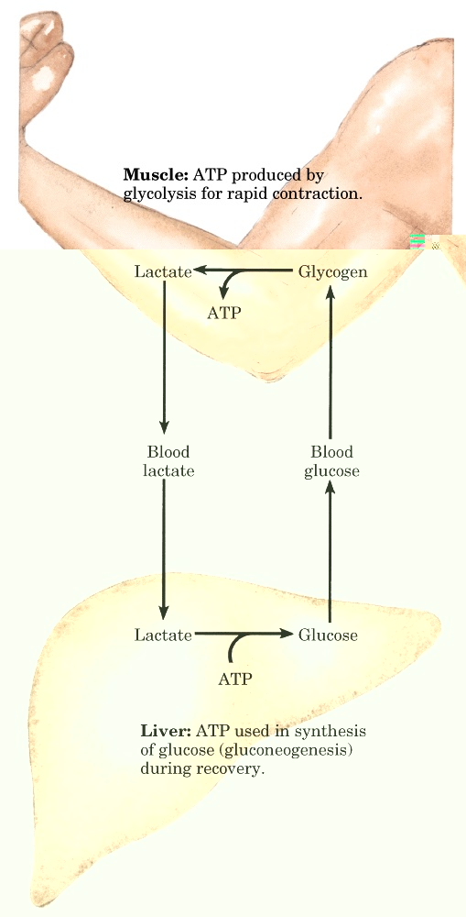
Cori cycle

Slide 22
8. Gluconeogenesis and glycolysis are reciprocally regulated to avoid futile cycles that waste ATP consumption
If the three pairs of bypassing reactions of glucose degradation and synthesis occur simultaneously, ATP will be consumed for heat generation, being often (not always) an energy wasting process.
To avoid such futile cycling processes, the two pathways are regulated coordinately and reciprocally: a common regulator molecule having opposite effect towards the pair of enzymes catalyzing the bypassing reactions.

Slide 23
9. Acetyl-CoA, AMP, and fructose 2,6-bisphosphate act reciprocally to coordinate both pathways
Acetyl-CoA inhibits the pyruvate dehydrogenase complex of glycolysis, but activates the pyruvate carboxylase of gluconeogenesis.
AMP inhibits fructose 1,6-bisphosphatase (FBPase-1), but activates phosphofructokinase-1 (PFK-1).
Fructose-2,6-bisphosphate (a regulator, not an intermediate) in liver cells, activates PFK-1 and inhibits FBPase-1.

Slide 24
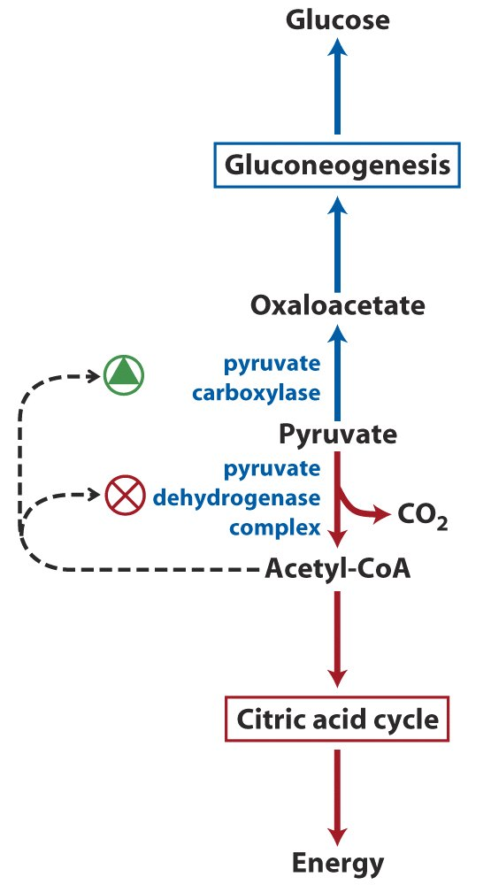
The alternative fates
of pyruvate are
coordinately regulated
by acetyl-CoA

Slide 25
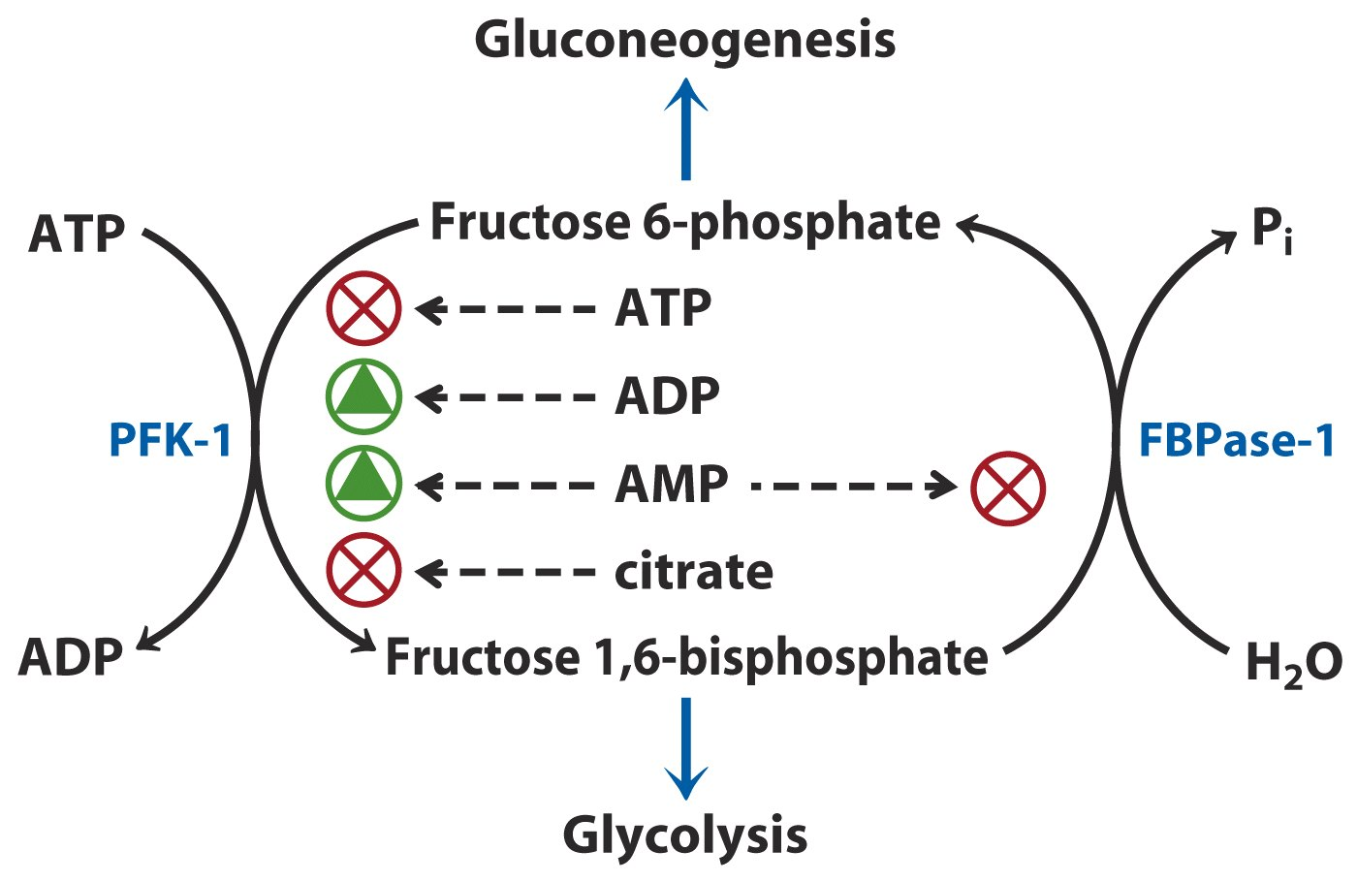
Regulation of PFK-1 and FBPase-1*****

Slide 26
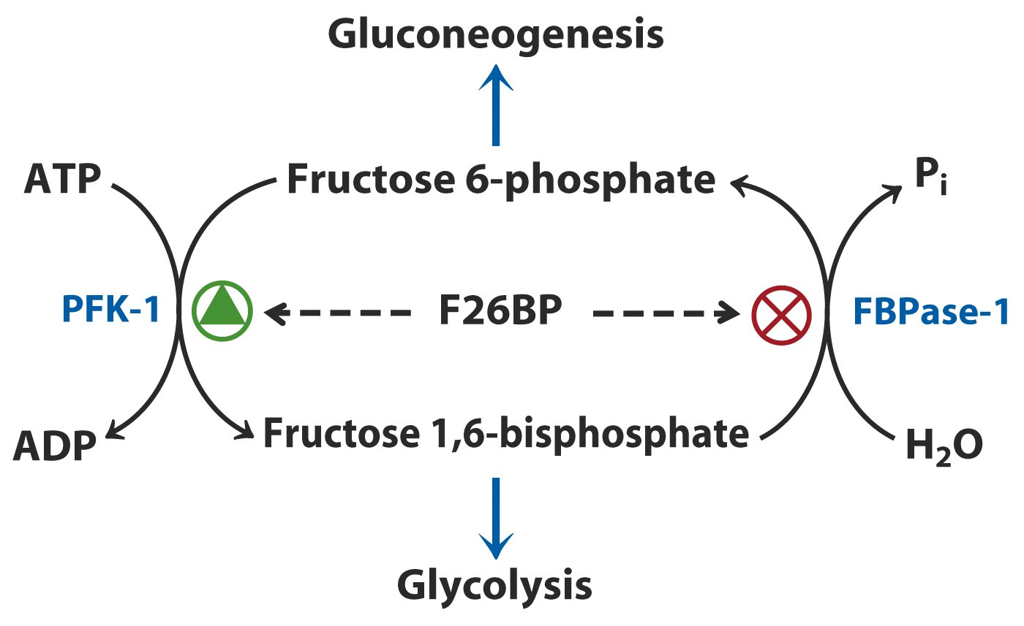
Regulation of PFK-1 and FBPase-1
by fructose-2,6-bisphosphate (F26BP)*****

Slide 27
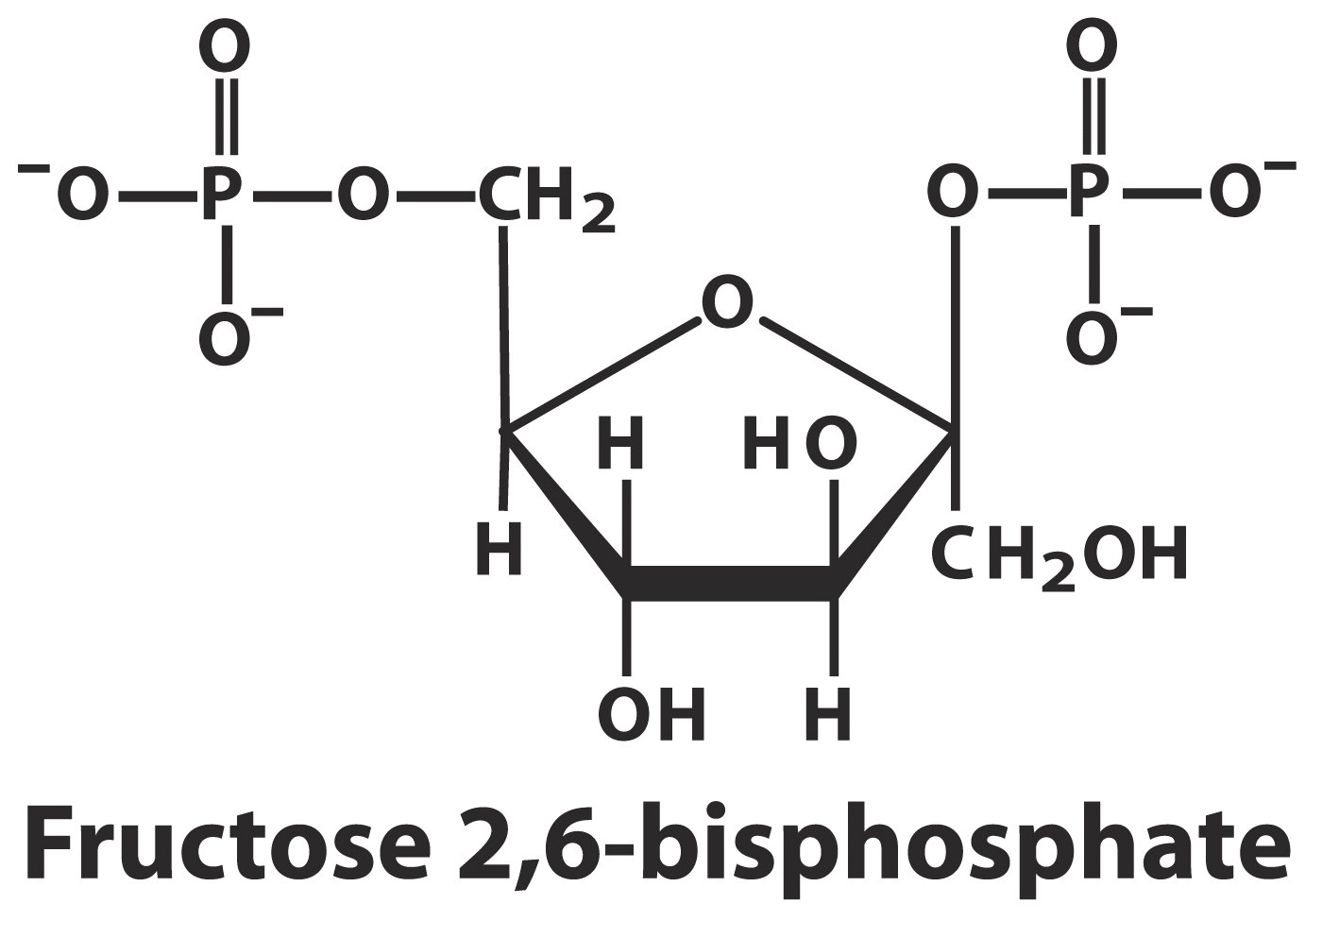

Slide 28
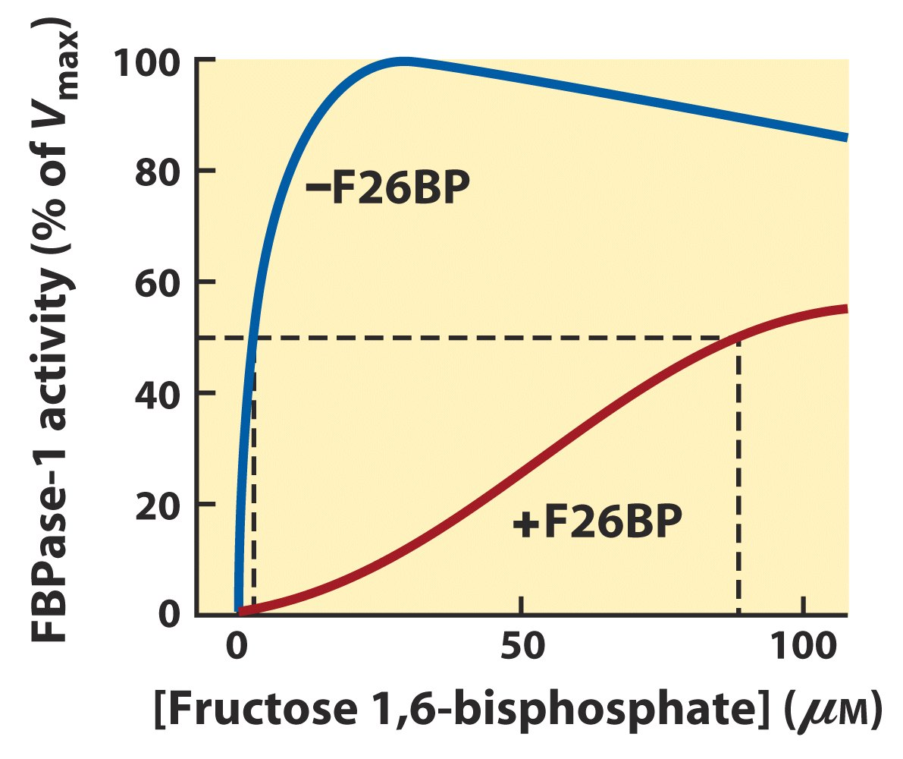
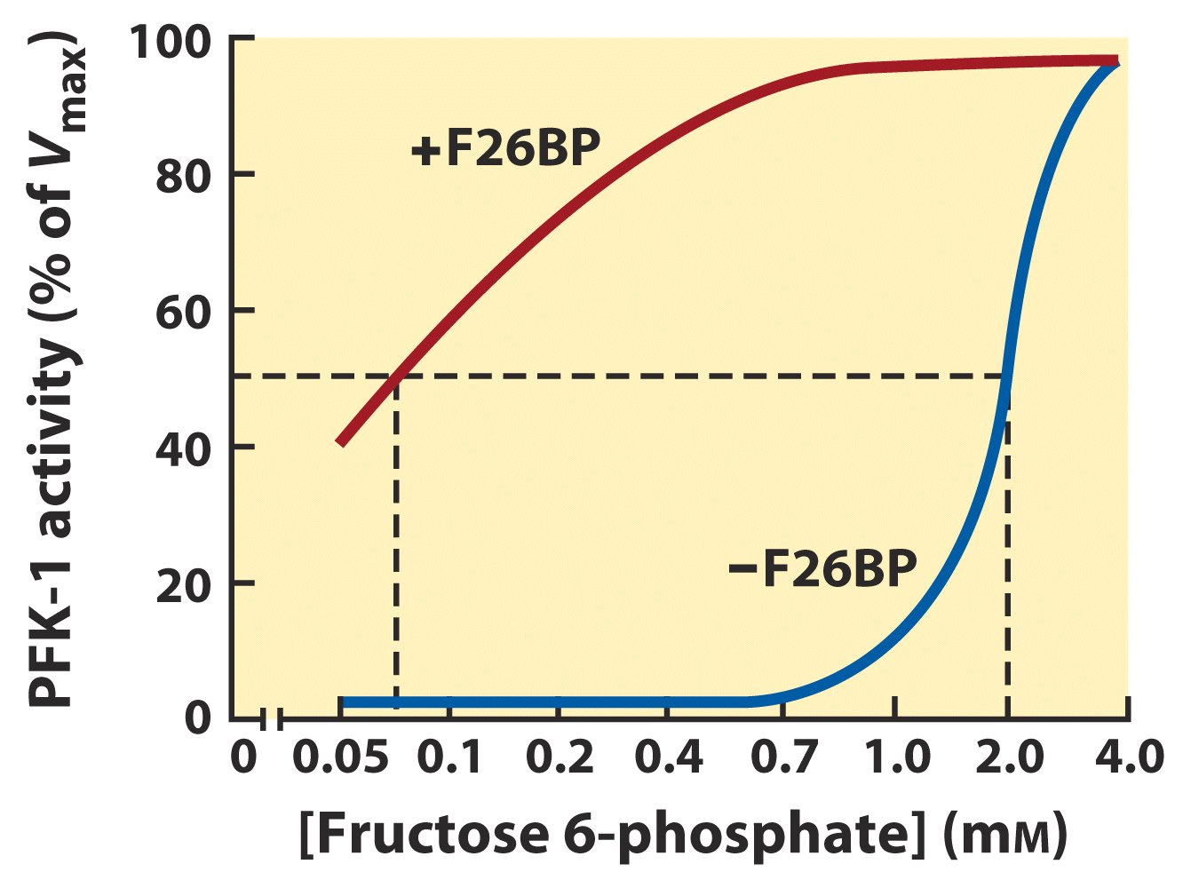
(25μM)
(0.13μM)
F-2,6-BP activates
PFK-1, but inhibits
FBPase-1

Slide 29
F-2,6-bisphosphate is synthesized from (and degraded to) fructose 6-phosphate in a reaction catalyzed by phosphofructokinase-2 (PFK-2) (and fructose-2,6-bisphosphatase (FBPase-2).
PFK-2 and FBPase-2 are two distinct activities of a single, bifunctional protein.
Glucagon stimulates the phosphorylation of PFK-2/FBPase-2, which inhibits the PFK-2 activity, but activates the FBPase-2 activity, thus inhibiting the glycolysis, but stimulating the gluconeogenesis.

Slide 30
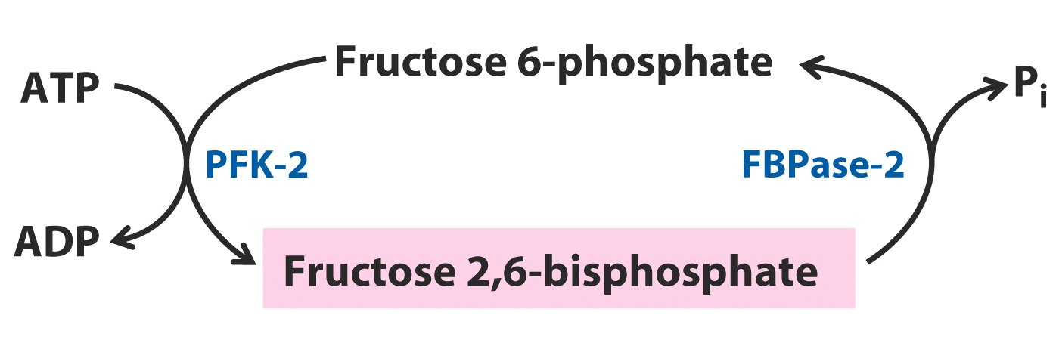
The level of F-2,6-BP is controlled by the
relative activity of PFK-2 and FBPase-2,
which are located on one polypeptide
chain and whose activities are regulated
by glucagon-stimulated phosphorylation.

Slide 31
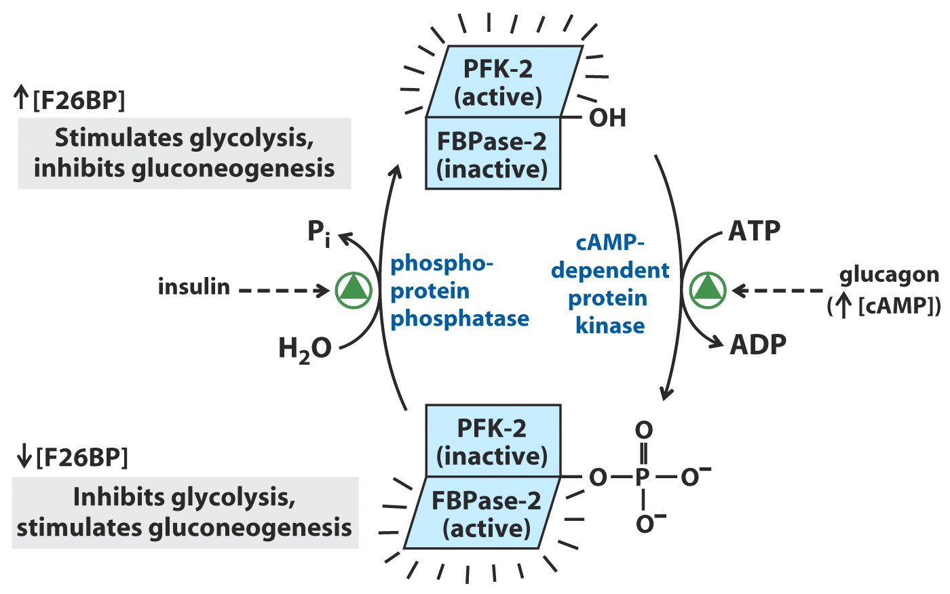
(胰岛素)
(胰高血糖素)
FPK-2 and FBPase-2 are regulated,
in a reciprocal way, by glucagon and insulin*****

Slide 32
10. Fatty acids in germinating seeds can be converted to sucrose
This occurs via four pathways: β-oxidation, glyoxylate cycle, citric acid cycle and gluconeogenesis.
The whole conversion finishes in three compartments of the cell: glyoxysomes, mitochondrion, and cytosol.
Sucrose is used as a major source for energy and biosynthetic precursors for the initial growth of plants.

Slide 33
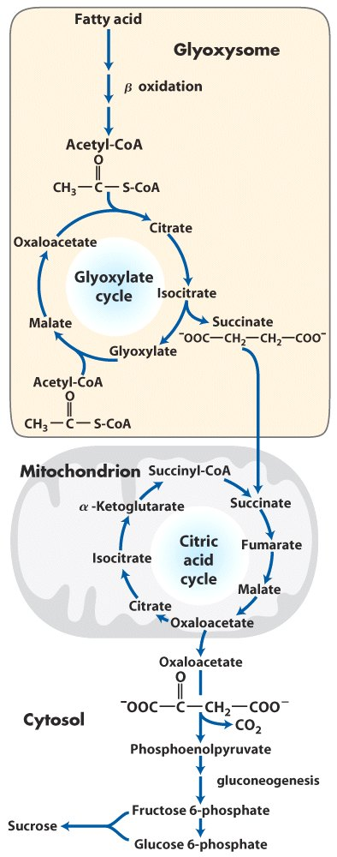
The transport form
of carbon in plants
Conversion of stored fatty acids to sucrose in germinating seeds

Slide 34
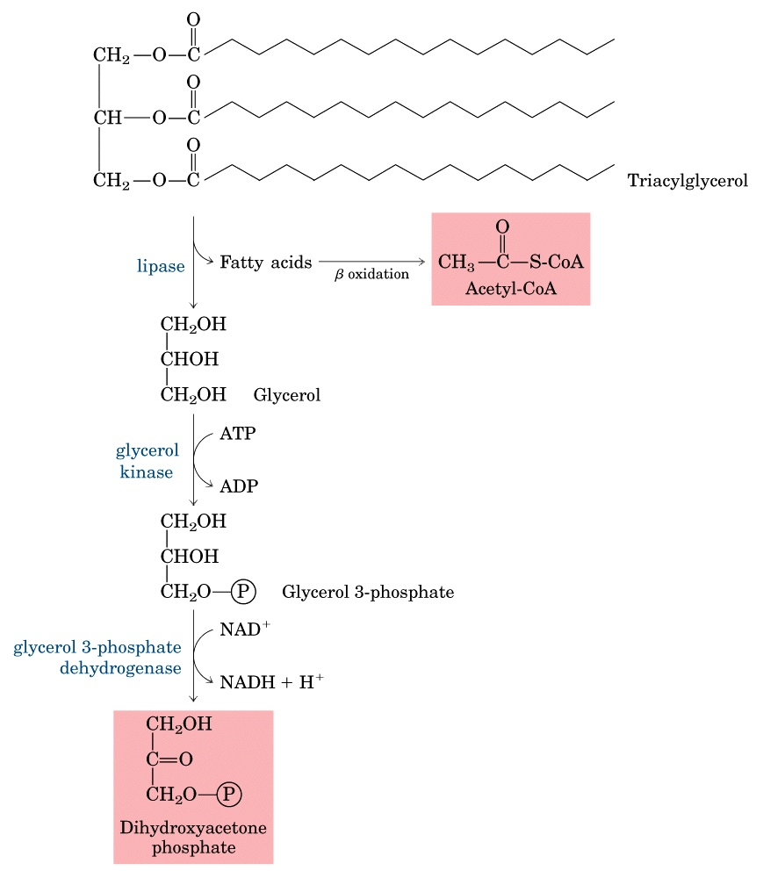
Conversion of the glycerol
moiety of triacylglycerols
to sucrose in germinating seeds
(Fig. 20-34)

Slide 35
11. Hexoses are converted to sugar nucleotides before being polymerized
Glycogen was initially thought to be synthesized by a simple reverse of phosphorolysis.
Leloir discovered in 1949 that one hexose is transformed to another via sugar nucleotide and he found in 1959 that glycogen is synthesized from UDP-glucose!
Hexose nucleotides are common precursors for carbohydrate transformation and polymerization.
A hexose nucleotides is formed via a condensation reaction occurring between a NTP and a hexose 1-phosphate.

Slide 36
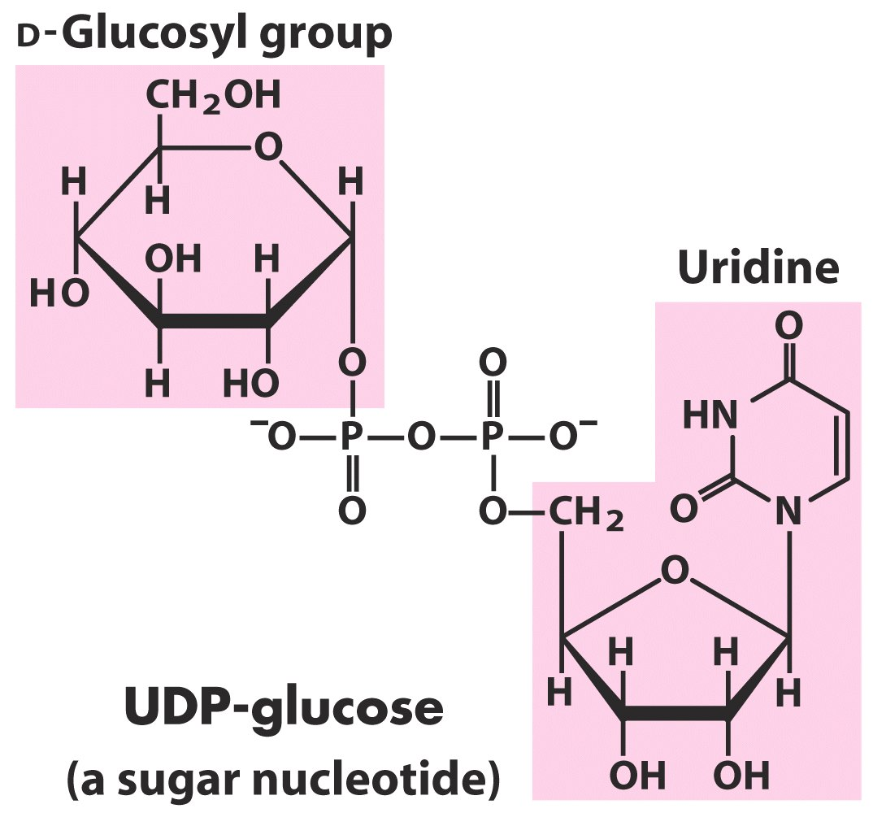
Sugar nucleotides were found to be the activated forms of sugars participating in biosynthesis

Slide 37
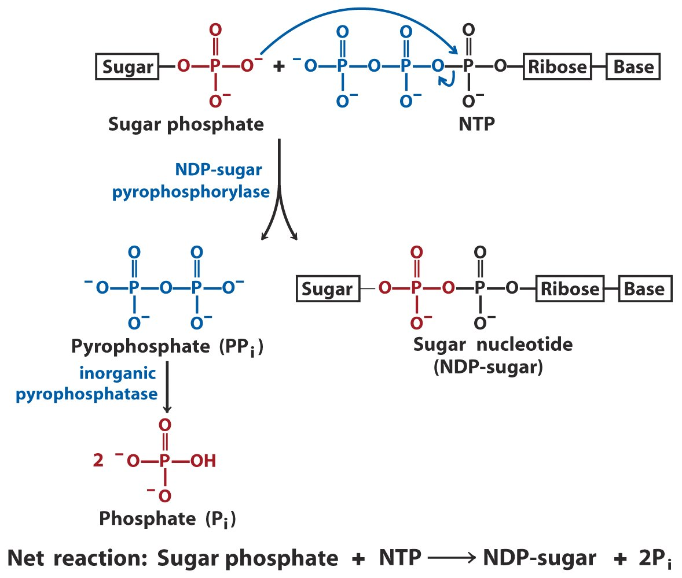
A sugar nucleotide is formed through a condensation reaction between a NTP and a sugar phosphate

Slide 38
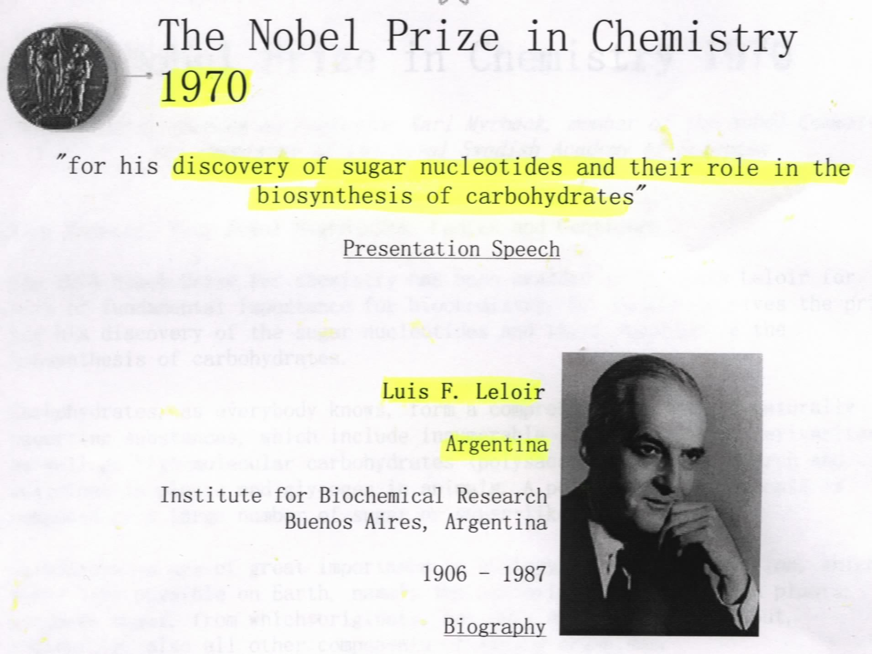

Slide 39
12. Glycogen is synthesized using UDP-glucose
Glucose 6-phosphate (from glucose phosphorylation or gluconeogenesis) is converted to glucose 1-phosphate (catalyzed by phosphoglucomutase), which then condenses with UTP to form UDP-glucose in a reaction catalyzed by UDP-glucose pyrophosphorylase (named for the reverse reaction).
The glucose residue of UDP-Glucose is transferred to the nonreducing end of a primer or glycogen branch (of at least 4 glucose residues) to make a new α-1,4 glycosidic bond in a reaction catalyzed by glycogen synthase.

Slide 40
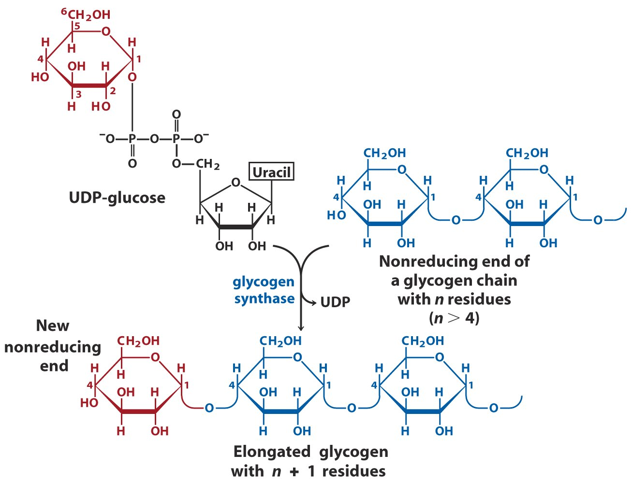
Glycogen is extended from the nonreducing end using UDP-glucose

Slide 41
The formation of (α1→6) branches of glycogen is catalyzed by glycosyl-(4→6)-transferase: a terminal fragment of 6 or 7 residues is transferred from a branch having at least 11 residues to the C-6 hydroxyl group at a more interior position of the same or another glycogen chain.
The very first glucose residue, transferred from UDP-glucose, is covalently attached to Tyr¹⁹⁴ of glycogenin, a 37 kD protein that also catalyzes the assembly of the first 8 glucose residues in a complex formed between glycogenin and glycogen synthase.

Slide 42
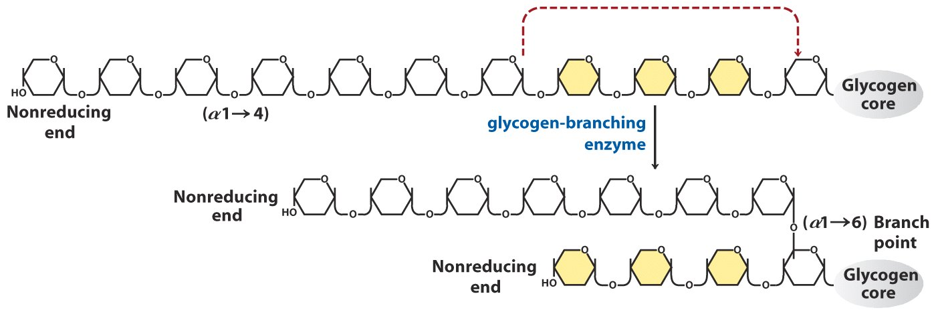
A branching enzyme catalyzes the
transferring of a short stretch of glucose
residues from one nonreducing end
to the interior of the glycogen to make
an α1→6 linkage (thus a branch).

Slide 43
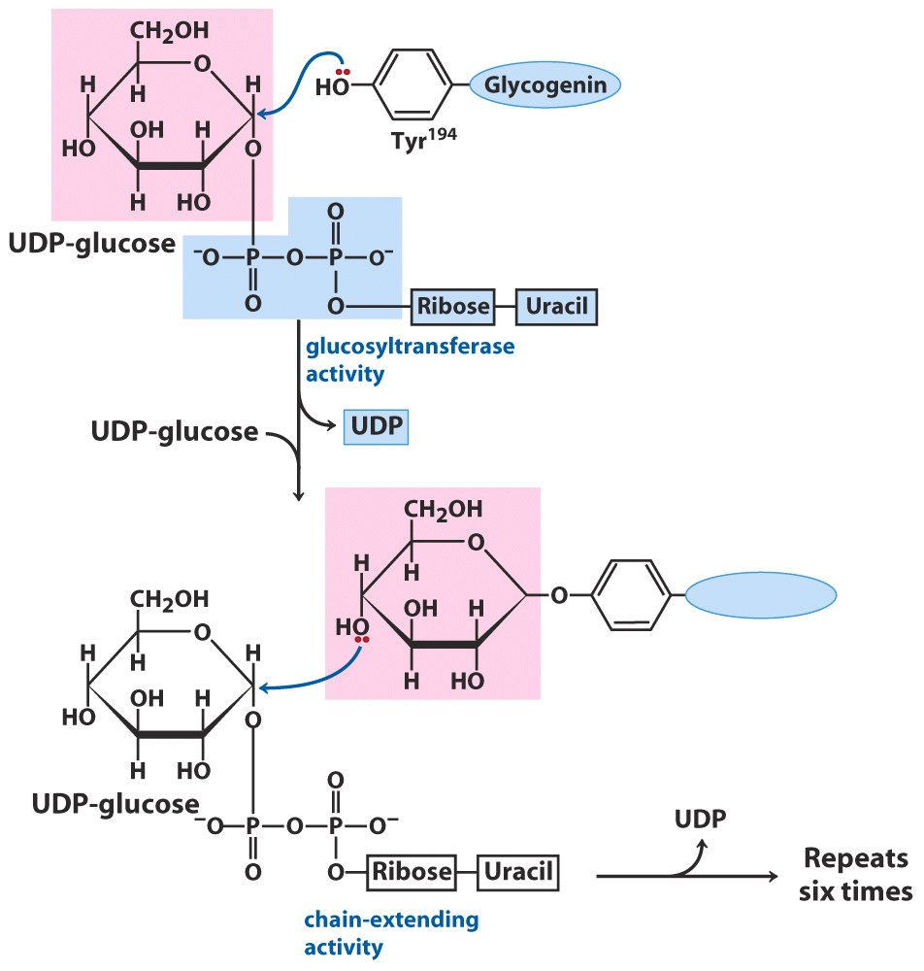
Glycogenin catalyzes two distinct reactions

Slide 44
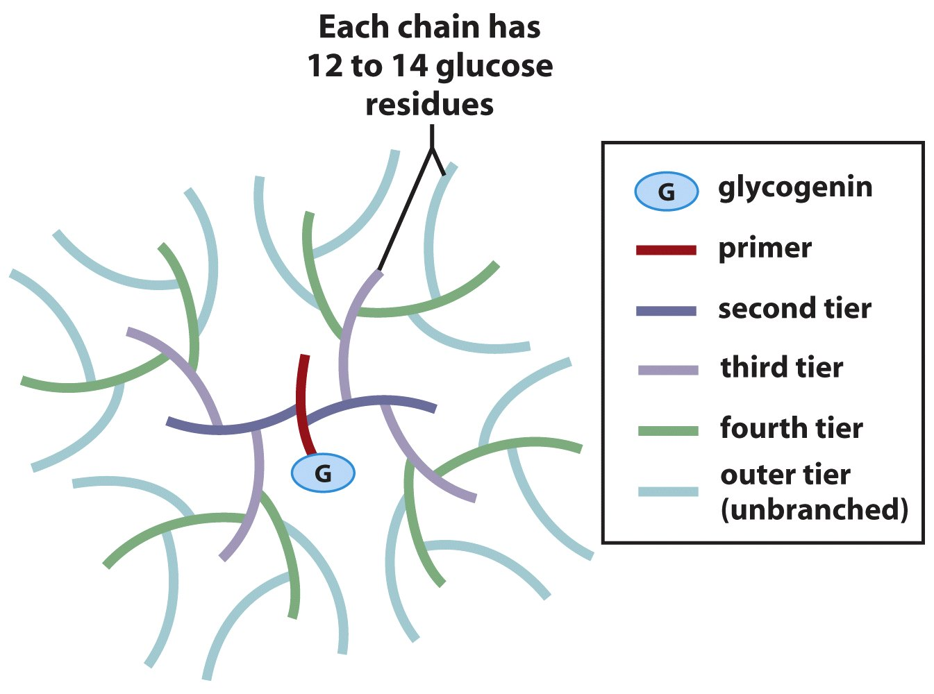
Structure of the glycogen particle

Slide 45
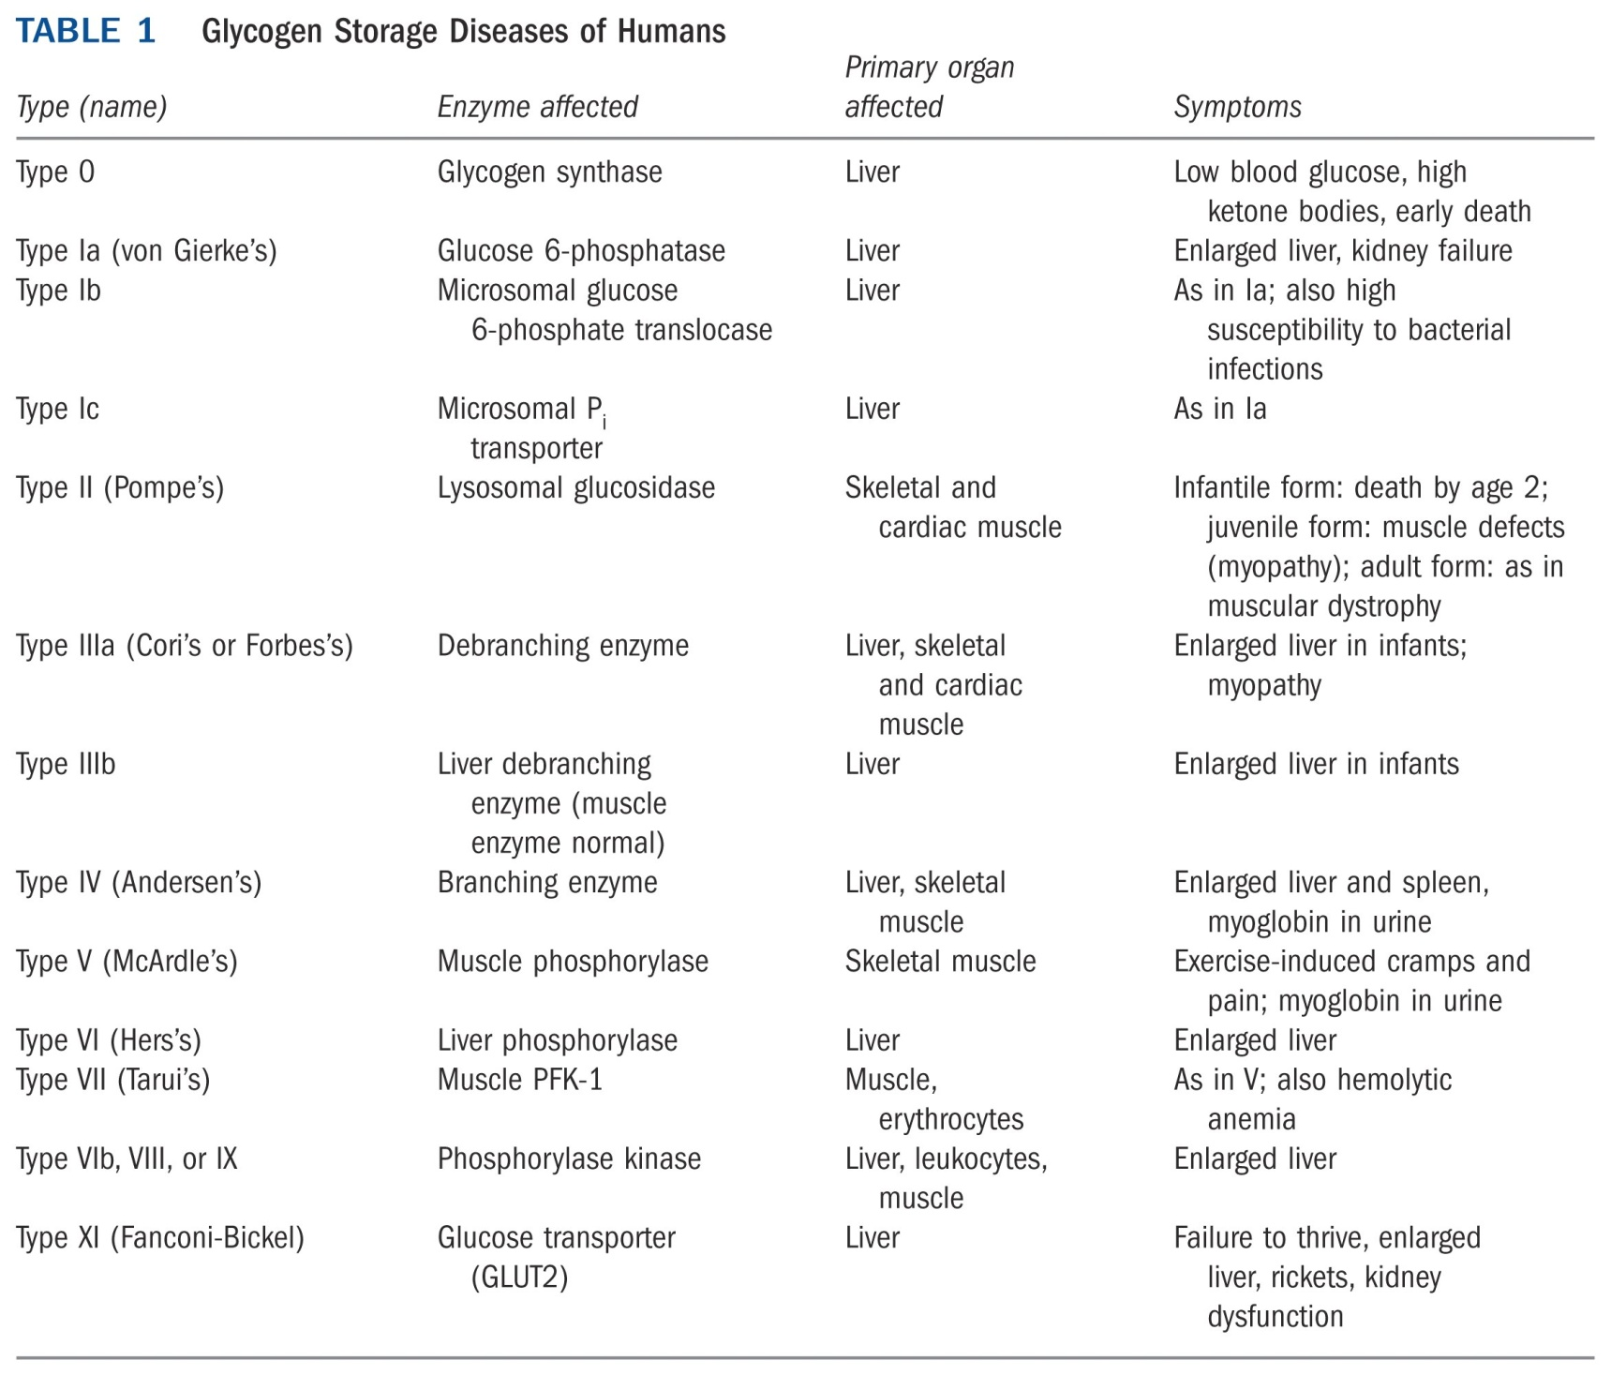

Slide 46
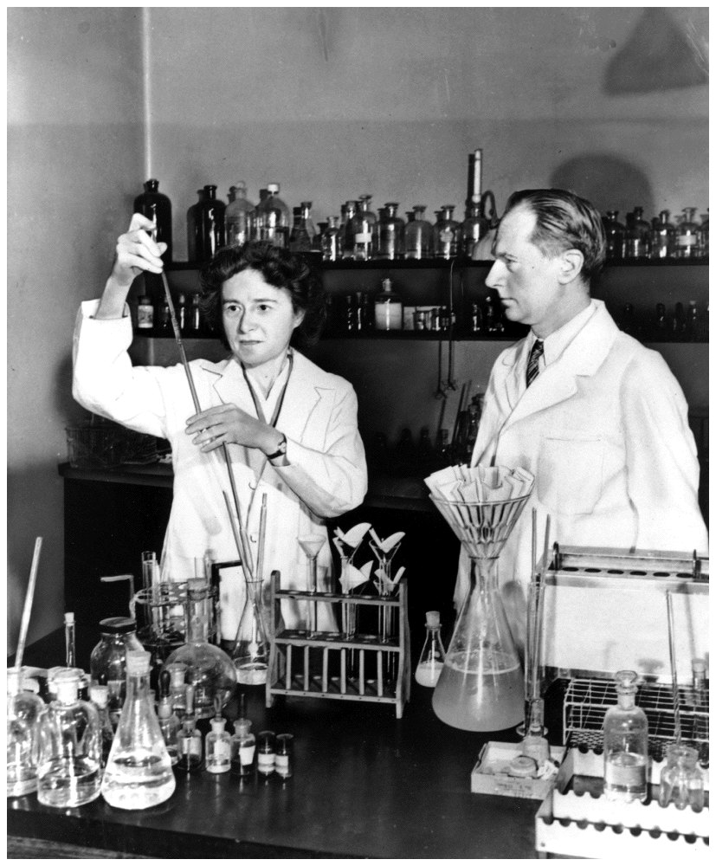
Carl and Gerty Cori
won the Nobel Prize
in Physiology or
Medicine in 1947 for
their pioneering work
in glycogen metabolism
and disease.

Slide 47
Integration of glycogen synthesis and degradation

Slide 48
13. Glycogen synthase and glycogen phosphorylase are reciprocally regulated in vertebrates by hormones
Phosphorylation and dephosphorylation have opposite effects towards the enzymatic activities of these two enzymes.
Hormones like epinephrine (acting on muscle or liver cells) or glucagon (acting on liver cells) will activate protein kinase A, which will lead to phosphorylation modification of both the glycogen phosphorylase (thus activating it) and the glycogen synthase (thus inactivating it).

Slide 49
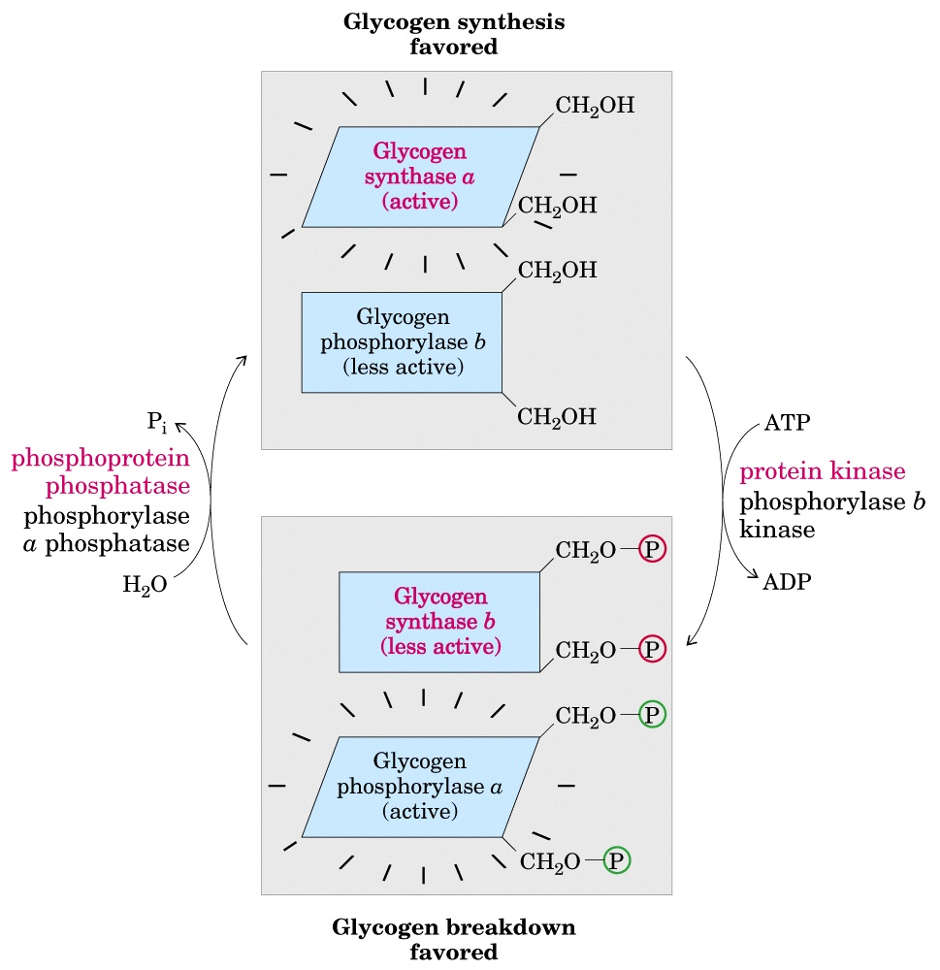
Glycogen synthase
and phosphorylase
are reciprocally
regulated by
hormones via
phosphorylation-
dephosphorylation
Glycogen
synthase
kinase
(GSK3)
Phosphoprotein
phosphatase 1 (PP1)

Slide 50
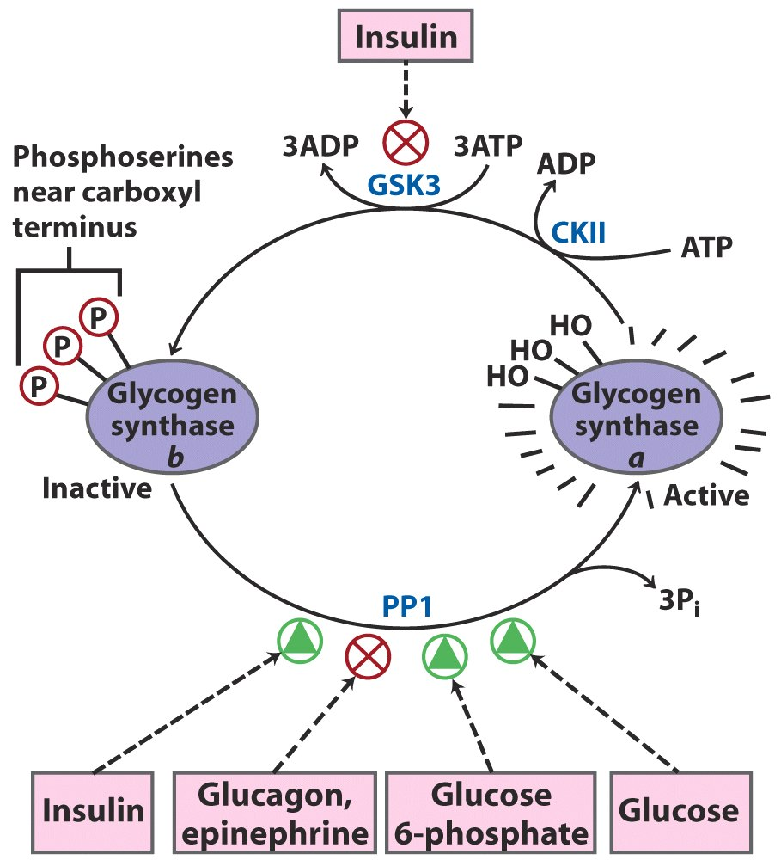
Effects of GSK3 on glycogen synthase activity*****

Slide 51
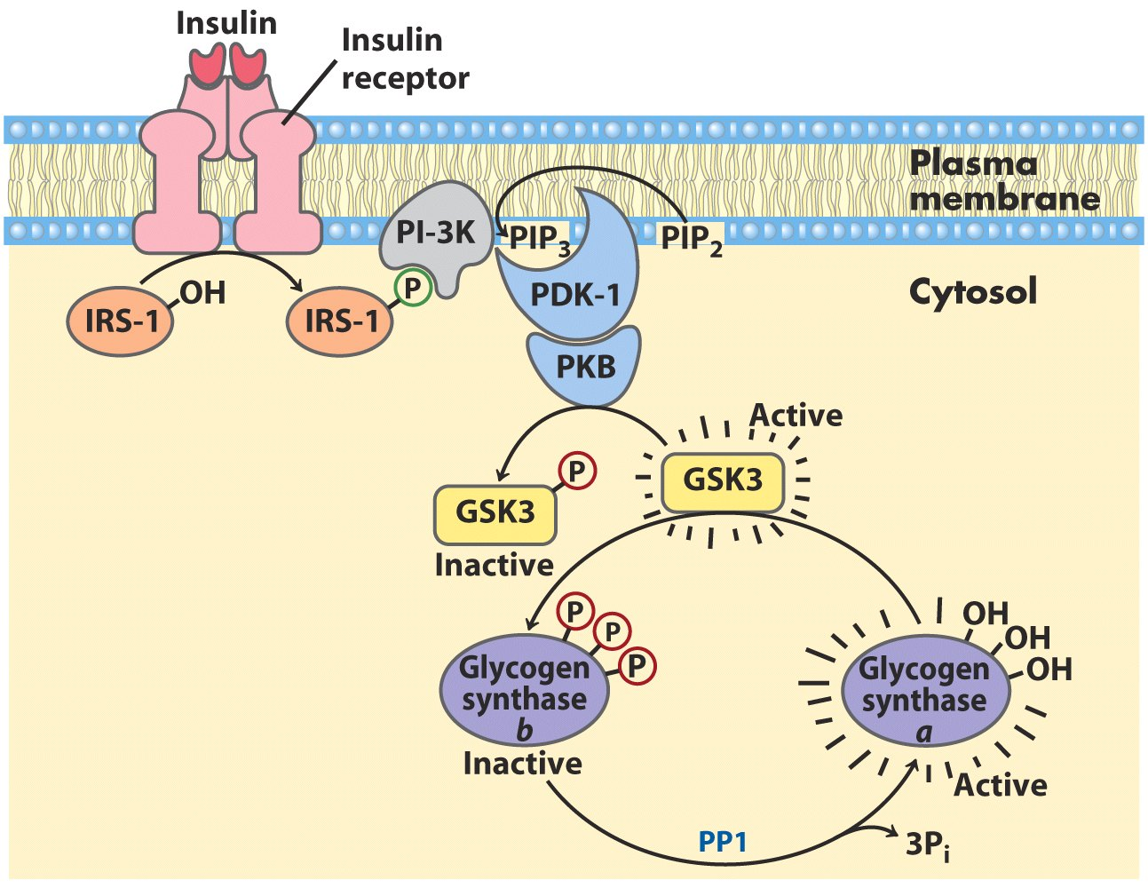
The path from insulin to GSK3 and glycogen synthase

Slide 52
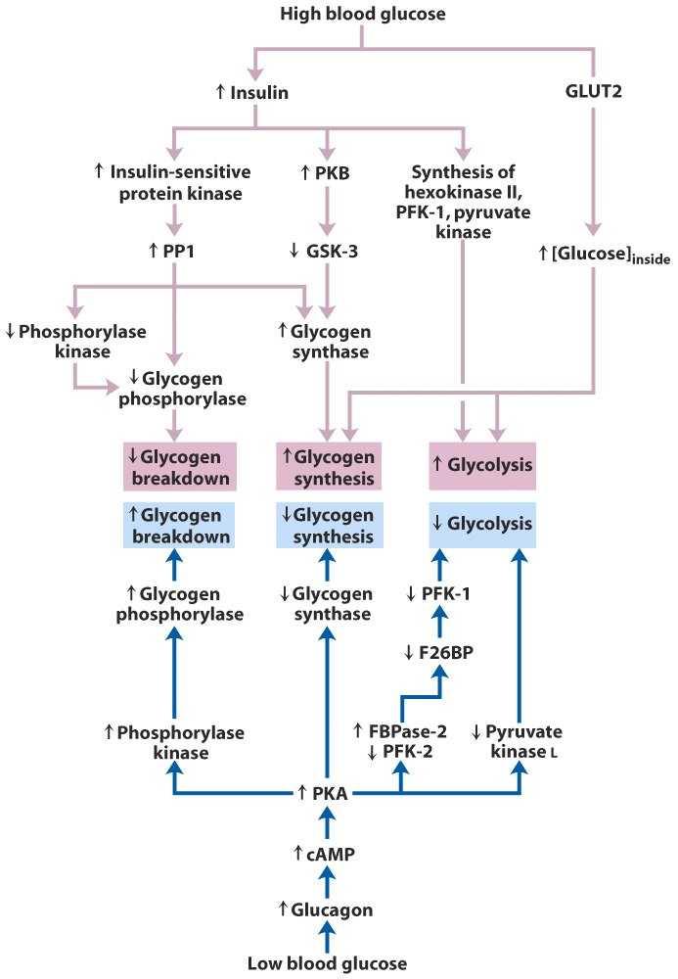
Glycogen
synthesis
Glycogen
breakdown
Regulation of carbohydrate metabolism in the hepatocyte*****

Slide 53
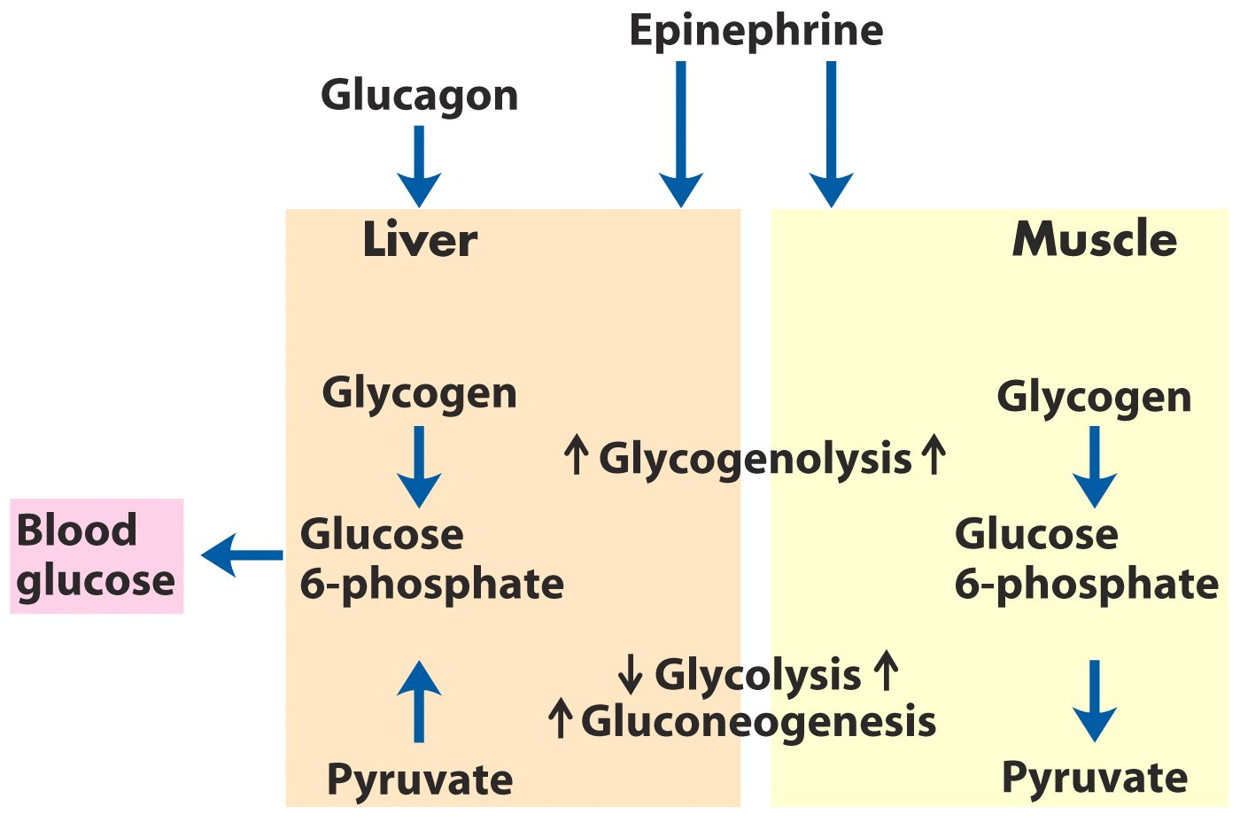
Difference in the regulation of carbohydrate
metabolism in liver and muscle*****

Slide 54
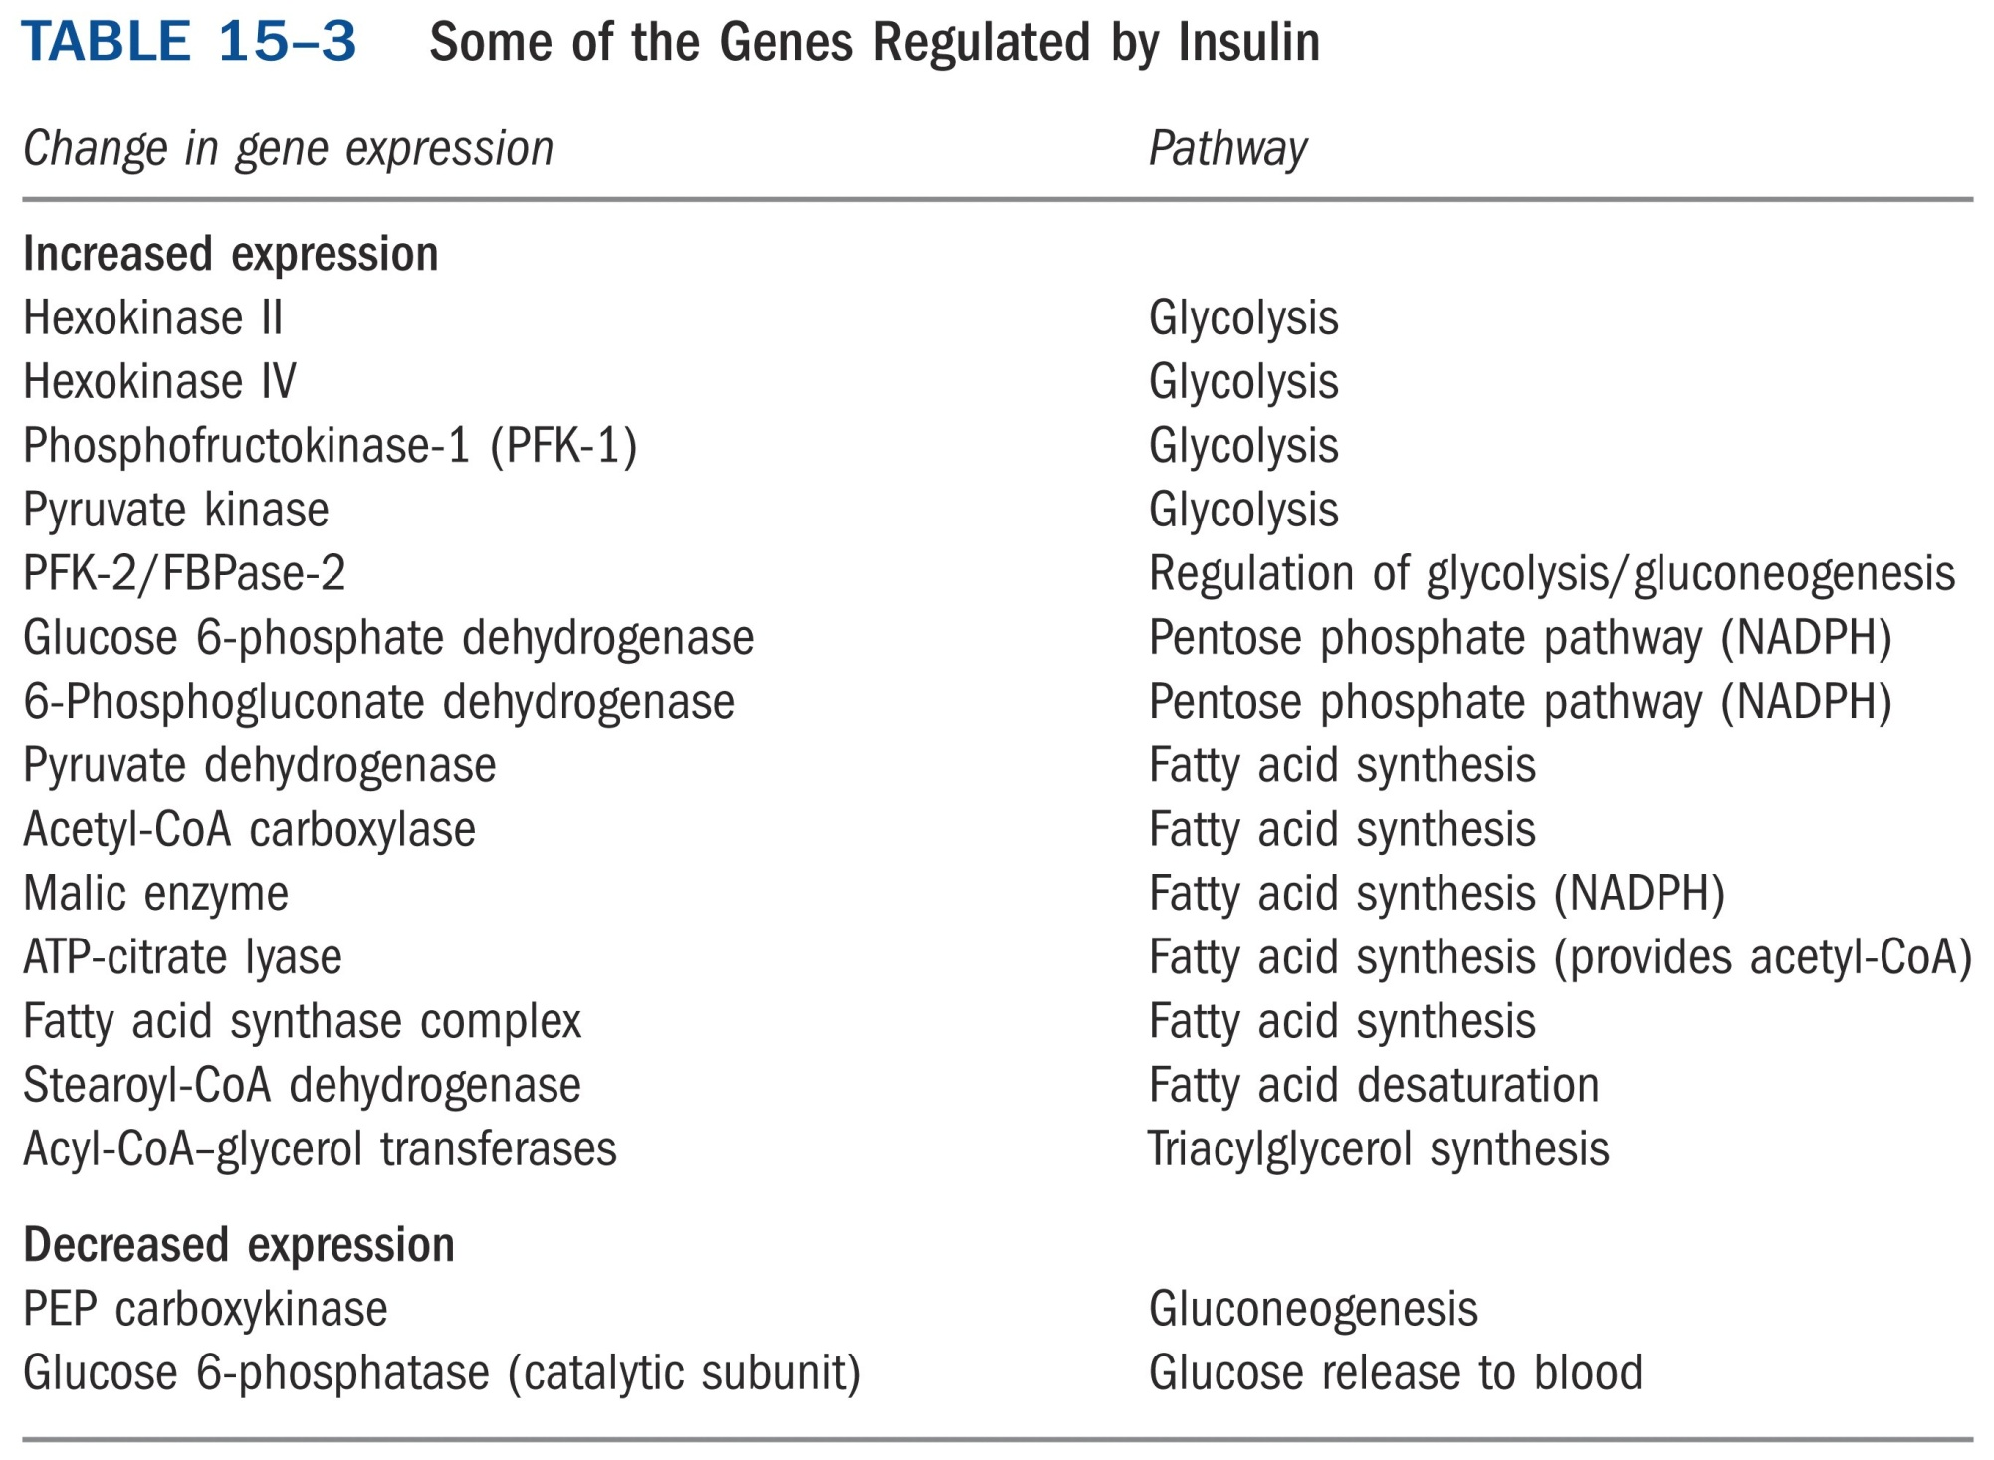
*****

Slide 55
14. Starch synthesis in chloroplast stroma is similar to glycogen synthesis
ADP-glucose is used as the precursor (UDP-glucose is used at the priming stage).
starch synthase has two equivalent active sites that alternate in inserting a glucosyl residue onto the nonreducing end of the growing chain.
Branches in amylopectin are synthesized using a similar branching enzyme.
The synthesis of ADP-glucose, catalyzed by ADP-glucose pyrophosphorylase, is rate limiting.
ADP-glucose is also used by bacteria to synthesize bacterial glycogen.

Slide 56
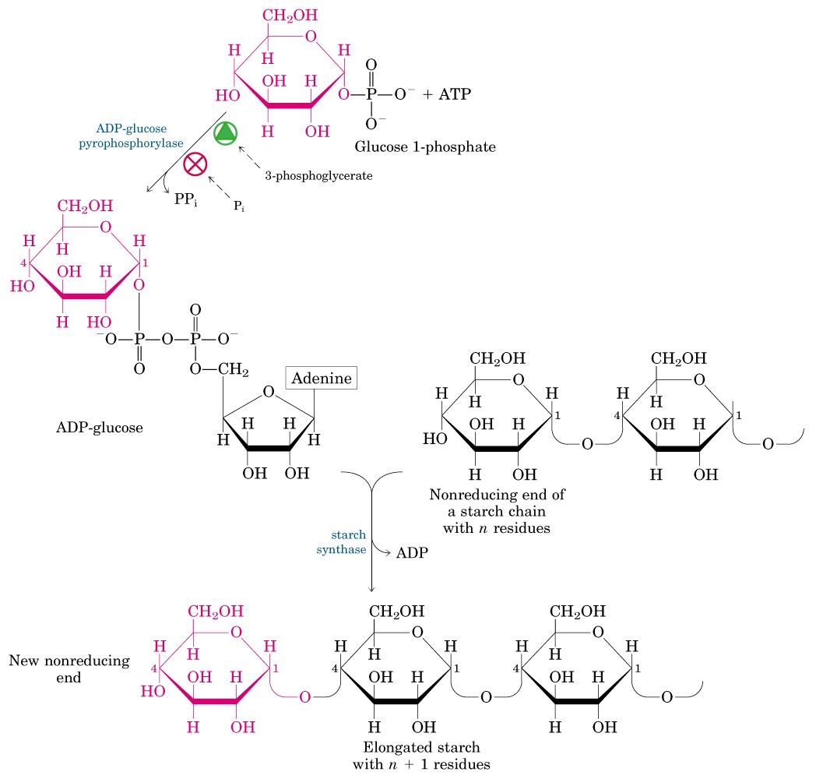

Slide 57
15. Sucrose is synthesized from UDP-glucose and fructose 6-phosphate in the cytosol of plant cells
Sucrose 6-phosphate is first synthesized by the catalysis of sucrose 6-phosphate synthase.
The phosphate is then removed in a reaction catalyzed by sucrose 6-phosphate phosphatase.
Sucrose, having no anomeric carbons (thus nonreducing), is then transported to other tissues.

Slide 58
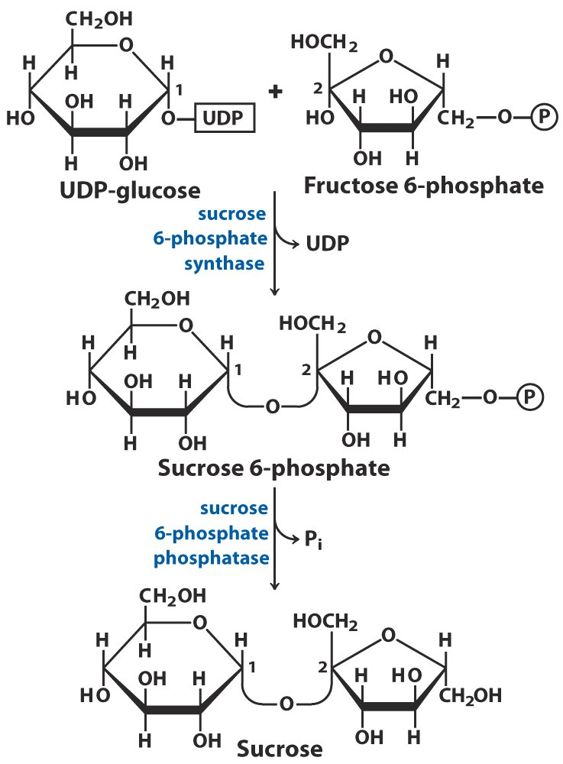
Sucrose is synthesized
from UDP-glucose
and fructose-6-phosphate

Slide 59
16. Carbohydrates can be synthesized from CO₂ in photosynthetic organisms
Organic compounds of at least three carbons are used as precursors for carbohydrate synthesis in animals (via gluconeogenesis).
The “path” of CO₂ in photosynthesis was revealed by studies using radioisotope tracer (¹⁴CO₂) and chromatographic separation of labeled intermediates (Melvin Calvin, early 1950s).
3-phosphoglycerate, a glycolysis/gluconeogenesis intermediate, was found to be the first metabolite labeled when algae suspensions having ¹⁴CO₂ was illuminated for a short period of time!

Slide 60
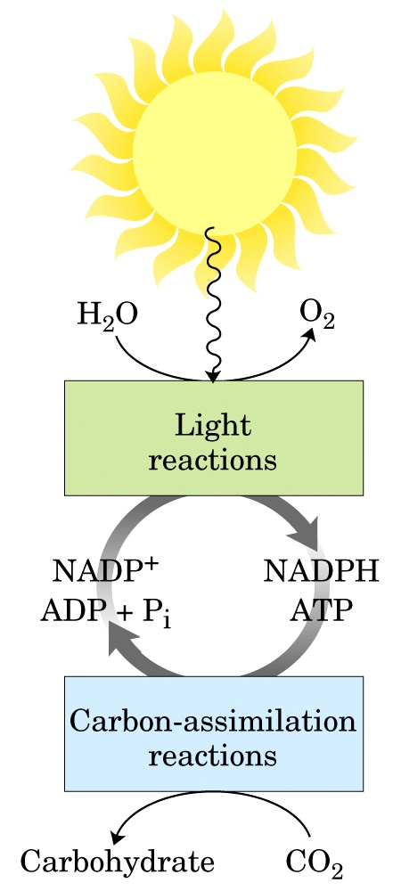
The light reactions of
photosynthesis generate
ATP and NADPH, which are used in the carbon-assimilation reactions.

Slide 61
All the ¹⁴C was found to be in the carboxyl group of 3-phosphoglycerate.
Ribulose-1,5-bisphosphate (RuBP) was revealed to be the CO₂ acceptor by comparing the steady-state concentrations of various compounds after suddenly raising or lowering the CO₂ levels.
The assimilation of CO₂ was found to occur through a cyclic pathway called the Calvin cycle.

Slide 62
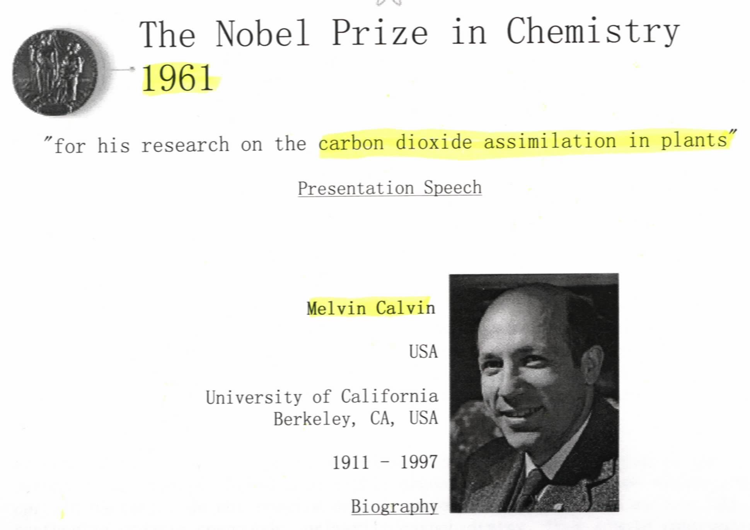

Slide 63
17. The CO₂ assimilation process via the Calvin cycle can be divided into three stages
Stage I (fixation): CO₂ is condensed with a five-carbon acceptor, ribulose-1,5-bisphosphate, to form 3-phosphoglycerate.
Stage II (reduction): 3-phosphoglycerate is reduced to form glyceraldehyde 3-phosphate.
Stage III (regeneration): ribulose-1,5-bisphosphate is regenerated using glyceraldehyde 3-phosphate.

Slide 64
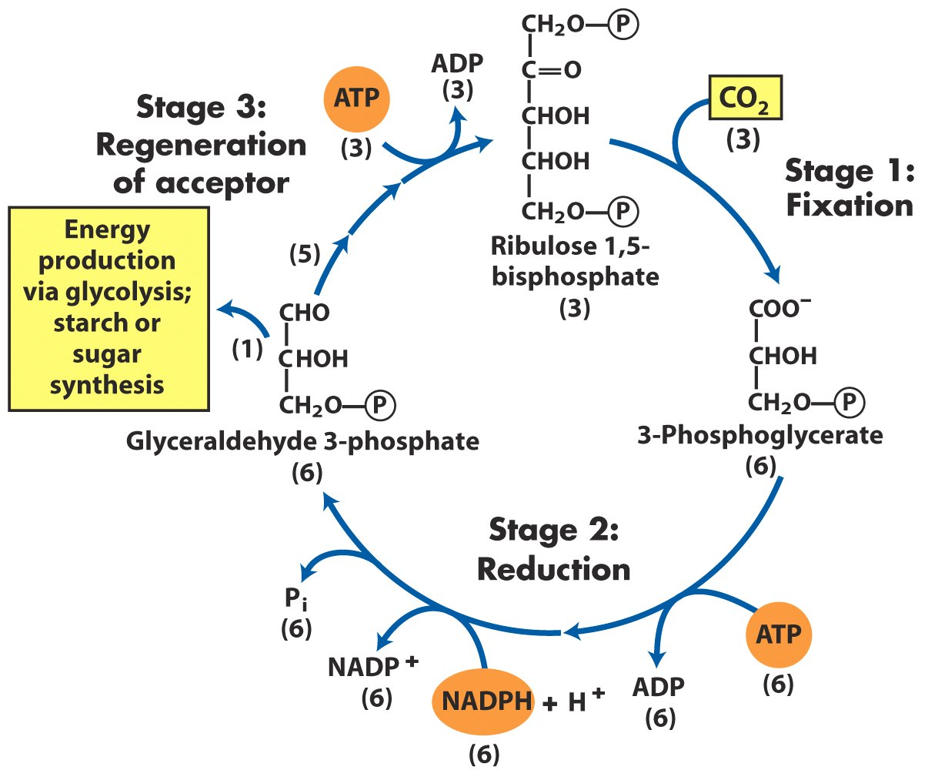
The three stages of CO2 assimilation
in photosynthetic organisms*****

Slide 65
18. One CO₂ is initially added to one ribulose 1,5-bisphosphate to form two molecules of 3-phosphoglycerate
Ribulose-1,5-bisphosphate is converted to an enediol (烯二醇) intermediate before being condensed with CO₂.
CO₂ (not bicarbonate) is added to the second carbon of the enediol intermediate to form a six-carbon β-keto acid intermediate, which is then hydrated to form another six-carbon intermediate.
Two 3-phosphoglycerate molecules are formed from the cleavage of the six-carbon intermediate via a carbanion.
The whole conversion is catalyzed by ribulose-1,5-bisphosphate carboxylase/oxygenase (rubisco in short).

Slide 66
19. Rubisco has a complex structure, low efficiency and large quantity
The plant enzyme consists of 8 large (with both catalytic and regulatory sites) and 8 small subunits (with unknown function).
It has both a carboxylase and an oxygenase activity sharing the same active site, located at the interface of the large subunits.
O₂ competes with CO₂ at the active site.
It is the most abundant enzyme in the biosphere (being about 250 mg/ml in the chloroplast stroma).
The bacterial enzyme is a dimer (both similar to the large subunits of the plant enzyme).

Slide 67
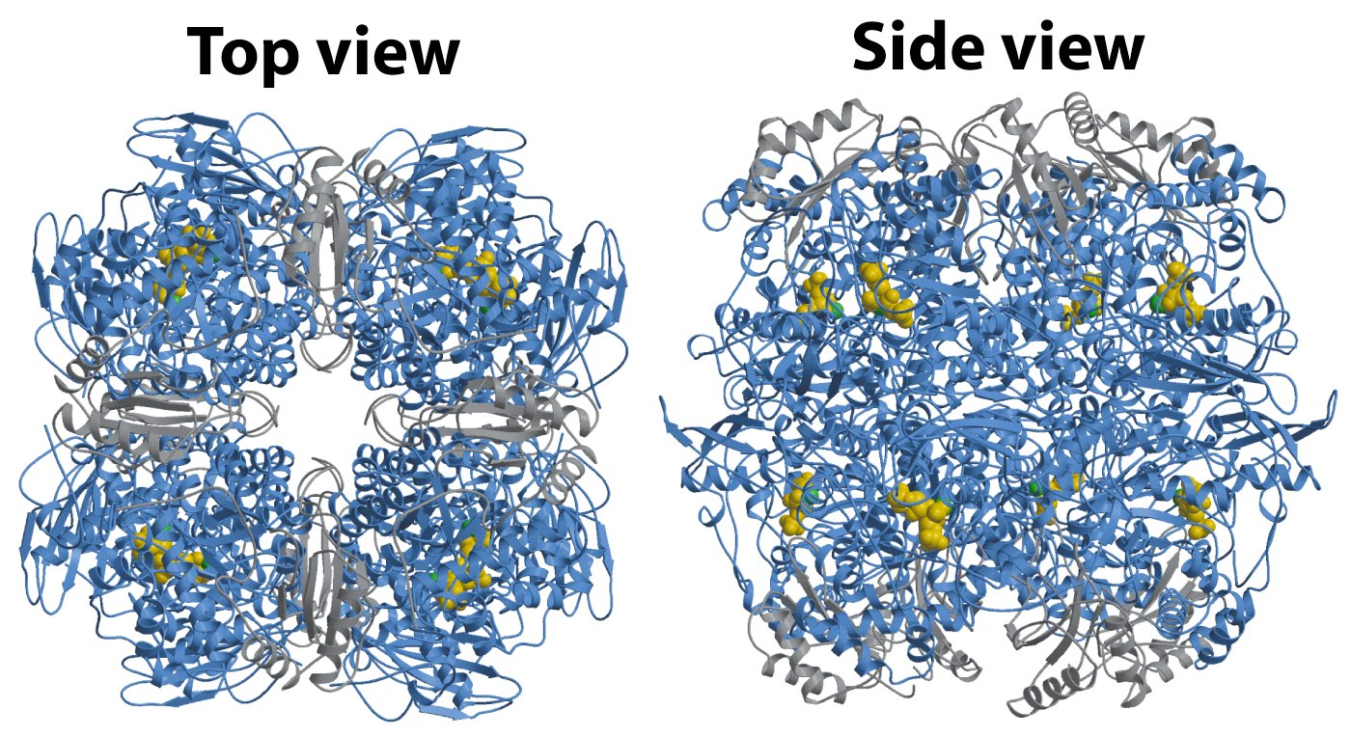
Structure of rubisco

Slide 68
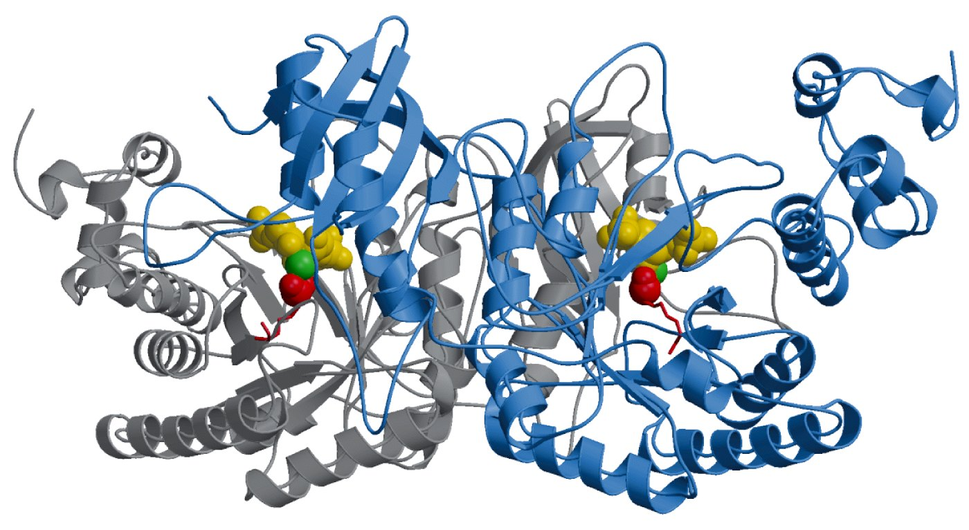
The bacterial rubisco consists of two subunits

Slide 69
20. 3-phosphoglycerate is reduced to glyceraldehyde 3-phosphate via a two-step reaction
Essentially the reversal of the two steps of the glycolysis pathway.
3-phosphoglycerate kinase converts 3-phosphoglycerate to 1,3-bisphophoglycerate (consuming one ATP), which is then reduced to glyceraldehyde 3-phosphate by glyceraldehyde 3-phosphate dehydrogenase.
NADPH, in stead of NADH, is used here.

Slide 70
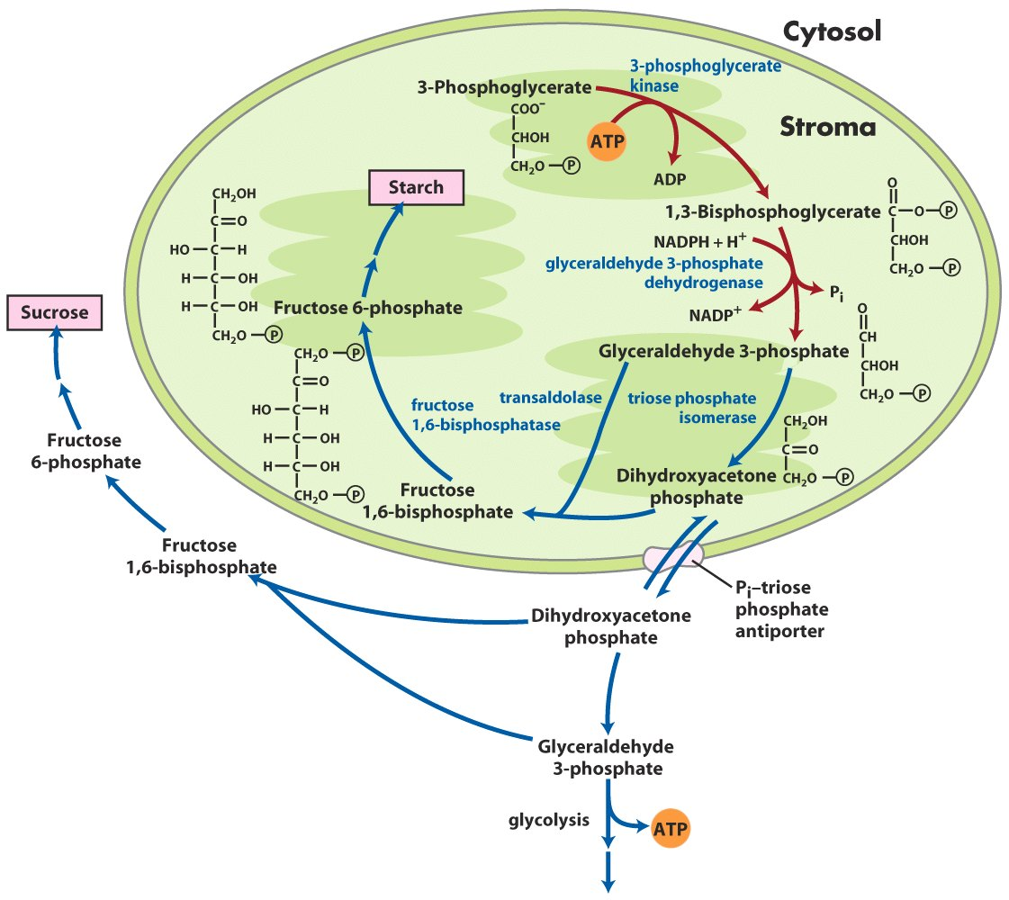
Second stage of CO2 assimilation

Slide 71
21. Glyceraldehyde 3-phosphate has three alternative fates
Fate I: to be used for starch synthesis in the stroma of chloroplasts after being converted to glucose-1-phosphate via the gluconeogenesis pathway.
Fates II and III: to be transported out into the cytosol (using a specific P_{i}-triose phosphate antiporter) and then used for sucrose synthesis (sucrose is then transported to other growing regions of the plant) or enter glycolysis to provide additional energy for the developing leaves.

Slide 72
22. Ribulose 1,5-bisphosphate is regenerated from glyceraldehyde 3-phosphate for the cycle to continue
For each 6 triose phosphates, 5 are used for regenerating 3 molecules of ribulose-1,5-bisphosphate (RuBP), leaving one for the alternative fates.
RuBP regeneration occurs by carbon skeleton rearrangement starting with the triose phosphates, involving four-, five-, six-, and seven-carbon sugar phosphate intermediates.

Slide 73
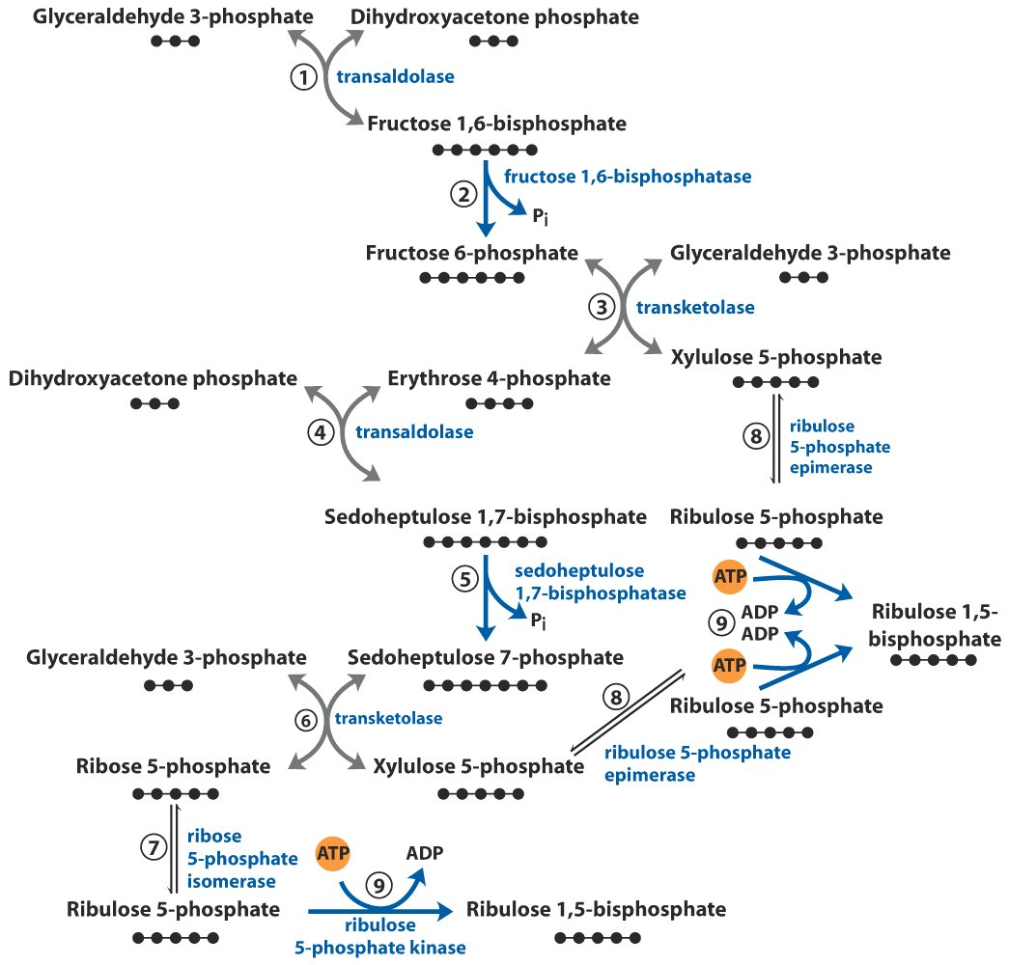
Third stage of CO2 assimilation

Slide 74
The carbon rearrangement is mainly catalyzed by two transketolases and two transaldolases (also called aldolase), but also helped by a bisphosphatase, an isomerase, an epimerase, and a kinase.
The pathway is essentially the reversal of the nonoxidative part of the pentose phosphate pathway.

Slide 75
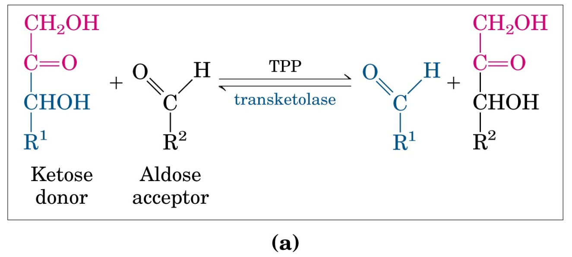
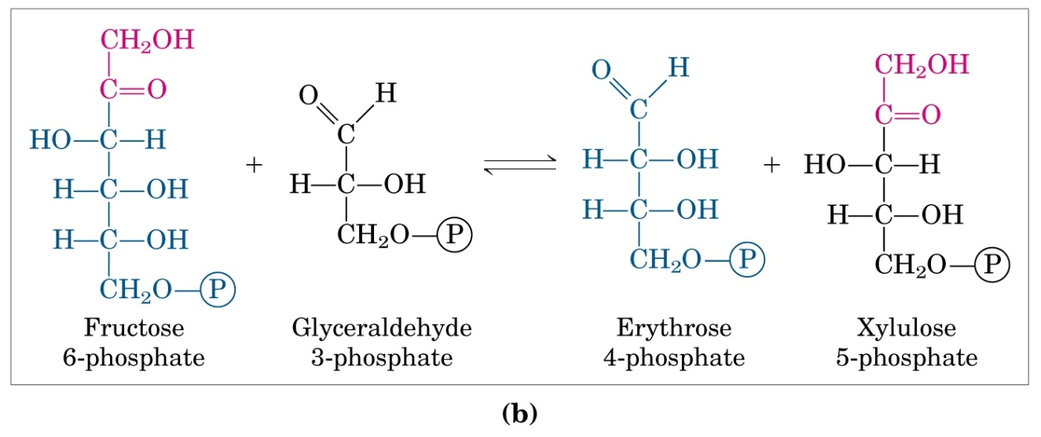
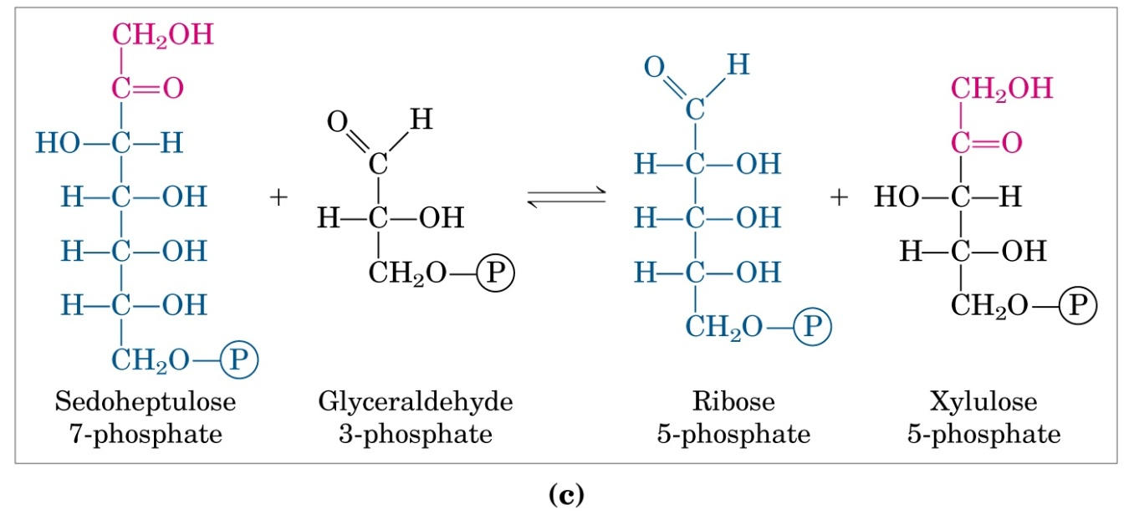
The TPP-containing
transketolases catalyze the
transfer of a ketol (醇酮)
group from a ketose donor
to an aldose acceptor

Slide 76
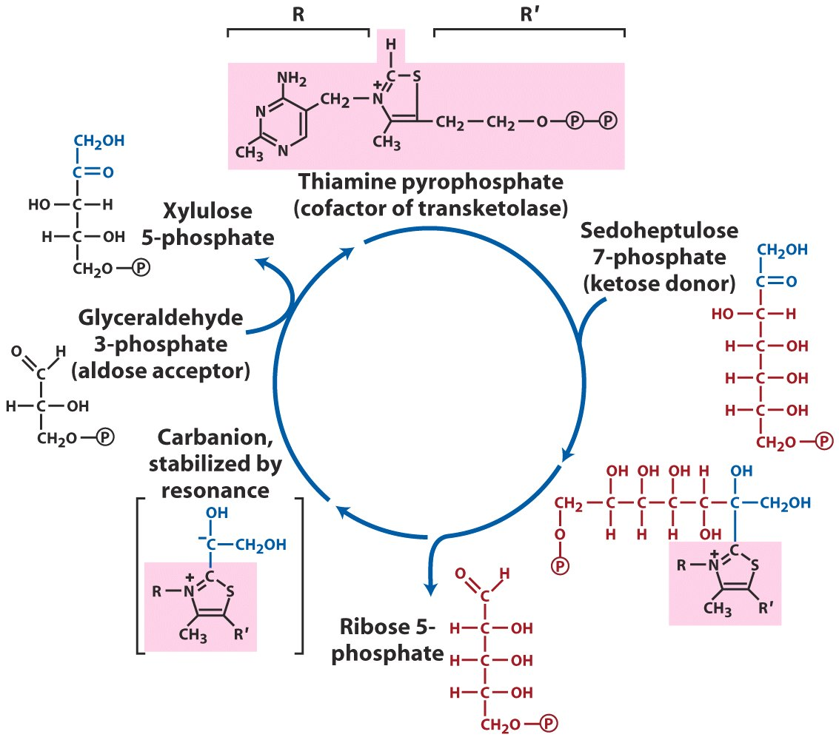
TPP acts as a temporary carrier of two-carbon
units in transketolase

Slide 77
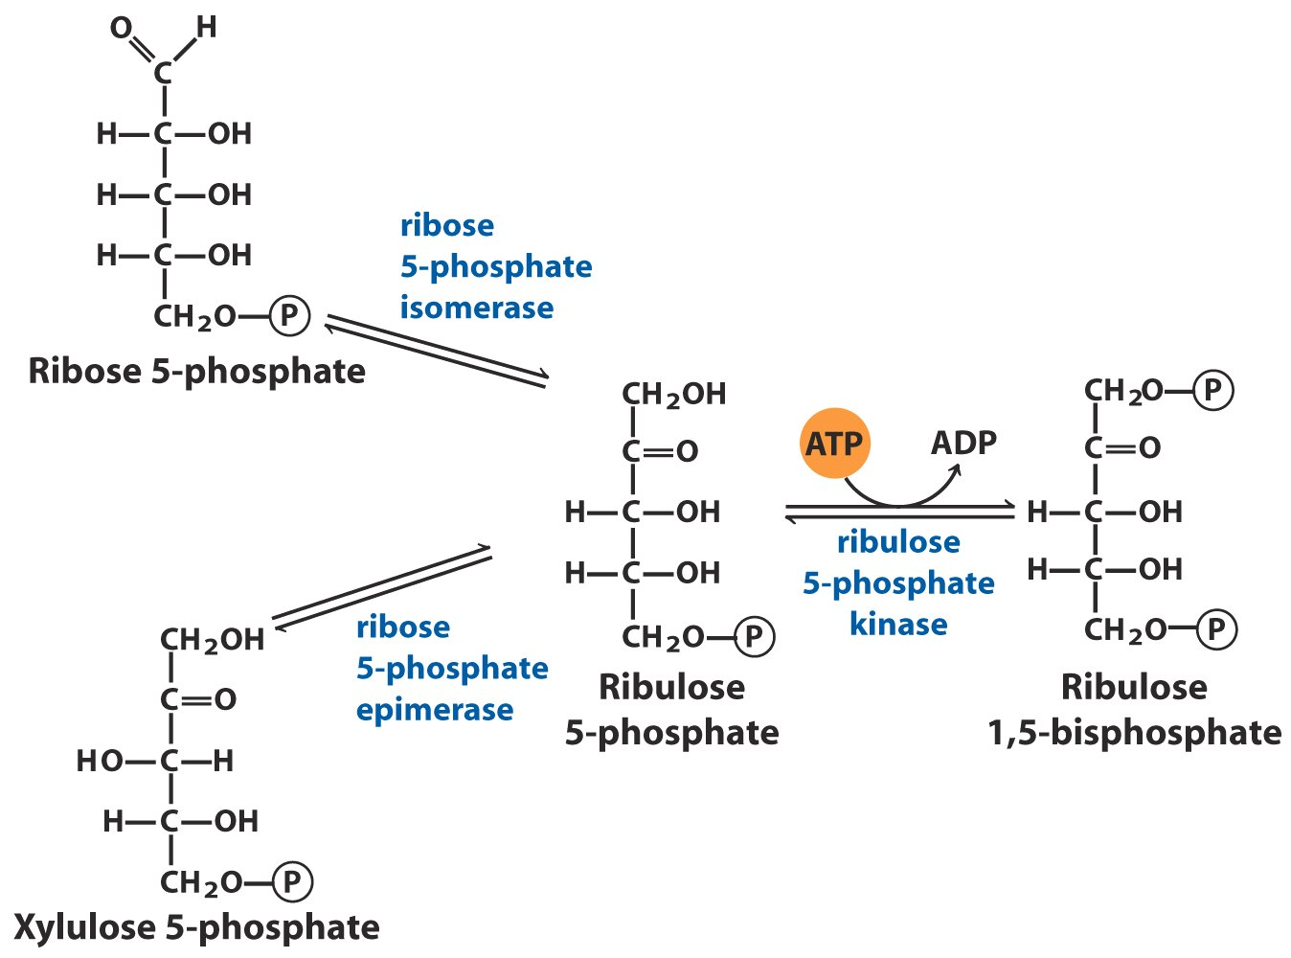
Both ribose 5-phosphate and
xylulose 5-phosphate are
converted to RuBP through
isomerization and
phosphorylation

Slide 78
23. The synthesis of one triose phosphate from 3 CO₂ consumes 6 NADPH and 9 ATP
Six NADPH and Six ATP are used for reducing six 3-phosphoglycerate to six glyceraldehyde 3-phosphate.
Three ATP are consumed in the last step of regenerating RuBP: phosphorylation of ribulose 5-phosphate.
Two NADPH and Three ATP are needed for fixing each CO₂.
3CO₂ + 9ATP + 6NADPH
glyceraldehyde 3-phosphate+ 9ADP + 8P_{i} + 6NADP⁺

Slide 79

Two NADPH and three ATP are consumed for
fixing each CO2

Slide 80
24. The P_{i}-triose phosphate antiport system of the inner chloroplast membrane facilitates the inside-outside transport of materials and energy
For one role the newly synthesized triose phosphate can be exported from the stroma to the cytosol, where it is converted to sucrose, meanwhile, P_{i} is imported from the cytosol to the stroma for ATP synthesis there.
The P_{i}-triose phosphate antiporter is also effectively used for exporting ATP and reducing equivalents (NADH/NADPH) from the stroma to the cytosol.

Slide 81

The Pi-triose phosphate antiporter moves triose
phosphate out of and Pi into the chloroplast

Slide 82

ATP/reducing equivalents
are exported from stroma
to cytosol via the Pi-triose
phosphate antiporter and
the dihydroxyacetone
phosphate-
3-phosphoglycerate cycle

Slide 83
25. Rubisco is both positively and negatively regulated
Carbamoylation of a specific Lys residue (forming a carbamate) by CO₂ activates the enzyme.
At high CO₂ levels, carbamoylation occurs nonenzymatically.
At low CO₂ levels, this reaction is catalyzed by rubisco activase (with ATP consumed).
The carbamate binds Mg²⁺ which is needed for the enzymatic activity.

Slide 84

The enzyme is inactivated by a naturally occurring transition-state analog, 2-carboxyarabinitol 1-phosphate (also called “nocturnal inhibitor”), which acts in the dark and breaks down in light (thus carbon fixation does not occur in the dark).
(nocturnal inhibitor)

Slide 85
26. Certain enzymes are indirectly activated by light
Light will drive the proton pumping from stroma to thylakoid lumen, thus increasing the pH of the stroma of chloroplast, accompanied by a flow of Mg²⁺ from thylakoid lumen into the stroma.
The enzymatic activity of fructose 1,6-bisphosphatase increases with increasing pH and Mg²⁺ concentration.

Slide 86

Light drives a decrease
of [H⁺] and increase
of [Mg²⁺] in the
stroma of chloroplasts

Slide 87

Activation of chloroplast fructose 1,6-bisphosphatase

Slide 88
A few Calvin cycle enzymes (including glyceraldehyde 3-phosphate dehydrogenase, fructose 1,6-bisphosphatase, sedoheptulose 1,7-bisphosphatase, and ribulose 5-phosphate kinase) are activated by light-driven reduction of disulfide bonds, mediated by a soluble, small disulfide-containing thioredoxin (reduced form), which is in turn activated by the reduced ferredoxin generated from PSI under illumination.

Slide 89

(ferredoxin)
Light indirectly drives the reduction of a disulfide
bond of a few Calvin cycle enzymes, therefore
activating these enzymes.

Slide 90
27. Photophosphorylation, CO₂ fixation, sucrose/starch syntheses, and glycolysis are tightly regulated
The triose phosphates newly synthesized from the Calvin cycle have to be properly partitioned between sucrose/starch syntheses (which releases Pi for ATP synthesis in photophosphorylation) and regeneration of ribulose 1,5-bisphosphate for the effective running of the Calvin cycle.
Carbohydrate biosynthesis (gluconeogenesis) should slow down and degradation (glycolysis) should speed up in the dark and vice versa.

Slide 91
Fructose 2,6-bisphosphate also plays a key role in regulating these processes in plants!
Photosynthetic 3-carbon products, present at a high level under illumination, inhibit PFK-2, thus lowering the level of fructose-2,6-bisphosphate, which will in turn increase the activity of FBPase-1 of gluconeogenesis.
P_{i}, present at a high level in the dark, stimulates PFK-2, thus raising the level of fructose-2,6-bisphosphate, which in turn increases the activity of PFK-1 and the level of glycolysis.

Slide 92

Fructose 2,6-bisphosphate
reciprocally regulates the
gluconeogenesis and
glycolysis in the light and
dark—the concentration
of F-2,6BP varies inversely
with the rate of
photosynthesis.

Slide 93
Sucrose 6-phosphate synthase is allosterically activated by glucose 6-phosphate, present at a high level when triose phosphate is actively produced from the Calvin cycle, and inactivated by Pi, present at a high level in the dark; it is also regulated by reversible phosphorylation (phosphorylated in the dark and less active).
ADP-glucose pyrophosphorylase, the key regulatory enzyme for starch synthesis, is activated by 3-phosphoglycerate and inhibited by P_{i}.
3-phosphoglycerate accumulates when sucrose synthesis slows down, which leads to a stimulation of starch synthesis.

Slide 94

(rate-limiting)
Regulation of ADP-glucose pyrophosphorylase
by 3-phosphoglycerate and Pi

Slide 95

Assimilation of CO2 into biomass in plants

Slide 96

Carbohydrate synthesis from simple precursors*****

Slide 97
28. Rubisco’s oxygenase activity results in photorespiration
O₂ can be added to the same position as CO₂ to ribulose 1,5-bisphosphate in the same active site of rubisco, generating 3-phosphoglycerate and phosphoglycolate.
O₂ condensation competes with CO₂ fixation in the active site of the enzyme.
Phosphoglycolate, with no known roles, can be converted to 3-phosphoglycerate via the multicompartmental glycolate pathway, in which O₂ is consumed (in two steps) and CO₂ is produced (in one step), thus called photorespiration.

Slide 98

Oxygenase activity
of rubisco

Slide 99

Glycolate pathway

Slide 100
Unlike mitochondrial respiration, no energy is conserved in photorespiration.
The oxygenase activity increases more rapidly with temperature increase than the carboxylase activity.

Slide 101
29. C₄ plants have evolved a mechanism to minimize photorespiration
In one pathway, CO₂ is first fixed (temporarily) to phosphoenolpyruvate (PEP) to form the 4-carbon oxaloacetate in mesophyll cells by a reaction catalyzed by PEP carboxylase, which has a high affinity to HCO₃⁻.
Oxaloacetate is then reduced to malate, which moves to the bundle-sheath cells via the plasmodesmata (胞间连丝) linkage.

Slide 102

Electron micrograph showing chloroplasts
of adjacent mesophyll and bundle-sheath cells

Slide 103
Malate is then converted to pyruvate in a reaction catalyzed by malic enzyme, releasing CO₂ in the bundle-sheath cells.
Carbon fixation then occur via the Calvin cycle in the bundle sheath cells exactly like what happens in C₃ plants, exposing rubisco at a high level of CO₂ but low level of O₂ (the bundle sheath cells are away from the air).
The pyruvate generated in the bundle sheath cells is transported back into the mesophyll cells, and is converted to PEP in a reaction catalyzed by pyruvate phosphate dikinase.

Slide 104

C4 plants (e.g., maize, sugarcane
and sorghum) have evolved a
mechanism to minimize
photorespiration
Carbon assimilation in C4 plants

Slide 105
C₄ plants consume five ATP to fix one CO₂ (whereas C₃ plants consume only three)
When temperature increases to about 28ºC to 30ºC, the gain in efficiency from the elimination of photorespiration in C₄ plants more than compensates for this higher energy cost, thus C₄ plants grows faster than C₃ plants under these temperatures.

Slide 106
Keywords
Gluconeogenesis --- reaction and regulation
Reciprocal regulation of glycolysis and gluconeogenesis by fructose 2,6-bisphosphate
Reciprocal regulation of glycogen synthase and glycogen phosphorylase by insulin & glucagon
Calvin cycle --- reaction

Slide 107
Words of the Week
reciprocal regulation
coordinate regulation
allosteric regulation
regulation by covalent modification

Slide 108
Text-book reading of the week
Summary 14.4 (p574)
Summary 15.3 (p612)
Summary 15.4 (p619)
Summary 15.5 (p626)
Summary 20.1 (p812)
p604-606 (Reciprocal regulation of glycolysis and gluconeogenesis by fructose 2,6-bisphosphate)
p620-626 (Coordinated regulation of glycogen synthesis and breakdown)

Slide 109
Summary
Gluconeogenesis, the synthesis of glucose from 3-carbon compounds (mainly pyruvate), is highly conserved in all organisms.
Gluconeogenesis shares most of the reactions occurring in glycolysis, but bypassing the three irreversible reactions (using different enzymes).
Gluconeogenesis consumes more energy than glycolysis releases.
Most of the amino acids, but not fatty acids, can be used for net production of glucose in vertebrates.
Gluconeogenesis and glycolysis are reciprocally regulated by molecules like acetyl-CoA, AMP, and fructose 2,6-bisphosphate.

Slide 110
Glycogen synthase a is inactivated by phosphorylation catalyzed by GSK3, which can be blocked by insulin. PP1, activated by insulin, reverse the inhibition by dephosphorylating glycogen synthase b.
Sugar nucleotides are used for biosynthesis: UDP-glucose is used for glycogen and sucrose synthesis; ADP-glucose is used for starch synthesis.
CO₂ can be fixed into ribulose 1,5-bisphosphate (RuBP) in plants, initially producing 3-phosphoglycerate, which is then reduced to glyceraldehyde 3-phosphate (a triose phosphate) via the Calvin cycle (with RuBP constantly regenerated).
Triose phosphates are then converted to glucose via the gluconeogenesis pathway.

Slide 111
Rubisco is an oligomeric protein having a large quantity in the stroma of chloroplasts.
Rubisco can add either CO₂ or O₂ to RuBP in the same active site leading to either CO₂ fixation or photorespiration.
The P_{i}-triose phosphate antiport system of the inner chloroplast membrane facilitates the inside-outside transport of materials and energy.
Certain enzymes of the Calvin cycle are indirectly regulated by light.
Photophosphorylation, CO₂ fixation, sucrose/starch syntheses, and glycolysis are tightly regulated.
C₄ plants have evolved a mechanism to minimize photorespiration.

