Slide 1
Chapter 21 Lipid Biosynthesis
1. Fatty acids
2. Eicosanoids
3. Triacylglycerols
4. Membrane phospholipids
5. Cholesterol, steroids, and isoprenoids

Slide 2
Fatty acid synthesis takes a different pathway from its degradation
Occurs in the cytosol (chloroplasts in plants).
Acetyl-CoA provides the first two carbons, which is elongated by sequential addition of two-carbon units donated from malonyl-CoA.
Intermediates are attached to the -SH groups of an acyl carrier protein (ACP).
NADPH is the reductant.

Slide 3
The enzymes (fatty acid synthase) are associated as a multi-enzyme complex or even being in one polypeptide chain in higher organisms.
Elongation by the fatty acid synthase complex stops upon formation of palmitate (C₁₆), further elongation and desaturation are carried out by other enzyme systems.

Slide 4
2. Malonyl-CoA is formed from acetyl-CoA and bicarbonate
Acetyl-CoA carboxylase (being trimeric in bacteria, monomeric in animals and both in plants) catalyzes this carboxylation reaction.
The enzyme has three functional parts: a biotin carrier protein; an ATP-dependent biotin carboxylase; and a transcarboxylase.
This irreversible reaction commits acetyl-CoA to fatty acid synthesis.

Slide 5
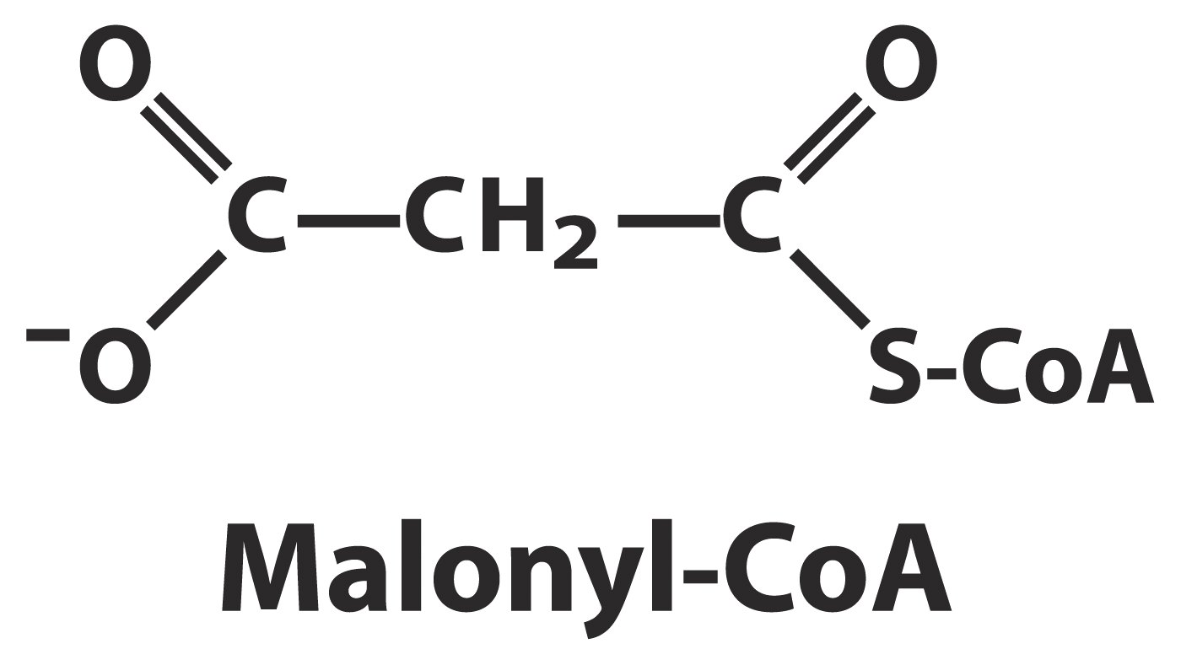

Slide 6
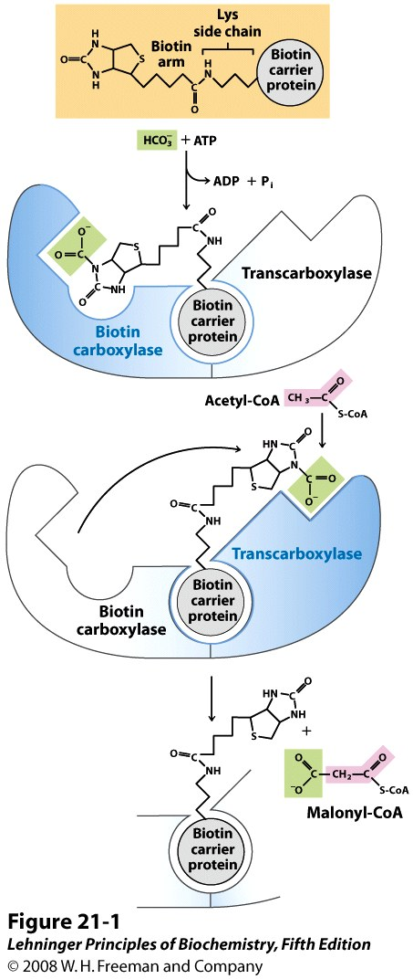
Acetyl-CoA carboxylase
catalyzes the two-step
carboxylation reaction of
acetyl-CoA on two active sites.
Notes:
FIGURE 21-1 The acetyl-CoA carboxylase reaction. Acetyl-CoA carboxylase has three functional regions: biotin carrier protein (gray); biotin carboxylase, which activates CO₂ by attaching it to a nitrogen in the biotin ring in an ATP-dependent reaction (see Figure 16-16); and transcarboxylase, which transfers activated CO₂ (shaded green) from biotin to acetyl-CoA, producing malonyl-CoA. The long, flexible biotin arm carries the activated CO₂ from the biotin carboxylase region to the transcarboxylase active site. The active enzyme in each step is shaded blue.

Slide 7
Fatty acid biosynthesis is catalyzed
by a multi-enzyme complex called fatty acid synthase
(FAS II)

Slide 8
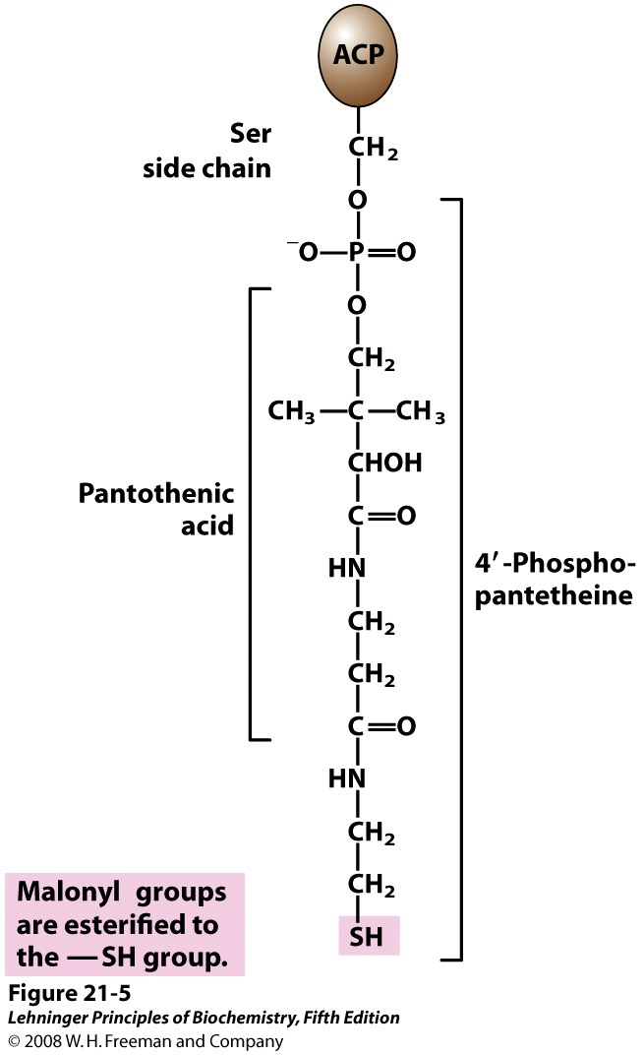
Acyl carrier protein (ACP)
Notes:
FIGURE 21-5 Acyl carrier protein (ACP). The prosthetic group is 4′-phosphopantetheine, which is covalently attached to the hydroxyl group of a Ser residue in ACP. Phosphopantetheine contains the B vitamin pantothenic acid, also found in the coenzyme A molecule. Its —SH group is the site of entry of malonyl groups during fatty acid synthesis.

Slide 9
Fatty acid biosynthesis is catalyzed
by a multi-enzyme complex called fatty acid synthase
(FAS II)
MAT：Malonyl/acetyl-CoA-ACP transferase ( FAS I)

Slide 10
3. The acetyl and malonyl groups are first transferred to two -SH groups of the fatty acid synthase complex
The acetyl group of acetyl-CoA is first transferred to the -SH group of a Cys residue on the β-ketoacyl-ACP synthase (KS) in a reaction catalyzed by acetyl-CoA-ACP transacetylase (AT).
The malonyl group is transferred from malonyl-CoA
to the -SH group of the 4’-phosphopantetheine covalently attached to a Ser residue of the acyl carrier protein (ACP) in a reaction catalyzed by malonyl-CoA-ACP transferase (MT).

Slide 11
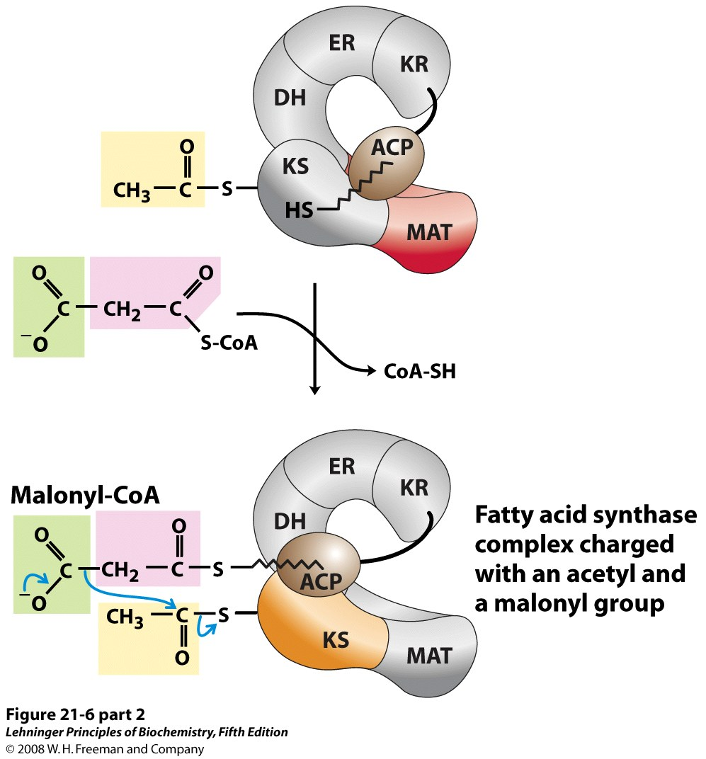
Notes:
FIGURE 21-6 (part 2) Sequence of events during synthesis of a fatty acid. The mammalian FAS I complex is shown schematically, with catalytic domains colored as in Figure 21-3. Each domain of the larger polypeptide represents one of the six enzymatic activities of the complex, arranged in a large, tight "S" shape. The acyl carrier protein (ACP) is not resolved in the crystal structure shown in Figure 21-3, but is attached to the KS domain. The phosphopantetheine arm of ACP ends in an —SH. After the first panel, the enzyme shown in color is the one that will act in the next step. As in Figure 21-4, the initial acetyl group is shaded yellow, C-1 and C-2 of malonate are shaded pink, and the carbon released as CO₂ is shaded green. Steps 1 to 4 are described in the text.

Slide 12
4. Fatty acids are synthesized by a repeating four-step reaction sequence
In the condensation reaction (step 1), catalyzed by β-ketoacyl-ACP synthase (KS), the methylene group of malonyl-CoA (linked to ACP) undergoes a nucleophilic attack on the carbonyl carbon of the acetyl group linked to KS, forming the β-ketobutyryl-ACP with simultaneous elimination of CO₂.

Slide 13
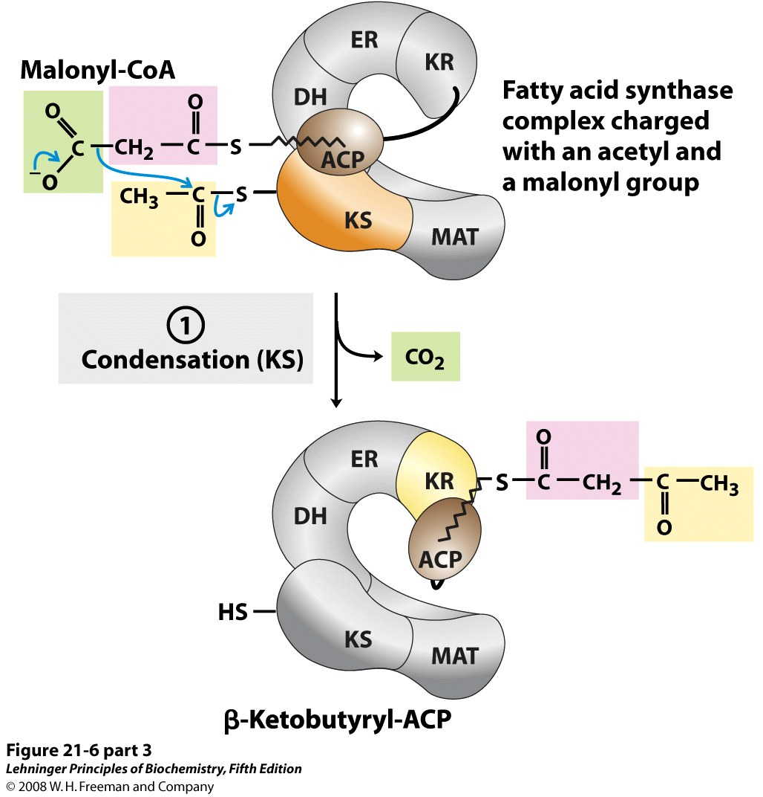
β-ketoacyl-ACP synthase (KS)
β-ketobutyryl-ACP
Notes:
FIGURE 21-6 (part 3) Sequence of events during synthesis of a fatty acid. The mammalian FAS I complex is shown schematically, with catalytic domains colored as in Figure 21-3. Each domain of the larger polypeptide represents one of the six enzymatic activities of the complex, arranged in a large, tight "S" shape. The acyl carrier protein (ACP) is not resolved in the crystal structure shown in Figure 21-3, but is attached to the KS domain. The phosphopantetheine arm of ACP ends in an —SH. After the first panel, the enzyme shown in color is the one that will act in the next step. As in Figure 21-4, the initial acetyl group is shaded yellow, C-1 and C-2 of malonate are shaded pink, and the carbon released as CO₂ is shaded green. Steps 1 to 4 are described in the text.

Slide 14
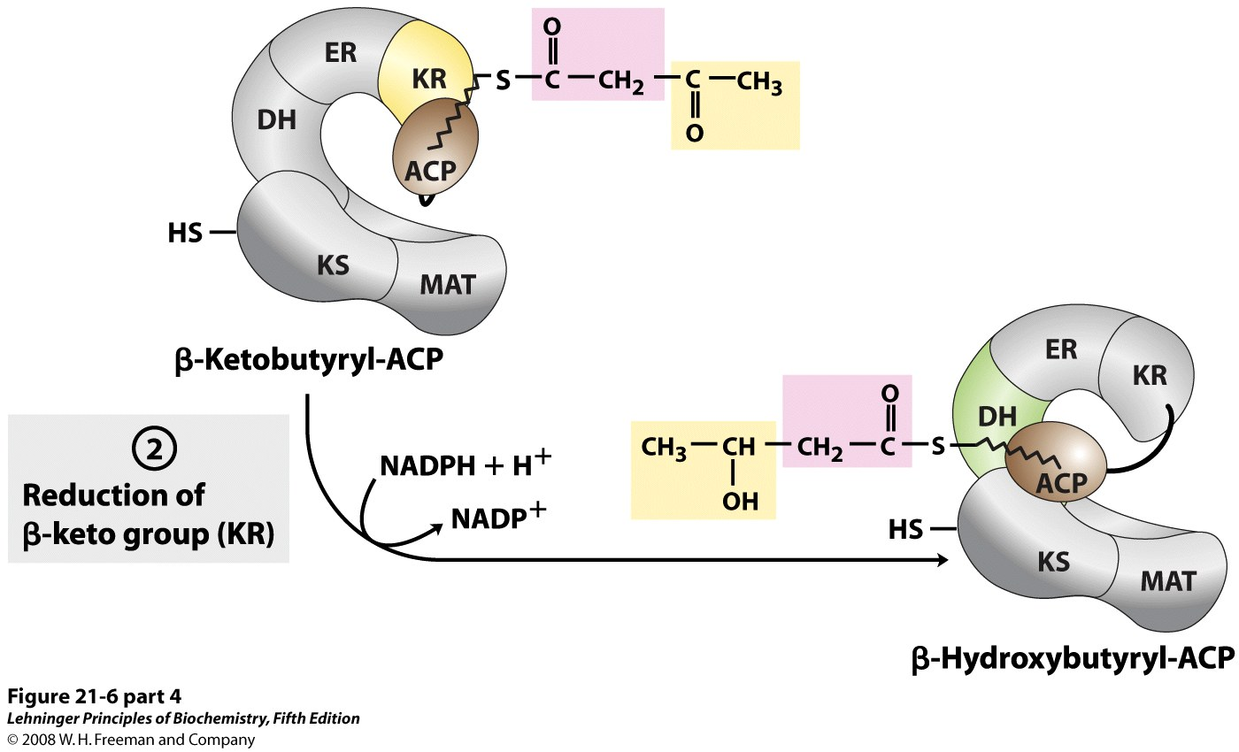
Step 2: β-ketobutyryl-ACP
is reduced to
D-β-hydroxybutyryl-ACP,
using NADPH and the
β-ketoacyl-ACP reductase (KR)
Notes:
FIGURE 21-6 (part 4) Sequence of events during synthesis of a fatty acid. The mammalian FAS I complex is shown schematically, with catalytic domains colored as in Figure 21-3. Each domain of the larger polypeptide represents one of the six enzymatic activities of the complex, arranged in a large, tight "S" shape. The acyl carrier protein (ACP) is not resolved in the crystal structure shown in Figure 21-3, but is attached to the KS domain. The phosphopantetheine arm of ACP ends in an —SH. After the first panel, the enzyme shown in color is the one that will act in the next step. As in Figure 21-4, the initial acetyl group is shaded yellow, C-1 and C-2 of malonate are shaded pink, and the carbon released as CO₂ is shaded green. Steps 1 to 4 are described in the text.

Slide 15
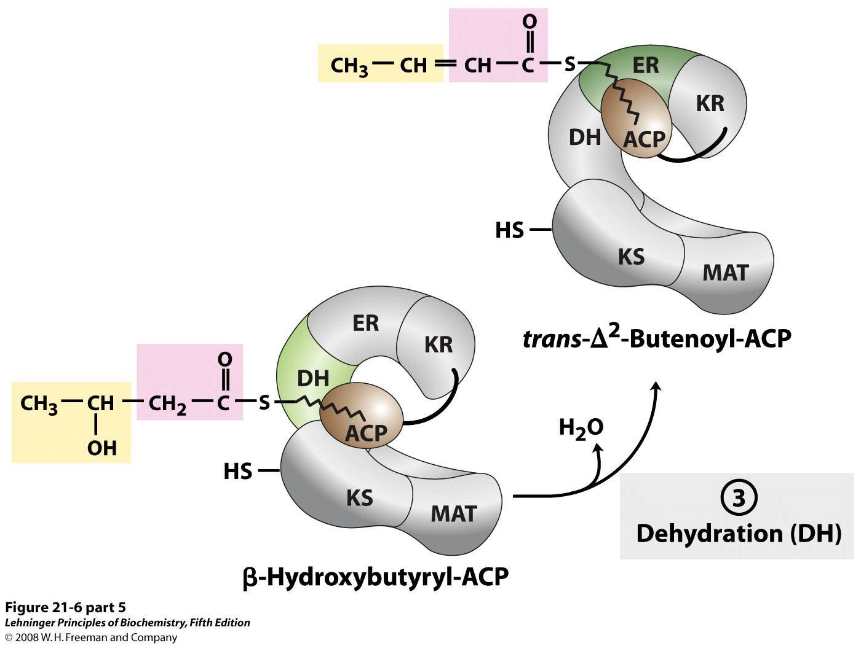
Step 3: A water molecule is
removed from
β-hydroxybutyryl-ACP
to produce
trans-Δ2-butenoyl-ACP
in a reaction catalyzed
by β-hydroxyacyl-ACP
dehydratase (HD)
Notes:
FIGURE 21-6 (part 5) Sequence of events during synthesis of a fatty acid. The mammalian FAS I complex is shown schematically, with catalytic domains colored as in Figure 21-3. Each domain of the larger polypeptide represents one of the six enzymatic activities of the complex, arranged in a large, tight "S" shape. The acyl carrier protein (ACP) is not resolved in the crystal structure shown in Figure 21-3, but is attached to the KS domain. The phosphopantetheine arm of ACP ends in an —SH. After the first panel, the enzyme shown in color is the one that will act in the next step. As in Figure 21-4, the initial acetyl group is shaded yellow, C-1 and C-2 of malonate are shaded pink, and the carbon released as CO₂ is shaded green. Steps 1 to 4 are described in the text.

Slide 16
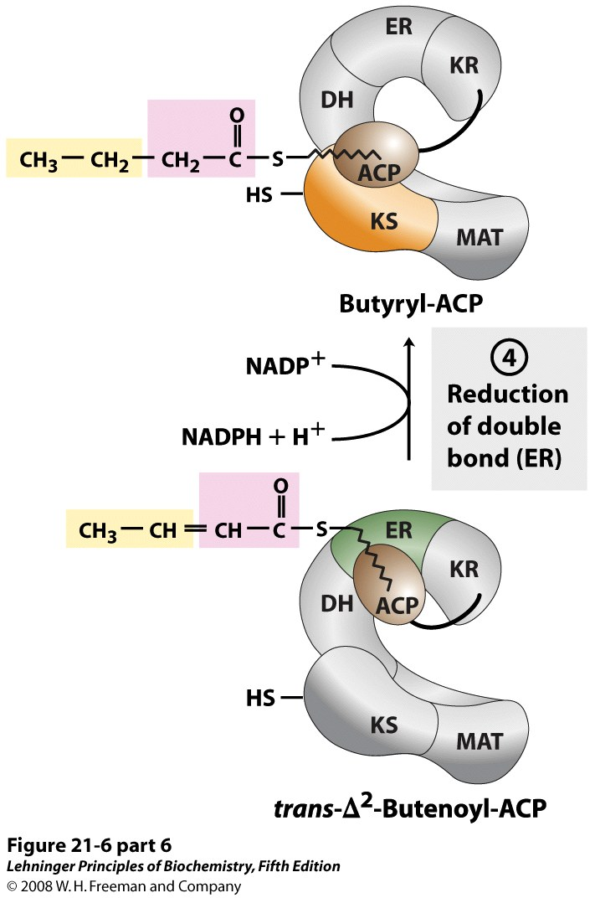
Step 4: The carbon-carbon
double bond in
trans-Δ2-butenoyl-ACP is reduced
by NAPDH in a reaction catalyzed
by enoyl-ACP reductase (ER),
producing a saturated acyl on
ACP (butyryl-ACP)
Notes:
FIGURE 21-6 (part 6) Sequence of events during synthesis of a fatty acid. The mammalian FAS I complex is shown schematically, with catalytic domains colored as in Figure 21-3. Each domain of the larger polypeptide represents one of the six enzymatic activities of the complex, arranged in a large, tight "S" shape. The acyl carrier protein (ACP) is not resolved in the crystal structure shown in Figure 21-3, but is attached to the KS domain. The phosphopantetheine arm of ACP ends in an —SH. After the first panel, the enzyme shown in color is the one that will act in the next step. As in Figure 21-4, the initial acetyl group is shaded yellow, C-1 and C-2 of malonate are shaded pink, and the carbon released as CO₂ is shaded green. Steps 1 to 4 are described in the text.

Slide 17
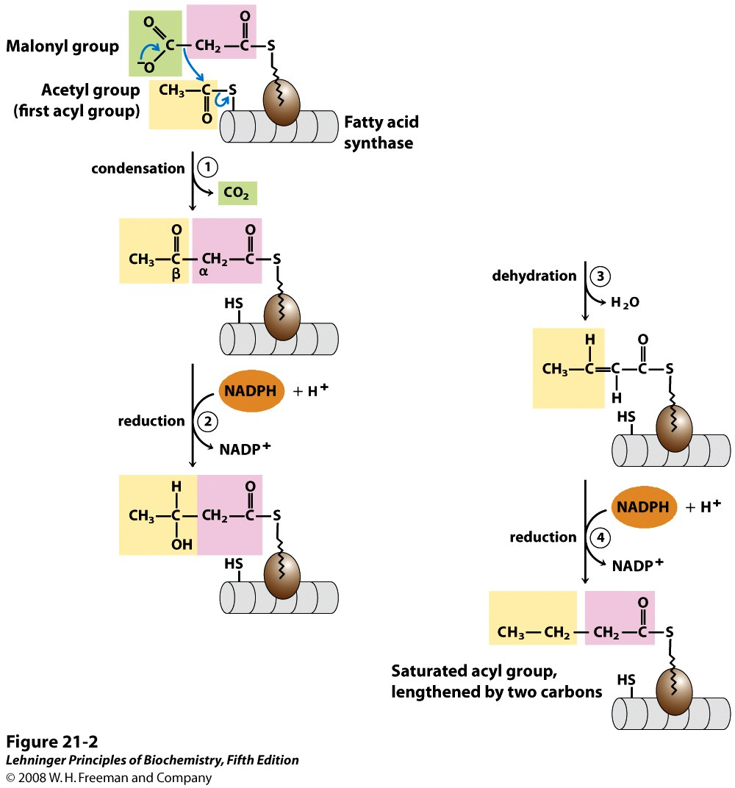
Fatty acids are synthesized by a repeating four-step reaction sequence
Notes:
FIGURE 21-2 Addition of two carbons to a growing fatty acyl chain: a four-step sequence. Each malonyl group and acetyl (or longer acyl) group is activated by a thioester that links it to fatty acid synthase, a multienzyme system described later in the text. 1 Condensation of an activated acyl group (an acetyl group from acetyl-CoA is the first acyl group) and two carbons derived from malonyl-CoA, with elimination of CO₂ from the malonyl group, extends the acyl chain by two carbons. The mechanism of the first step of this reaction is given to illustrate the role of decarboxylation in facilitating condensation. The β-keto product of this condensation is then reduced in three more steps nearly identical to the reactions of β oxidation, but in the reverse sequence: 2 the β-keto group is reduced to an alcohol, 3 elimination of H₂O creates a double bond, and 4 the double bond is reduced to form the corresponding saturated fatty acyl group.

Slide 18
Fatty acid biosynthesis is catalyzed
by a multi-enzyme complex called fatty acid synthase
(FAS II)

Slide 19
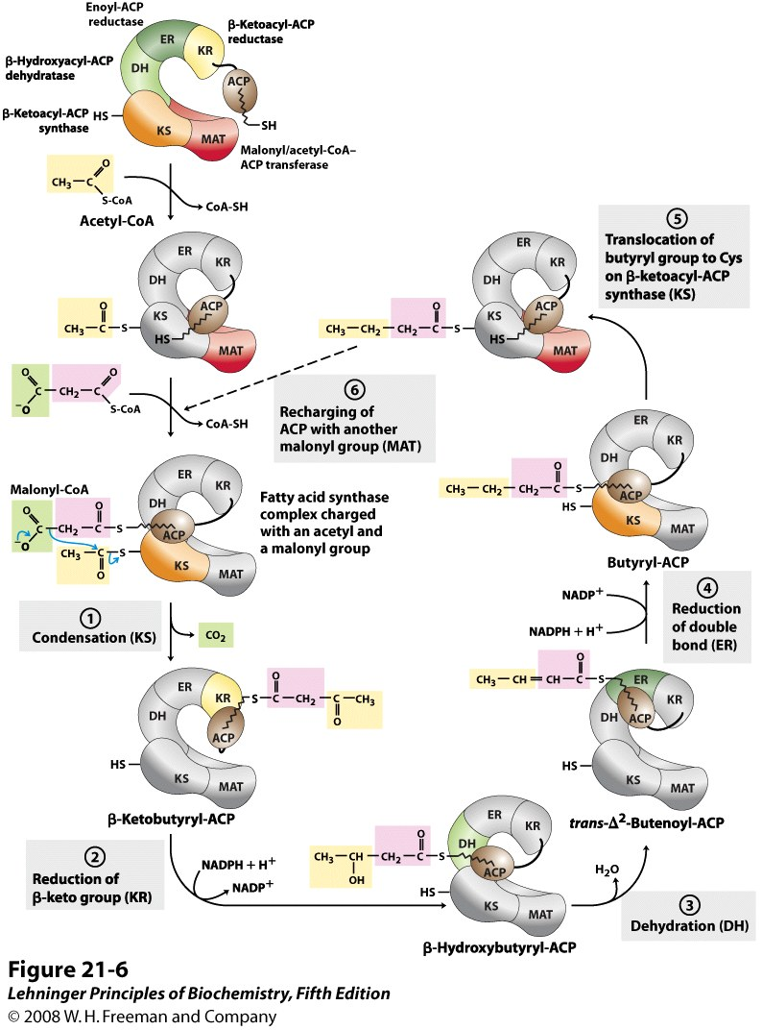
Sequence of events during synthesis of a fatty acid
Notes:
FIGURE 21-6 Sequence of events during synthesis of a fatty acid. The mammalian FAS I complex is shown schematically, with catalytic domains colored as in Figure 21-3. Each domain of the larger polypeptide represents one of the six enzymatic activities of the complex, arranged in a large, tight "S" shape. The acyl carrier protein (ACP) is not resolved in the crystal structure shown in Figure 21-3, but is attached to the KS domain. The phosphopantetheine arm of ACP ends in an —SH. After the first panel, the enzyme shown in color is the one that will act in the next step. As in Figure 21-4, the initial acetyl group is shaded yellow, C-1 and C-2 of malonate are shaded pink, and the carbon released as CO₂ is shaded green. Steps 1 to 4 are described in the text.

Slide 20
The butyryl group is then transferred to the Cys -SH group of β-ketoacyl-ACP synthase (KS) for another round of four reactions, which will extend the chain by two more carbons.
Seven rounds of the four-step lengthening reactions produce palmitoyl-ACP, which will be hydrolyzed to release a free palmitate.
The flexible 4’-phosphopantetheine group covalently attached to ACP is believed to act as a switch arm to move the intermediates from one active site to the next on the enzyme complex (i.e., the substrates are channeled).

Slide 21
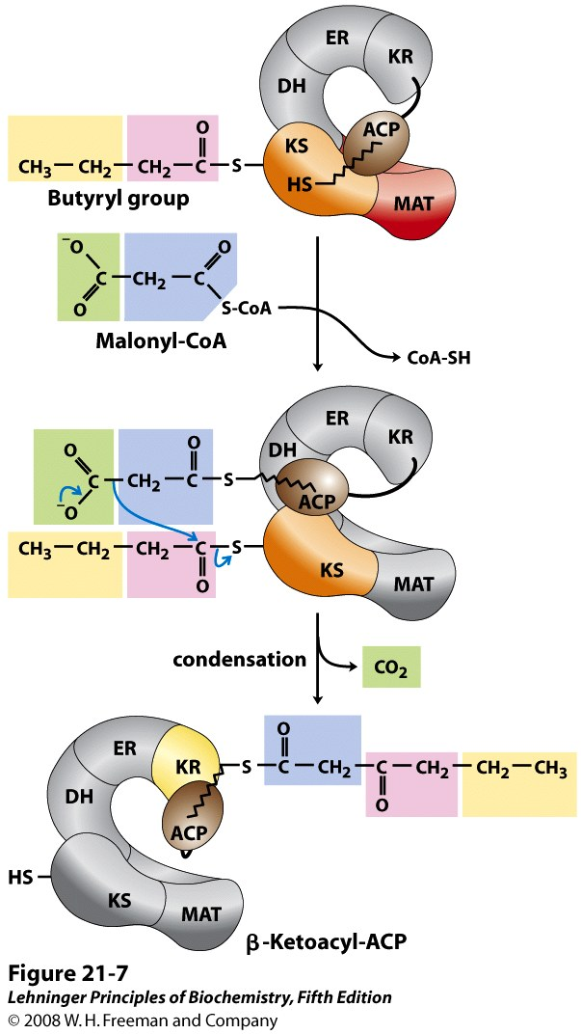
Beginning of the second round of the fatty acid synthesis cycle
Notes:
FIGURE 21-7 Beginning of the second round of the fatty acid synthesis cycle. The butyryl group is on the Cys —SH group. The incoming malonyl group is first attached to the phosphopantetheine ﾑSH group. Then, in the condensation step, the entire butyryl group on the Cys —SH is exchanged for the carboxyl group of the malonyl residue, which is lost as CO₂ (green). This step is analogous to step 1 in Figure 21-6. The product, a six-carbon β-ketoacyl group, now contains four carbons derived from malonyl-CoA and two derived from the acetyl-CoA that started the reaction. The β-ketoacyl group then undergoes steps 2 through 4, as in Figure 21-6.

Slide 22
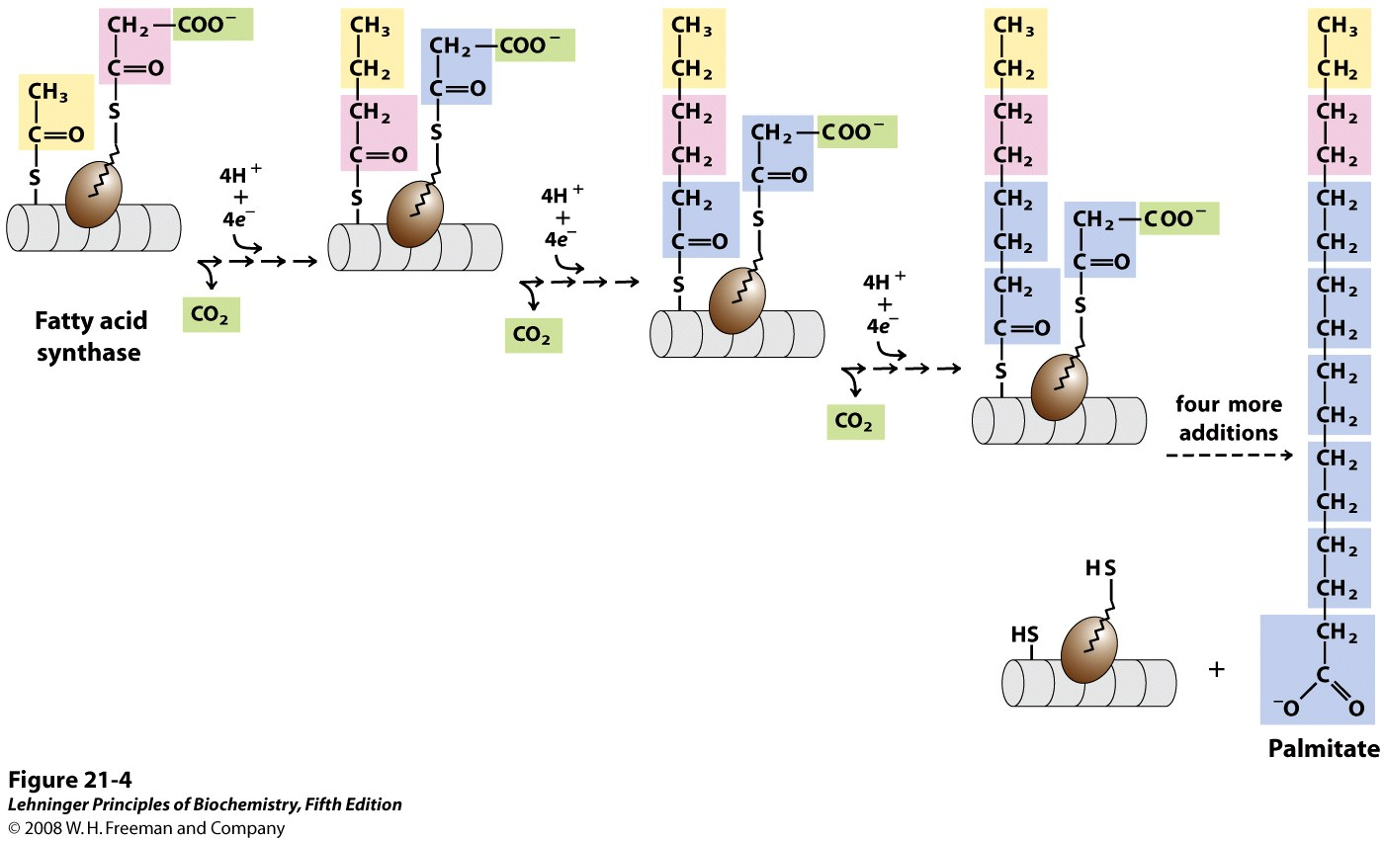
The overall process of palmitate synthesis
Notes:
FIGURE 21-4 The overall process of palmitate synthesis. The fatty acyl chain grows by two-carbon units donated by activated malonate, with loss of CO₂ at each step. The initial acetyl group is shaded yellow, C-1 and C-2 of malonate are shaded pink, and the carbon released as CO₂ is shaded green. After each two-carbon addition, reductions convert the growing chain to a saturated fatty acid of four, then six, then eight carbons, and so on. The final product is palmitate (16:0).

Slide 23
A total of 7 ATP and 14 NADPH will be consumed for making one palmitate molecule.
8 acetyl-CoA + 7ATP + 14 NADPH + 14 H⁺
palmitate + 8 CoA + 6 H₂O+ 7 ADP + 7 P_{i} + 14 NADP⁺

Slide 24
Comparison between degradation and biosynthesis of fatty acids*****
Degradation
dehydrogenation
hydration
dehydrogenation
thiolytic cleavage
NAD⁺/FAD
CoA
Mitochondrial matrix
Removal of acetyl group
Biosynthesis
condensation
reduction
dehydration
reduction
NADPH
ACP
Cytosol
Addition of two-carbon units
donated from malonyl-CoA

Slide 25
5. The seven activities of fatty acid synthase from different organisms have different level of integration
Each activity resides in a separate polypeptide chain in bacteria and higher plants---FAS II
The seven activities reside in two separate polypeptide chains in yeast---FAS I
The seven activities reside in one large polypeptide chain in vertebrates, with the synthase present as dimers---FAS I

Slide 26
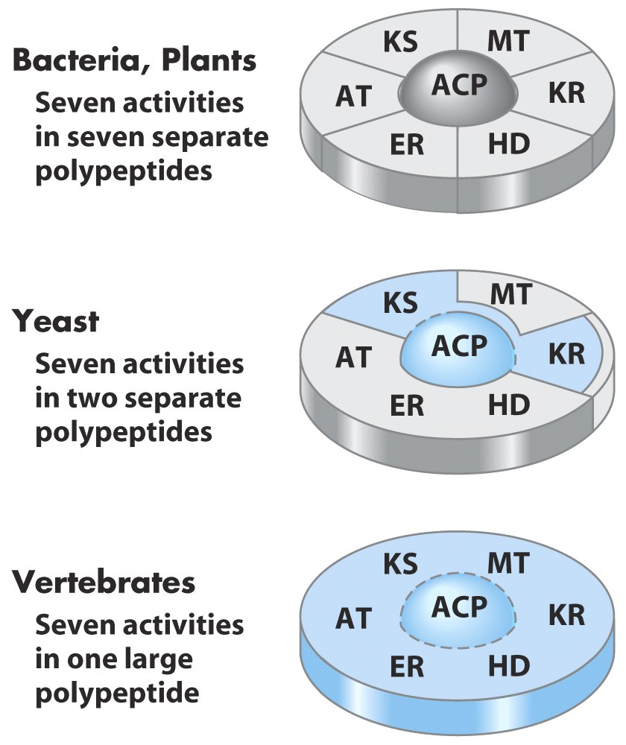
The seven activities
of fatty acid synthase
are integrated to
different levels in
different organisms.

Slide 27
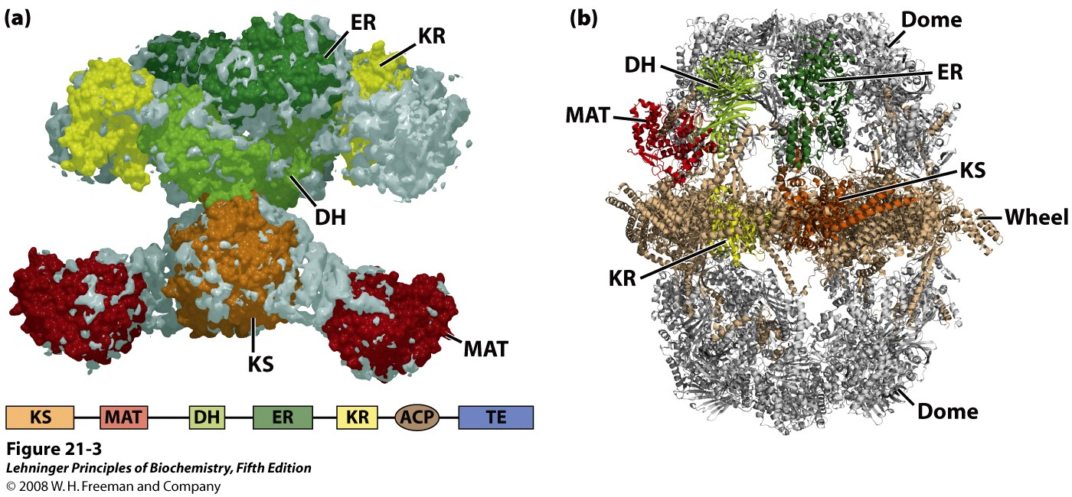
Mammalian FAS I
Fungal FAS I
Thioesterase
Malonyl/acetyl-CoA-ACP transferase
The structure of fatty acid synthase type I (FAS I) systems
Notes:
FIGURE 21-3 The structure of fatty acid synthase type I systems. The low-resolution structures of (a) the mammalian (porcine; derived from PDB ID 2CF2) and (b) fungal enzyme systems (derived from PDB IDs 2UV9, 2UVA, 2UVB, and 2UVC) are shown. (a) All of the active sites in the mammalian system are located in different domains within a single large polypeptide chain. The different enzymatic activites are: β-ketoacyl-ACP synthase (KS), malonyl/acetyl-CoA—ACP transferase (MAT), β-hydroxyacyl-ACP dehydratase (DH), enoyl-ACP reductase (ER), and β-ketoacyl-ACP reductase (KR). ACP is the acyl carrier protein. The linear arrangement of the domains in the polypeptide is shown in the lower panel. The seventh domain (TE) is a thioesterase that releases the palmitate product from ACP when the synthesis is completed. The ACP and TE domains are disordered in the crystal and are therefore not shown in the structure. (b) In the structure of the FAS I from the fungus Thermomyces lanuginosus, the same active sites are divided between two multifunctional polypeptide chains that function together. Six copies of each polypeptide are found in the heterododecameric complex. A wheel of six α subunits, which include ACP as well as the KS and KR active sites, is found at the center of the complex. In the wheel three subunits are found on one face, three on the other. On either side of the wheel are domes formed by trimers of the β subunits (containing the ER and DH active sites, as well as two domains with active sites analogous to MAT in the mammalian enzyme). The domains of one of each type of subunit are colored according to the active site colors of the mammalian enzyme in (a).

Slide 28
6. Fatty acid synthesis occurs in cellular compartments having a high NADPH/NADP⁺ ratio
NAD and NADP have been selected for functioning as electron carriers in oxidative catabolism and reductive anabolism, respectively.
In the hepatocytes and adipocytes, NADPH is mainly produced in the cytosol via the pentose phosphate pathway and by the malic enzyme.
In photosynthetic plants, fatty acid synthesis occur in the chloroplast stroma, using NADPH made from photosynthesis.

Slide 29
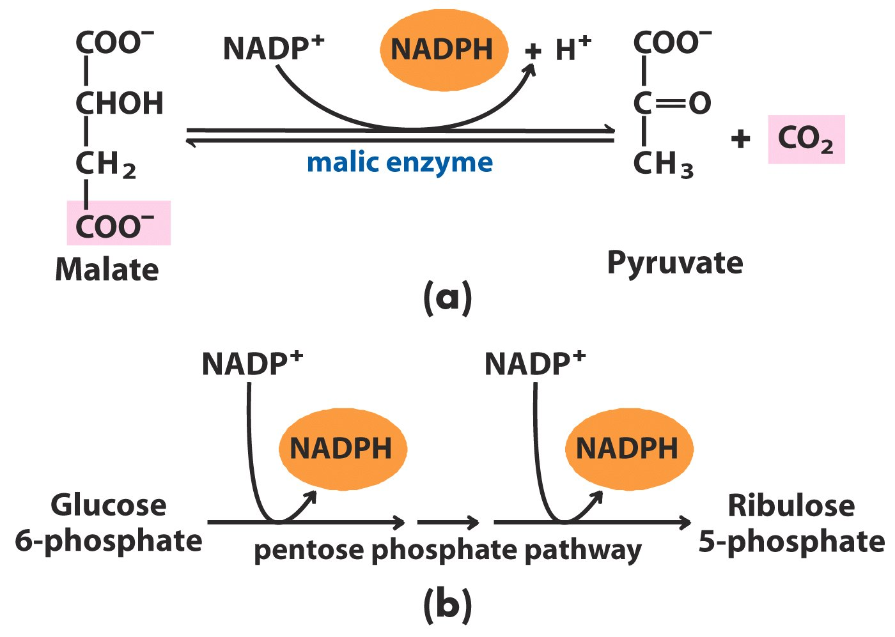
NADPH in the cytosol of animal cells is largely produced by the oxidative decarboxylation of
malate and the pentose phosphate pathway

Slide 30
In photosynthetic plants, fatty acid synthesis
occur in the chloroplast stroma, using
NADPH made from photosynthesis
Production of NADPH by photosynthesis

Slide 31
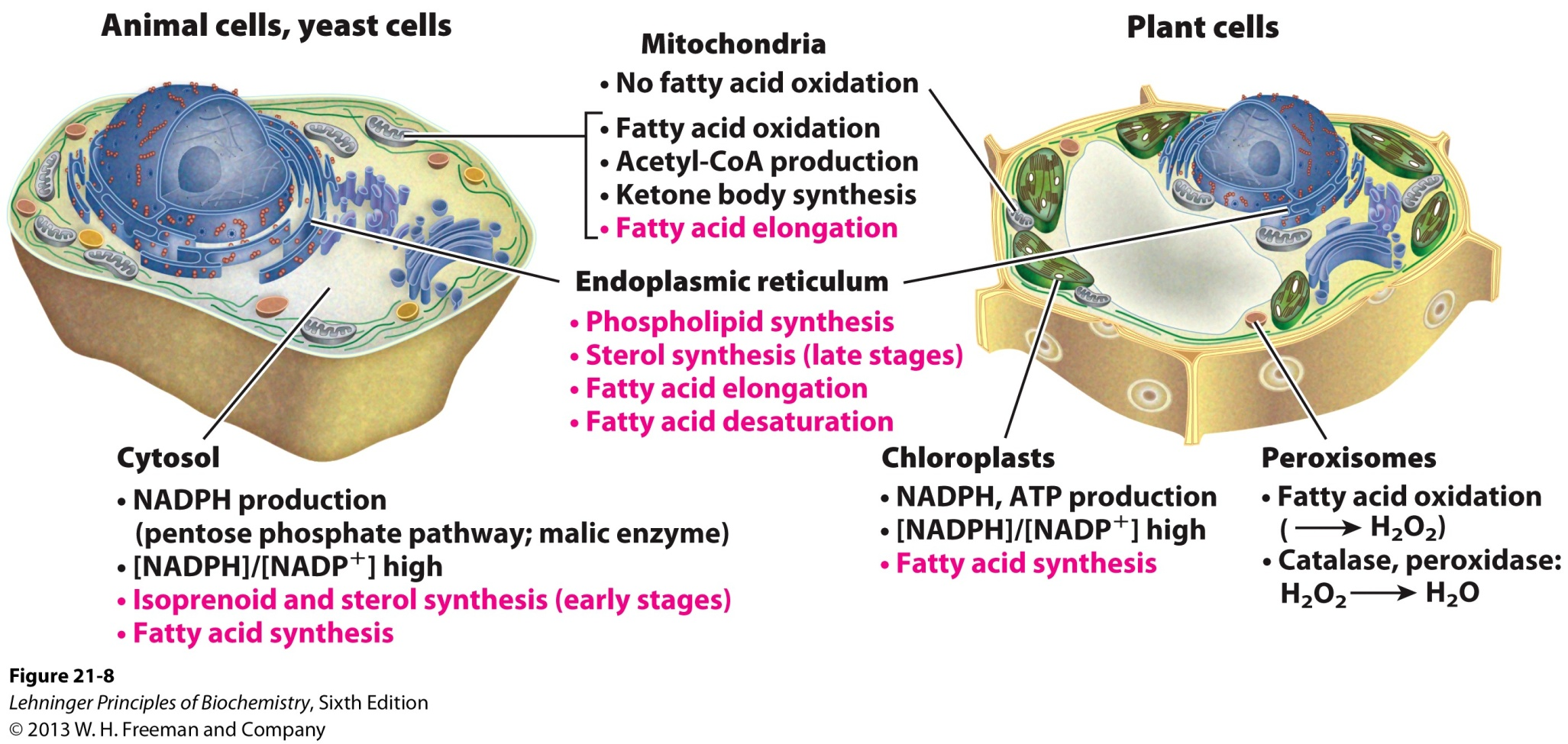
Subcellular localization of lipid metabolism

Slide 32
7. The acetyl groups of the mitochondrion are transported into the cytosol in the form of citrate
The acetyl-CoA molecules are made from glucose and amino acids in mitochondria.
They are shuttled into the cytosol in the form of citrate via the citrate transporter of the inner membrane.
Acetyl-CoA is regenerated by the action of ATP-dependent citrate lyase in the cytosol.
Oxaloacetate is shuttled back into the mitochondria as malate or pyruvate.

Slide 33
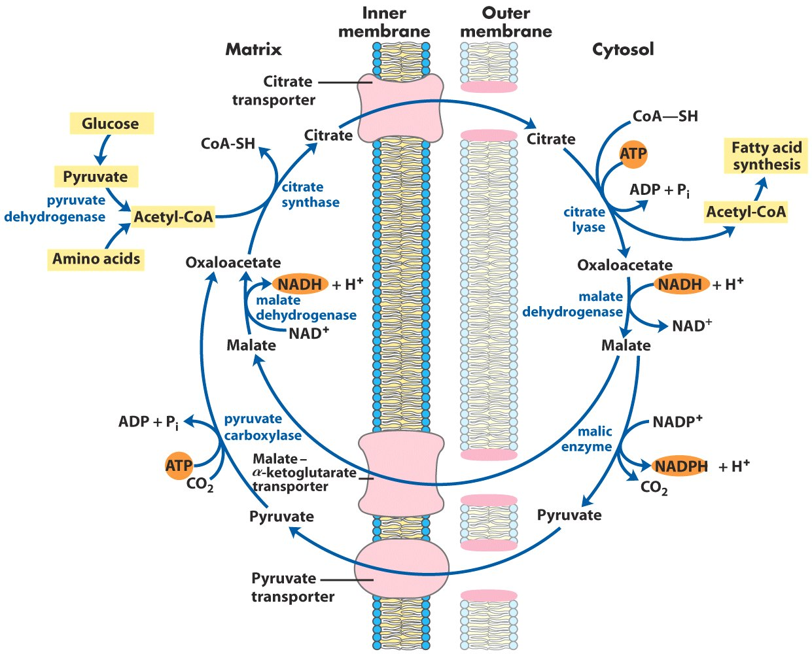
Shuttle for transfer of acetyl groups from mitochondria to the cytosol

Slide 34
8. The rate of fatty acid biosynthesis is controlled by acetyl-CoA carboxylase
Excess fuel is generally converted to fatty acids/triacylglycerol for long term storage.
Acetyl-CoA carboxylase, catalyzing the committing and rate-limiting step of fatty acid synthesis, is allosterically inhibited by palmitoyl-CoA and activated by citrate.
Glucagon and epinephrine triggers the phosphorylation and disassociation of the polymeric enzyme subunits, which inactivates the enzyme.

Slide 35
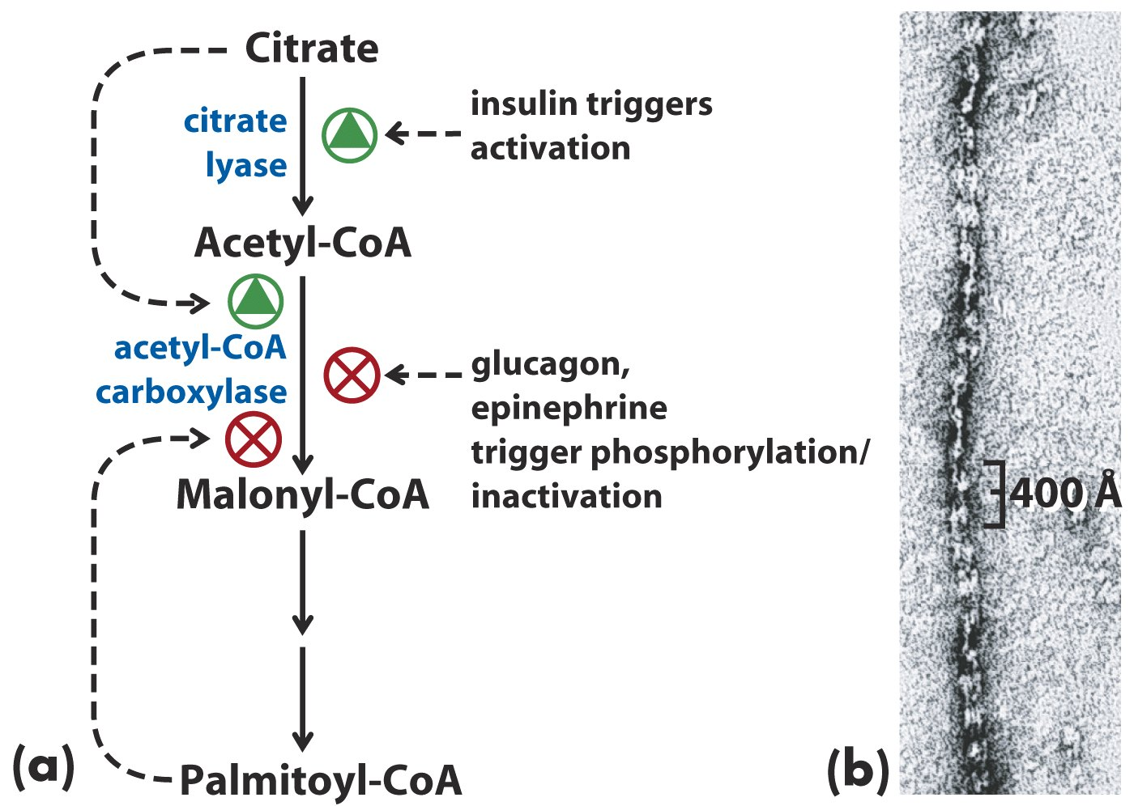
Acetyl-CoA carboxylase
is regulated by allosteric
effectors and reversible
phosphorylation
Acetyl-CoA carboxylase is regulated by allosteric
effectors and reversible phosphorylation

Slide 36
Filaments of acetyl-CoA carboxylase
(the active, dephosphorylated form)

Slide 37
Citrate partially activates the phosphorylated acetyl-CoA carboxylase (similar to how AMP partially activates the dephosphorylated glycogen phosphorylase).
In plants, acetyl-CoA carboxylase is activated by a increase of Mg ²⁺ concentration and a decrease of H⁺ concentration that accompany illumination.
Malonyl-CoA inhibits carnitine acyltransferase I, thus shutting down β-oxidation.

Slide 38
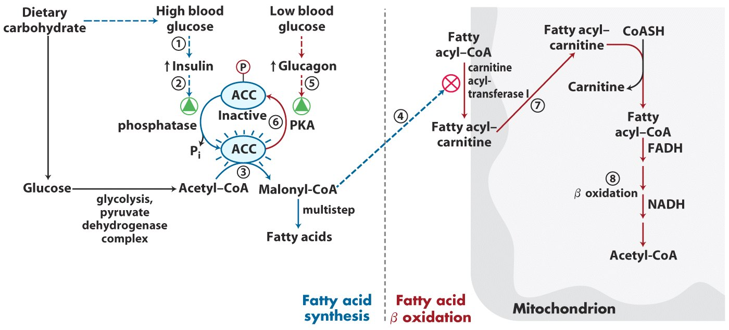
Coordinated regulation of fatty acid synthesis and breakdown*****
(Figure 17-12)

Slide 39
9. Palmitate can be further elongated and desaturated in smooth ER
Palmitoyl-CoA can be further elongated to Stearoyl-CoA by the fatty acid elongation systems present mainly in the smooth endoplasmic reticulum (ER), with two-carbon units also donated by malonyl-CoA.
Palmitoyl-CoA and Stearoyl-CoA can be desaturated between C-9 and C-10 to produce palmitoleate, 16:1( Δ⁹), and oleate, 18:1( Δ⁹), respectively.

Slide 40
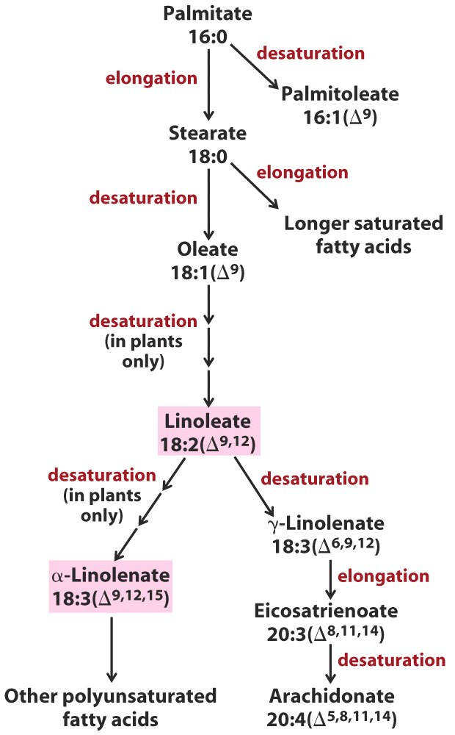
Palmitate is the
precursor for the
biosynthesis of
other fatty acids
Essential fatty acids
for mammals

Slide 41
10. Newly synthesized fatty acids have mainly two alternative fates in cells
Fate I: To be incorporated into triacylglycerols as a storage form of metabolic energy in long terms
Fate II: To be incorporated into membrane phospholipids (during rapid growth).

Slide 42
11. Phosphatidic acid is the common precursor for the syntheses of both triacylglycerols and glycerophospholipids
Phosphatidic acid (or diacylglycerol 3-phosphate) is made by transferring two acyl groups from two acyl-CoAs to L-glycerol 3-phosphate, which is derived from either glycerol or dihydroxyacetone phosphate.
A phosphatidic acid is converted to a triacylglycerol via a dephosphorylation reaction (catalyzed by phosphatidic acid phosphatase) and an acyl transferring reaction.

Slide 43
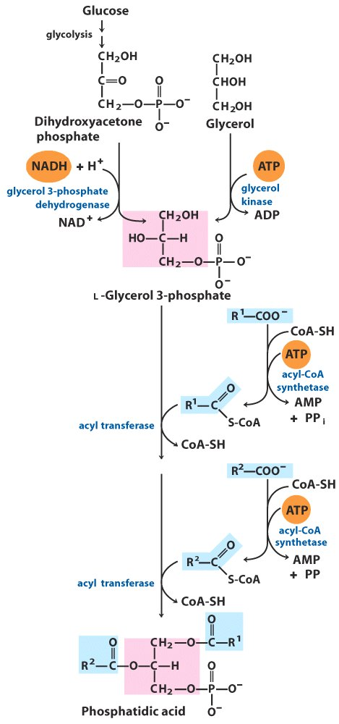
Phosphatidic
acid is derived
from L-glycerol 3-
phosphate and two acyl-CoAs

Slide 44
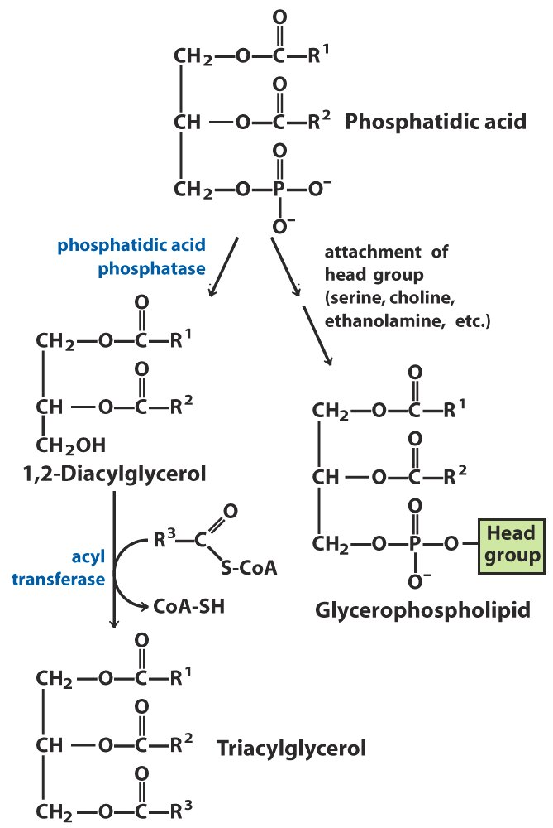
Phosphatidic acid
is the common
precursor for both
triacylglycerols and
glycerophospholipids

Slide 45
12. Insulin stimulates conversion of dietary carbohydrates or proteins into fat
Diabetes patients, due to lack of insulin, not only are unable to use glucose properly, but also fail to synthesize fatty acids from carbohydrates or amino acids.
They show increased rates of fatty acid oxidation and ketone body formation, thus losing weight.

Slide 46
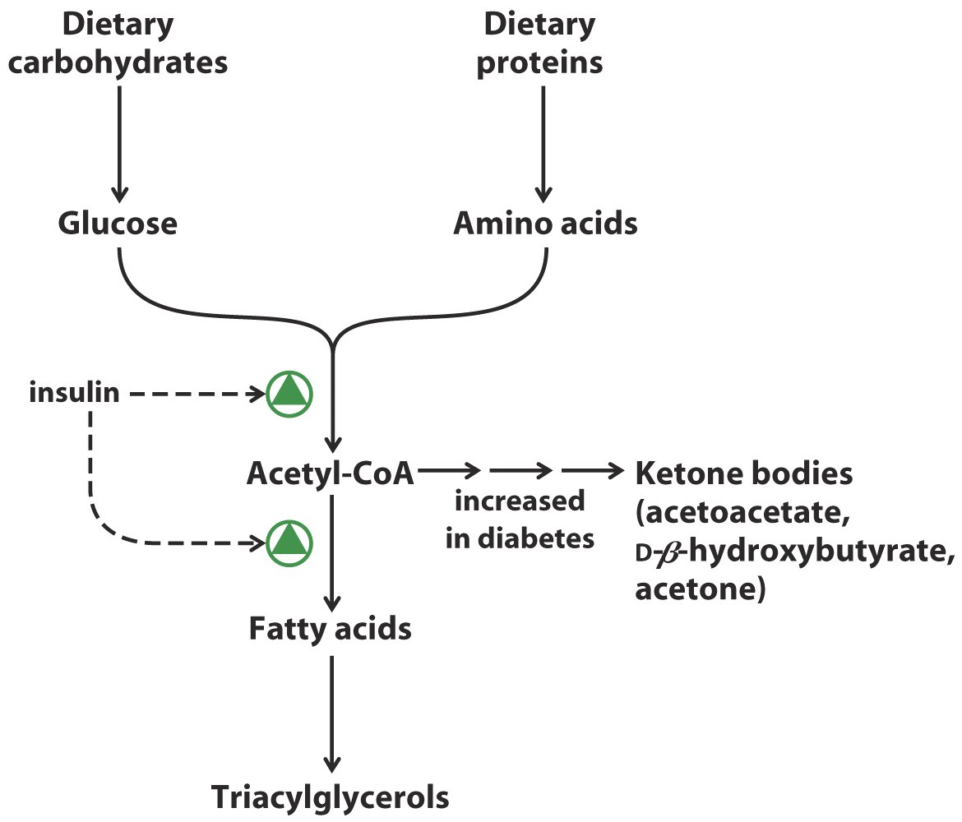
Regulation of triacylglycerol synthesis by insulin*****

Slide 47
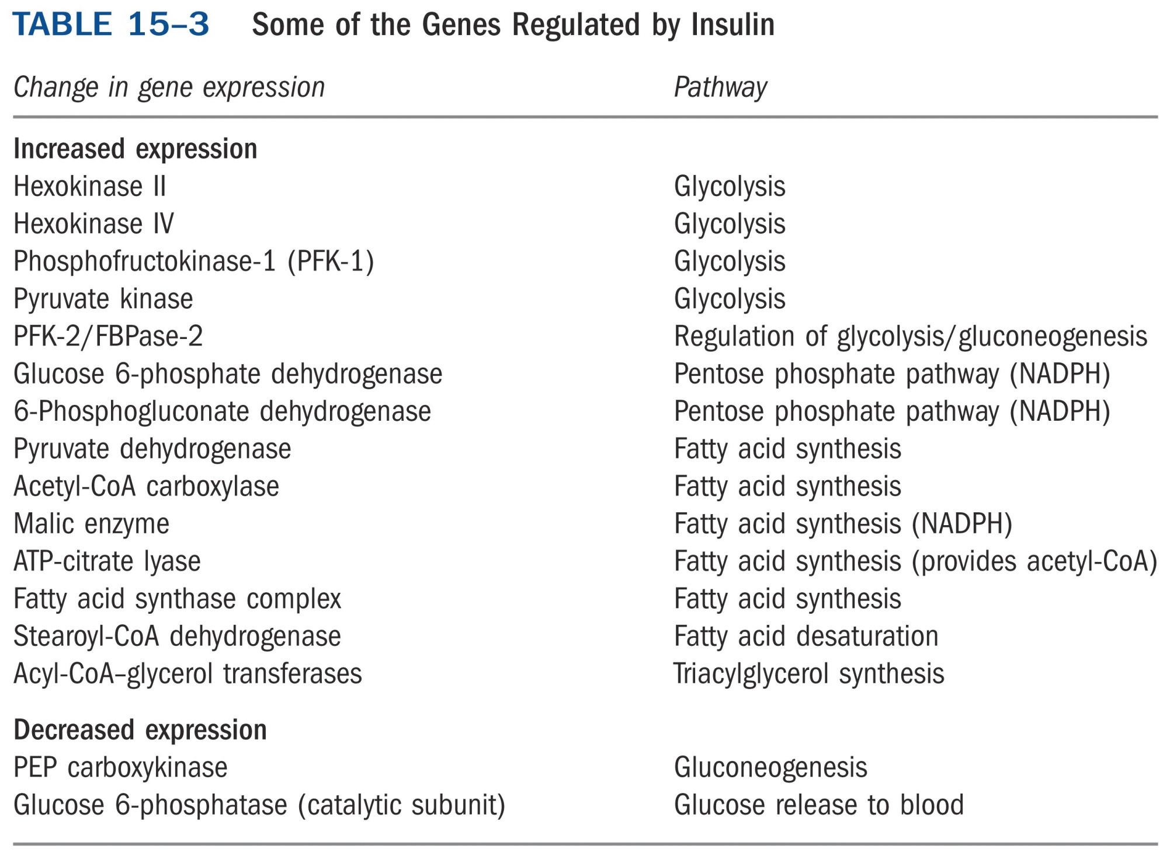
*****

Slide 48
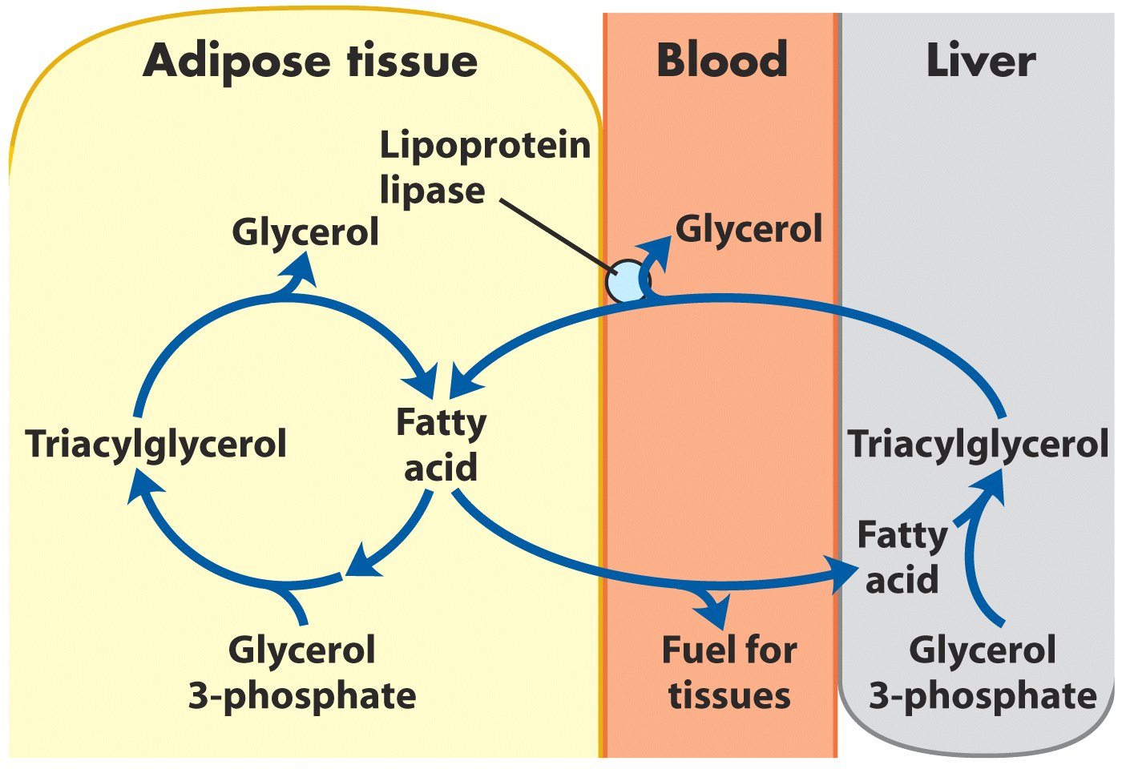
In mammals, triacylglycerol molecules are broken down
and resynthesized in a triacylglycerol cycle

Slide 49
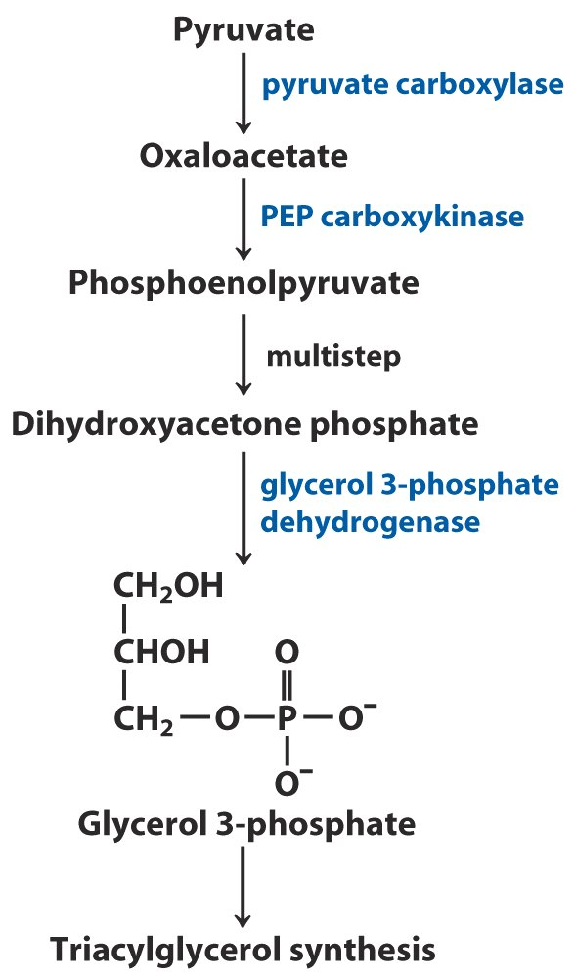
(in adipose tissue)
(in adipose tissue)
The dihydroxyacetone
phosphate precursor of
glycerol-3-phosphate is
derived from pyruvate via
glyceroneogenesis

Slide 50
13. Radioisotope tracer experiments revealed that all of the 27 carbons of cholesterol are derived from acetyl-CoA
The origin of the carbon atoms of cholesterol
(胆固醇) was deduced from tracer experiments where either the methyl carbon or the carboxyl carbon in acetate is labeled with ¹⁴C (1940s).
The pattern of labeling provided the blueprint for revealing the detail enzymatic steps for cholesterol biosynthesis occurring in mammals.
The 30-carbon squalene (of six isoprene units) and mevalonate were found to be intermediates of cholesterol biosynthesis.

Slide 51
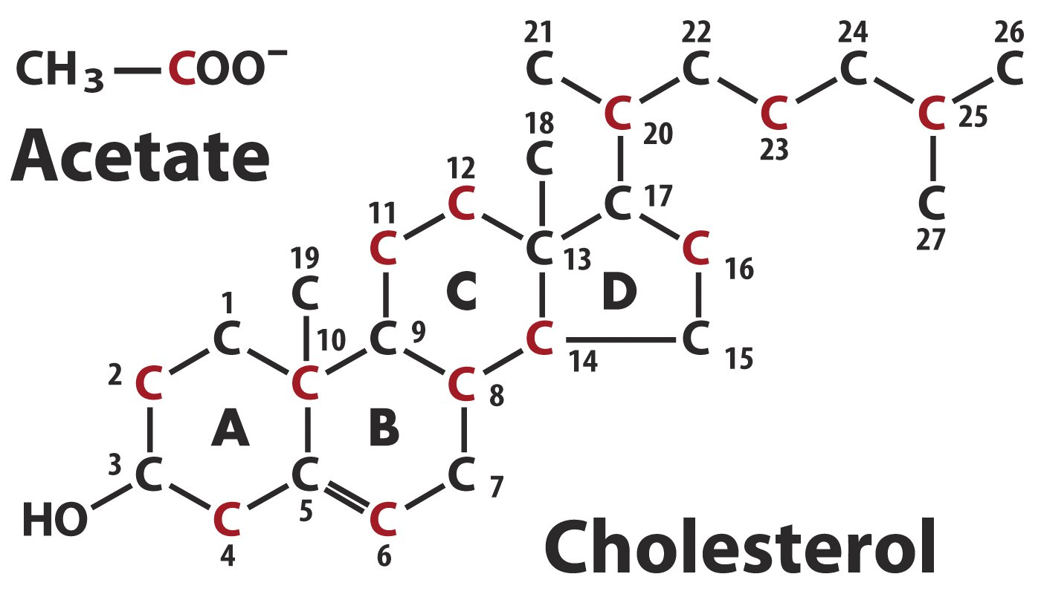
The carbon origins of cholesterol as revealed by
radioisotope labeling studies

Slide 52
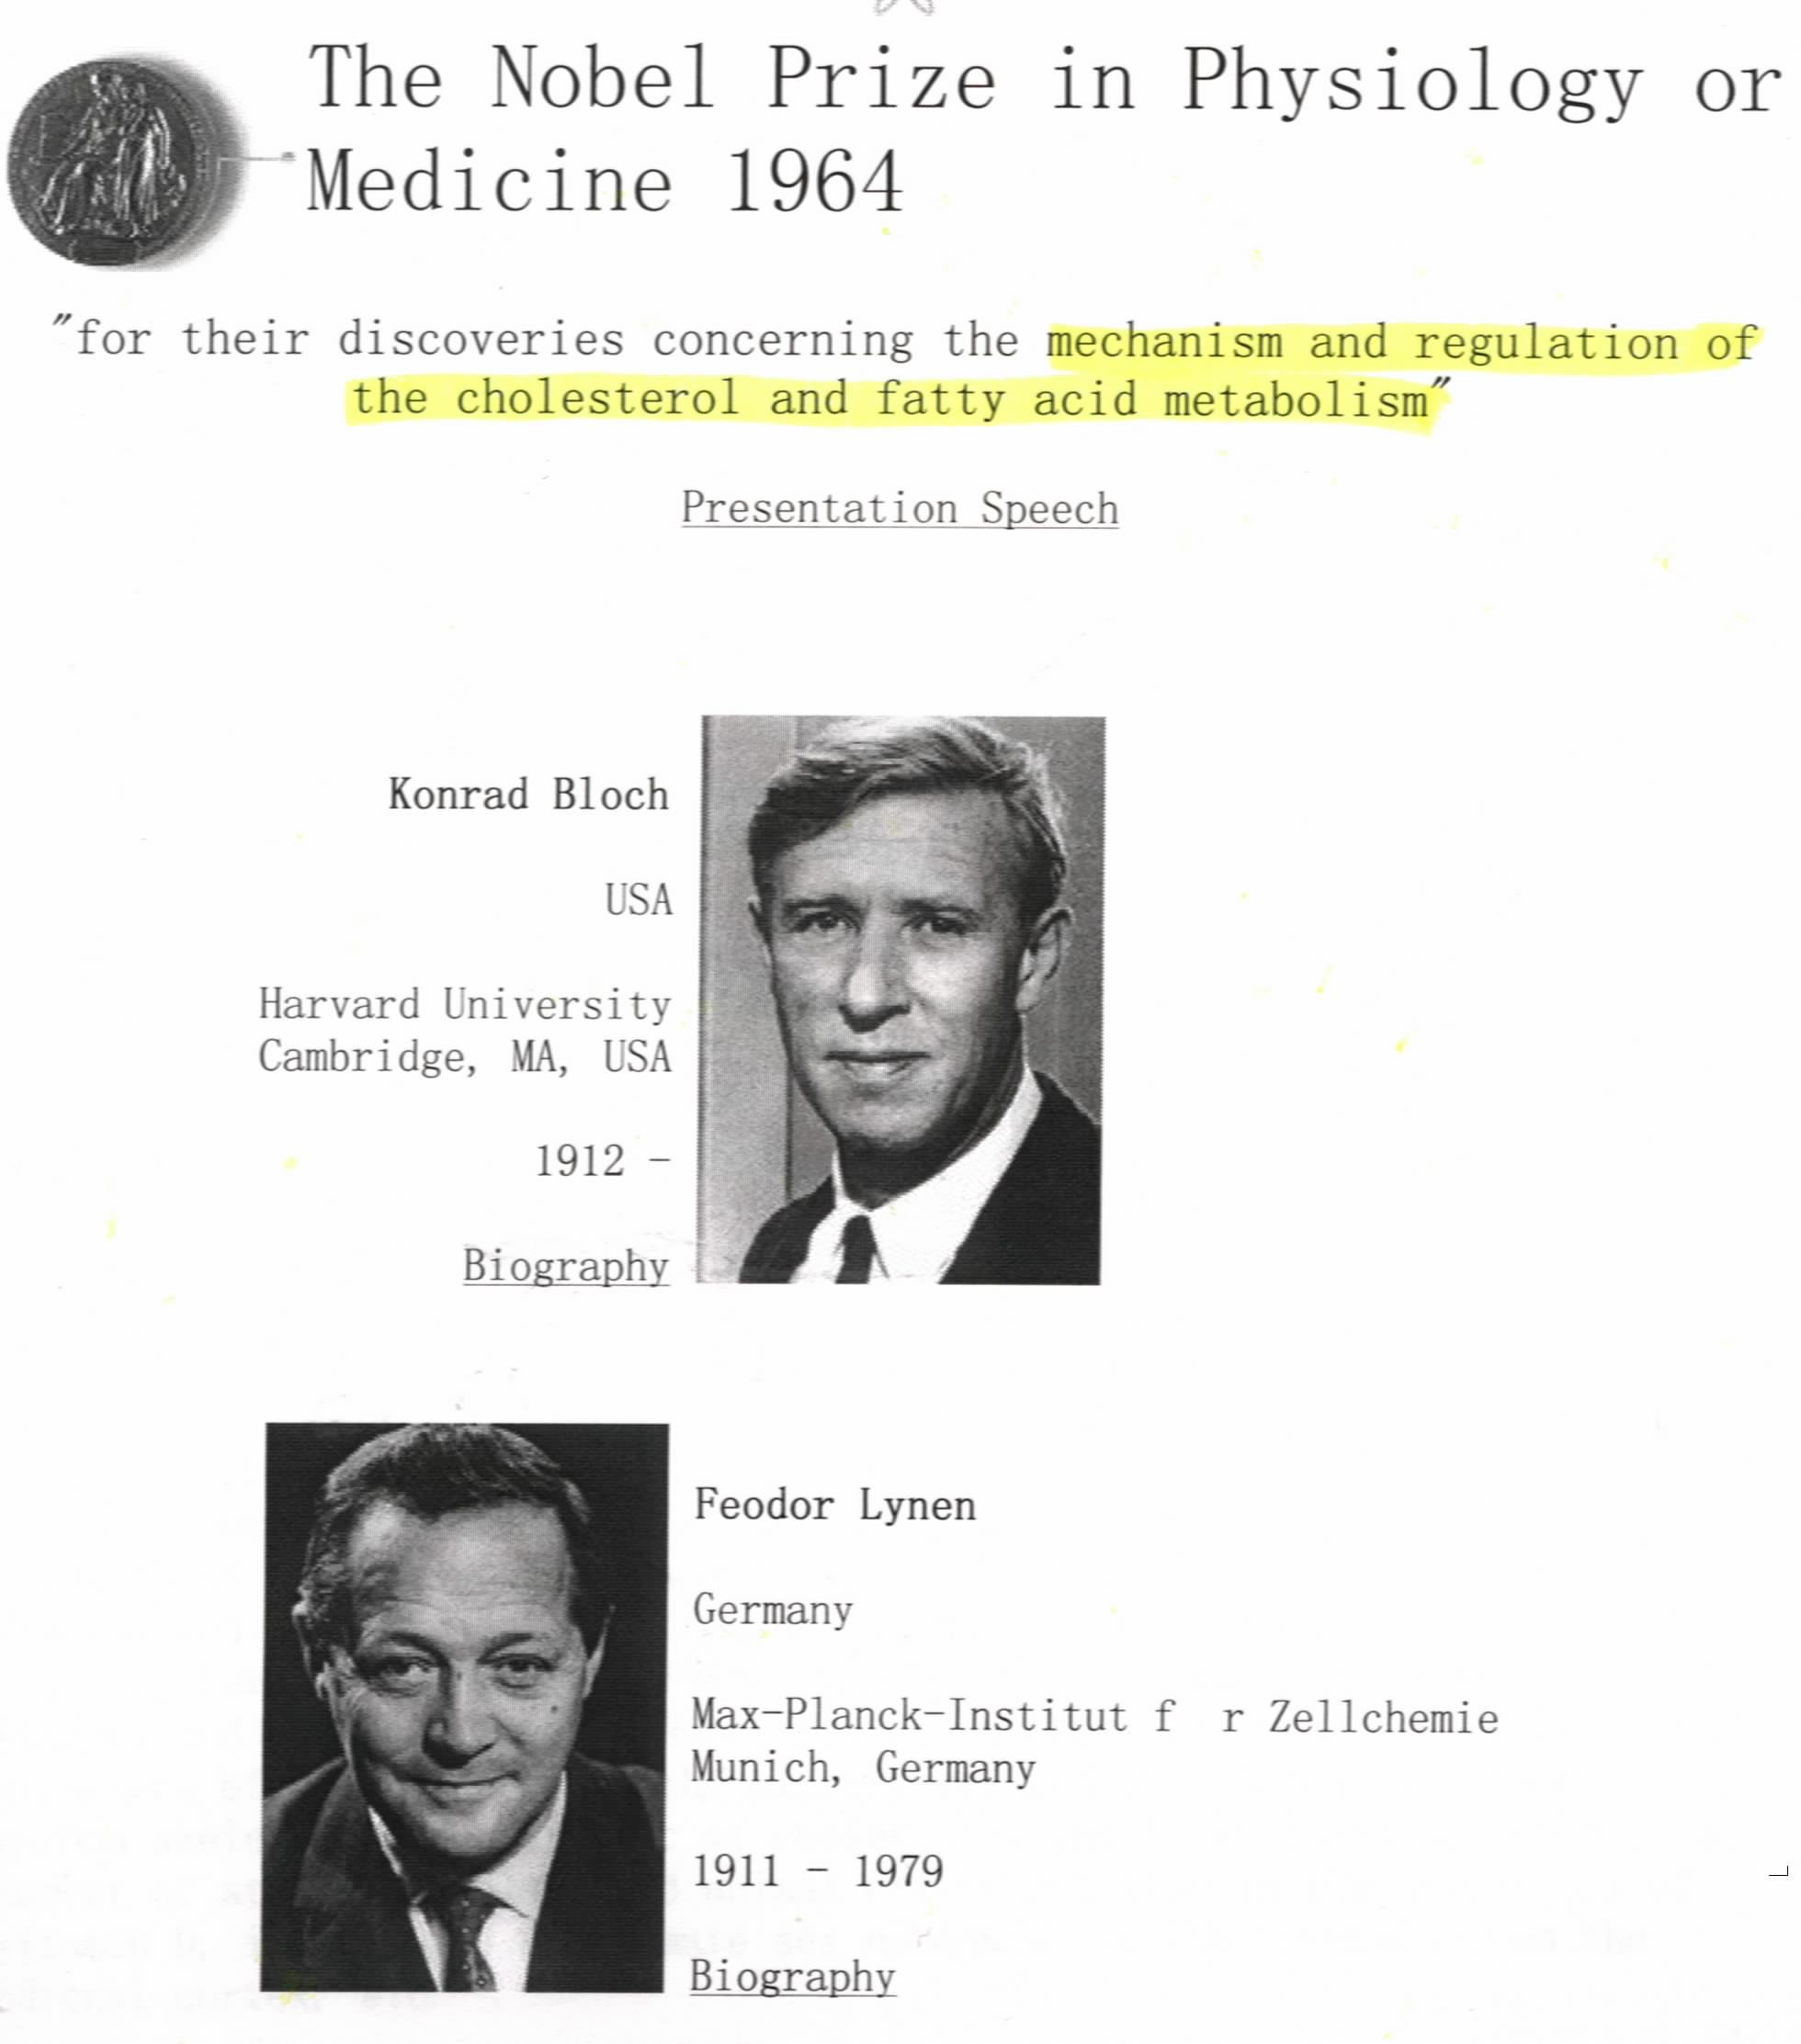

Slide 53
14. The cholesterol biosynthesis pathway can be divided into four stages
Stage I: three acetyl-CoA molecules condense to form the 6-carbon mevalonate (甲羟戊酸).
Stage II: mevalonate is converted to activated 5-carbon isoprene (异戊二烯) unit.
Stage III: Six isoprene units condense to form the linear 30-carbon squalene(鲨烯).
Stage IV: The linear squalene is cyclized to form a four-ring structure, which is eventually converted to the 27-carbon cholesterol through a series of complicated reactions.

Slide 54
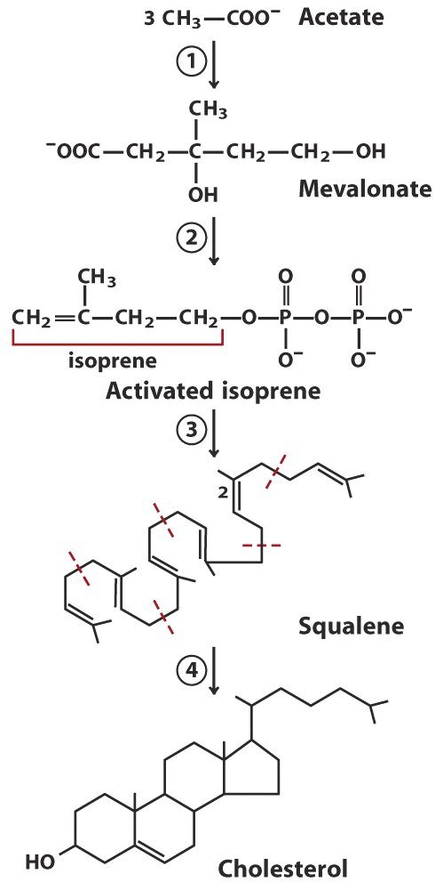
Reactions assembling
cholesterol from
acetyl-CoA can be
divided into four stages

Slide 55
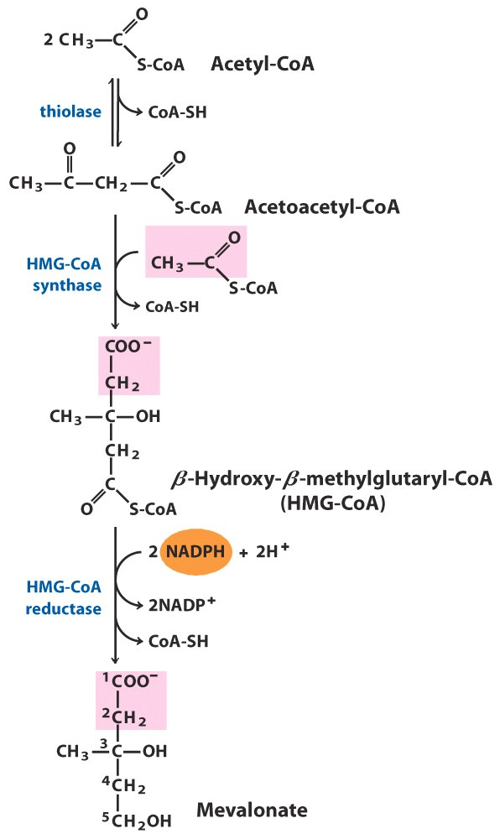
The irreversible
committing step
for cholesterol
biosynthesis
Formation of mevalonate
from acetyl-CoA

Slide 56
15. Mevalonate commits the acetyl groups for cholesterol synthesis
One molecule of β-hydroxy-β-methylglutaryl-CoA (HMG-CoA) is formed from three acetyl-CoA molecules in the cytosol via the same reactions as occurring in mitochondria for ketone body formation.
HMG-CoA reductase (an integral membrane protein in the smooth ER) catalyzes the irreversible reduction of HMG-CoA (using two molecules of NADPH) to form mevalonate: committing the acetyl groups for cholesterol synthesis (thus being the major regulation step).

Slide 57
16. Cholesterols made in vertebrate livers can be converted to bile acids and cholesterol esters before exporting
Cholesterol can be converted to bile acids and bile salts, which will be secreted to the intestine for emulsifying lipids.
Cholesterol can also be converted to the more hydrophobic cholesterol esters, which will be stored in the liver or transported to other tissues after being incorporated into lipoprotein particles.

Slide 58
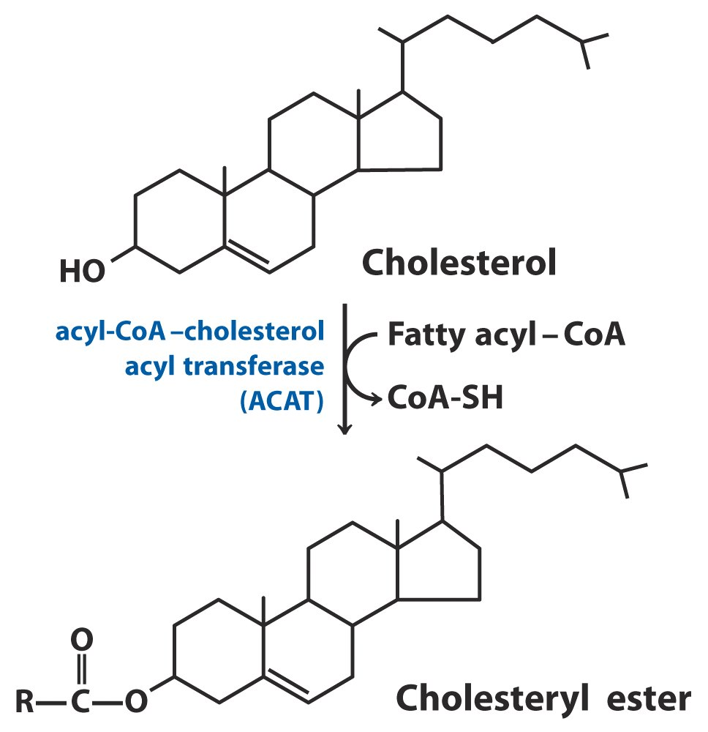
Acyl-CoA-Cholesterol
acyl transferase
(ACAT) catalyzes the
addition of an acyl
group to the hydroxyl
group of cholesterol
(more hydrophobic form
for storage and transport)

Slide 59
17. Lipids (including cholesterols) are transported in the vertebrate plasma as various lipoprotein particles
The different lipoprotein particles, having different combinations of lipids and apolipoproteins, can be separated by ultracentrifugation due to different densities and sizes.
The human plasma lipoproteins include chylomicrons (which transport exogenous lipids from intestine to various tissues), VLDL (very low-density lipoproteins which transport endogenous lipids synthesized in the liver), LDL (low-density lipoproteins) and HDL (high-density lipoproteins).

Slide 60
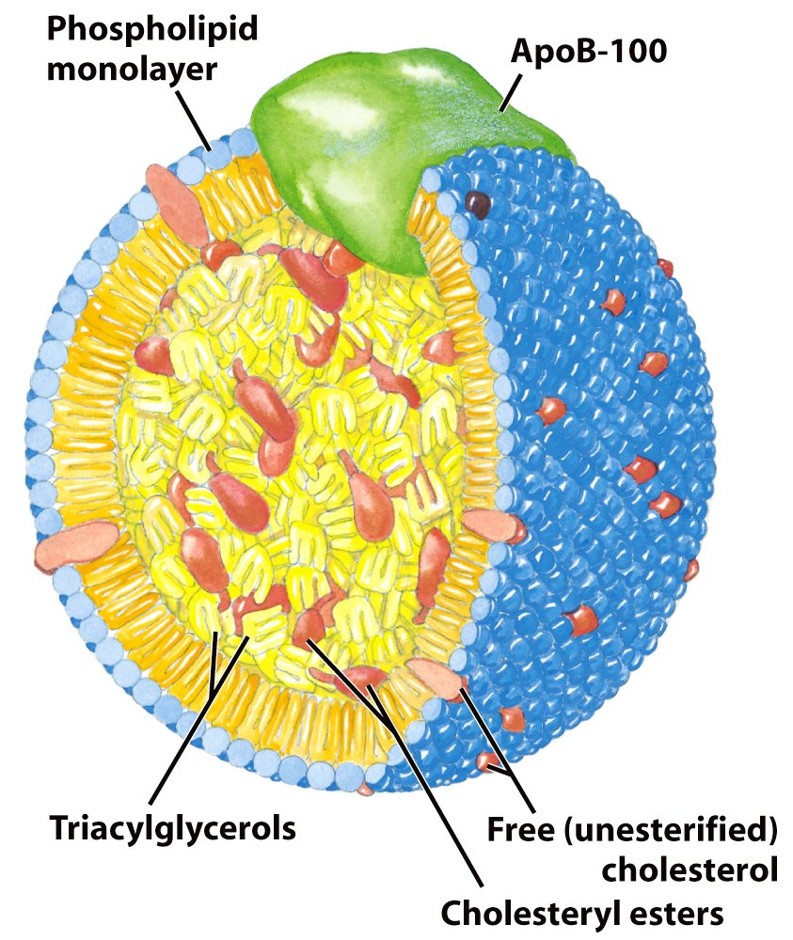
Structure of a low-density lipoprotein (LDL)

Slide 61
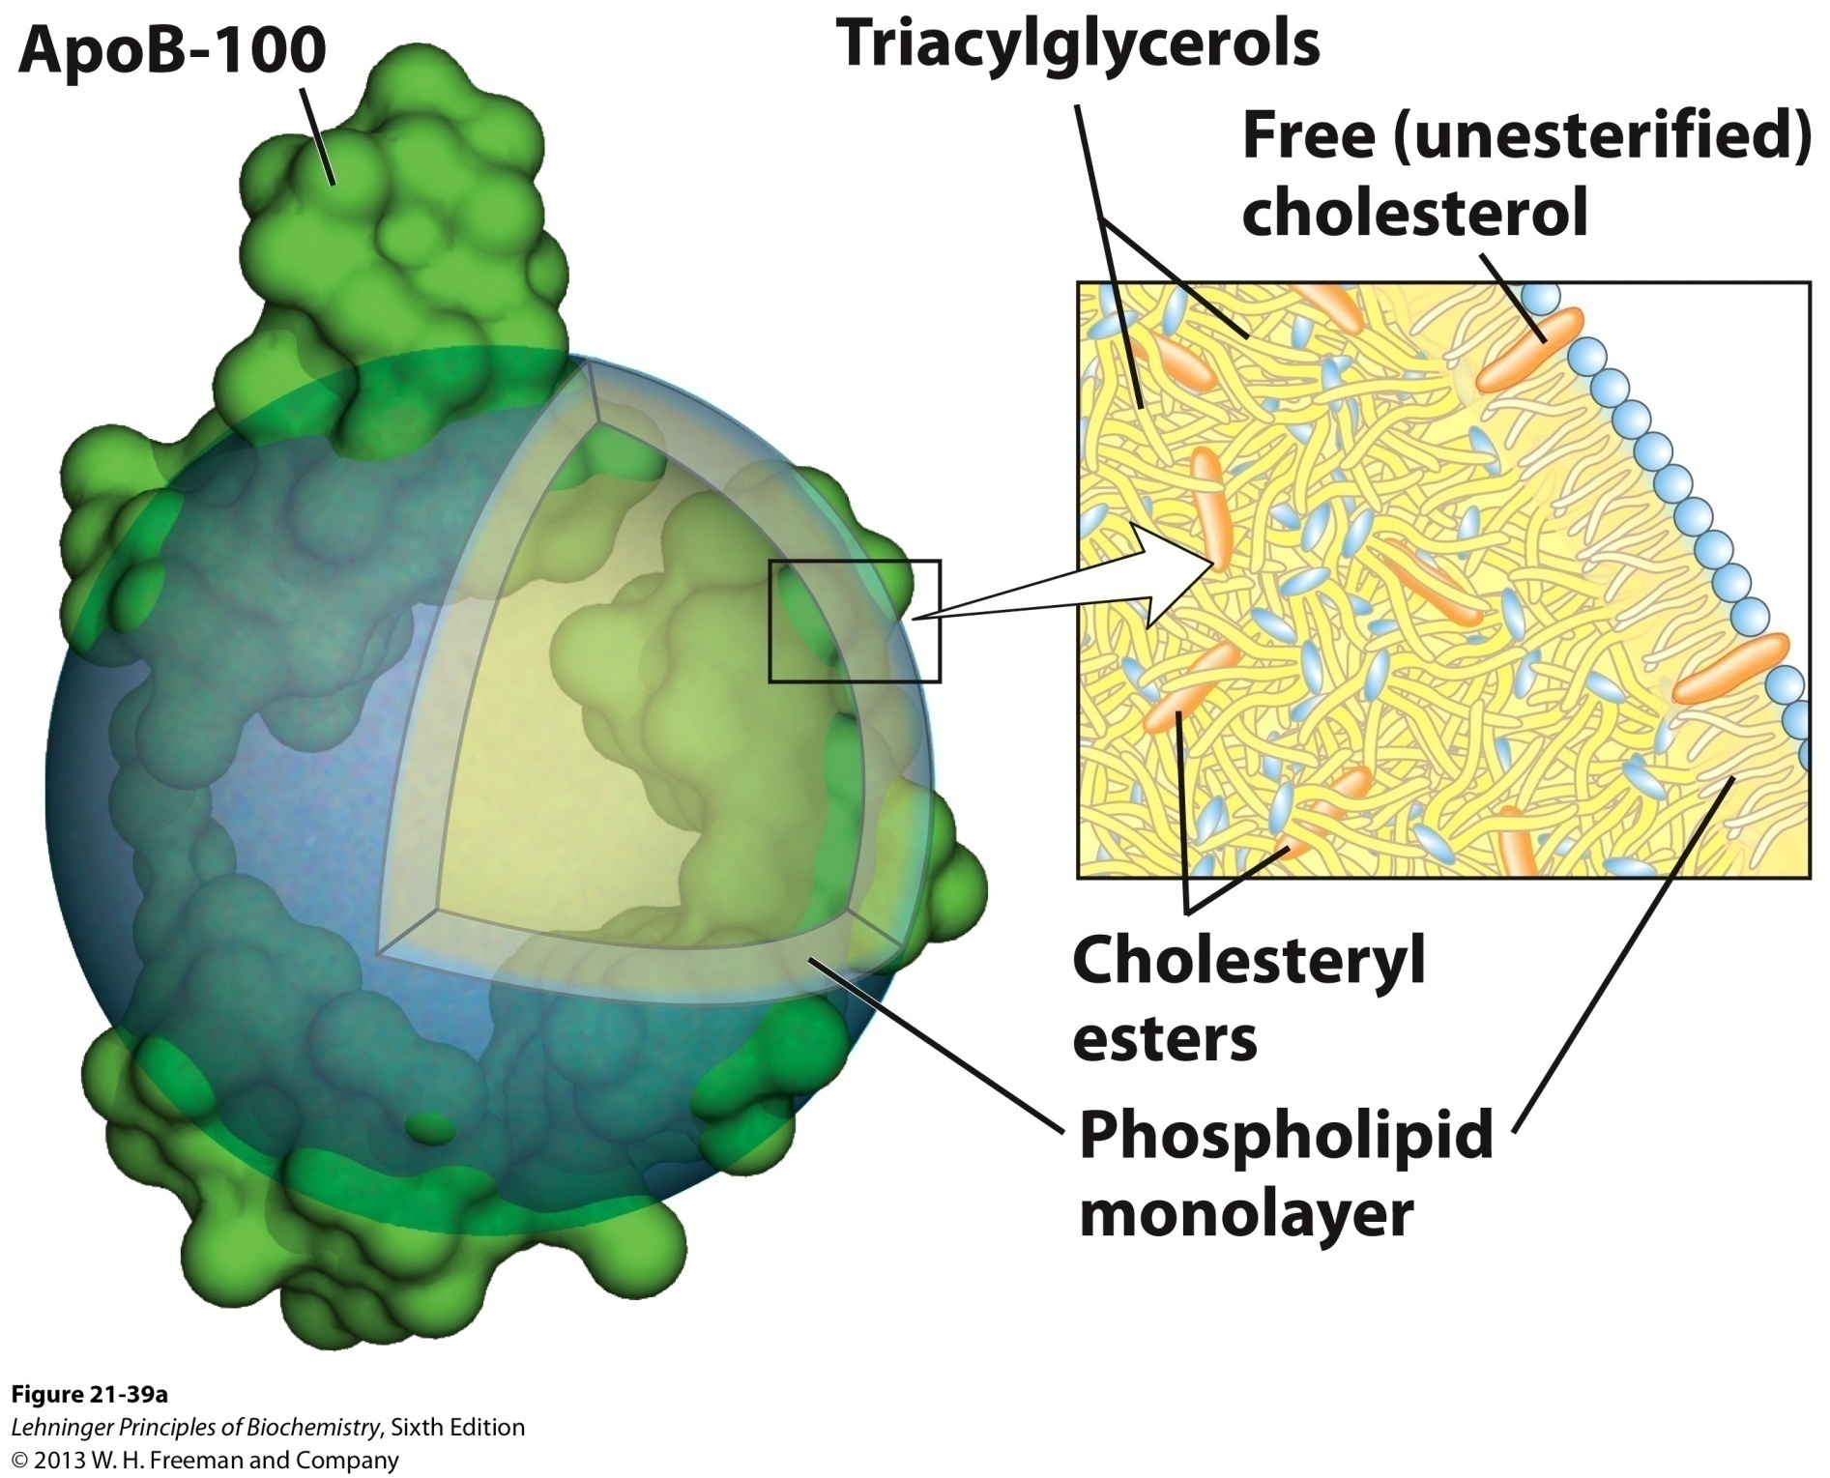
Structure of a low-density lipoprotein (LDL)

Slide 62
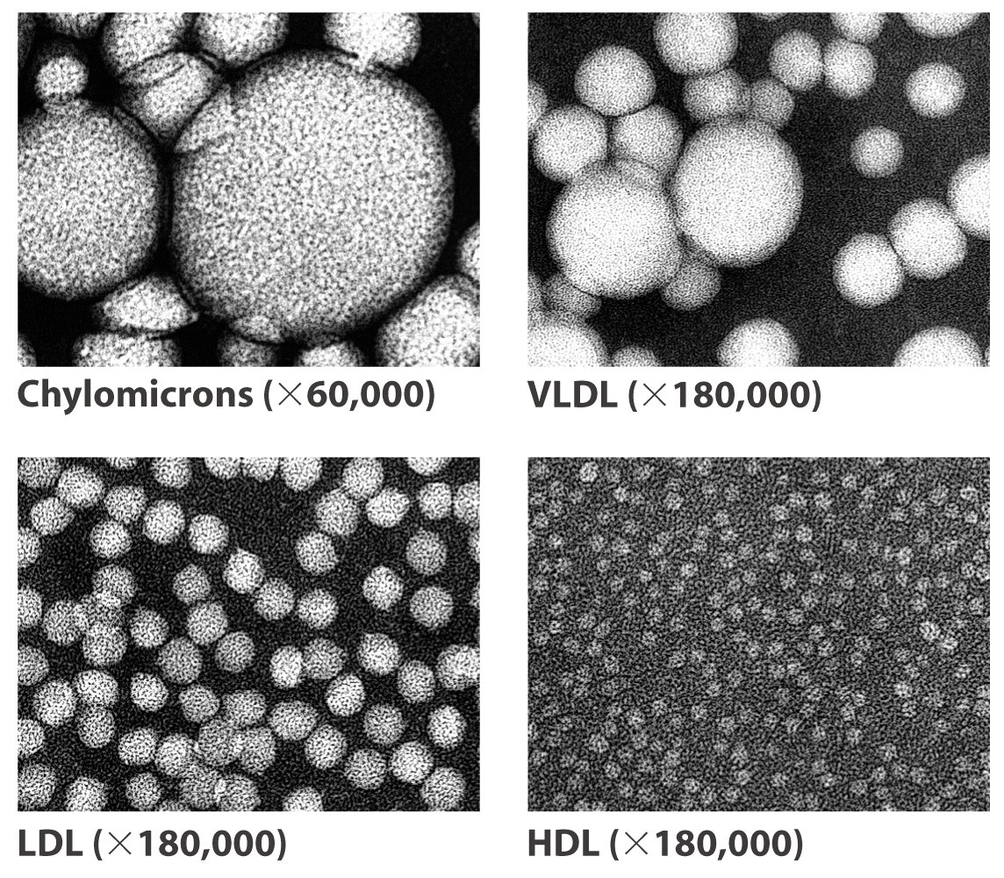

Slide 63
Notes:
TABLE 21-1 Major Classes of Human Plasma Lipoproteins: Some Properties

Slide 64
At least ten apolipoproteins (named as ApoA, B, C, D, E) have been found in human, which act as signals to target lipoproteins to specific tissues or to activate enzymes that act on the lipoproteins.
Dietary lipids are packaged into chylomicrons.
Endogenous lipids made in liver are transported to other tissues as VLDL particles (~ 87% lipids and 12% proteins).
The ApoC-II protein in VLDL activates the lipoprotein lipase in muscle and adipocyte tissues, thus releasing free fatty acids there.

Slide 65
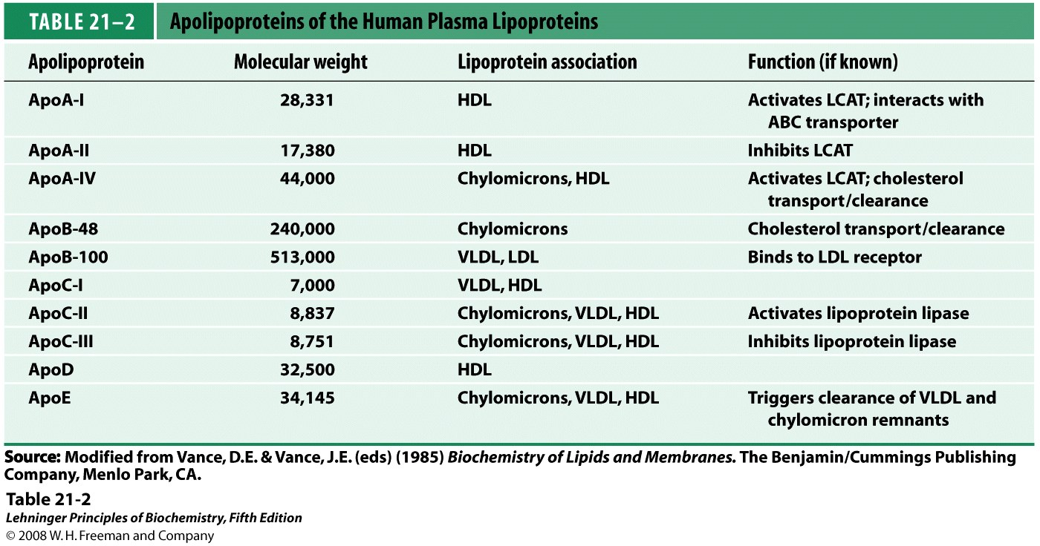
Notes:
TABLE 21-2 Apolipoproteins of the Human Plasma Lipoproteins

Slide 66
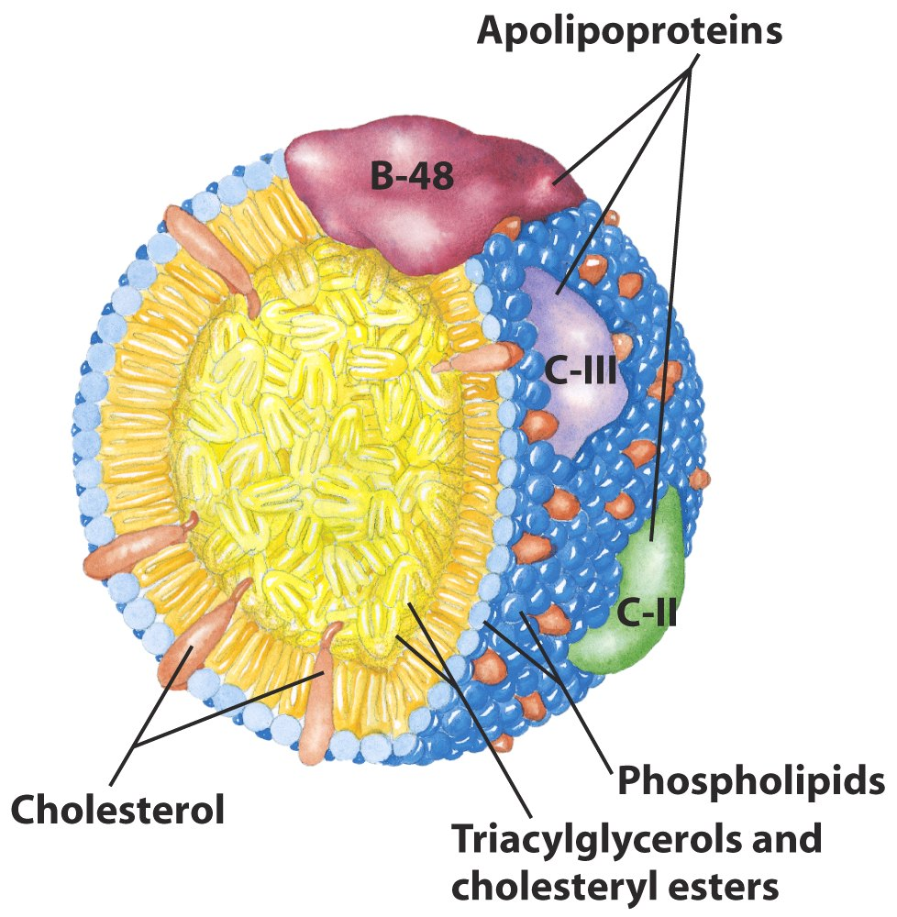
Molecular structure of a chylomicron

Slide 67
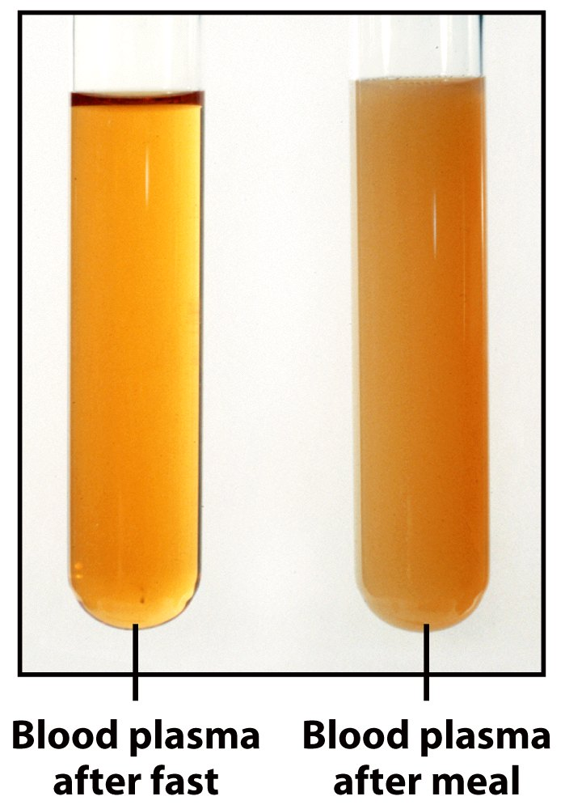
(high-fat)
Blood plasma samples collected after a fast and a high-fat meal

Slide 68
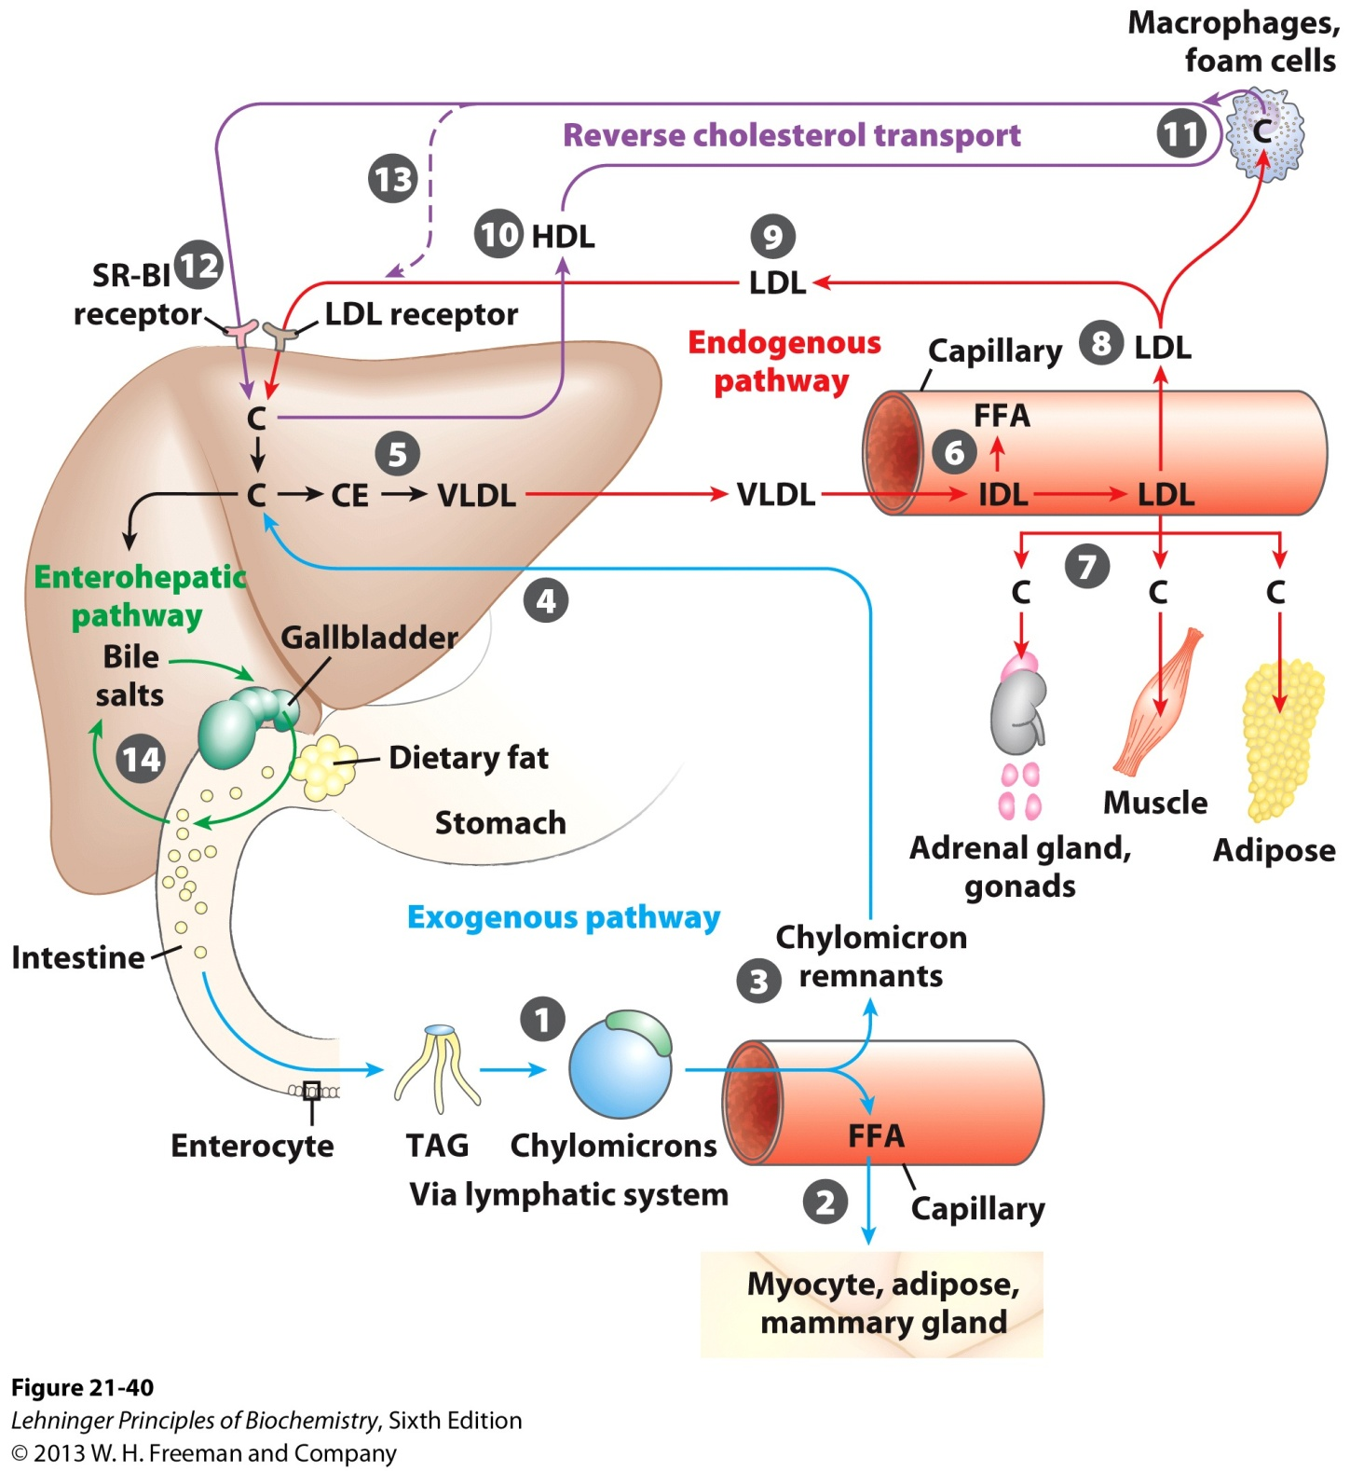
Lipoproteins and lipid transport

Slide 69
Some VLDL remnants is then converted to LDL (with 23% proteins and 75% lipids) with the others being absorbed by the liver cells via receptor-mediated endocytosis.
LDL delivers cholesterols to extrahepatic tissues, where its ApoB-100 protein is recognized by specific LDL receptors and LDL is endocytosed.
HDL, with its precursors formed in the liver or intestine cells, collects the cholesterols in the plasma and deliver them to the liver cells.
The liver is the only route for excretion of cholesterol (via bile salts lost in digestive processes)
A negative correlation between blood HDL level and arterial diseases has been observed.

Slide 70
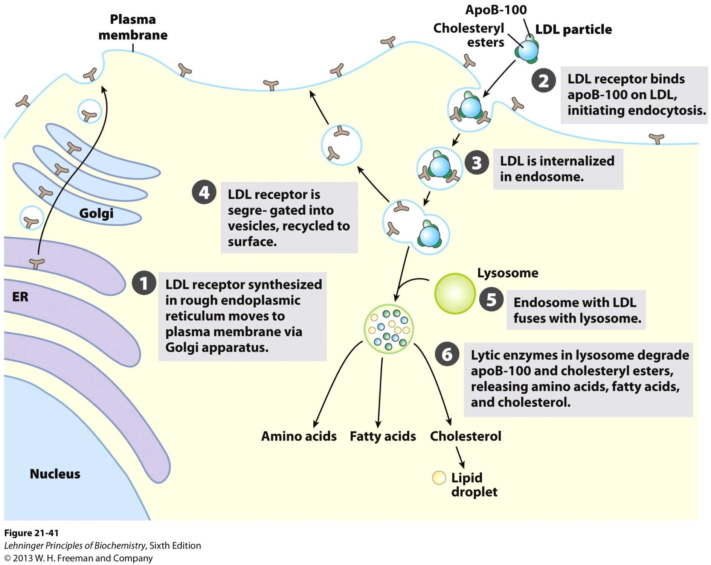
Uptake of cholesterol by receptor-mediated endocytosis

Slide 71
18. The de novo synthesis of cholesterol is regulated to complement dietary intake
HMG-CoA reductase, catalyzing the rate-limiting step of the de novo cholesterol synthesis, has an activity variable over 100 fold!
The expression of genes encoding HMG-CoA reductase and other enzymes mediating the uptake and synthesis of cholesterol is regulated by a small family of proteins called sterol regulatory element-binding proteins (SREBPs).
Hormones (insulin and glucagon) regulate the activity of the HMG-CoA reductase via reversible phosphorylation.

Slide 72
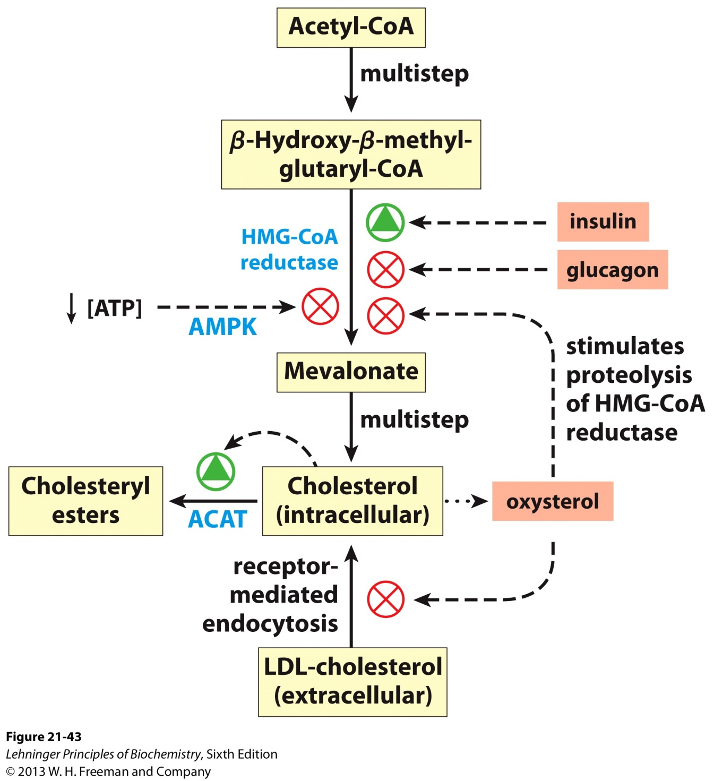
The de novo synthesis of
cholesterol is regulated
to complement the
dietary uptake*****
Regulation of cholesterol formation balances synthesis with dietary uptake and energy state

Slide 73
High intracellular cholesterol diminishes transcription of the gene encoding the LDL receptor, thus reducing the uptake of cholesterol from the blood.
Genetic defect of the LDL receptor was found to cause the familial hypercholesterolemia and atherosclerosis (动脉粥样硬化), the LDL cholesterols can not enter the cells, while de novo synthesis continues despite the high cholesterol level in the blood.
Mevalonate analogs (e.g., compactin and lovastatin) can be used to treat patients with familial hypercholesterolemia.

Slide 74
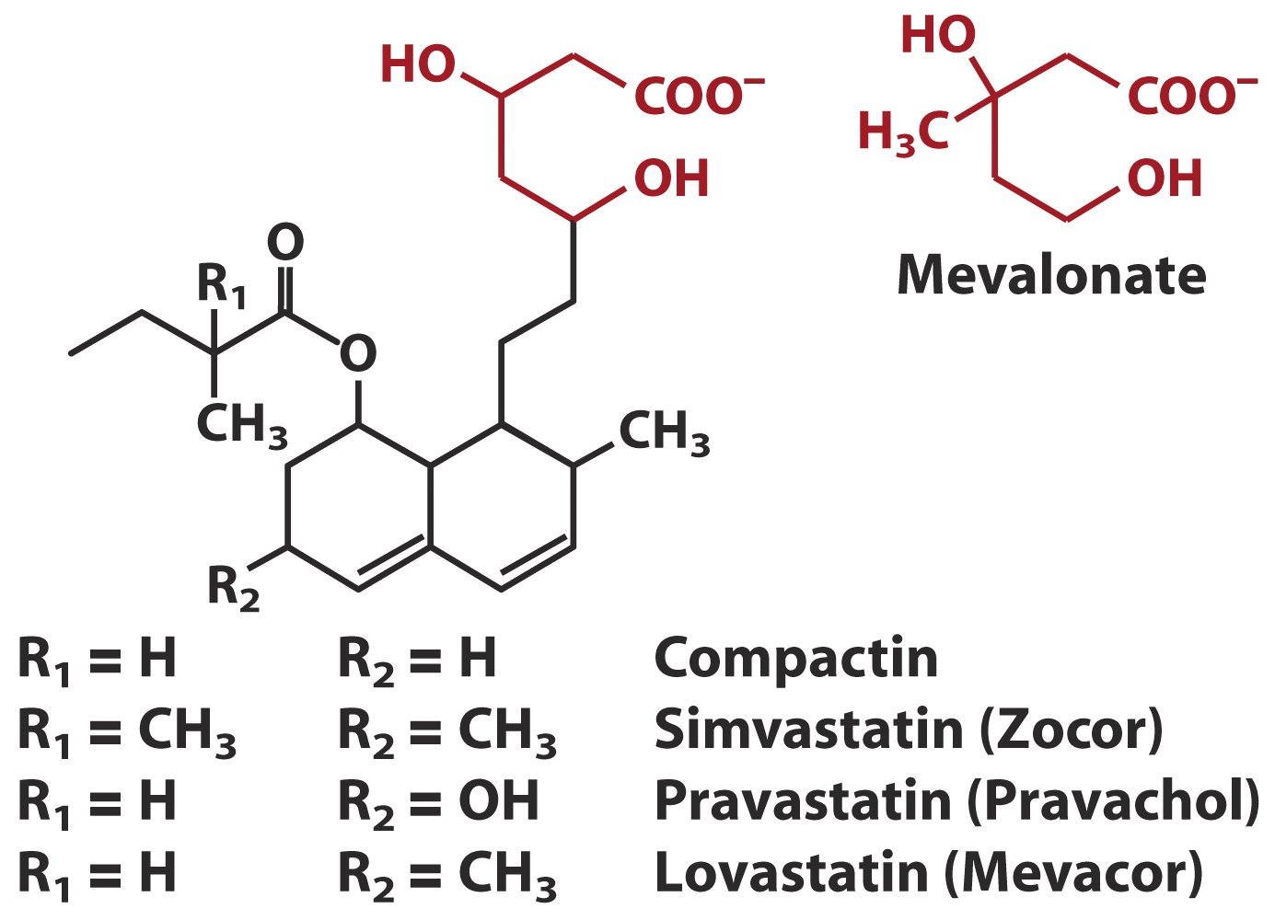
The mevalonate analogs
are used to treat
hypercholesterolemia
patients
洛伐他汀

Slide 75
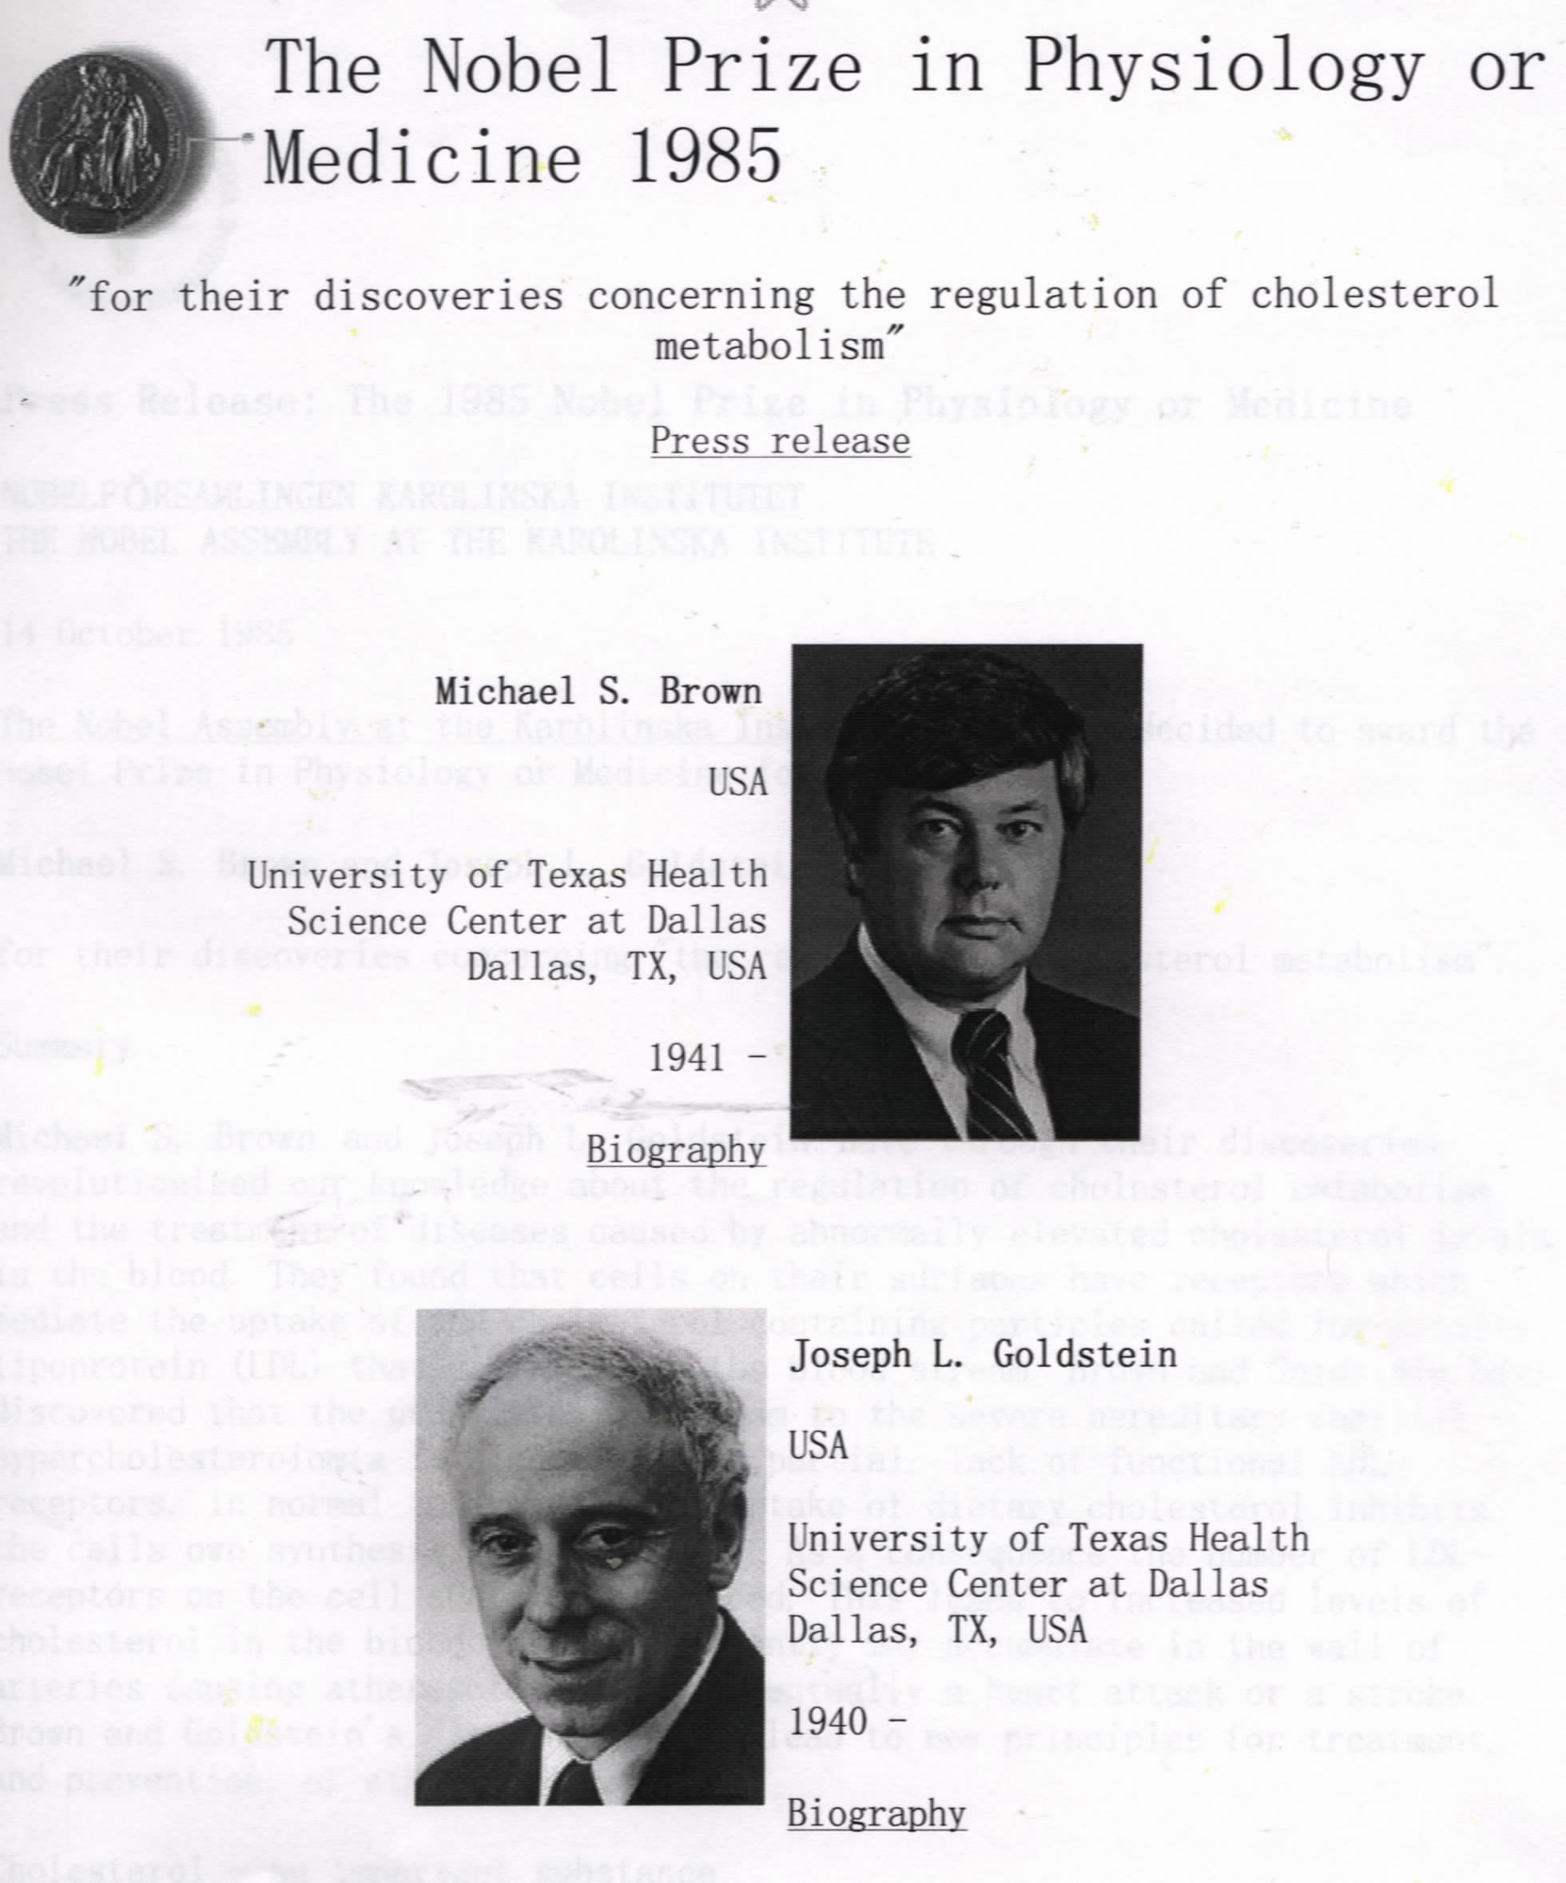
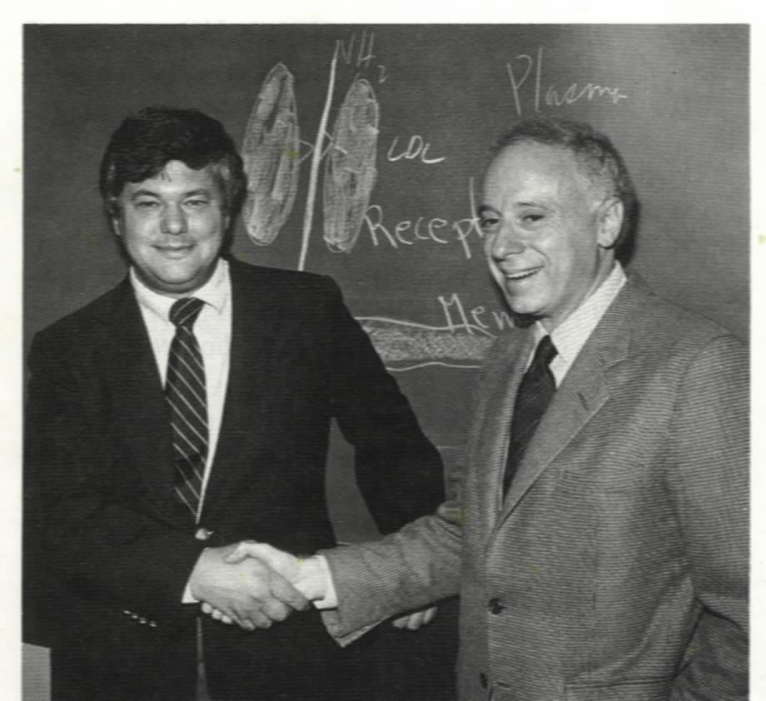

Slide 76
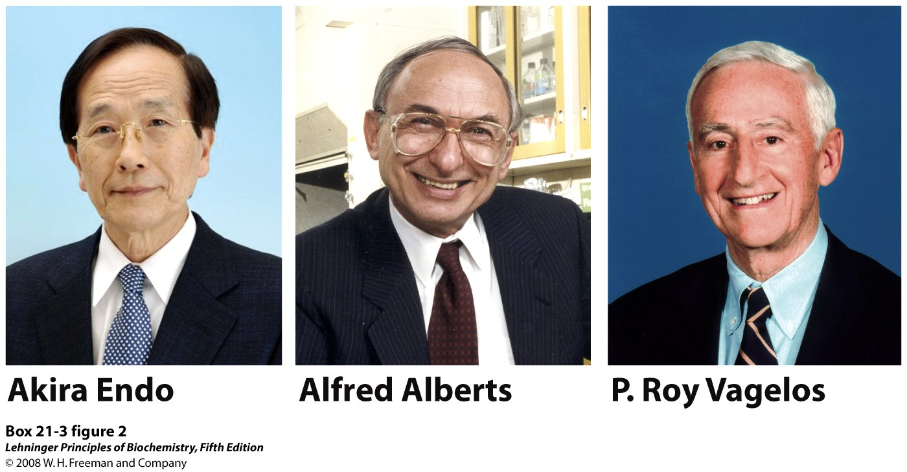

Slide 77
19. Pregnenolone, the common precursor of all steroid hormones, is derived from cholesterol
The tail chain of cholesterol is first hydroxylated at C₂₀ and C₂₂, and then cleaved between these two carbons to remove a 6-carbon unit, forming pregnenolone(孕烯醇酮).
The hydroxylation is catalyzed by cytochrome P-450 monooxygenases (a mitochondrial enzyme) that utilize NADPH and O₂.
Cytochrome P-450 is a large family of enzymes with different substrate specificity and hydroxylates many hydrocarbon chains.

Slide 78
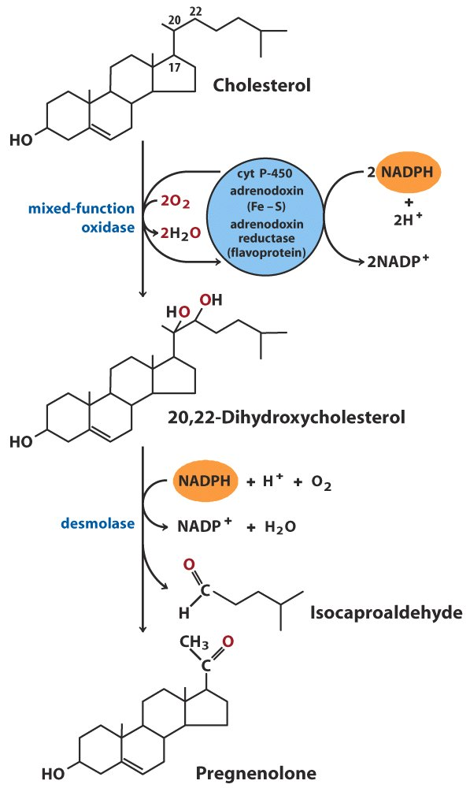
Prognenolone, the
common precursor
of steroid hormones,
is synthesized from
cholesterol

Slide 79
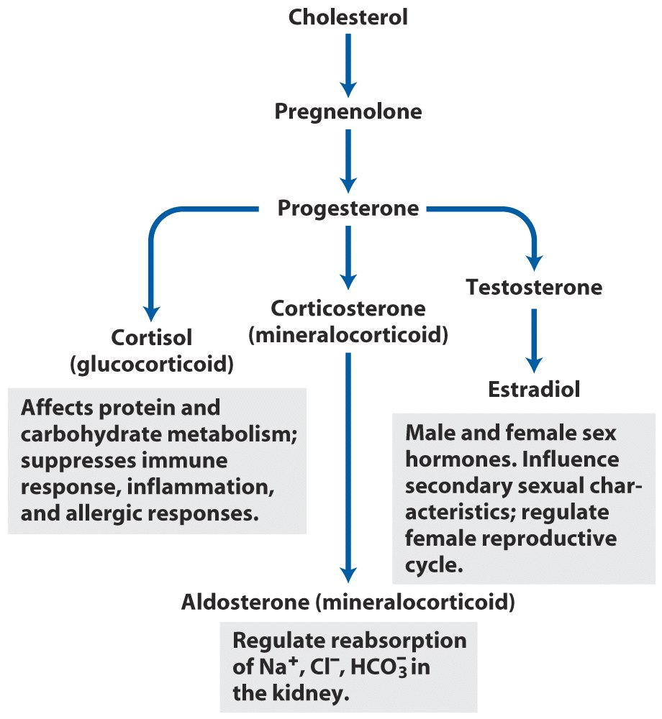
糖皮质激素
All steroid hormones are derived from cholesterol

Slide 80
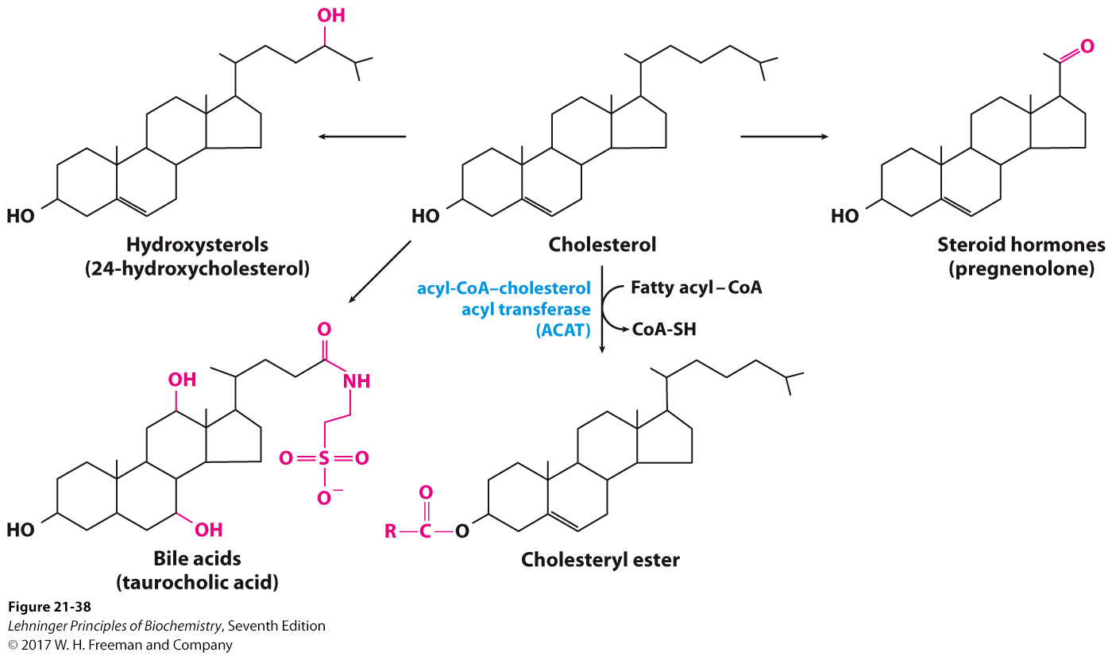
Metabolic fates of cholesterol
Notes:
FIGURE 21-38 Metabolic fates of cholesterol. Modifications of the cholesterol structure are shown in red. Esterification converts cholesterol to an even more hydrophobic form for storage and transport; each of the other modifications yields a less hydrophobic product.

Slide 81
20. A huge array of biomolecules, all called isoprenoids, are synthesized using activated isoprenes
These include many plant pigments (carotene and the phytol chain of chlorophyll), fragrant principles, vitamins (A, E, K), natural rubber, dolichols, quinones (ubiquinone, plastoquinone), and juvenile hormones of insects.
Prenylation of proteins (attaching of geranylgeranyl and farnesyl groups) leads to membrane association.

Slide 82
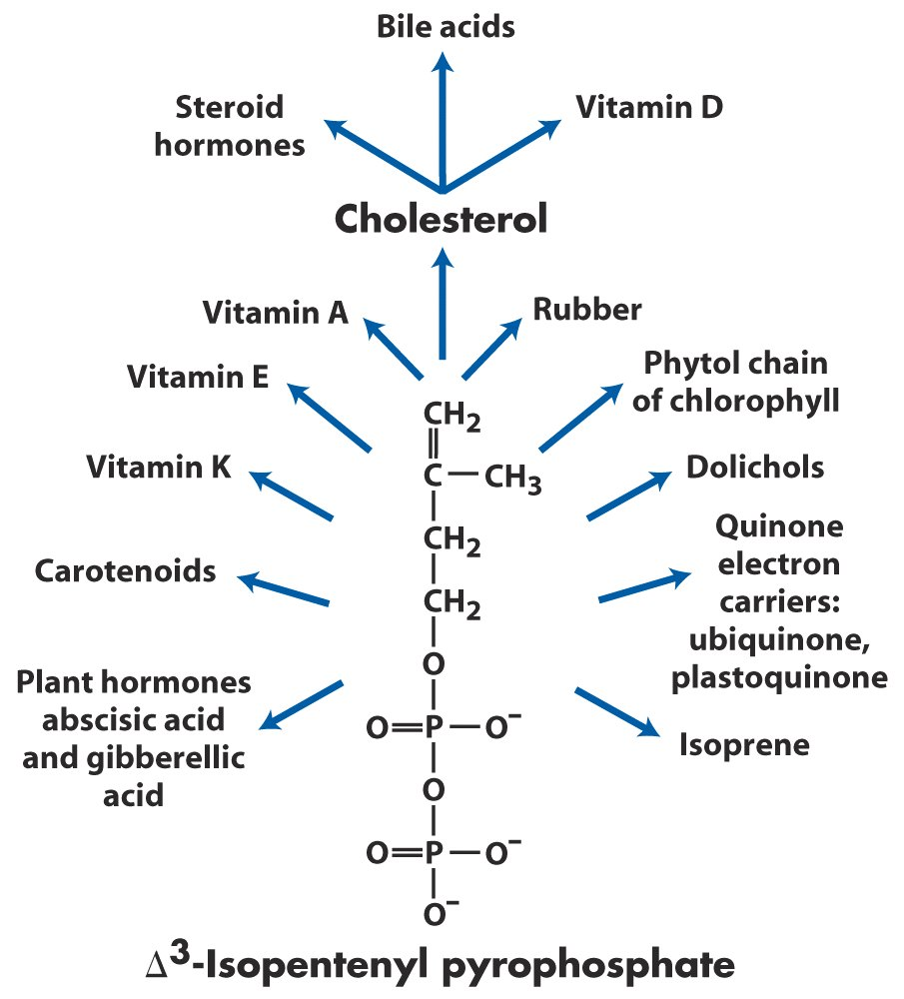
Overview of isoprenoid biosynthesis

Slide 83
Keywords
Fatty acid biosynthesis --- reaction, regulation
(acetyl-CoA carboxylase)
Biosynthesis of cholesterol --- regulation
(HMG-CoA reductase)
Lipid transportation --- lipoprotein particles

Slide 84
Words of the Week
de novo
in vitro
in vivo

Slide 85
Text-book reading of the week
Summary 21.1 (p847)
Summary 21.2 (p852)
Summary 21.4 (p875)
p869 (HDL carries out reverse cholesterol transport)
p872-873 (Box21-3 --- The lipid hypothesis and the development of statins)

Slide 86
Summary
Fatty acid biosynthesis takes a different pathway from the reverse of its degradation and takes place in different cellular compartments.
The acetyl-CoA units are transported out of mitochondrial matrix as citrate.
Acetyl-CoA carboxylase catalyzes the rate-limiting step of fatty acid synthesis and is highly regulated by allosteric and covalent modifications.
Fatty acids are synthesized by a repeating four-step reaction sequence by a multi-enzyme complex called fatty acid synthase.

Slide 87
Palmitate, the usual final product of fatty acid synthesis, can be further elongated and desaturated in ER.
Phosphatidic acid (diacylglycerol 3-phosphate) is the common precursor of both triacylglycerol and glycerophospholipids.
Radioisotope tracer experiments revealed that all of the 27 carbons of cholesterol are from acetyl-CoA.

Slide 88
The biosynthesis of cholesterol takes a long pathway, with the reaction catalyzed by HMG-CoA reductase being the rate-limiting step for de novo synthesis of cholesterol.
The lipids are transported as lipoprotein particles (including chylomicrons, VLDL, LDL, and HDL).
The de novo biosynthesis of cholesterol is regulated to complement the dietary uptake.
All steroid hormones are derived from cholesterol.
A huge arrays of isoprenoids are made using activated isoprene units.

