Slide 1
Chapter 22 Biosynthesis of Amino Acids, Nucleotides, and Related Molecules
1. Reduction (fixation) of N₂ into ammonia (NH₃ or NH₄⁺)
2. Synthesis of the 20 amino acids
3. Synthesis of other biomolecules from amino acids
4. The de novo pathways for purine and pyrimidine biosynthesis
5. The salvage pathways for purine and pyrimidine reuse

Slide 2
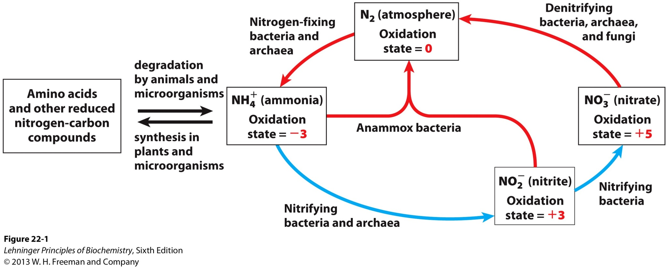
The nitrogen cycle

Slide 3
1. The nitrogenase complex in certain bacteria (diazotrophs, 固氮生物) catalyzes the conversion of N₂ to NH₃
The nitrogen in amino acids, purines, pyrimidines and other biomolecules ultimately comes from atmospheric nitrogen.
Cyanobacteria (蓝藻细菌, photosynthetic) and rhizobia (根瘤菌, symbiont) can fix N₂ into NH₃.
The reduction of N₂ to NH₃ is thermodynamically favorable :
N₂ + 3H₂ 2NH₃ ΔG’º = -33.5 kJ/mol
But kinetically unfavorable: the bond energy for the triple bond in N₂ is 930 kJ/mol.

Slide 4
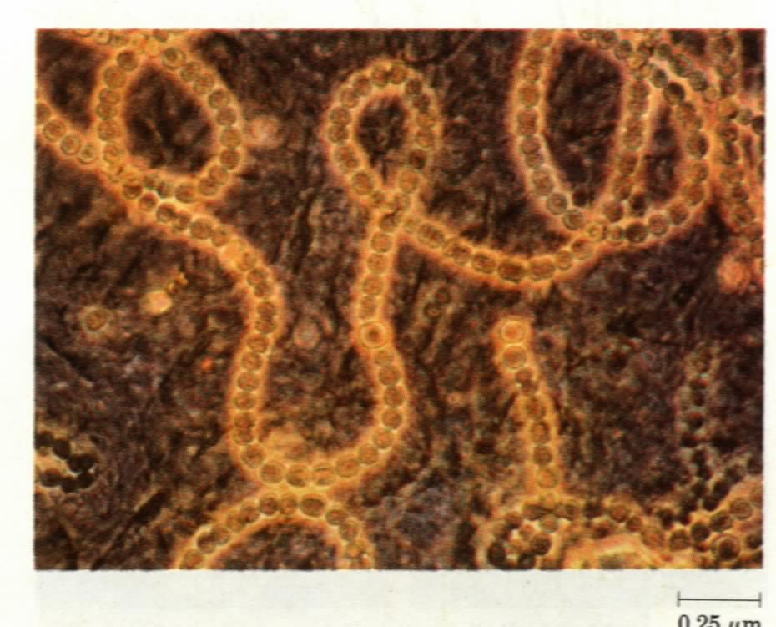
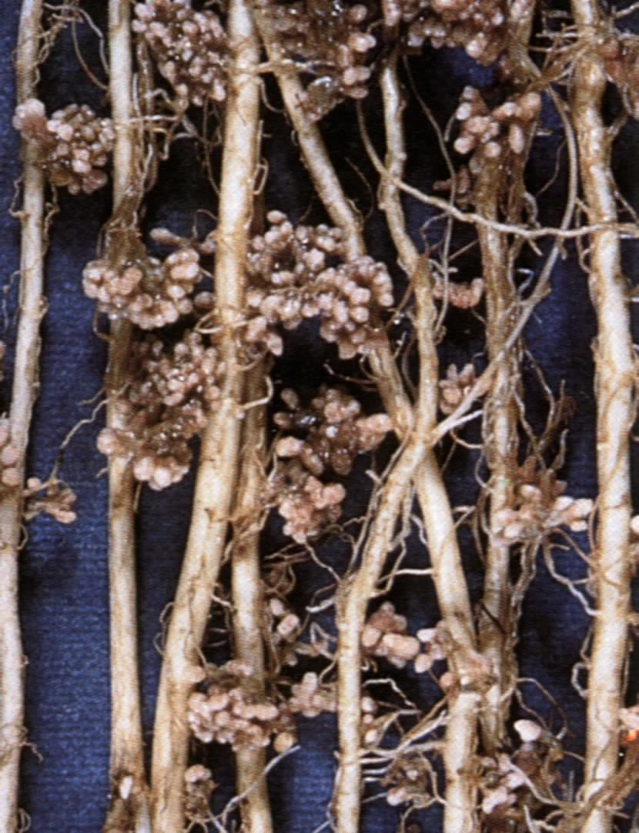
Cyanobacteria and Rhizobia can fix N₂ into ammonia
Rhizobia exist in the
root nodules of
leguminous plants

Slide 5
The nitrogenase (固氮酶) complex mainly consists of two types of enzymes: the dinitrogenase and the dinitrogenase reductase.
The dinitrogenase (containing both iron and molybdenum 钼, thus called the MoFe protein) is a tetramer of two different subunits, containing multiple 4Fe-4S centers and two Mo-Fe clusters.
The dinitrogenase reductase (also called the Fe protein) is a dimer of two identical subunits, containing a single 4Fe-4S redox center.
The nitrogenase complex is highly conserved among different diazotrophs.

Slide 6
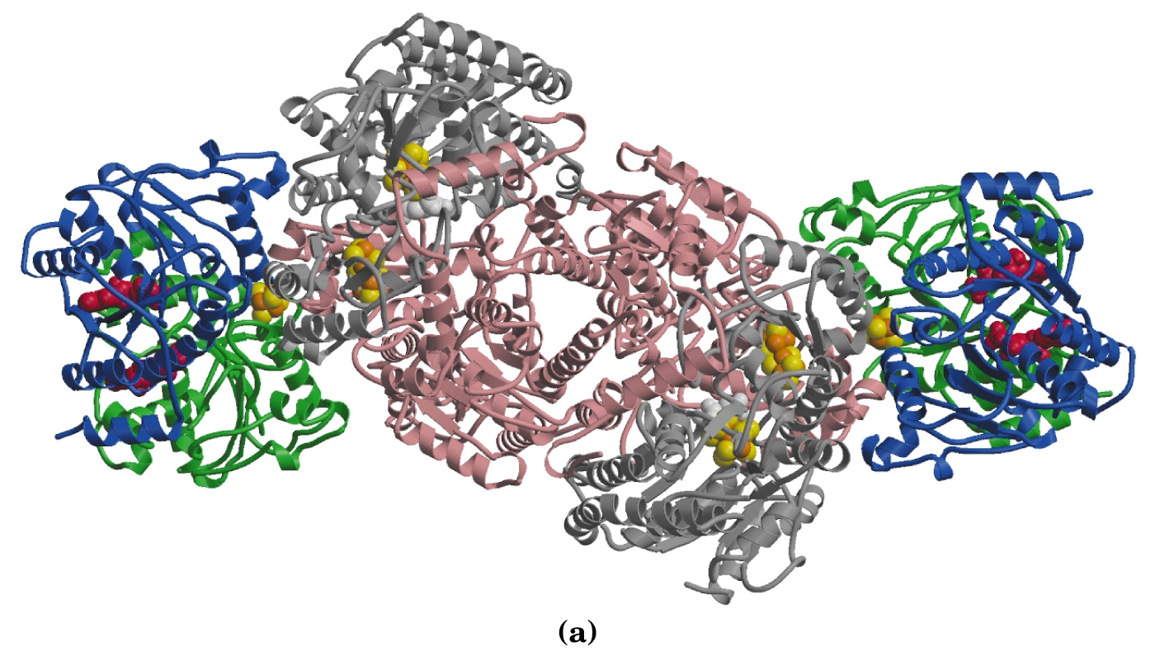
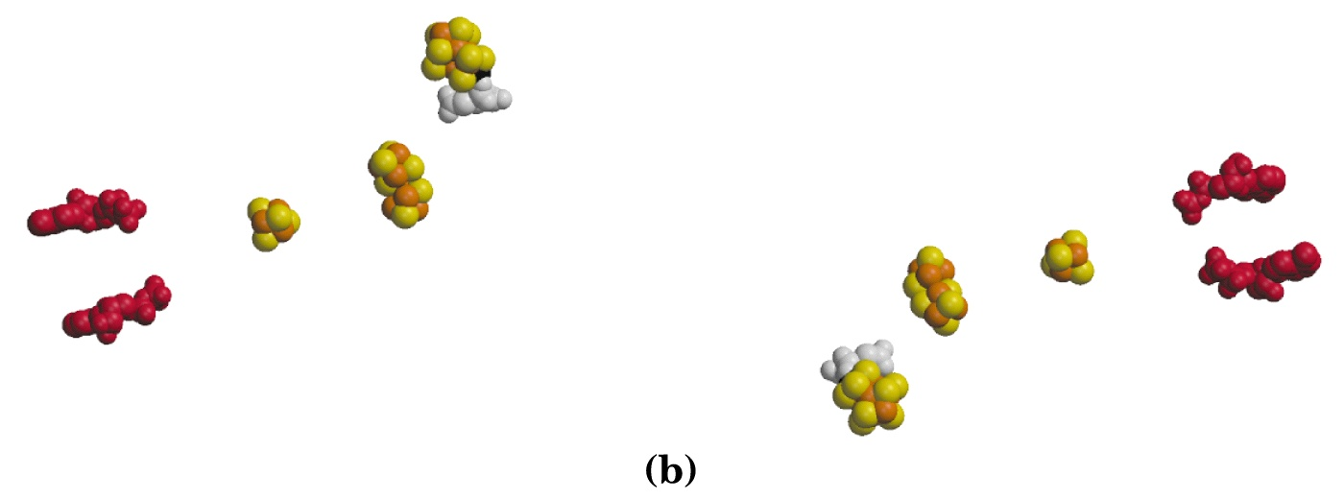
The dinitrogenase
reductase (dimer)
The dinitrogenase
(tetramer)
Fe-Mo
4Fe-4S
4Fe-4S-4Fe-4S
(P clusters)
ADP

Slide 7
2. Electrons are transferred through a series of carriers to N₂ for its reduction on the nitrogenase complex
Eight electrons are believed to be needed for each round of fixation reaction: with six for reducing one N₂ and two for reducing 2H⁺ (to form H₂).
The electrons mainly come from reduced ferredoxin (from photophosphorylation) or reduced flavodoxin (from oxidative phosphorylation) and are transferred to dinitrogenase via dinitrogenase reductase.

Slide 8
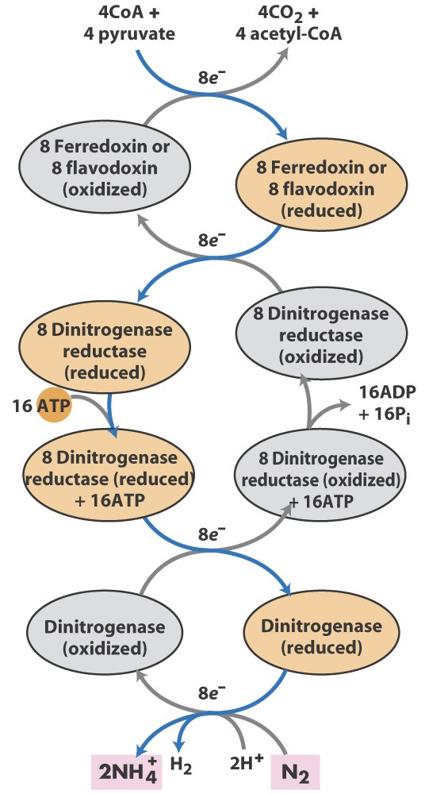
Electrons are transferred
to N₂ bound in the
active site of dinitrogenase
via ferredoxin/flavodoxin
and dinitrogenase reductase

Slide 9
For each electron to be transferred from dinitrogenase reductase to dinitrogenase, two ATPs are hydrolyzed, causing a conformational change which reduces the electron affinity for the reductase (i.e., an increased reducing power).
The oxidized and reduced dinitrogenase reductase dissociates from and associates with the dinitrogenase, respectively.
The nitrogenase is an imperfect enzyme: H₂ is formed along with NH₃.

Slide 10
The overall nitrogen fixation reaction is:
N₂ + 8H⁺ +8e⁻ + 16ATP + 16H₂O →
2NH₃ + H₂ + 16ADP + 16P_{i}

Slide 11
3. The nitrogenase complex is extremely labile to O₂ and various protective mechanisms have evolved
Some diazotrophs exist only anaerobically.
Some cyanobacteria cells develop thick walls to prevent O₂ from entering.
The bacteria in root nodules are isolated from O₂ by being bathed in a solution of the oxygen-binding protein leghemoglobin.

Slide 12
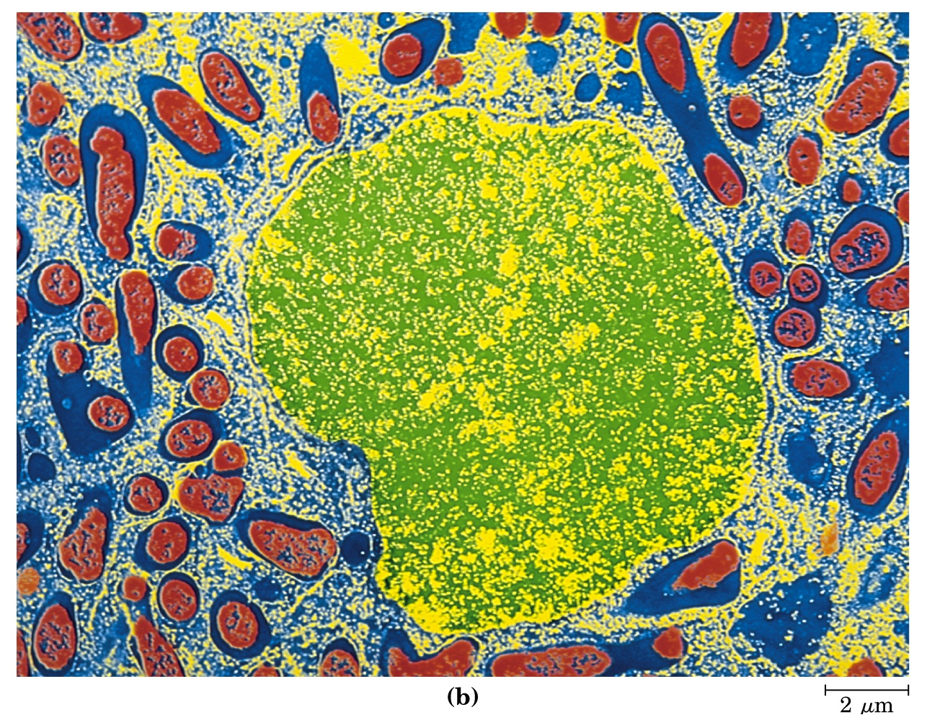
Leghemoglobin, produced in leguminous plants, has a high affinity
to O₂ and protects the nitrogenase complex in rhizobia.

Slide 13
4. Reduced nitrogen in the form of NH₄⁺ is assimilated into amino acids via a two-enzyme pathway
First NH₄⁺ is added to the side chain of glutamate to form glutamine in an ATP-dependent reaction catalyzed by glutamine synthetase.
Glutamate + ATP + NH₄⁺
glutamine + ADP + P_{i} + H⁺
Then the side chain amino group of Gln is further transferred to α-ketoglutarate to form Glu in a reaction catalyzed by glutamate synthase, an enzyme only present in bacteria and plants, not in animals.
α-ketoglutarate + glutamine + NAPDH + H⁺
2 glutamate + NADP⁺

Slide 14
The amide group of Gln is a source of nitrogen in the synthesis of a variety of compounds, such as carbamoyl phosphate, Trp, His, glucosamine-6-phosphate, CTP, and AMP.
The amino groups of most other amino acids are derived from glutamate via transamination.

Slide 15
5. The bacterial glutamine synthetase is a central control point in nitrogen metabolism
The bacterial glutamine synthetase has 12 identical subunits (each having an independent active site) arranged as two hexagonal rings.
Each subunit of the enzyme is accumulatively inhibited by at least eight allosteric effectors.

Slide 16
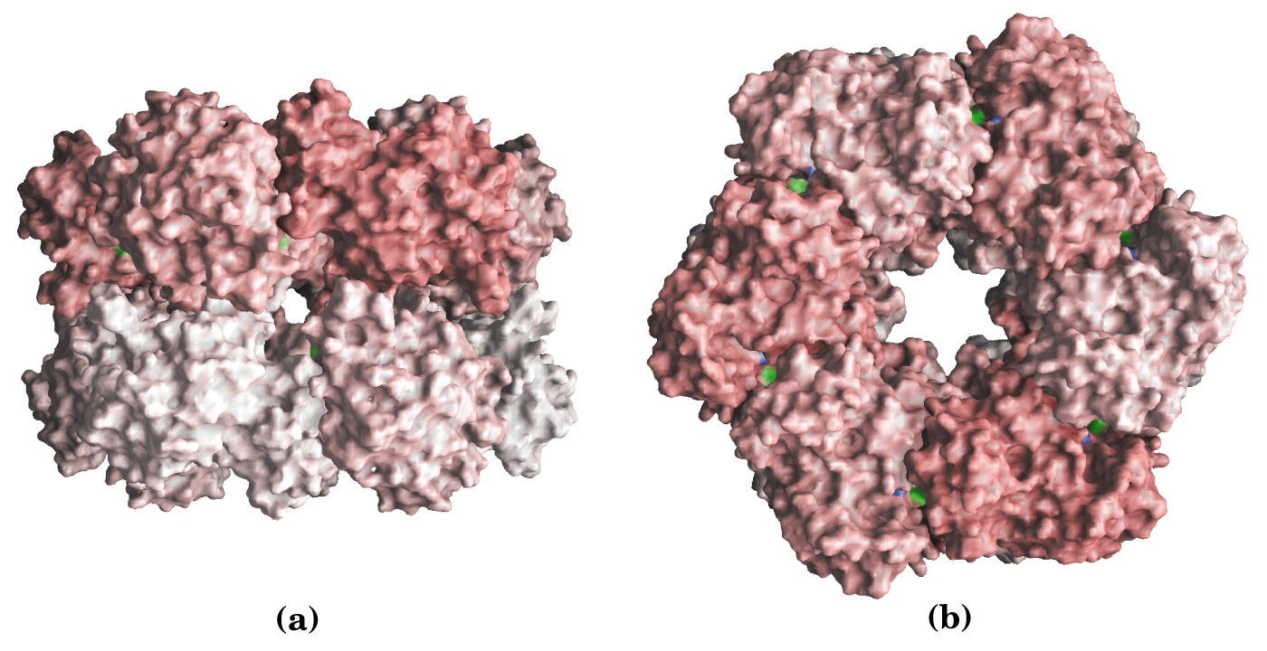
Top view
Side view
Active site
The bacterial glutamine synthetase has 12 subunits
arranged as two rings of hexamers

Slide 17
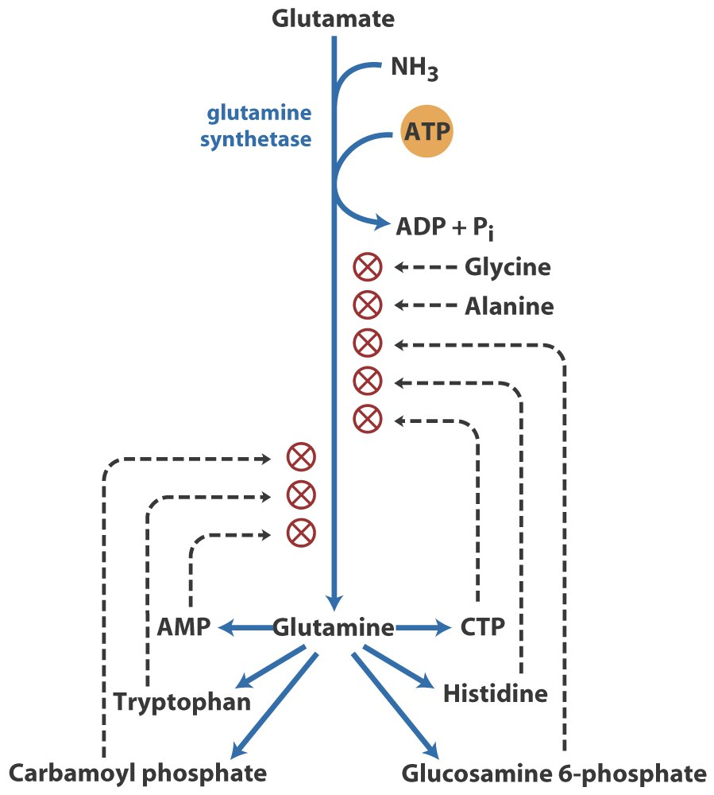
The glutamine
synthetase is
accumulatively
inhibited by at least 8
allosteric effectors,
mostly end products
of glutamine
metabolism.

Slide 18
In addition, the enzyme is more susceptible to the allosteric inhibition by having Tyr³⁹⁷ residue modified by adenylylation.
The addition and removal of the AMP group to the glutamine synthetase are catalyzed by two active sites of the same bifunctional adenylyltransferase (AT).
The substrate specificity of AT was found to be controlled by a regulatory protein, P_{II}.

Slide 19
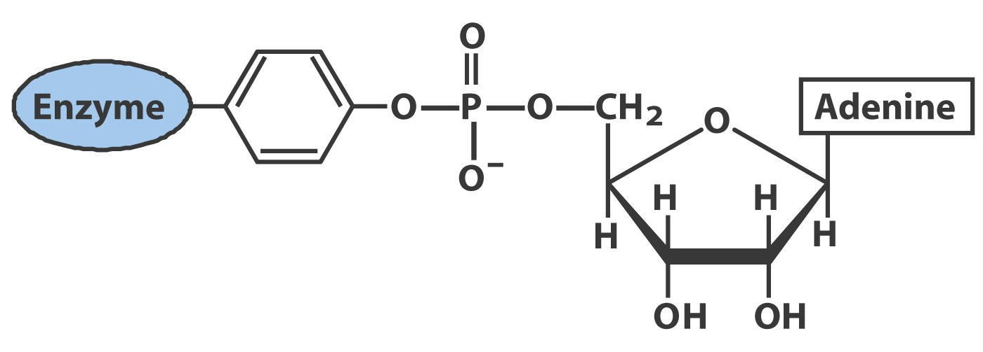
A specific Tyr residue in bacterial glutamine
synthetase can be reversibly adenylylated

Slide 20
The activity of P_{II}, in turn, is regulated by the uridylylation of a specific Tyr residue: P_{II}-UMP stimulates the deadenylylation activity of AT, however, the unmodified P_{II} stimulates the adenylylation activity of AT.
The addition and removal of UMP to P_{II}, in turn, are again catalyzed by two active sites of the same protein, uridylyltransferase (UT): α-ketoglutarate and ATP stimulate the uridylylation, however, Gln and P_{i} stimulate the deuridylylation (thus adenylylation activity of AT, inactivating glutamine synthetase).

Slide 21
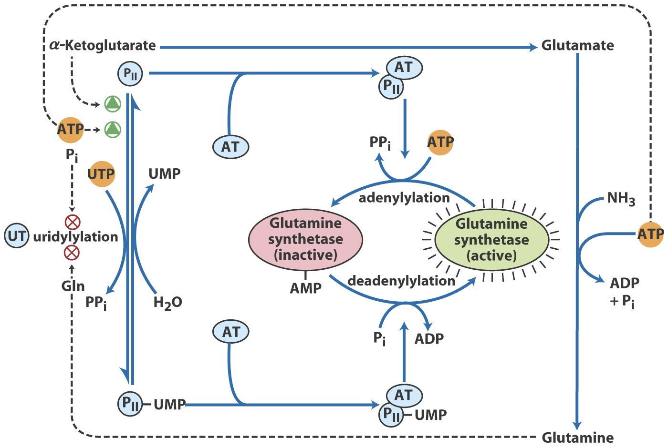
Covalent regulation of glutamine synthetase

Slide 22
6. The 20 amino acids are synthesized from intermediates of glycolysis, the citric acid cycle, or pentose phosphate pathway
The nitrogen is provided by Glu and Gln.
As in amino acid degradation, some of the synthetic pathways (e.g., for Ala, Glu, and Asp) are very simple, but others (e.g., the aromatic ones) are very complex.

Slide 23
Most bacteria and plants can synthesize all 20 amino acids, but mammals can only synthesize about 10 of them, with 10 being “essential”, needed in the diet.
The pathways for the biosynthesis of the 20 amino acids can be categorized into six families according to the metabolic precursors used.

Slide 24
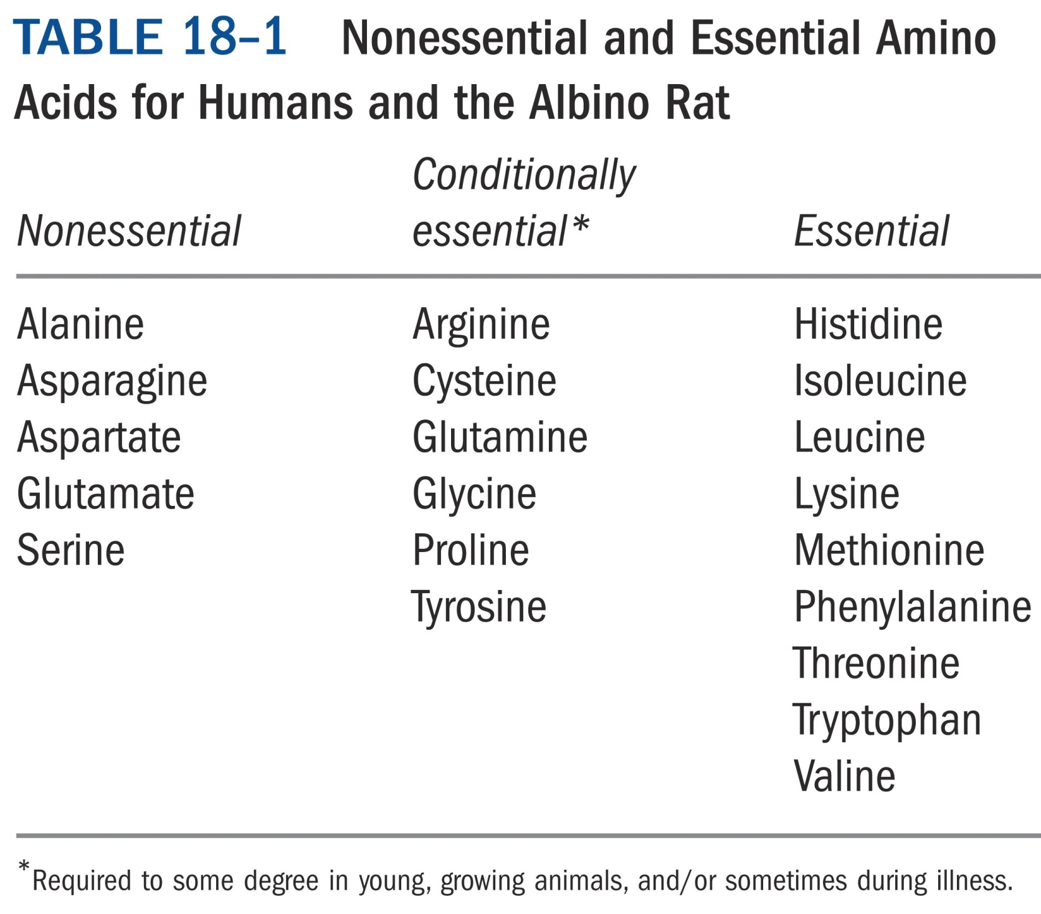

Slide 25
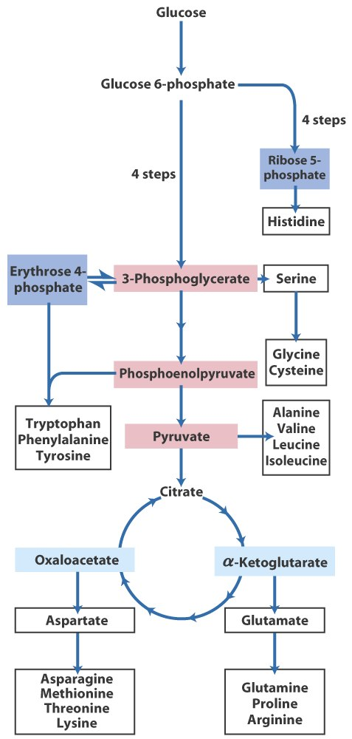
Overview of amino acid biosynthesis*****

Slide 26
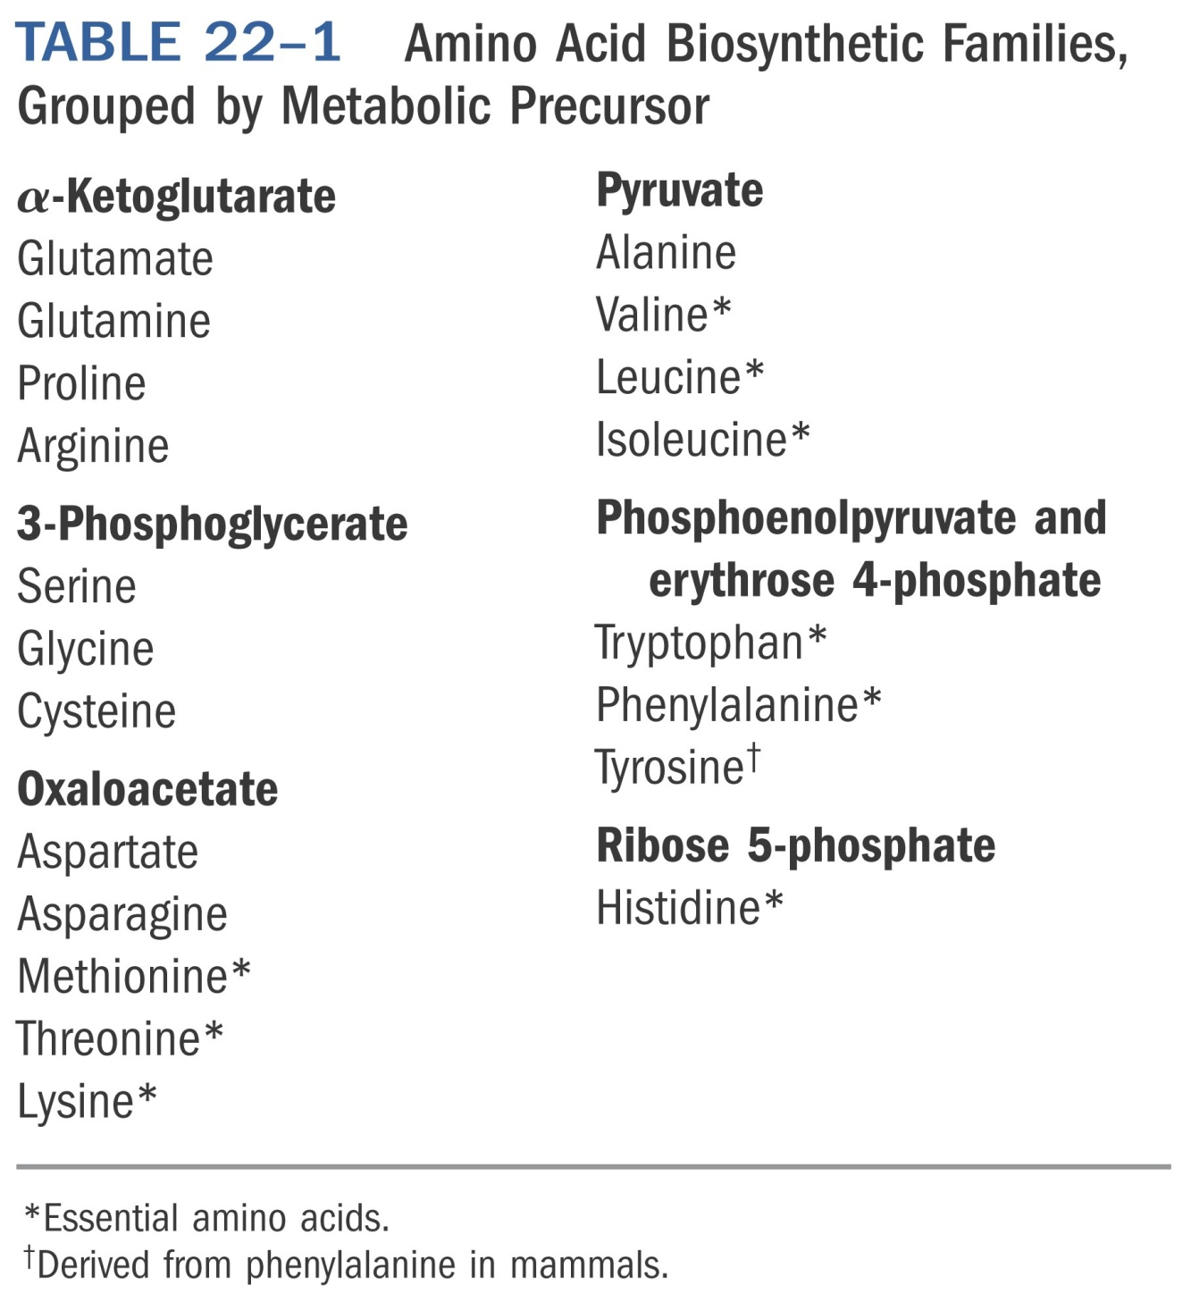
*****
Notes:
Table 22-01

Slide 27
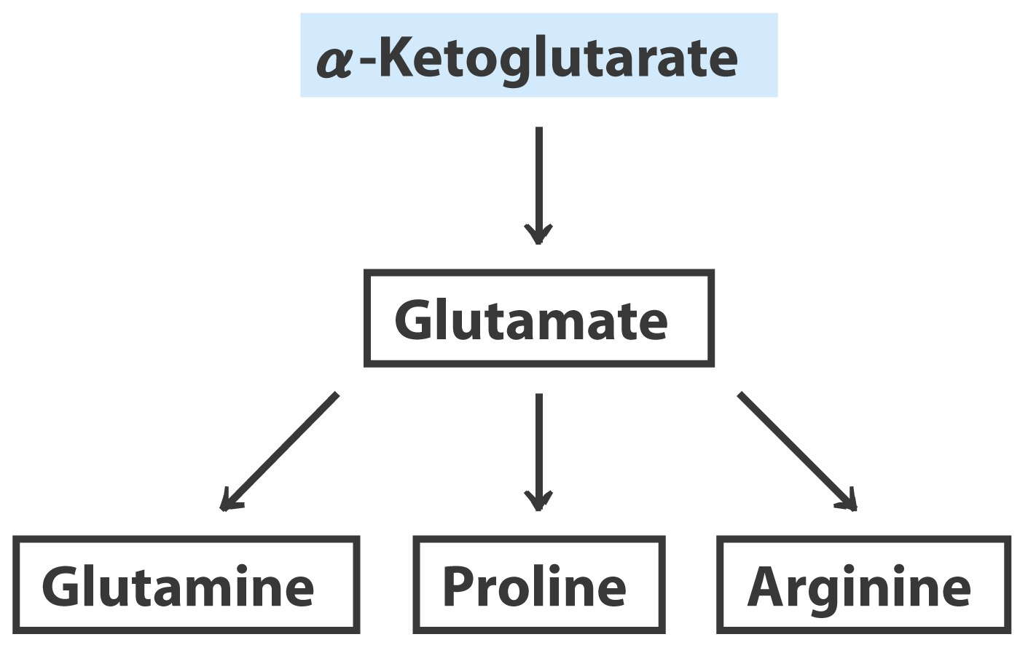

Slide 28
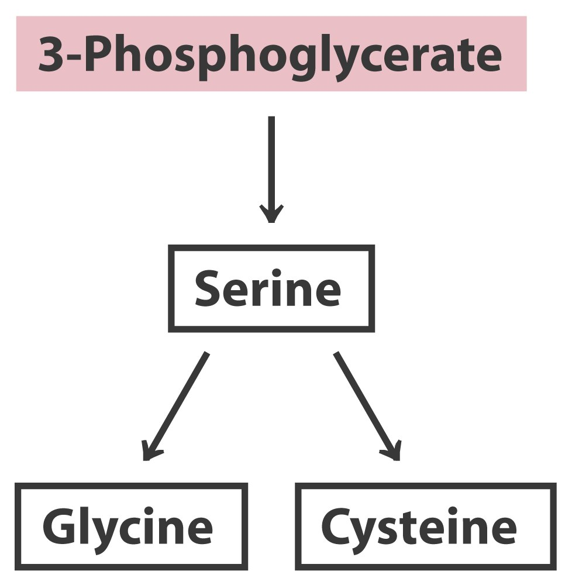

Slide 29
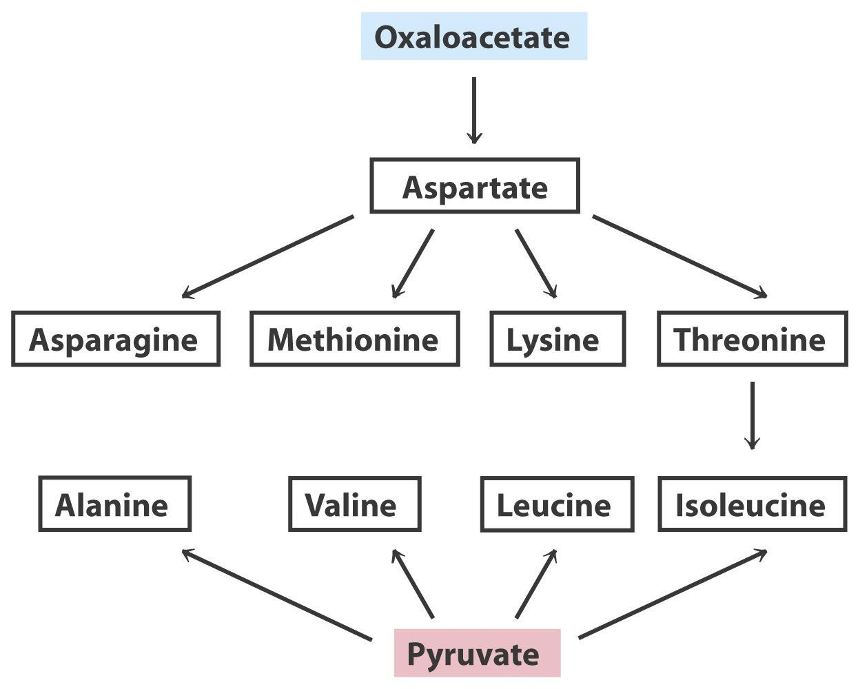

Slide 30
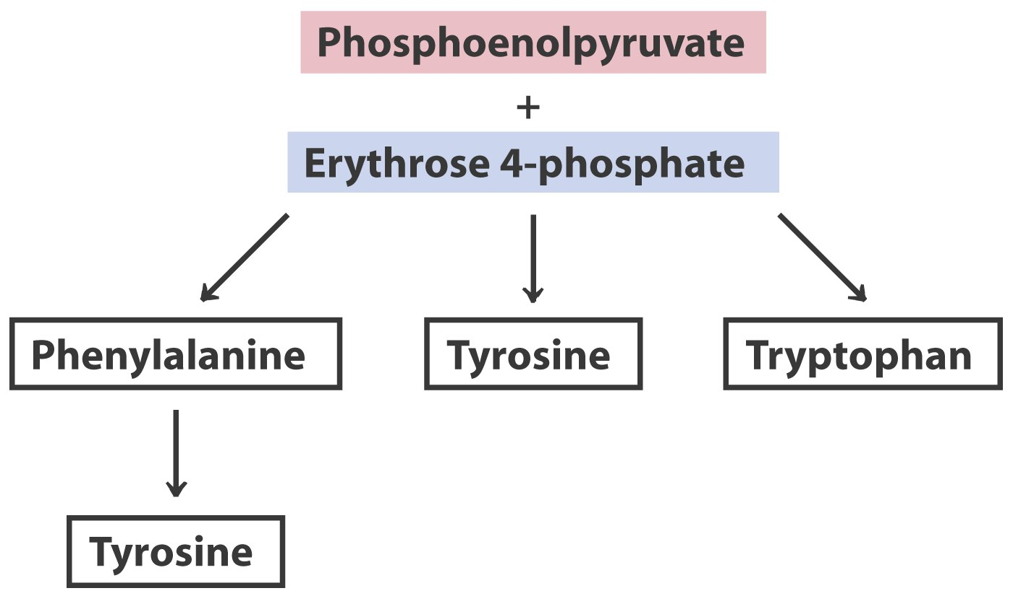
The biosynthesis of all aromatic
amino acids share the first seven
steps of reactions

Slide 31
7. Histidine is derived from three precursors: 5-phosphoribosyl-1-pyrophosphate (PRPP), ATP and Gln
The synthesis begins with the condensation of ATP and PRPP: N-1 of the purine ring is linked to the C-1 of the ribose.
For the final synthesis of Histidine, PRPP contributes five carbons, ATP contributes one nitrogen and one carbon (both from the purine ring), Gln contributes one nitrogen, and Glu contributes the 3rd nitrogen (of the α-amino group).

Slide 32
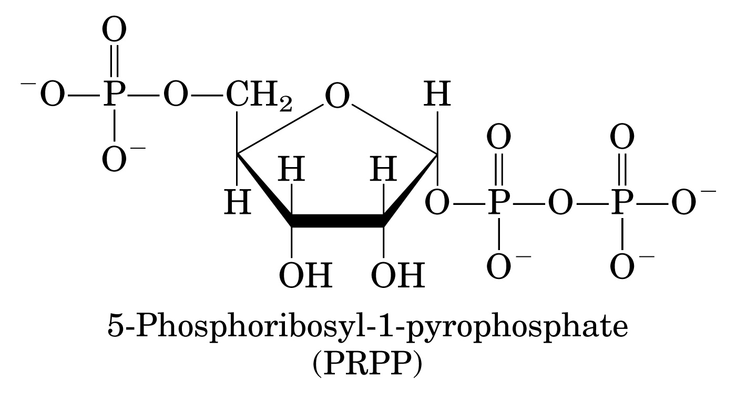

Slide 33
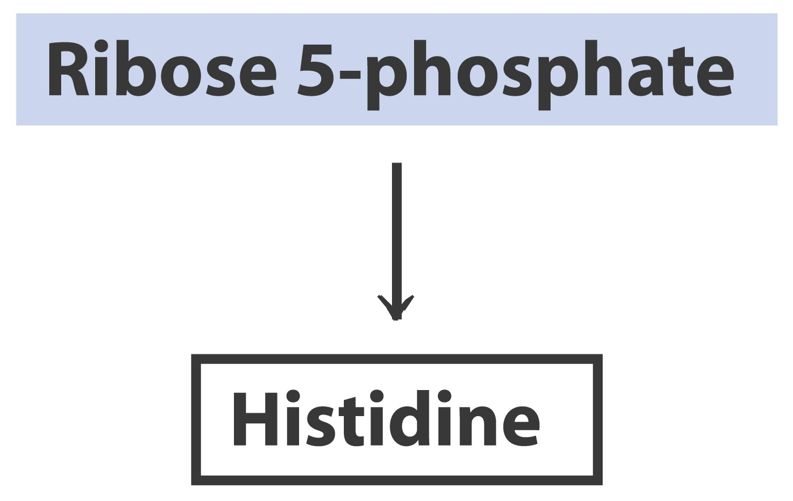
Ribose 5-phosphate + ATP PRPP + AMP
(Ribose phosphate pyrophosphokinase)

Slide 34
8. Several feedback inhibition mechanisms are found to work in regulating amino acid biosynthesis
The first case of allosteric feedback inhibition was discovered in studying Ile biosynthesis in E. coli.
The enzyme catalyzing the first reaction (threonine dehydratase) is inhibited by the end product (Ile) in a synthetic pathway.

Slide 35
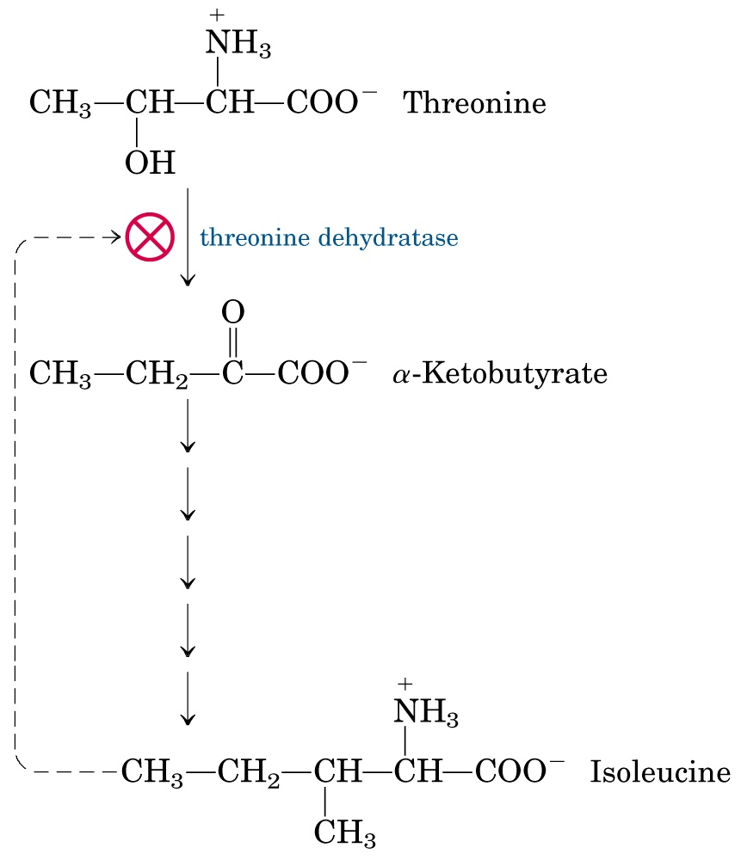
The first case of
allosteric feedback
inhibition was
discovered in studying Ile synthesis in E. coli.

Slide 36
Several intricate feedback inhibition mechanisms have been found in branched pathways for amino acid biosynthesis.
In enzyme multiplicity, several isozymes are present to catalyze a common step of reaction: each isozyme responds to a different allosteric modulator, avoiding the inhibition of a common reaction by only one end product.
In concerted inhibition, one enzyme is inhibited by two or more than two modulators, with effect more than additive.
In sequential feedback inhibition, a metabolite inhibits its own formation at several different points in a pathway.

Slide 37
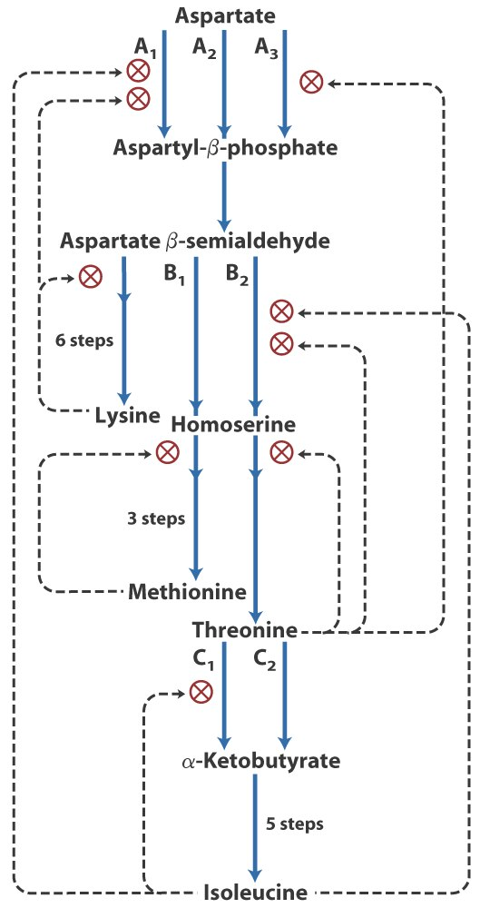
In branching pathways leading to
the synthesis of multiple end
products from common precursors,
several forms of feedback inhibition
mechanisms are used to coordinately
regulate the synthesis of all the
amino acids.

Slide 38
9. Nucleotides are synthesized via either the de novo pathways or the salvage pathways
In the de novo pathway, simple precursors, including amino acids, PRPP, NH₄⁺, CO₂, and one-carbon units (carried on tetrahydrofolate) are used.
In the salvage pathway, the free bases and nucleosides released from nucleic acid breakdown are used.

Slide 39
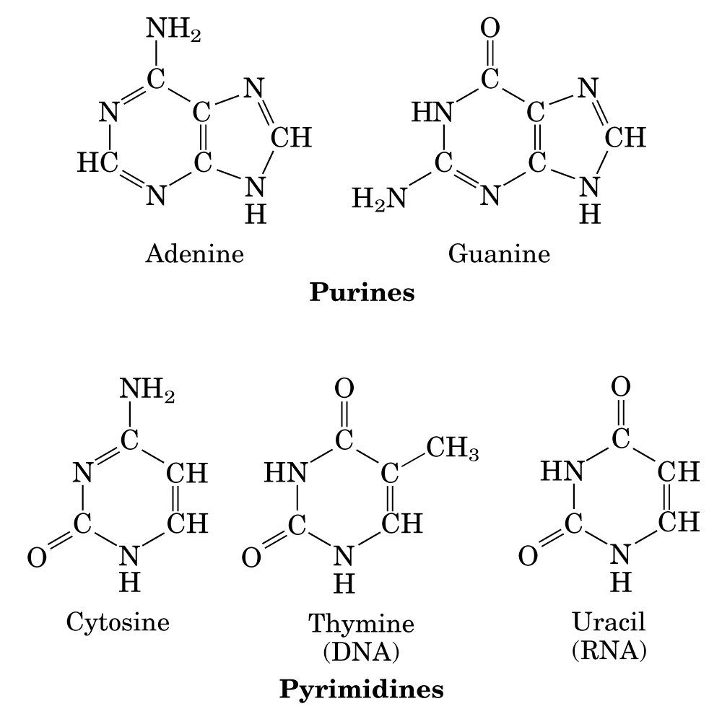
嘌呤
嘧啶
Major purine and pyrimidine bases of nucleic acids

Slide 40
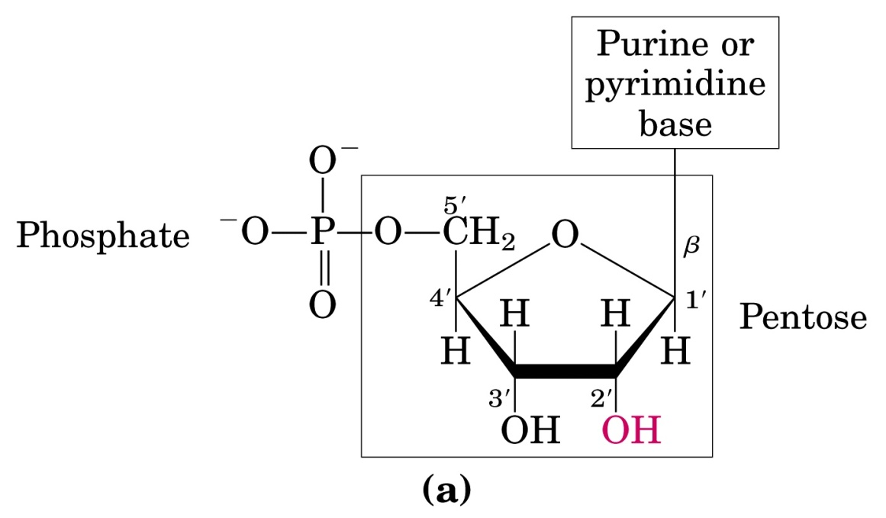
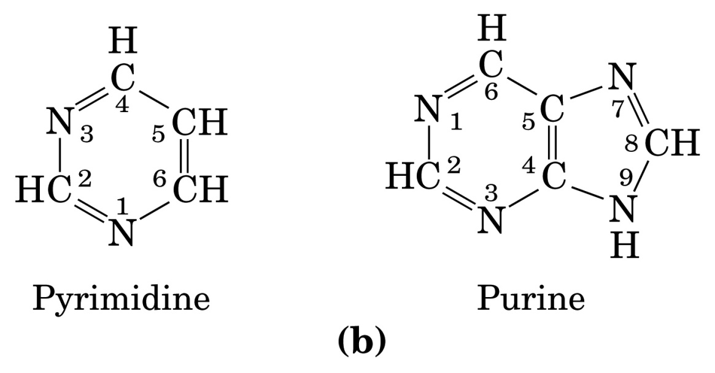
Structure of nucleotides

Slide 41
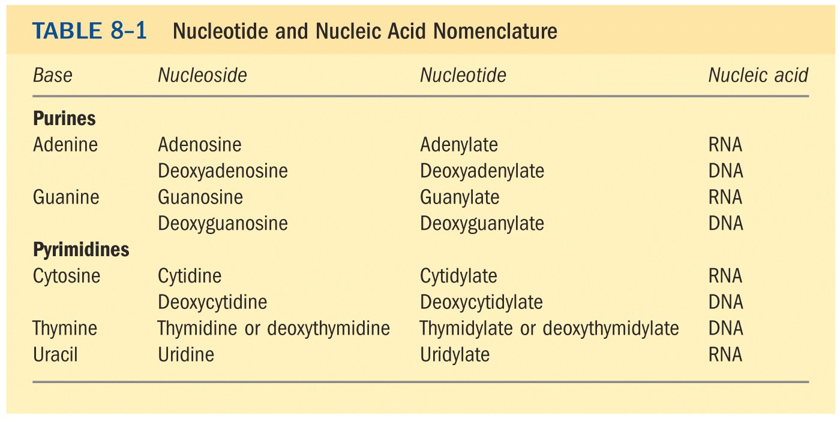

Slide 42
The free bases (A, G, C, U, T) are not intermediates during the de novo synthesis: the purine ring is assembled on ribose phosphate to make AMP and GMP; the pyrimidine ring is first synthesized as orotate, which is then attached to ribose phosphate before being converted to UTP and CTP (dTMP is made from dUMP).
The deoxyribonucleotides (dNDPs) are synthesized by reduction of ribonucleotides (NDPs).

Slide 43
10. Radioisotope tracer experiments revealed the origins of the atoms in the purine and pyrimidine rings
Buchanan and Greenberg revealed this by feeding a variety of isotopically labeled compounds to pigeons (1940s).
The atoms of the purine rings were found to be derived from formate, CO₂, Gly, Asp, and Gln.
The atoms of the pyrimidine rings were found to be derived from Asp, Gln and HCO₃⁻.

Slide 44
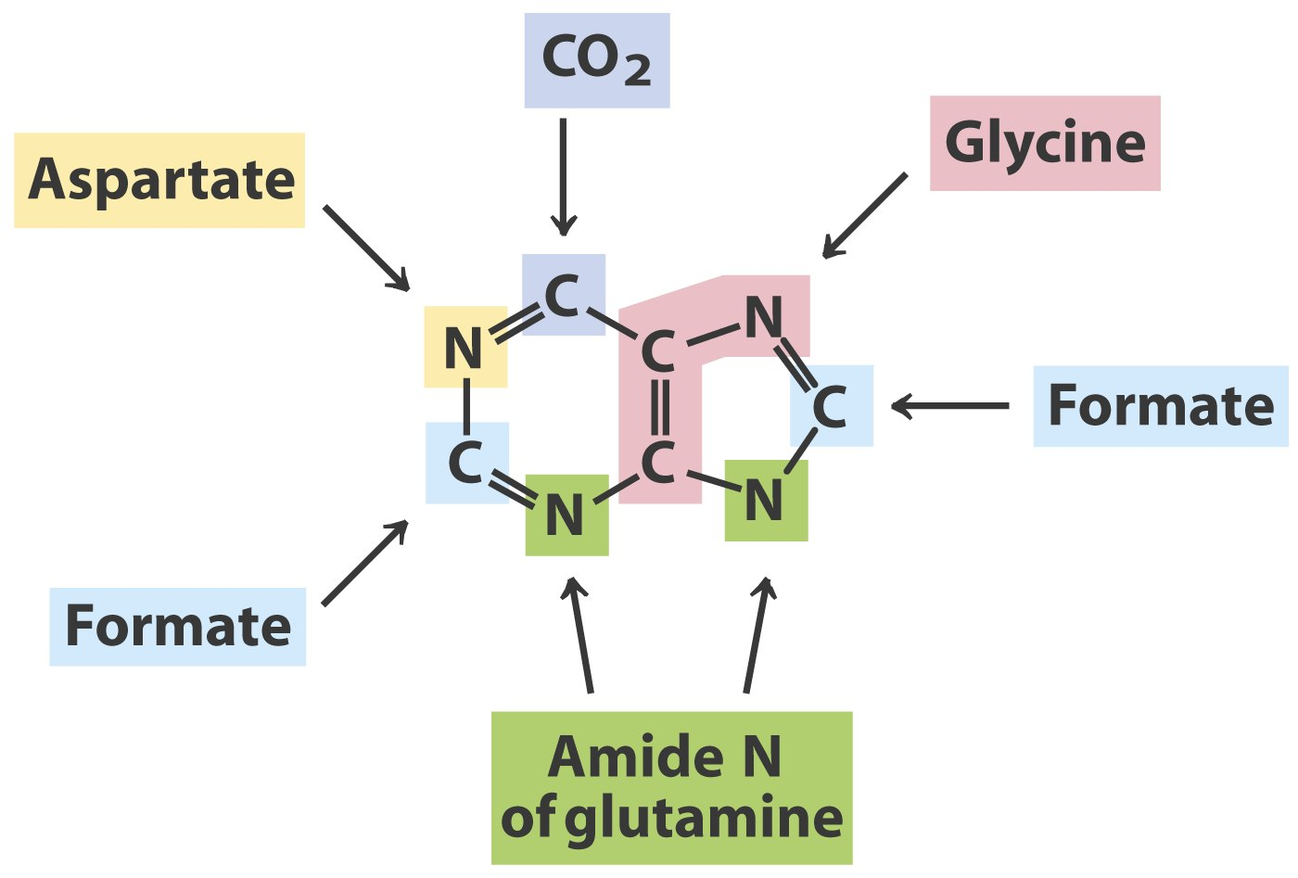
Radioisotope tracer experiments revealed the
origins of the atoms of the purine rings*****

Slide 45
11. De novo purine nucleotide synthesis begins with the transferring of an amino group from Gln to PRPP
PRPP is synthesized from ribose 5-phosphate.
In the first (committing) step of purine nucleotide synthesis, the PP_{i} part on PRPP (at C-1) is replaced by the side chain amino group of Gln, forming 5-phosphoribosylamine.
A glycine (2C +1N), a N¹⁰-formyltetrahydrofolate (1C), a Gln (1N), a HCO₃⁻(1C), Asp (1N), and another N¹⁰-formyltetrahydrofolate (1C) then bring the rest atoms for the purine ring.

Slide 46
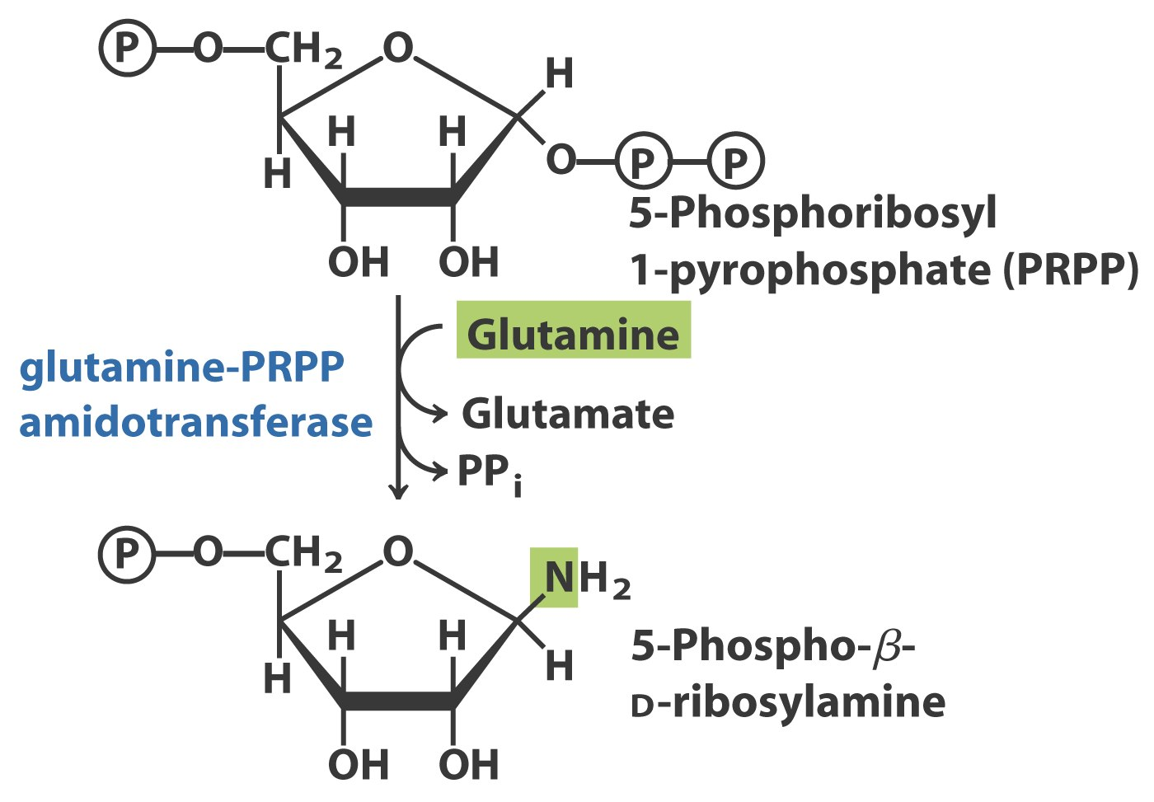
Commitment step
The purine ring is built up one or a few atoms
at a time on ribose 5-phosphate

Slide 47
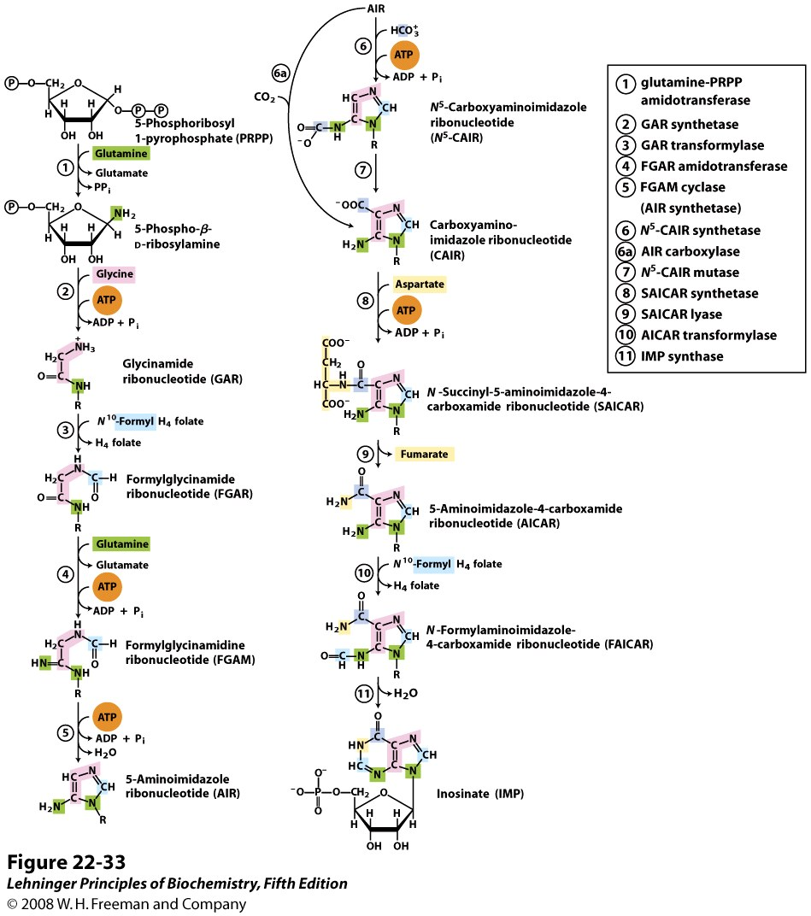
Commitment step
The purine ring is built up
one or a few atoms
at a time on ribose 5-phosphate
Notes:
FIGURE 22-33 De novo synthesis of purine nucleotides: construction of the purine ring of inosinate (IMP). Each addition to the purine ring is shaded to match Figure 22-32. After step 2, R symbolizes the 5-phospho-D-ribosyl group on which the purine ring is built. Formation of 5-phosphoribosylamine (step 1) is the first committed step in purine synthesis. Note that the product of step 9, AICAR, is the remnant of ATP released during histidine biosynthesis (see Figure 22-20, step 5). Abbreviations are given for most intermediates to simplify the naming of the enzymes. Step 6a is the alternative path from AIR to CAIR occurring in higher eukaryotes.

Slide 48
The first intermediate having a complete purine ring is IMP (inosinate).
IMP is converted to AMP by accepting an amino group from Asp, and converted to GMP by a NAD⁺-dependent dehydrogenation reaction (at C-2) and an amino group transfer from Gln (catalyzed by an amidotransferase).
Production of AMP from IMP requires GTP, and production of GMP from IMP requires ATP.

Slide 49
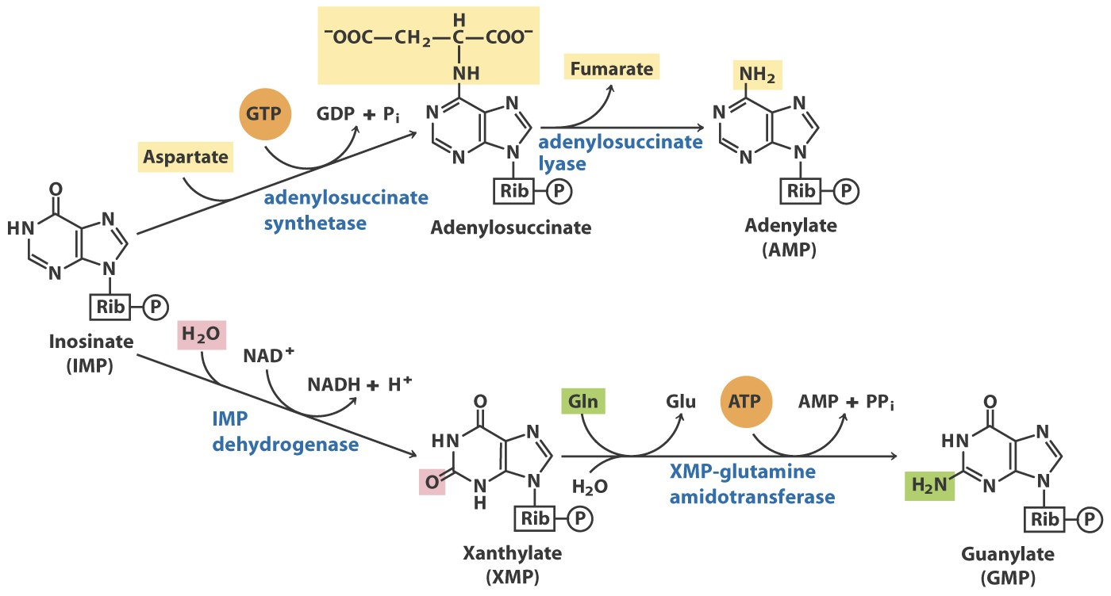
IMP is converted to AMP by accepting an amino
group from Asp (GTP is needed to activate Asp);
IMP is converted to GMP by accepting an amino
group from Gln (ATP is needed to activate XMP)

Slide 50
12. The biosynthesis of AMP and GMP is regulated by feedback inhibition
Glutamine-PRPP amidotransferase is inhibited by the end products IMP, AMP and GMP (AMP and GMP act synergistically).
AMP inhibits adenylosuccinate synthetase and GMP inhibits IMP dehydrogenase.
AMP and GMP synthesis is balanced by the following mechanism: GTP is needed for AMP synthesis and ATP is needed for GMP synthesis.

Slide 51
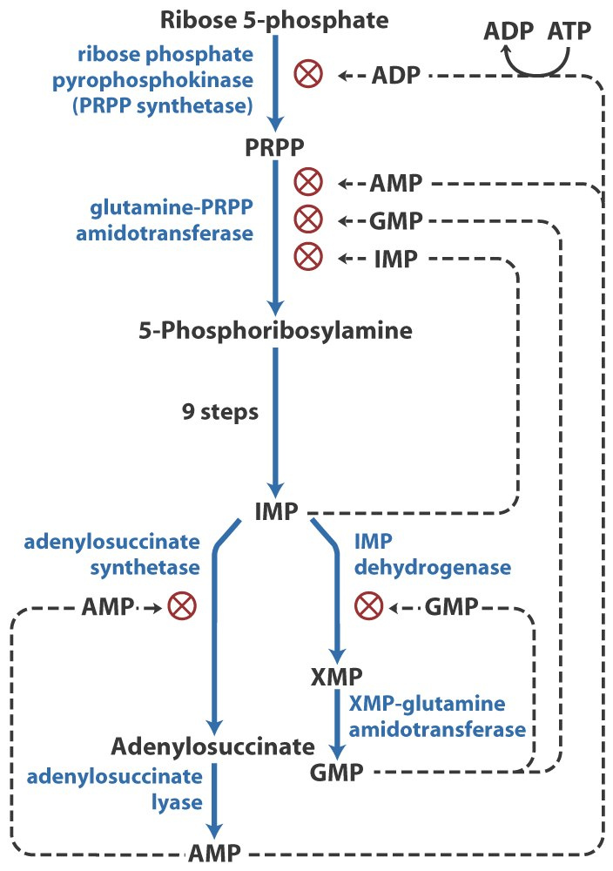
Regulation of the biosynthesis
of AMP and GMP in E. coli*****

Slide 52
13. The de novo biosynthesis of pyrimidines begin with the formation of carbamoyl phosphate
Carbamoyl phosphate is formed from Gln, HCO₃⁻, and ATP in a reaction catalyzed by the carbamoyl phosphate synthetase II in the cytosol.
In the committing step of pyrimidine biosynthesis, carbamoyl phosphate condenses with Asp to form N-carbamoylaspartate in a reaction catalyzed by aspartate transcarbamoylase (ATCase).

Slide 53
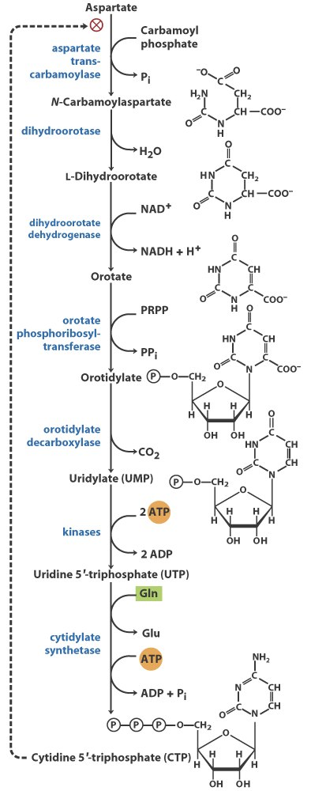
Committing step
De novo synthesis of pyrimidine nucleotides

Slide 54
A ring closing reaction generates L-dihydroorotate, which is then oxidized to form orotate (乳清酸) in a reaction catalyzed by dihydroorotate dehydrogenase.
Orotate is then linked to PRPP to form orotidylate, which is then converted to UMP by a decarboxylation reaction.
CTP is derived from UTP by accepting an amino group from Gln or NH₄⁺.
In eukaryotic cells, carbamoyl phosphate synthetase II, aspartate transcarbamoylase, and dihydroorotase are part of a trifunctional protein called CAD.

Slide 55
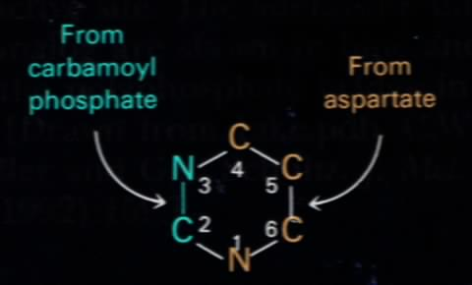
Gln amide
C
HCO₃⁻
The atoms of the pyrimidine ring were revealed to
be derived from HCO₃⁻, Gln and Asp.*****

Slide 56
14. Pyrimidine nucleotide biosynthesis is regulated through the aspartate transcarbamoylase (ATCase)
ATCase is inhibited by CTP, the end product of the de novo pyrimidine nucleotide biosynthesis pathway.
CTP binds at the regulatory subunits, which changes the conformation of the catalytic subunits, inactivating them.
ATP is able to prevent the changes induced by CTP.

Slide 57
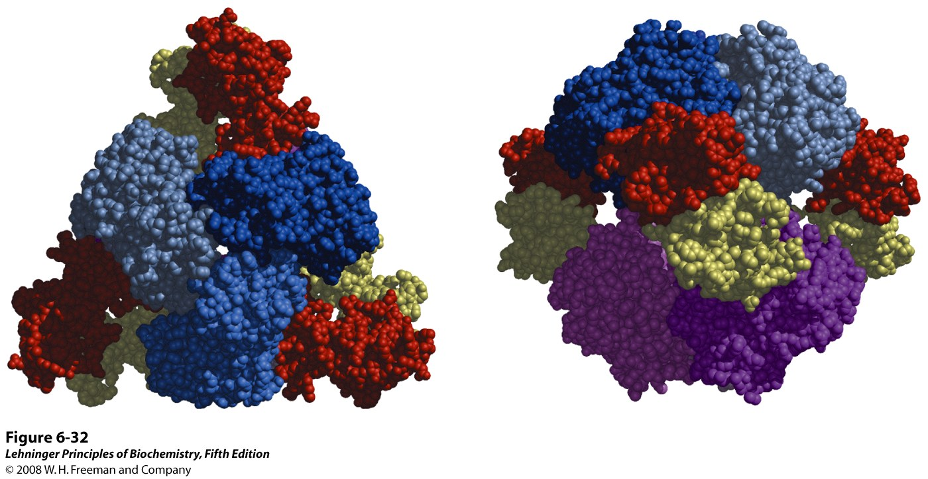
Two views of the regulatory enzyme aspartate transcarbamoylase
This allosteric regulatory enzyme has two stacked catalytic clusters, each with three
catalytic polypeptide chains (in shades of blue and purple), and three regulatory clusters,
each with two regulatory polypeptide chains (in red and yellow). The regulatory clusters
form the points of a triangle surrounding the catalytic subunits. Binding sites for allosteric
modulators are on the regulatory subunits. Modulator binding produces large changes
in enzyme conformation and activity.
Notes:
FIGURE 6-32 Two views of the regulatory enzyme aspartate transcarbamoylase. (Derived from PDB ID 2AT2.) This allosteric regulatory enzyme has two stacked catalytic clusters, each with three catalytic polypeptide chains (in shades of blue and purple), and three regulatory clusters, each with two regulatory polypeptide chains (in red and yellow). The regulatory clusters form the points of a triangle surrounding the catalytic subunits. Binding sites for allosteric modulators are on the regulatory subunits. Modulator binding produces large changes in enzyme conformation and activity. The role of this enzyme in nucleotide synthesis, and details of its regulation, are discussed in Chapter 22.

Slide 58
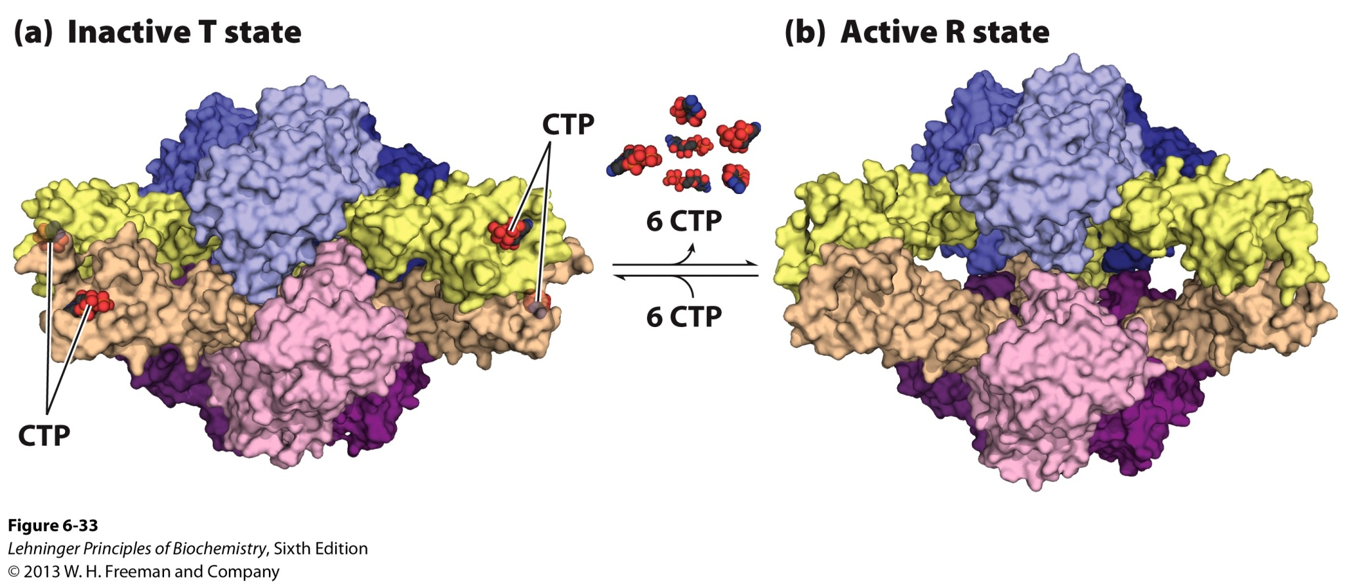
Allosteric regulation of aspartate
transcarbamoylase by CTP

Slide 59
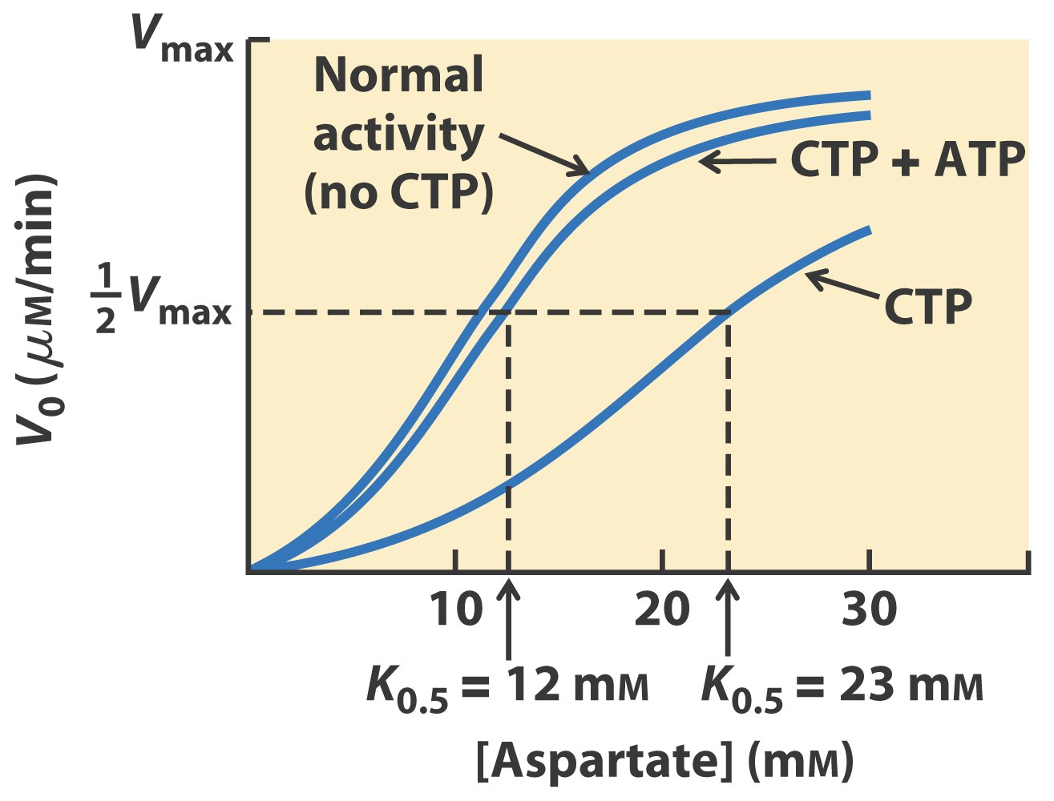
Allosteric regulation of aspartate
transcarbamoylase by CTP and ATP

Slide 60
15. Base specific NMP kinases together with a nonspecific NDP kinase convert NMPs to NTPs
Nucleotides participate in biosynthesis of RNA and DNA in the forms of NTPs.
Each specific nucleoside monophosphate (NMP) kinase converts the corresponding NMP/dNMPs to NDP/dNDPs using ATP.
The nonspecific nucleoside diphosphate (NDP) kinase converts all NDP/dNDPs to NTP/dNTPs using ATP or other NTPs.

Slide 61
16. Deoxyribonucleotides are made from ribonucleotides at the NDP level
This occurs by direct reduction at the 2’-carbon.
Ribonucleotide reductase catalyzes all such conversions.
The electrons are provided by NADPH and are transferred to the ribonucleotide reductase via two possible paths (via either thioredoxin or glutaredoxin).

Slide 62
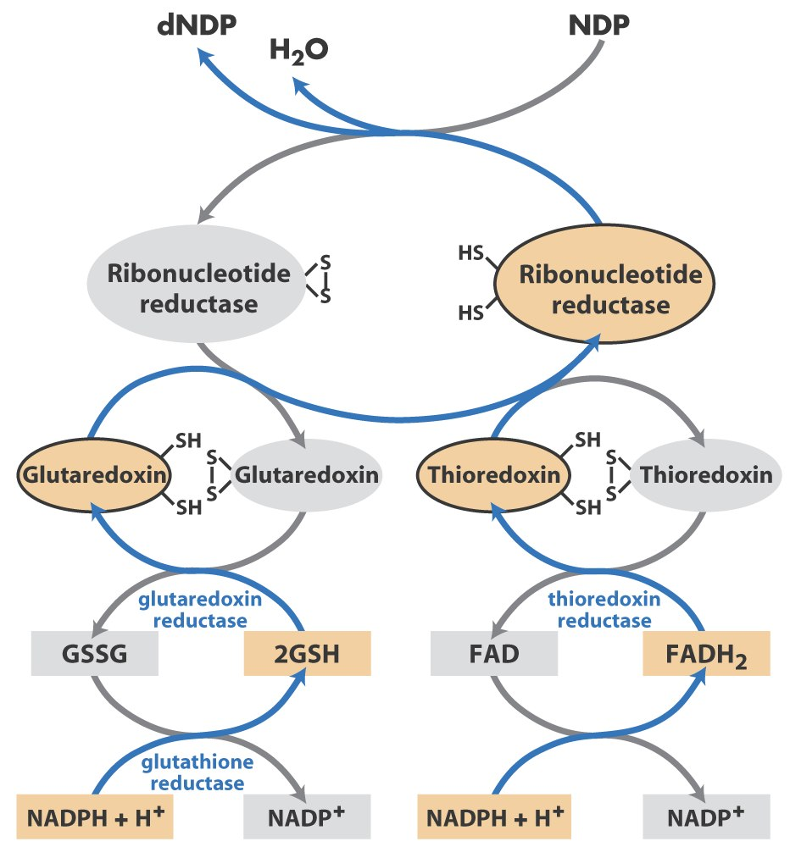
NDPs are converted
to dNDPs with the
catalysis of
ribonucleotide
reductase, with
electrons ultimately
coming from NADPH

Slide 63
17. Free radicals are involved in converting NDPs to dNDPs by the ribonucleotide reductase
Ribonucleotide reductase exists as a tetramer, with two R₁ and two R₂ subunits.
Each tetramer has two active sites formed at the interface of R₁ and R₂ subunits: R₁ contributes two -SH groups and R₂ contributes a radical (stabilized by a Tyr radical, which, in turn is stabilized by a Fe³⁺-Fe³⁺ binuclear center in class I ribonucleotide reductase).

Slide 64
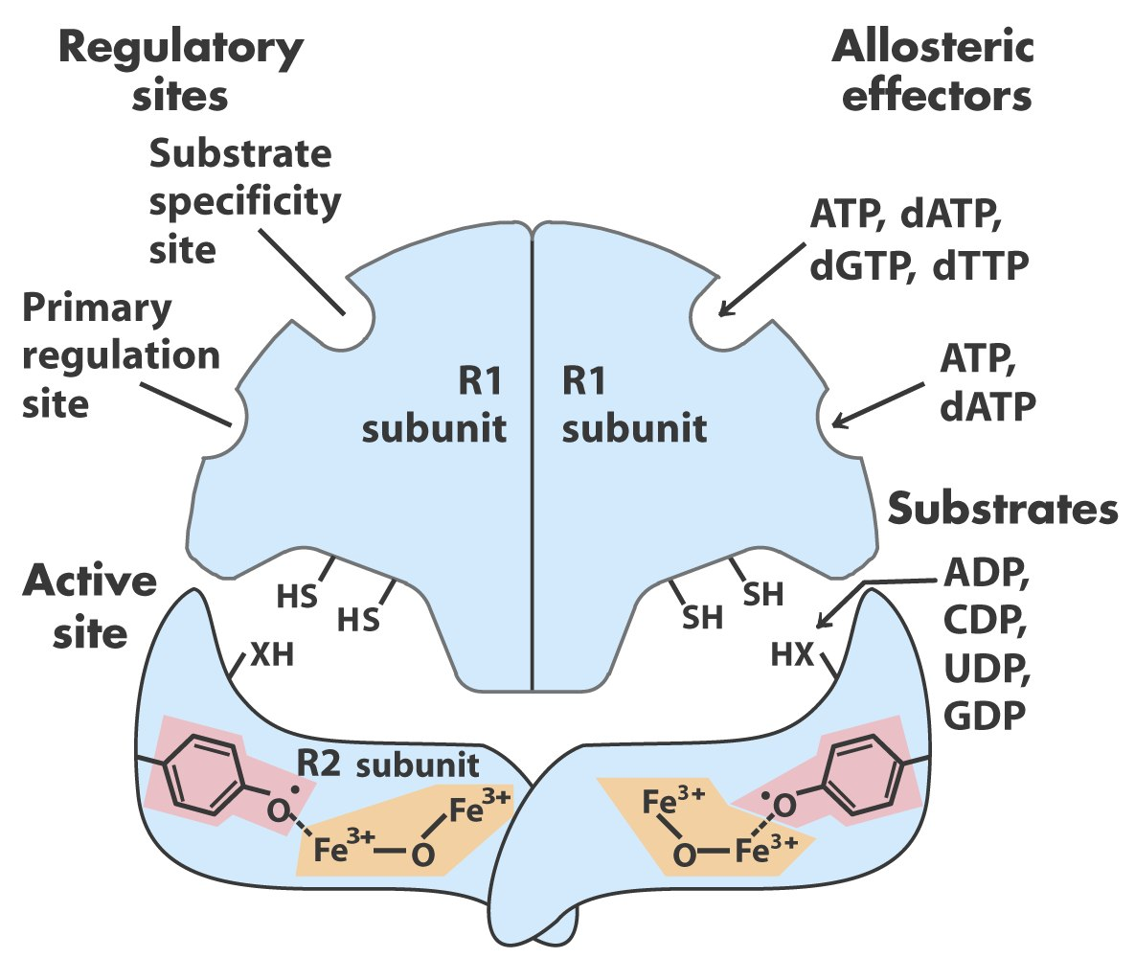
Ribonucleotide reductase is a tetramer of two
different subunits

Slide 65
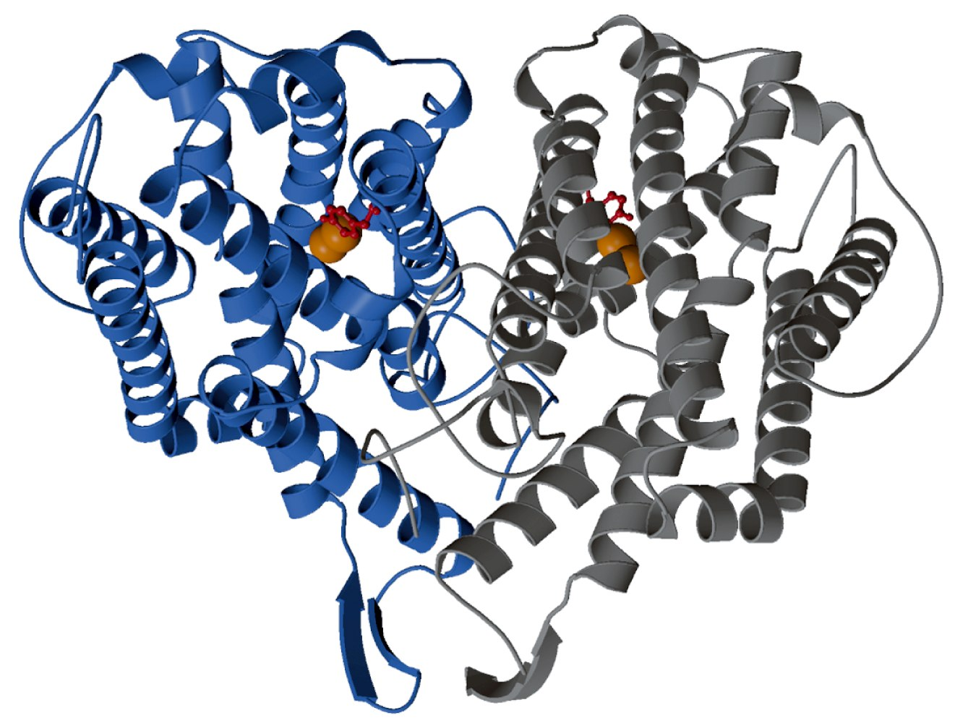
The R2 dimer of
ribonucleotide reductase
with a Tyr radical and a
Fe³⁺-Fe³⁺ binuclear center
Tyr radical

Slide 66
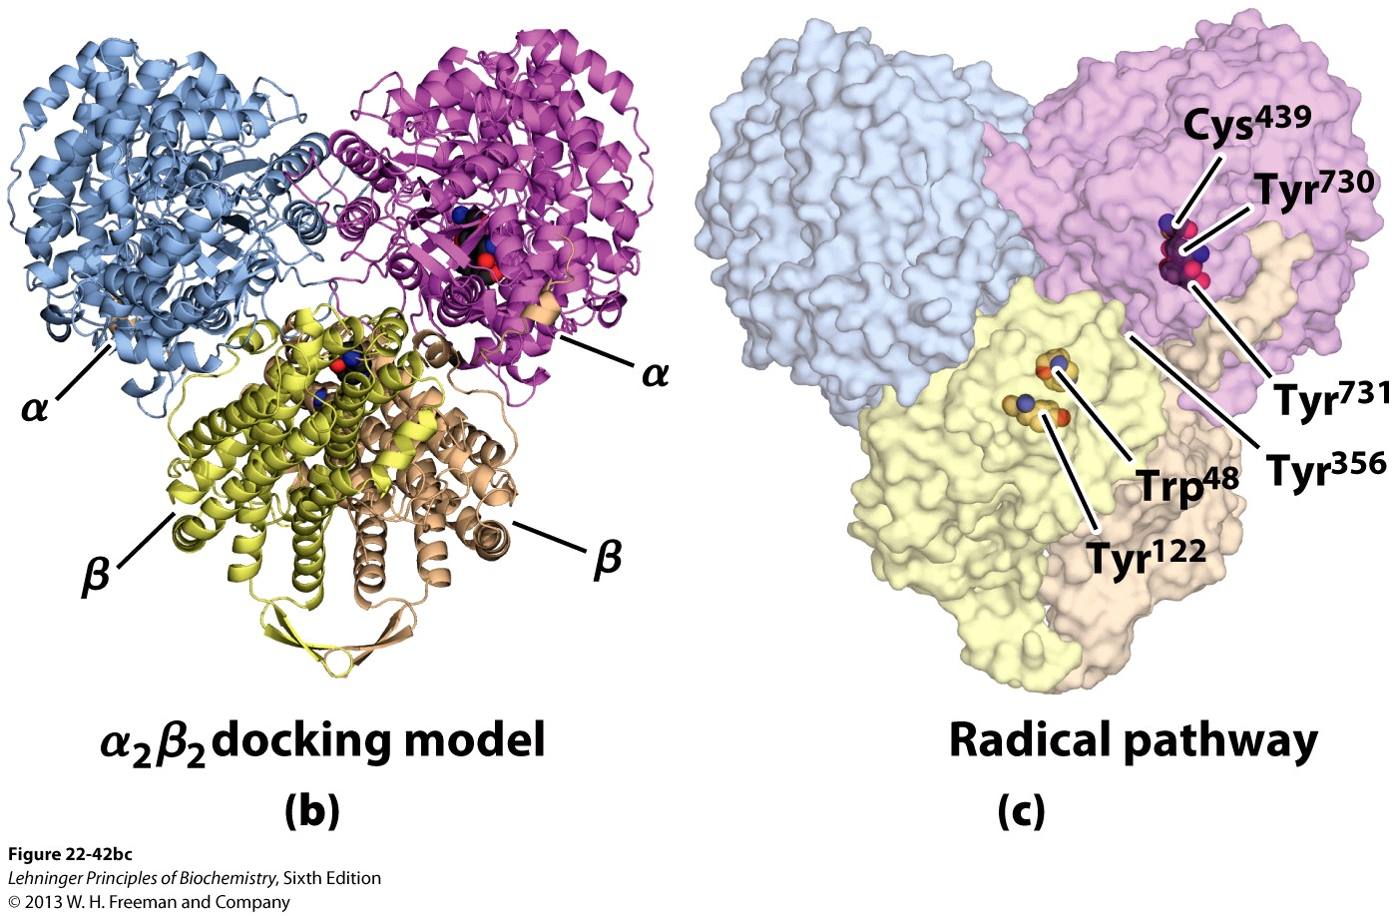
Ribonucleotide reductase is a tetramer of two
different subunits

Slide 67
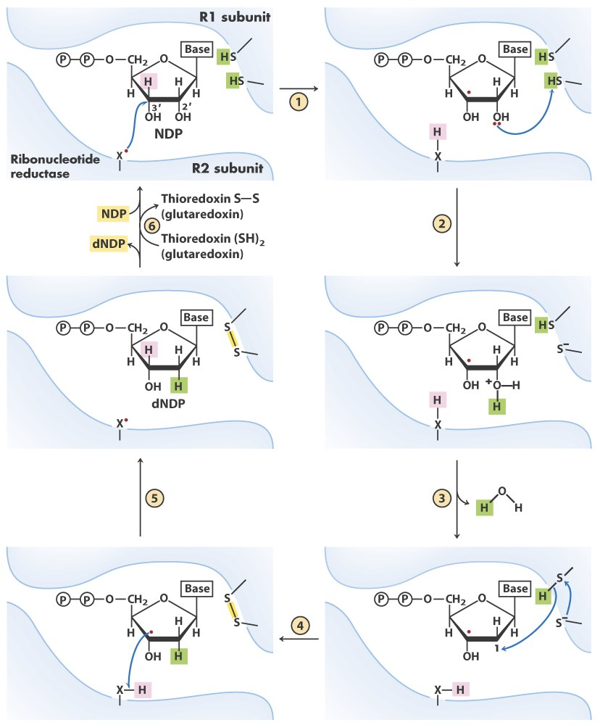
A proposed
mechanism for
converting a
NDP to a dNDP
by ribonucleotide
reductase: the
radical property
of the enzyme is
transiently
transferred to the
substrate; the
presence of the
radical at C-3
stabilizes the
carbon cation
formed at C-2.

Slide 68
The deoxygenation reaction is proposed to occur via a 3’-ribonucleotide radical, which helps to stabilize the 2’ carbon cation subsequently formed.

Slide 69
18. The E. coli ribonucleotide reductase is regulated for both its activity and substrate specificity
Two types of regulatory sites are present on the R₁ subunits: one for substrate specificity and the other for the overall enzyme activity.
At the overall enzymatic activity site: when ATP binds, the enzyme is activated; when dATP binds, the enzyme is inactivated.

Slide 70
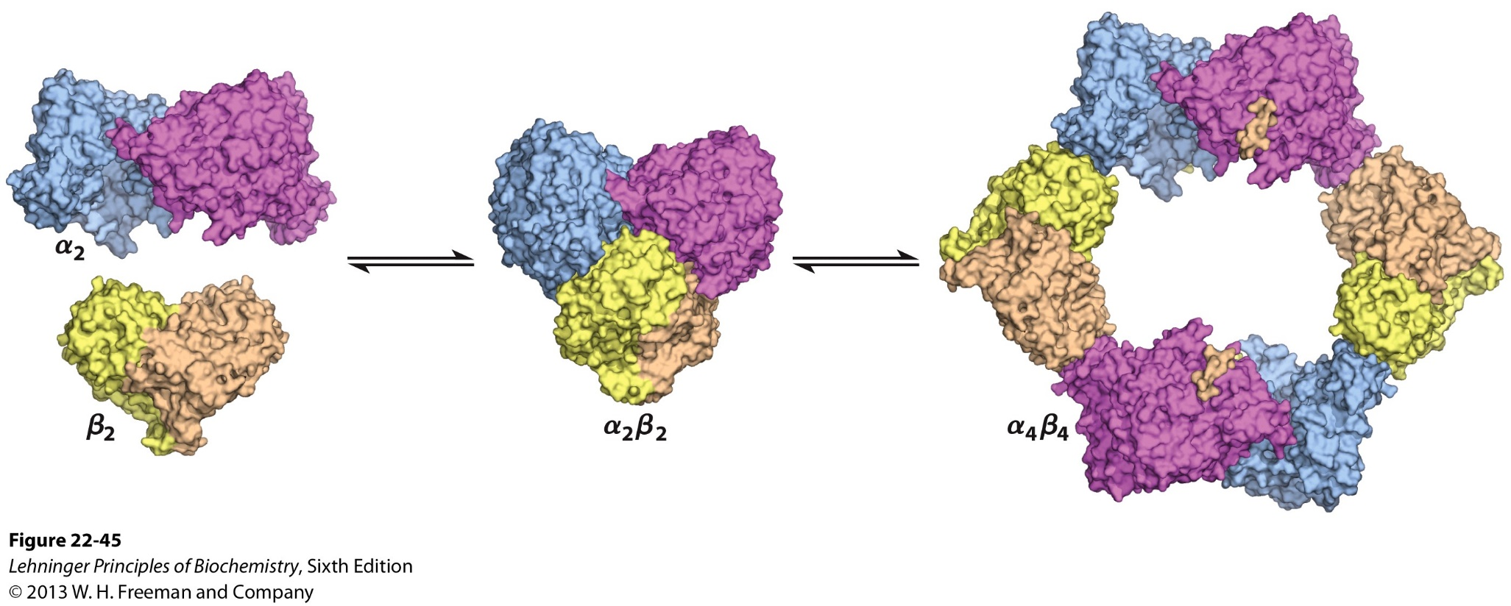
50μM dATP
Oligomerization of ribonucleotide reductase
induced by the allosteric inhibitor dATP

Slide 71
At the substrate specificity site:
when dATP or ATP binds, reduction of CDP and UDP is favored;
when dTTP binds, reduction of GDP is favored (and the reduction of CDP and UDP is inhibited);
when dGTP binds, reduction of ADP is favored.

Slide 72
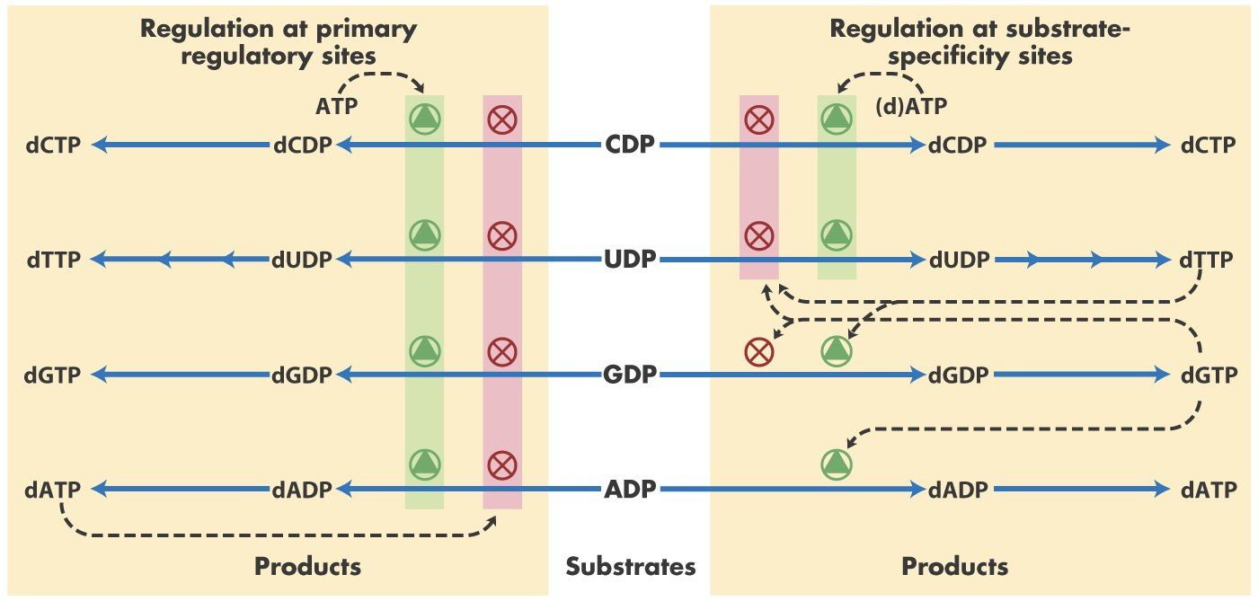
Both substrate specificity and the overall enzymatic
activity of ribonucleotide reductase are regulated to
balance the biosynthesis of all nucleotides.

Slide 73
19. dTMP is synthesized by methylation of dUMP
dUTP is first formed from either dUDP (via phosphorylation) or dCTP (via deamination).
dUMP is then formed from dUTP in a reaction catalyzed by a dUTPase (keeping dUTP at a low level to prevent its incorporation into DNA).
dUMP is then converted to dTMP by the catalysis of thymidylate synthase, with a methylene group transferred from and reduced by N⁵, methylenetetrahydrofolate (being donors of both one-carbon unit and electrons!).

Slide 74
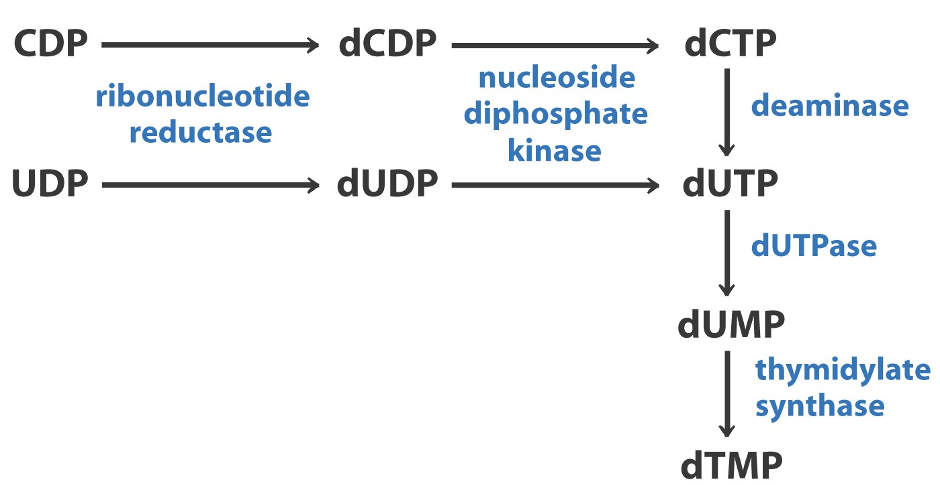
Biosynthesis of thymidylate (dTMP)*****

Slide 75
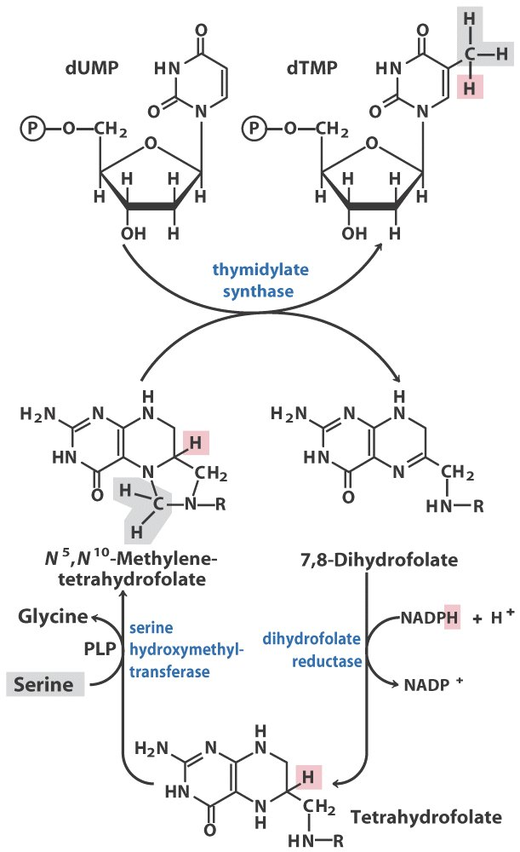
dTMP is derived from dUMP via a methylation reaction
using N⁵, N¹⁰-methylenetetrahydrofolate as donors of
both one-carbon unit and electrons.

Slide 76
The reactions catalyzed by ribonucleotide reductase and thymidylate synthase are probably key reactions for the transition from an RNA world to one in which DNA stores genetic information.

Slide 77
20. Uric acid is the excreted end product of purine catabolism in humans and many other animals
For adenosine, the amino group is hydrolyzed before the ribose group is removed.
For guanosine, the amino group is hydrolyzed after the ribose group is removed.
Xanthine oxidase, having multiple cofactors (including an FAD, a Mo complex, four different Fe-S clusters), catalyzes the O₂-dependent conversion of hypoxanthine to xanthine and xanthine to uric acid.

Slide 78
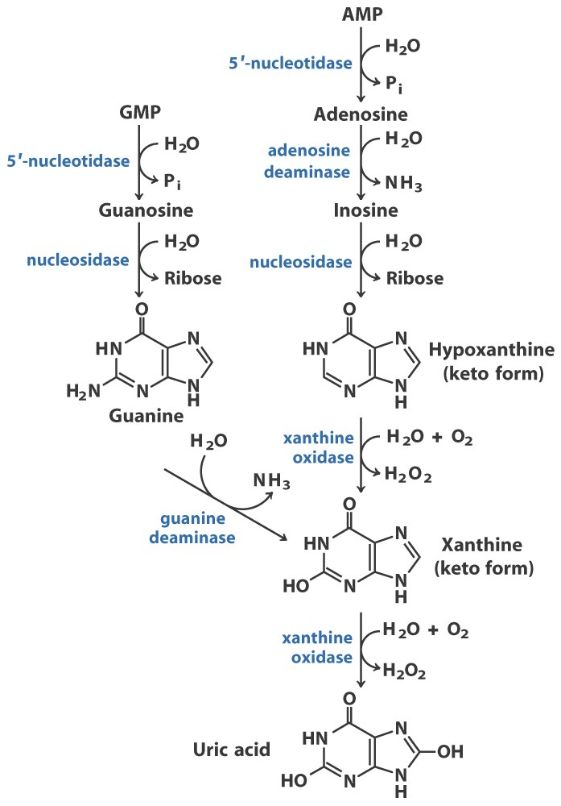
尿酸
Catabolism of purine nucleotides

Slide 79
Uric acid can be further converted to allantoin, allantoate, urea or NH4⁺ in various animals.
The deficiency of adenosine deaminase causes the severe immunodeficiency disease in humans (the accumulated adenosine is converted to dATP, which inhibits the formation of all dNDPs by ribonucleotide reductase).
Overproduction of uric acid was revealed to cause gout (痛风).
Allopurinol, an inhibitor of xanthine oxidase, is used to treat gout.

Slide 80
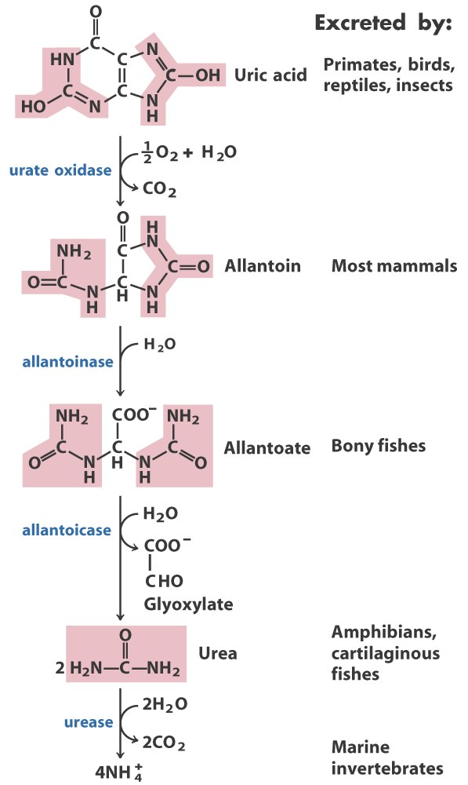

Slide 81
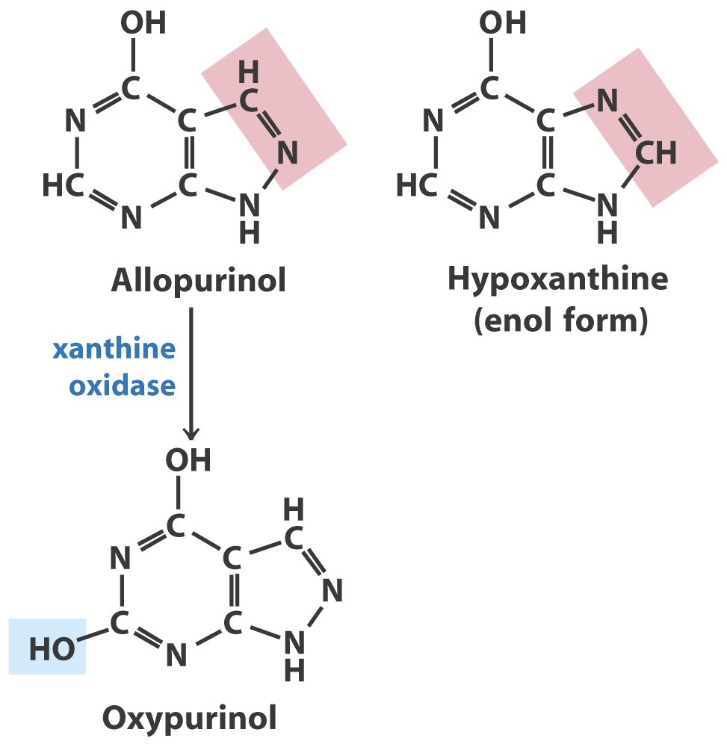
Allopurinol was designed to be a competitive inhibitor of xanthine oxidase to treat gout by Elion and Hitchings.

Slide 82
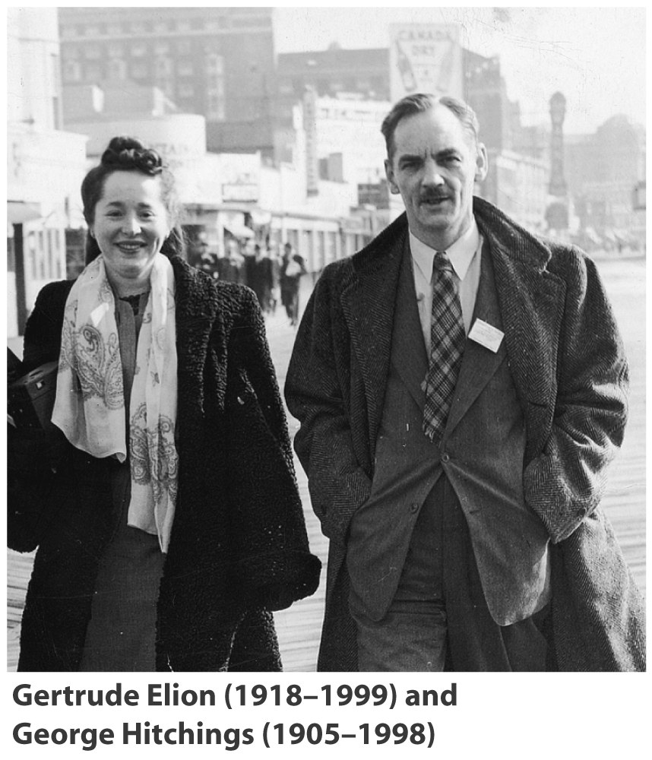
They shared the Nobel Prize
in 1988 for their discoveries
of important principles for
drug treatment.

Slide 83
21. Pyrimidines are broken down via reduction
The degradation of thymine produces methylmalonyl-CoA, which can be converted to succinyl-CoA (a citric acid cycle intermediate) by the catalysis of a mutase.
The degradation of uracil and cytidine produces malonyl-CoA, which is the precursor for fatty acid biosynthesis.
To a limited extent, catabolism of pyrimidine nucleotides contributes to the energy metabolism of the cell.
The end product of pyrimidine degradation is urea.

Slide 84
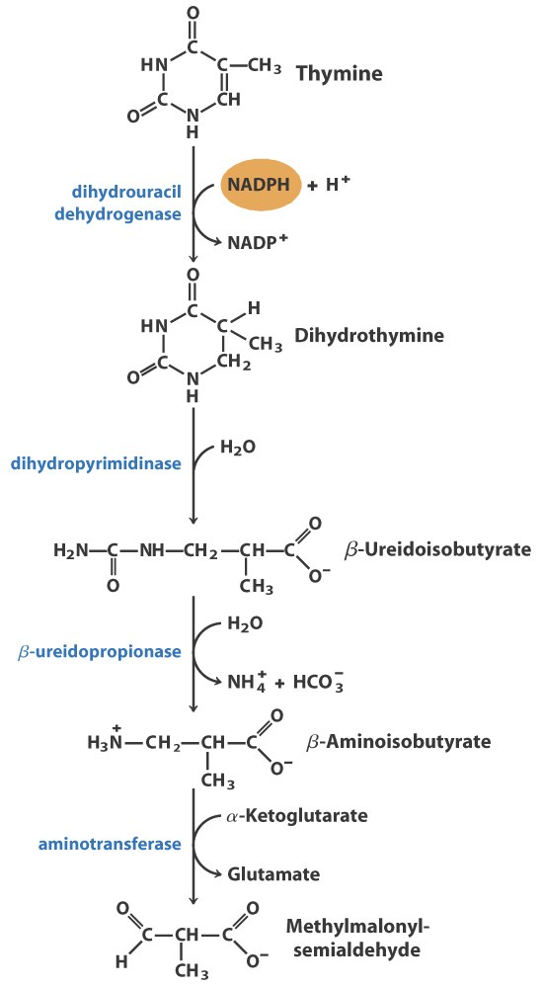
Degradation products of
pyrimidines can enter the
citric acid cycle
Propionyl-CoA
Succinyl-CoA

Slide 85
22. Purine and pyrimidine bases can be reconverted to nucleotides via the salvage pathway
Adenine phosphoribosyltransferase catalyzes the synthesis of AMP from adenine and PRPP.
Adenine + PRPP AMP + PP_{i}
Hypoxanthine-guanine phosphoribosyltransferase (HGPRT) catalyzes the synthesis of GMP and IMP.
The lack of HGPRT will cause Lesch-Nyhan syndrome.
Pyrimidine bases are recycled in a similar way in microorganisms, but pyrimidine bases does not seem to be salvaged in significant amounts in mammals.

Slide 86
23. Many cancer chemotherapeutic drugs target enzymes in the nucleotide biosynthetic pathways
Analogs of Gln, like azaserine and acivicin, inhibits many amidotransferases used in nucleotide (and amino acid) biosynthesis.
Fluorouracil, after being converted to FdUMP by the salvage pathway, can inhibit the thymidylate synthase after two steps of conversion, thus inhibit dTMP synthesis.
Methotrexate, a folate analog, inhibits the dihydrofolate reductase, thus dTMP synthesis.

Slide 87
Azaserine or acivicin
inhibits glutamine
amidotransferases,
thus inhibiting the
biosynthesis of nucleotides
and amino acids.

Slide 89
FdUMP (from fluorouracil) and methotrexate inhibit
thymidylate synthase and dihydrofolate
reductase (DHFR), respectively.

Slide 90
Keywords
N₂ fixation
Amino acid biosynthesis --- feedback regulation
De novo synthesis of nucleotides --- origin of atoms
Ribonucleotide reductase --- reaction and regulation
Synthesis of dTMP --- reaction

Slide 91
Words of the Week
glutamine synthetase
ribonucleotide reductase
thymidylate synthase
chemotherapy

Slide 92
Text-book reading of the week
Summary 22.1 (p891)
Summary 22.2 (p902)
Summary 22.4 (p925)
p917-920 (ribonucleotide reductase)

Slide 93
Summary
Atmospheric N₂ is reduced to ammonia by the dinitrogenase reductase and the dinitrogenase (containing a key Fe-Mo cofactor) of the nitrogenase complex present only in certain bacteria.
Ammonia enters organic molecules via Glu and Gln.
Glutamine amidotransferases catalyzes the transferring of the amide amino group to many acceptor molecules.

Slide 94
Amino acids are mainly derived from intermediates of glycolysis, the citric acid cycle, and the pentose phosphate pathway.
His is derived from one PRPP, one ATP, one Gln, and one Glu.
Amino acid biosynthesis is regulated by various forms of feedback inhibition (including enzyme multiplicity, concerted inhibition and sequential feedback inhibition).

Slide 95
The atoms of the purine rings were found to be derived from formate, CO₂, Gly, Asp, and Gln.
Pyrimidine nucleotides are synthesized using HCO₃⁻, Gln, Asp, and PRPP.
De novo synthesis of nucleotides are regulated via feedback inhibition.
Deoxyribonucleotides are derived from ribonucleotides at the NDP level, with the catalysis of ribonucleotide reductase, which contains a chain of electron carriers, uses free radicals, and is regulated for both substrate specificity and overall enzymatic activities.

Slide 96
The dTMP molecule is derived from dUMP by thymidylate synthase, an enzyme using N⁵, N¹⁰-methylenetetrahydrofolate as the donor of both one-carbon unit and electrons.
Degradation of purines and pyrimidines produces uric acid and citric acid cycle intermediate/fatty acid synthesis precursor, respectively.
Purine and pyrimidine bases can be reused via the salvage pathway.
Many cancer chemotherapeutic drugs (e.g., azaserine, acivicin, fluorouracil, and methotrexate) inhibit enzymes in the nucleotide biosynthetic pathways.

