Slide 1
Part III
Information Pathways

Slide 2
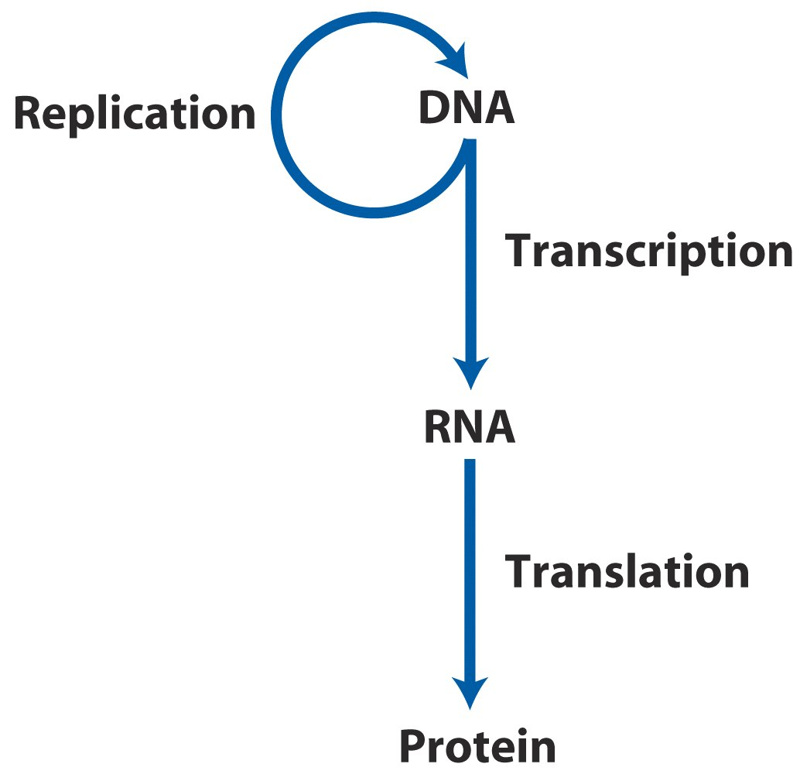
Information Pathway

Slide 3
Chapter 24
Genes and Chromosomes
A. What is a gene?
B. What are the various structures of DNA?

Slide 4
1. General Introduction
DNA molecules are the largest macromolecules in the cell and are commonly packaged into structures known as chromosomes.
A single chromosome may carry thousands of genes.
All of a cell’s genes and intergenic DNA form the cellular genome.

Slide 5
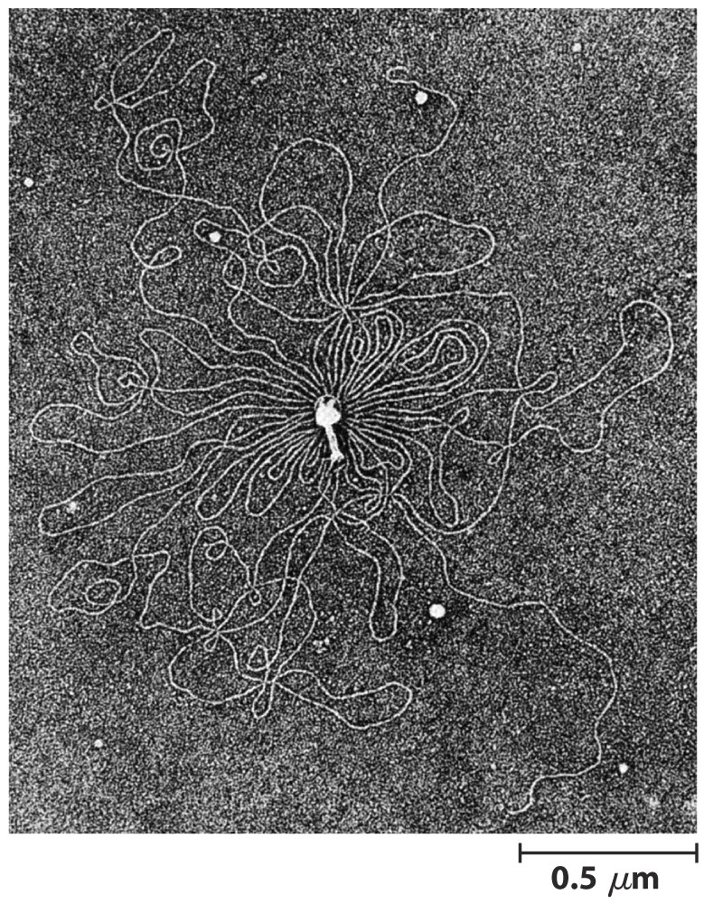
Bacteriophage T2 protein coat surrounded by its single, linear molecular DNA

Slide 6
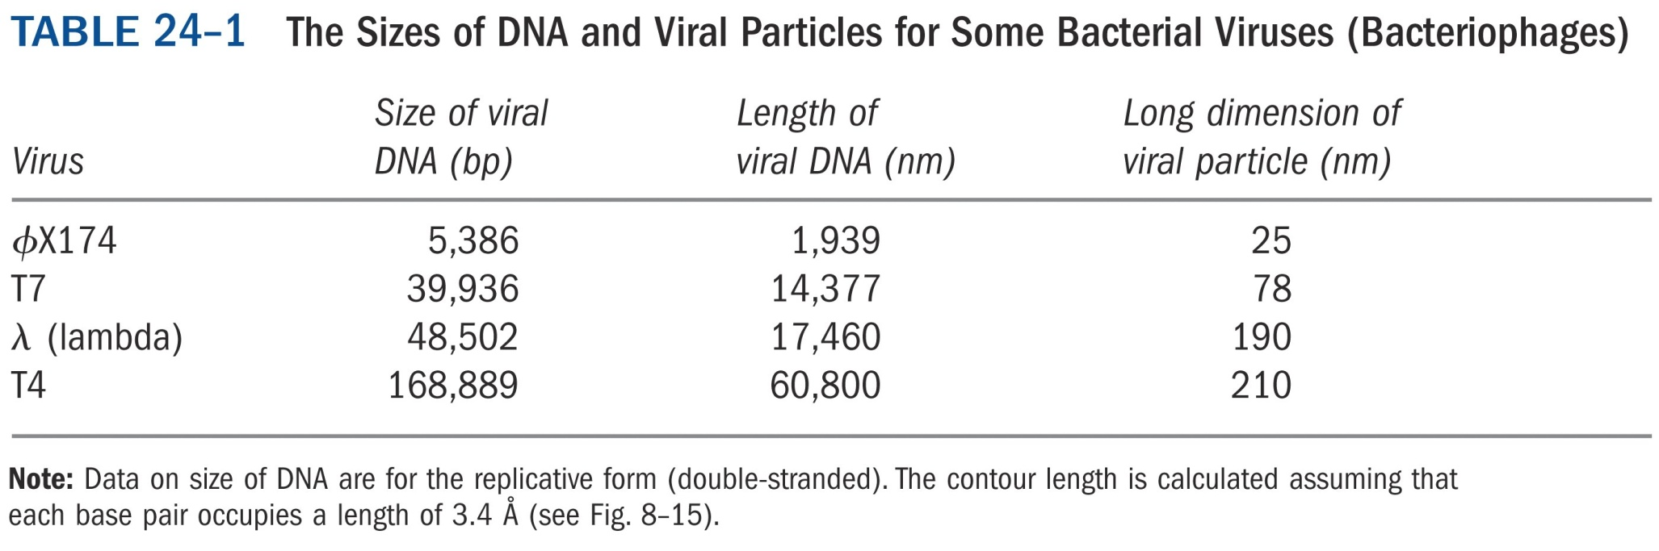

Slide 7
2. Genes are segments of DNA that code for polypeptide chains and RNAs
Our understanding of genes has evolved tremendously over the last century.

Slide 8
Classically a gene was defined as a portion of a chromosome that determines or affects a single character or phenotype, a visible property, such as eye color.
After exposing spores of the fungus Neurospora crassa to X rays and other agents known to damage DNA and cause alternations in DNA sequences (mutations), George Beadle and Edward Tatum detected mutant fungal strains that lacked one or another specific enzyme, sometimes resulting in the failure of an entire metabolic pathway.

Slide 9
Beadle and Tatum concluded that a gene is a segment of genetic material that determines or codes for one enzyme: the one gene-one enzyme hypothesis. Later this concept was broadened to one gene-one protein, because many genes code for proteins that are not enzymes.
Since many proteins have multiple polypeptides, such as hemoglobin, thus the gene-protein relationship is more accurately described as one gene-one polypeptide.

Slide 10
However, there are more complications…
Not all genes are ultimately expressed in the form of polypeptide chains. Some, for example, code for tRNAs and rRNAs.
A gene is thus all of the DNA that encodes the primary sequence of some final gene products, such as polypeptide or RNA with a structural or catalytic function.

Slide 11
DNA also contains other segments or sequences that have a purely regulatory function, and these segments are called regulatory sequences.
Furthermore, in eukaryotes and a few in prokaryotes, one same segment of DNA may undergo alternative splicing during mRNA maturation, and thus codes for different polypeptides. These transcripts are normally said to be coded by the same gene.

Slide 12
A gene is defined biochemically as a
segment of DNA (or, in a few cases,
RNA) that encodes the information
required to produce a functional
biological product.

Slide 13
How many genes are there in a genome?
E. coli has a single circular DNA with 4,639,221 base pairs, coding for about 4405 genes.
The human genome has 24 different chromosomes with 3.2 billion base pairs as genome size (the total number of base pairs in a haploid), coding for about 35,000 genes.

Slide 14
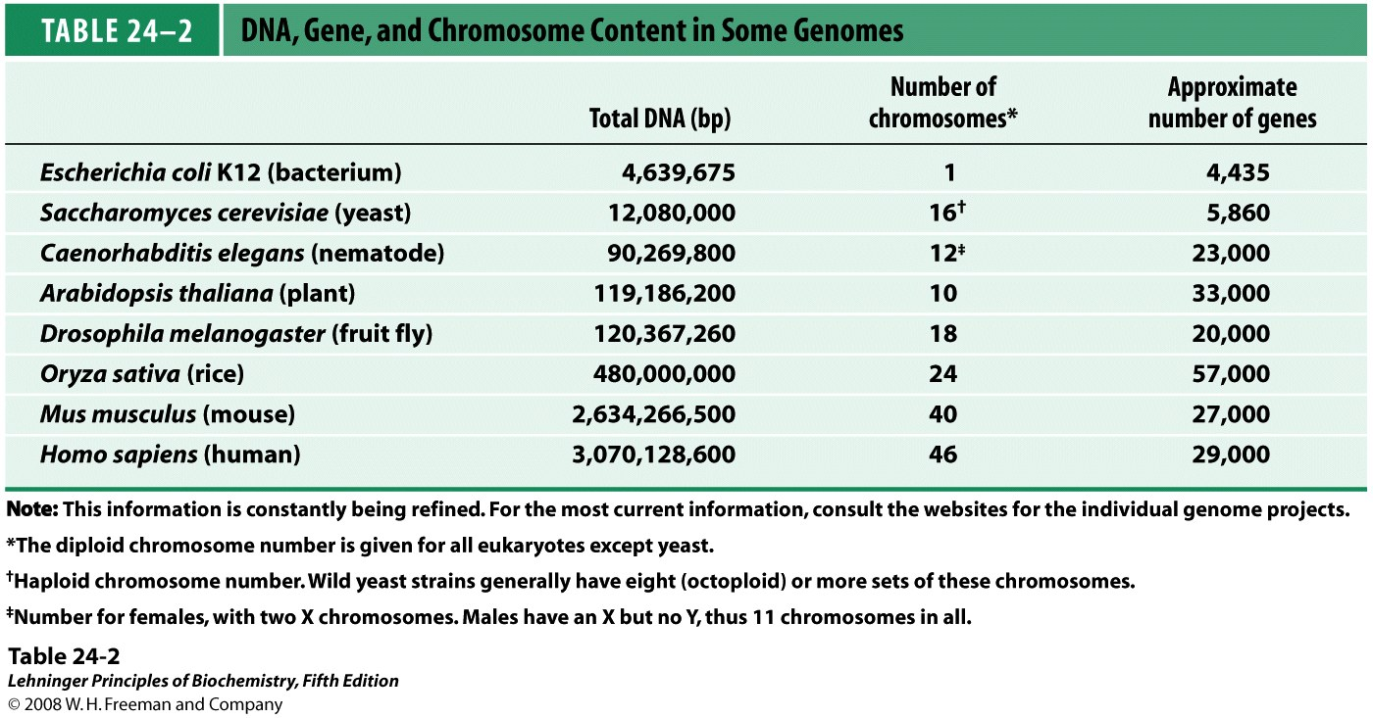
Notes:
TABLE 24-2 DNA, Gene, and Chromosome Content in Some Genomes

Slide 15
3. Bacteria chromosomes are relatively simple
Bacteria usually have only one chromosome per cell, and in nearly all cases, each chromosome contains only one copy of each gene, except a few genes, such as rRNAs.
Regulatory sequences and genes account for almost all of the DNA in prokaryotes, and almost every gene is precisely colinear with the amino acid sequence or RNA sequence.

Slide 16
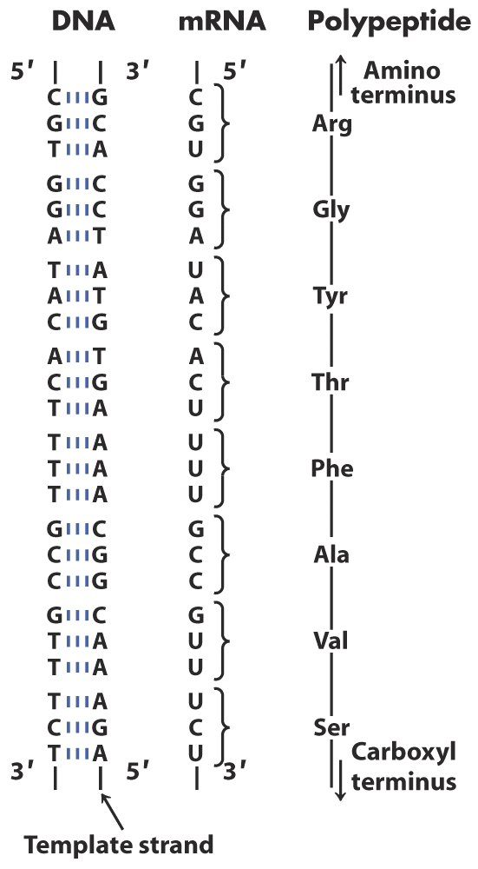
DNA RNA Polypeptide Colinearity

Slide 17
4. Eukaryotic genes are much more complex in structure and function
Some segments of DNA occur in multiple copies, and are called repeats. In the mouse genome, there are:
10% of the DNA contains less than 10 bps segments and is repeated millions of times. They are called highly repetitive sequences or simple-sequence DNA.
20% of the DNA has lengths of up to a few hundred bps and are repeated at least 1,000 times. They are called moderately repetitive sequences.

Slide 18
The remaining 70% consists of unique segments or those repeated only a few times. The unique sequences include most of the genes.
The simple-sequence DNA has also been called satellite DNA, so named because its unusual composition often causes it to migrate as “satellite” bands (separated from the rest of the DNA) when fragmented cellular DNA samples are centrifuged in cesium chloride density gradients.

Slide 19
Microsatellites, also called short tandem repeats (STRs), STR polymorphisms (STRPs), or short sequence length polymorphisms (SSLPs) , are repeat sequences usually consisting of two, three, or four nucleotides with various tandem copy numbers among different individuals. They are commonly used in genetic linkage analysis.
Studies suggest that simple-sequence DNA do not encode proteins or RNAs. Much of it is associated with centromeres and telomeres.

Slide 20
Centromere is the sequence that functions during cell division as an attachment point for proteins that link the chromosome to the mitotic spindle. This attachment is essential for the equal and orderly distribution of chromosome sets to daughter cells.

Slide 21
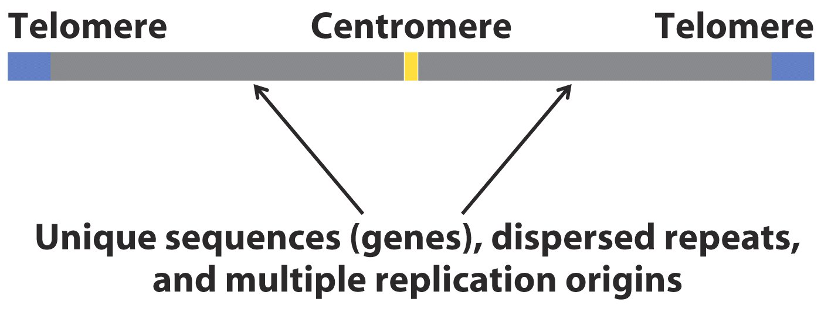
Important structural elements of a yeast chromosome

Slide 22
The sequences essential to yeast centromere function are about 130 bp long and are rich in A=T pairs. The sequences for higher eukaryotes are much longer and generally contain simple-sequence DNA, consisting of thousands of tandem copies of one or a few short sequences of 5 to 10 bp, in the same orientation. The precise role of simple-sequence in centromere function is not yet understood.

Slide 23
Telomeres are sequences at the ends of eukaryotic chromosomes that help to stabilize the chromosomes. Yeast telomeres end with about 100 bp of imprecisely repeated sequences of the form
(5’)(T_{x}G_{y})_{n}
(3’)(A_{x}C_{y})_{n} where x and y are generally between 1 and 4, and n is between 20 to 100 for single-celled eukaryotes and generally over 1,500 in mammals.

Slide 24
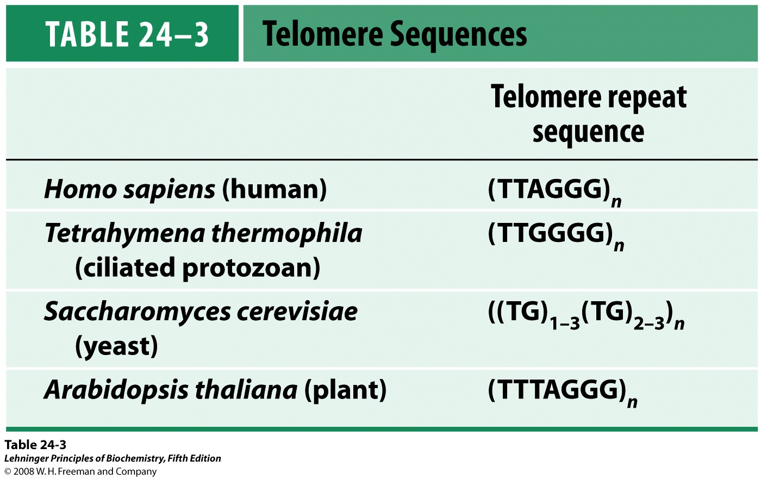
Notes:
TABLE 24-3 Telomere Sequences

Slide 25
Artificial chromosomes have been developed for biotechnology research. They are required to include three components: centromere, telomere, and DNA replication initiation site. Artificial chromosomes, such as YACs and HACs, allow large segments of foreign DNA to be included and propagated.

Slide 26
Intervening nontranslated sequences, or introns, are found in many eukaryotic genes
Introns do not code for the amino acid sequence of the polypeptide product, and interrupt the otherwise colinear relationship between DNA and polypeptide sequences. Those coding DNA segments are called exons.
Few prokaryotes contain introns.

Slide 27
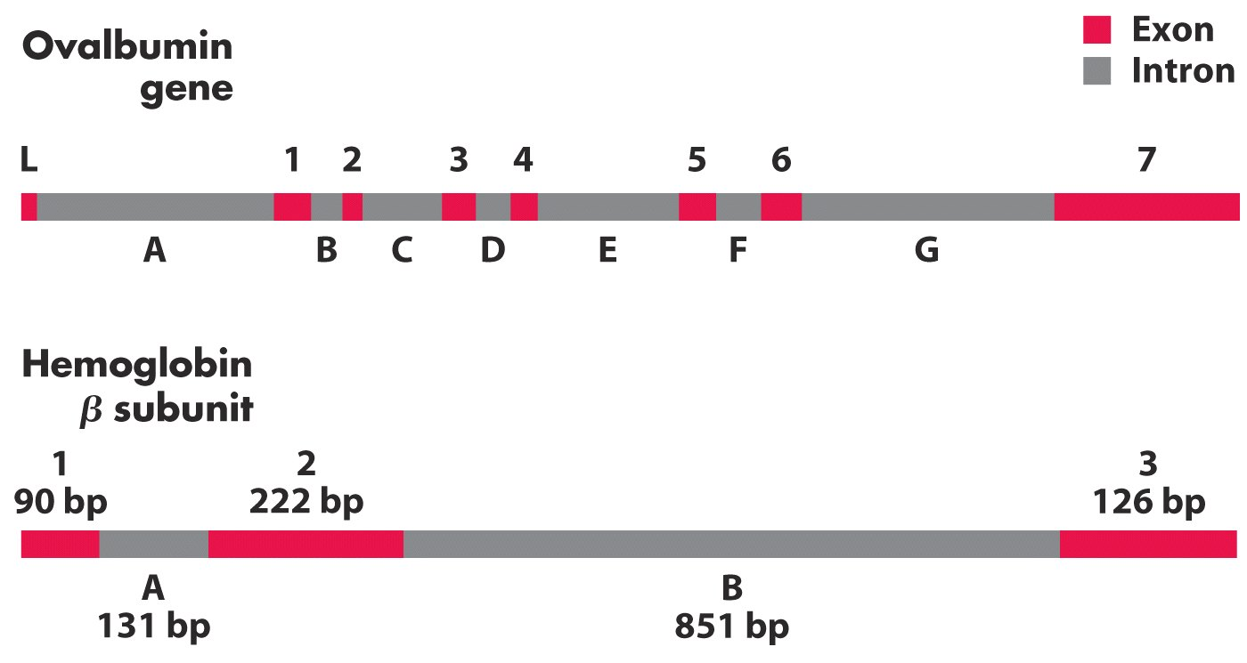
Introns in two eukaryotic genes

Slide 28
5. The size and sequence structures of DNA molecules are quite different for various organisms
Viral DNA molecules are relatively small.
Viruses use host cell’s resources and thus generally contain considerably less genetic information than cells.
Almost all plant viruses and some bacterial and animal viruses have RNA genomes, tending to be particularly small, e.g., HIV virus has a genome size of about 9,000 nucleotides.

Slide 29
The genomes of DNA viruses vary greatly in size. The contour length (helix length) of a DNA could be calculated from its length.

Slide 30
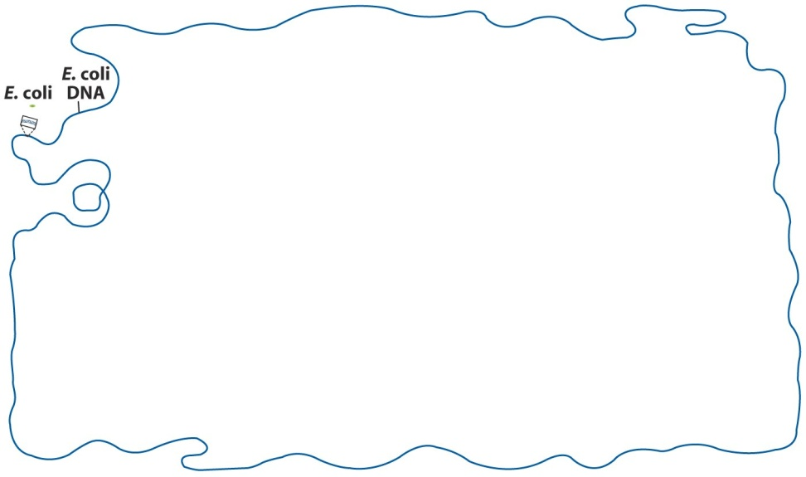
Bacteria contain chromosomes and extrachromosomal DNA
The contour length of E. coli chromosome (1.7 mm) is about 850 times the length of the E. coli cell (2 μm). Thus bacterial DNA must have a tightly compacted tertiary structure.

Slide 31
Many bacteria contain one or more small, circular DNA molecules that are free in cytosol, and they are called plasmids.
Most plasmids are only a few thousand bp long, but some contain over 100k bp.
Plasmids have been found in yeast and other fungi as well as in bacteria.
Plasmids carry genetic information and undergo replication to yield daughter plasmids, which pass into the daughter cells at cell division.

Slide 32
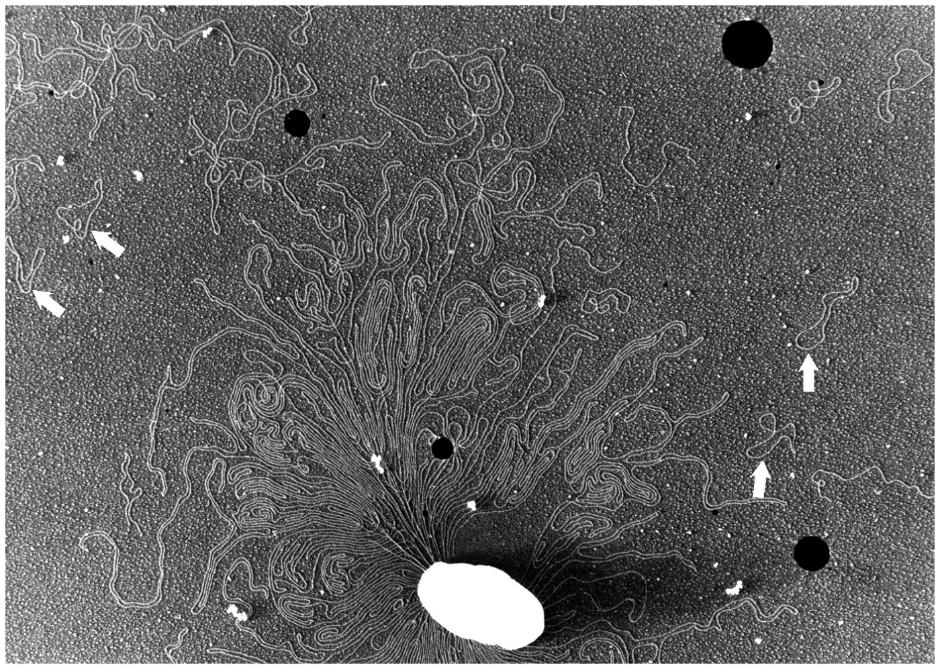
DNA from a lysed E. coli cell

Slide 33
In many cases plasmids confer no obvious advantage on their host, and solely target for self-propagation. However, some plasmids carry genes that make a host bacterium resistant to antibacterial agents.
Some plasmids could be temporarily incorporated into the chromosomal DNA, later to be excised in a precise manner by means of specialized recombination processes.
Plasmids are quite easily isolated intact from bacteria and yeast cells, and are the central component of the modern technologies used to isolate, clone, and artificially modify genes.

Slide 34
Eukaryotic cells contain more DNA than prokaryotic cells
Human and many other mammals have about 600 times as much DNA as E. coli.
Eukaryotic genome contains a greater proportion of apparently noncoding DNA. There are roughly 50 genes per millimeter of human DNA, compared with over 2,500 genes per millimeter of E. coli DNA.
Less than one-third of human genomic DNA consists of genes. Much of the remainder consists of repeated sequences of various types.

Slide 35
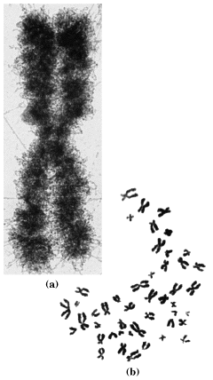
Microscopic observation of nuclei in dividing eukaryotic cells has shown that the genetic material is subdivided into chromosomes, with diploid number depending upon the species.
Human chromosomes

Slide 36
Organelles of eukaryotic cells, including mitochondria and chloroplasts, also contain DNA
Mitochondrial DNA codes for the mitochondrial tRNAs and rRNAs and for a few mitochondrial proteins. More than 95% of the mitochondrial proteins are coded by nuclear DNA.

Slide 37
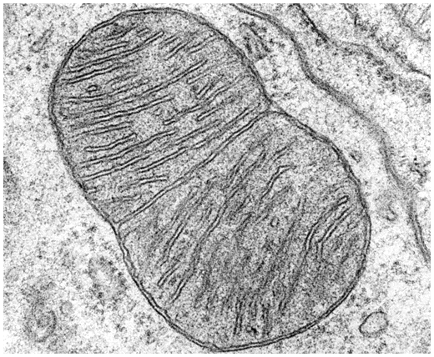
A dividing mitochondrion

Slide 38
6. DNA supercoiling
Cellular DNA is highly compacted. But the folding mechanism must permit access to the information in the DNA.
An intrinsic property of DNA tertiary structure
The study of supercoiling benefits greatly from a branch of mathematics called topology, the study of the properties of an object that do not change under continuous deformations.
For DNA, continuous deformations would include conformational changes due to thermal motion or an interaction with proteins or other molecules. Discontinuous deformations involve DNA stand breakage.

Slide 39
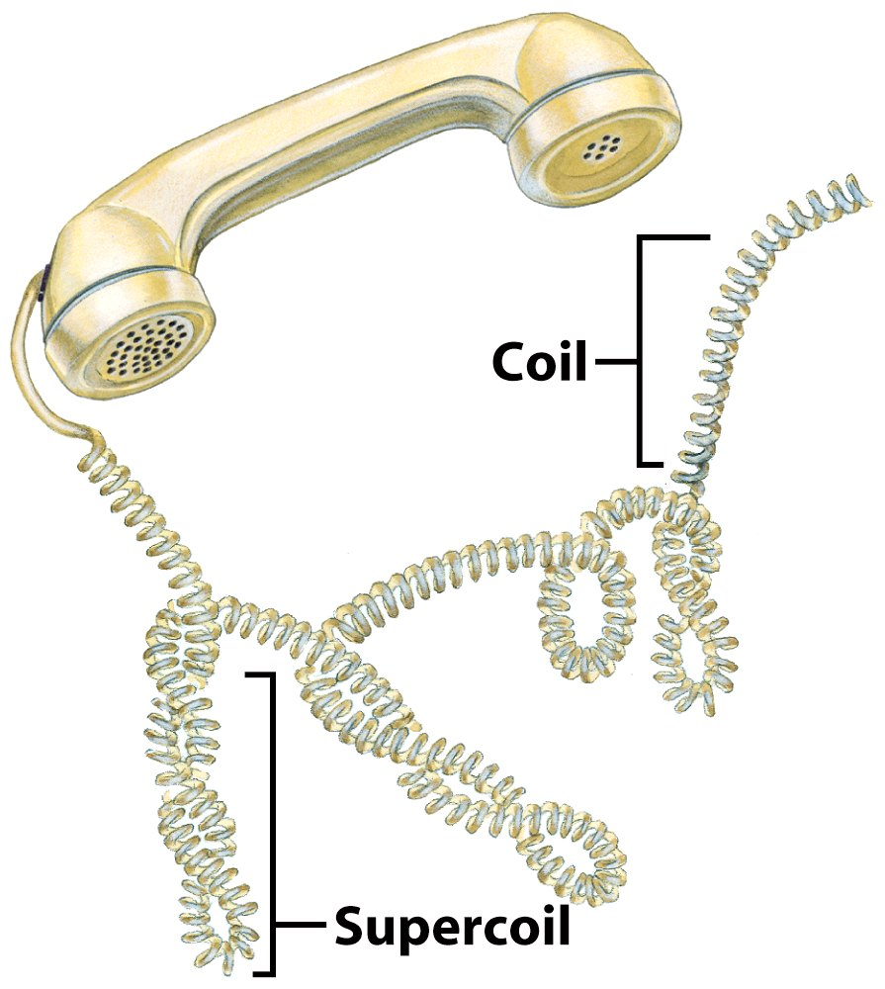
Supercoils

Slide 40
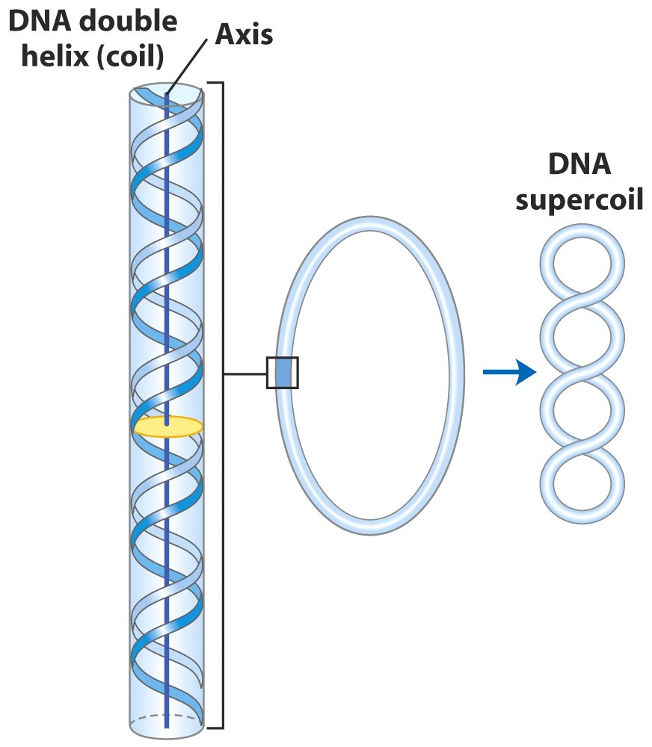
DNA supercoiling

Slide 41
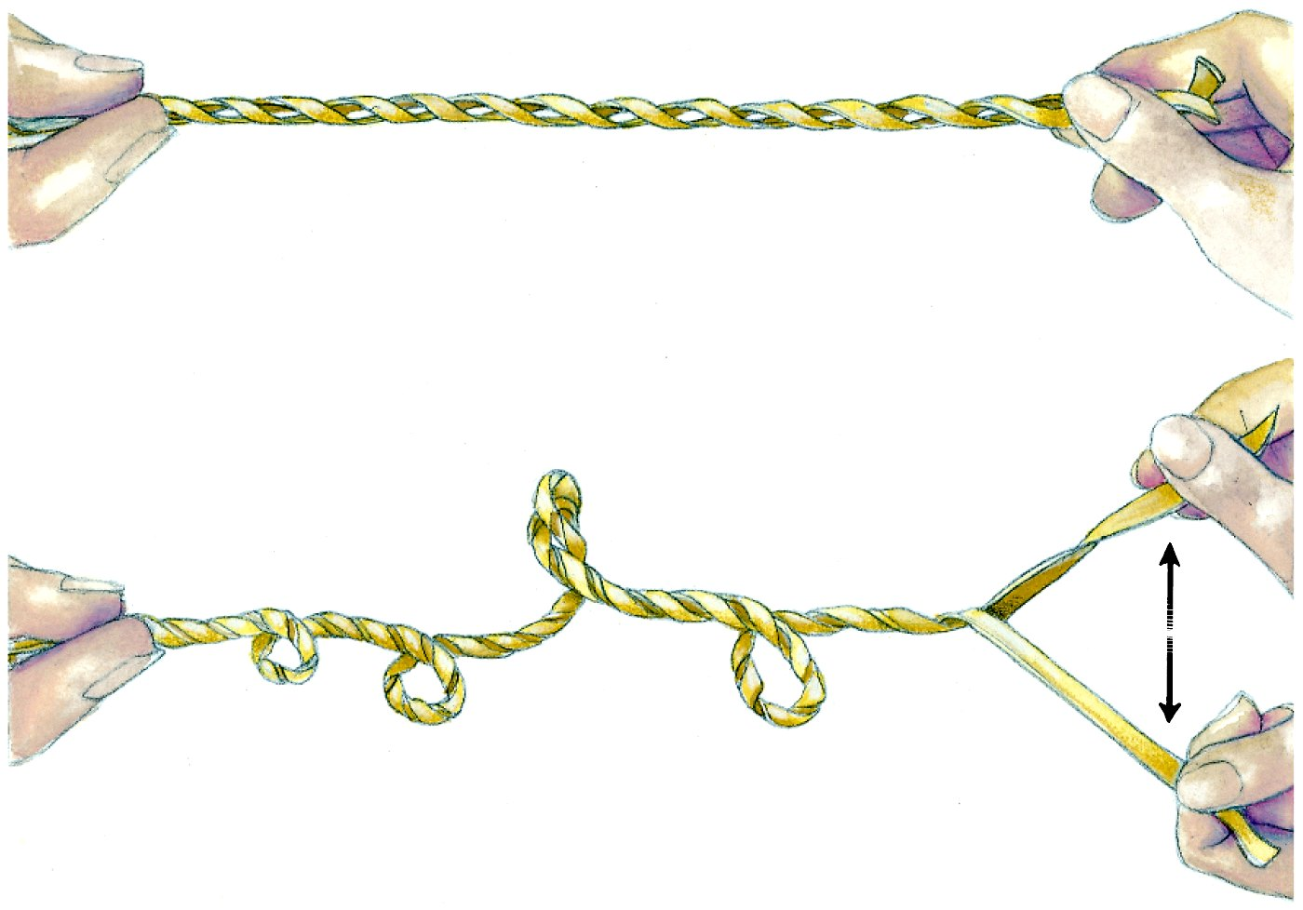
Supercoiling could be introduced by separating the strands of a helical structure.

Slide 42
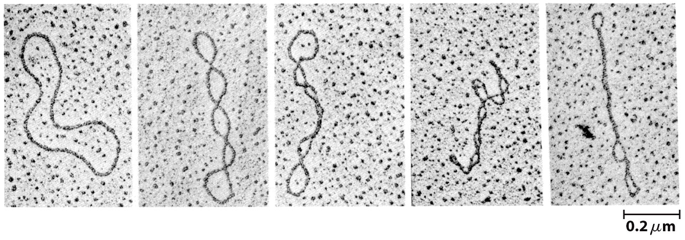
Relaxed
supercoiled
Relaxed and supercoiled plasmid DNAs

Slide 43
Most cellular DNA is underwound
Underwinding: the DNA has fewer helical turns than would be expected for the B-form structure.
Every cell actively underwinds its DNA with the aid of enzymatic process.
DNA underwinding is defined by topological linking number.
The linking number, Lk, can be defined as the number of times the second strand pierces the surface of the first strand.

Slide 44
Linking number describes supercoiling
In circular DNA, changing the helical turns requires breaking a strand transiently.
Linking number in relaxed DNA:
  Lk = #bp ÷ #bp/turn
  Example: Relaxed circular dsDNA of 2100 bp in the B form (10.5 bp/turn) has
  Lk = 2100 bp ÷ 10.5/turn = 200
  Lk is an integer for closed-circular DNA and is (+), reflecting a right-handed helix.

Slide 45
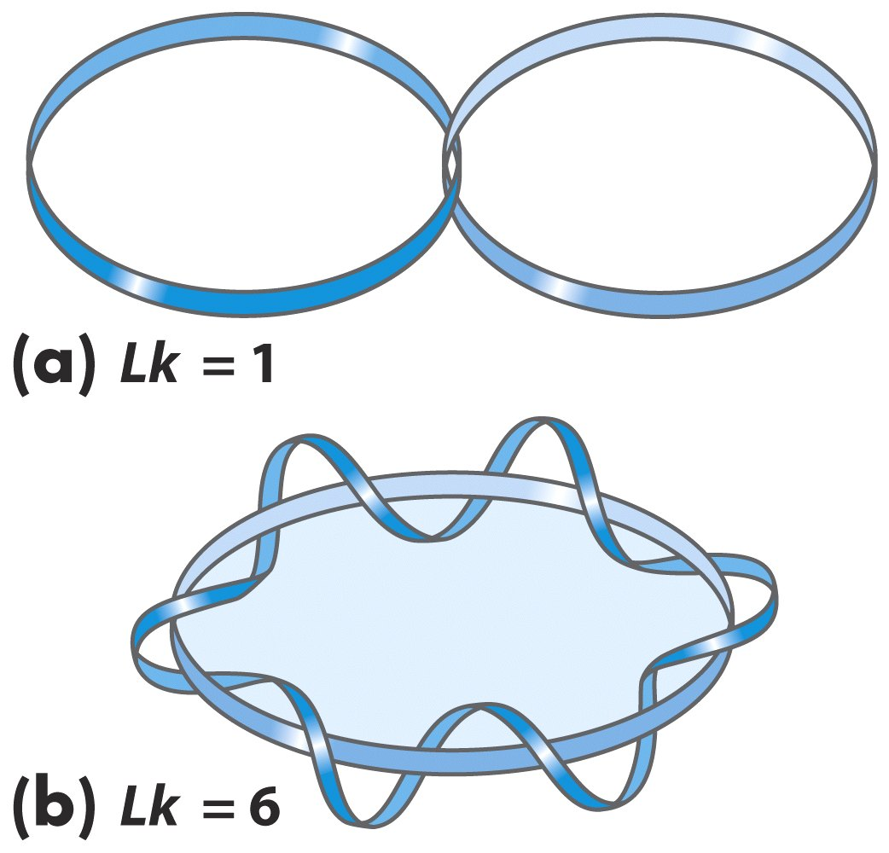
Linking number, Lk

Slide 46
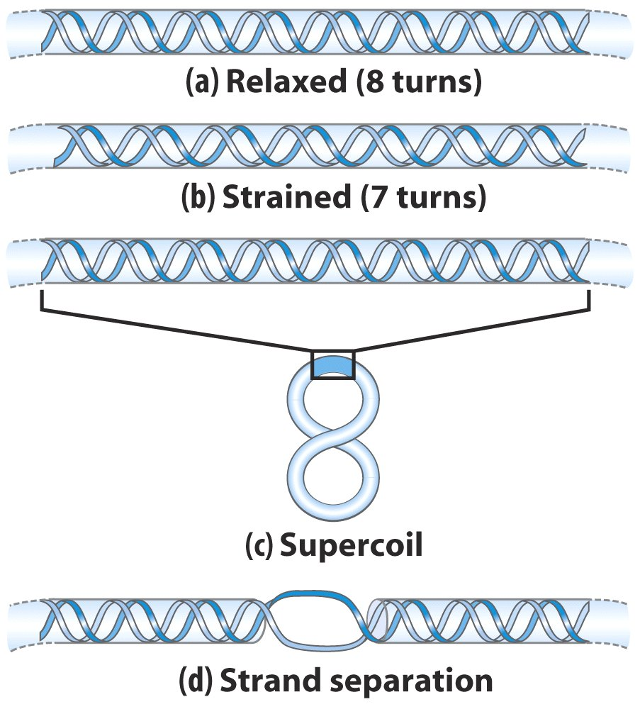
Effects of DNA underwinding

Slide 47
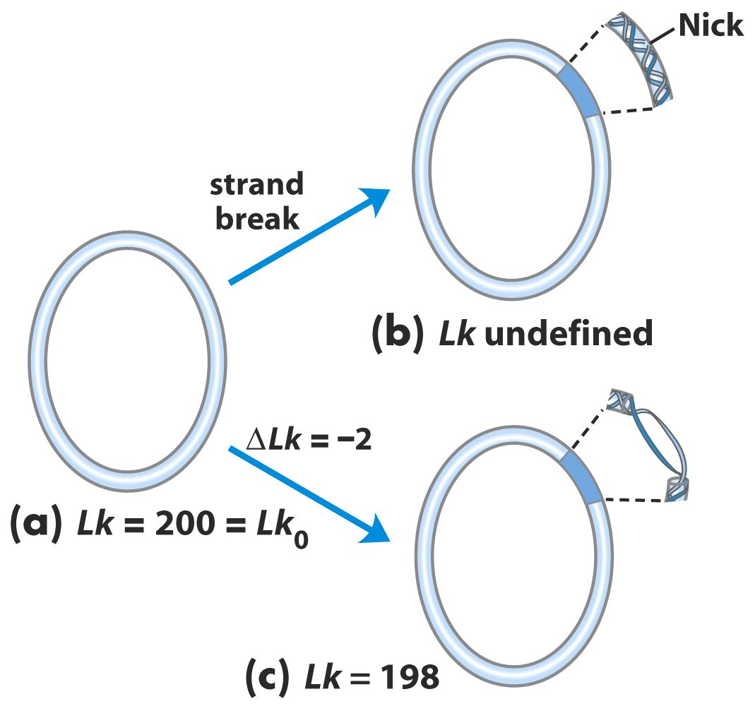
Nicked
Relaxed
A closed-circular
DNA with 2,100
base pairs
Underwound

Slide 48
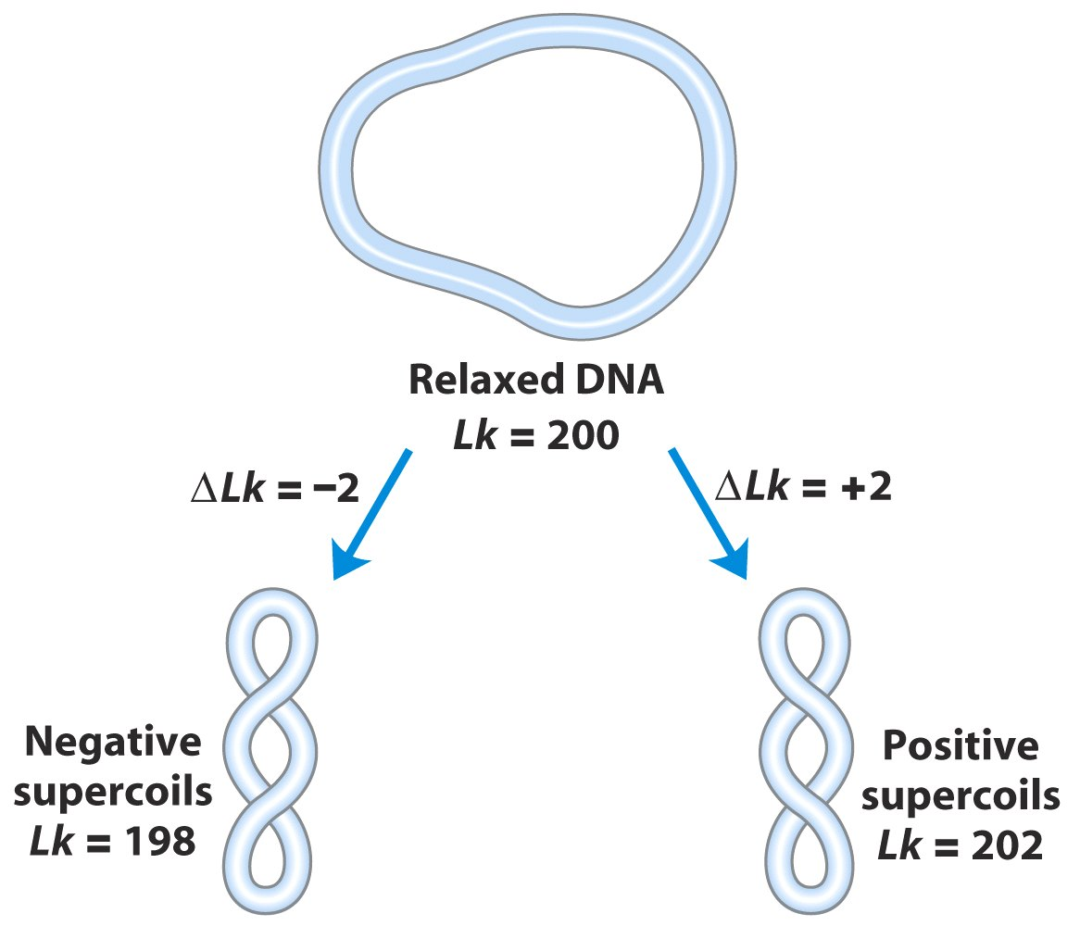
Supercoiling induced by underwinding is defined as negative supercoiling. Conversely, under some conditions DNA can be overwound, resulting in positive supercoiling.

Slide 49
Topoisomerases catalyze changes in the linking number of DNA
DNA supercoiling is a precisely regulated process.
Every cell has enzymes solely functioning to underwind and/or relax DNA.
Enzymes that increase or decrease the extent of DNA underwinding are called topoisomerases.
Topoisomerases change linking number.
Two major types:
  Type I: make a transient cut in one DNA strand, changing Lk by 1
  Type II: make a transient cut in both DNA strands, changing Lk by 2

Slide 50
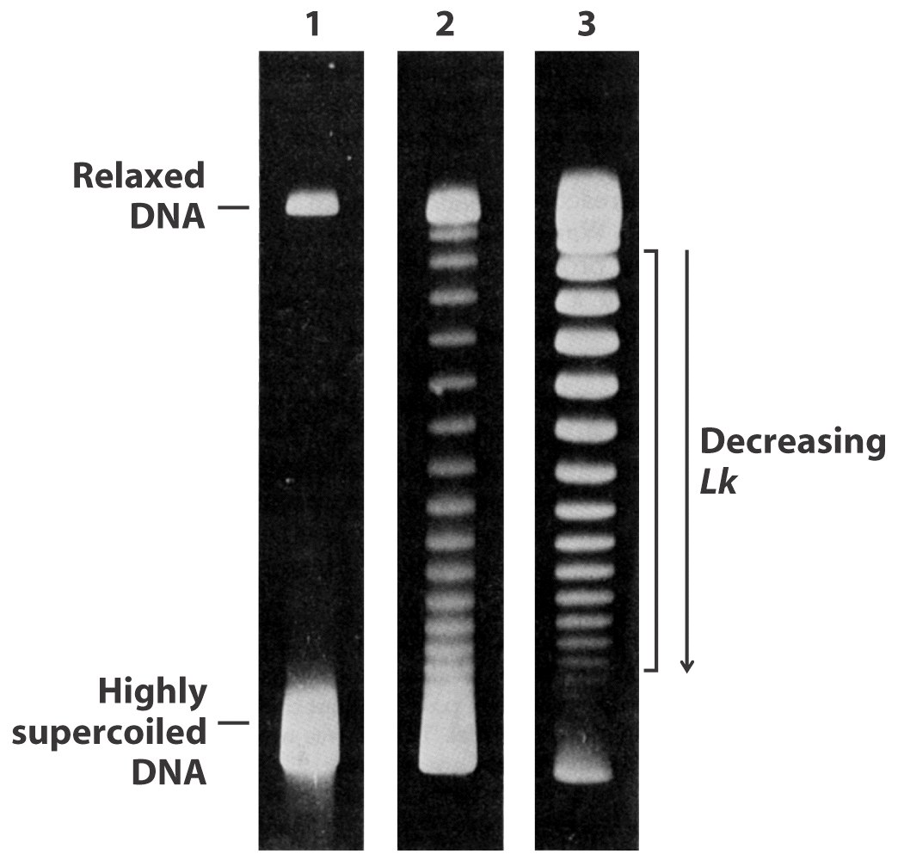
Topoisomers are
DNAs that differ
only in
linking number
Visualization of topoisomers

Slide 51
The topoisomerases I–IV of E. Coli
Topo I and III are Type I.
  remove negative supercoils to relax DNA
  increase Lk
  use single-stranded breaks
Topo II is called DNA gyrase.
  introduces negative supercoils
  decreases Lk
  uses ATP and double-stranded breaks

Slide 52
TABLE 24-4 |  | Diversity in DNA Topoisomerases
Type | Mechanism |  | Family (defined by structural class) | Domain(s) | Notes
IA | Strand passageª |  | Topoisomerase I Topoisomerase III Reverse gyrase | Bacteria, eukaryotes Bacteria, eukaryotes Archaea, bacteria | Relaxes (–) Relaxes (–) Uses ATP to introduce positive supercoils; thermophilic bacteria and archaea only
IB | Swivelase^{b} |  | Topoisomerase IB | Bacteria, eukaryotes | A few bacteria; all eukaryotes
IC | Swivelase |  | Topoisomerase V | Archaea | Methanopyrus only
IIA | Strand passage^{c} |  | Topoisomerase II (DNA gyrase) Topoisomerase IIα Topoisomerase IIβ Topoisomerase IV | Archaea, bacteria Eukaryotes Eukaryotes Bacteria | Introduces negative supercoils (ATPase) Relaxes (+ or –) Relaxes (+ or –) Decatenase^{d}
IIB | Strand passage |  | Topoisomerase VI | Archaea, bacteria, eukaryotes | Among eukaryotes, plants, algae, and protists only
ªSee Figure 24-19. ^{b}A nick is made in one strand, and the other strand is allowed to rotate to relieve topological strain. ^{c}See Figure 24-20a. ^{d}See Figure 24-20b.
Notes:
Table 24-4 Diversity in DNA Topoisomerases

Slide 53
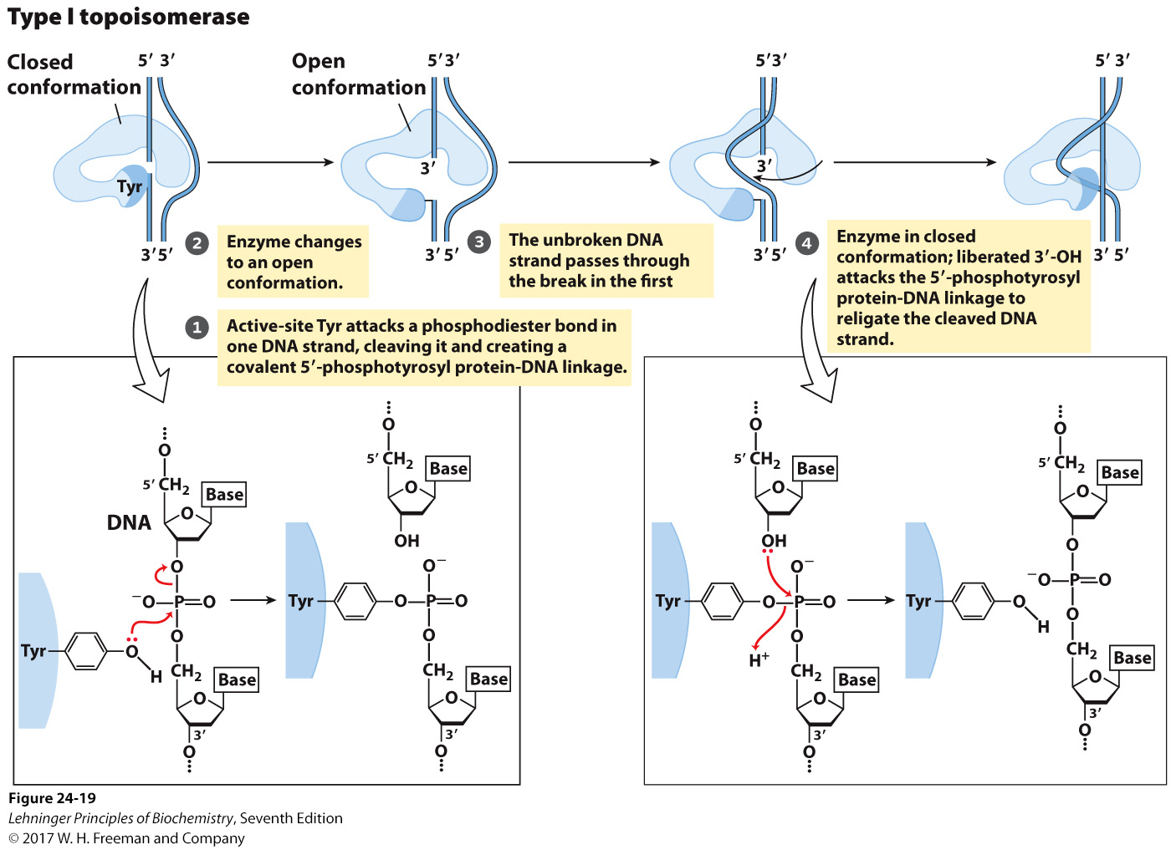
The type I topoisomerase reaction
Notes:
MECHANISM FIGURE 24–19 step 3,4 The type I topoisomerase reaction. Bacterial topoisomerase I increases Lk by breaking one DNA strand, passing the unbroken strand through the break, then resealing the break. Nucleophilic attack by the active-site Tyr residue breaks one DNA strand. The ends are ligated by a second nucleophilic attack. At each step, one high-energy bond replaces another.

Slide 54
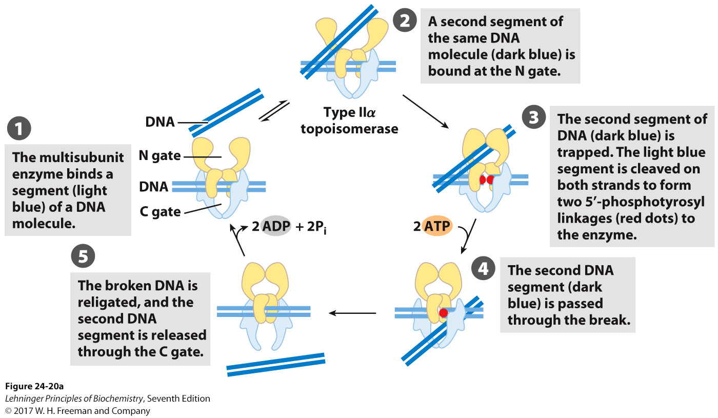
Alteration of the linking number by a eukaryotic type IIα topoisomerase
Notes:
FIGURE 24–20 Alteration of the linking number by a eukaryotic type IIα topoisomerase. The general mechanism features the passage of one intact duplex DNA segment through a transient double-strand break in another segment. The DNA segment enters and leaves the topoisomerase through gated cavities above and below the bound DNA, which are called the N gate and the C gate. Two ATPs are bound and hydrolyzed during this cycle. The enzyme structure and use of ATP are specific to this reaction.

Slide 55
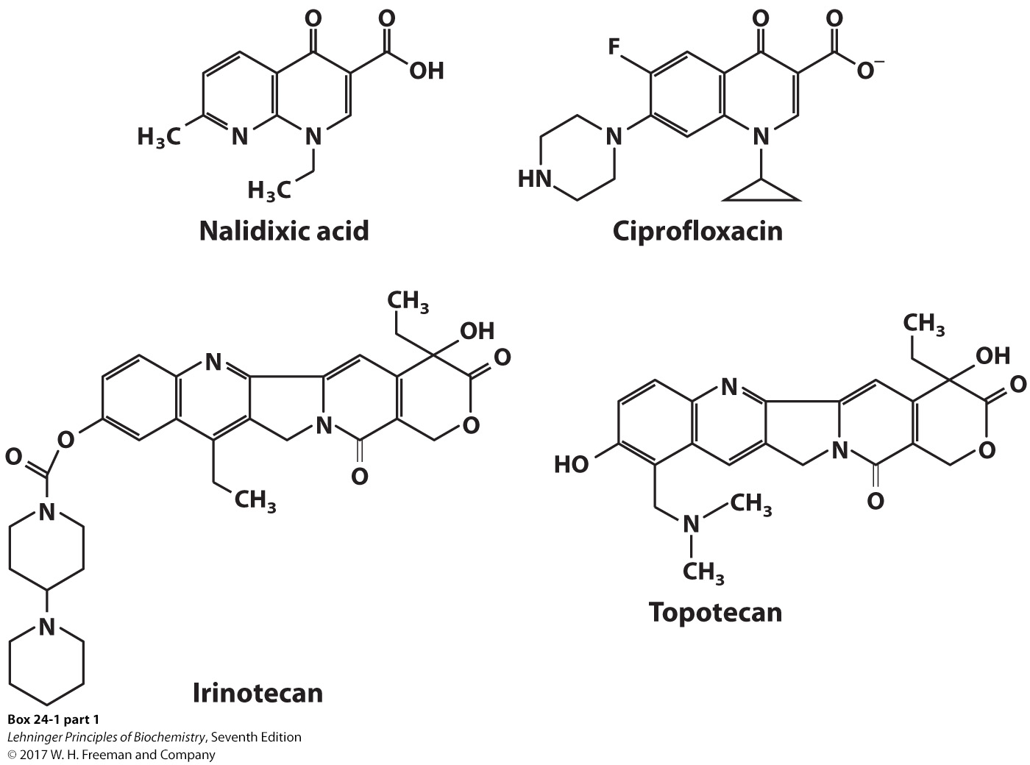
Topoisomerase inhibitors used as antibiotics
Notes:
BOX 24-1 FIGURE 1 part 1

Slide 56
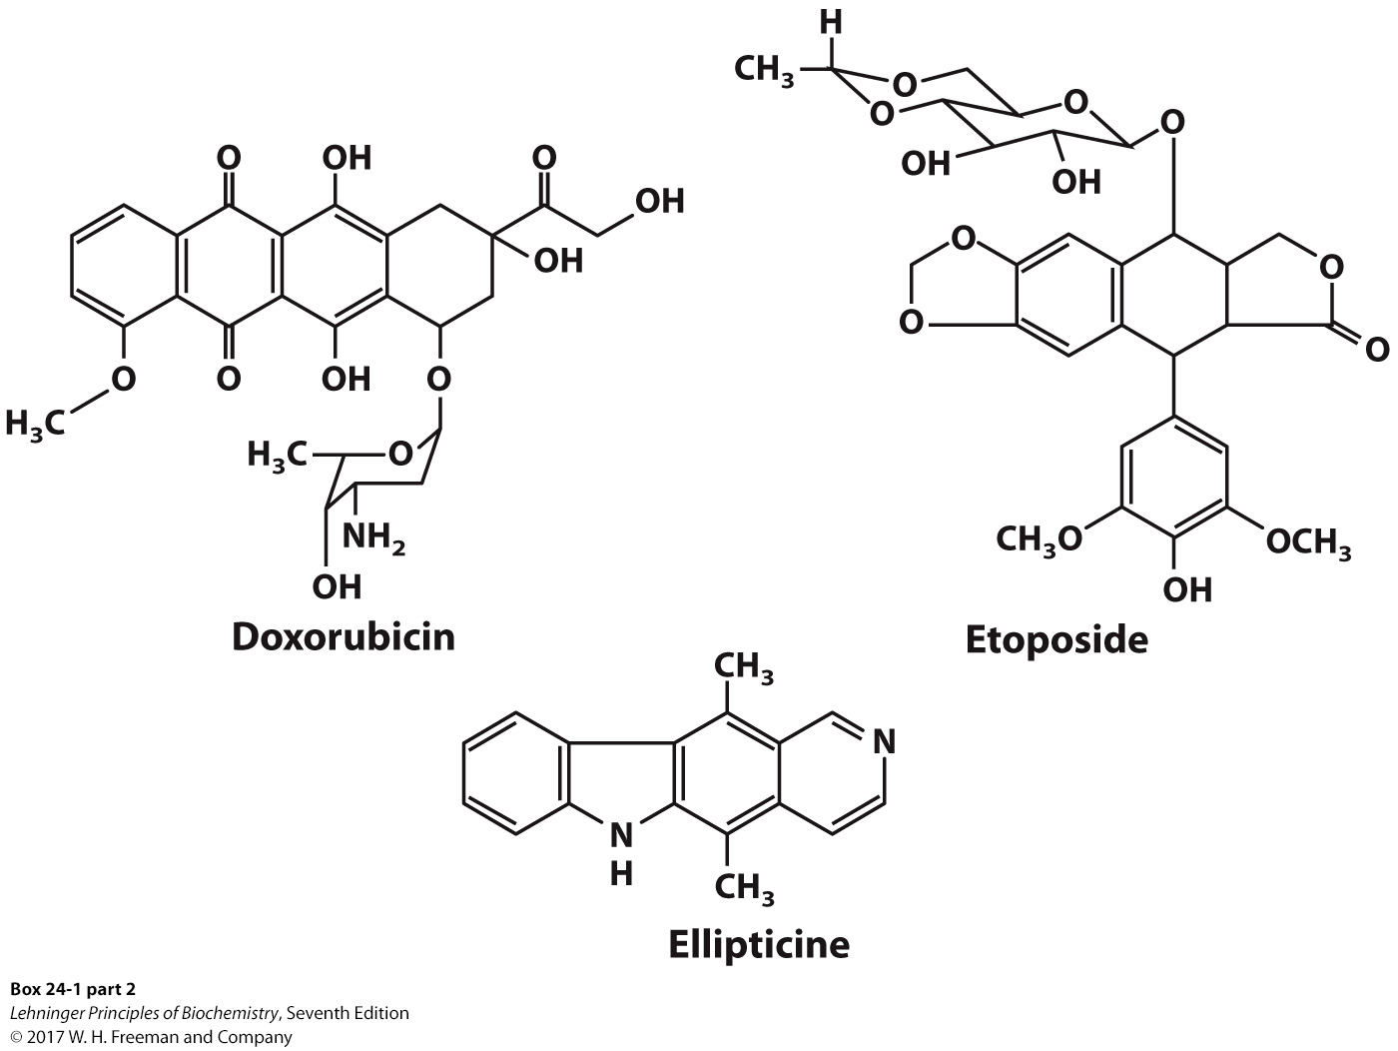
Topoisomerase inhibitors used as chemotherapy drugs
Notes:
BOX 24-1 FIGURE 1 part 2

Slide 57
7. Chromatin and nucleoid structure
In non-dividing eukaryotic cells, the chromosomal material, called chromatin, is amorphous and appears to be randomly dispersed throughout the nucleus. When the cells prepare to divide, the chromatin condenses and assembles itself into a species-specific number of well-defined chromosomes.

Slide 58
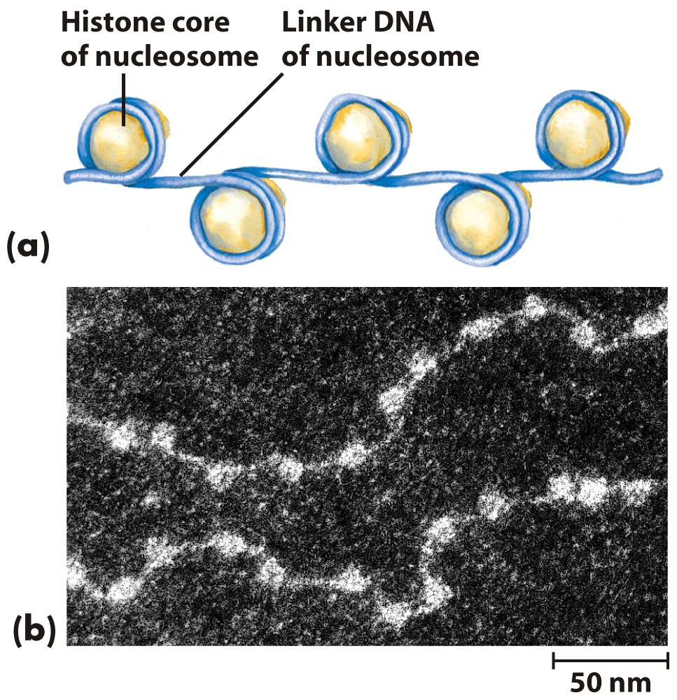
The DNA in chromatin is very tightly associated with proteins called histones, which package and order the DNA into structural units called nucleosomes.

Slide 59
Histones are small, basic proteins
MW between 11,000 and 21,000
Rich in positively charged amino acids, arginine and lysine
Four different kinds of histones (H1-H4)
H3 and H4 are nearly identical in amino acid sequence in all eukaryotes.

Slide 60
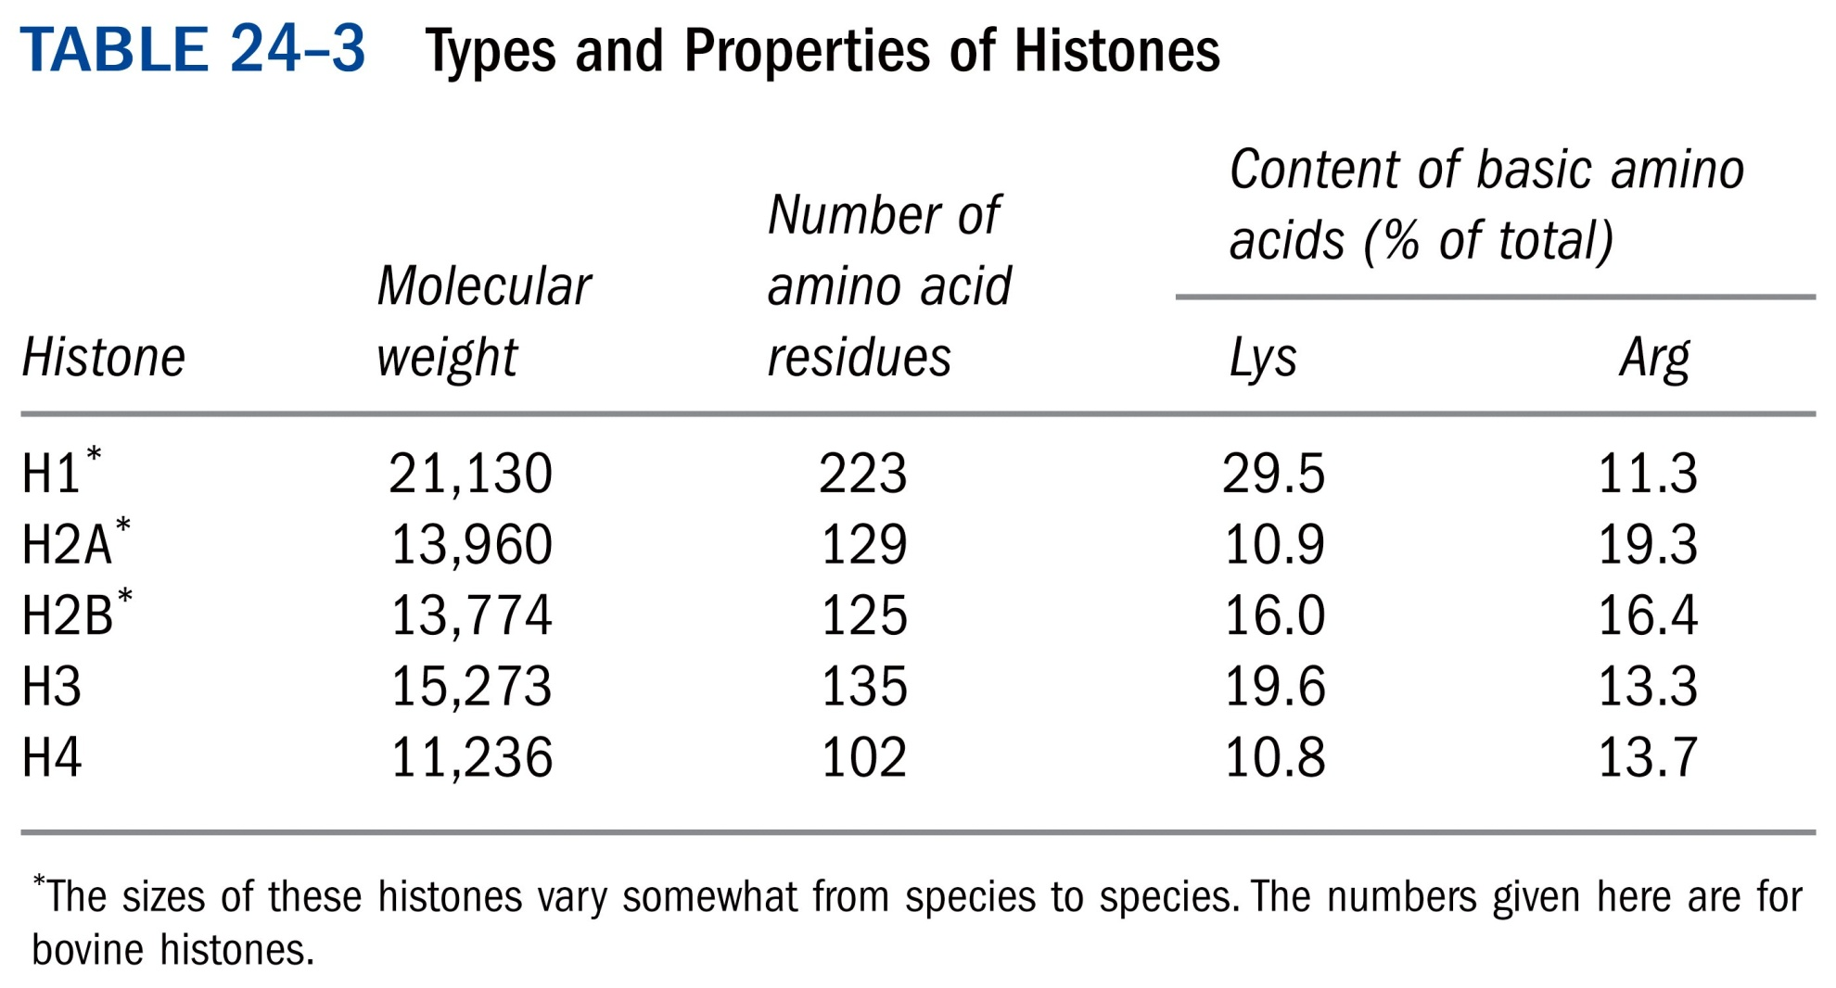

Slide 61
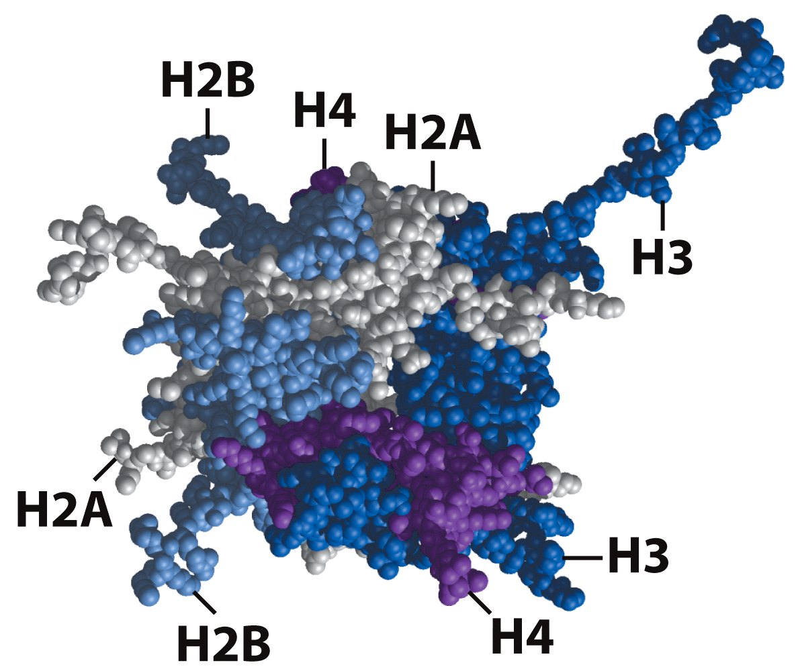
DNA wrapped around a nucleosome core

Slide 62
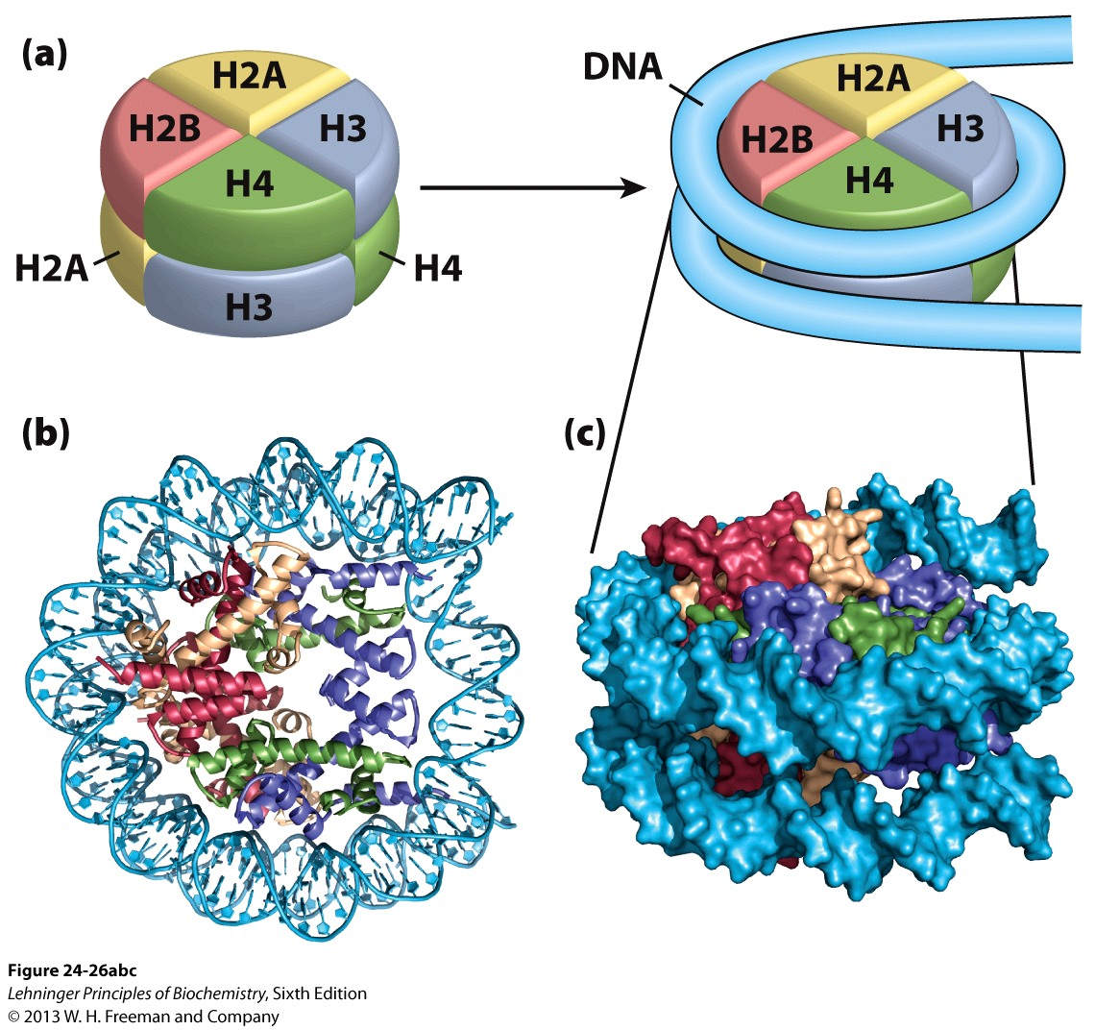
DNA wrapped around a nucleosome core

Slide 63
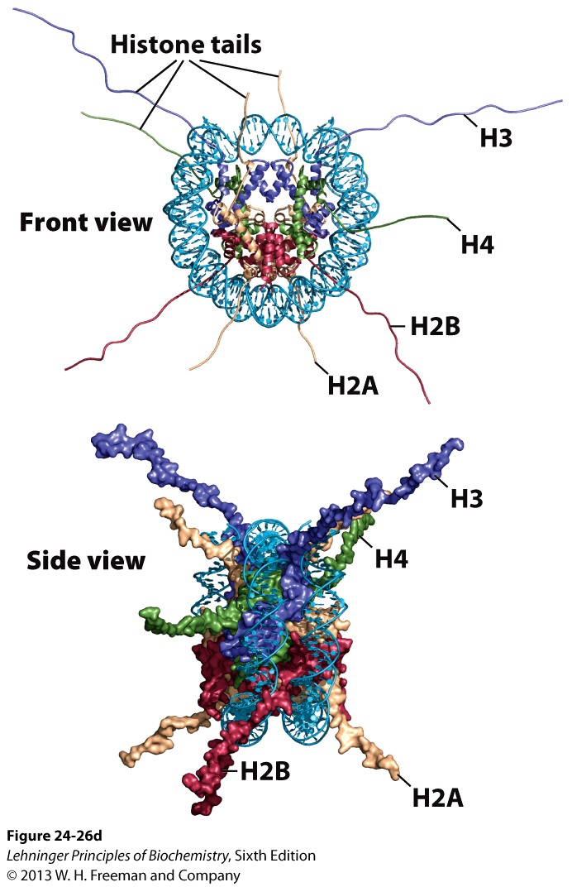
DNA wrapped around a nucleosome core

Slide 64
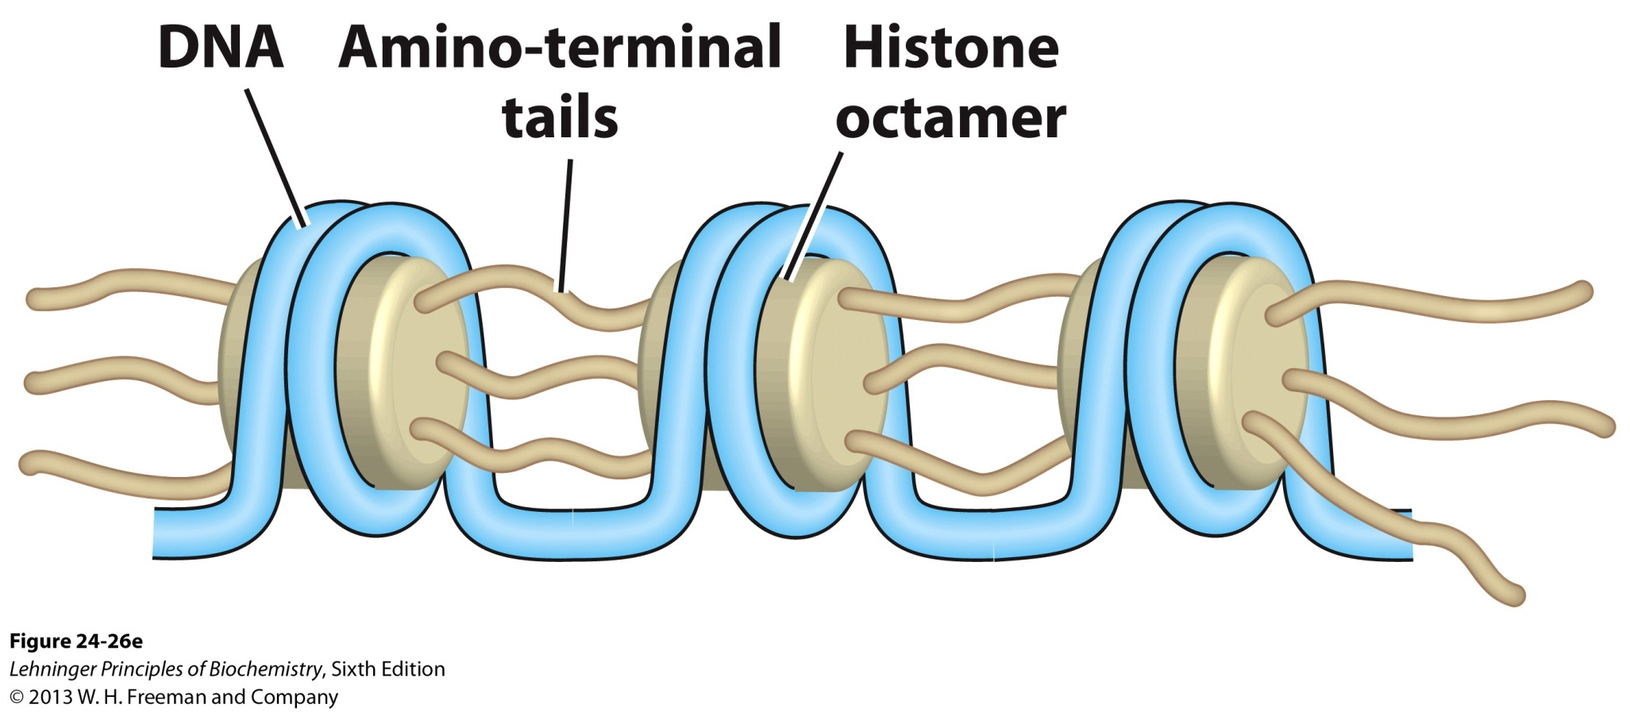
The amino-terminal tails of one nucleosome extrude from the particle and interact with adjacent nucleosomes, helping to define higher-order DNA packaging.

Slide 65
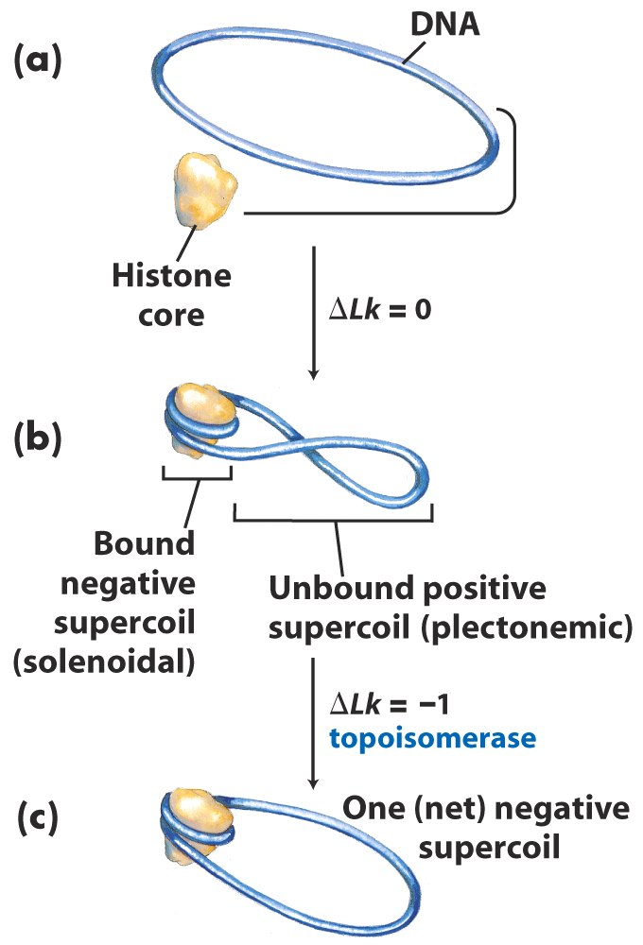
Nucleosomes are packed into successively higher-order structures
Chromatin assembly

Slide 66
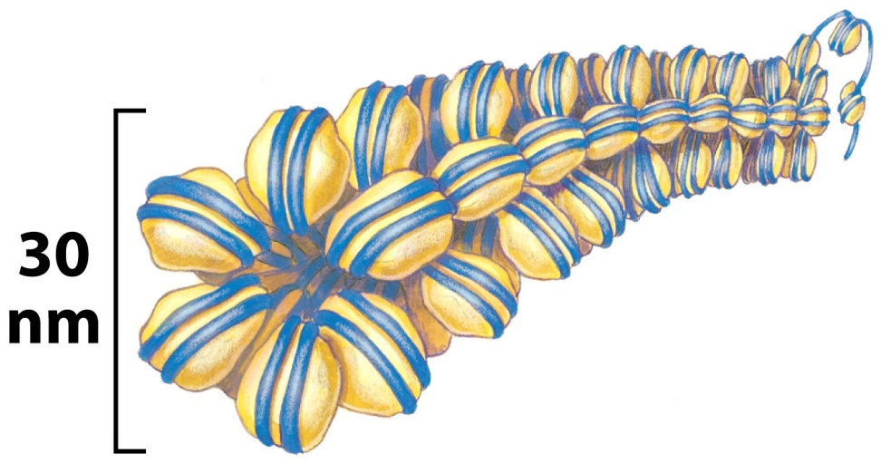
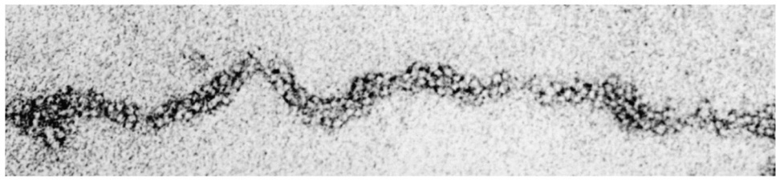
Nucleosomes appear to be organized into a structure called the 30 nm fiber, which provides an approximately 100-fold compaction of the DNA.

Slide 67
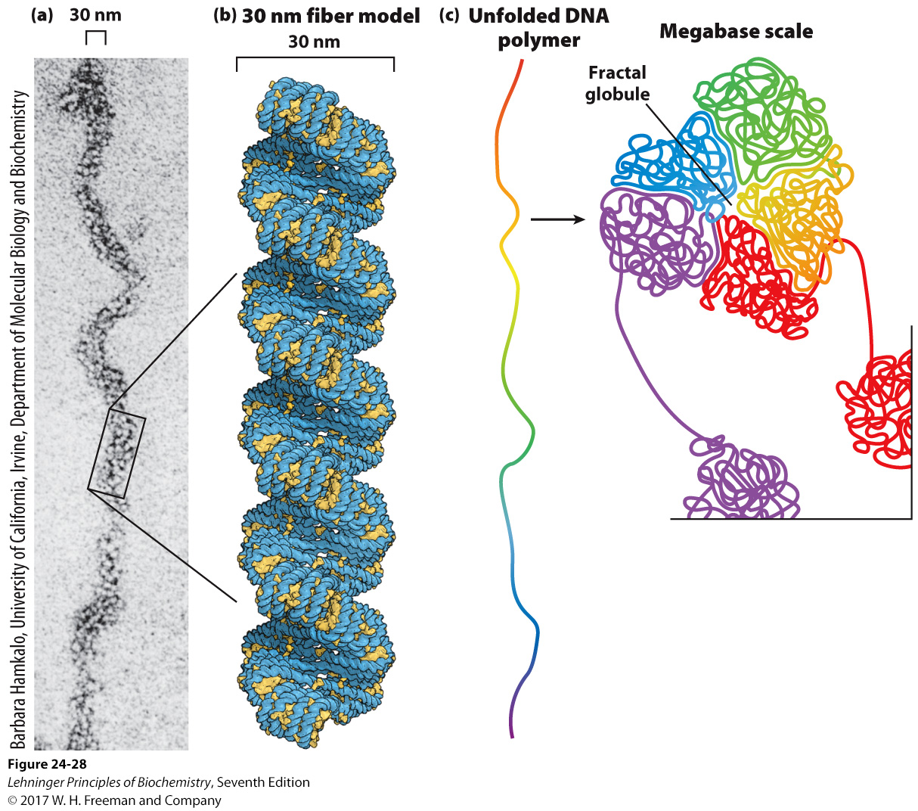
Higher-order organization of nucleosomes
Notes:
FIGURE 24–28 Higher-order organization of nucleosomes. The compact fiber is formed by the tight packing of nucleosomes. (a) The 30 nm fiber, as seen by electron microscopy. (b) A model for nucleosome organization within a 30 nm fiber. Two 10 nm fibers are coiled around each other, with nucleosomes stacked in each. DNA is blue; nucleosomes are yellow. (c) A crumpled globule folding arrangement of 10 nm fibers in a condensed chromosome. The folding appears to be random, but nearby chromosomal segments remain associated and the folding occurs so as to minimize the formation of knots.

Slide 68
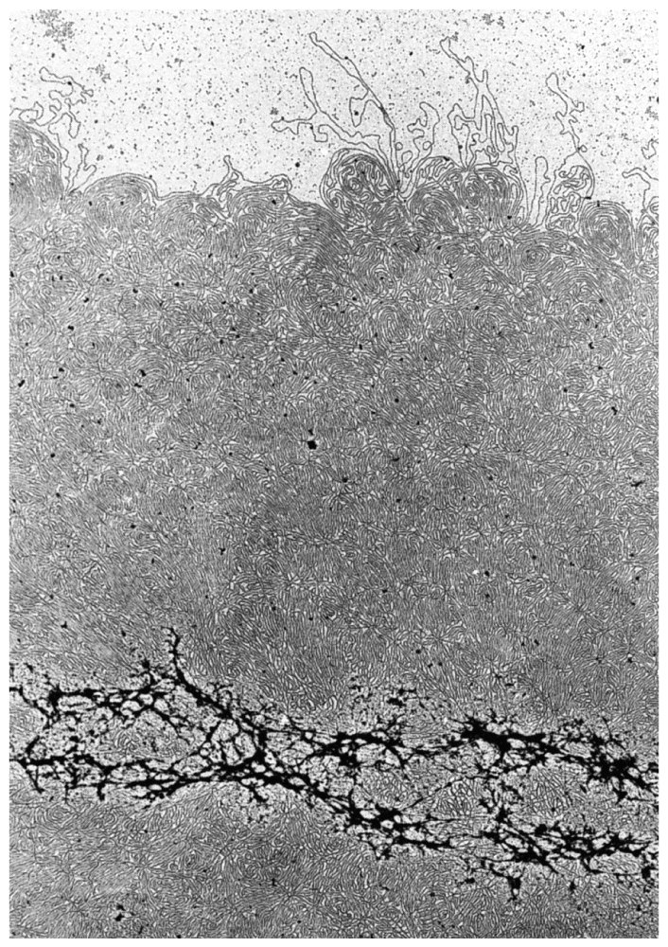
The next levels of compaction are not yet understood, but it appears that certain regions of DNA associate with a nuclear scaffold. The scaffold-associated regions are separated by loops of DNA with perhaps 20,000 to 100,000 bps.

Slide 69
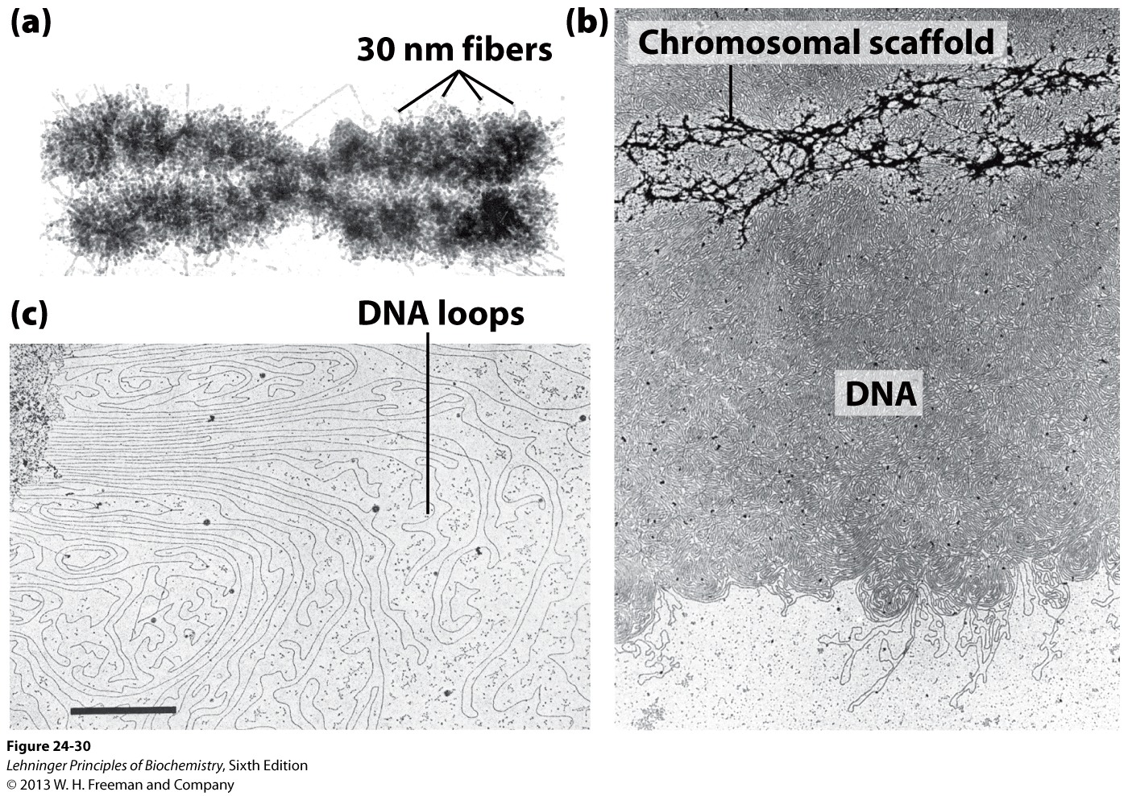
Loops of DNA attached to a chromosomal scaffold

Slide 70
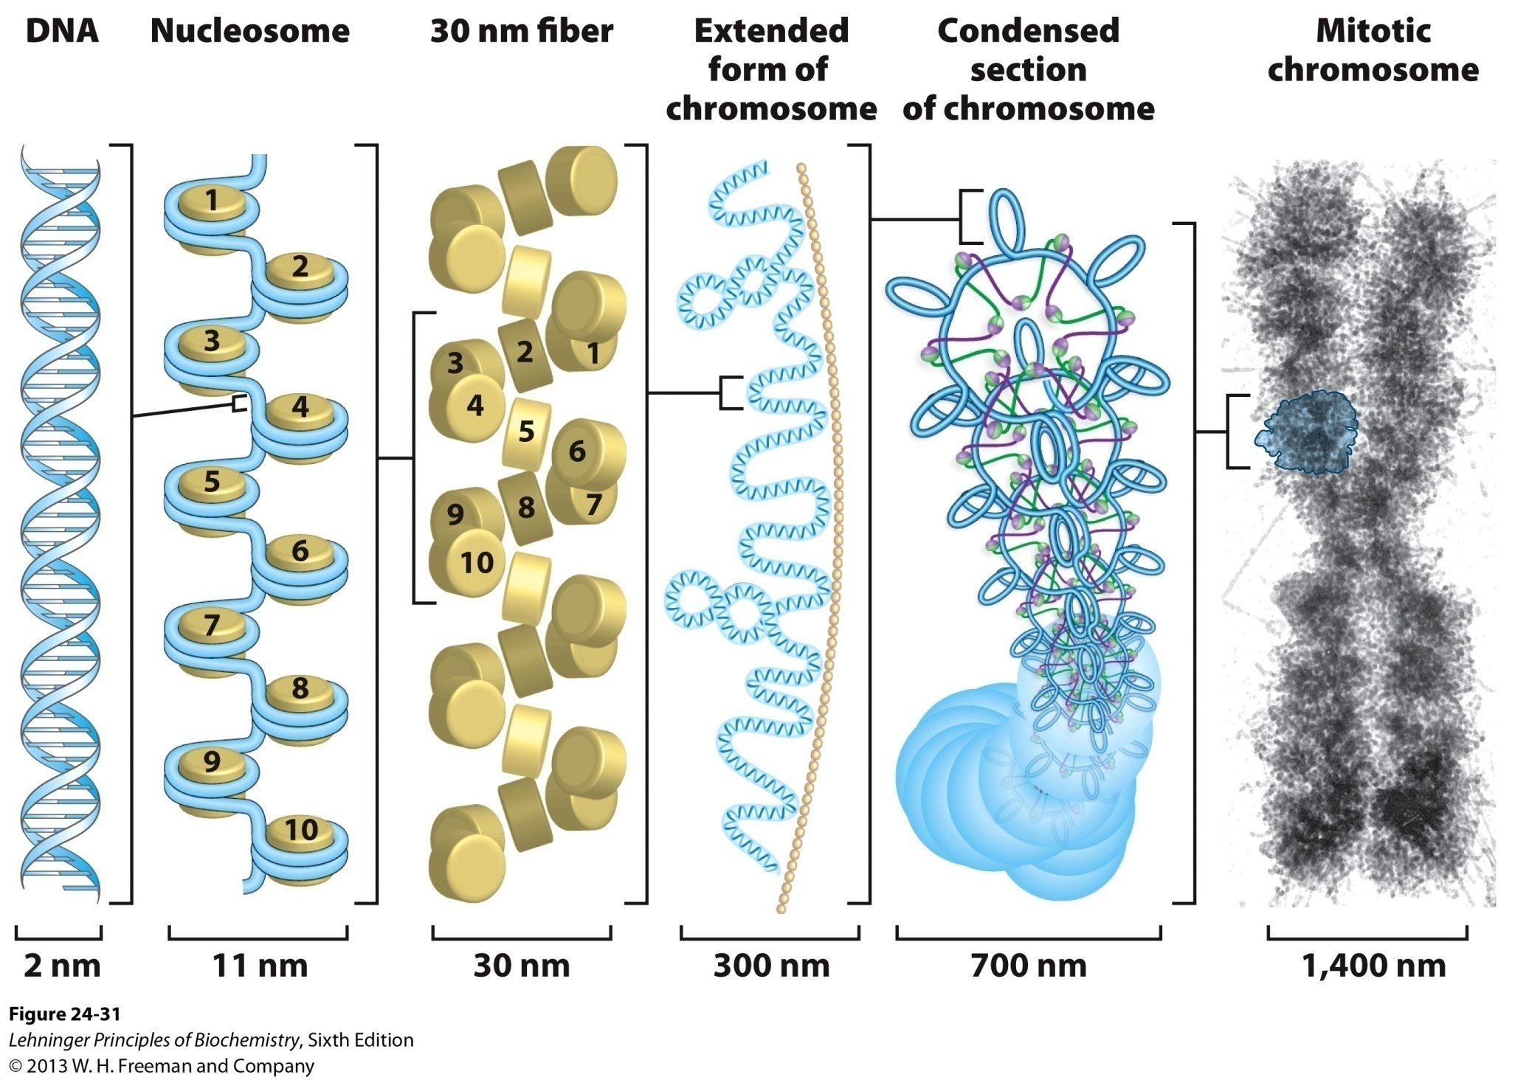
Compaction of DNA in a eukaryotic chromosome

Slide 71
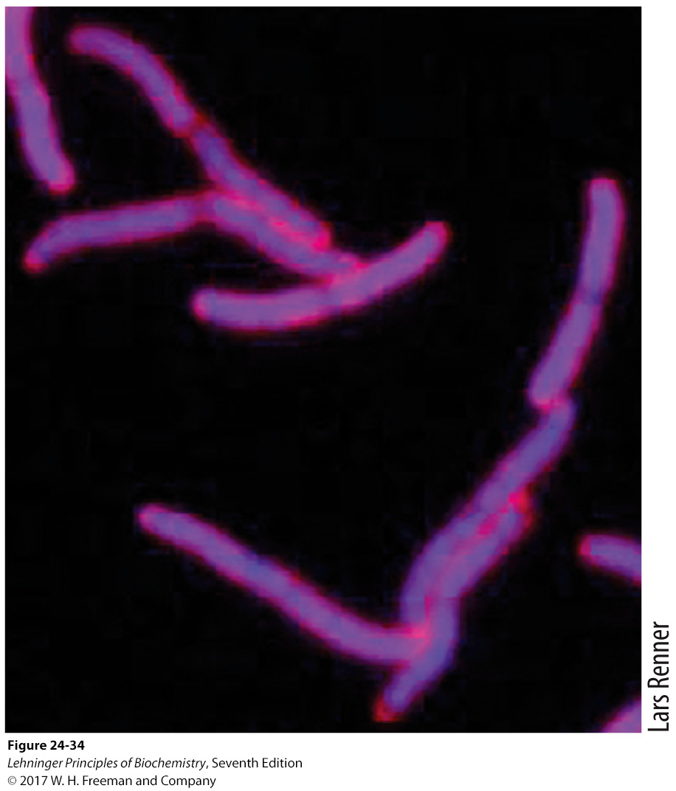
Bacterial DNA is also highly organized.
nucleoid

Slide 72
Bacterial DNA is compacted in a structure called the nucleoid, which occupies a large fraction of the cell volume.
Appears to be attached at one or more points to the inner surface of the plasma membrane.
In E. coli, a scaffold-like structure appears to organize the circular chromosome into a series of looped domains, similar to chromatin.
Histone-like proteins are abundant in nucleoids, but these proteins bind and dissociate within minutes, with no regular, stable structure found yet.

Slide 73
Keywords
Gene
Chromosome
DNA Supercoiling

Slide 74
Words of the week
Underwinding --- negative supercoiling
Overwinding --- positive supercoiling

Slide 75
Text-book reading of the week
Summary 24.1 (p985)
Summary 24.2 (p993)
Summary 24.3 (p1003)

