Slide 1
Chapter 25 DNA Metabolism
1. How does a DNA molecule replicate with
high fidelity?---DNA replication (复制)*****
2. How are DNA lesions (damages) repaired
to maintain the integrity of genetic
information?---DNA repair (修复)*
3. How do DNA molecules recombine
(rearrange)?---DNA recombination (重组)

Slide 2
1. The deduced double helix structure of DNA revealed the possible ways for its replication
Each DNA strand was proposed to act as the template (complement) of the other.
The way a DNA molecule replicates was hypothesized to be semiconservative (半保留): each of the newly synthesized DNA duplexes consists of one strand from the parent DNA and one strand of newly synthesized (Watson and Crick, 1953). (The conservative replication would generate two daughter DNA molecules with one consisting of two new and one consisting of two old strands.)

Slide 3
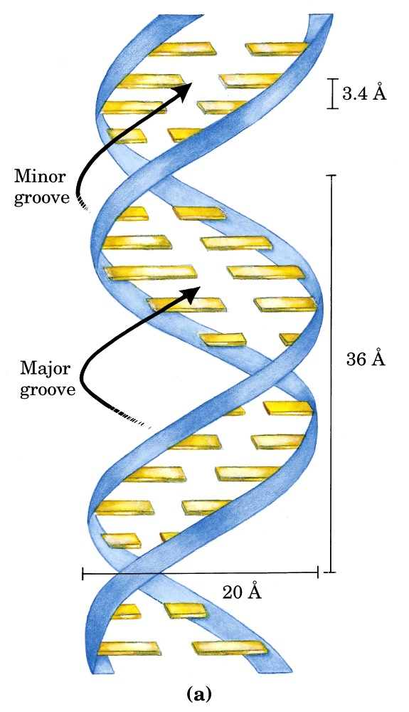
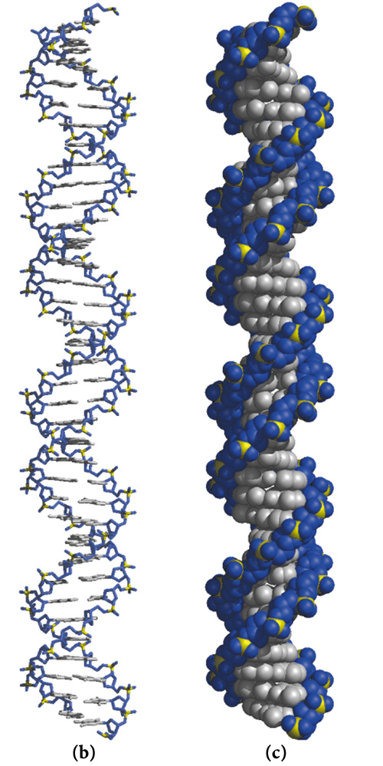
Watson-Crick model for the structure of DNA

Slide 4
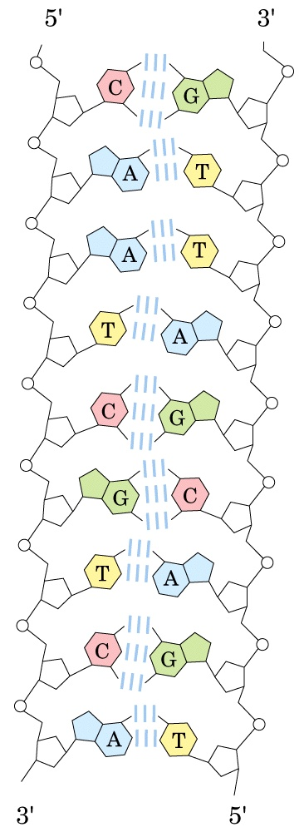
Complementarity of
strands in the DNA
double helix

Slide 5
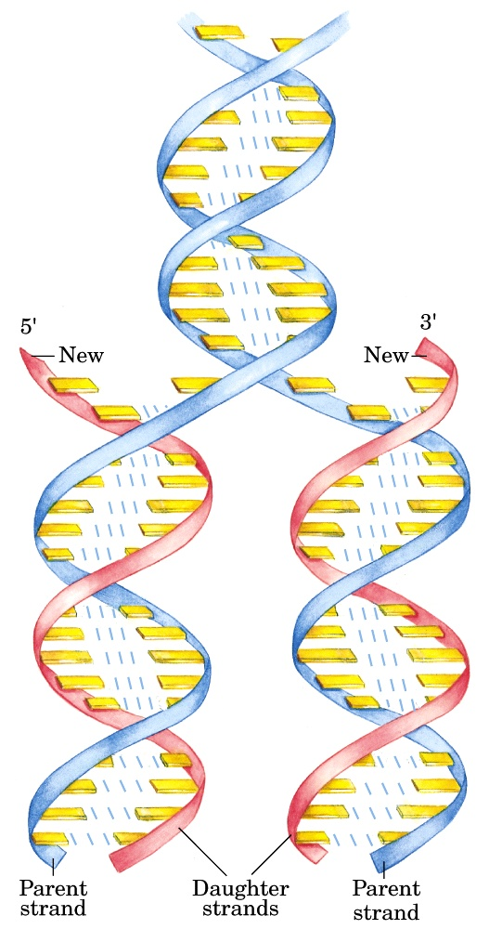
The hypothesis of
semiconservative
replication proposed
by Watson and Crick
in 1953

Slide 6
2. DNA replication was proved to be semiconservative by the Meselson-Stahl experiment using E. coli cells (1957)
¹⁵N (the Heavy isotope) and ¹⁴N (the Light isotope) were used (as NH₄Cl) to label the DNA to distinguish the old and the newly synthesized DNA molecules in cells.
Three types of DNA molecules containing various proportions of ¹⁵N and ¹⁴N (H-H, H-L, L-L) were separated by centrifugation to equilibrium in a cesium chloride (CsCl) density gradient.

Slide 7
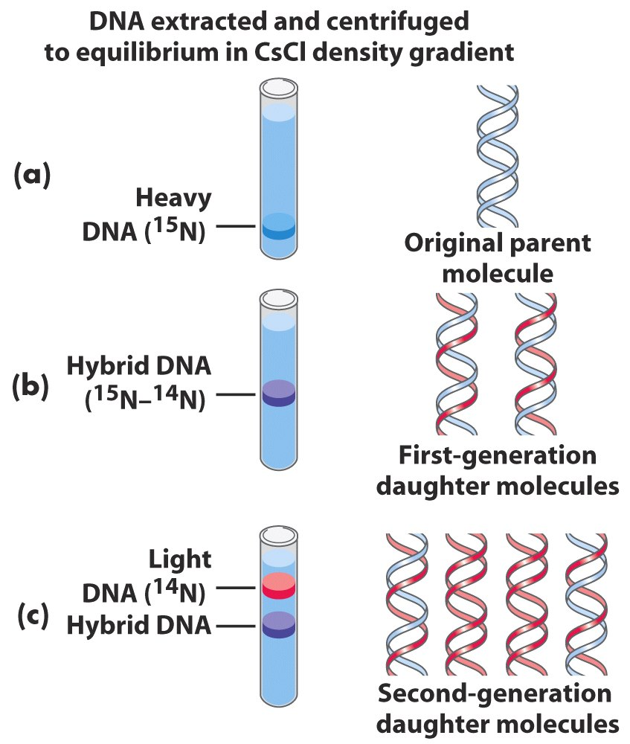
Radioisotope labeling
and density gradient
centrifugation clearly
distinguished
replications of
semiconservative
from conservative.

Slide 8
3. A variety of simple questions were asked about DNA replication
Are the two parental strands completely unwound before replication begins?
Does replication begin at random sites or at a unique site?
Does DNA replication proceed in one direction or both directions?
Does overall chain growth occur in 5’ 3’, 3’ 5’, or both directions?

Slide 9
3. A variety of simple questions were asked about DNA replication (continued)
What mechanisms ensure that DNA replicates once per cell division?
What enzymes take part in DNA synthesis?
How does duplication of the long helical duplex occur without the strands becoming tangled? …...

Slide 10
4. Autoradiography studies: daughter strands are synthesized immediately after parental strands separate
Electron micrographs of the autoradiography of replicating plasmid, SV40 virus, and E. coli chromosomal DNA with ³H-thymidine incorporated revealed θ-like structures: no single stranded DNA was visible.
The chromosomal DNA of E. coli is a single huge circle!
No temporary creation of linear DNA occurred during replication of the circular DNA.

Slide 11
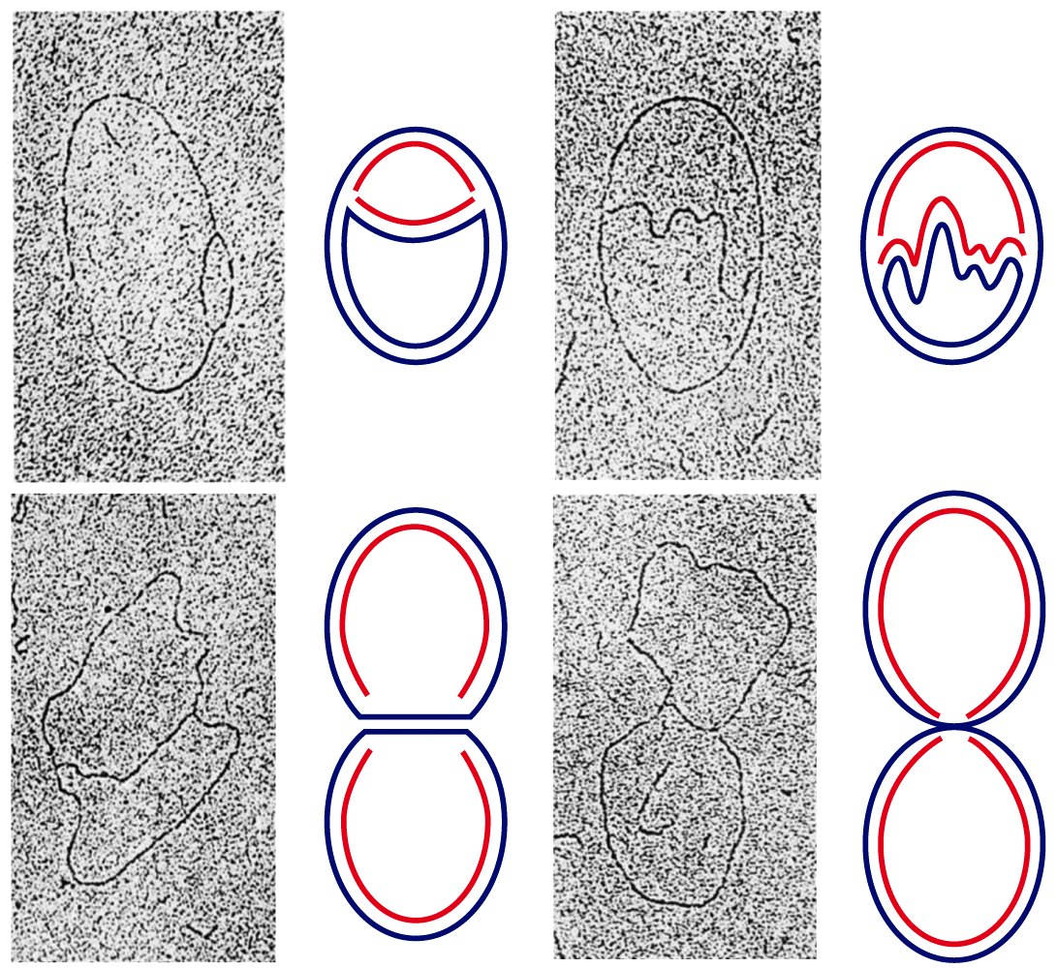
Autoradiogram of a replicating E.coli chromosome
labeled by [³H]thymidine:
No complete unwinding of DNA strands observed!
Both DNA strands are replicated simultaneously!

Slide 12
5. DNA replication was found to begin at specific sites and proceed bidirectionally
Pulse-chase labeling studies of replicating DNA, as well as direct EM examination of intermediates of replicating linear T7 bacteriophage DNA all revealed that DNA replication is bidirectional.
Denaturation mapping studies with a series of replication intermediates of circular DNA and direct observation of those of linear DNA revealed that DNA replication begins at specific replication origins.

Slide 13
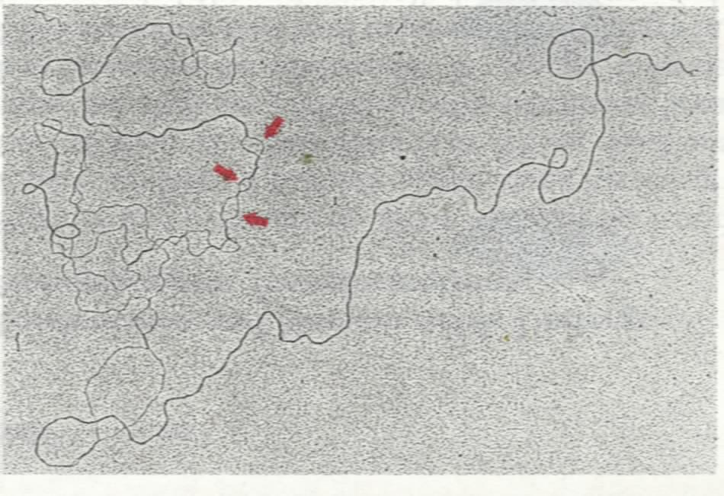
Nondenatured DNA
(double-stranded)
Denatured loops
(single-stranded)
Denaturation mapping:
The denatured loops are
reproducible and thus can be
used as points of reference
(DNA replication starts at
specific origins).

Slide 14
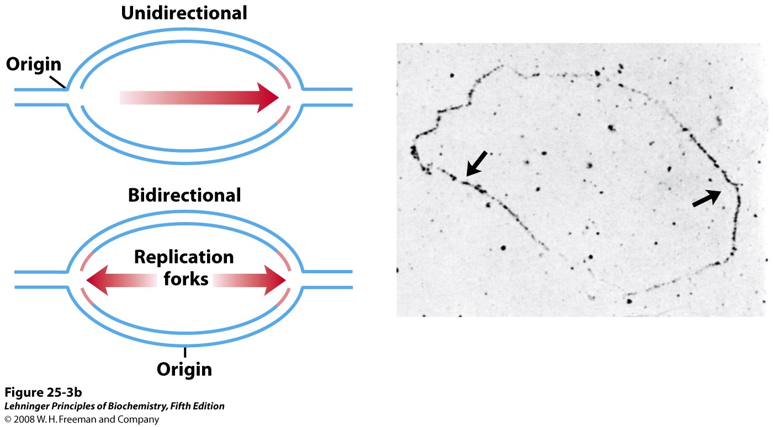
Pulse-chase labeling
Notes:
FIGURE 25-3b Visualization of bidirectional DNA replication. (b) Replication could be either unidirectional or bidirectional, and these can be distinguished by autoradiography: when tritium (3H) is added for a short period just before replication is stopped, label (pink) would be found at one or both replication forks, respectively. This technique has revealed bidirectional replication in E. coli, Bacillus subtilis, and other bacteria. The autoradiogram here shows a replication bubble from B. subtilis. The heaviest grain density (arrows) is at the two ends, where replication is occurring. The unreplicated part of the chromosome, outside the bubble, is unlabeled and thus not visible.

Slide 15
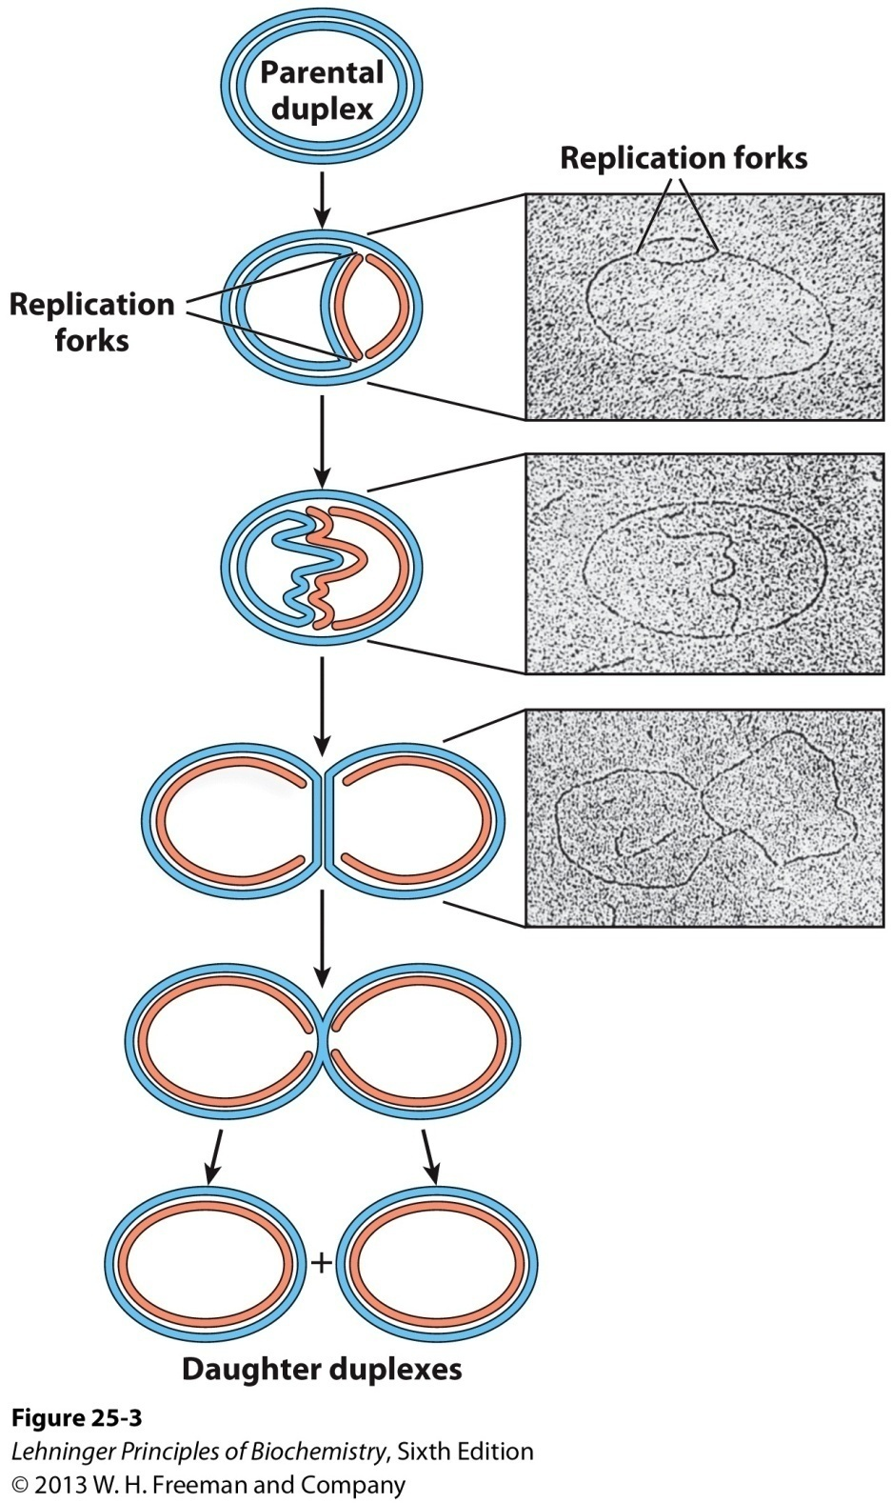
Visualization of DNA replication

Slide 16
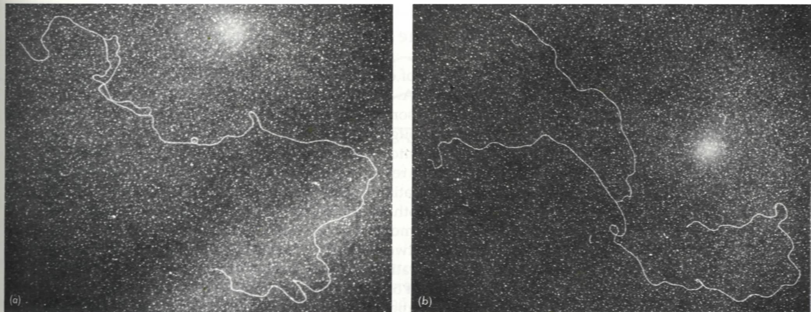
Examination of T7 DNA (linear) replication using electron microscopy:
1. The daughter strands are synthesized almost as soon as the parental strands separate (no complete unwinding of chains);
2. Replication always began at a specific internal site (not from the ends, not random);
3. The replication proceeds in both directions (determined by measuring the distance between the replication fork and the ends)
Replication
origin
Replication
forks

Slide 17
6. The chemistry of DNA polymerization was revealed by in vitro studies using a DNA polymerase purified from E. coli
Arthur Kornberg purified DNA polymerase I, a monomeric 103 kDa protein, from E. coli in 1955 and revealed the major features of the DNA synthesis process.
DNA polymerase I was found to catalyze DNA polymerization in vitro in the presence of a single-stranded DNA template (模板), a preexisting primer (引物) with a free 3’-OH group, and dNTPs.

Slide 18
(where the incoming
nucleotide binds)
(where the newly made base pair resides when the polymerase moves forward)
Elongation of a DNA chain

Slide 19
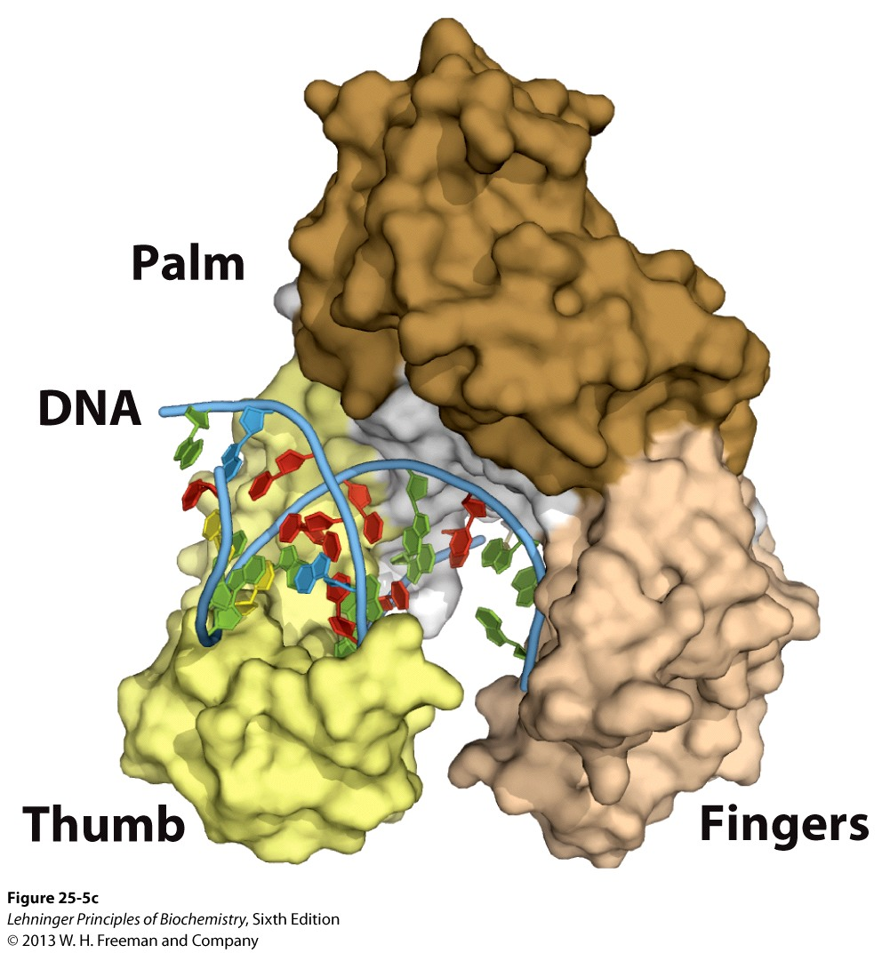
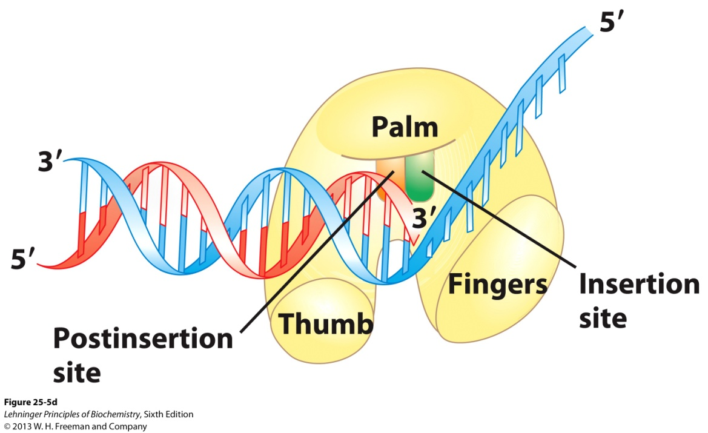
The thumb domain plays a potential
role in the processivity, translocation,
and positioning of the DNA
Binds dNTP
DNA polymerase I bound to DNA

Slide 20
The fundamental reaction for DNA synthesis is a nucleophilic attack by the 3’-OH group of the growing strand on the 5’-α-phosphorus of a incoming dNTP selected via base-pairing: the newly synthesized DNA is always extended in the 5’ to 3’
(5’ 3’) direction.

Slide 21
DNA is degraded by nucleases (DNases)
Exonucleases degrade nucleic acids from one end of the molecule. Many operate in only the 5’ 3’ or the 3’ 5’ direction, removing nucleotides only from the 5’ or the 3’ end, of one strand of a double stranded nucleic acid.
Endonucleases can begin to degrade at any site in a nucleic acid strand or molecule, reducing it to smaller and smaller fragments.

Slide 22
The DNA Polymerase I enzyme can be cleaved into two parts by mild protease treatment: the small fragment contains the 5’ 3’ exonuclease activity and the large (called the Klenow fragment) contains the rest two activities.

Slide 23
Protease cleavage
DNA polymerase I has three enzymatic
activities in a single polypeptide chain,
which can be cleaved into two functional
parts by mild protease treatment.

Slide 24
7. DNA polymerase I has 3’ 5’, as well as 5’ 3’ exonuclease activities
The 3’ 5’ exonuclease activity was found to be able to remove mismatched base pairs, thus to proofread the newly incorporated nucleotides (increasing the polymerization accuracy by 100 to 1000 fold).
The nuclease activity is highly specific for mismatched base pairs. A “sliding back” model was proposed for DNA polymerase I to proofread mismatched base pairs.

Slide 25
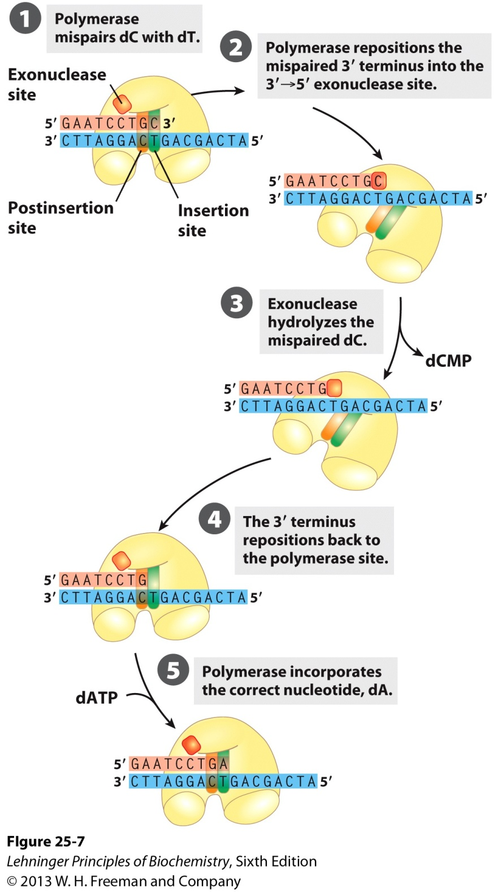
DNA polymerase I
is proposed to slide
back to proofread
a mismatched base
pair using its
3’ 5’ exonuclease
activity.
Error correction by the
3’ 5’ exonuclease
activity of DNA
polymerase I

Slide 26
The 5’ 3’ exonuclease activity of DNA polymerase I enables it to catalyze the nick translation process: an RNA or DNA strand paired to a DNA template is simultaneously degraded and replaced; an activity used for both DNA repair and the removal of RNA primers in DNA replication.

Slide 27
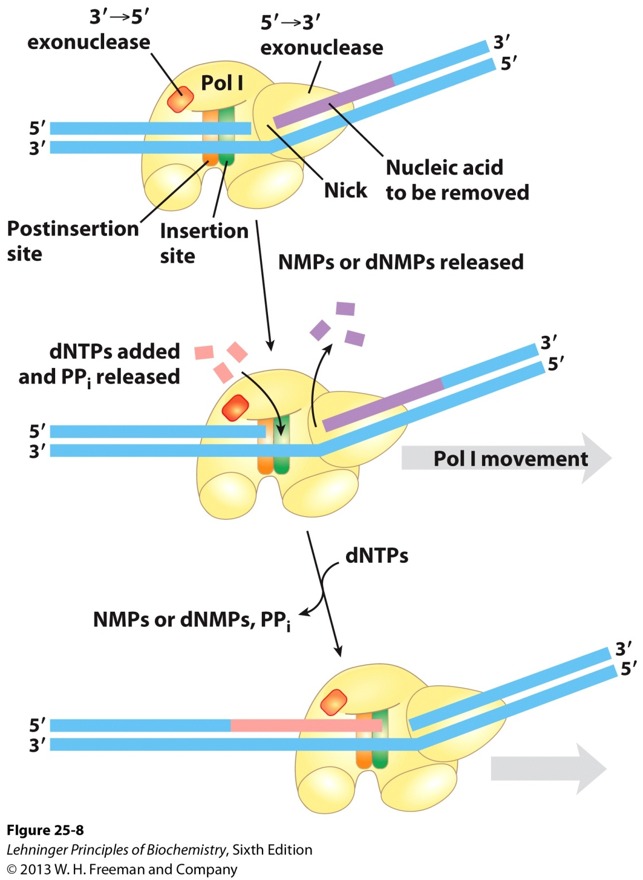
The 5’ 3’ exonuclease
activity of DNA
polymerase I allows the
enzyme to catalyze the
nick translation process
of a DNA or RNA
fragment base paired
with a template.
Nick translation

Slide 28
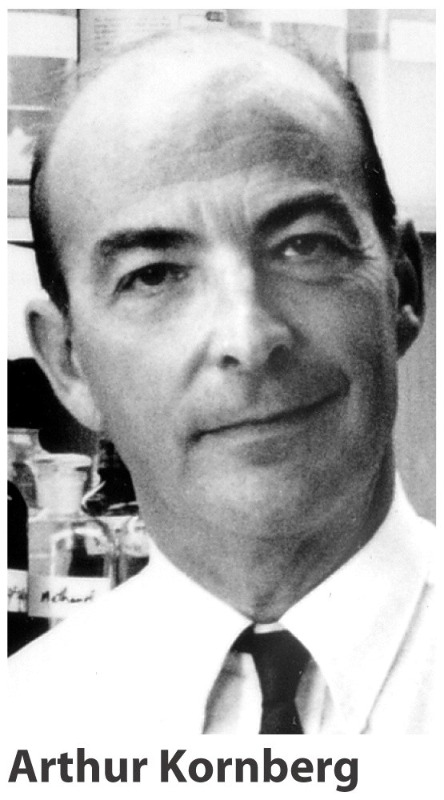
Arthur Kornberg won
the Nobel Prize in 1959
in Medicine for his
discovery of the
mechanism in the
biological synthesis of
deoxyribonucleic acid
(before Watson and
Crick won theirs
in 1962!)
(1918-2007)

Slide 29
8. The synthesis of the two daughter DNA strands was found to be semidiscontinuous
At a replication fork, the overall elongation direction for one daughter strand is 5’ to 3’ and 3’ to 5’ for the other due to the antiparallel features of DNA duplexes.
DNA polymerase catalyzing 3’ to 5’ extension was hypothesized but never identified.
Reiji Okazaki discovered (in the 1960s) that a significant proportion of the newly synthesized DNA exists as small fragments!

Slide 30
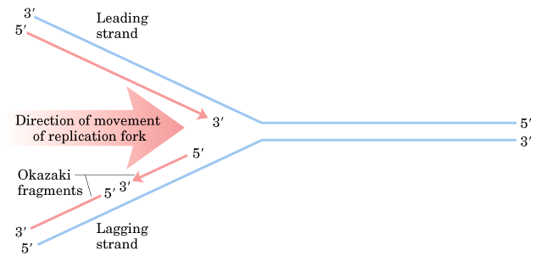
The leading strand
The lagging strand
Both daughter strands at the replication fork are synthesized in
5’ 3’ direction, but one (the leading strand) is synthesized
continuously and the other (the lagging strand) discontinuously
(synthesized initially as Okazaki fragments and then joined
by ligases).

Slide 31
These so-called Okazaki fragments were found to be joined together by DNA ligases to form one of the daughter strands.
Thus both daughter strands are synthesized in
5’ to 3’ direction.
One daughter strand at the replication fork is synthesized continuously and the other discontinuously, called the leading and lagging strands, respectively.

Slide 32
9. DNA polymerase I was found to be not responsible for DNA replication in E. coli cells
The reaction velocity of this enzyme (600 nucleotides/min) is too low to account for the observed rates of fork movement.
Its processivity—the average number of nucleotides added before it dissociates from the template-- is too low (about 50 nucleotides).
E.coli cells having a defective DNA polymerase I were found to be still viable, although sensitive to UV light.
Two more DNA polymerases (II and III) were revealed in E.coli cells in the early 1970s and two more in 1999.

Slide 33
10. DNA polymerase III is responsible for DNA replication in E.coli cells
DNA polymerase III is a multimeric enzyme containing nine different subunits.
The polymerization and proofreading activities are located on separate subunits, α and ε, respectively.
The core domains are linked by the “clamp-loader” complex τ₃δδ’.
The enzyme has no 5’ to 3’ exonuclease activity.
The β subunits provide high processivity, with more than 500,000 nucleotides added per binding.
The rate of DNA synthesis is high, with 1000 nucleotides/second.

Slide 34
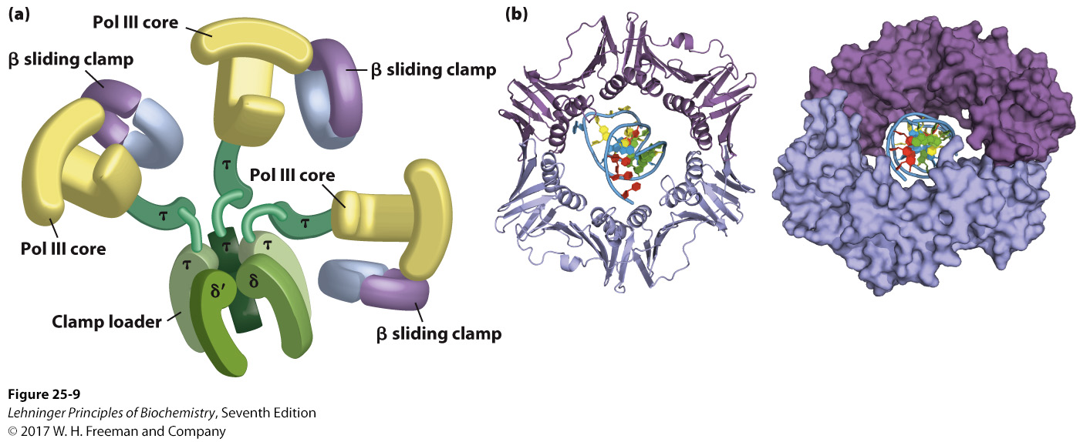
DNA polymerase III
Core domains, composed of subunits α, ε, and θ, are linked by a five-subunit clamp-loading complex (also known as the γ complex) with the composition τ₃δδ’.
Clamp-loading
complex (γ complex)
Notes:
FIGURE 25–9 DNA polymerase III. (a) Architecture of bacterial DNA polymerase III (Pol III). Two core domains, composed of subunits α, ε, and θ, are linked by a five-subunit clamp-loading complex (also known as the γ complex) with the composition τ₂γδδ’. The core subunits and clamp-loader complex constitute DNA polymerase III*. The γ and τ subunits are encoded by the same gene. The γ subunit is a shortened version of the τ subunit; τ thus contains a domain identical to γ, along with an additional segment that interacts with the core polymerase. The other two subunits of DNA polymerase III*, χ and ψ (not shown), also bind to the clamp-loading complex. Two β clamps interact with the two-core subassembly, each clamp a dimer of the subunit. The complex interacts with the DnaB helicase (described later in the text) through the subunits. (b) Two β subunits of E. coli polymerase III form a circular clamp that surrounds the DNA. The clamp slides along the DNA molecule, increasing the processivity of the polymerase III holoenzyme to greater than 500,000 nucleotides by preventing its dissociation from the DNA. The two subunits are shown in two shades of purple as ribbon structures (left) and surface images (right), surrounding the DNA (derived from PDB ID 2POL).

Slide 35
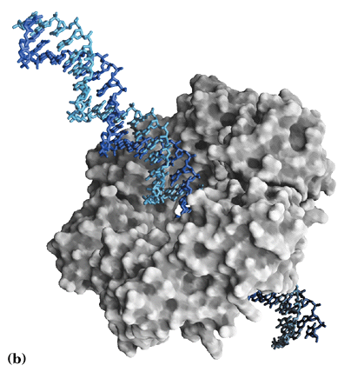
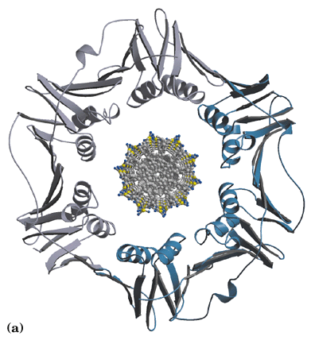
A clamping
β dimer
The two β subunits of
E. coli polymerase III
form a circular clamp
that surround DNA to
increase its processivity.

Slide 36
*****
TABLE 25-2 |  | Subunits of DNA Polymerase III of E. coli
Subunit | Number of subunits per holoenzyme |  | M_{r} of subunit | Gene | Function of subunit
α | 3 |  | 129,900 | polC (dnaE) | Polymerization activity | Core polymerase
ε | 3 |  | 27,500 | dnaQ (mutD) | 3' → 5' proofreading exonuclease
θ | 3 |  | 8,600 | holE | Stabilization of ε subunit
τ | 3 |  | 71,100 | dnaX | Stable template binding; core enzyme dimerization | Clamp-loading (γ) complex that loads β subunits on lagging strand at each Okazaki fragmentª
δ | 1 |  | 38,700 | holA | Clamp opener
δ' | 1 |  | 36,900 | holB | Clamp loader
χ | 1 |  | 16,600 | holC | Interaction with SSB
ψ | 1 |  | 15,200 | holD | Interaction with τ and χ
β | 6 |  | 40,600 | dnaN | DNA clamp required for optimal processivity
ªThe clamp-loading complex is also called the γ complex, because of the existence of another version of the complex in which three subunits called γ replace the τ subunits. The γ subunit is encoded by a portion of the gene for the τ subunit (dnaX), such that the amino-terminal 66% of the τ subunit has the same amino acid sequence as the γ subunit. The γ subunit is generated by a translational frameshifting mechanism (p. 1085) that leads to premature translational termination. The γ subunit shares the clamp-loading functions of τ but lacks the protein segments that interact with the core polymerase or with DnaB helicase. Clamp-loading complexes incorporating γ subunits may operate independently of the DNA polymerase III holoenzyme, promoting the unloading of β clamps discarded on the lagging strand as the replication fork progresses. They may also promote loading of β clamps for some DNA repair processes that require DNA synthesis away from the replication fork.

Slide 37
*****
TABLE 25-1 | Comparison of the Five DNA Polymerases of E. coli
 |  | DNA polymerase
 |  | I | IIª | III | IVª | Vª
Structural gene^{b} |  | polA | polB | polC (dnaE) | dinB | umuC
Subunits (number of different types) |  | 1 | 7 | 9 | 1 | 3
M_{r} |  | 103,000 | 88,000^{c} | 1,065,400 | 39,100 | 110,000
3' → 5' exonuclease (proofreading) |  | Yes | Yes | Yes | No | No
5' → 3' exonuclease |  | Yes | No | No | No | No
Polymerization rate (nucleotides/s) |  | 10–20 | 40 | 250–1,000 | 2–3 | 1
Processivity (nucleotides added before polymerase dissociates) |  | 3–200 | 1,500 | ≥500,000 | 1 | 6–8
ªTranslesion (mutagenic) DNA polymerases. For DNA polymerase IV, processivity is increased substantially by association with a β clamp. These polymerases are slowed when a DNA lesion is present in the DNA template strand. ^{b}For enzymes with more than one subunit, the gene listed here encodes the subunit with polymerization activity. Note that dnaE is an earlier designation for the gene now referred to as polC. ^{c}Polymerization subunit only. DNA polymerase II shares several subunits with DNA polymerase III, including the β, δ, δ', χ, and ψ subunits (see Table 25-2).

Slide 38
11. DNA polymerase III and many other proteins are part of the replisome for DNA replication in E. coli cells
In vitro studies revealed about 20 proteins are involved in DNA replication in E.coli cells.
These include:
the helicase (dnaB) for moving along the DNA and separating the two DNA strands using energy from ATP;
the topoisomerases for relieving topological strains in the helical structure (positive supercoils) generated during strand separation;
the DNA-binding protein for binding and stabilizing the single-stranded DNA generated;

Slide 39
the primase (dnaG) for generating a short RNA primer;
the DNA polymerase III for polymerizing and proofreading the nucleotides according to the templates;
the DNA polymerase I (polA) for removing the RNA primers and replacing by a DNA sequence;
the DNA ligase for sealing nicks between the Okazaki fragments.

Slide 40
12. A 245 bp fragment in the E.coli chromosomal DNA, OriC, was identified to be the replication origin
OriC contains a tandem array of three 13-mer with nearly identical sequences and five 9-mer repeats, all of which are highly conserved among all bacterial replication origins.
OriC contains 11 GATC (palindromic) sequences, which can be methylated at the base ring of A, which is believed to be important in having only one replication per cell division.

Slide 41
OriC, the replication origin of E. coli
chromosome, contains three repeats
of 13 bp and five repeats of 9 bp.
DUE: DNA unwinding element

Slide 42
13. The molecular details of the replication of E. coli chromosomal DNA are the best understood by in vitro studies
The whole process can be divided into three stages: initiation, elongation, and termination.
During the initiation stage, the DNA is open at the OriC site and a prepriming complex is formed, with the participation of at least nine proteins.
During the elongation stage, short RNA primers are synthesized by the primase, extended by the DNA polymerase III, and ligated by the DNA ligase (for the Okazaki fragments of the lagging strand).

Slide 43
During the termination stage, the two replication forks meet at the Ter sequences (a 20 base pair sequence), the replisome dissociates, and the two catenated chromosomes are separated by DNA topoisomerase IV.

Slide 44
14. Multiple proteins participate at the initiation stage of DNA replication of the E. coli chromosome
The replication process begins when a single complex of about 8 DnaA protein molecules (with ATP bound) bind to the five 9 bp repeats at OriC that is supercoiled.
Aided by HU (a histone-like protein), the bound DnaA complex opens the two DNA strands at the AT-rich 13-mer repeats.
DnaB, the helicase, binds (aided by DnaC protein) to the opened DNA strands as two hexamer clamps and further opens (unwinds) the strands in both directions, thus forming the prepriming complex.

Slide 45
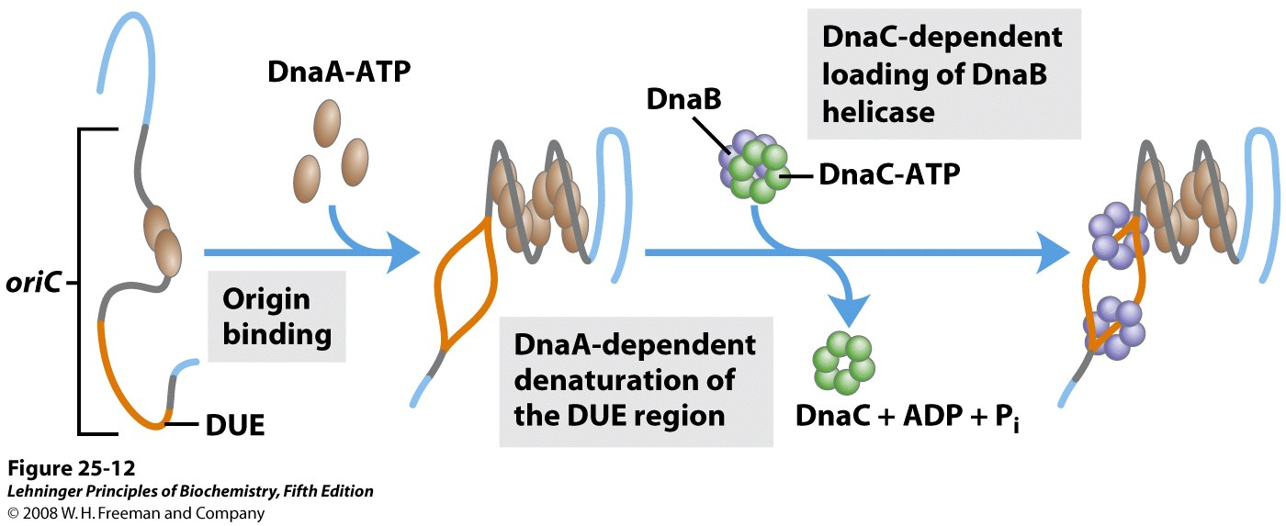
Model for initiation of replication at the E. coli origin, oriC
DnaA: a member of the AAA+ ATPase protein family, the ATP-bound form is active and the ADP-bound form is inactive
Notes:
FIGURE 25-12 Model for initiation of replication at the E. coli origin, oriC. Eight DnaA protein molecules, each with a bound ATP, bind at the R and I sites in the origin (see Figure 25-11). The DNA is wrapped around this complex, which forms a right-handed helical structure. The A=T-rich DUE region is denatured as a result of the strain imparted by the adjacent DnaA binding. Formation of the helical DnaA complex is facilitated by the proteins HU, IHF, and FIS, which are not shown here because their detailed structural roles have not yet been defined. Hexamers of the DnaB protein bind to each strand, with the aid of DnaC protein. The DnaB helicase activity further unwinds the DNA in preparation for priming and DNA synthesis.

Slide 46
*****
TABLE 25-3 | Proteins Required to Initiate Replication at the E. coli Origin
Protein |  | M_{r} | Number of subunits | Function
DnaA protein |  | 52,000 | 1 | Recognizes oriC sequence; opens duplex at specific sites in origin
DnaB protein (helicase) |  | 300,000 | 6ª | Unwinds DNA
DnaC protein |  | 174,000 | 6ª | Required for DnaB binding at origin
HU |  | 19,000 | 2 | Histonelike protein; DNA-binding protein; stimulates initiation
FIS |  | 22,500 | 2ª | DNA-binding protein; stimulates initiation
IHF |  | 22,000 | 2 | DNA-binding protein; stimulates initiation
Primase (DnaG protein) |  | 60,000 | 1 | Synthesizes RNA primers
Single-stranded DNA-binding protein (SSB) |  | 75,000 | 4ª | Binds single-stranded DNA
DNA gyrase (DNA topoisomerase II) |  | 400,000 | 4 | Relieves torsional strain generated by DNA unwinding
Dam methylase |  | 32,000 | 1 | Methylates (5')GATC sequences at oriC
ªSubunits in these cases are identical.

Slide 47
15. The leading strand is synthesized continuously but the lagging strand discontinuously
Further unwinding of the DNA duplex needs DNA gyrase (a topoisomerase II) to relieve the supercoils ahead the replication forks and SSB (single-stranded DNA-binding protein) for stabilizing the unwound single-stranded DNAs.
Kornberg discovered that the nascent DNA is always covalently linked to a short stretch of RNA.
The RNA primers were found to be 10-60 nucleotides in length.

Slide 48
The primase (a RNA polymerase), recruited to the open templates via DnaB, was found to be the enzyme that catalyzes the synthesis of the RNA primers.
For the leading strand, only one primer is synthesized, which is then elongated by DNA polymerase III in a continuous way.
On the lagging strand, DnaB (the helicase) intermittently recruits DnaG (the primase) to form a complex called primosome, and repeatedly making primers for the Okazaki fragments.
Each Okazaki fragment is then synthesized on one RNA primer by DNA polymerase III.

Slide 49
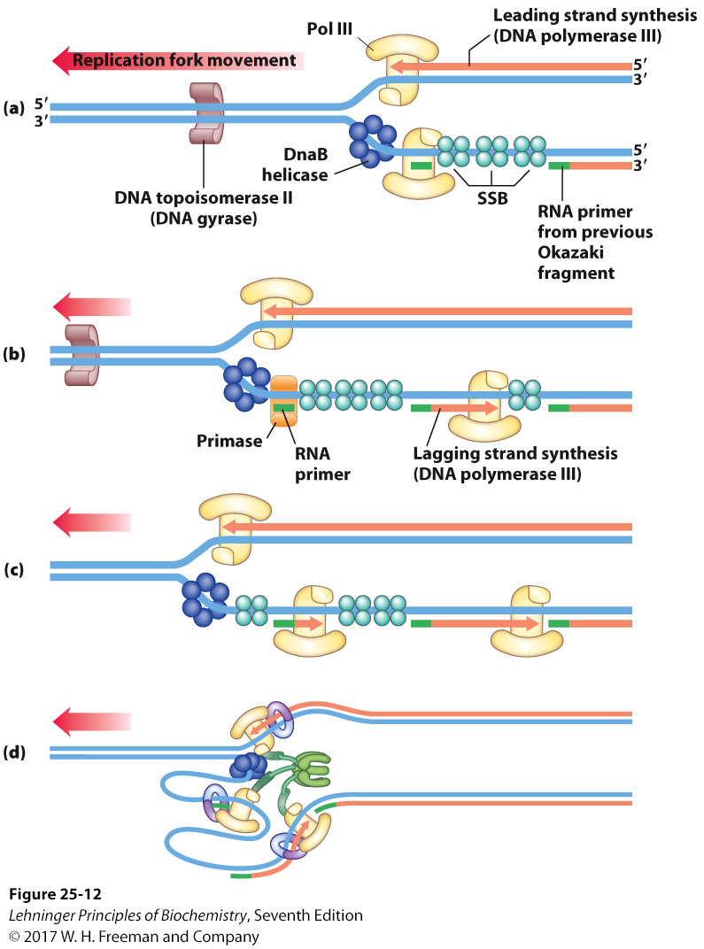
Synthesis of Okazaki fragments
Each DNA Pol III holoenzyme
has three sets of core
subunits, so one or two
Okazaki fragments can be
synthesized simultaneously,
along the lagging strand.
Notes:
FIGURE 25–12 Synthesis of Okazaki fragments. (a) At intervals, primase synthesizes an RNA primer for a new Okazaki fragment. Note that if we consider the two template strands as lying side by side, lagging strand synthesis formally proceeds in the opposite direction from fork movement. (b) Each primer is extended by DNA polymerase III. (c) DNA synthesis continues until the fragment extends as far as the primer of the previously added Okazaki fragment. A new primer is synthesized near the replication fork to begin the process again.

Slide 50
The RNA primers are removed and replaced by a DNA sequence in a reaction catalyzed by DNA polymerase I, using its nick translation activity
(5’ to 3’ exonuclease + polymerase).
The final Okazaki fragments are joined together by the DNA ligase.
DNA ligase catalyzes the formation of a phosphodiester bond between a 3’-OH group and a 5’ phosphate group of two DNA strands, where the 5’ phosphate is first activated by being modified by an AMP group coming from NAD⁺ (the bacterial enzyme) or ATP (the virus and animal enzymes).

Slide 51
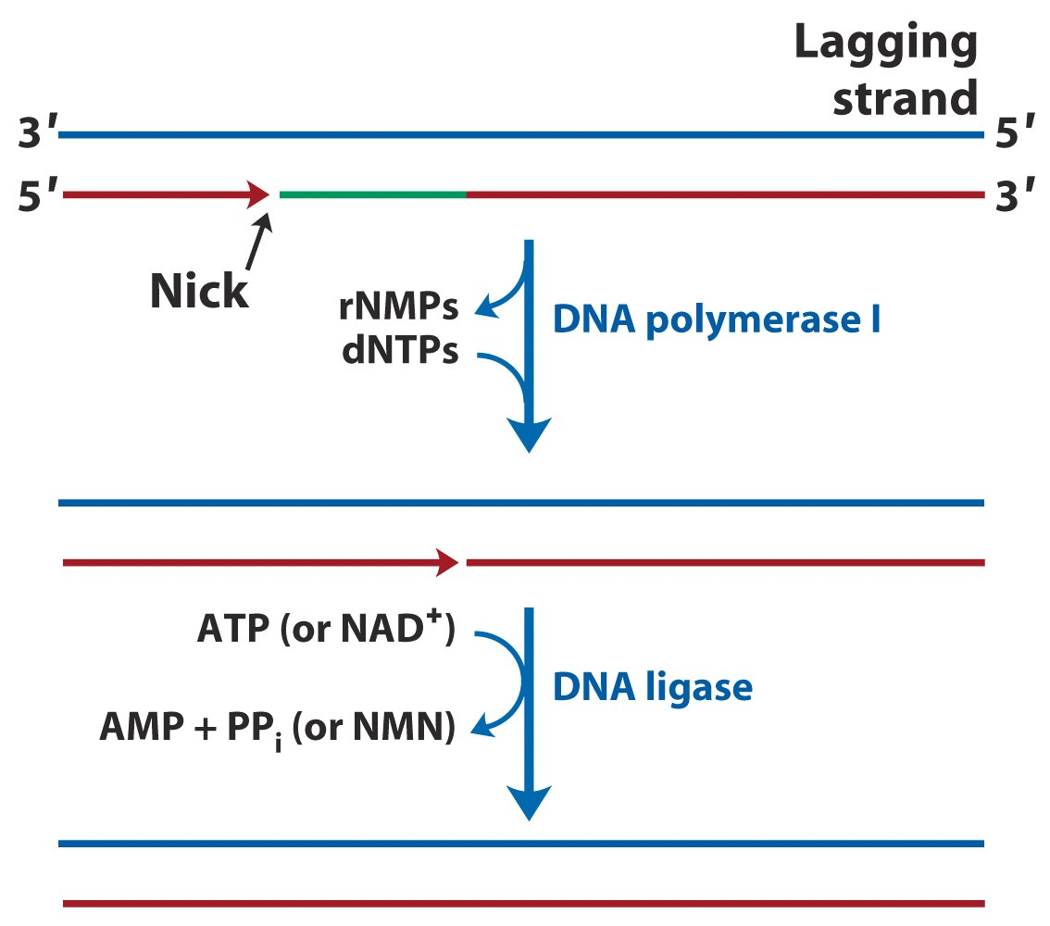
DNA polymerase I replaces the RNA primers by DNA sequences and DNA ligase seals the nicks.
Final steps in the synthesis of lagging strand segments

Slide 52
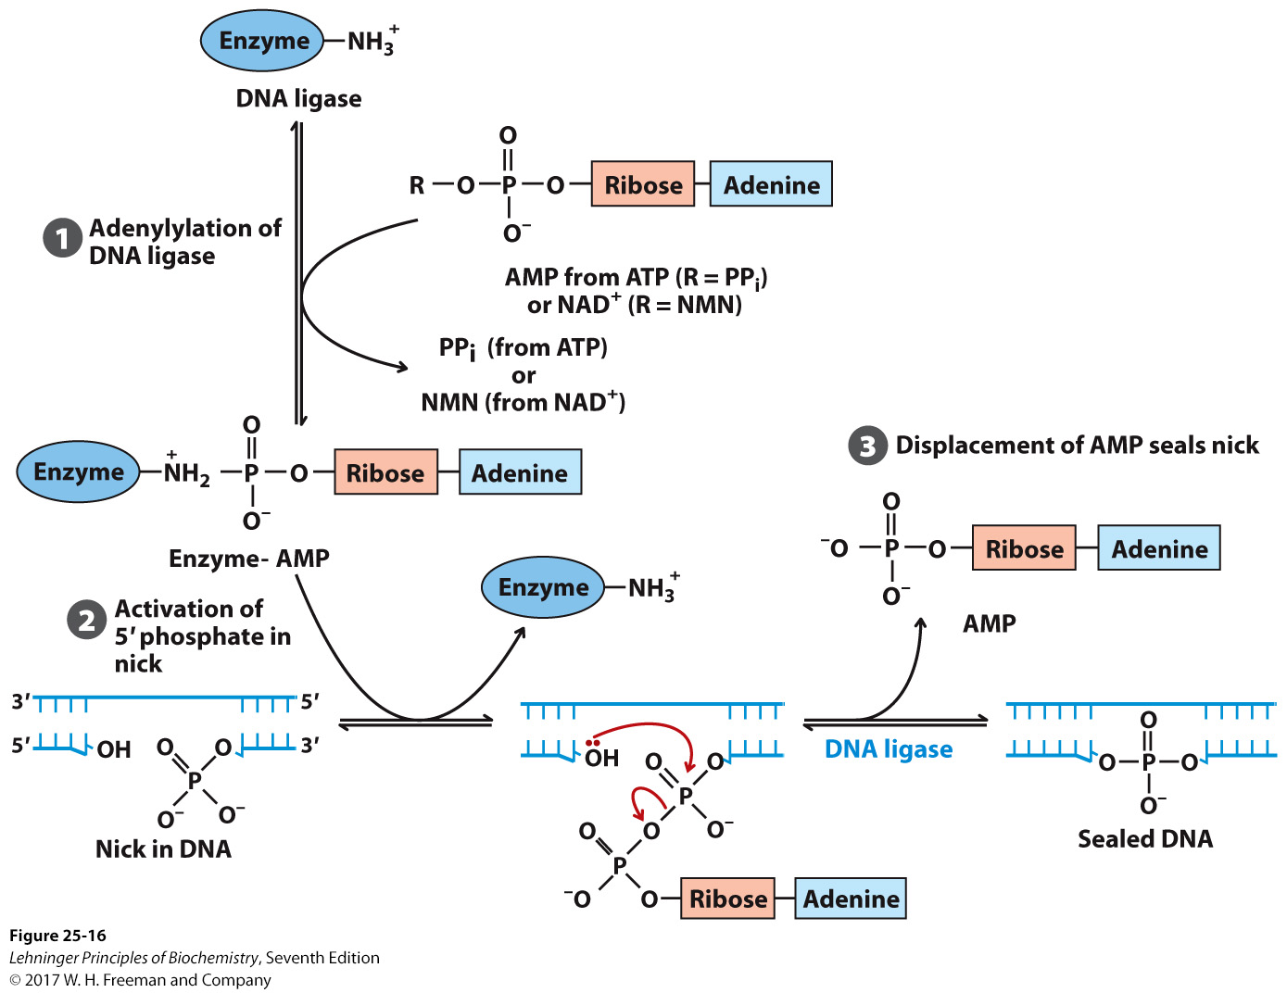
Mechanism of the DNA ligase reaction
Notes:
FIGURE 25–16 Mechanism of the DNA ligase reaction. In each of the three steps, one phosphodiester bond is formed at the expense of another. Steps 1 and 2 lead to activation of the 5’ phosphate in the nick. An AMP group is transferred first to a Lys residue on the enzyme and then to the 5’ phosphate in the nick. In step 3, the 3’-hydroxyl group attacks this phosphate and displaces AMP, producing a phosphodiester bond to seal the nick. In the E. coli DNA ligase reaction, AMP is derived from NAD⁺. The DNA ligases isolated from some viral and eukaryotic sources use ATP rather than NAD⁺ and they release pyrophosphate rather than nicotinamide mononucleotide (NMN) in step 1.

Slide 53
16. The leading and lagging strands are believed to be synthesized coordinately by a single asymmetric DNA polymerase III dimer
The two polymerase III cores (having the αεθ subunits) are believed to be connected by two τ subunits.
The coupling is believed to be accomplished via looping of the lagging strand template.

Slide 54
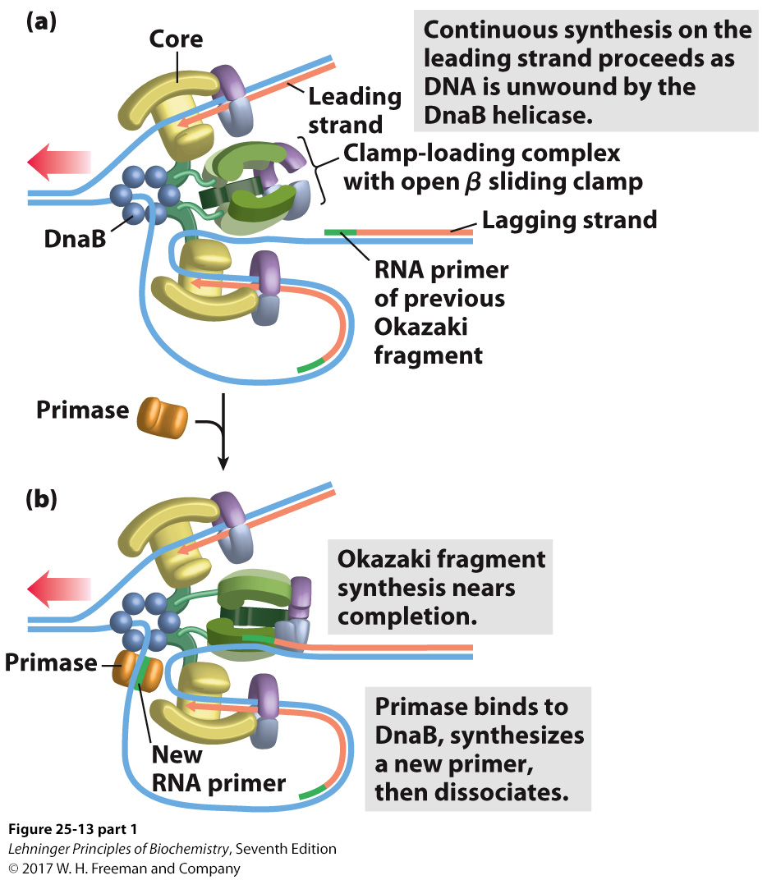
DNA synthesis on the leading and lagging strands
Notes:
FIGURE 25–13 part 1 DNA synthesis on the leading and lagging strands. Events at the replication fork are coordinated by a single DNA polymerase III dimer, in an integrated complex with DnaB helicase. This figure shows the replication process already underway (parts (a) through (e) are discussed in the text). The lagging strand is looped so that DNA synthesis proceeds steadily on both the leading and lagging strand templates at the same time. Red arrows indicate the 3’ end of the two new strands and the direction of DNA synthesis. The heavy black arrows show the direction of movement of the parent DNA through the complex. An Okazaki fragment is being synthesized on the lagging strand. The subunit colors and the functions of the clamp-loading complex are explained in Figure 25–14.

Slide 55
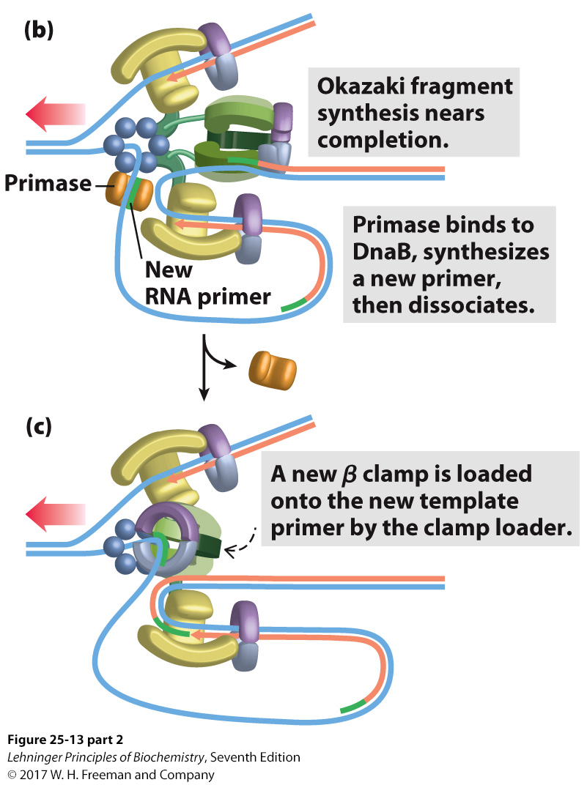
Notes:
FIGURE 25–13 part 2 DNA synthesis on the leading and lagging strands. Events at the replication fork are coordinated by a single DNA polymerase III dimer, in an integrated complex with DnaB helicase. This figure shows the replication process already underway (parts (a) through (e) are discussed in the text). The lagging strand is looped so that DNA synthesis proceeds steadily on both the leading and lagging strand templates at the same time. Red arrows indicate the 3’ end of the two new strands and the direction of DNA synthesis. The heavy black arrows show the direction of movement of the parent DNA through the complex. An Okazaki fragment is being synthesized on the lagging strand. The subunit colors and the functions of the clamp-loading complex are explained in Figure 25–14.

Slide 56
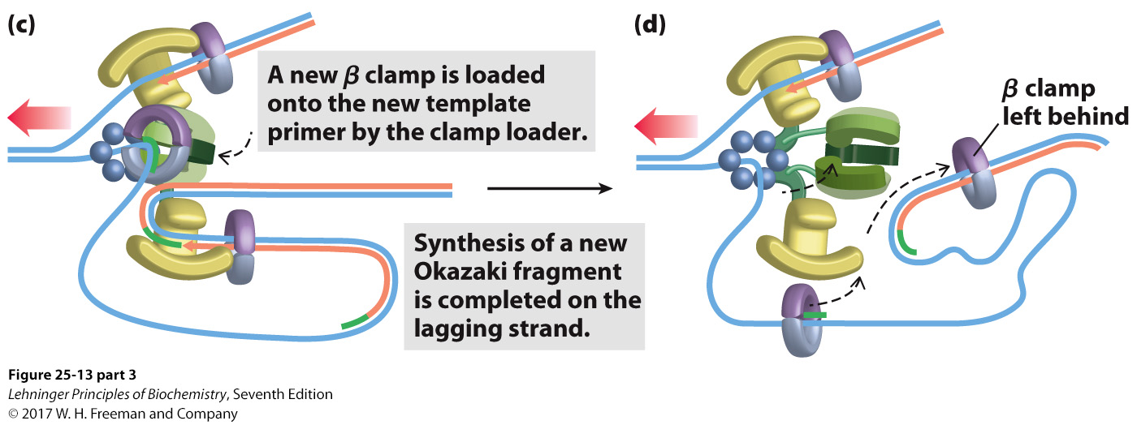
Notes:
FIGURE 25–13 part 3 DNA synthesis on the leading and lagging strands. Events at the replication fork are coordinated by a single DNA polymerase III dimer, in an integrated complex with DnaB helicase. This figure shows the replication process already underway (parts (a) through (e) are discussed in the text). The lagging strand is looped so that DNA synthesis proceeds steadily on both the leading and lagging strand templates at the same time. Red arrows indicate the 3’ end of the two new strands and the direction of DNA synthesis. The heavy black arrows show the direction of movement of the parent DNA through the complex. An Okazaki fragment is being synthesized on the lagging strand. The subunit colors and the functions of the clamp-loading complex are explained in Figure 25–14.

Slide 57
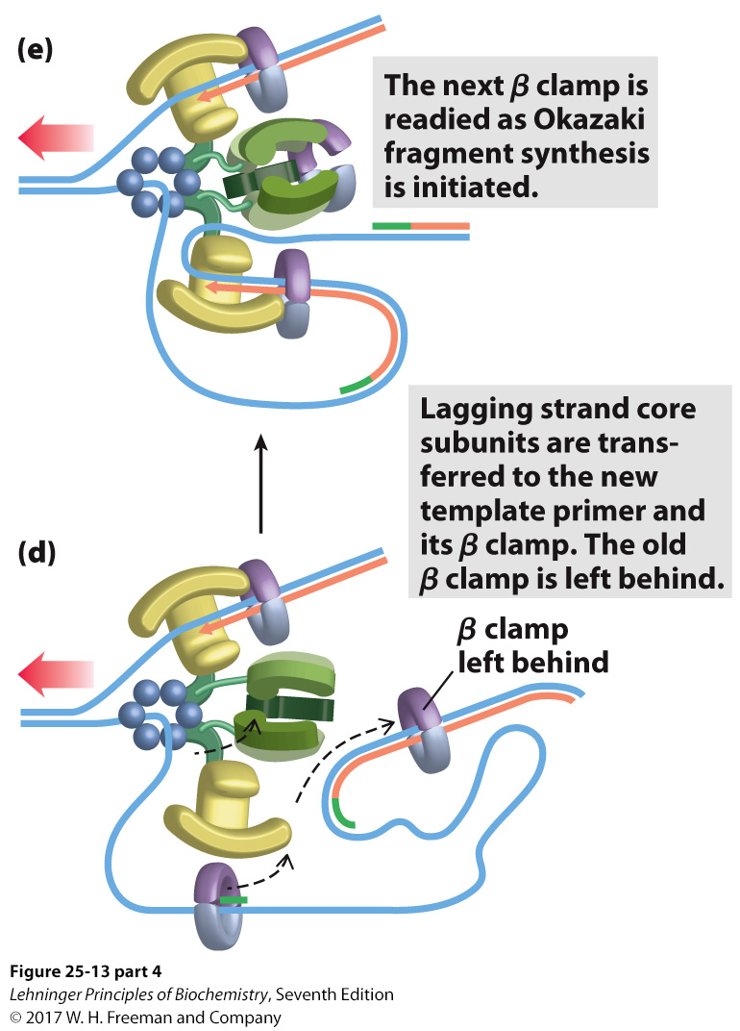
Notes:
FIGURE 25–13 part 4 DNA synthesis on the leading and lagging strands. Events at the replication fork are coordinated by a single DNA polymerase III dimer, in an integrated complex with DnaB helicase. This figure shows the replication process already underway (parts (a) through (e) are discussed in the text). The lagging strand is looped so that DNA synthesis proceeds steadily on both the leading and lagging strand templates at the same time. Red arrows indicate the 3’ end of the two new strands and the direction of DNA synthesis. The heavy black arrows show the direction of movement of the parent DNA through the complex. An Okazaki fragment is being synthesized on the lagging strand. The subunit colors and the functions of the clamp-loading complex are explained in Figure 25–14.

Slide 58
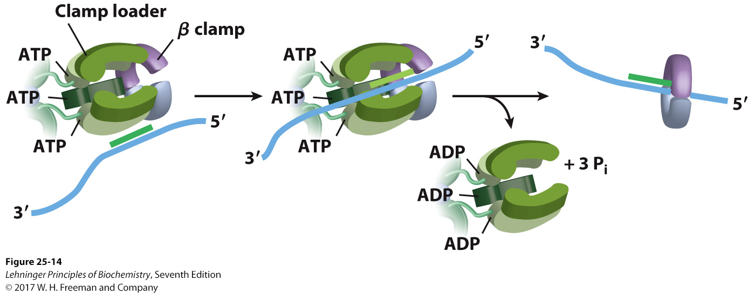
The DNA polymerase III clamp loader
Notes:
FIGURE 25–14 The DNA polymerase III clamp loader. The five subunits of the clamp-loading complex are the γ, δ, and δ’ subunits and the amino-terminal domain of each τ subunit (see Fig. 25–9). The complex binds to three molecules of ATP and to a dimeric β clamp. This binding forces the β clamp open at one of its two subunit interfaces. Hydrolysis of the bound ATP allows the β clamp to close again around the DNA.

Slide 59
The Polymerase III on the lagging strand intermittently releases the β sliding clamp and the completed Okazaki fragment before rebinding to a new β subunit dimer loaded at a RNA primer and synthesizing a new Okazaki fragment.
Accumulating evidence seem to support that the Polymerase III dimer complex is associated with the plasma membrane and does not actually move itself; the DNA moves through the fixed complex.

Slide 60
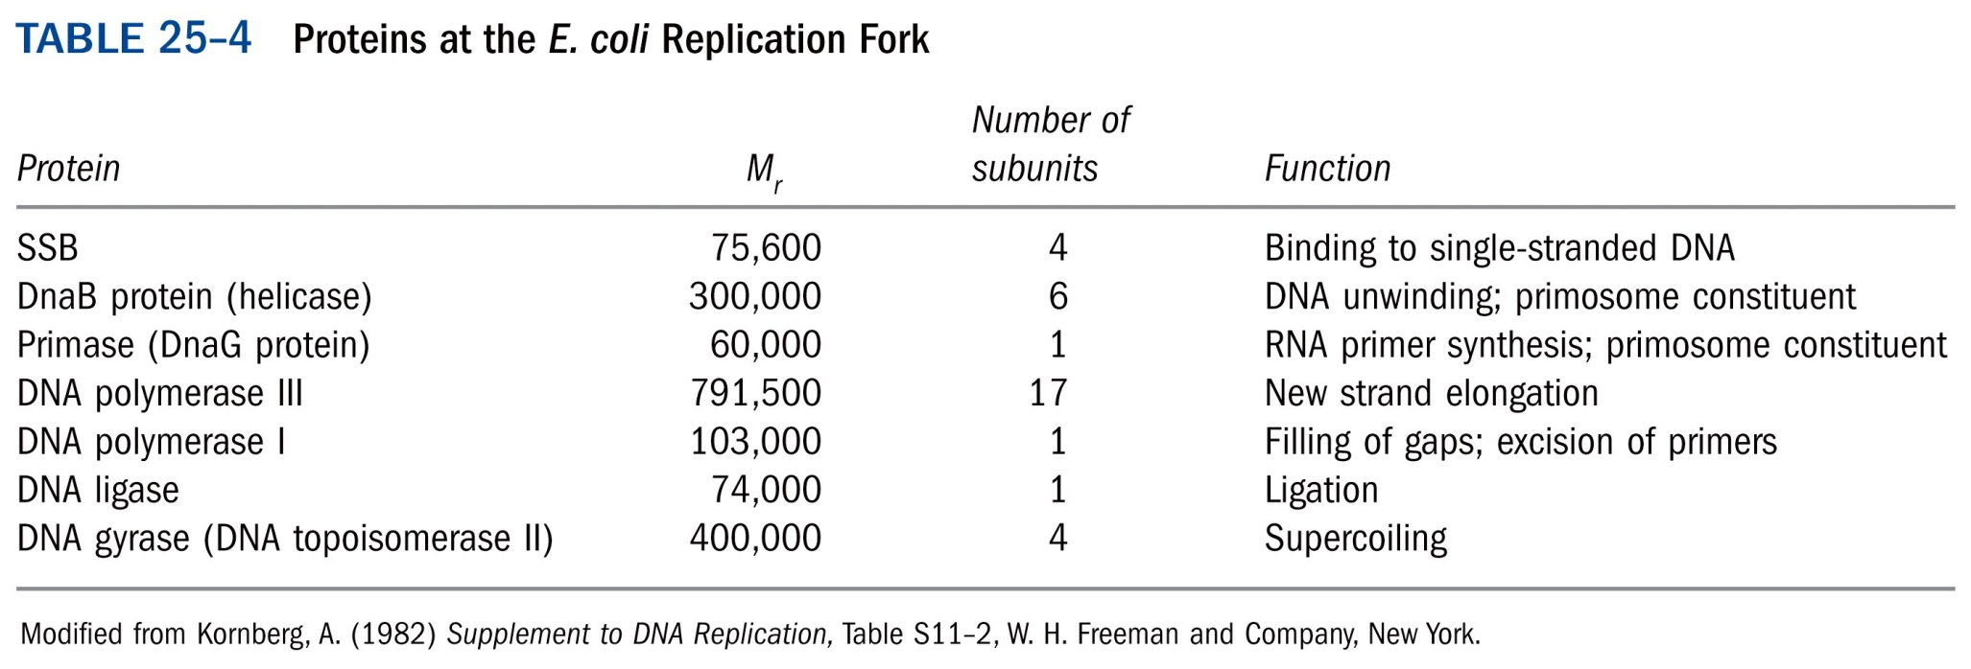
*****

Slide 61
17. E.coli DNA replication ends at a specific terminus region with multiple copies of a 20 bp Ter sequence
The Ter sequences are positioned in two clusters with opposite orientations.
The Tus (terminus utilization substance) protein can bind to the Ter sequences.
At each round of DNA replication, only one Tus-Ter complex seems to function to arrest a replication fork from one direction.
The opposing replication forks generally halt when they collide.
The Ter sequences do not seem to be essential for stopping replication.

Slide 62
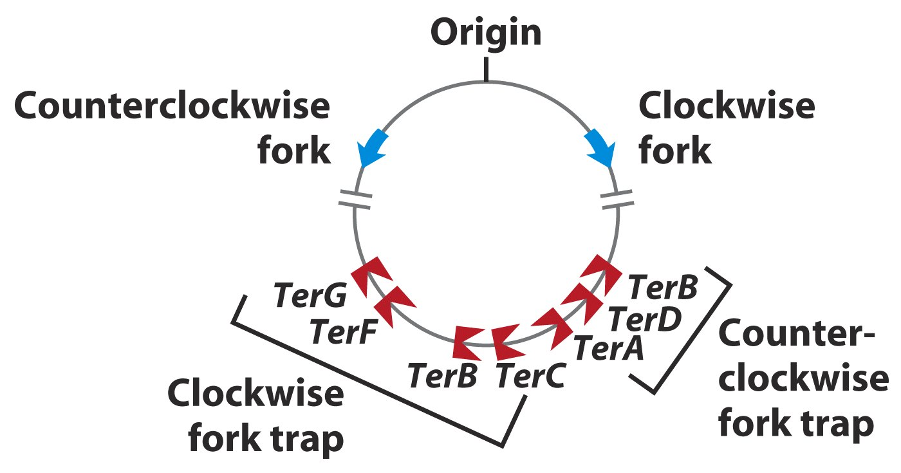
The Ter sequences are positioned on the chromosome
in two clusters with opposite orientations.

Slide 63
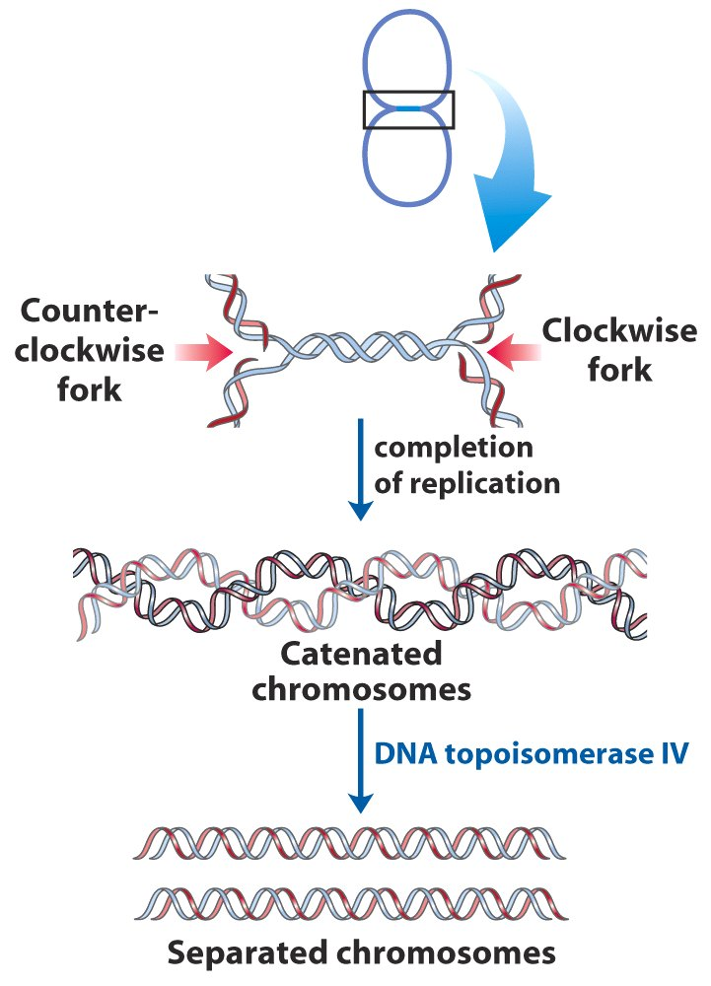
The two newly synthesized circular chromosomal DNAs are topologically interlinked (catenated) and is finally separated by the action of a Type II topoisomerases.

Slide 64
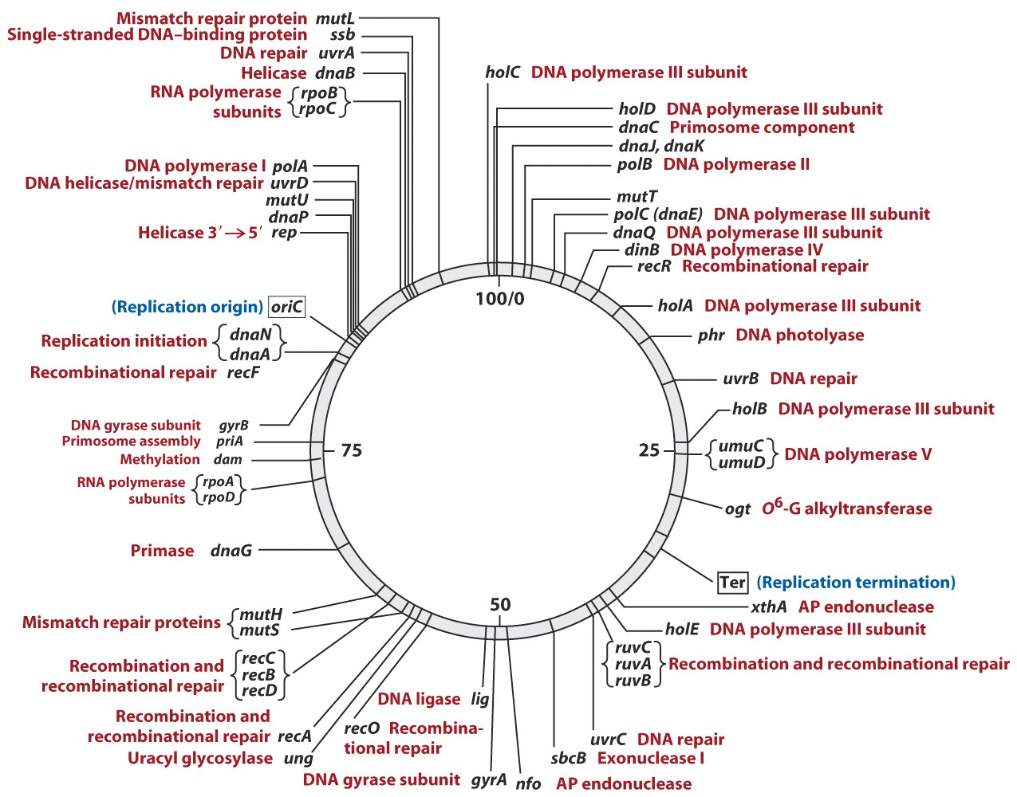
Map of the E. coli chromosome

Slide 65
18. Methylation of GATC sequences at OriC is believed to control the replication frequencies in E. coli cells
Hemimethylated OriC was found to be unable to initiate another round of DNA replication.
It is believed that the hemimethylated GATC sequences at OriC is sequestered in the plasma membrane immediately after one round of DNA replication, thus blocking another round of replication until the GATC sequences are released and fully methylated by Dam methylase.
The delay of methylation is hypothesized to limit DNA replication to occur once per cell division.
The slow hydrolysis of ATP by DnaA protein was also proposed to regulate replication initiation.

Slide 66
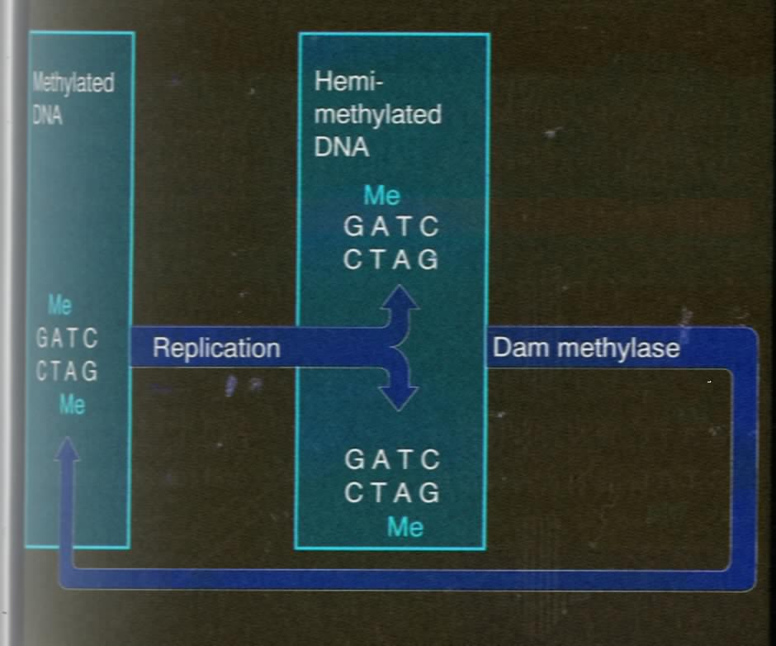
Hemimethylated OriC
is not active for
initiating DNA
Replication.
Inactive
Active

Slide 67
19. DNA replication in eukaryotic cells use essentially the same principles but more complex in the details
The best understood eukaryotic replication system is that of yeast.
Formation of the RNA primers and the initial incorporation of deoxynucleotides are believed to be catalyzed by DNA polymerase α (which has no proofreading activity).
Later chain extension is believed to be catalyzed by DNA polymerase δ, which has proofreading activity.

Slide 68
Specific sequences (~150 bp) that can function as replication origins have only been identified in yeast (called autonomously replicating sequences, or ARS).
The rate of DNA synthesis in eukaryotic cells is about one twentieth of that of the E.coli cells.
Replication in the eukaryotic genomes begins at many replication origins.
Termination of replication on linear eukaryotic chromosomes involves the synthesis of special structures called telomeres at the ends of the chromosomes.

Slide 69
ORC-- origin recognition complex, is required for initiation. ORC interacts with and is regulated by a number of proteins involved in the control of cell cycle.
Pol α/primase -- synthesizes the RNA primers and a stretch of DNA sequences, has no proofreading activity.
Pol δ --replaces Pol α/primase to further extend the RNA-DNA strand, has proofreading activity.
PCNA (proliferating cell nuclear antigen)-- a trimeric ring-shaped protein that clamps Pol δ onto the DNA template.
RFC (replication factor C)-- a clamp loader for PCNA.
Topoisomerases-- relieves the torsional strain induced by the growing replication fork.
Ligases--joins the Okazaki fragments (much shorter than those in E.coli cells), as well as the leading strand.

Slide 70
A variety of simple questions were asked about DNA replication
Are the two parental strands completely unwound before replication begins? No
Does replication begin at random sites or at a unique site?
Does DNA replication proceed in one direction or both directions?
Does overall chain growth occur in 5’ 3’, 3’ 5’, or both directions?

Slide 71
A variety of simple questions were asked about DNA replication (continued)
What mechanisms ensure that DNA replicates once per cell division? (methylation of GATC)
What enzymes take part in DNA synthesis? (DNA polymerases)
How does duplication of the long helical duplex occur without the strands becoming tangled? (Topoisomerases)

Slide 72
20. DNA Repair: maintaining the integrity of the genomic DNA is essential to all cells
The DNA molecules can become damaged via a variety of internal (e.g., autonomous deamination of bases) or external (e.g., exposure to UV light and chemical agents) processes.
Unrepaired DNA damages can introduce mutations, which can cause cancers in mammals (e.g., xeroderma pigmentosum, 着色性干皮病, is caused by a defect of the DNA repair systems).
Most carcinogens are found to be strong mutagens: the Bruce Ames Test has been used to examine whether a chemical is a potential human carcinogen by testing its mutagenicity on certain bacterial strains.

Slide 73
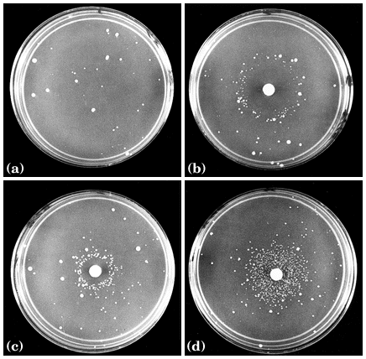
Back
mutations
No mutagen
High level of mutagen
Ames Test:
carcinogens are
tested for their
mutagenicity on
bacterial genomes.
Plating of
his⁻ Salmonella
typhimurium
Medium level of mutagen
Low level of mutagen

Slide 74
A diversity of repair systems have evolved : mismatch repair, base-excision repair, nucleotide-excision repair and direct repair are the common types found.
Many DNA repair systems are energetically expensive (very inefficient compared with other metabolic pathways) and redundant (especially to some common types of lesions).
Complementary synthesis (based on the duplex DNA structure) after elimination of the damaged nucleotides is a common principle for all the repair systems.

Slide 75
TABLE 25-5 | Types of DNA Repair Systems in E. coli
Enzymes/proteins |  | Type of damage
Mismatch repair Dam methylase MutH, MutL, MutS proteins DNA helicase II SSB DNA polymerase III Exonuclease I Exonuclease VII RecJ nuclease Exonuclease X DNA ligase |  | Mismatches
Base-excision repair DNA glycosylases AP endonucleases DNA polymerase I DNA ligase |  | Abnormal bases (uracil, hypoxanthine, xanthine); alkylated bases; in some other organisms, pyrimidine dimers
Nucleotide-excision repair ABC excinuclease DNA polymerase I DNA ligase |  | DNA lesions that cause large structural change (e.g., pyrimidine dimers)
Direct repair DNA photolyases |  | Pyrimidine dimers
O⁶-Methylguanine-DNA methyltransferase |  | O⁶-Methylguanine
AlkB protein |  | 1-Methylguanine, 3-methylcytosine

Slide 76
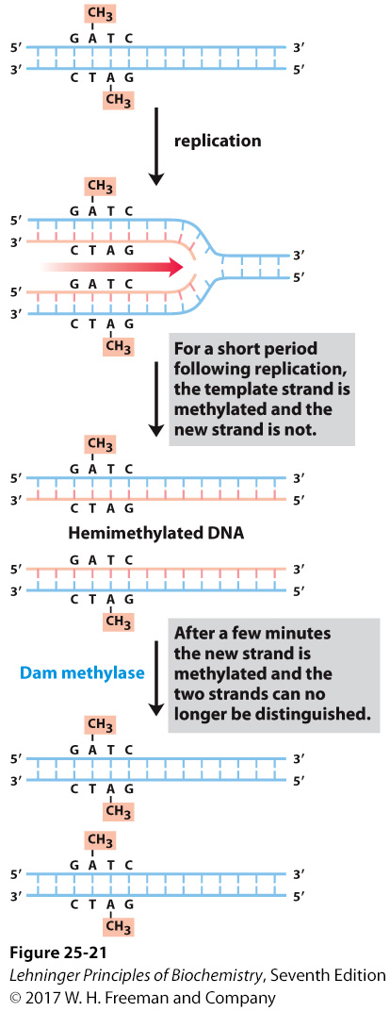
Methylation of DNA strands can serve to distinguish parent (template) strands from newly synthesized strands in E. coli DNA, a function that is critical to mismatch repair.
Methylation and mismatch repair
Notes:
FIGURE 25–21 Methylation and mismatch repair. Methylation of DNA strands can serve to distinguish parent (template) strands from newly synthesized strands in E. coli DNA, a function that is critical to mismatch repair (see Fig. 25–22). The methylation occurs at the N⁶ of adenines in (5’)GATC sequences. This sequence is a palindrome (see Fig. 8–18), present in opposite orientations on the two strands.

Slide 77
When the DNA strands are extensively damaged, the SOS response and error-prone repair (or translesion replication, being a desperate strategy) will occur.
Some proteins may act to repair lesions (the ABC excinuclease, RecA, Pol II), some to inhibit cell divisions (e.g., sulA), and others to act in translesion replication (Rec A protein, SSB, DNA polymerase V made of UmuC and the shortened UmuD or DNA polymerase IV encoded by the dinB gene).
Random nucleotides may be added in place of the damaged ones during translesion replications, but the detailed mechanism has not been revealed.
The increased mutations may generate a few cells (although almost all dead) that are better fit to survive the catastrophic conditions (better species may thus evolve).

Slide 78
Nobel Prize in Chemistry 2015

Slide 79
Keywords
DNA replication --- semiconservative, bidirectional, and semidiscontinuous
DNA polymerases I --- excision of primers,
filling of gaps
DNA polymerases III --- new strand elongation

Slide 80
Words of the week
template
primer
DNA polymerase

Slide 81
Text-book reading of the week
Summary 25.1 (p1027)
p1037-1038: Box 25-1 DNA repair and cancer

Slide 82
Summary
DNA replication begins at specific origins, is semiconservative, bidirectional, and semidiscontinuous.
All DNA polymerases need a primer, extend the DNA chain in 5’ to 3’ direction (using dNTPs), and have 3’ to 5’ exonuclease activity for proofreading.
DNA polymerase III in E. coli and DNA polymerase α and δ in eukaryotic cells are responsible for DNA replication in vivo.

Slide 83
DNA replisomes contain many protein components including helicases, single-stranded DNA binding proteins, topoisomerases, primases, ligases etc.
It is likely that one DNA polymerase complex catalyzes the synthesis of both the leading and lagging strands at each replication fork via DNA looping.
Complex and redundant DNA repair systems have evolved to correct lesions in the DNA molecules.

