Slide 1
Chapter 26 RNA Metabolism
1. How is RNA synthesized using DNA templates (transcription 转录)?
2. How is newly synthesized primary RNA transcripts further processed to make functional RNA molecules (RNA processing)?
3. How is RNA and DNA synthesized using RNA as template (reverse transcription 逆转录)?
4. What is the evolutionary implication of the structural and functional complexity of RNA molecules?

Slide 2
1. RNA molecules have great structural and functional diversity
With structures comparable to proteins in complexity and uniqueness
Function as messengers between DNA and polypeptides (mRNA), adapters (tRNA) to match a specific amino acid with its specific genetic code carried on mRNA, and the structural and catalytic components of the protein-synthesizing machines---ribosomes (rRNA)
Store genetic information in RNA viruses
Catalyze the processing of primary RNA transcripts
Might have appeared before DNA during evolution

Slide 3
2. DNA and RNA synthesis are similar in some aspects but different in others
Similar in fundamental chemical mechanism: both are guided by a template; both have the same polarity in strand extension (5’ to 3’); both use nucleoside 5’- triphosphates (dNTP or NTP).
Different aspects: No primers are needed; only involves a short segment of a large DNA molecule; uses only one of the two complementary DNA strands as the template strand; no proofreading.

Slide 4
Template and nontemplate (coding) DNA strands

Slide 5
Transcription by RNA polymerase in E. coli

Slide 6
5’
3’
3’
5’
Organization of coding information
in the adenovirus genome

Slide 7
3. The multimeric RNA polymerase in E.coli has multiple functions
The holoenzyme consists of five types of subunits (α₂ββ’ω σ) and is used to synthesize all the RNA molecules in E. coli.
The multiple functions include:
searches for initiation sites on the DNA molecule and unwinds a short stretch of DNA (initiation);
selects the correct NTP and catalyzes the formation of phosphodiester bonds (elongation);
detects termination signals for RNA synthesis (termination).

Slide 8
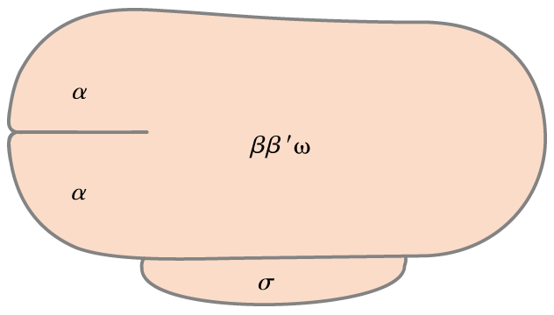
Enzyme assembly,
promoter recognition,
activator binding
Possible catalytic subunits
Role unknown
(not needed in vitro)
151
155
11 kDa
36.5 kDa
Promoter
specificity
(32-90 kDa)
The E. coli RNA polymerase holoenzyme
consists of six subunits: α₂ββ’ω σ.

Slide 9
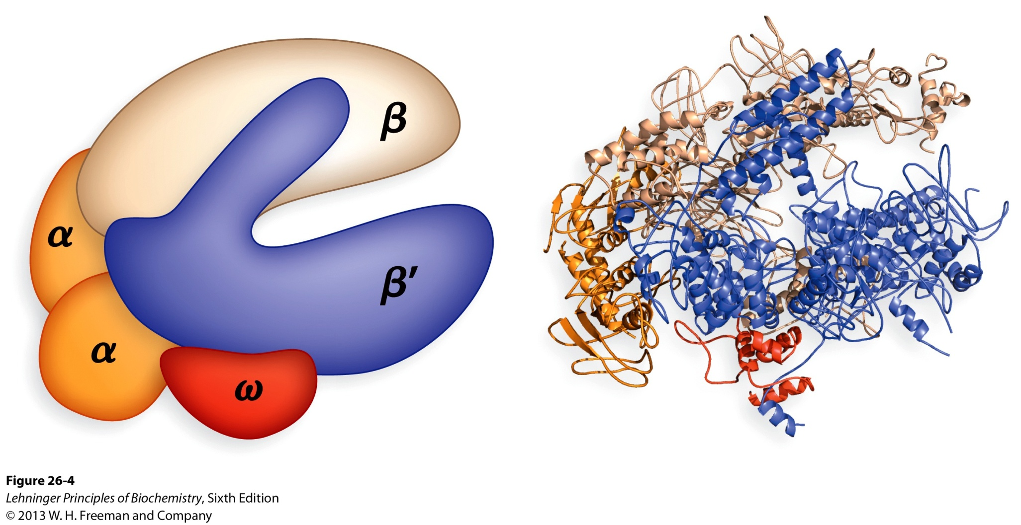
Structure of the RNA polymerase
holoenzyme of the bacterium Thermus aquaticus

Slide 10
4. RNA synthesis occurs in a “moving” transcription bubble on the DNA template
Only a short RNA-DNA hybrid (~8 bp in bacteria) is present through the transcription process.
At each moment, a region of about 17 bp on the E. coli DNA is unwound in the transcription bubble.
The RNA chain is extended at a rate of 50-90 nucleotides/second by the E. coli RNA polymerase.
Unwinding ahead of and rewinding behind of the transcription bubble produces positive and negative supercoils respectively on the DNA (relieved by the action of topoisomerases).

Slide 11
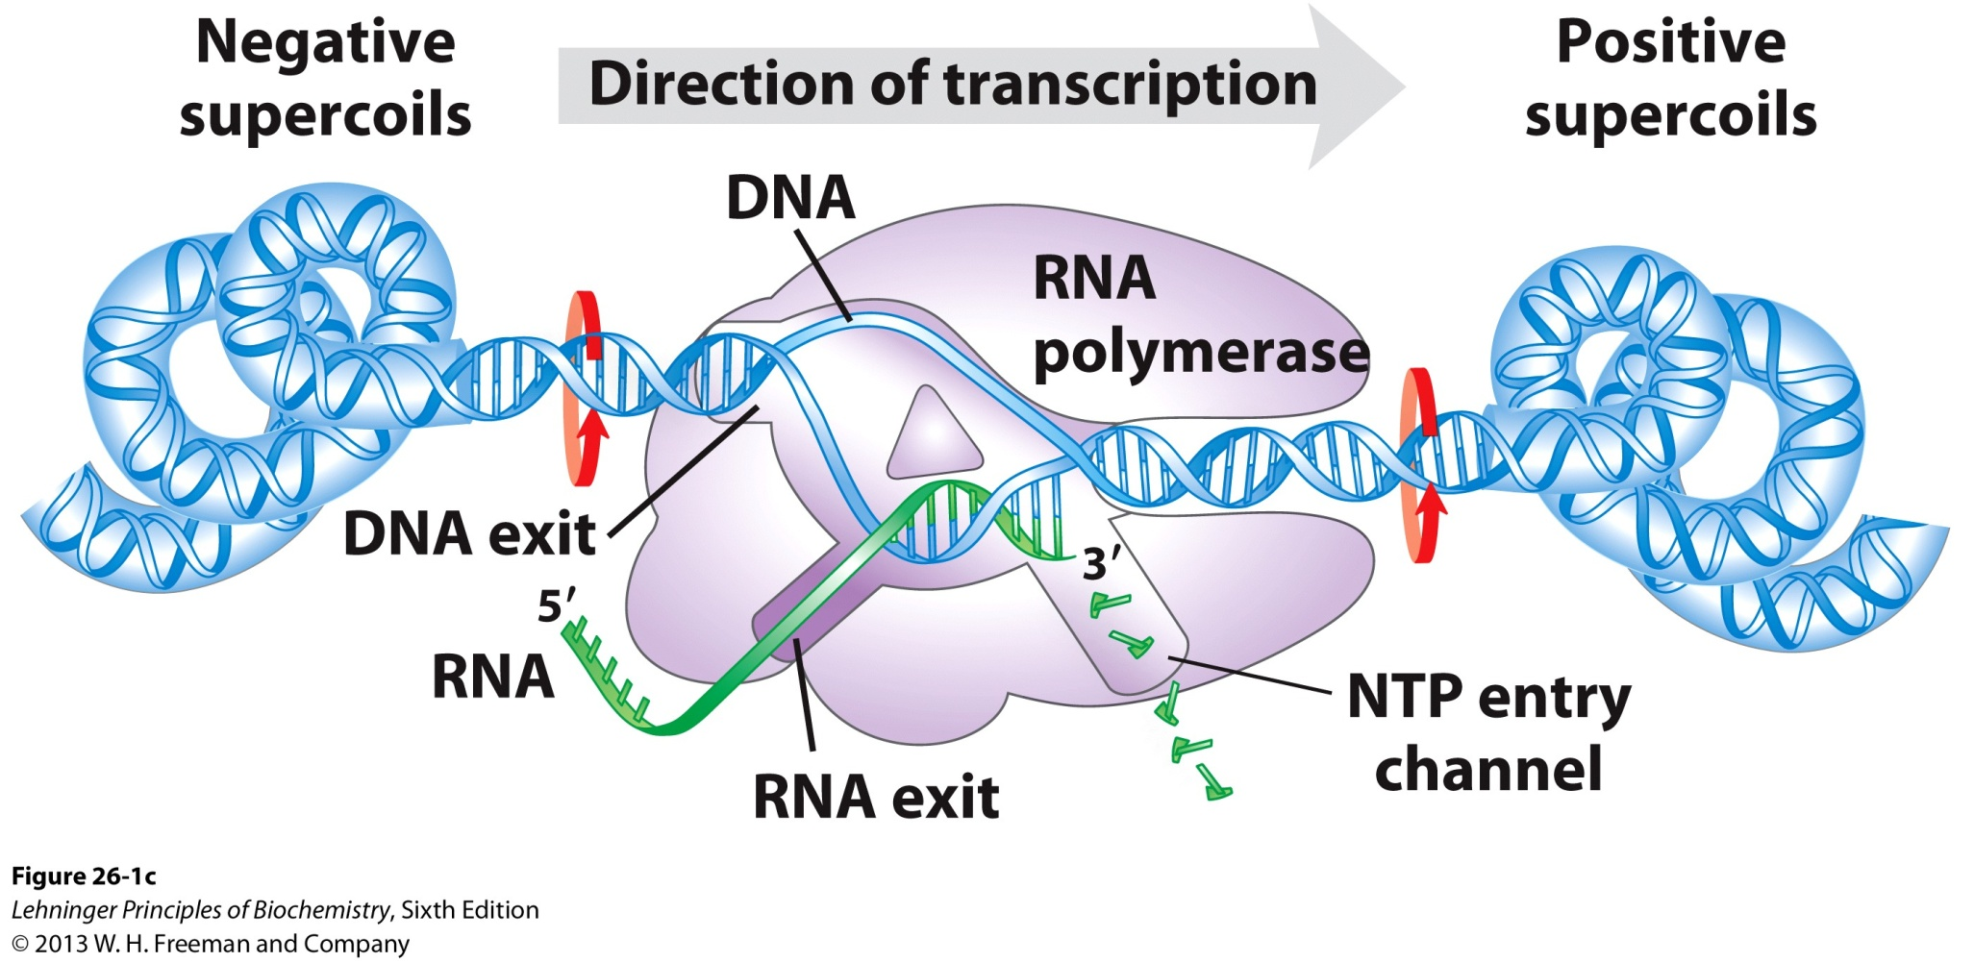
Underwound
Overwound
Changes in the supercoiling of DNA brought by transcription

Slide 12
5. RNA polymerase recognizes specific promoter sequences on DNA to initiate transcription
Promoter sequences are located adjacent to genes.
Promoters, although all bind to the same polymerase, have quite variable DNA sequences (surprisingly), but with two consensus sequences centered at –10 and –35 positions (the first residue of the RNA is given +1).
Promoters having sequences more similar to the consensus are more efficient, and vice versa (from studies of mutations and activity comparison).
Promoters can be identified using “protection assays” (e.g., footprinting techniques).

Slide 13
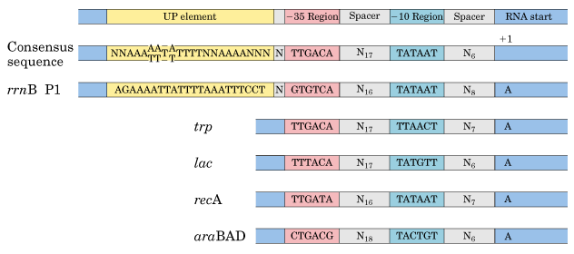
Present only in certain highly expressed genes
Sequences of the
coding DNA strand
is conventionally
shown
Alignment of different promoter sequences from
E.coli genes: the –10 (the Pribnow box) and –35
consensus region were revealed.

Slide 14
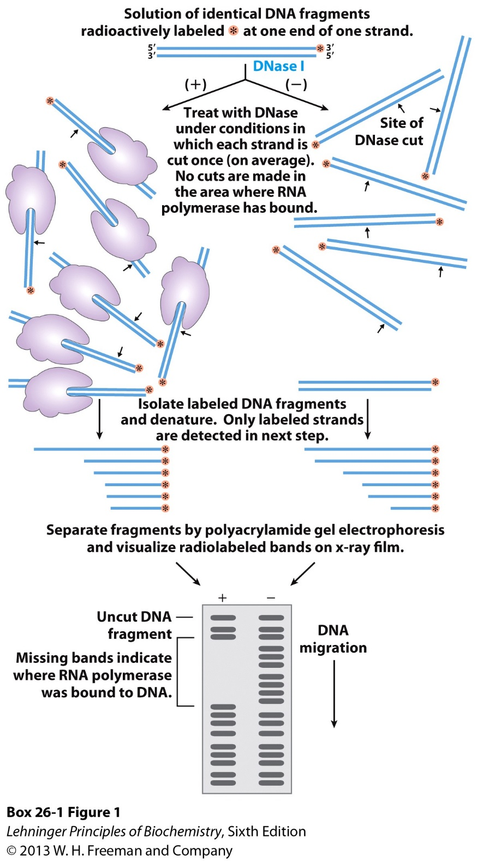
Footprinting: Purified RNA polymerase (or other DNA binding protein) is first mixed with isolated and labeled DNA fragment that is believed to bind to the added protein before that DNA is cut with nonspecific DNase.

Slide 15
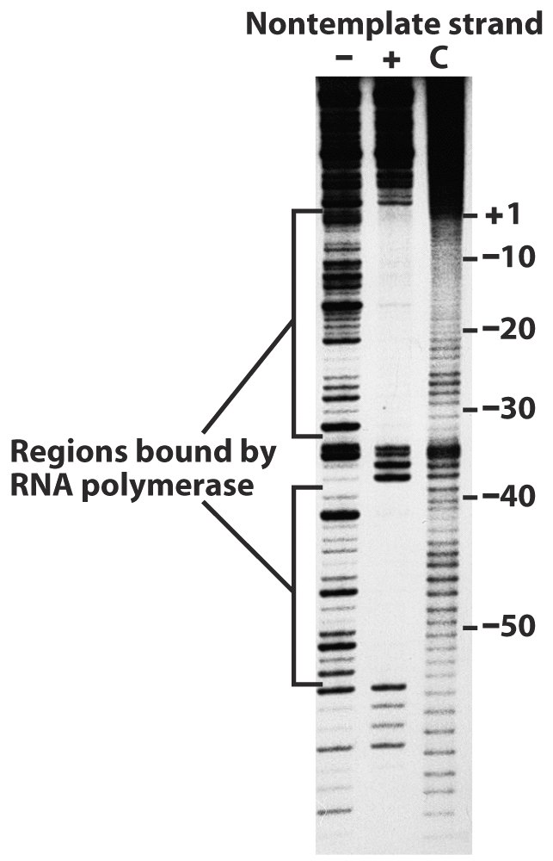
An actual footprinting
result (RNA polymerase
binding to the lac promoter)

Slide 16
6. The σ subunits enable the E.coli RNA polymerase to recognize specific promoter sites
The RNA polymerase without the σ subunit (i.e., the α₂ββ’ω) is unable to start transcription at a promoter.
The σ subunit decreases the affinity of RNA polymerase for general (non-promoter) regions of DNA by a factor of 10⁴.
E.coli contains multiple σ factors for recognizing different promoters, e.g., σ⁷⁰ for standard promoters; σ³² for heat-shock promoters; σ⁵⁴ for nitrogen-starvation promoters.
Each type of σ factors allows the cell to coordinately express a set of genes.

Slide 17
E.coli contains multiple σ factors for
recognizing different types of promoters
Standard
Heat-shock
Nitrogen
starvation
σ⁷⁰ for standard promoters
σ³² for heat-shock promoters
σ⁵⁴ for nitrogen-starvation promoters

Slide 18
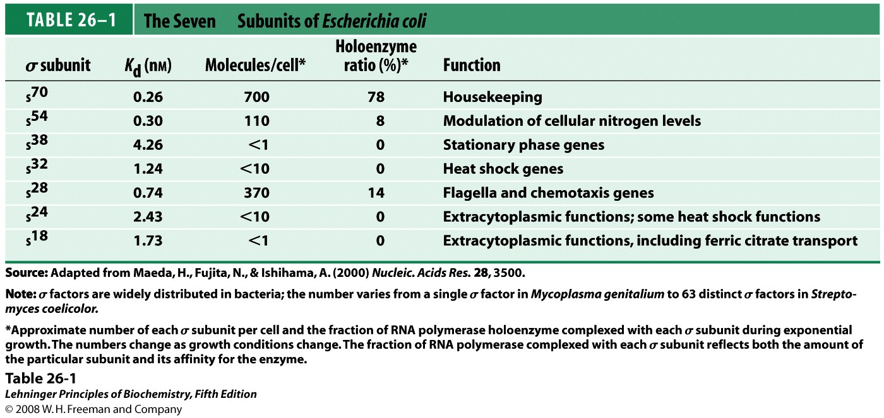
σ
Notes:
TABLE 26-1 The Seven σ Subunits of Escherichia coli

Slide 19
7. RNA polymerase unwinds the template DNA then initiate RNA synthesis
The enzyme slides to a promoter region and forms a more tightly bound “closed complex”.
Then the polymerase-promoter complex has to be converted to an “open complex”, in which a 12-15 bp covering the region from the AT-rich –10 site to +3 site is unwound.
The essential transition from a “closed” to an “open” complex sets the stage for RNA synthesis, after which the core polymerase moves away from the promoter.

Slide 20
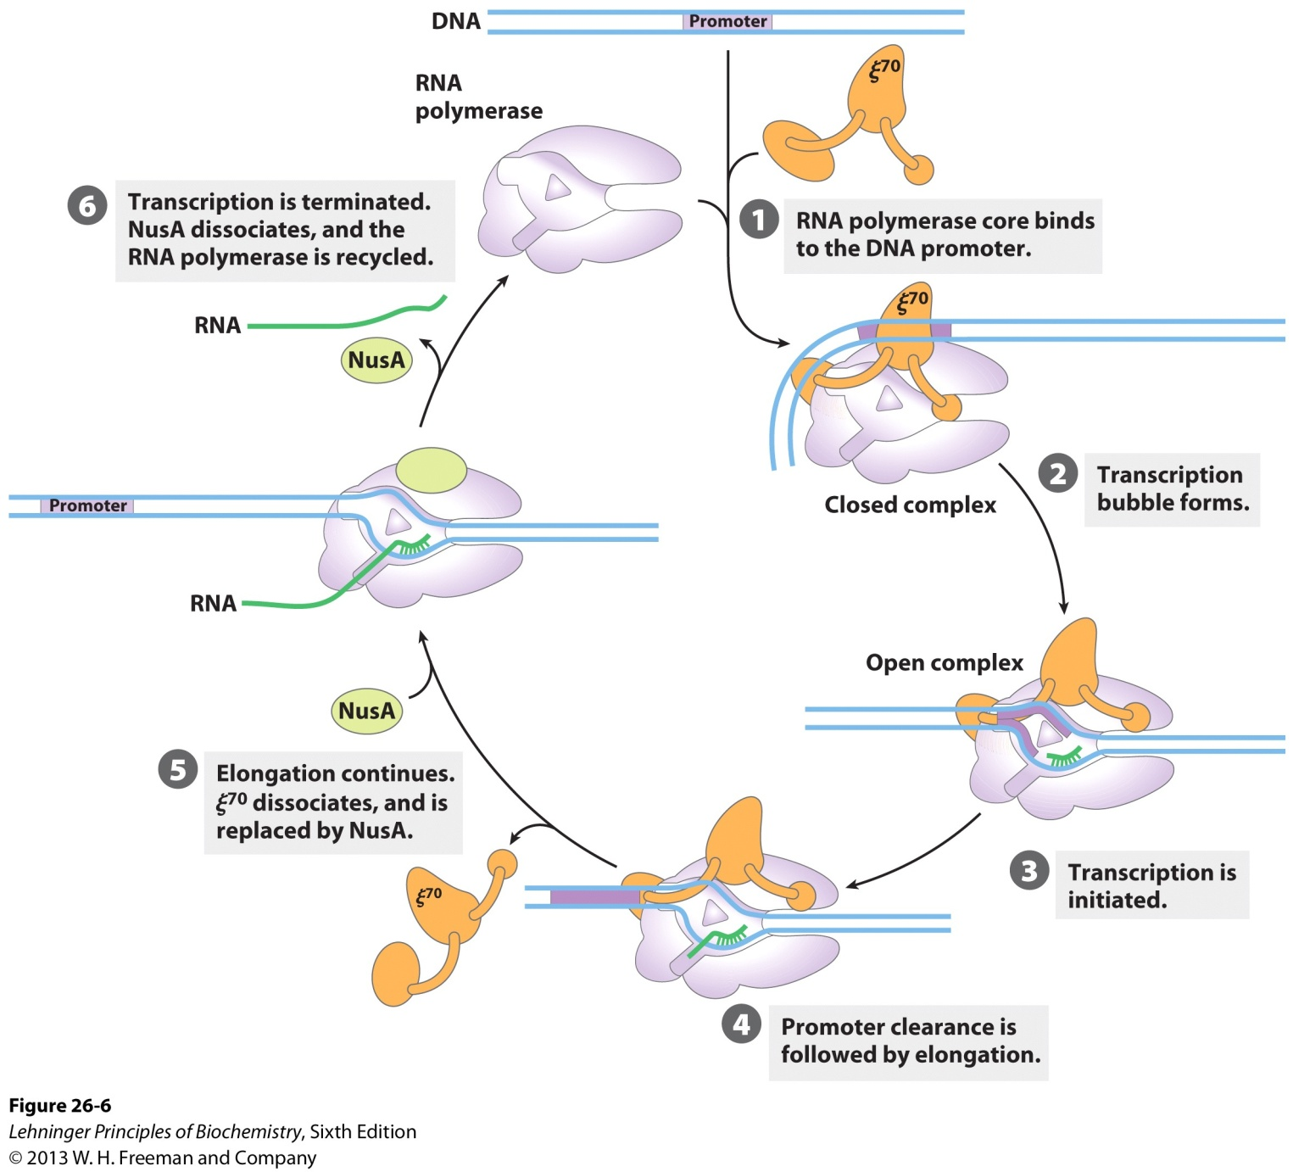
Transcription initiation and elongation
by E. coli RNA polymerase

Slide 21
8. E.coli RNA polymerase stops synthesizing RNA at specific terminator DNA sequences
Two classes of transcription terminators have been identified in bacteria: one depends on ρ protein, the other is ρ-independent.
At the ρ-independent terminator, the transcribed RNA is able to form a stem-loop (palindromic in DNA sequence) structure followed by a stretch of Us (oligoA in DNA).

Slide 22
The ρ-dependent terminator needs the ρ protein, which has an ATP-dependent RNA-DNA helicase activity, for stopping RNA synthesis.
The ρ-dependent terminator DNA exhibits no obvious sequence similarities (probably the RNA polymerase detects noncontiguous structural features?).
The ρ-dependent terminator is more often found in phages (where it was originally discovered), but rarely in E.coli.
In contrast to what was originally expected, the active signals for stopping RNA synthesis in both ρ-independent and ρ-dependent transcription terminators lie in the newly synthesized RNA rather than in the DNA template.

Slide 23
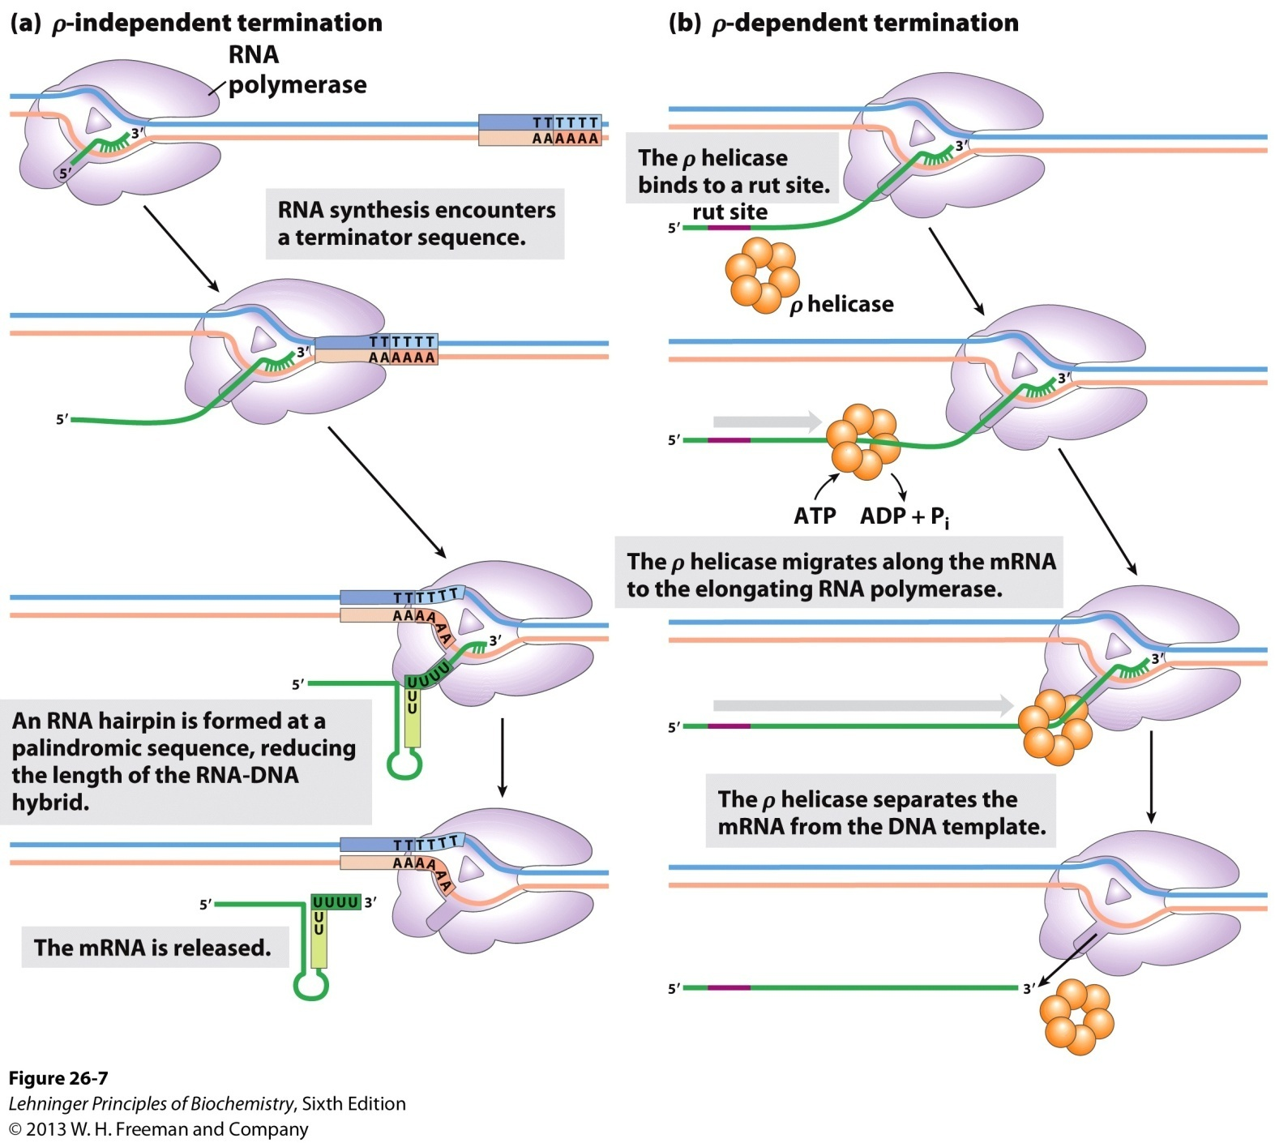
Termination of transcription in E. coli

Slide 24
9. Transcription is a highly regulated process
Transcription is the first step in the complicated and energy-expensive pathway leading to protein synthesis, therefore, an ideal target for regulating gene expression.
The RNA polymerase binds to each promoter with very different efficiency.
Protein factors binding to DNA sequences close or distant to the promoters can promote (activator) or repress (repressor) the synthesis of certain RNA molecules.

Slide 25
10. Three kinds of RNA polymerases (I, II, and III) have been revealed for making RNAs in the nucleus of eukaryotic cells
Each is responsible for the transcription of a certain groups of genes: rRNA, mRNA or tRNA genes.
The enzymes are often identified by examining their sensitivity towards α-amanitin (from a toxic mushroom).

Slide 26
Eukaryotic RNA polymerases
*****
S: sedimentation coefficient, the ratio of the velocity of sedimentation of a molecule to the centrifugal force required to produce this sedimentation, given in Svedberg units that are nonadditive

Slide 27
11. RNA polymerase II (Pol II) binds to promoters of thousands of protein-coding genes
Many Pol II promoters contain a TATAAA sequence (called a TATA box) at -30 position and an initiator sequence (Inr) at +1 position.
The preinitiation complex (including Pol II) is believed to assemble at the TATA box, with DNA unwound at the Inr sequence.
However, many Pol II promoters lack a TATA or Inr or both sequences!

Slide 28
Common sequences in promoters recognized
by eukaryotic RNA polymerase II

Slide 29
12. Pol II is helped by an array of protein factors (called transcription factors) to form an active transcription complex at a promoter
First the TATA-binding protein (TBP) binds to the TATA box, then TFIIB, TFIIF-Pol II, TFIIE, and TFIIH will be added in order, forming the closed complex at the promoter.
TFIIH then acts as a helicase to unwind the DNA duplex at the Inr site, forming the open complex.
A kinase activity of TFIIH will phosphorylate the C-terminal domain (CTD) of Pol II, which will initiate RNA synthesis and release the elongation complex.

Slide 30
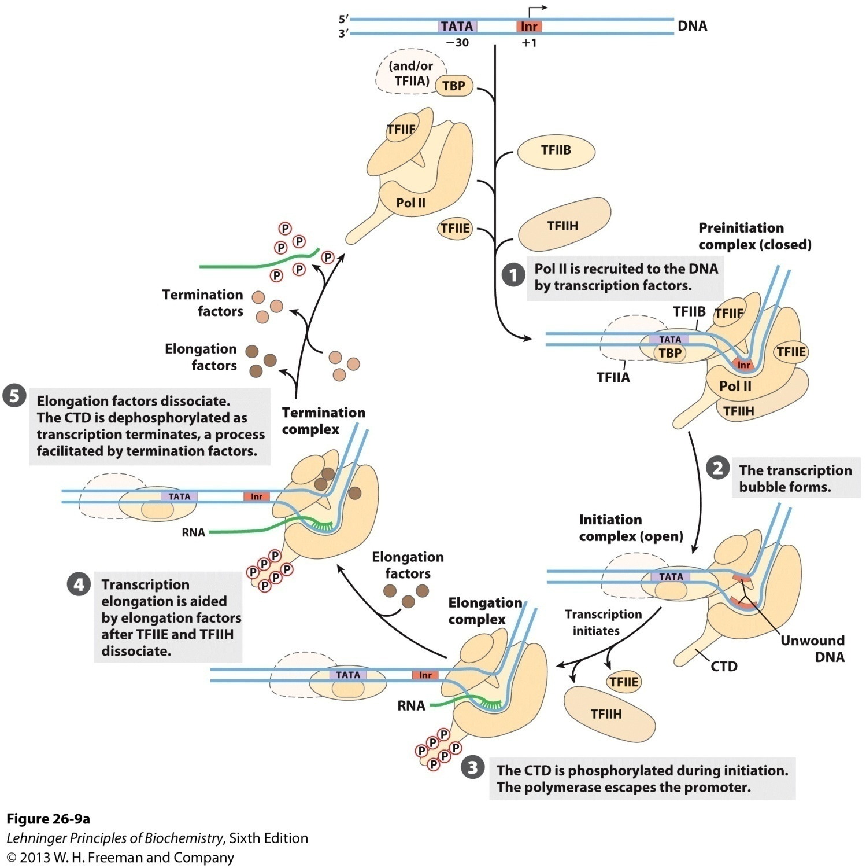
Transcription at RNA
polymerase II promoters

Slide 31
TFIIE and TFIIH will be released after the elongation complex moves forward for a short distance.
Elongation factors will then join the elongation complex and will suppress the pausing or arrest of the Pol II-TFIIF complex, greatly enhancing the efficiency of RNA synthesis.
The termination of transcription of Pol II happens by an unknown mechanism.

Slide 32
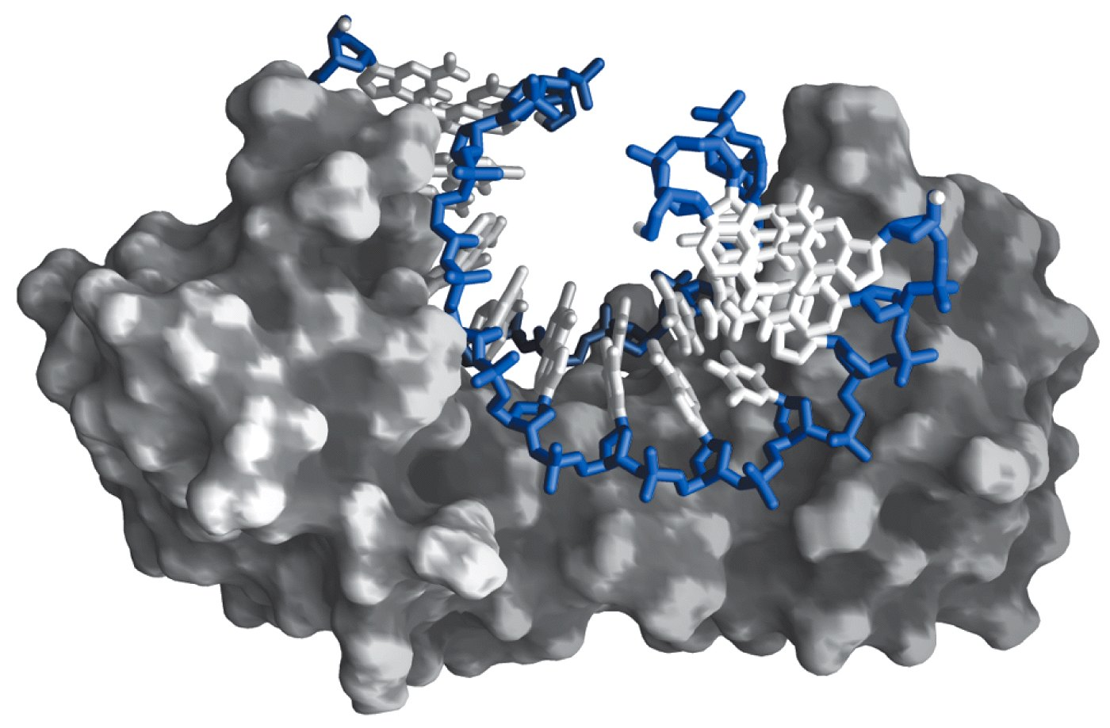
The structure of human TBP Bound to DNA

Slide 33
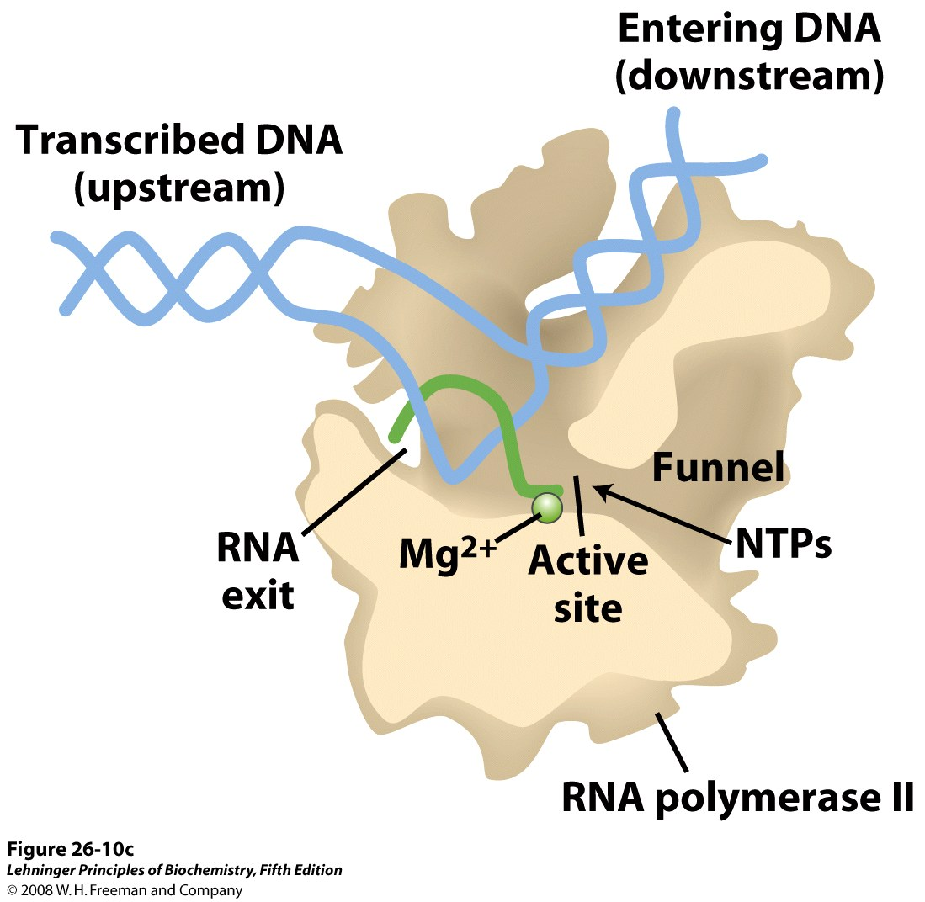
A cutaway view of transcription elongation promoted by the Pol II core enzyme
Notes:
FIGURE 26-10c Transcription at RNA polymerase II promoters. (c) A cutaway view of transcription elongation promoted by the Pol II core enzyme. The drawing is based on the structure featured on the cover of this book.

Slide 34
This basal process of initiating RNA synthesis by Pol II is elaborately regulated by many cell- or tissue- specific protein factors that bind to the transcription factors, mostly acting in a positive way.
When Pol II transcription stalls at a site of DNA lesion, TFIIH will binds at the lesion site and appears to recruit the entire nucleotide-excision repair complex.

Slide 35
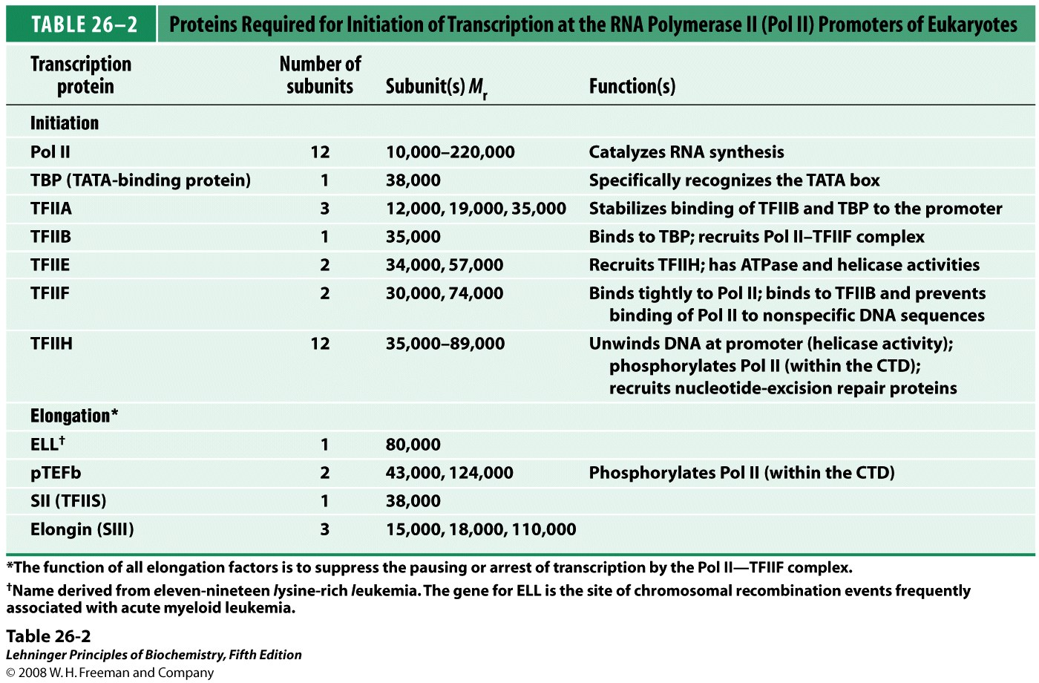
*****
Notes:
TABLE 26-2 Proteins Required for Initiation of Transcription at the RNA Polymerase II (Pol II) Promoters of Eukaryotes

Slide 36
13. The action of RNA polymerases can be specifically inhibited
Three-ring-containing, planar antibiotic molecules like actinomycin (放射菌素) D intercalates between two successive GC base pairs in duplex DNA, preventing RNA polymerases (all types) to move along the template (thus the elongation of RNA synthesis).
Rifampicin (利福平) (an antibiotic) binds to the β subunit of bacterial RNA polymerases, preventing the initiation of RNA synthesis.
α-amanitin (蝇蕈素) blocks eukaryotic mRNA synthesis by binding to RNA polymerase II.

Slide 37
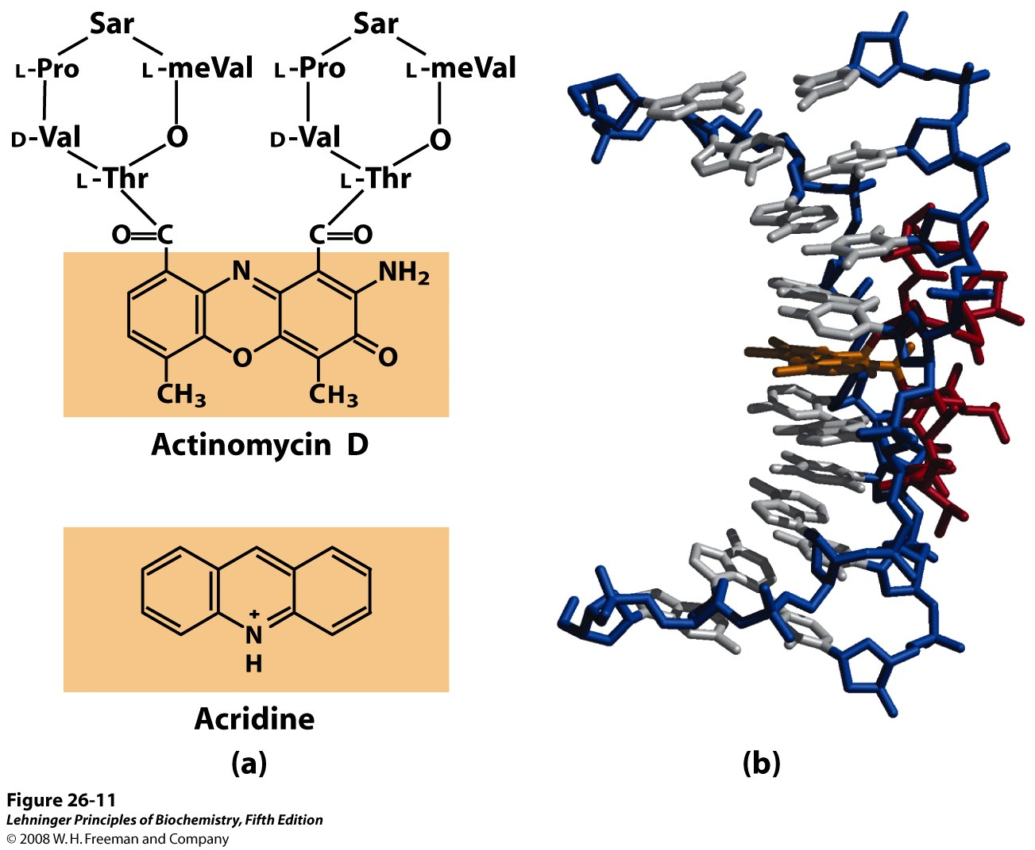
A complex of actinomycin D
with DNA

Slide 38
14. RNA molecules are often further processed after being synthesized on the DNA template
The primary transcripts of eukaryotic mRNAs are often capped at the 5’ end, spliced in the middle (introns removed and exons linked), polyadenylated at the 3’ end.
The primary transcripts of both prokaryotic and eukaryotic tRNAs are cleaved from both ends, spliced in some cases, and modified for many of the bases and sugars.

Slide 39
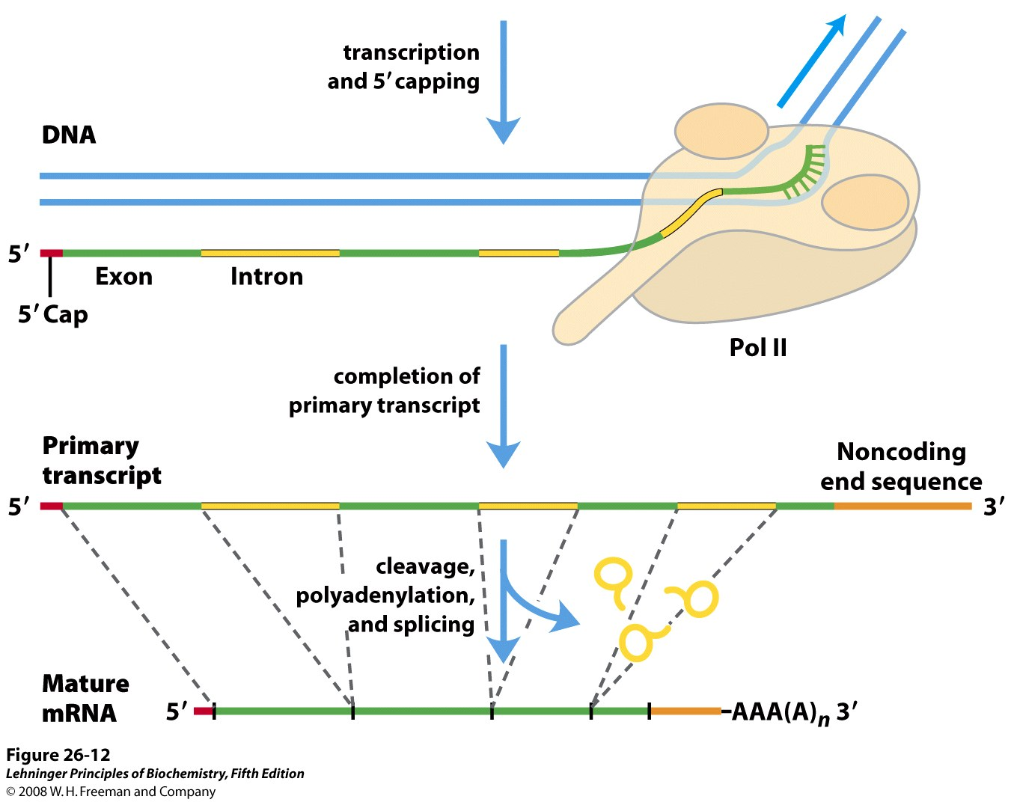
Processing of eukaryotic mRNA

Slide 40
15. An eukaryotic mRNA precursor acquires a 5’ cap shortly after transcription initiates
A GMP component (from a GTP) is joined to the 5’ end of the mRNA in a novel 5’,5’-triphosphate linkage.
The guanine base is then methylated at the N-7.
The 2’-OH groups of the 1st and 2nd nucleotides adjacent to the 7-methylguanine cap may also be methylated in certain organisms.
The methyl groups are transferred from S-adenosylmethionine.

Slide 41
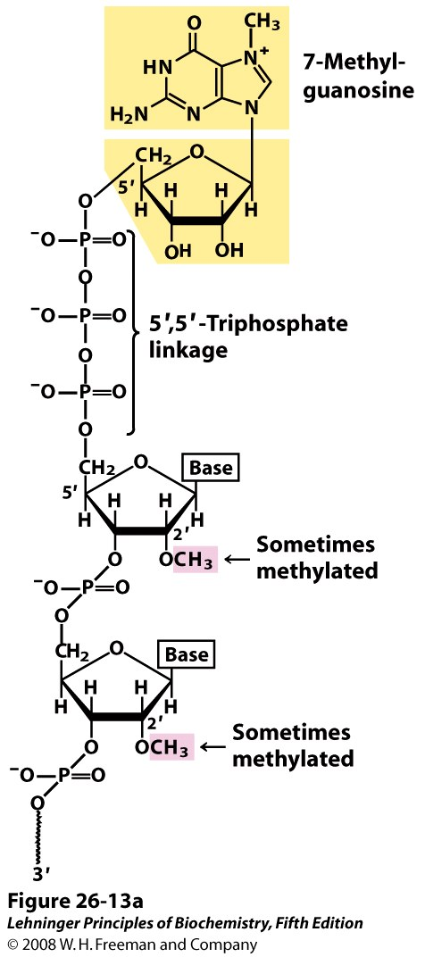
The 5’ cap of mRNA

Slide 42
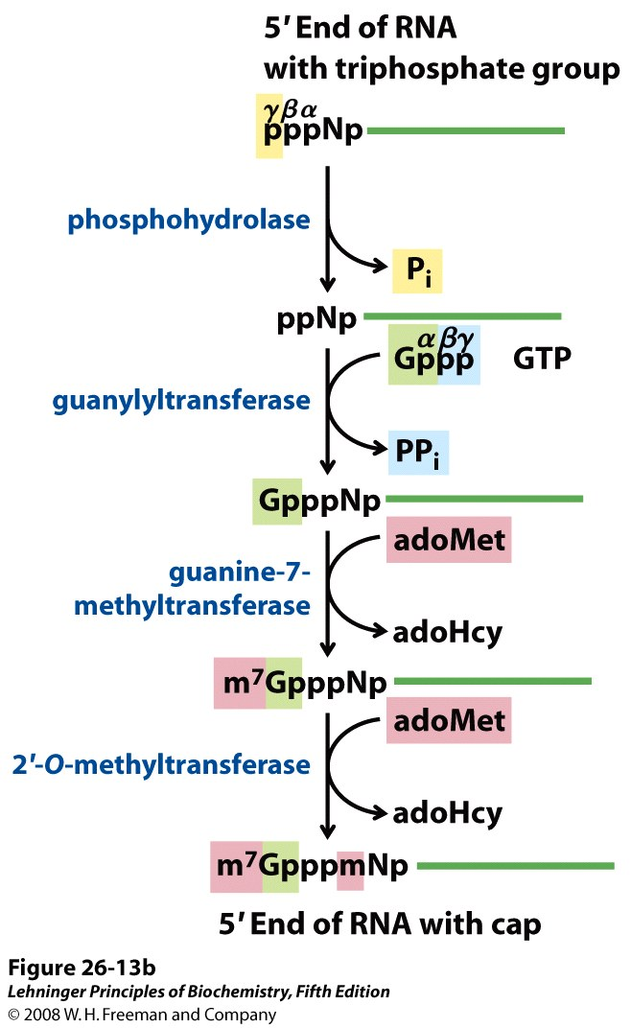
A 5’ cap is added
to eukaryotic
mRNAs before
transcription
ends.
)
Generation of the 5’ cap

Slide 43
16. Most eukaryotic mRNAs have a poly(A) tail at the 3’ end
The tail consists of 80 to 250 adenylate residues.
The mRNA precursors are extended beyond the site where poly(A) tail is to be added.
An AAUAAA sequence was found to be present in all mRNAs and marks (together with other signals at the 3’ end) the site for cleavage and poly(A) tail addition (11 to 30 nucleotides on the 3’ end of the AAUAAA sequence).
The specific endonuclease and polyadenylate polymerase, and other proteins probably exist as a multiprotein complex to catalyze this event.

Slide 44
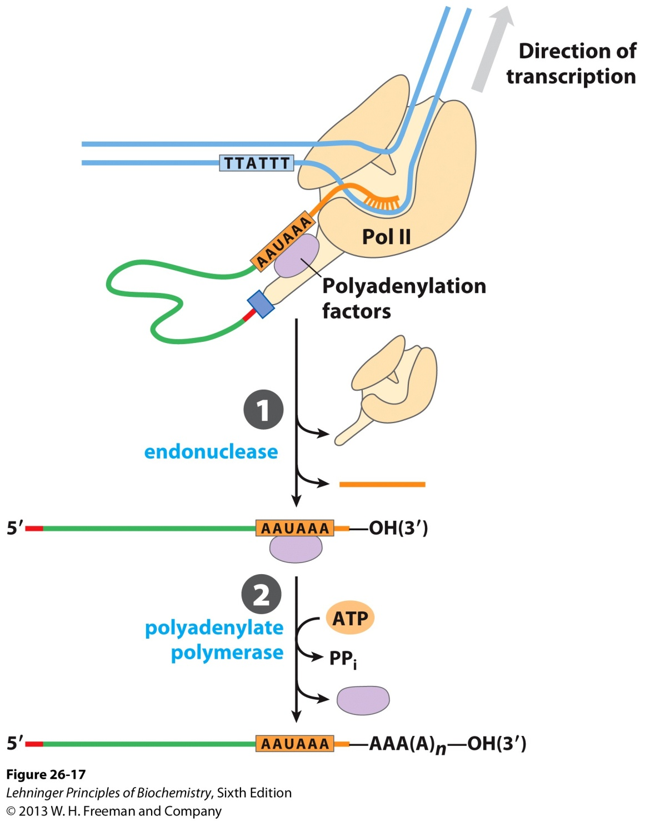
A poly(A) tail
is usually added
at the 3’ end of an
mRNA molecule
via a processing
step.
Addition of the poly(A) tail to the primary RNA transcript of eukaryotes

Slide 45
17. EM studies of mRNA-DNA hybrids revealed the discontinuity of eukaryotic genes
Each gene was found to be a continuous fragment of DNA in the bacterial genome.
But Roberts and Sharp (1977) observed single-stranded DNA loops when examining adenovirus mRNA-DNA hybrids by electron microscopy.
Such single-stranded DNA loops were widely observed when examining such RNA-DNA hybrids.
Intron sequences were proposed to be present on the template DNA sequences, which are removed during RNA processing, with exons linked together precisely.

Slide 46
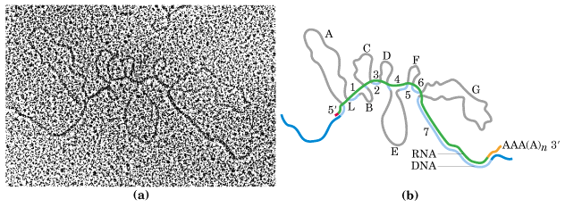
EM studies of mRNA-DNA hybrids for the
chicken ovalbumin gene
(the R-looping technique)

Slide 47
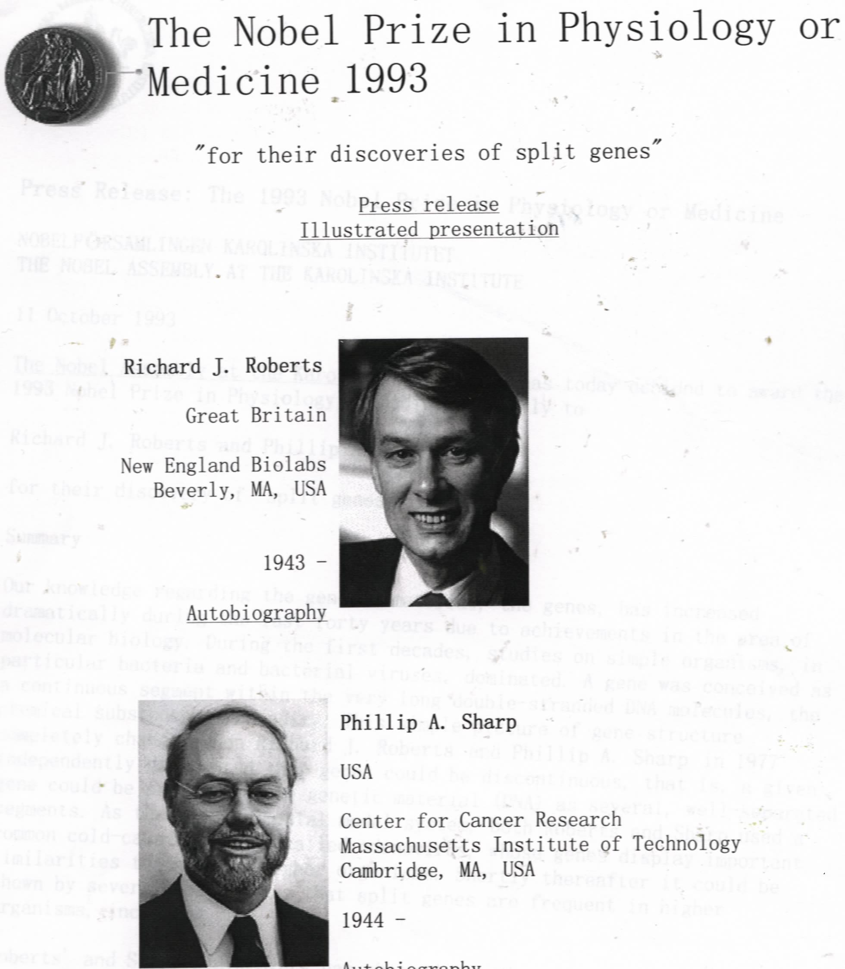

Slide 48
18. Four classes of introns have been revealed and have different splicing mechanisms
Group I introns are found in some nuclear, mitochondrial and chloroplast genes encoding rRNAs, mRNAs, and tRNAs.
Group II introns are often found in genes encoding mRNAs in mitochondrial and chloroplast DNA of fungi, algae, and plants.
Type III introns (the largest group) are found in genes encoding eukaryotic nuclear mRNAs.
Group IV introns are found in genes encoding the tRNAs in the nuclear genomic DNA of eukaryotes.

Slide 49
19. Group I introns are self-splicing and use a guanine nucleoside or nucleotide as the cofactor
The intron present in the rRNA precursor of Tetrahymena was found to be removed by itself without using any proteins (Thomas Cech, 1982).
The intron is removed and the two exons precisely linked via two nucleophilic transesterification reactions (with two 3’-OH group act as the nucleophiles).

Slide 50
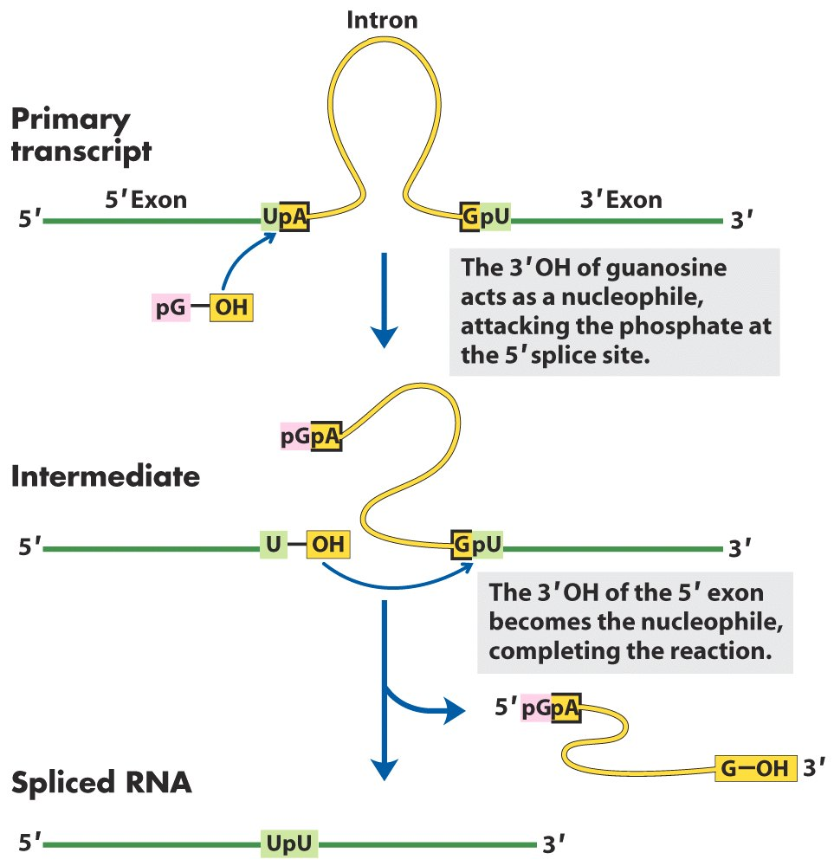
Group I introns
are removed by self-splicing via
two nucleophilic
transesterification
reactions.

Slide 51
20. Group II introns also undergo self-splicing by forming a lariat-like intermediate
The 2’-OH group of an adenylate residue within the removing intron played the role of the 3’-OH group of the guanine nucleoside in group I intron self-splicing.

Slide 52
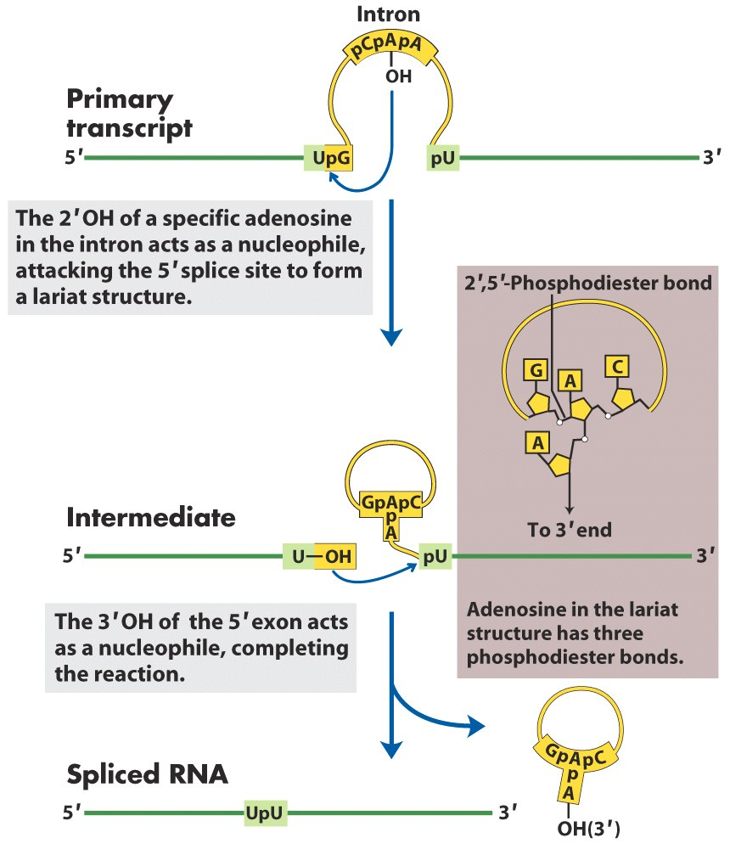
Group II introns are removed via self-splicing with an adenylate residue of the removing
intron acting as the nucleophile,
forming an lariat-like intermediate.

Slide 53
21. Type III introns are found in the nuclear mRNA primary transcripts and have the largest numbers
The splicing exon-intron junctions are determined by comparing the sequences of the genomic DNA with that of the cDNA prepared from the corresponding mRNA. mRNA precursors are specified by sequences at the two ends of the introns: begin with GU and end with AG.
Type (not group) III introns are removed via a very similar way as that of group II introns except being helped by several highly conserved small nuclear ribonucleoproteins (snRNPs), each containing a class of U-rich small nuclear RNAs (snRNAs).

Slide 55
RNA pairing interactions in the formation
of spliceosome complexes

Slide 56
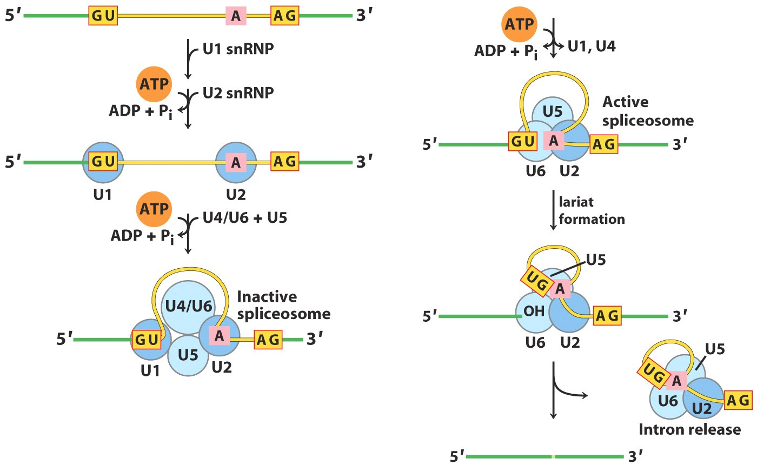
Type III introns, found on nuclear mRNA primary
transcripts, are removed via the spliceosomes.

Slide 57
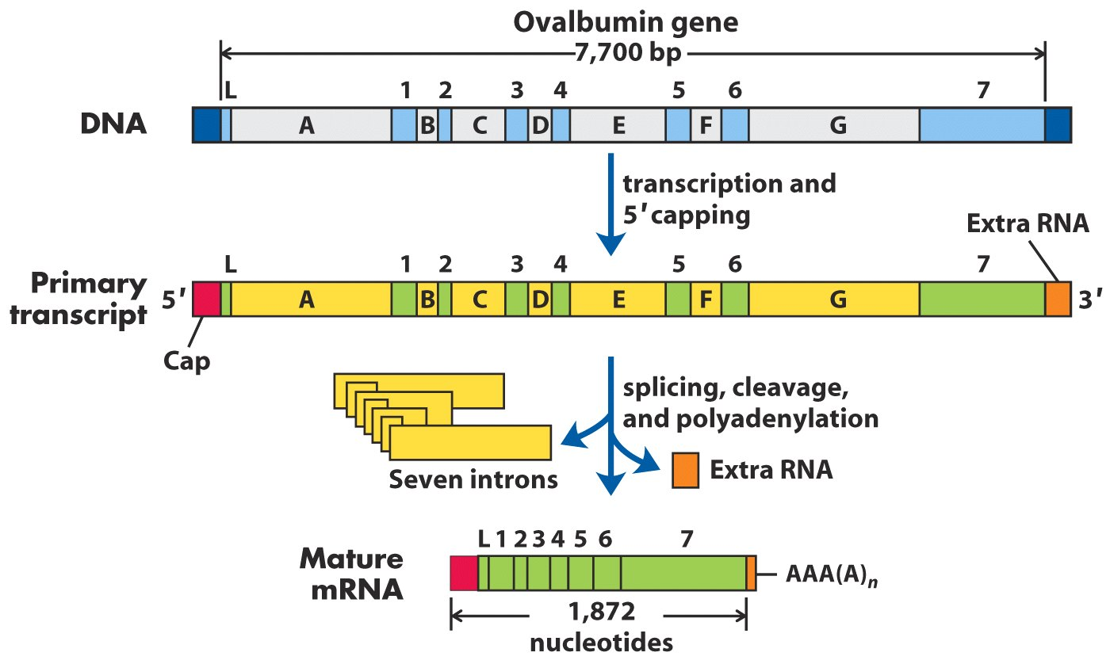
Processing of ovalbumin pre-mRNA

Slide 58
22. Group IV introns are found in tRNA precursors and are removed by endonuclease and RNA ligase
The splicing endonuclease first cleaves the phosphodiester bonds at both ends of the intron.
ATP is needed for the RNA ligase activity to join the two exons.
The joining reaction is similar to the DNA ligase-catalyzed reaction.
The mechanism of cleaving group IV introns is different from that of groups I, II, and type III introns, all including two transesterification reactions.

Slide 59
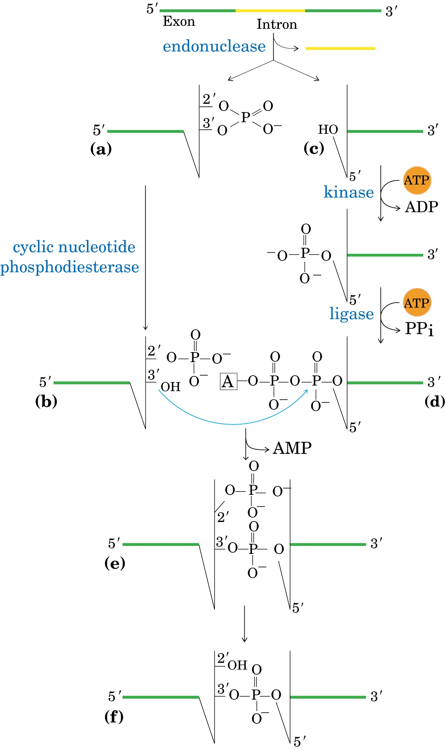
Group IV introns are spliced via the
action of specific
endonuclease and
RNA ligase.

Slide 60
23. Alternative proteins may be produced from one single gene via differential RNA processing
The multiple transcripts produced from such a gene may have more than one site for cleavage and polyadenylation (as for immunoglobulin heavy chains), alternative splicing (as for the myosin heavy chains in fruit flies), or both (as for the calcitonin gene in rats).
In different cells or at different stages of development, the transcript may be processed differently to produce different gene products (proteins).

Slide 61
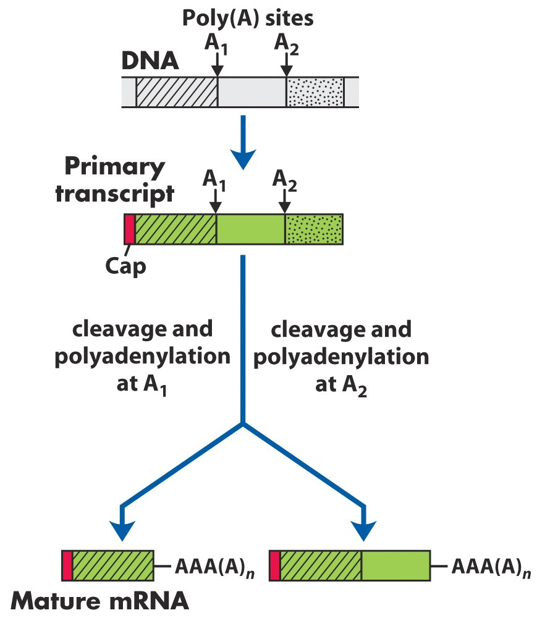
Multiple mRNAs (thus polypeptide chains) can be produced via differential RNA processing.

Slide 62
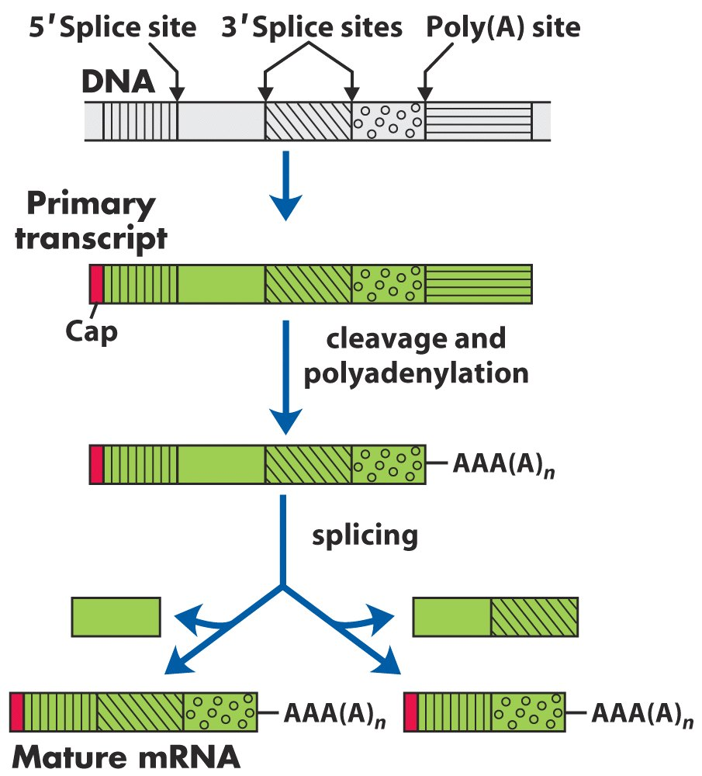
Multiple mRNAs (thus polypeptide chains) can
be produced via differential RNA processing.

Slide 63
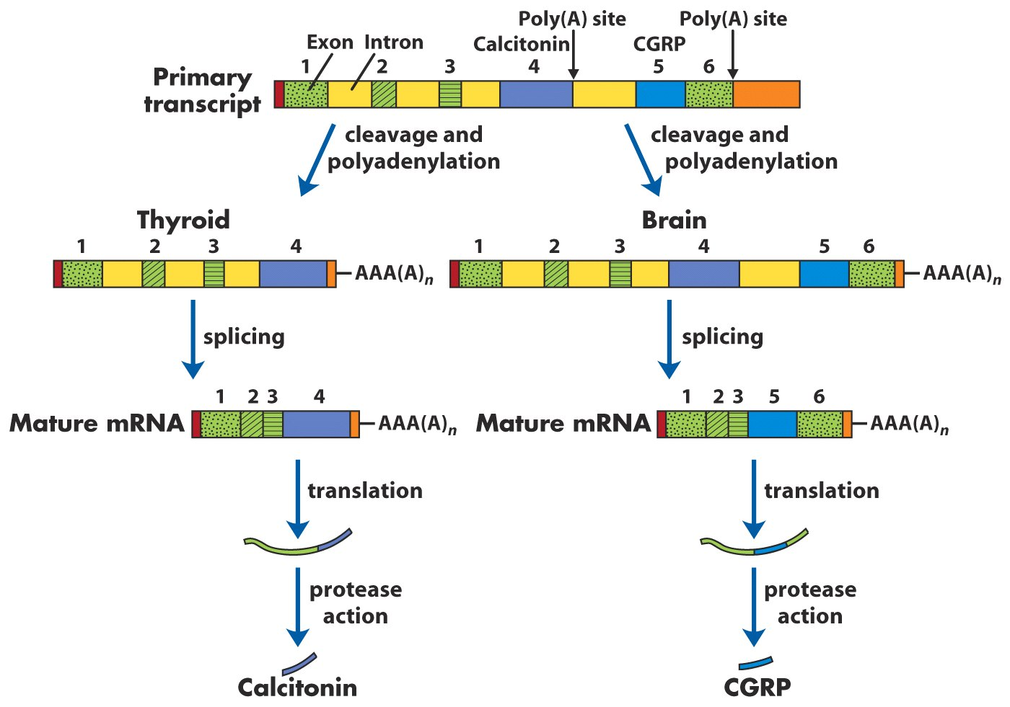
Alternative processing of the calcitonin gene transcript in rats

Slide 64
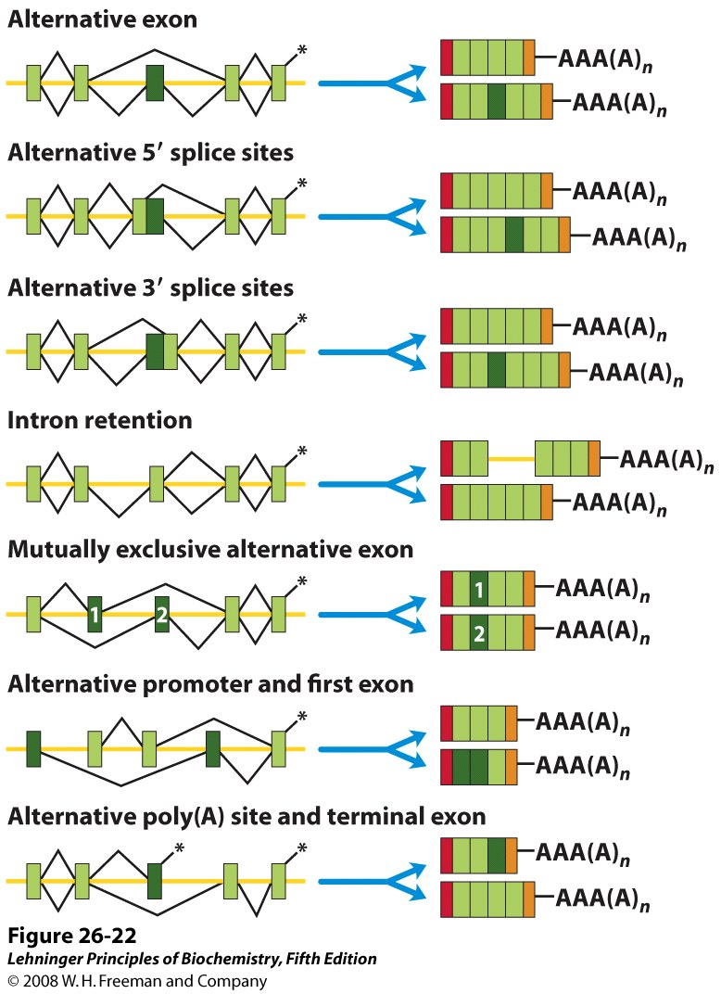
Summary of splicing patterns
Notes:
FIGURE 26-22 Summary of splicing patterns. Exons are shown in shades of green, and introns/untranslated regions as yellow lines. Positions where polyadenosine is to be added are marked with asterisks. Exons joined in a particular splicing scheme are linked with black lines. The alternative linkage patterns above and below the transcript lead to the top and bottom spliced mRNA products, respectively. In the products, red and orange boxes represent the 5′ cap and 3′ untranslated regions, respectively.

Slide 65
24. The different rRNA molecules of both prokaryotes and eukaryotes are generated from single pre-rRNAs
The 16S, 23S and 5S rRNAs (together with certain tRNAs) in bacteria are all generated from a single 30S pre-rRNA (about 6.5 kb, transcribed by RNA polymerase I).
There are seven pre-rRNA genes in the E.coli genome (region between each encoding different tRNAs).
The 18S, 28S and 5.8S rRNAs in eukaryotes are generated from a single 45S pre-rRNA (~14 kb).
The 5S rRNA in eukaryotic cells is generated separately (transcribed by RNA polymerase III).

Slide 66
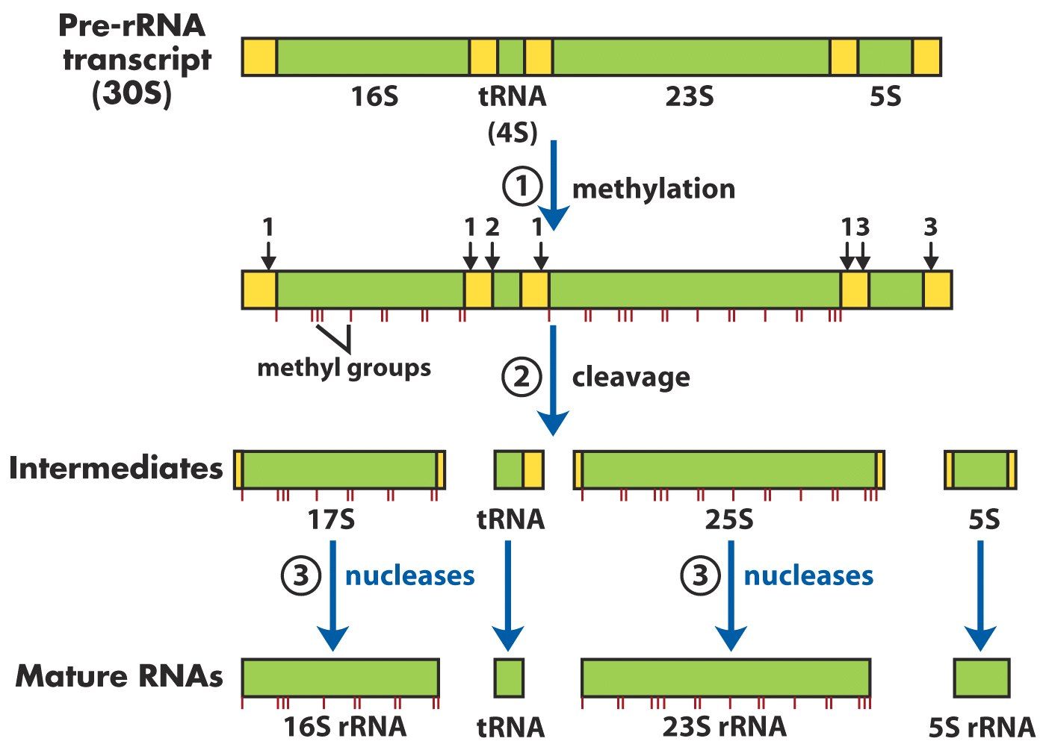
All the rRNAs are derived from a single precursor in prokaryotic cells. Cleavage sites labeled with 1, 2 and 3 are recognized by RNase III, RNase P, and RNase E, respectively.

Slide 67
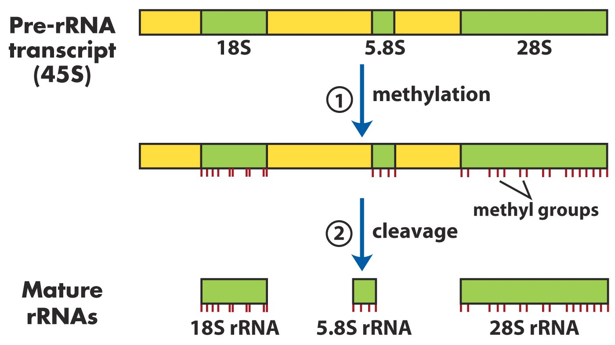
The 18S, 5.8S, and 28S rRNAs in eukaryotic cells are
derived from one pre-rRNA molecule (the processing
needs small nucleolar RNA-containing proteins).

Slide 68
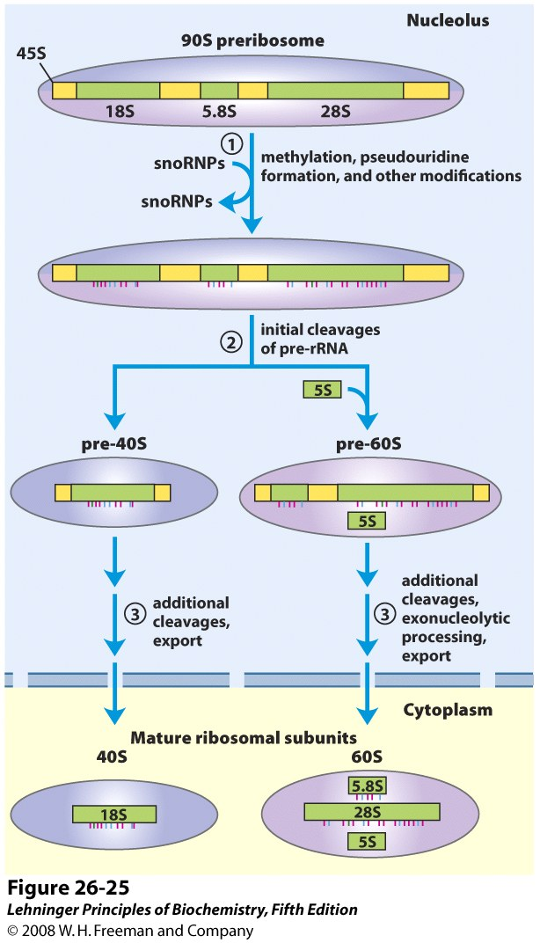
Processing of pre-rRNA
transcripts in vertebrates
Notes:
FIGURE 26-25 Processing of pre-rRNA transcripts in vertebrates. During transcription, the 45S primary transcript is incorporated into a nucleolar 90S preribosomal complex, in which rRNA processing and ribosome assembly are tightly coupled. 1 The 45S precursor is methylated at more than 100 of its 14,000 nucleotides, either on the bases or on the 2′-OH groups, some uridines are converted to pseudouridine, and a few other modifications occur. 2 A series of enzymatic cleavages of the 45S precursor produces the 18S, 5.8S, and 28S rRNAs, and the ribosomal subunits gradually take shape with the assembling ribosomal proteins. The cleavage reactions and all of the modifications require small nucleolar RNAs (snoRNAs) found in protein complexes (snoRNPs) in the nucleolus that are reminiscent of spliceosomes. The 5S rRNA is produced separately

Slide 69
25. Primary tRNA transcripts undergo a series of posttranscriptional processing
The extra sequences at the 5’ and 3’ ends are removed by RNase P and RNase D respectively.
The RNA in RNaseP is catalytic (Altman, 1983).
Group IV introns are occasionally present in pre-tRNAs in eukaryotic cells.
The CCA sequence is generated at the 3’ end by the action of tRNA nucleotidyltransferase (having three active sites for the three ribonucleotides added).
Some of the bases in tRNA molecules are modified by methylation, deamination, reduction and others.

Slide 70
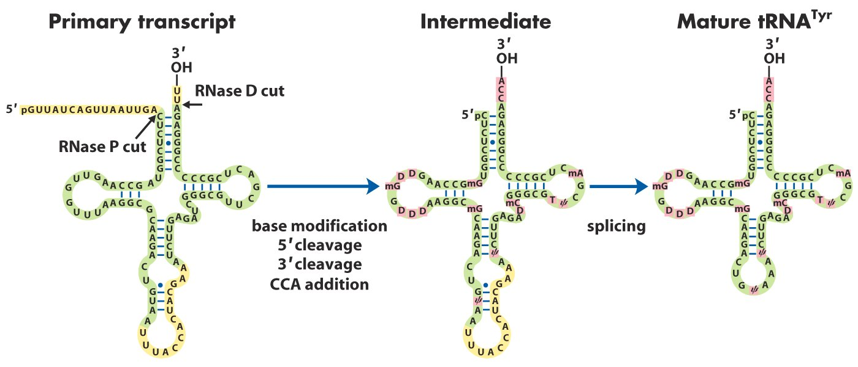
intron
The processing of the primary tRNA transcripts
include removal of the 5’and 3’ ends, addition of the CCA sequence at the 3’ end, modification of many bases, and splicing of introns (in eukaryotic cells).

Slide 71
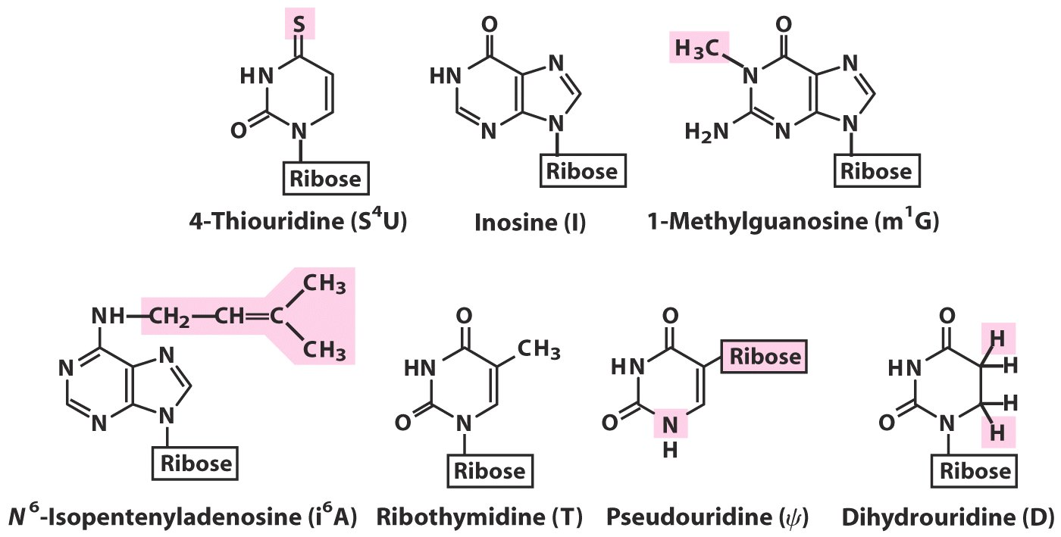
Some typical modified bases found in mature tRNA molecules

Slide 72
26. More RNA molecules (ribozymes) were found to be catalytic
Catalytic RNA molecules were also found in the virusoid RNA (called hammerhead ribozymes).
RNAs in the spliceosomes (the U-rich RNAs) and ribosomes are also believed to be catalytic.
A specific 3-D structure is required for ribozymes to be catalytic.
Ribozymes often orient their substrates via base pairing.

Slide 73
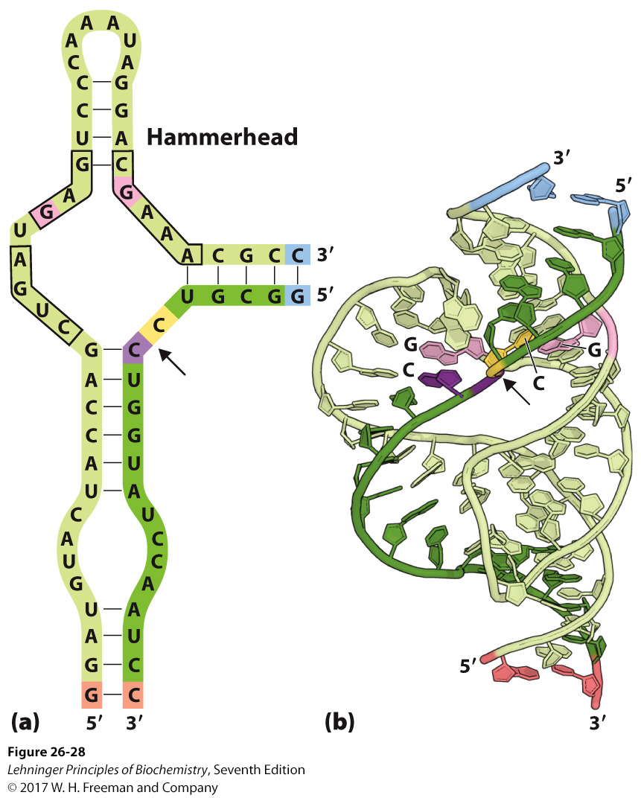
The minimal sequences required for catalysis
Site of
self-cleavage
Three-dimensional structure
Hammerhead ribozyme
Notes:
FIGURE 26–28 Hammerhead ribozyme. Certain viruslike elements, or virusoids, have small RNA genomes and usually require another virus to assist in their replication or packaging or both. Some virusoid RNAs include small segments that promote site-specific RNA cleavage reactions associated with replication. These segments are called hammerhead ribozymes, because their secondary structures are shaped like the head of a hammer. Hammerhead ribozymes have been defined and studied separately from the much larger viral RNAs. (a) The minimal sequences required for catalysis by the ribozyme. The boxed nucleotides are highly conserved and are required for catalytic function. The arrow indicates the site of self-cleavage. (b) Three-dimensional structure (PDB ID 1MME; see Fig. 8–25b for a space-filling view). The strands are colored as in (a). The hammerhead ribozyme is a metalloenzyme; Mg²⁺ ions are required for activity in vivo. The phosphodiester bond at the site of self-cleavage is indicated by an arrow.

Slide 74
The excised intron (414 nucleotides) of the pre-rRNA of Tetrahymena is further processed to a RNA fragment of 395 nucleotides named as L-19 IVS (intervening sequence lacking 19 nucleotides)
A portion of the internal guide sequence remains at the 5’ end of L-19 IVS and the guanosine binding site is still intact.
Dr. Cech reasoned that L-19 IVS might act on external substrates.
L-19 IVS is able to catalyze the lengthening of some oligonucleotides, like a (C)₅ oligomer, at the expense of others (being both a nuclease and polymerase).

Slide 75
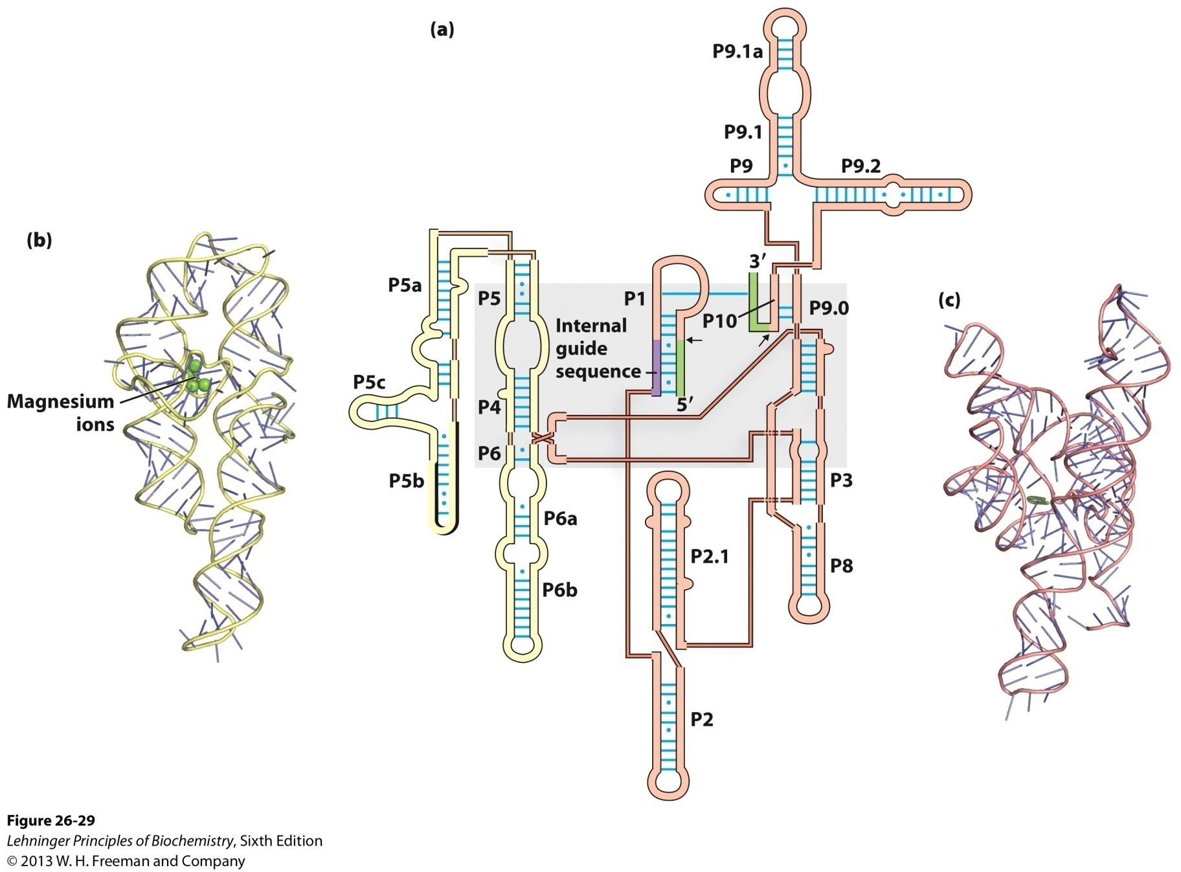
The catalytic core of the
self-splicing activity is shaded
Secondary structure of the self-splicing rRNA
intron from Tetrahymena

Slide 76
L-19 IVS is generated by the autocatalytic removal of 19 nucleotides from the 5’ end of the spliced Tetrahymena intron.

Slide 77
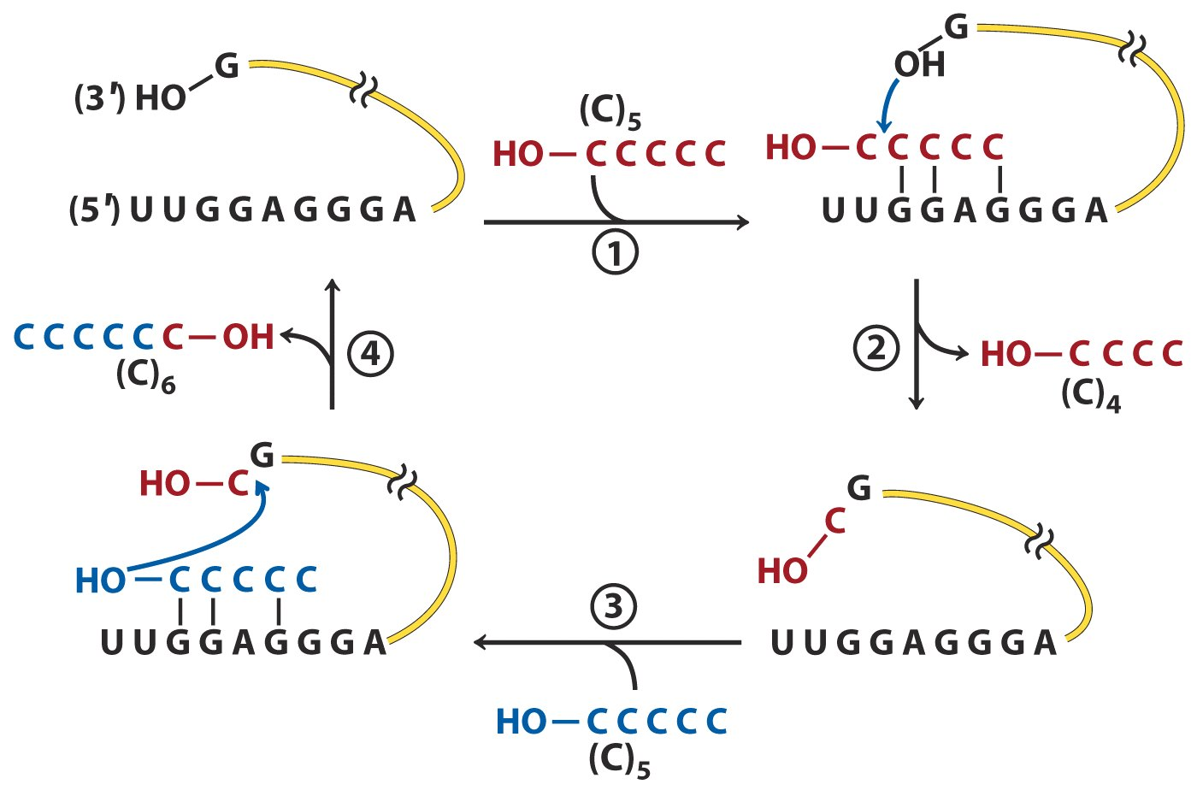
In vitro catalytic activity of L-19 IVS

Slide 78
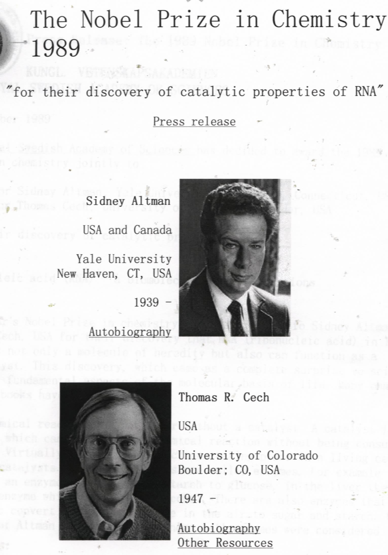
The M1 RNA
in RNase P is
catalytic
The intron in
the pre-rRNA of
Tetrahymena
is self-spliced

Slide 79
27. The cellular mRNAs are degraded at different rates
The level of a protein in a cell is determined to some extent by the level of its mRNA, which depends on a balance of the rates on its synthesis and degradation.
The half-lives of different mRNA molecules vary greatly, from seconds to many cell generations.
3’ hairpin and poly(A) tails have been shown to increase the half lives of mRNAs, but multiple, sometimes overlapping AUUUA sequences have been shown to decrease the half lives.

Slide 80
Average half-lives of mRNA molecules Bacteria 1.5 minutes Vertebrates 3 hours

Slide 81
The 5’ to 3’ exoribonuclease is probably the major degrading enzyme for mRNAs.
The polynucleotide phosphorylase may be the other enzyme degrading mRNAs.
Polynucleotide phosphorylase was used to synthesize RNA for the first time in the test tube (in 1955) (Severo Ochoa shared the Nobel Prize with Arthur Kornberg in 1959 for this discovery).---template-independent
(NMP)_{n+1} + P_{i} (NMP)_{n} + NDP
This enzyme was used to synthesize RNA polymers of different sequences and frequencies of bases for the elucidation of the genetic codes.

Slide 82
28. Reverse transcriptases catalyze the production of DNA from RNA
The existence of this enzyme in retroviruses ( RNA viruses) was predicted by Howard Temin in 1962, and proved by Temin and David Baltimore in 1970.
This enzyme catalyzes three reactions:
RNA-directed DNA synthesis using tRNAs as primers
Degradation of the RNA template
DNA-directed DNA synthesis
The enzyme has no 3’ to 5’ proofreading exonuclease activity, thus generating high rate of mutations.
This enzyme is widely used to synthesize complementary DNAs (cDNAs) from mRNAs.

Slide 83
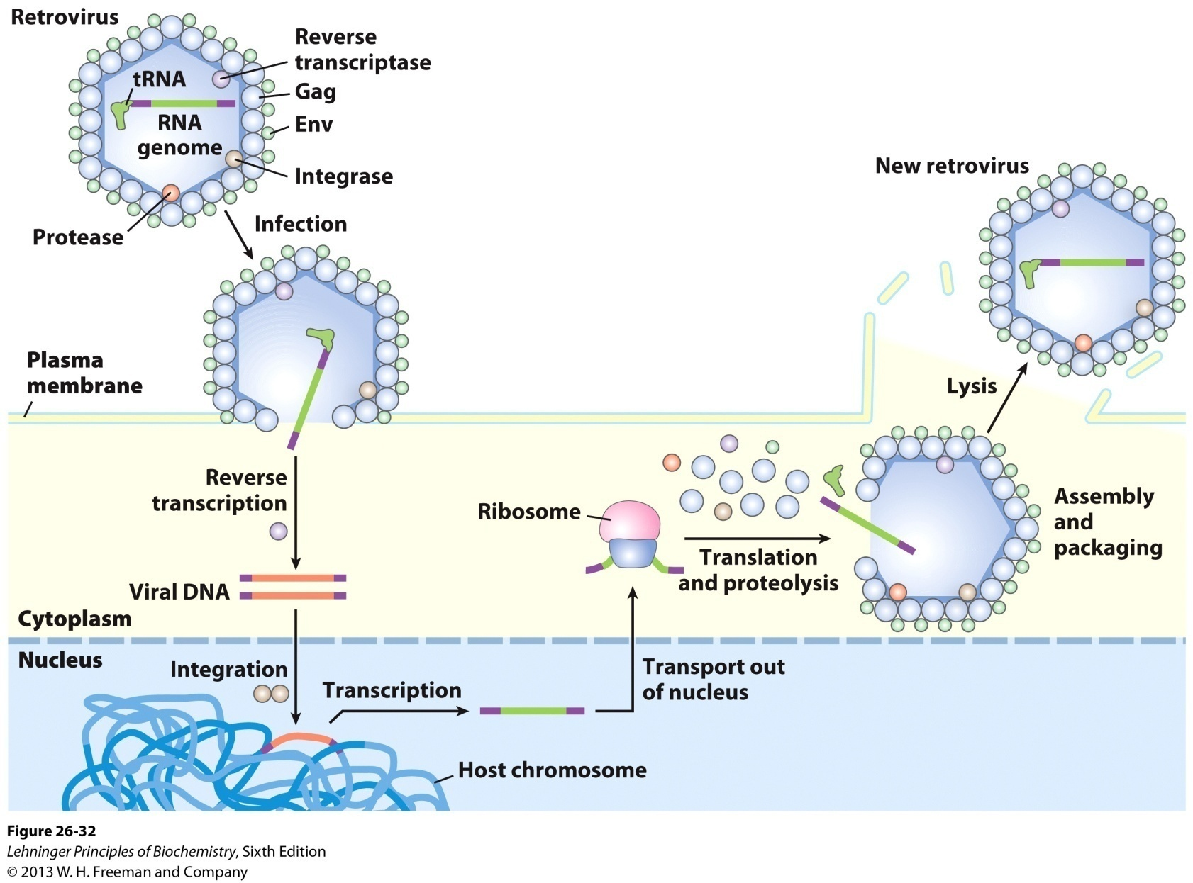
Retroviral infection of a mammalian cell and integration of the retrovirus into the host chromosome

Slide 84
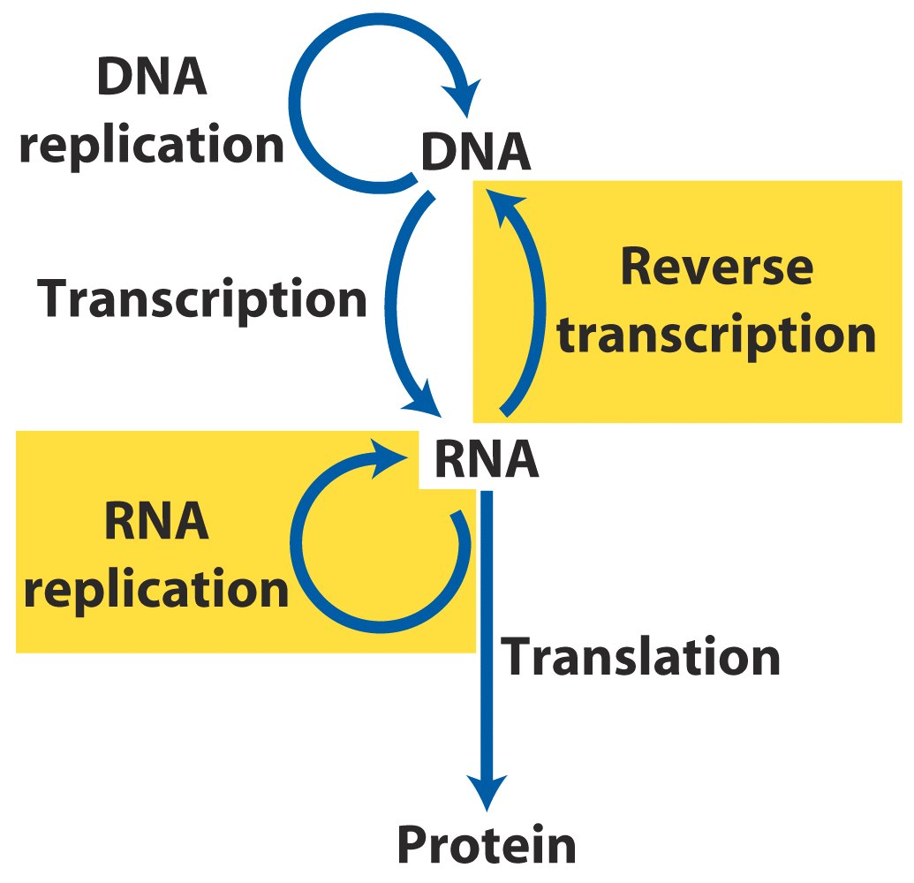
Reverse transcriptases catalyze the
synthesis of DNA from RNA template.

Slide 85
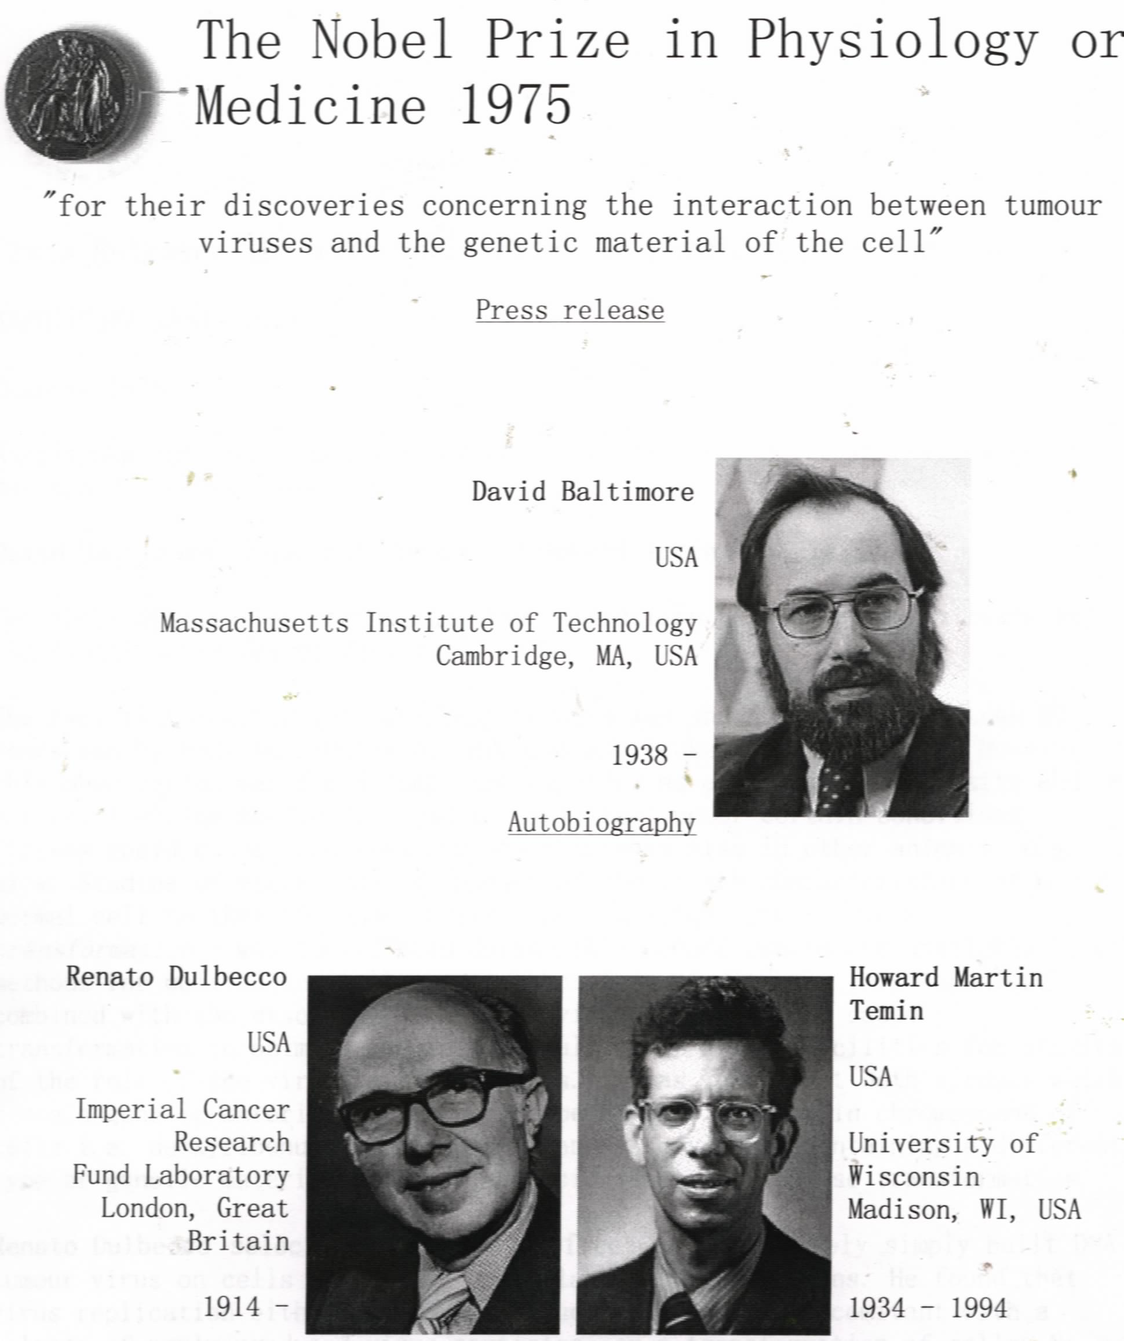

Slide 86
29. Telomerase catalyzes the synthesis of the repeating telomere sequences (T_{x}G_{y}) using an internal RNA template
Telomeres (端粒) consist of a few to a large number of tandem copies of a short oligonucleotide sequence that are located at the two ends of the linear chromosomal DNAs, having a 3’ single strand extension (on the TG strand).
Telomerase acts to prevent the chromosomal ends from becoming shortened after each replication (the end part of the lagging strand can not be duplicated).

Slide 87
Telomerase (端粒酶) is actually a reverse transcriptase, but uses a short segment of an internal RNA molecule (~150 nucleotides) as the template to extend the end.
The C_{y}A_{x} strand is believed to be synthesized by a DNA polymerase using a RNA primer.
The ends of a linear chromosome is often protected by binding to specific proteins, forming a T loop structure in higher eukaryotes, where the single-stranded DNA is sequestered.
The length of the telomere seems to be inversely related to the life span of cells and individuals (shortens as one ages).

Slide 88
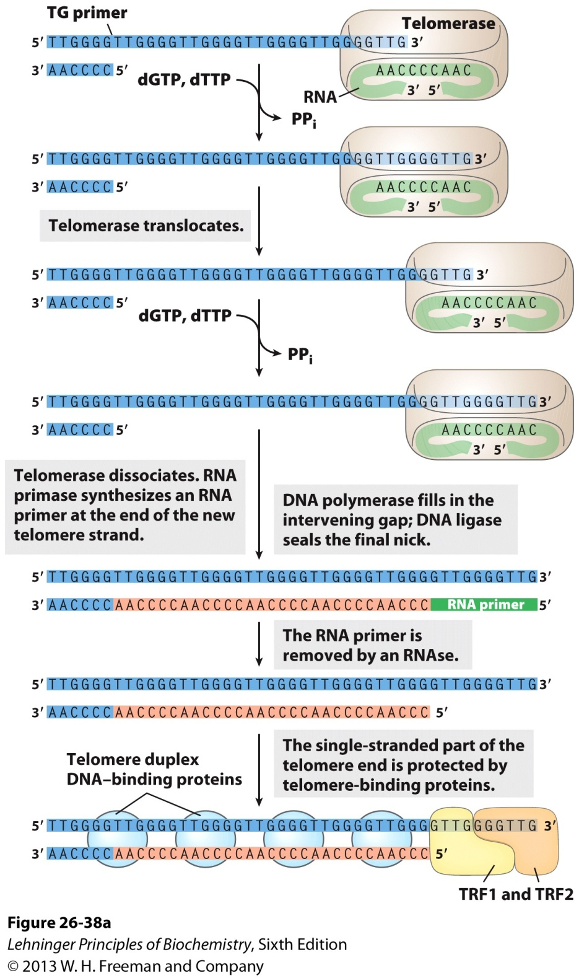
Telomere synthesis

Slide 89
Unique features of telomerase
Two components---- telomerase reverse
transcriptase (TERT) protein and telomerase
RNA
Internal RNA serves as template for reverse
transcription by TERT
Ability to translocate along the DNA

Slide 90
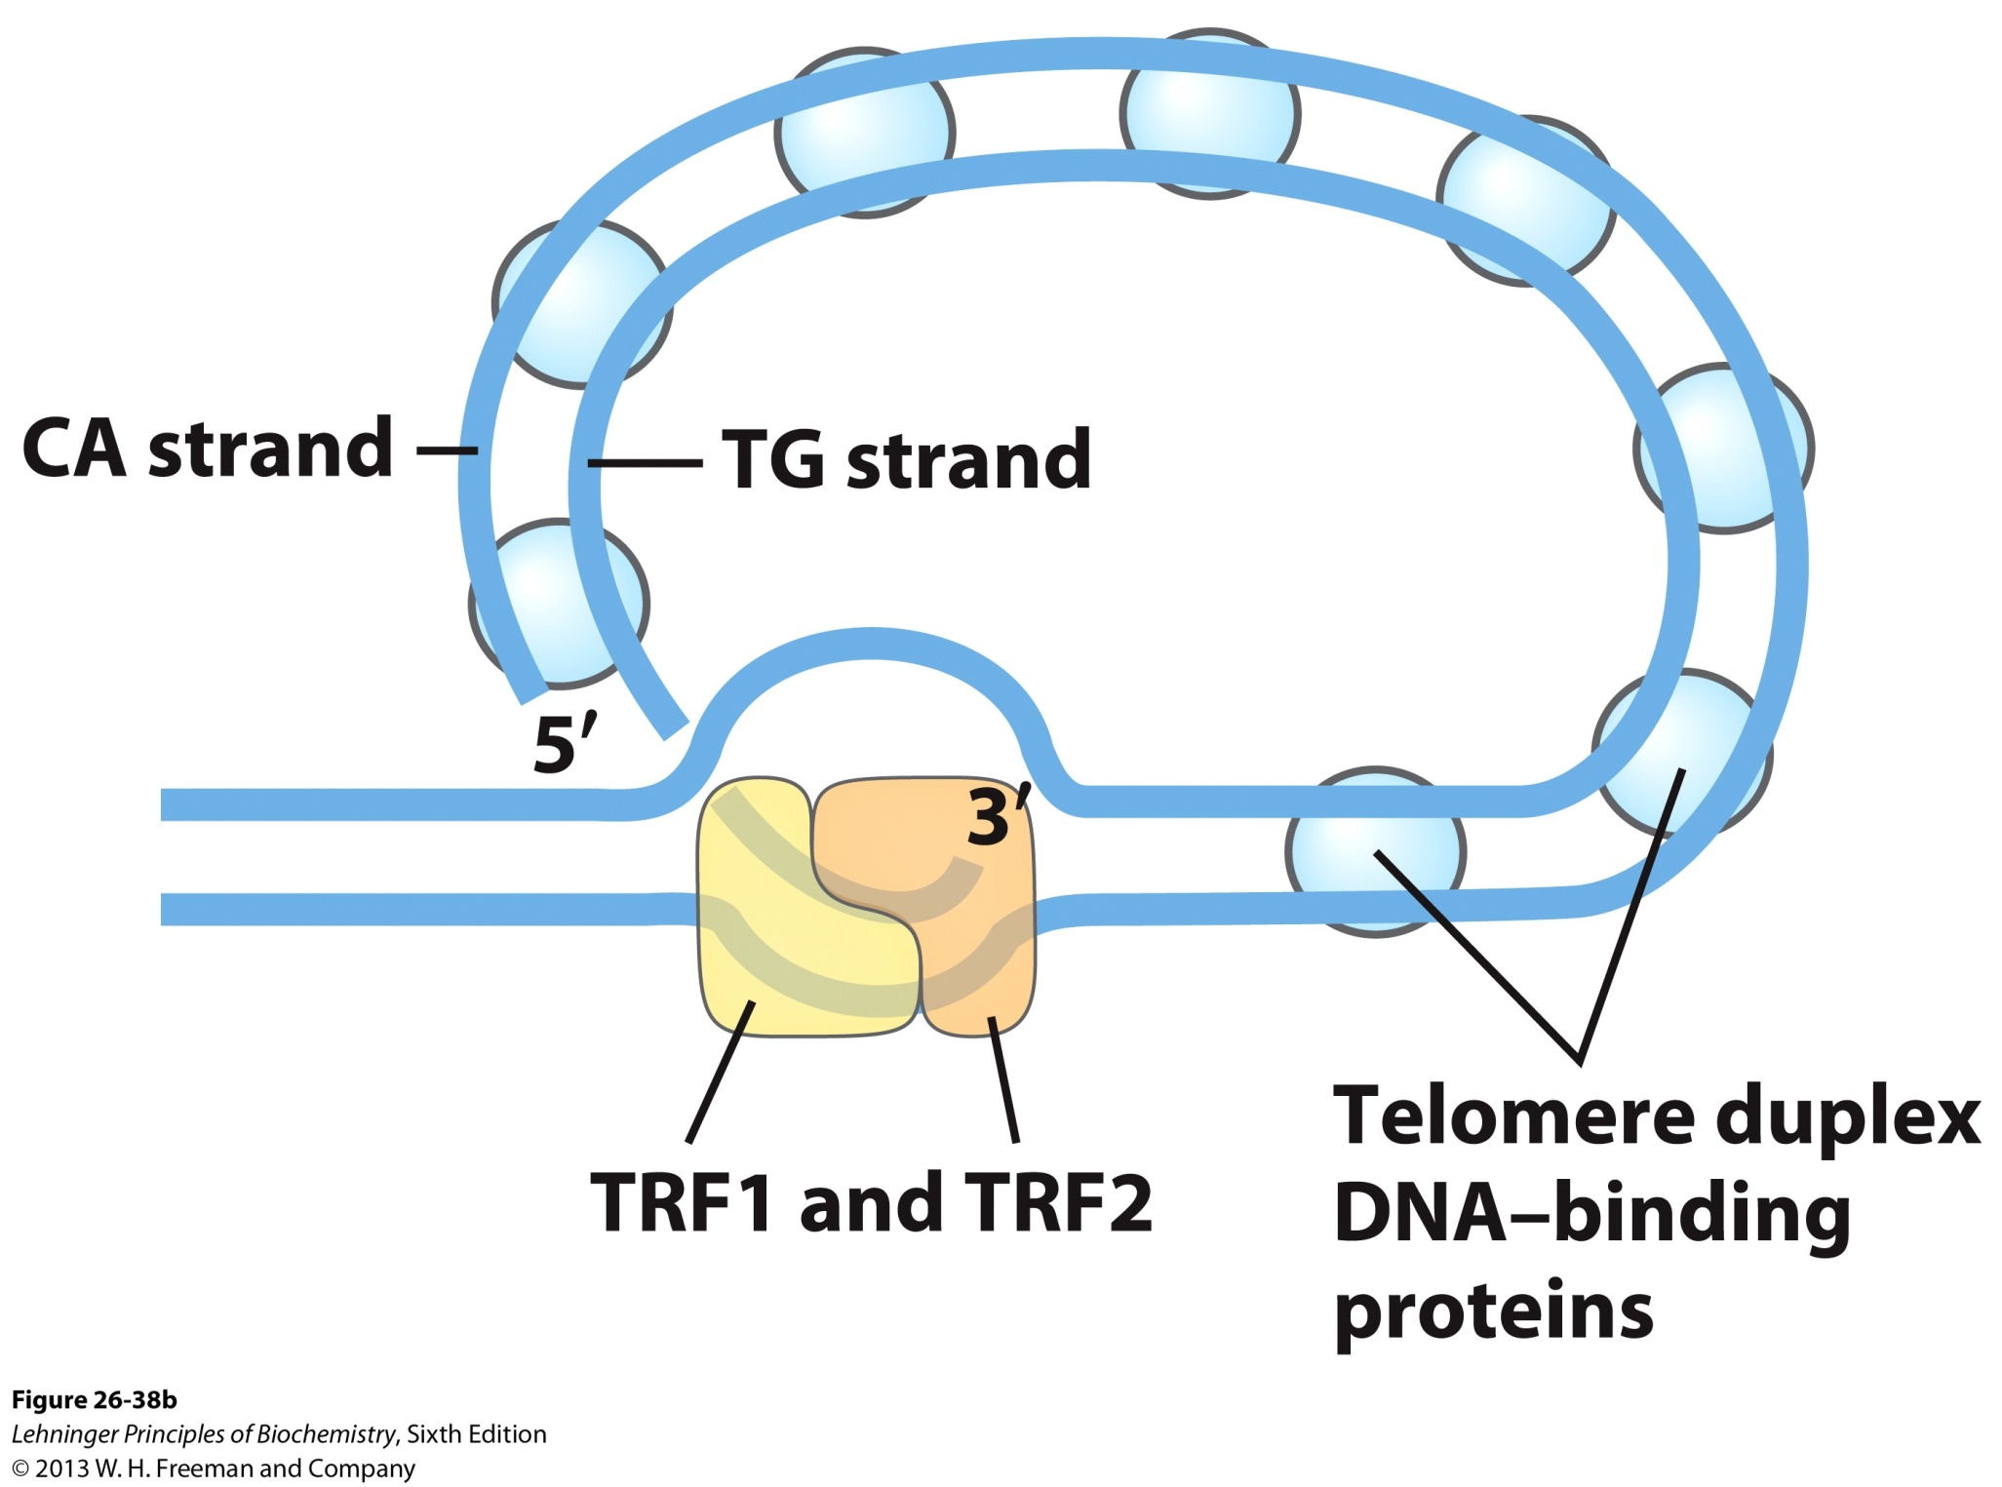
Proposed structure of T loops in telomeres

Slide 91
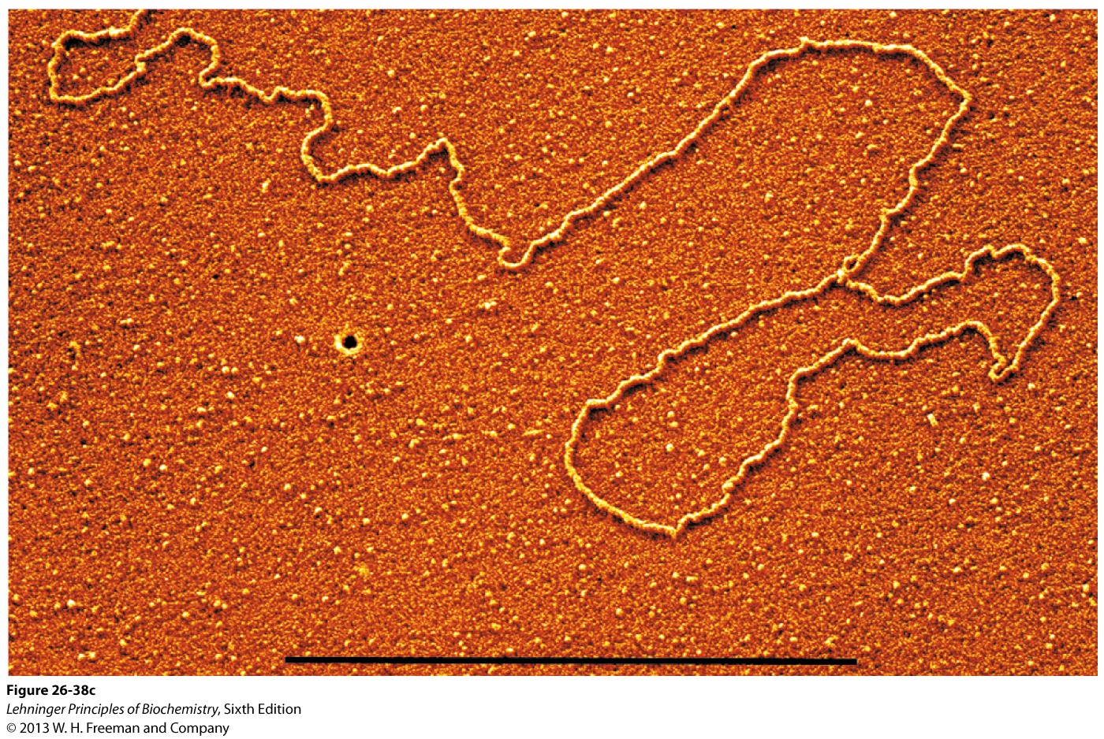
Electron micrograph of a T loop
at the end of a chromosome

Slide 92
2009 Nobel Prize for Medicine Elizabeth Blackburn, Carol Greider and Jack Szostak "for the discovery of how chromosomes are protected by telomeres and the enzyme telomerase"

Slide 93
30. Some viral RNAs are replicated by RNA-directed RNA polymerase
The RNA genomes of some viruses (having bacteria, animals or plants as their hosts) are replicated using RNA-directed RNA polymerases (or RNA replicases).
The RNA replicase from bacteriophage-infected E.coli cells consists of subunits encoded both by the viruses and the host genome.
They have features similar to that of DNA-directed RNA polymerases, but are usually specific for the RNA of the specific viruses.
RNA replicases do not have proofreading activities.

Slide 94
31. Self-replicating RNA molecules might be important for life to be produced at the very beginning
The realization of the structural and functional complexity of RNA motivated a few scientists to propose in the 1960s that RNA might have served as both information carrier and catalyst at the early stage of evolution---RNA world hypothesis
Synthesis of the peptide bonds of proteins seems to be catalyzed by the rRNA component of ribosomes.
A self-replicating mechanism for a RNA molecule can be proposed based on the studies of the self-splicing process of group I introns.

Slide 95
Keywords
Transcription---RNA Polymerase I, II, III
RNA processing---splicing
Reverse transcription---telomerase

Slide 96
Words of the week
Splicing
Ribozyme
Reverse transcription
Telomerase

Slide 97
Text-book reading of the week
Summary 26.1 (p1069)
Summary 26.2 (p1085)
Summary 26.3 (p1094)
p1089-1092: Telomerase is a specialized reverse transcriptase

Slide 98
Summary
Transcription shares the basic chemical mechanisms with replication except: no primers required, no proofreading activity exists.
Transcription begins at specific promoter sequences (which can be identified using footprinting technique) and ends at specific terminator sequences (being ρ-independent or dependent in bacteria, and not well understood in eukaryotes).
One multimeric RNA polymerase catalyzes the synthesis of all the RNA molecules in bacteria and three different RNA polymerases are used to synthesize the different types of RNAs in eukaryotes.

Slide 99
Primary RNA transcripts are further processed: capped, tailed, spliced and sometimes edited for the mRNAs; ends removed and modified, bases modified for the tRNAs; cleaved and sometimes spliced for the rRNAs.
Catalytic RNAs were discovered when studying RNA processing (splicing of group I and II introns, removal of the 5’ end of pre-tRNAs).
RNAs can act as real enzymes (L-19 IVS, hammerhead ribozymes).
DNA can be synthesized by using RNA as templates in a reaction catalyzed by reverse transcriptase.

Slide 100
The telomeres of eukaryotic chromosomes are synthesized by the action of telomerase, using an RNA as template.
RNA replicase catalyzes the synthesis of RNA from RNA templates.
RNA is very likely the first type of biomacromolecule produced during biochemical evolution.

