Slide 1
Biochemistry II

Slide 2
Self-Introduction
LI Zhen 李 珍
BS (Wuhan University)
PhD (Carnegie-Mellon Univ., USA)
Post-doctoral fellow (Univ. of Michigan & Stanford Univ., USA)
Research associate (Hong Kong Univ. of Science and Technology, Hong Kong)
Joined Tsinghua Univ. in 2004
Taught Biochemistry II since Spring, 2004

Slide 3
Self-Introduction
Contact information:
School of Life Sciences
Tsinghua University
Tel: 6277-0581
Office: Room 245, Life Sciences Building
Lab: Room 244 & 253, Life Sciences Building
E-mail: lizhen@tsinghua.edu.cn

Slide 4
Self-Introduction
Research interest:
Adiponectin-targeted drug development
Molecular mechanism of adiponectin multimerization and secretion
Screen for new drugs to treat type 2 diabetes
(糖尿病)

Slide 5
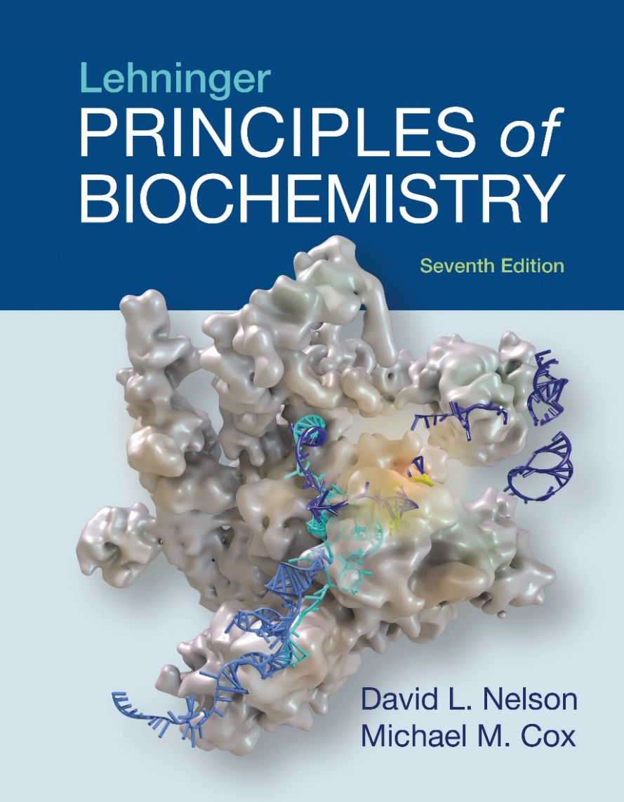
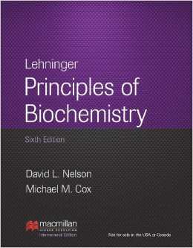
Course Introduction Textbook

Slide 6
Course Introduction
Reference textbooks:
* Biochemistry, Fifth Edition
(By Berg, Tymoczko and Stryer)
* The absolute, ultimate guide to Lehninger Principles of Biochemistry, Fifth Edition
(By Marcy Osgood and Karen Ocorr)
* Lehninger 生物化学原理, 第三版, 中文版
(周海梦,昌增益等译)

Slide 7
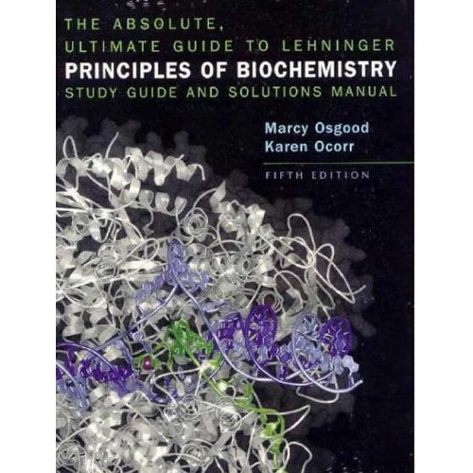
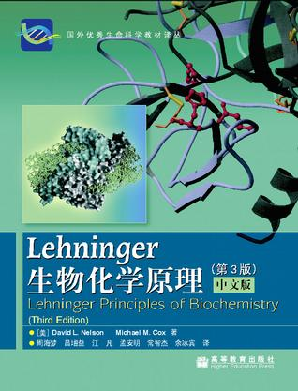
Course Introduction
Reference textbooks:

Slide 8
Biochemistry is the chemistry of life
Describe in molecular terms the structures, mechanisms, and chemical processes shared by all organisms
Provides organizing principles that underlie life in all its diverse forms
Provides important insights and practical applications in medicine, agriculture, nutrition, and industry

Slide 9
Three parts of Biochemistry
The structural chemistry of the components of living organisms and the relationship between chemical structure and biological function --- Part I (last semester)
Metabolism - the chemical reactions that occur in living organisms --- Part II (this semester)
The chemistry of molecules and processes that store and transmit biological information --- Part III (this semester)

Slide 10
Course Introduction
Part II --- Bioenergetics and metabolism:
covers most of the metabolic pathways in a living cell (hundreds of transformations)
Part III --- Information pathways:
covers information pathways (DNA, RNA and protein metabolism)
Exposed to a large amount of information within a relatively short period of time
Impossible to talk about everything in the textbook
Rely on you to self-study those not discussed in the lectures

Slide 11
Course Calendar
Part II
Part III

Slide 12
Course Introduction
Office hour:
3 - 5 pm, Friday
You are welcome to come to my office to ask questions about the course!
(For those who have classes on Friday afternoon, you can send your questions to me via e-mail or make an appointment with me by e-mail)

Slide 13
Course Introduction
TA:
Zhang Yudian 张雨点
Lab: Room 103, Life Sciences Building
Tel: 18810456412
E-mail: yudian_zhang@163.com
Zhao Lina 赵丽娜
Lab: Room E105, Medical Sciences Building
Tel: 15131200620
E-mail: 1186486691@qq.com

Slide 14
Grade for the course
Homework: accounts for 20% of the final grade
Quiz: accounts for 20% of the final grade
Final exam: accounts for 60% of the final grade
Active participation in the classroom and Web Learning is encouraged and will be awarded bonus points

Slide 15
Homework
Regular homework: one homework every week
Comprehensive homework: only one this semester
Accounts for 20% of the final grade
Posted on Tuesday, due on Sunday
Please hand in your homework online before the deadline (midnight Sunday)

Slide 16
Quiz
Regular quiz: total 4
Test in class: no advanced reminder
Accounts for 20% of the final grade
Questions including:
* Multiple-choice questions with one correct answer
* Multiple-choice questions with more than one
correct answers
* Simple-answer questions
* Comprehensive questions

Slide 17
Useful links
Website for the course:
http://biochem.life.tsinghua.edu.cn
Textbook:
https://www.macmillanlearning.com/Catalog/product/ lehningerprinciplesofbiochemistry-seventhedition-nelson
NCBI:
http://www.ncbi.nlm.nih.gov
清华大学网络学堂 (Web Learning):
http://learn.tsinghua.edu.cn
生物360:
http://bio360.net
生物通:
http://ebiotrade.com

Slide 18
One big change this semester
More lecture time (3x1x16 → 2x2x16) gives me time to
cover more in my lectures
introduce frontiers in relevant topics
address common questions in your homework

Slide 19
Course Introduction
Lecture time and location：
Monday, 15:20-16:55, 五教5103 Thursday, 8:00-9:35, 五教5103
or
Tuesday, 9:50-11:25, 一教201 Friday, 8:00-9:35, 一教201

Slide 20
Rules of the Classroom
Turn off your mobile phone
Keep quiet
Raise your hand if you have questions
Don’t be late for the lectures
Be honest in the quiz and final exam

Slide 21
Some useful tips
Preview (预习) before each lecture
Take notes effectively in class
Review (复习) and do homework after lectures
Spend at least 3 hours every week in this course
Ask for help if you have difficulties in your study
Have enough sleep the night before the lecture

Slide 22
Some useful tips
Pay attention to the Worked examples, Key Convention, Key Terms (Keywords) and Summary in the textbook and ppt files
Look for recurring patterns in metabolic pathways
Make use of all kinds of learning resources
Spend some time reading the textbook every week
Try to use as much English as possible in your reading, writing and thinking
Understanding is more important than memorization!

Slide 23
My goal
For you to learn the principles of biochemistry and to understand its relevance to medicine and to health issues in general, for a healthier life and a healthier planet

Slide 24
Let us work together to make this
a fun and fruitful experience!

