Slide 1
Summary

Slide 2
Important metabolic pathways
Carbohydrates:
glycolysis vs. gluconeogenesis
glycogen breakdown vs. glycogen synthesis
Fatty acids:
oxidation vs. synthesis
Amino acids:
oxidation vs. synthesis
Nucleotides: de novo synthesis

Slide 3
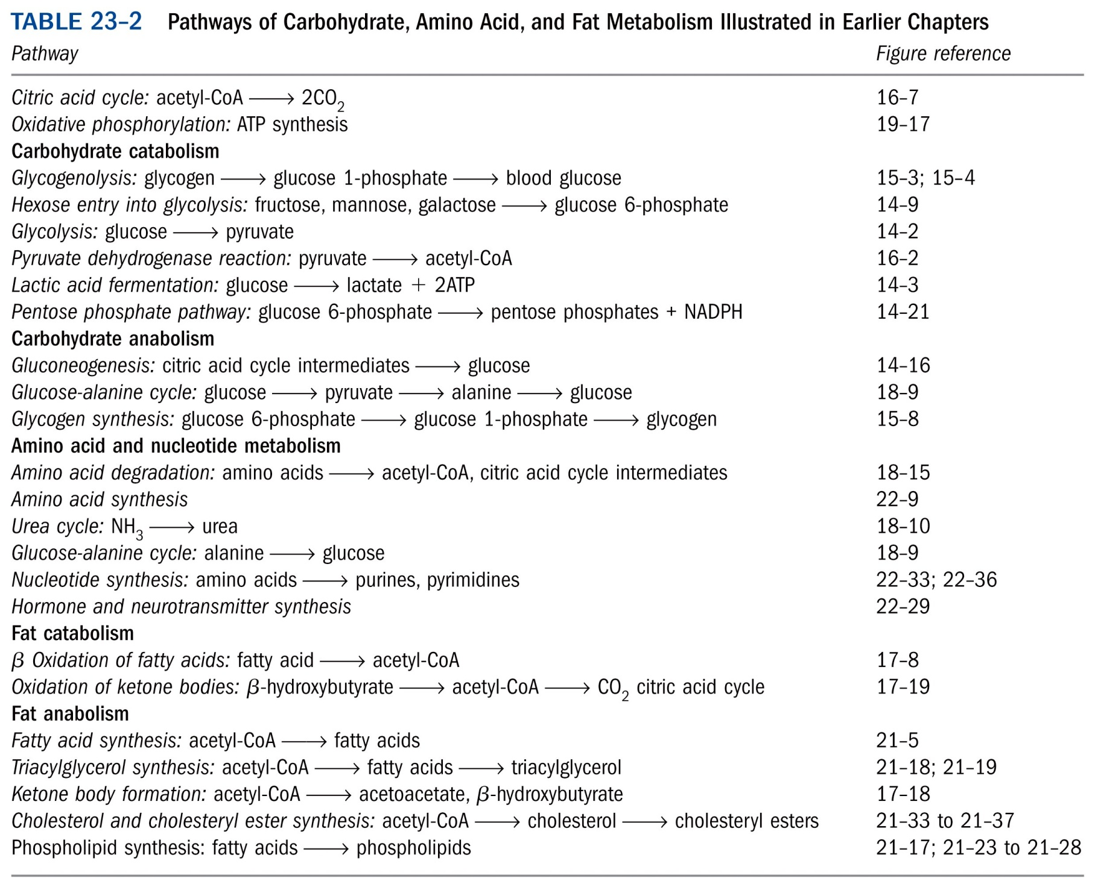
*****

Slide 4
Each tissue of the human body has a specialized function
Liver: processes and distributes nutrients
Adipose tissues: store and supply fatty acids;
secret adipokines
Skeletal muscle: generates ATP for motion
Brain: uses energy to transfer electrical
impulses
Blood: mediates metabolic interactions
among all tissues

Slide 5
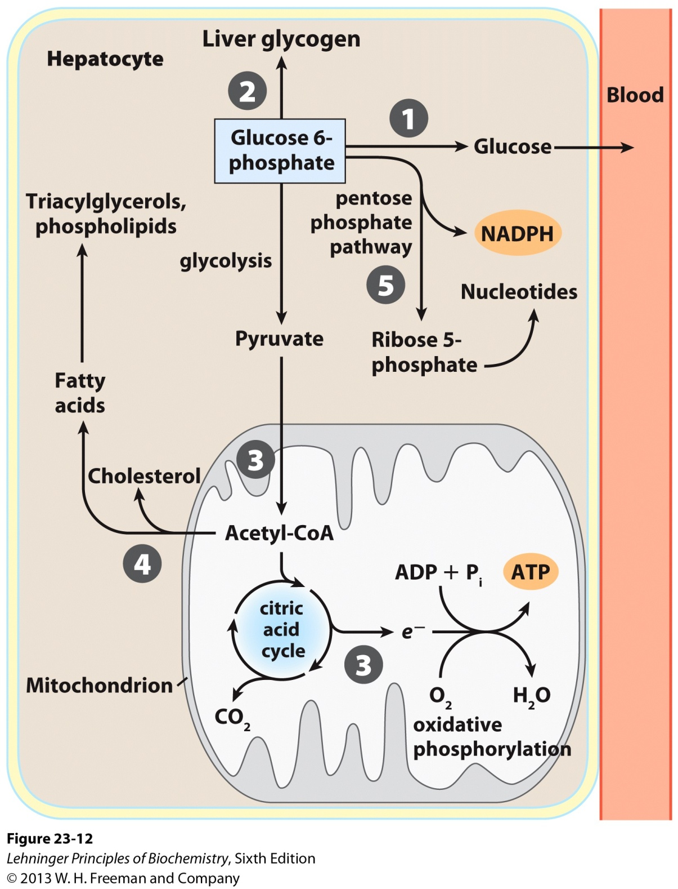
Exported to replenish
blood glucose
(exported)
Metabolic pathways
for glucose 6-phosphate
in the liver---5 different
metabolic routes
Glucose 6-phosphate is the key
intermediate in carbohydrate metabolism

Slide 6
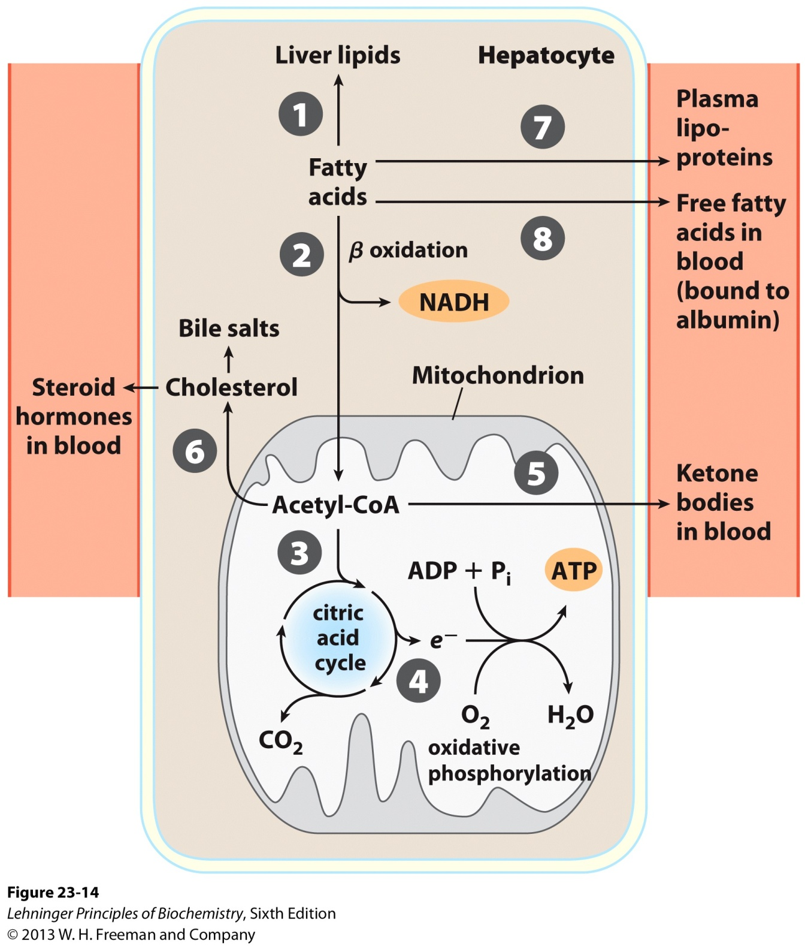
Under most circumstances,
fatty acids are the primary
oxidative fuel in the liver.
Metabolism of fatty acids in the liver

Slide 7
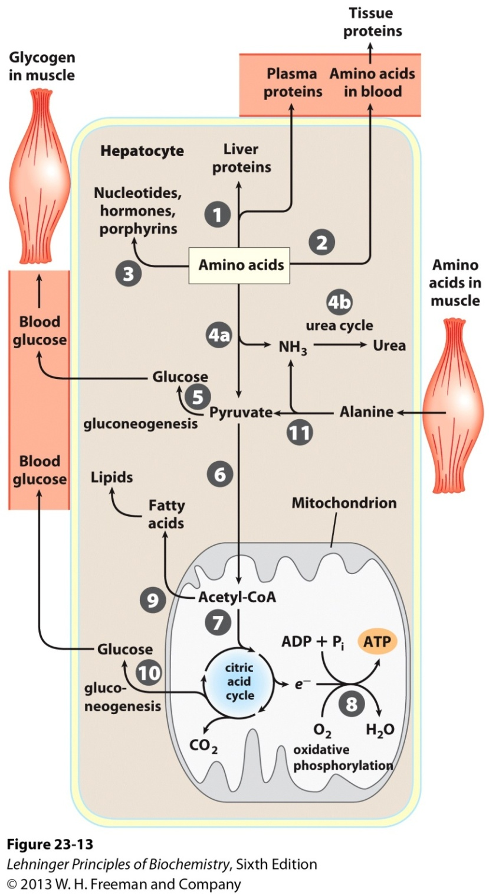
Metabolism of amino acids in the liver

Slide 8
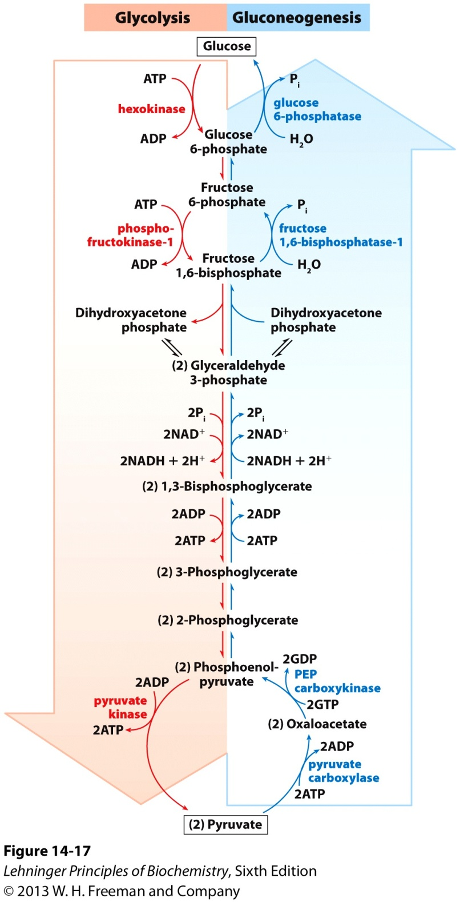
Opposing pathways of
glycolysis and
gluconeogenesis: with 3
different and 7 common
reactions*****

Slide 9
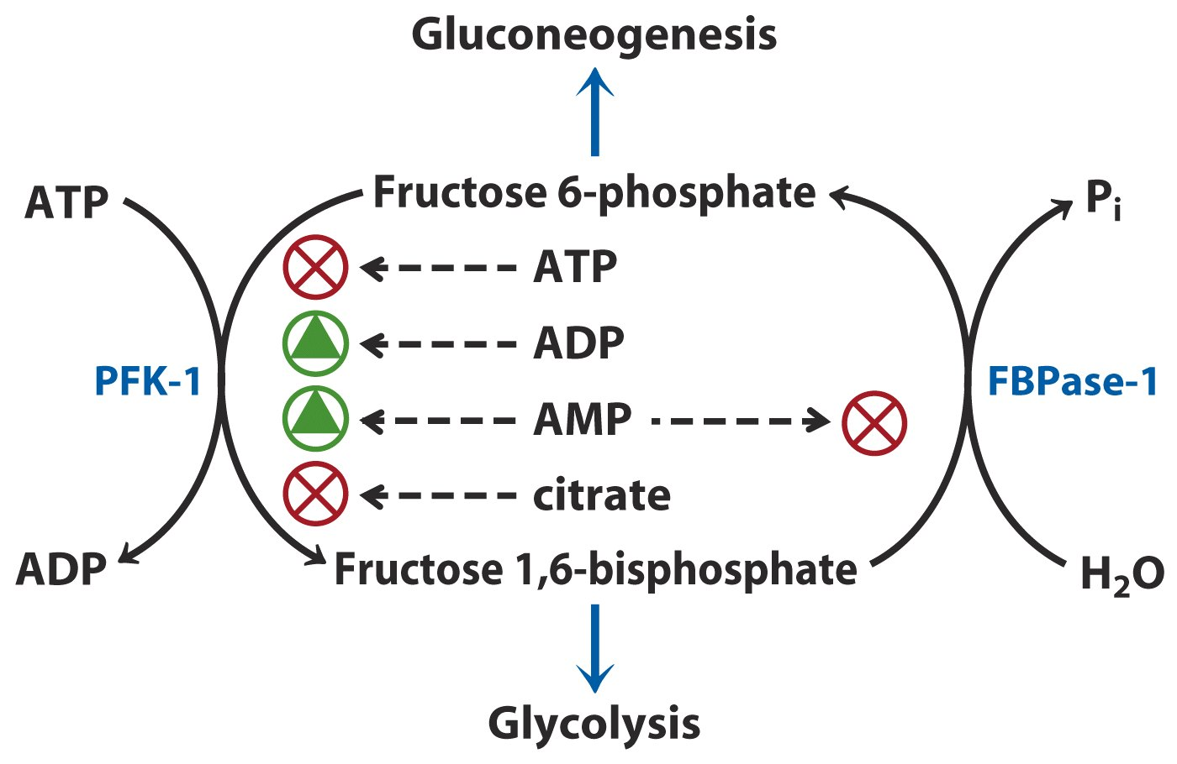
Regulation of PFK-1 and FBPase-1*****

Slide 10
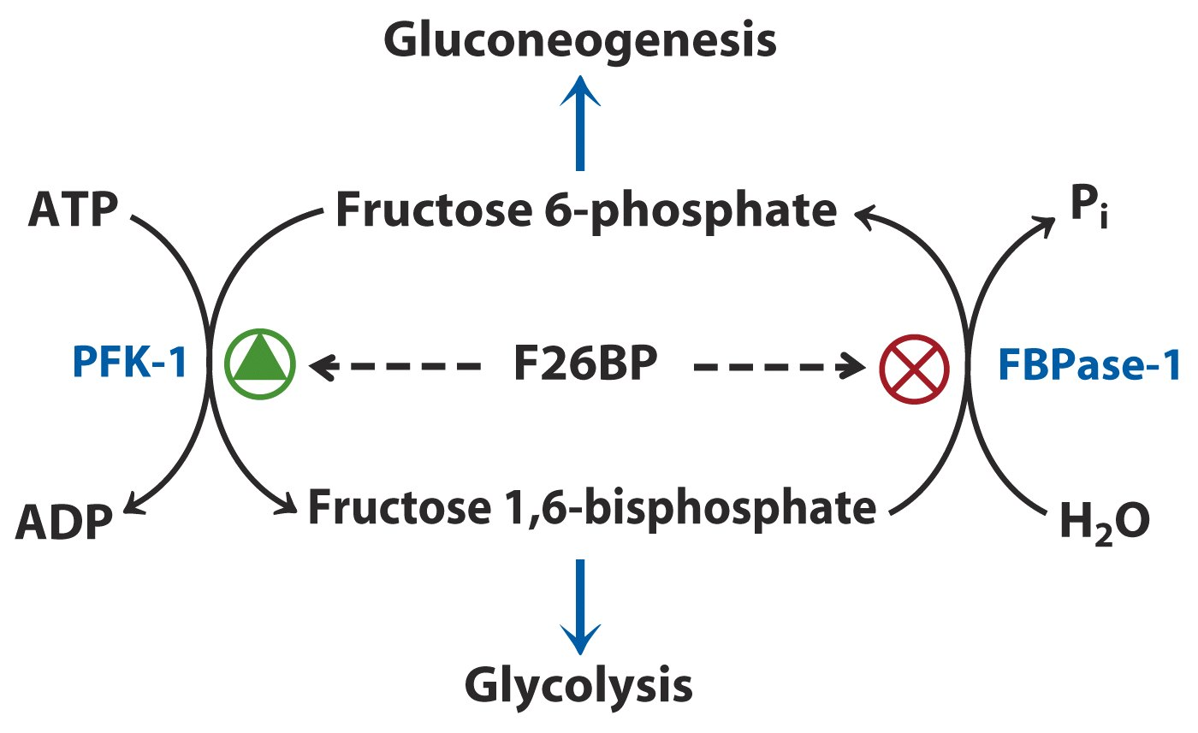
Regulation of PFK-1 and FBPase-1
by fructose-2,6-bisphosphate (F26BP)*****

Slide 11
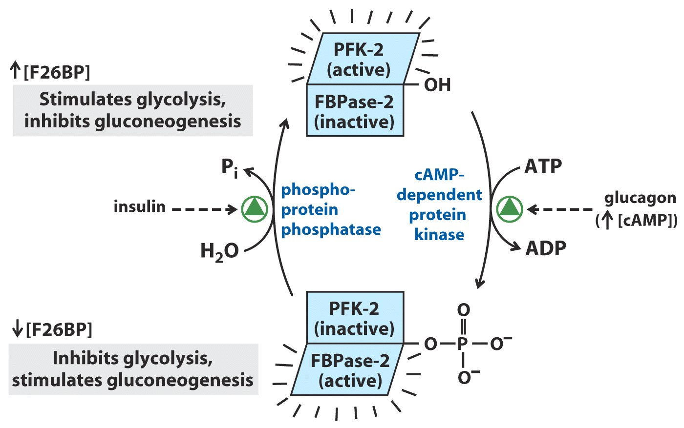
(胰高血糖素)
(胰岛素)
FPK-2 and FBPase-2 are regulated, in a
reciprocal way, by glucagon and insulin.*****

Slide 12
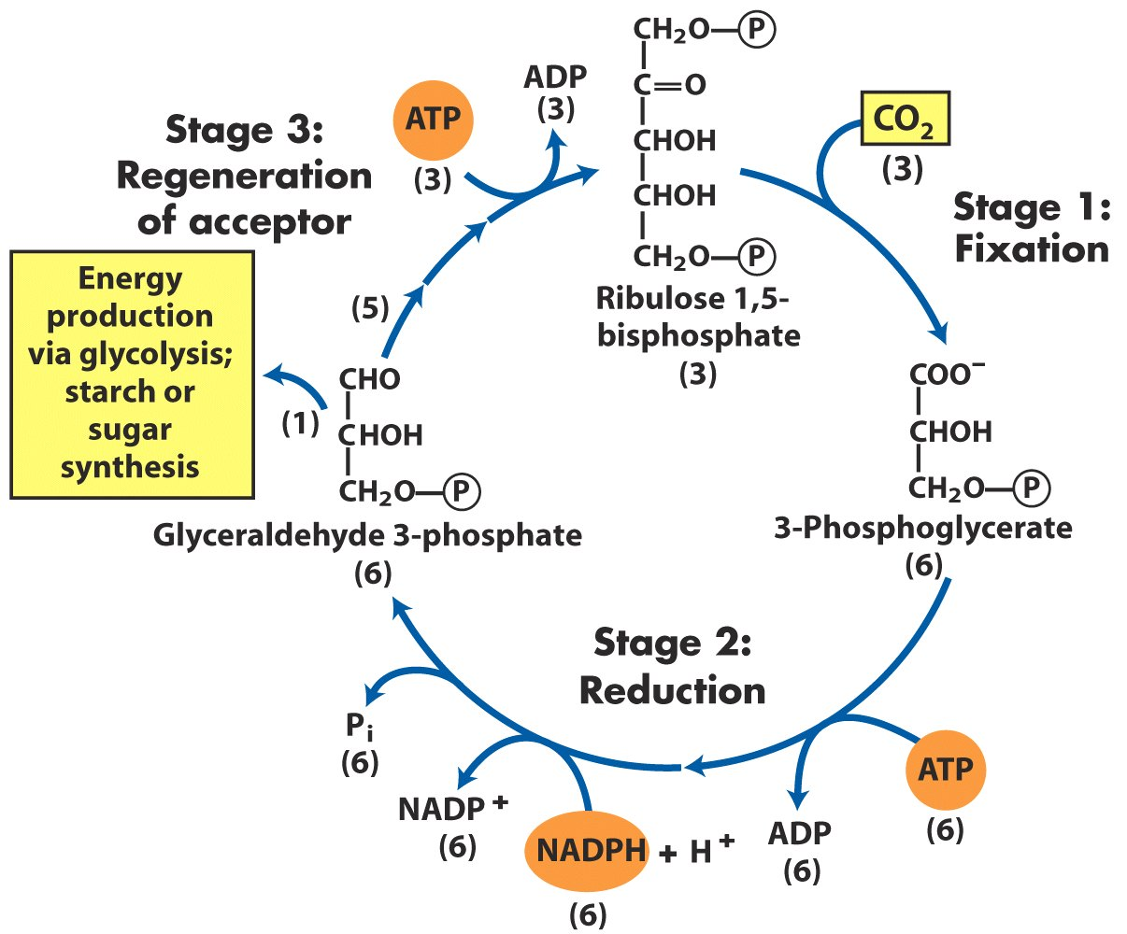
The three stages of CO₂ assimilation
in photosynthetic organisms

Slide 13
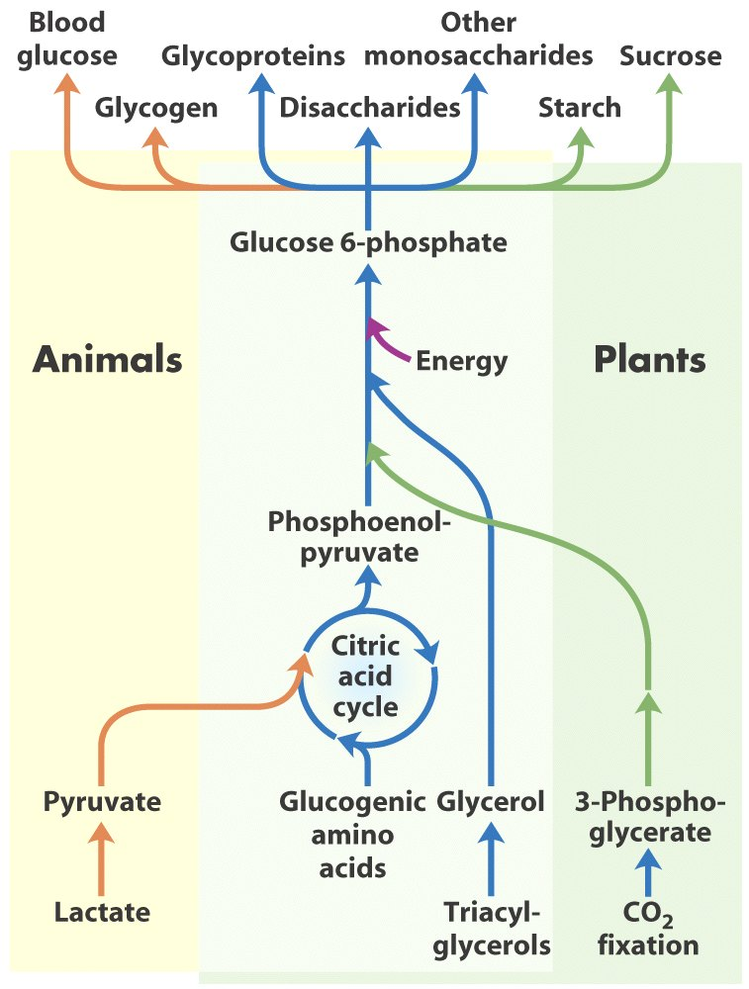
Carbohydrate synthesis from simple precursors*****

Slide 14
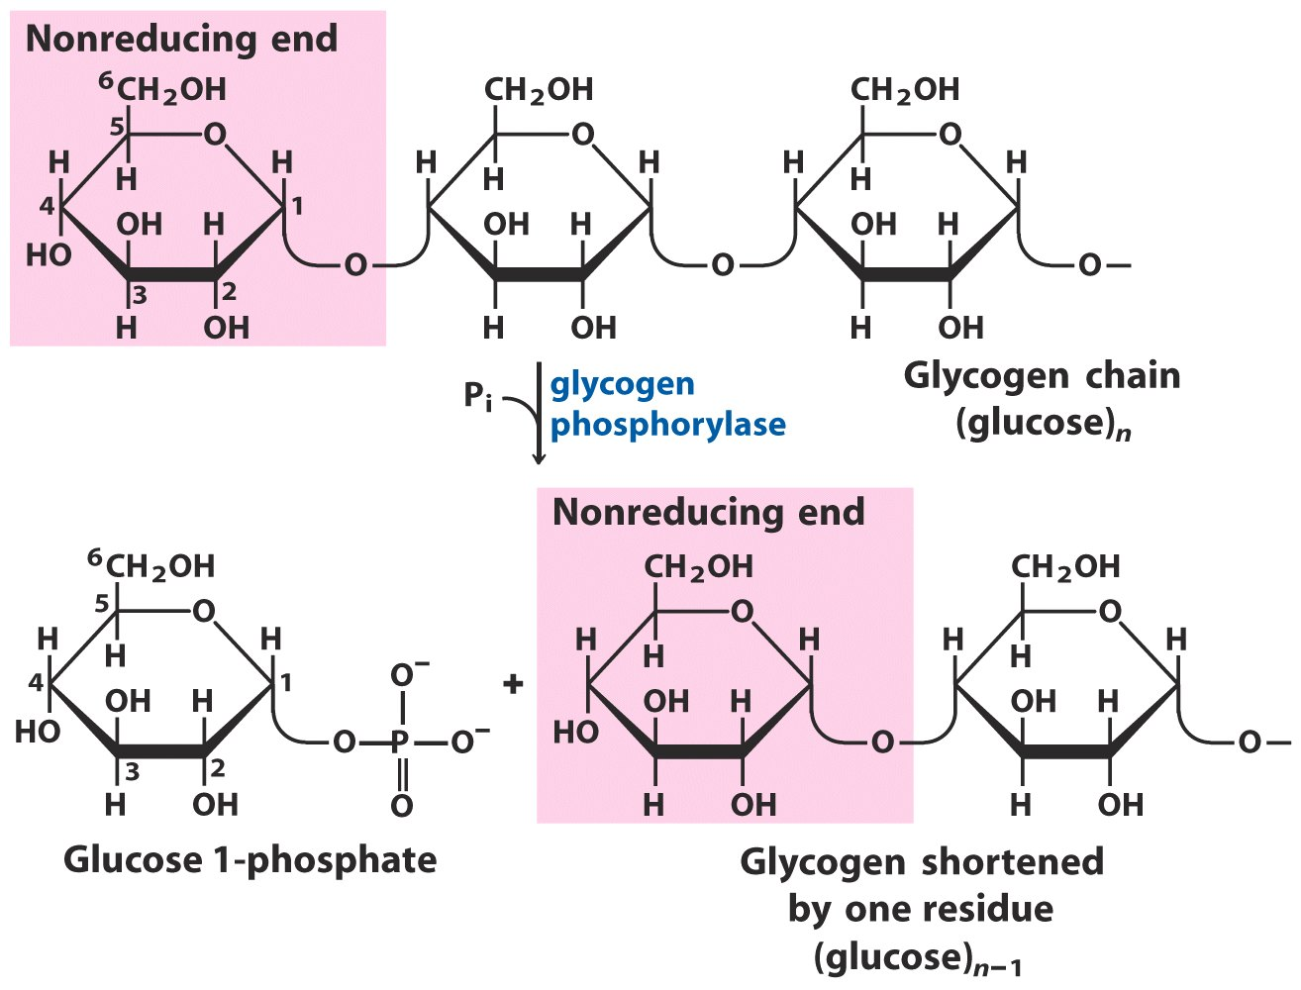
No ATP needed!
Glycogen breakdown by glycogen phosphorylase

Slide 15
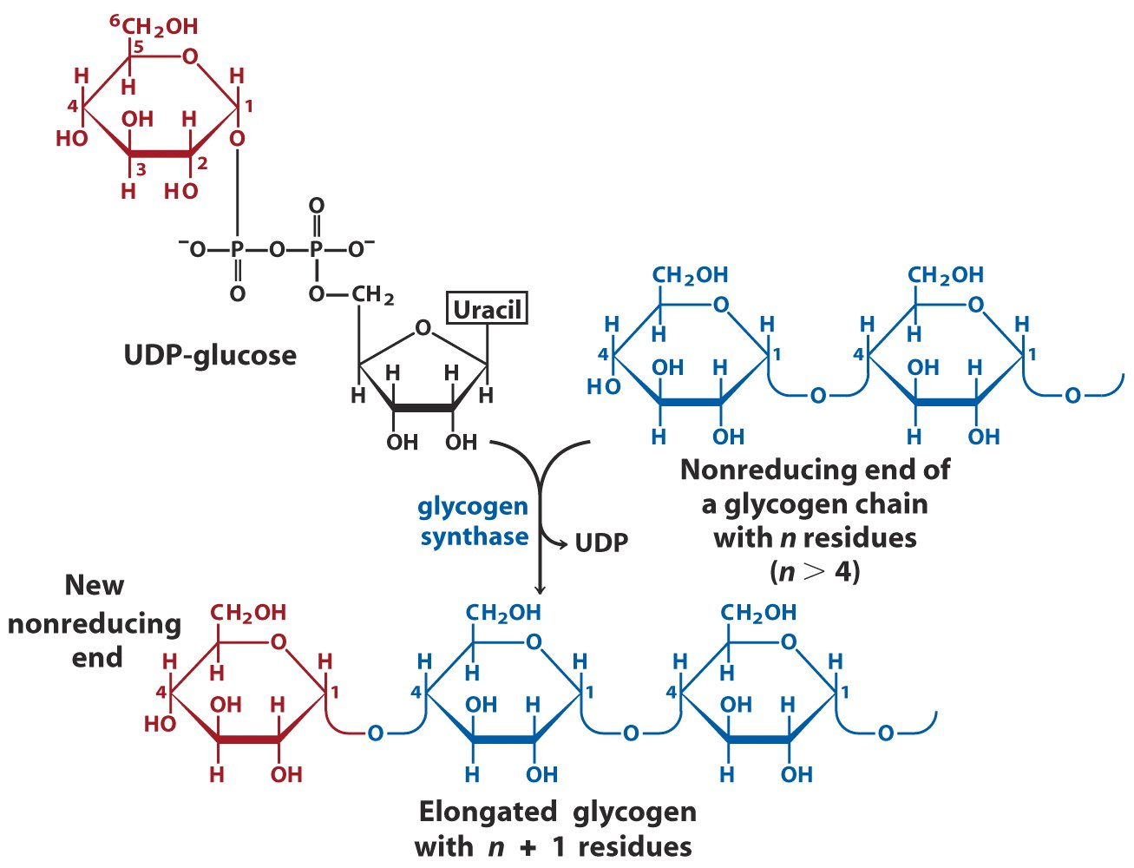
Glycogen is extended from the
nonreducing end using UDP-glucose

Slide 16
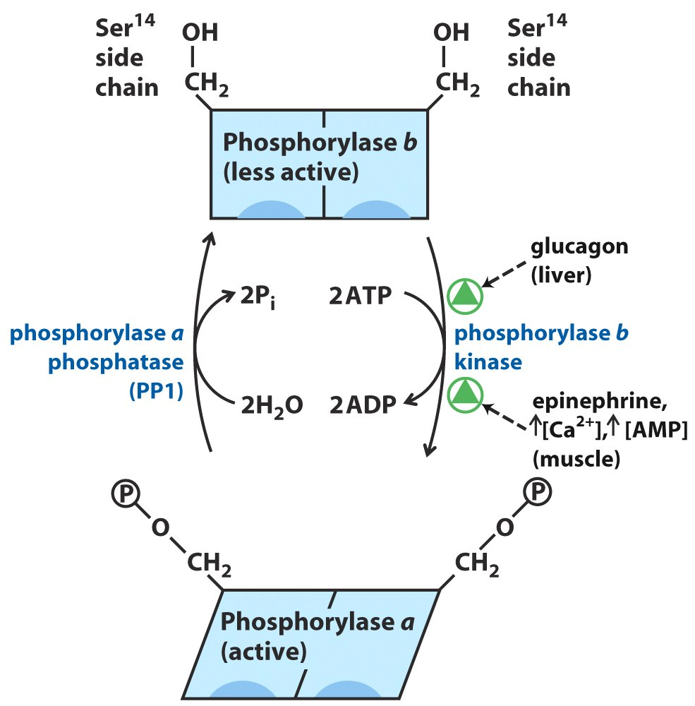
Regulation of muscle glycogen phosphorylase

Slide 17
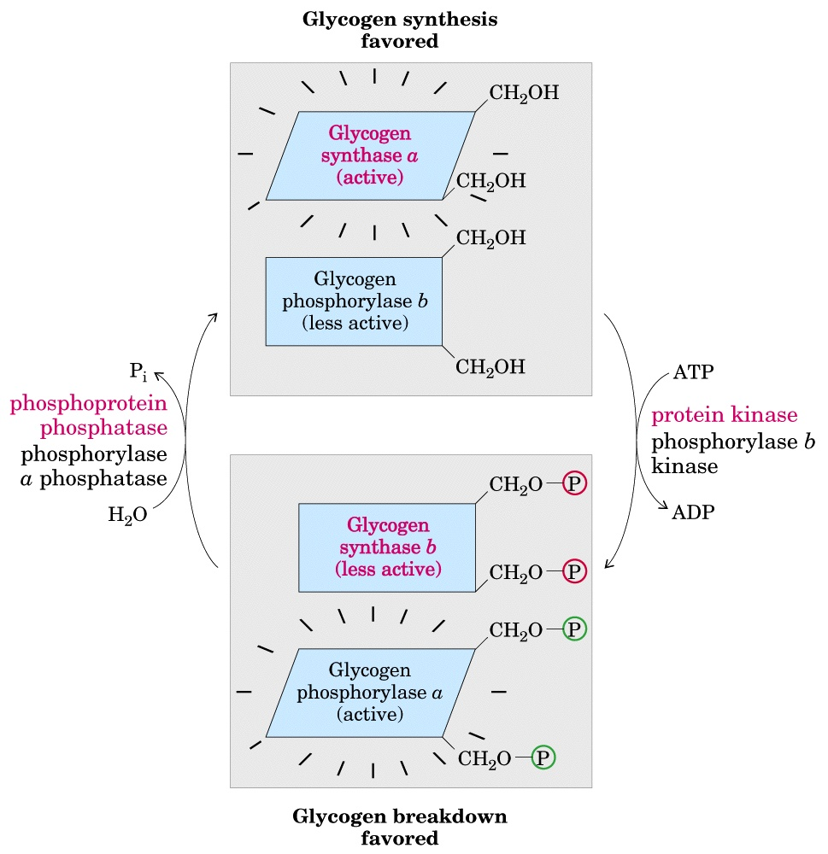
Glycogen synthase
and phosphorylase
are reciprocally
regulated by
hormones via
phosphorylation-
dephosphorylation
Glycogen
synthase
kinase
(GSK3)
Phosphoprotein
phosphatase 1 (PP1)

Slide 18
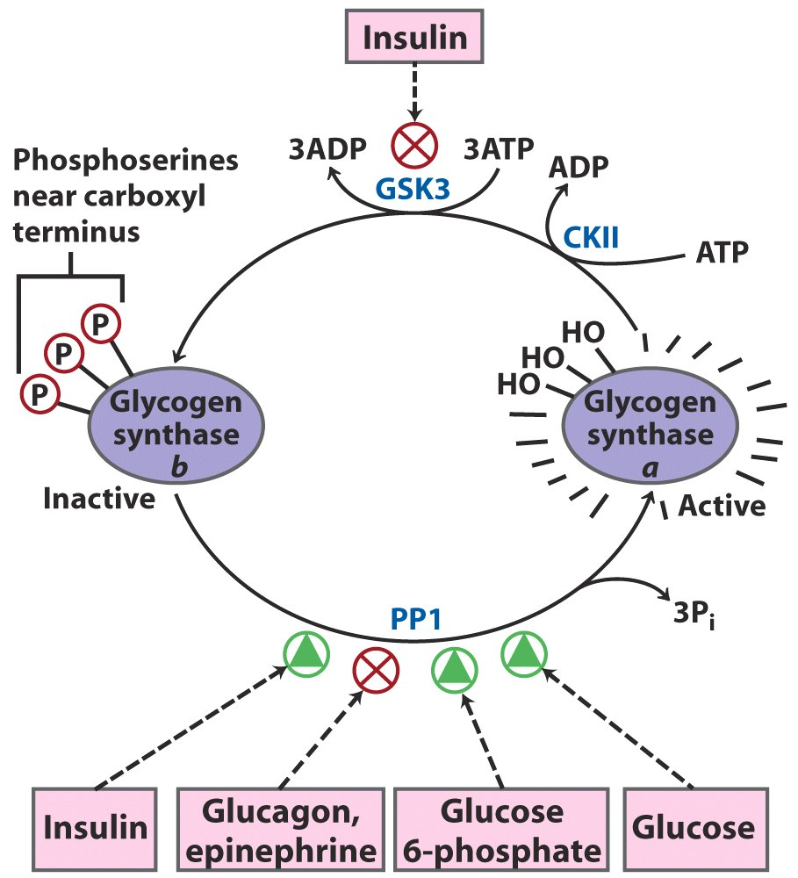
Effects of GSK3 on glycogen synthase activity

Slide 19
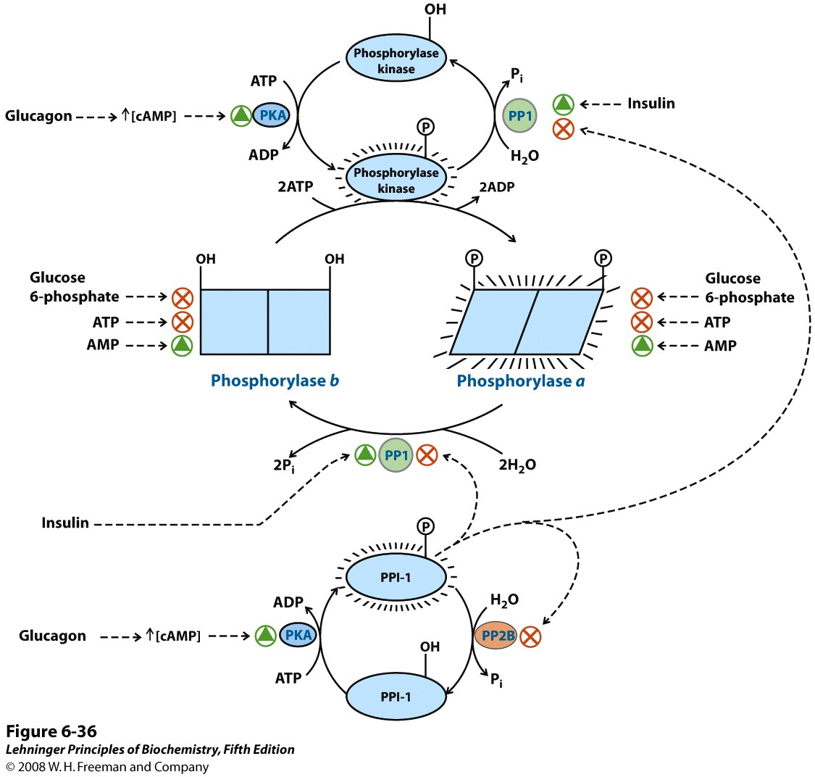
Covalent
modification
Allosteric
regulation
Hormonal
regulation
Regulation of muscle glycogen phosphorylase activity
by multiple mechanisms*****
Notes:
FIGURE 6-36 Regulation of muscle glycogen phosphorylase activity by multiple mechanisms. The activity of glycogen phosphorylase in muscle is subjected to a multilevel system of regulation, involving covalent modification (phosphorylation), allosteric regulation, and a regulatory cascade sensitive to hormonal status that acts on the enzymes involved in phosphorylation and dephosphorylation. In the more active form of the enzyme, phosphorylase a, specific Ser residues, one on each subunit, are phosphorylated. Phosphorylase a is converted to the less active phosphorylase b by enzymatic loss of these phosphoryl groups, promoted by phosphoprotein phosphatase 1 (PP1). Phosphorylase b can be reconverted (reactivated) to phosphorylase a by the action of phosphorylase kinase. The activity of both forms of the enzyme is allosterically regulated by an activator (AMP) and by inhibitors (glucose 6-phosphate and ATP) that bind to separate sites on the enzyme. The activities of phosphorylase kinase and PP1 are also regulated via a short pathway that responds to the hormones glucagon and epinephrine. When blood sugar levels are low, the pancreas and adrenal glands secrete glucagon and epinephrine. Epinephrine binds to its receptor in muscle and some other tissues, and activates the enzyme adenylyl cyclase. Glucagon plays a similar role, binding to receptors in the liver. This leads to the synthesis of high levels of the modified nucleotide cyclic AMP (cAMP; see p. 298), activating the enzyme cAMP-dependent protein kinase (also called protein kinase A or PKA). PKA phosphorylates several target proteins, among them phosphorylase kinase and phosphoprotein phosphatase inhibitor 1 (PPI-1). The phosphorylated phosphorylase kinase is activated and in turn phosphorylates and activates glycogen phosphorylase. At the same time, the phosphorylated PPI-1 interacts with and inhibits PP1. PPI-1 also keeps itself active (phosphorylated) by inhibiting phosphoprotein phosphatase 2B (PP2B), the enzyme that dephosphorylates (inactivates) it. In this way, the equilibrium between the a and b forms of glycogen phosphorylase is shifted decisively toward the more active glycogen phosphorylase a. Note that the two forms of phosphorylase kinase are both activated to a degree by Ca²⁺ ion (not shown). This pathway is discussed in more detail in Chapters 14, 15, and 23.

Slide 20
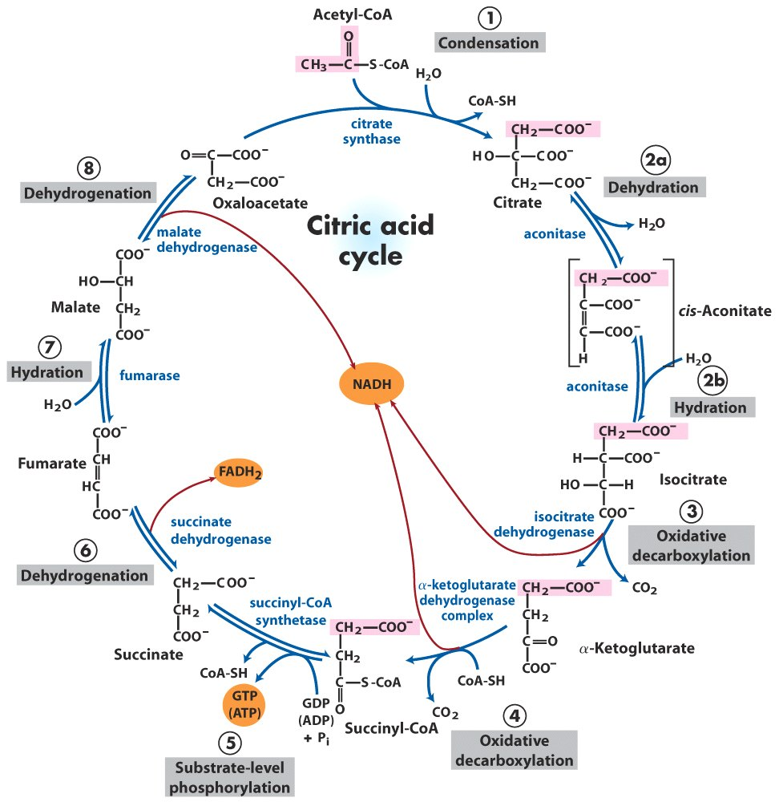
Reactions of the citric acid cycle

Slide 21
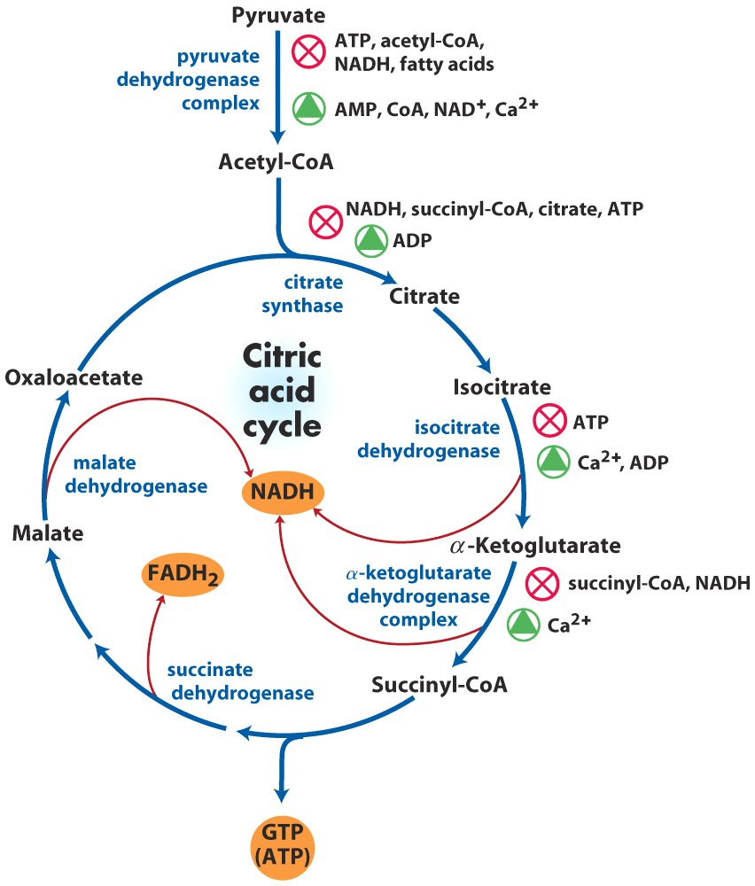
Regulation of the citric acid cycle

Slide 22
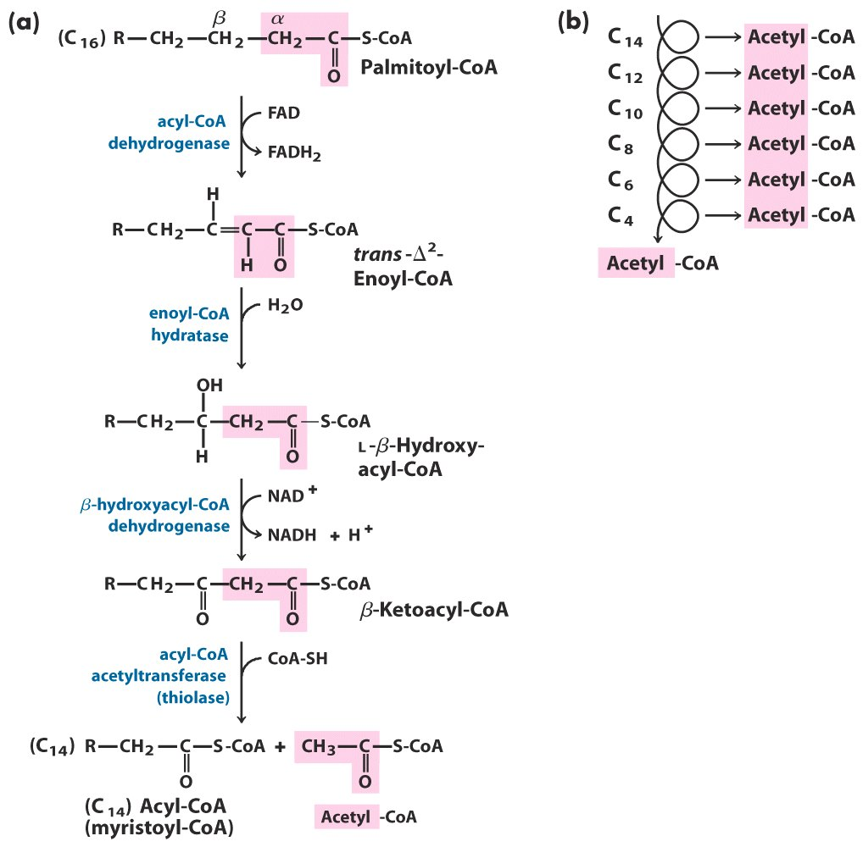
The β-oxidation pathway

Slide 23
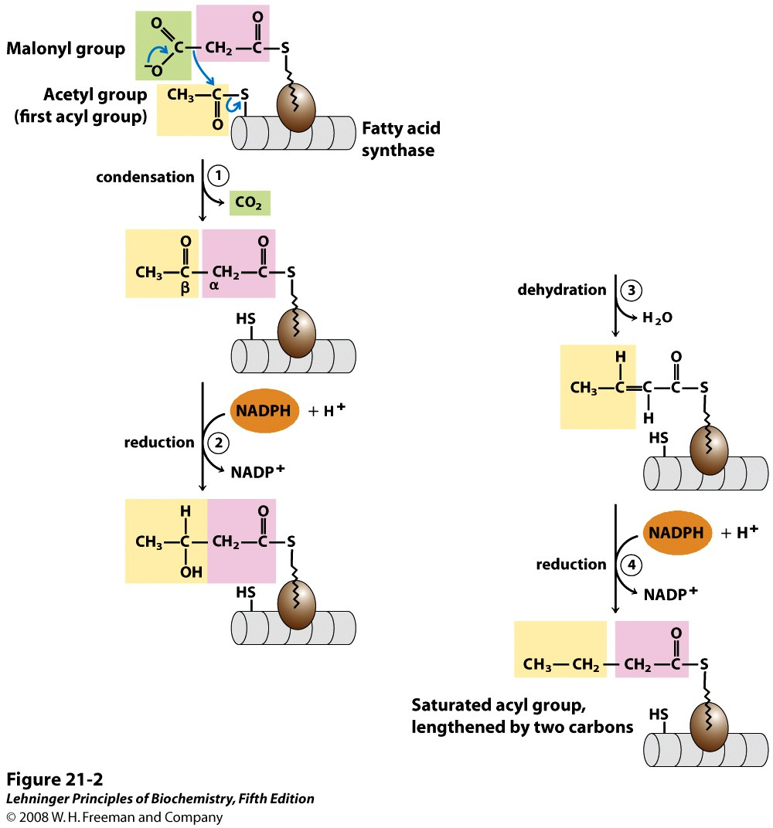
Fatty acids are synthesized by a repeating four-step reaction sequence
Notes:
FIGURE 21-2 Addition of two carbons to a growing fatty acyl chain: a four-step sequence. Each malonyl group and acetyl (or longer acyl) group is activated by a thioester that links it to fatty acid synthase, a multienzyme system described later in the text. 1 Condensation of an activated acyl group (an acetyl group from acetyl-CoA is the first acyl group) and two carbons derived from malonyl-CoA, with elimination of CO₂ from the malonyl group, extends the acyl chain by two carbons. The mechanism of the first step of this reaction is given to illustrate the role of decarboxylation in facilitating condensation. The β-keto product of this condensation is then reduced in three more steps nearly identical to the reactions of β oxidation, but in the reverse sequence: 2 the β-keto group is reduced to an alcohol, 3 elimination of H₂O creates a double bond, and 4 the double bond is reduced to form the corresponding saturated fatty acyl group.

Slide 24
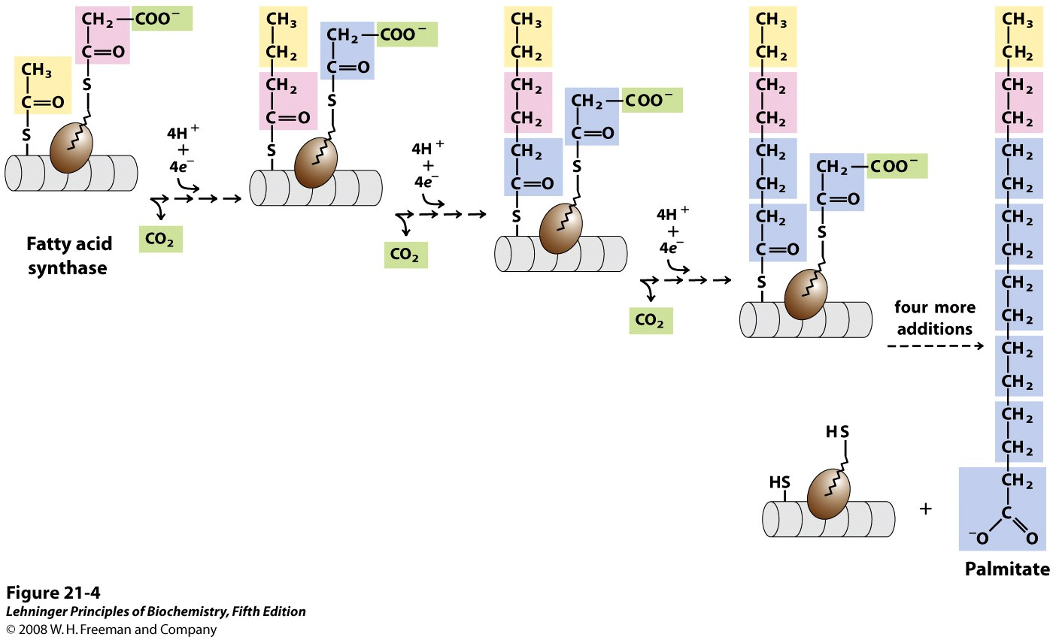
The overall process of palmitate synthesis
Notes:
FIGURE 21-4 The overall process of palmitate synthesis. The fatty acyl chain grows by two-carbon units donated by activated malonate, with loss of CO₂ at each step. The initial acetyl group is shaded yellow, C-1 and C-2 of malonate are shaded pink, and the carbon released as CO₂ is shaded green. After each two-carbon addition, reductions convert the growing chain to a saturated fatty acid of four, then six, then eight carbons, and so on. The final product is palmitate (16:0).

Slide 25
Comparison between degradation and biosynthesis of fatty acids*****
Degradation
dehydrogenation
hydration
dehydrogenation
thiolytic cleavage
NAD⁺/FAD
CoA
Mitochondrial matrix
Removal of acetyl group
Biosynthesis
condensation
reduction
dehydration
reduction
NADPH
ACP
Cytosol
Addition of two-carbon
units donated from
malonyl-CoA

Slide 26
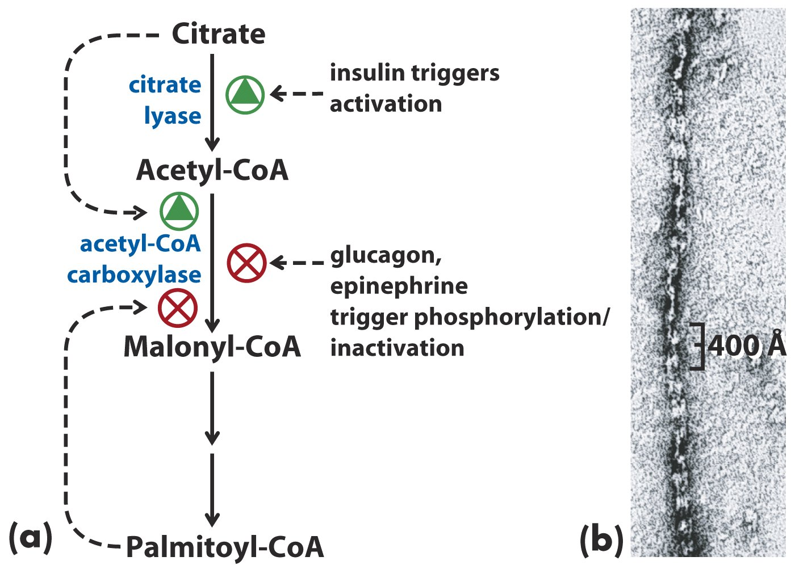
Acetyl-CoA carboxylase is regulated by allosteric
effectors and reversible phosphorylation

Slide 27
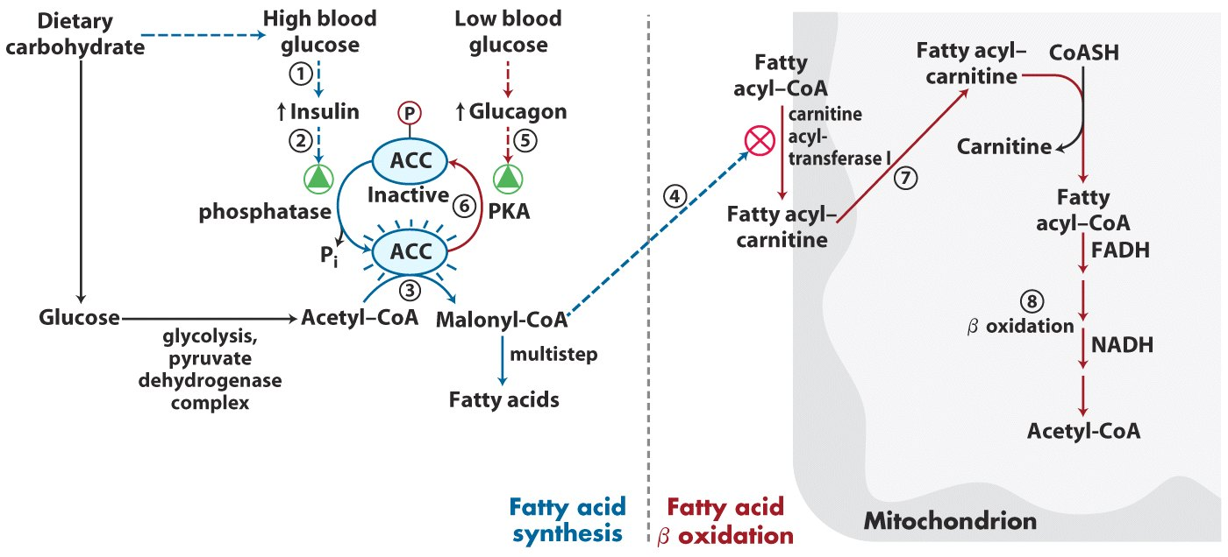
Coordinated regulation of fatty acid synthesis and breakdown*****

Slide 28
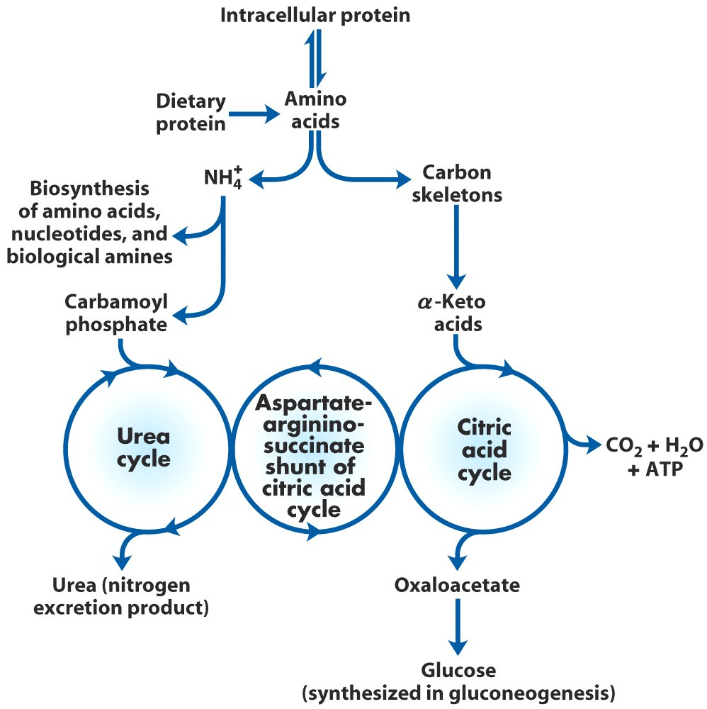
Overview of amino acid catabolism in mammals

Slide 29
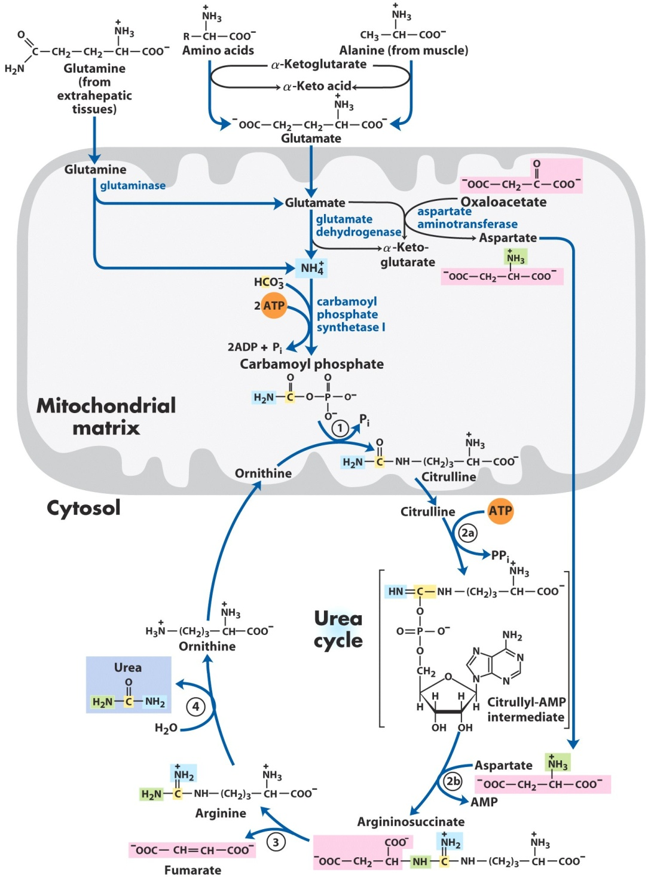
ornithine transcarbamoylase
argininosuccinate synthetase
argininosuccinate lyase
arginase
Urea cycle and reactions that feed amino groups into the cycle

Slide 30
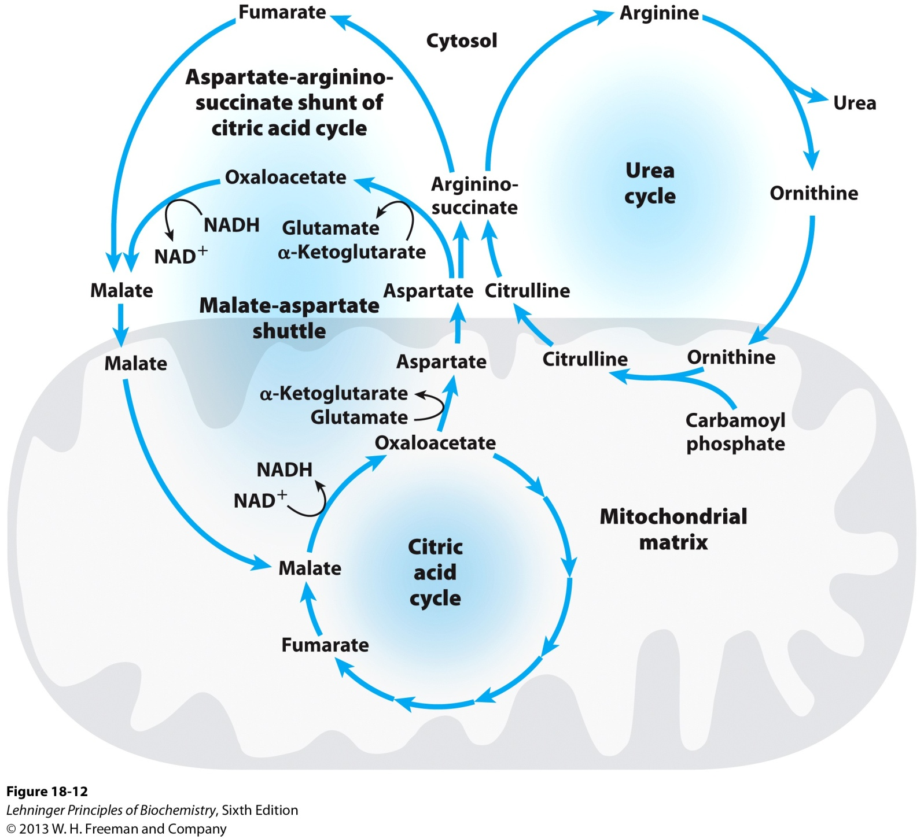
Links between the urea cycle and citric acid cycle

Slide 31
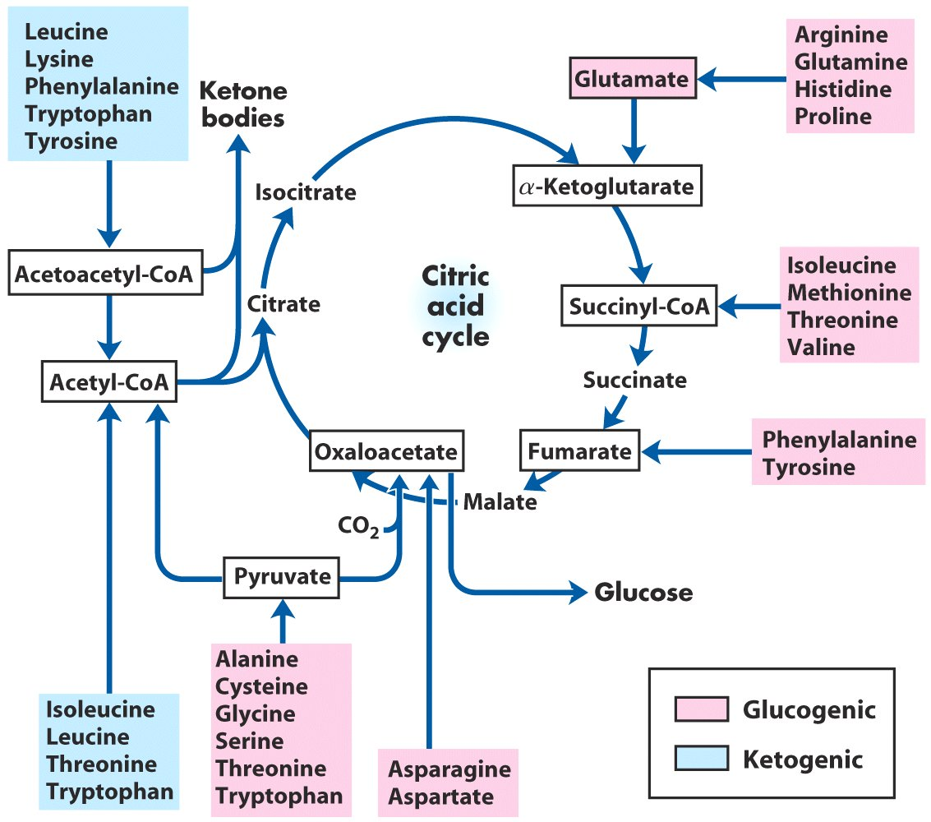
The carbon skeletons of amino acids are oxidized via the citric acid cycle*****

Slide 32
Amino acids can be converted to
glucose (glucogenic) or ketone bodies (ketogenic)

Slide 33
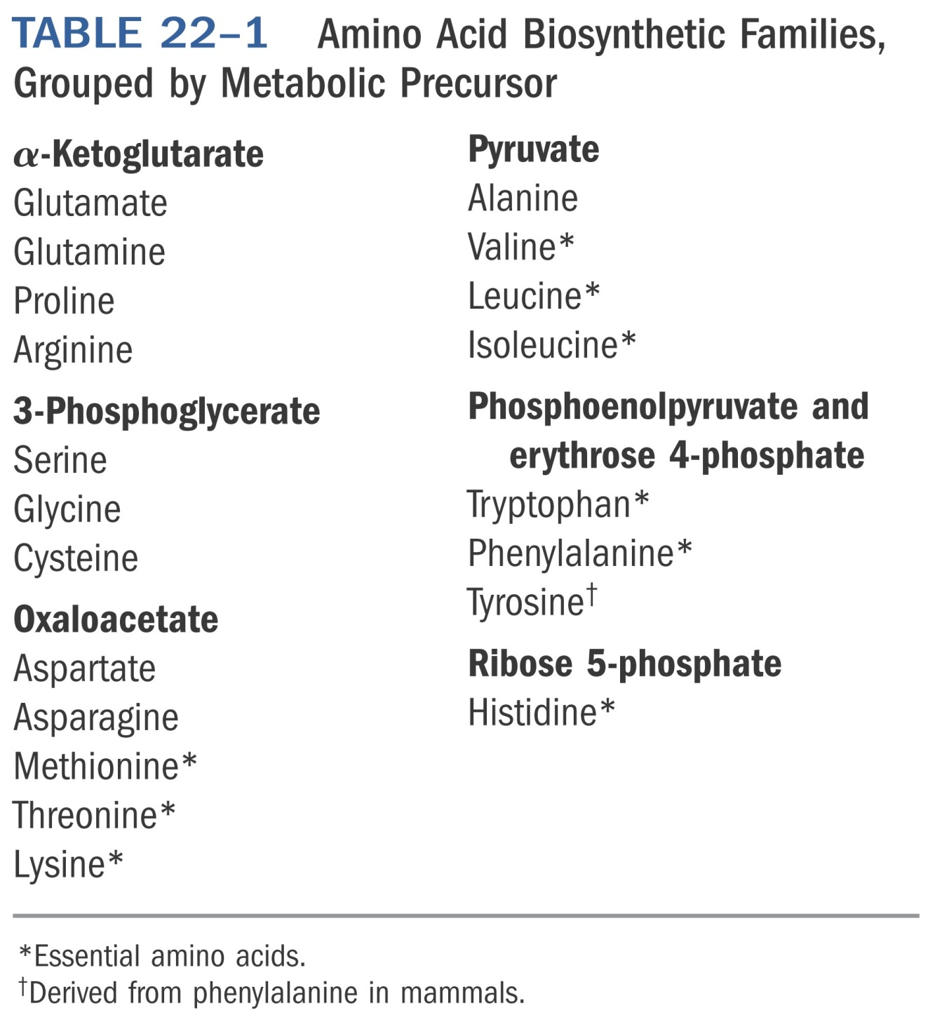
*****
Notes:
Table 22-01

Slide 34
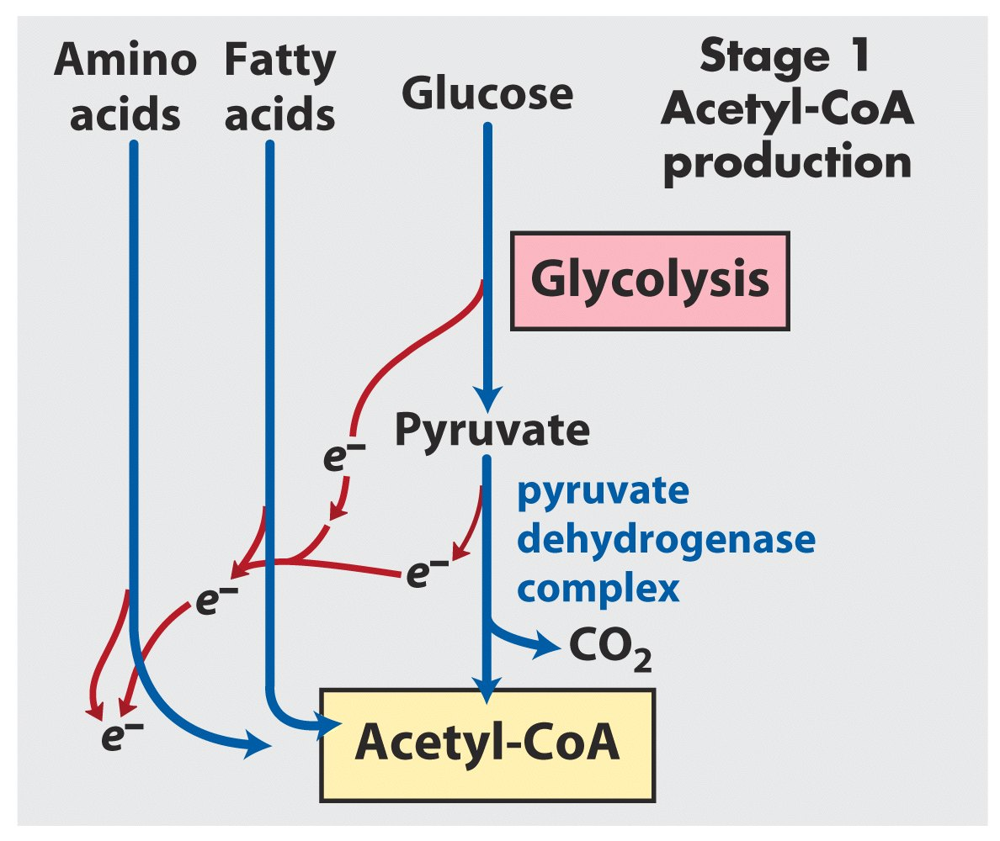

Slide 35
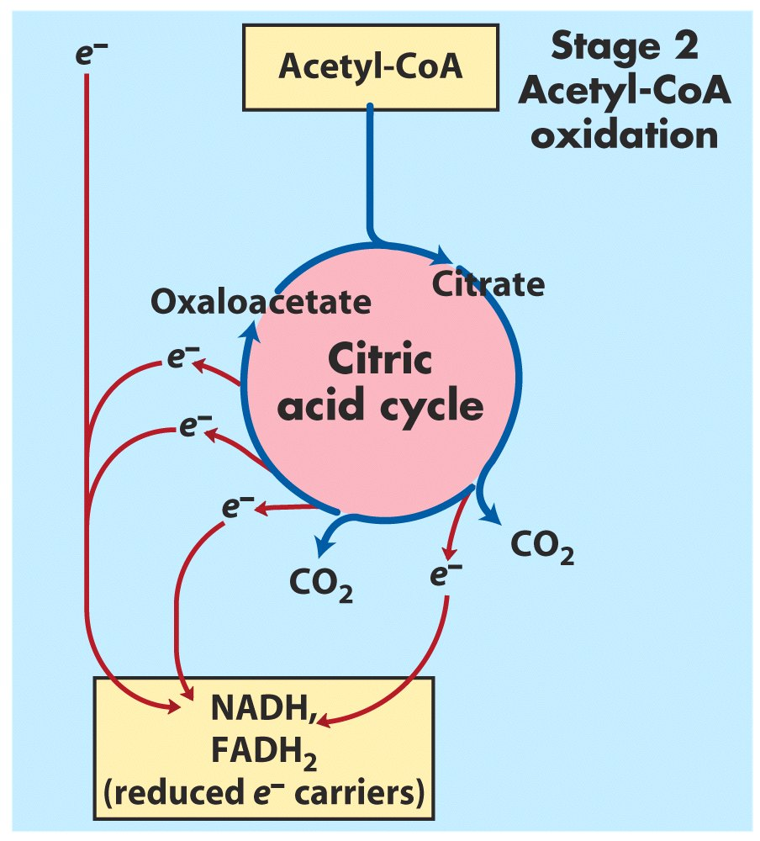

Slide 36
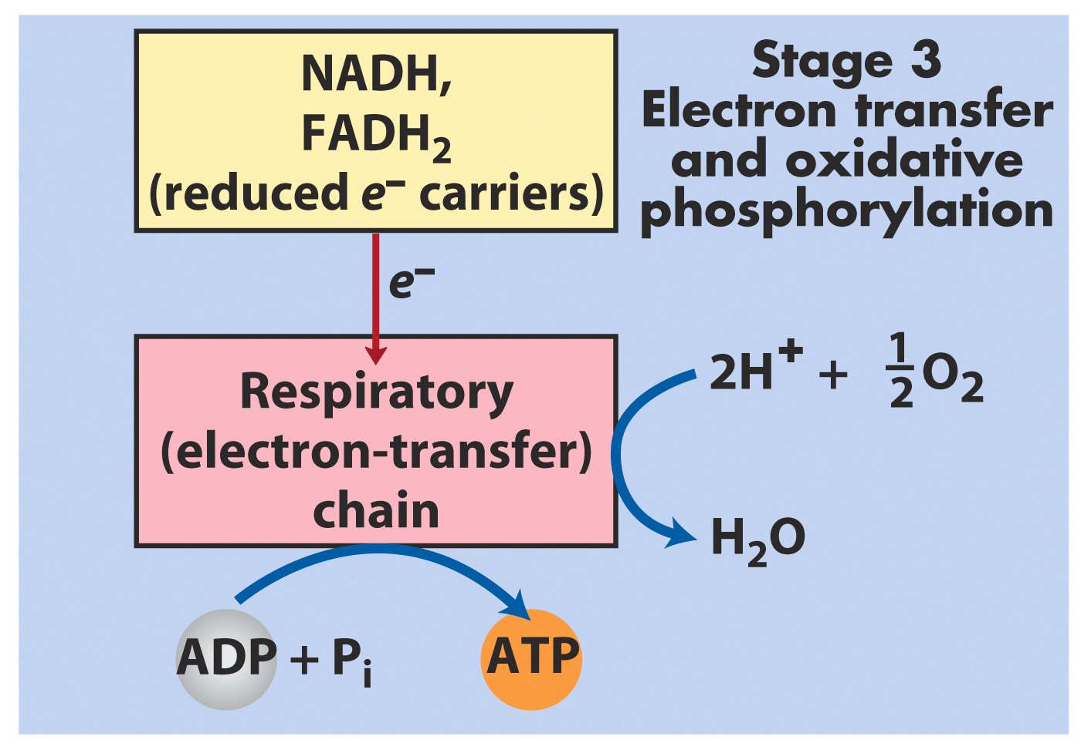

Slide 37
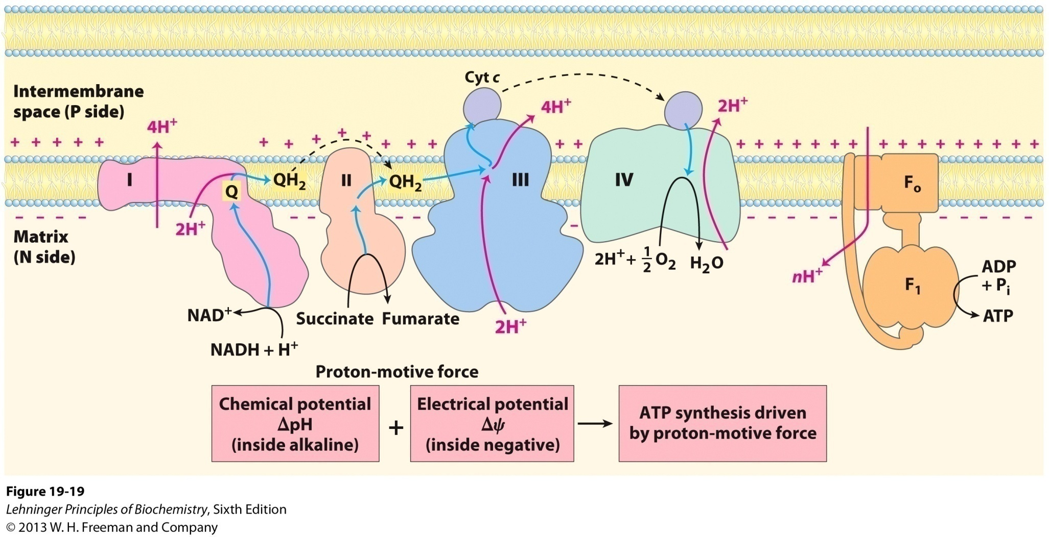
The chemiosmotic model by Mitchell

Slide 38
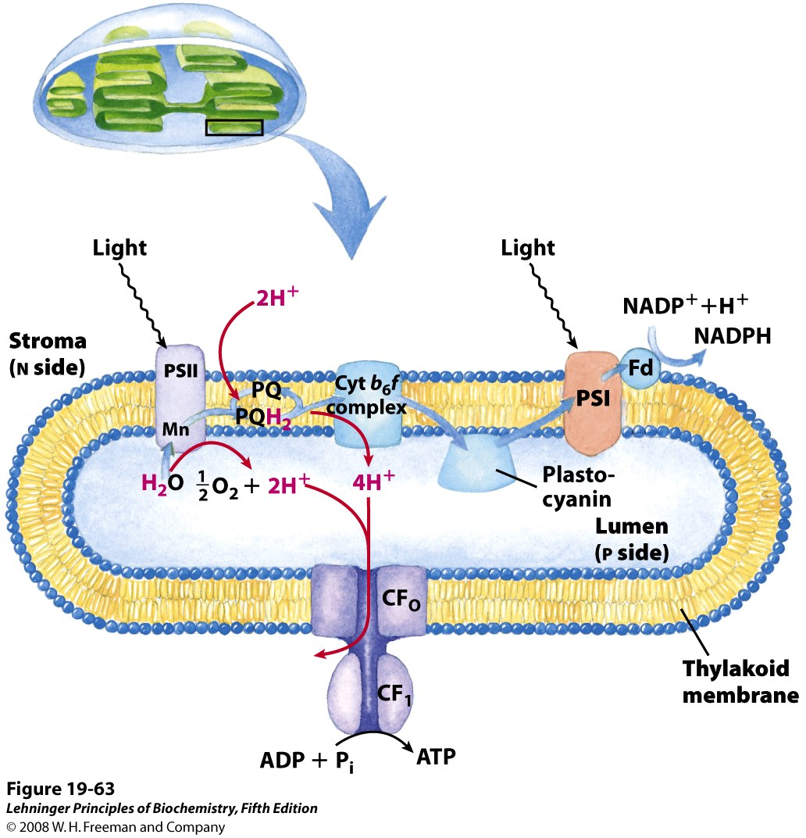
*****
Proton and electron circuits in thylakoids
2H₂O + 8 photons + 2NADP⁺ + ~3ADP + ~3P_{i}
O₂ + ~3ATP + 2NADPH

Slide 39
Oxidative phosphorylation and photophosphorylation are mechanistically similar
1). Both involve the flow of electrons through a chain of membrane-bound carriers.
2). The energy released from “downhill” electron flow is first used for “uphill” pumping of protons to produce a proton gradient (thus a transmembrane electrochemical potential) cross a biomembrane.
3). ATP is then synthesized by a “downhill” transmembrane flow of protons through a specific protein machinery (ATP synthase).

Slide 40
ATP is synthesized using the same strategy in oxidative phosphorylation and photophosphorylation
Oxidative phosphorylation is the process in which ATP is generated as a result of electron flow from NADH or FADH₂ to O₂ via a series of membrane-bound electron carriers called the respiratory chain (reducing O₂ to H₂O at the end)----氧化磷酸化
Photophosphorylation is the process in which ATP (and NADPH) is synthesized as a result of electron flow from H₂O to NADP⁺ via a series of membrane-bound electron carriers (oxidizing H₂O to O₂ at the beginning)----光合磷酸化

Slide 41
Differences between oxidative phosphorylation and photophosphorylation
1). The organelle in which the process occurs: mitochondrion vs. chloroplast
2). The initial source of electrons:
NADH or FADH₂ vs. H₂O (or H₂S, or organic hydrogen donors)
3). Source of energy for the electron donors:
fuel molecules vs. photons
4). Final electron acceptor: O₂ vs. NADP⁺

Slide 42
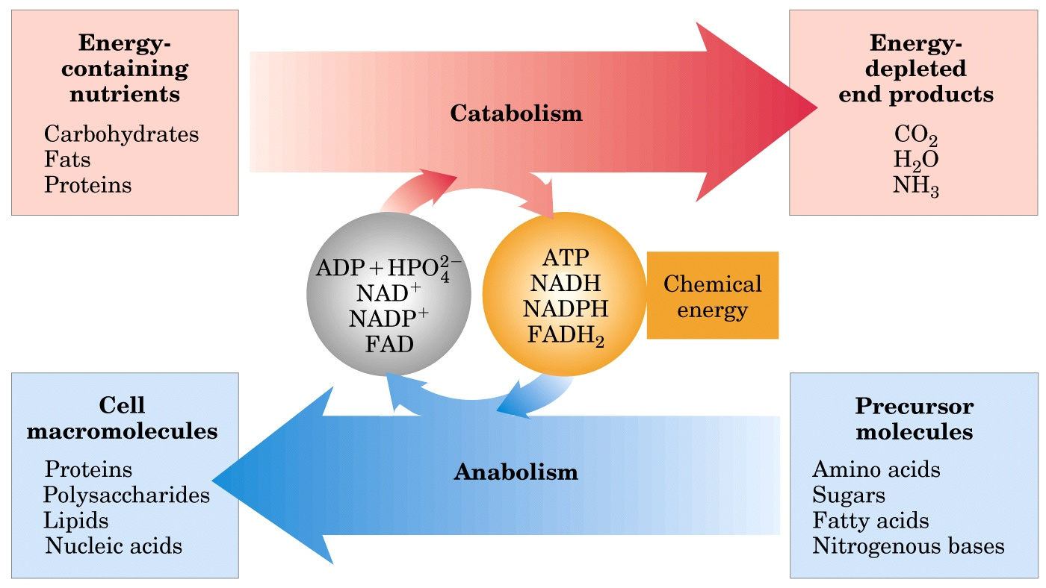
Energy relationships between catabolic and anabolic pathways

Slide 43
Important hormones
Glucagon
Epinephrine
Insulin

Slide 44
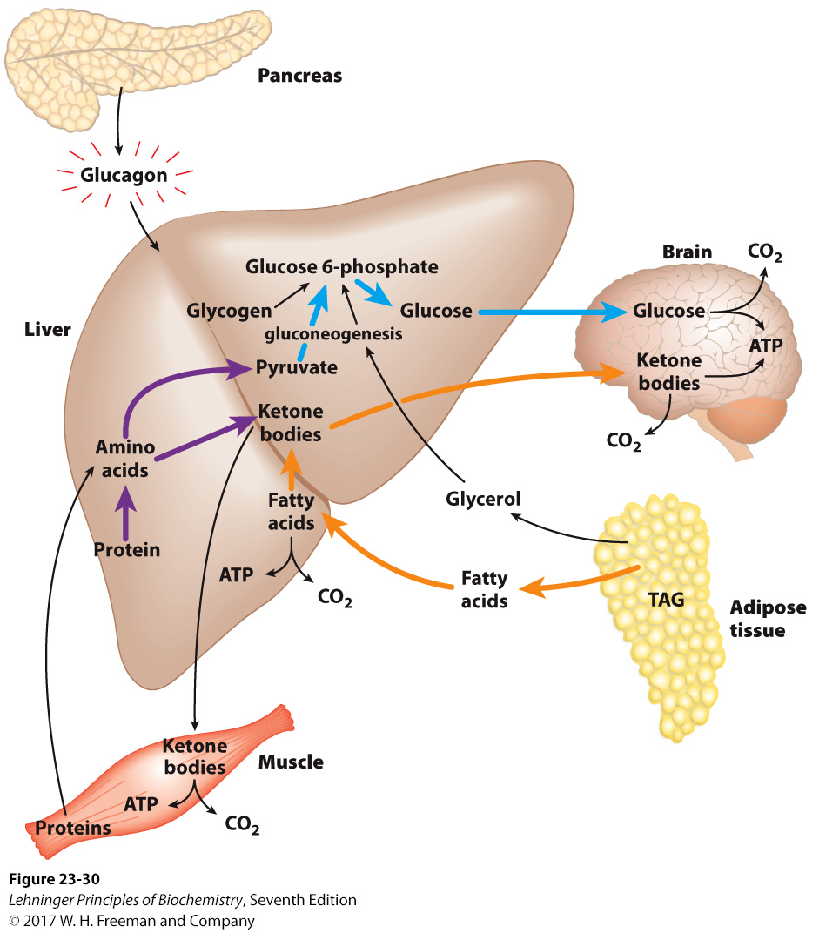
The fasting state: the glucogenic liver
Notes:
FIGURE 2330 The fasting state: the glucogenic liver. After some hours without a meal, the liver becomes the principal source of glucose for the brain. Liver glycogen is broken down to glucose 1-phosphate, and this is converted to glucose 6-phosphate, then to free glucose, which is released into the bloodstream. Amino acids from the degradation of proteins in liver and muscle, and glycerol from the breakdown of TAGs in adipose tissue, are used for gluconeogenesis. The liver uses fatty acids as its principal fuel, and excess acetyl-CoA is converted to ketone bodies for export to other tissues; the brain is especially dependent on this fuel when glucose is in short supply (see Fig. 23-23). Blue arrows follow the path of glucose; orange arrows, the path of lipids; and purple arrows, the path of amino acids.

Slide 45
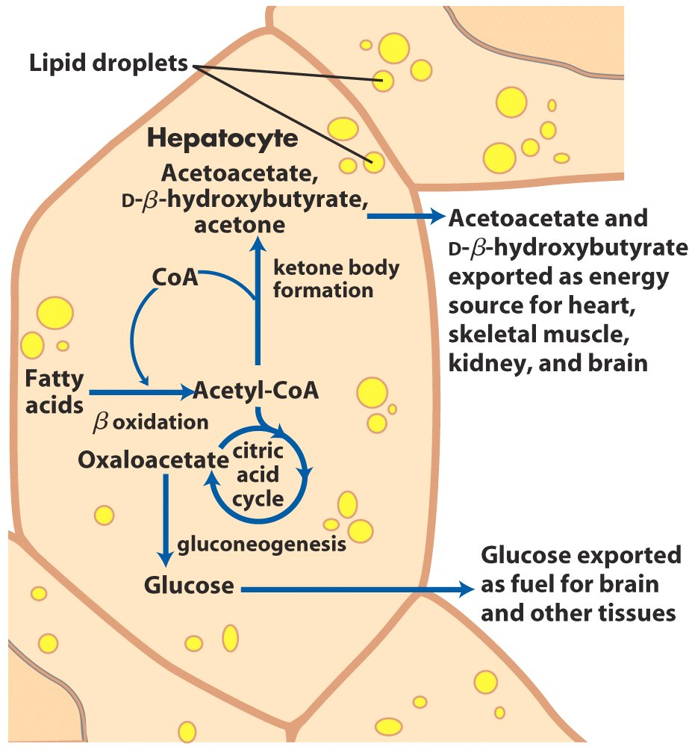
Ketone body formation and export from the liver

Slide 46
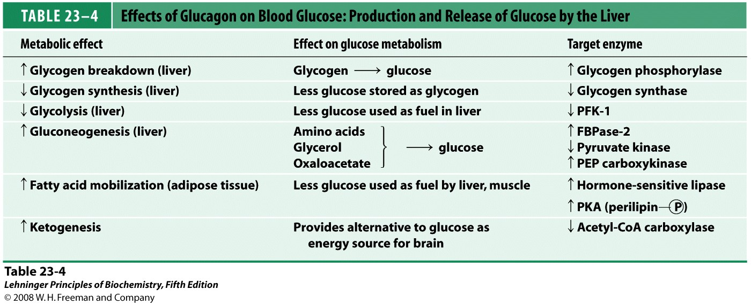
*****
Notes:
TABLE 23-4 Effects of Glucagon on Blood Glucose: Production and Release of Glucose by the Liver

Slide 47
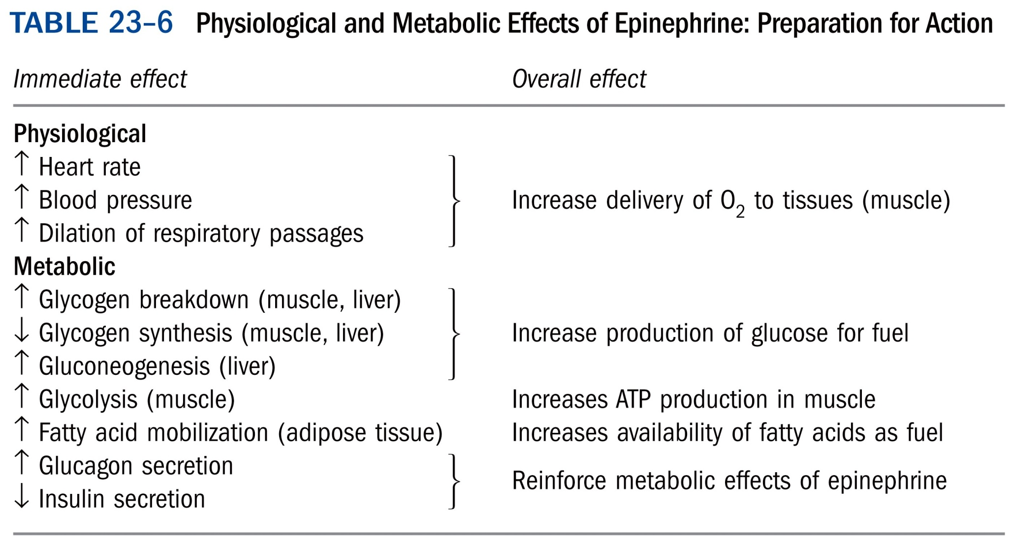
*****

Slide 48
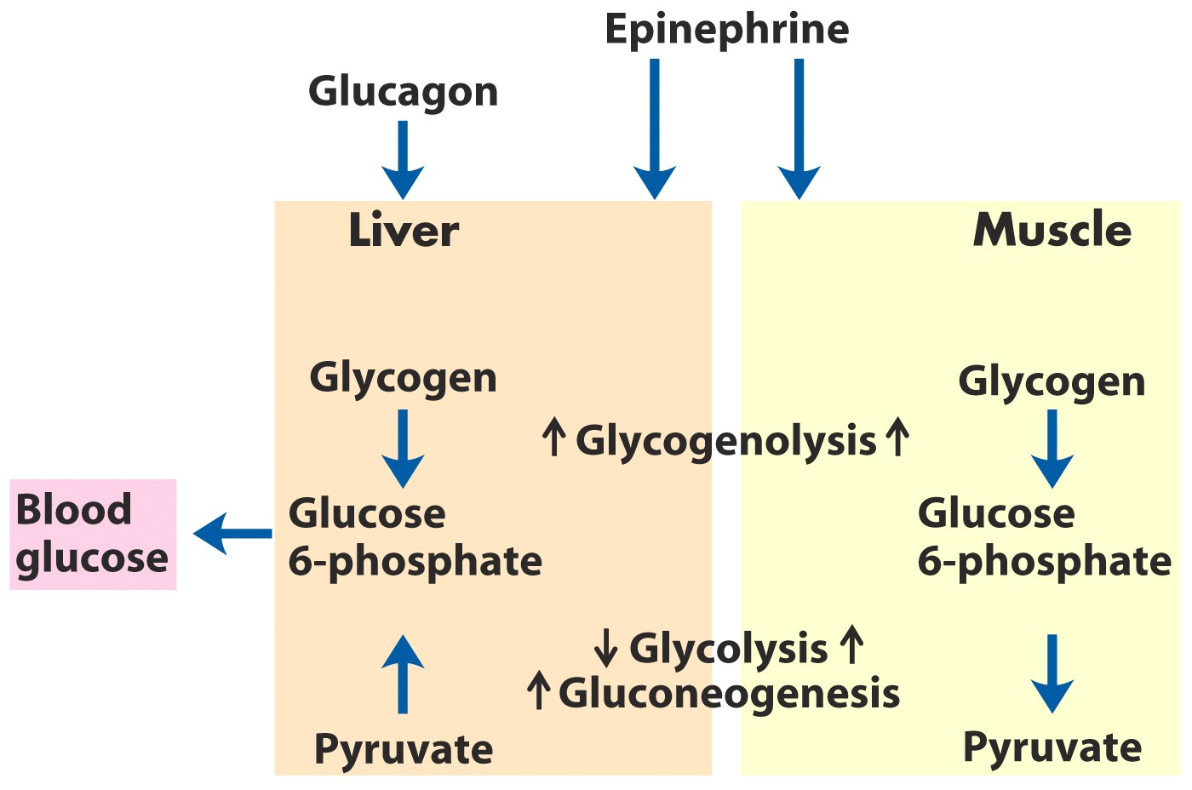
Difference in the regulation of carbohydrate
metabolism in liver and muscle*****

Slide 49
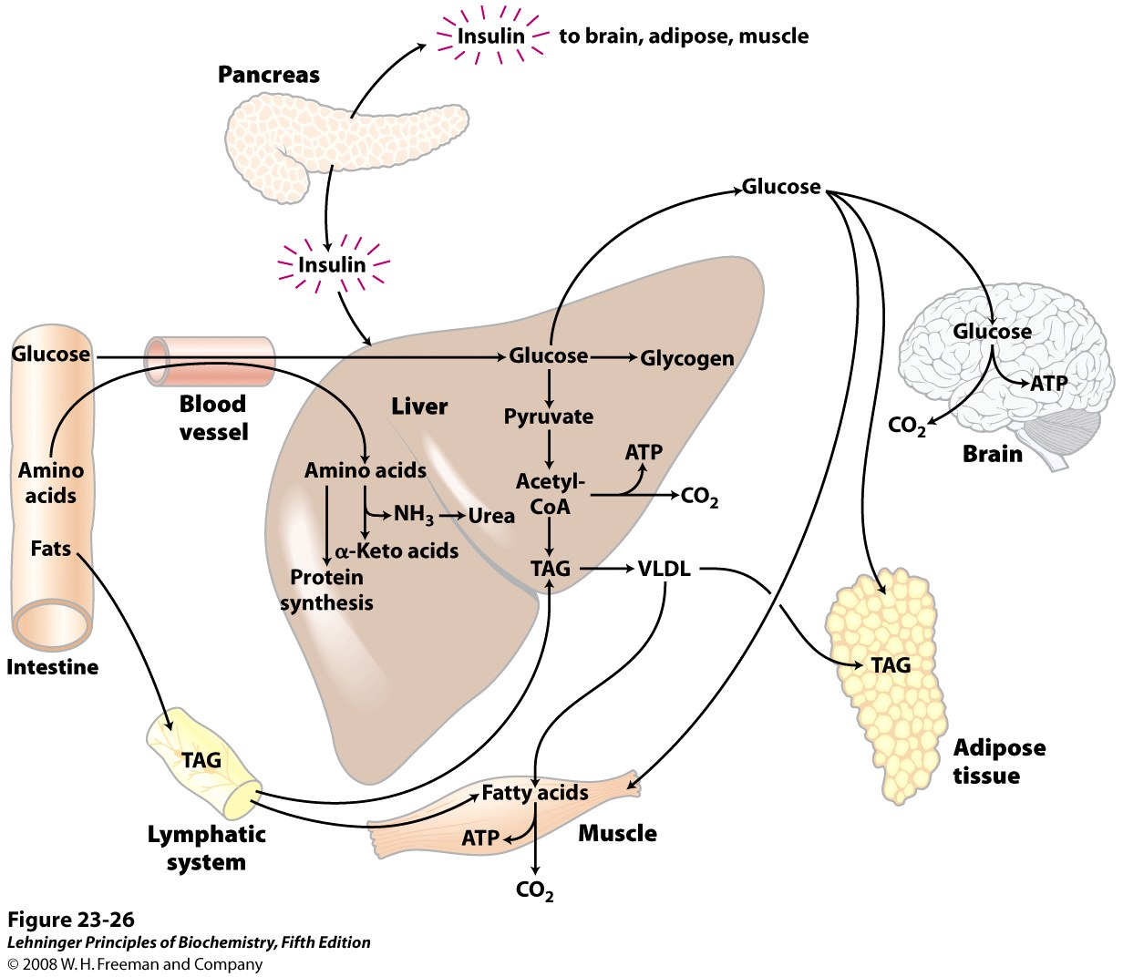
The well-fed state: the lipogenic liver
Notes:
FIGURE 23-26 The well-fed state: the lipogenic liver. Immediately after a calorie-rich meal, glucose, fatty acids, and amino acids enter the liver. Insulin released in response to the high blood glucose concentration stimulates glucose uptake by the tissues. Some glucose is exported to the brain for its energy needs, and some to adipose and muscle tissue. In the liver, excess glucose is oxidized to acetyl-CoA, which is used to synthesize fatty acids for export as triacylglycerols in VLDLs to adipose and muscle tissue. The NADPH necessary for lipid synthesis is obtained by oxidation of glucose in the pentose phosphate pathway. Excess amino acids are converted to pyruvate and acetyl-CoA, which are also used for lipid synthesis. Dietary fats move via the lymphatic system, as chylomicrons, from the intestine to muscle and adipose tissues.

Slide 50
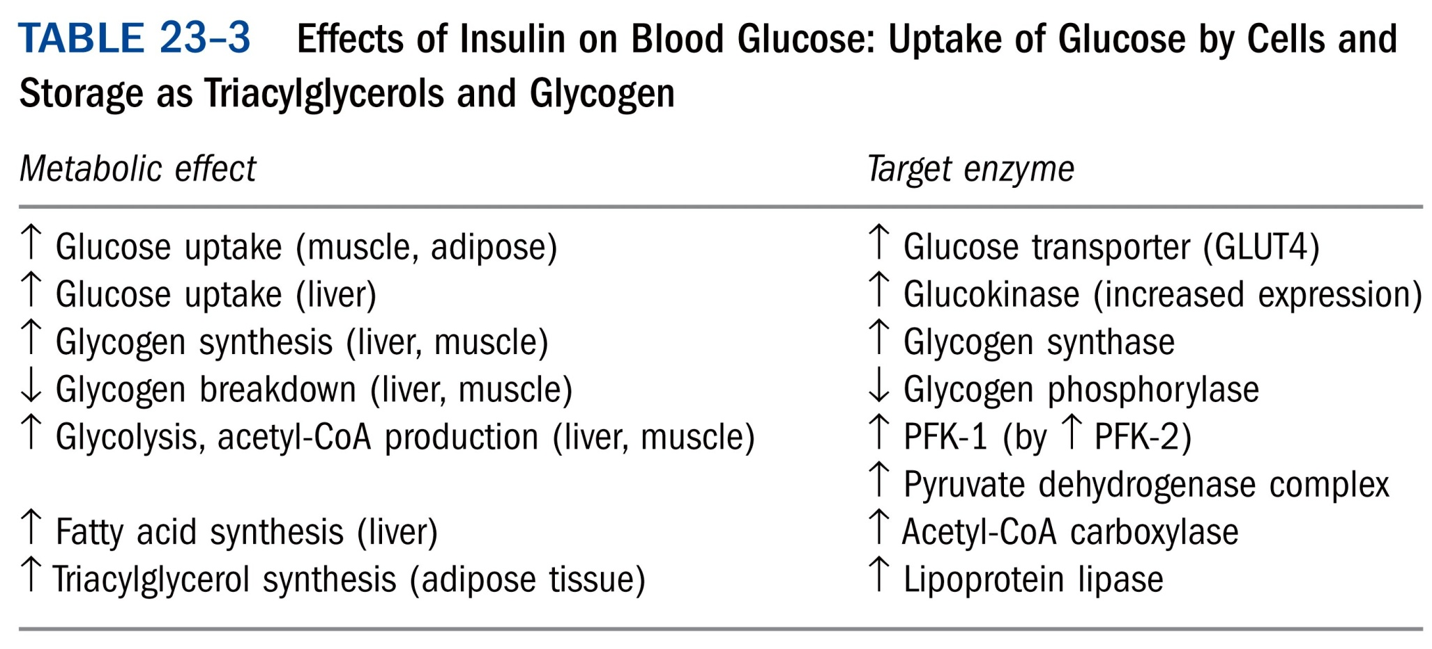
*****

Slide 51
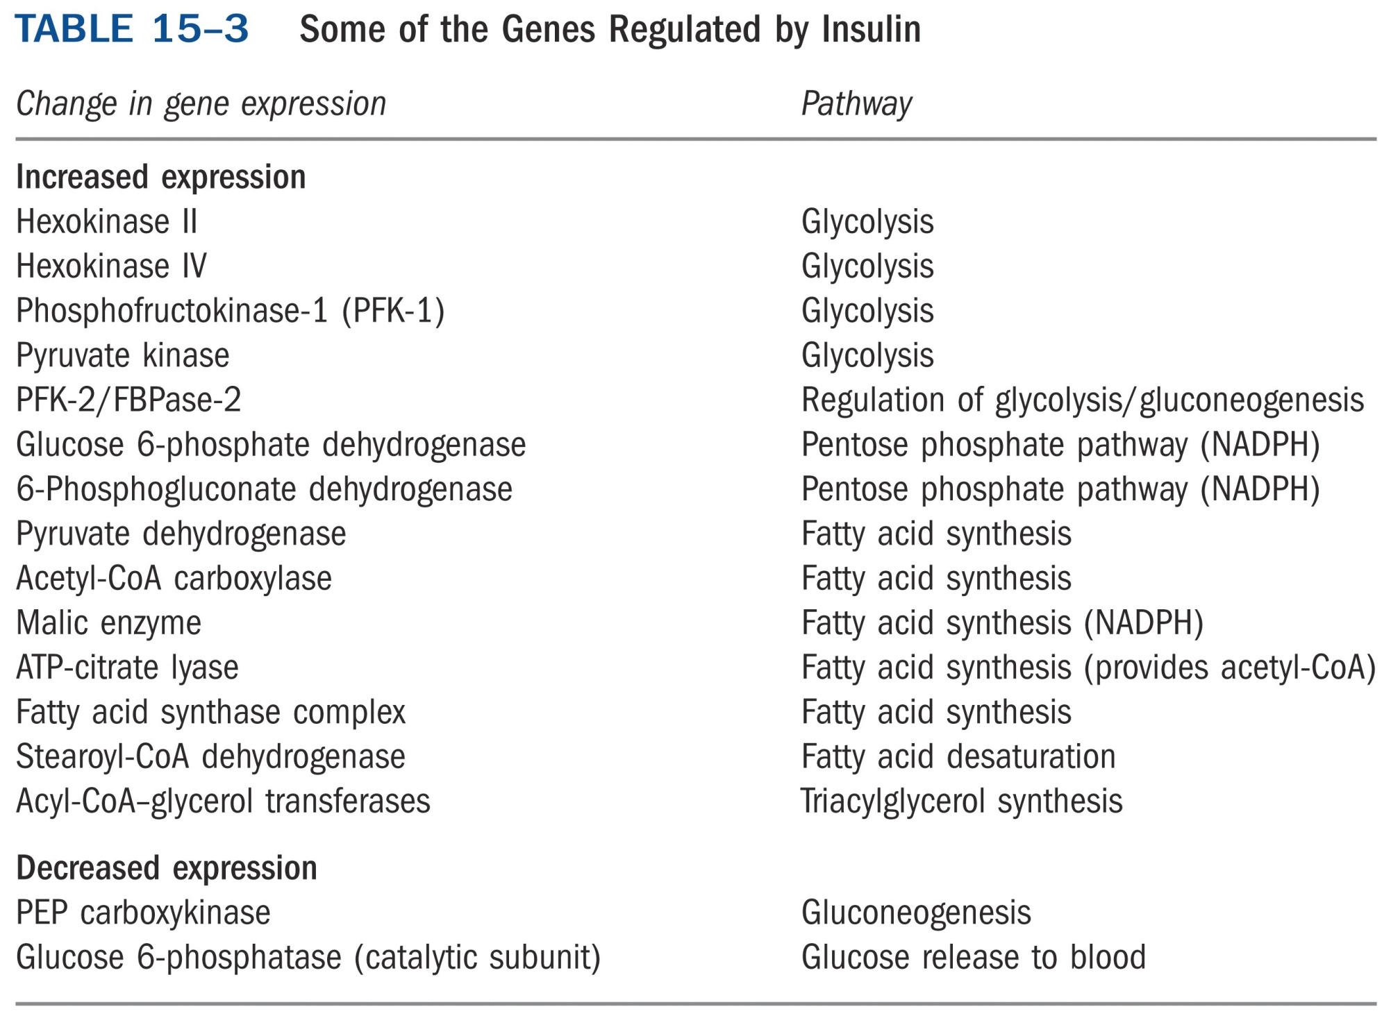
*****

Slide 52
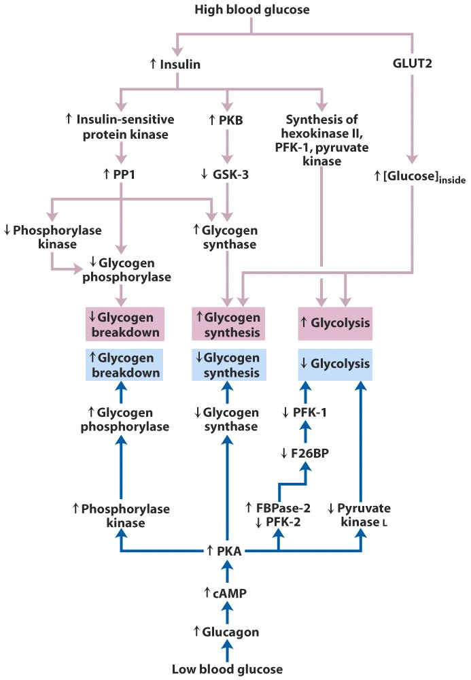
Glycogen
synthesis
Glycogen
breakdown
Regulation of carbohydrate metabolism in the hepatocyte

Slide 53
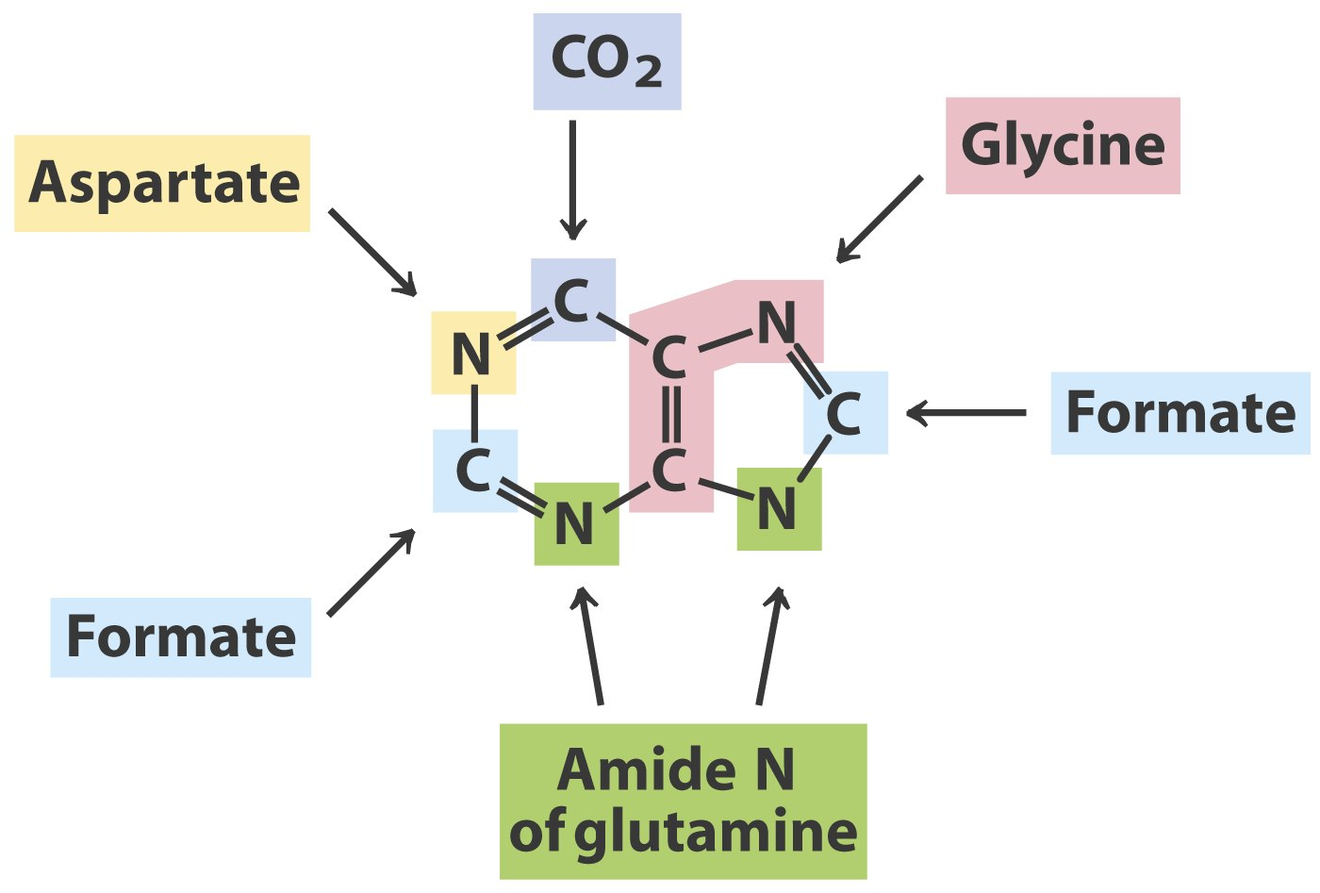
Radioisotope tracer experiments revealed the
origins of the atoms of the purine rings*****

Slide 54
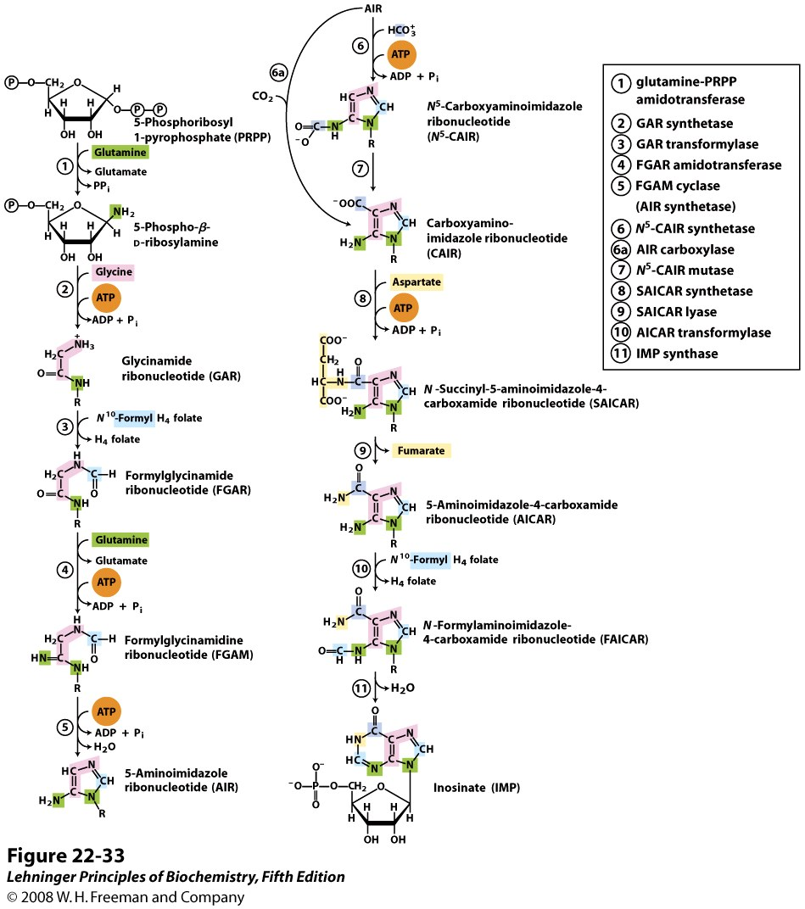
Commitment step
The purine ring is built up
one or a few atoms
at a time on ribose 5-phosphate
Notes:
FIGURE 22-33 De novo synthesis of purine nucleotides: construction of the purine ring of inosinate (IMP). Each addition to the purine ring is shaded to match Figure 22-32. After step 2, R symbolizes the 5-phospho-D-ribosyl group on which the purine ring is built. Formation of 5-phosphoribosylamine (step 1) is the first committed step in purine synthesis. Note that the product of step 9, AICAR, is the remnant of ATP released during histidine biosynthesis (see Figure 22-20, step 5). Abbreviations are given for most intermediates to simplify the naming of the enzymes. Step 6a is the alternative path from AIR to CAIR occurring in higher eukaryotes.

Slide 55
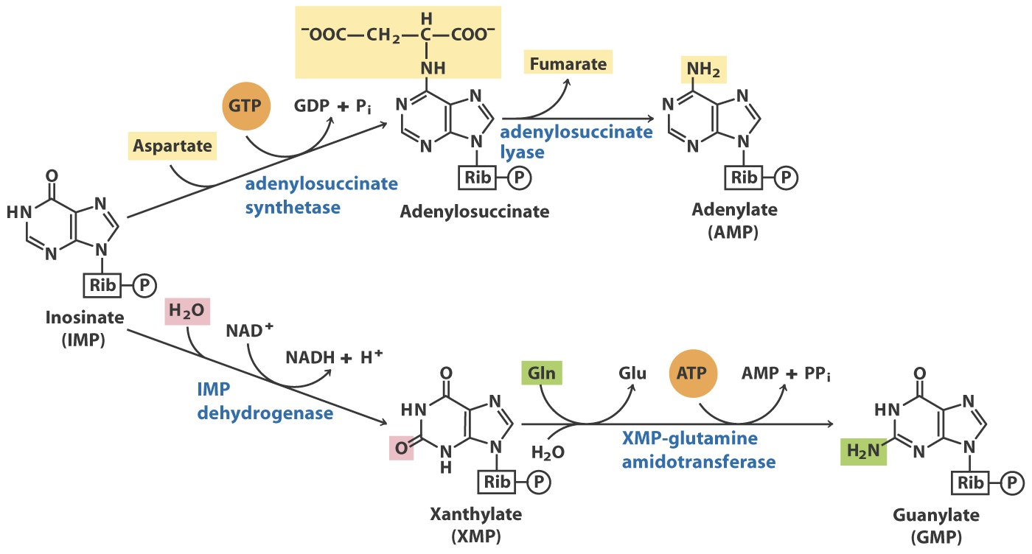
IMP is converted to AMP by accepting an amino
group from Asp (GTP is needed to activate Asp);
IMP is converted to GMP by accepting an amino
group from Gln (ATP is needed to activate XMP)

Slide 56
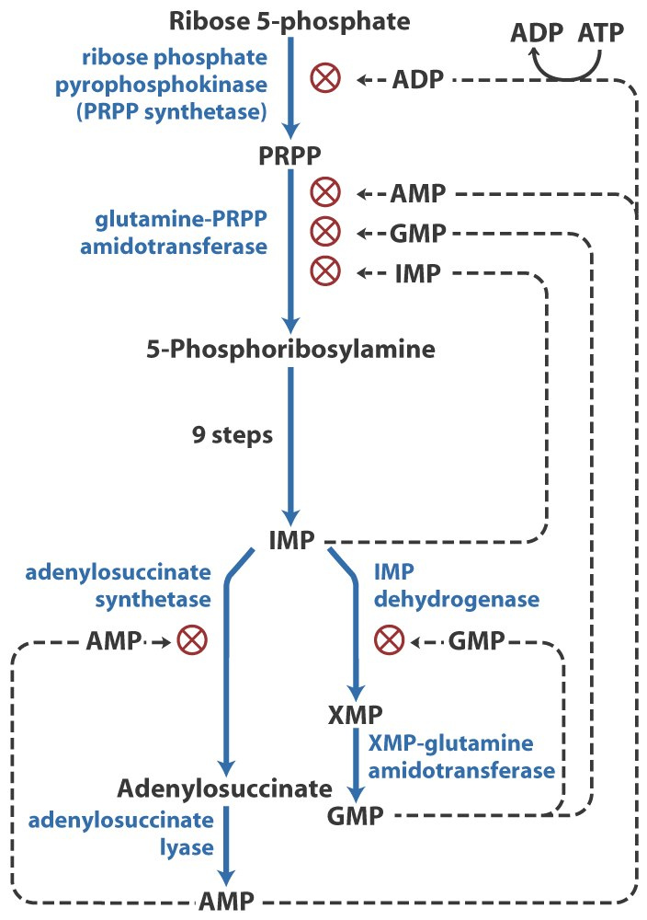
Regulation of the biosynthesis
of AMP and GMP in E. coli*****

Slide 57
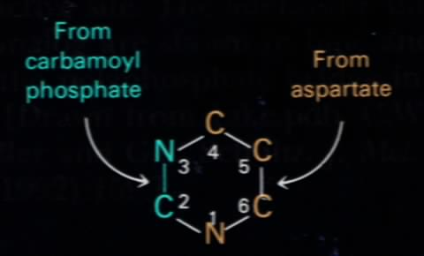
Gln amide
C
HCO₃⁻
The atoms of the pyrimidine ring were revealed to
be derived from HCO₃⁻, Gln and Asp.*****

Slide 58
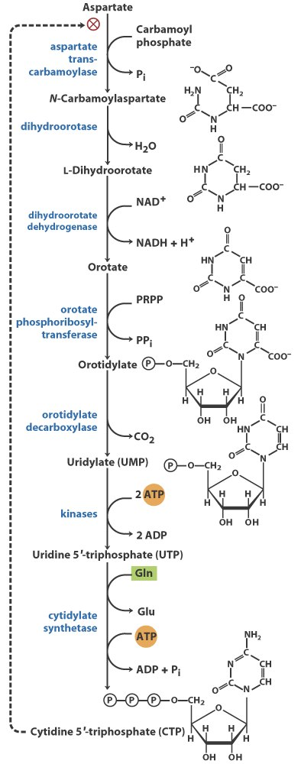
Committing step
De novo synthesis of pyrimidine nucleotides

Slide 59
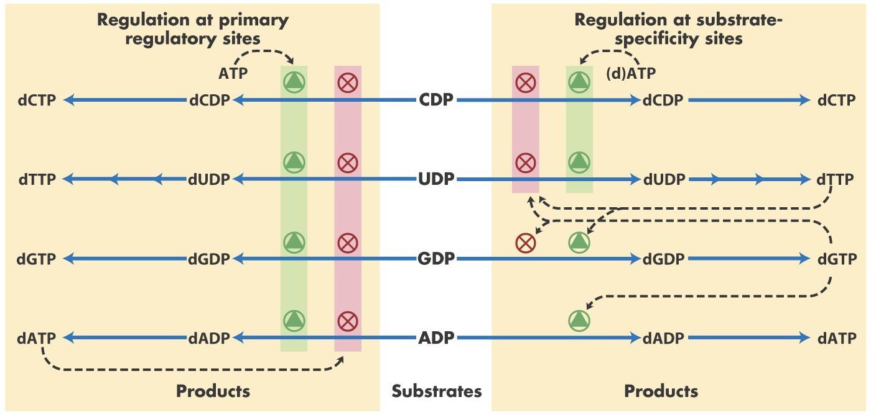
Both substrate specificity and the overall enzymatic
activity of ribonucleotide reductase are regulated to
balance the biosynthesis of all nucleotides.

Slide 60
Biosynthesis of thymidylate (dTMP)

Slide 61
FdUMP (from fluorouracil) and methotrexate inhibit
thymidylate synthase and dihydrofolate reductase(DHFR), respectively.

Slide 62
Five main reaction classes of biochemistry
Oxidation-reductions--dehydrogenations
Reactions that make or break
carbon-carbon bonds
Internal rearrangements, isomerizations and eliminations
Group transfers
Free radical reactions

Slide 63
Important enzymes & coenzymes
Dehydrogenase (NAD⁺, FAD, or NADP⁺)
Aminotransferase (PLP)
Amidotransferase (Gln)
Synthetase (ATP) vs. synthase
Kinase (ATP) vs. phosphatase
Carboxylase (biotin) vs. decarboxylase (TPP)
Phosphorylase
Isomerase
Reductase
Lyase

Slide 64
*****

Slide 65
*****

Slide 66
Important regulation
Allosteric regulation
Regulation by covalent modification
--- phosphorylation
Feedback inhibition

Slide 67
Allosteric regulation

Slide 68
Protein phosphorylation and dephosphorylation

Slide 69
Important inhibitors
Inhibitors of electron transfer
Inhibitors of ATP synthesis
Competitive inhibitor of enzymes
(as drugs to treat diseases)

Slide 70
*****

Slide 71
Notes:
FIGURE 6-15a

Slide 72
*****

Slide 73
Important drugs
Metformin (AMPK activator) for type 2 diabetes
Statins (competitive inhibitor) for hypercholesterolemia
Allopurinol (competitive inhibitor) for gout
Chemotherapeutic drugs for cancer
NaHCO₃ (小苏打) for acidosis

Slide 74
Important information pathways
DNA: replication
RNA: transcription, processing,
reverse transcription
Protein: translation

Slide 75
A variety of simple questions were asked about DNA replication
Are the two parental strands completely unwound before replication begins? No
Does replication begin at random sites or at a unique site?
Does DNA replication proceed in one direction or both directions?
Does overall chain growth occur in 5’ 3’, 3’ 5’, or both directions?

Slide 76
A variety of simple questions were asked about DNA replication (continued)
What mechanisms ensure that DNA replicates once per cell division? (methylation of GATC)
What enzymes take part in DNA synthesis? (DNA polymerases)
How does duplication of the long helical duplex occur without the strands becoming tangled? (Topoisomerases)

Slide 77
Protease cleavage
DNA polymerase I has three enzymatic
activities in a single polypeptide chain,
which can be cleaved into two functional
parts by mild protease treatment.

Slide 78
*****
TABLE 25-2 |  | Subunits of DNA Polymerase III of E. coli
Subunit | Number of subunits per holoenzyme |  | M_{r} of subunit | Gene | Function of subunit
α | 3 |  | 129,900 | polC (dnaE) | Polymerization activity | Core polymerase
ε | 3 |  | 27,500 | dnaQ (mutD) | 3' → 5' proofreading exonuclease
θ | 3 |  | 8,600 | holE | Stabilization of ε subunit
τ | 3 |  | 71,100 | dnaX | Stable template binding; core enzyme dimerization | Clamp-loading (γ) complex that loads β subunits on lagging strand at each Okazaki fragmentª
δ | 1 |  | 38,700 | holA | Clamp opener
δ' | 1 |  | 36,900 | holB | Clamp loader
χ | 1 |  | 16,600 | holC | Interaction with SSB
ψ | 1 |  | 15,200 | holD | Interaction with τ and χ
β | 6 |  | 40,600 | dnaN | DNA clamp required for optimal processivity
ªThe clamp-loading complex is also called the γ complex, because of the existence of another version of the complex in which three subunits called γ replace the τ subunits. The γ subunit is encoded by a portion of the gene for the τ subunit (dnaX), such that the amino-terminal 66% of the τ subunit has the same amino acid sequence as the γ subunit. The γ subunit is generated by a translational frameshifting mechanism (p. 1085) that leads to premature translational termination. The γ subunit shares the clamp-loading functions of τ but lacks the protein segments that interact with the core polymerase or with DnaB helicase. Clamp-loading complexes incorporating γ subunits may operate independently of the DNA polymerase III holoenzyme, promoting the unloading of β clamps discarded on the lagging strand as the replication fork progresses. They may also promote loading of β clamps for some DNA repair processes that require DNA synthesis away from the replication fork.

Slide 79
*****
TABLE 25-1 | Comparison of the Five DNA Polymerases of E. coli
 |  | DNA polymerase
 |  | I | IIª | III | IVª | Vª
Structural gene^{b} |  | polA | polB | polC (dnaE) | dinB | umuC
Subunits (number of different types) |  | 1 | 7 | 9 | 1 | 3
M_{r} |  | 103,000 | 88,000^{c} | 1,065,400 | 39,100 | 110,000
3' → 5' exonuclease (proofreading) |  | Yes | Yes | Yes | No | No
5' → 3' exonuclease |  | Yes | No | No | No | No
Polymerization rate (nucleotides/s) |  | 10–20 | 40 | 250–1,000 | 2–3 | 1
Processivity (nucleotides added before polymerase dissociates) |  | 3–200 | 1,500 | ≥500,000 | 1 | 6–8
ªTranslesion (mutagenic) DNA polymerases. For DNA polymerase IV, processivity is increased substantially by association with a β clamp. These polymerases are slowed when a DNA lesion is present in the DNA template strand. ^{b}For enzymes with more than one subunit, the gene listed here encodes the subunit with polymerization activity. Note that dnaE is an earlier designation for the gene now referred to as polC. ^{c}Polymerization subunit only. DNA polymerase II shares several subunits with DNA polymerase III, including the β, δ, δ', χ, and ψ subunits (see Table 25-2).

Slide 80
*****
Notes:
TABLE 25-3 Proteins Required to Initiate Replication at the E. coli Origin

Slide 81
*****

Slide 82
DNA and RNA synthesis are similar in some aspects but different in others
Similar in fundamental chemical mechanism: both are guided by a template; both have the same polarity in strand extension (5’ to 3’); both use nucleoside 5’- triphosphates (dNTP or NTP).
Different aspects: No primers are needed; only involves a short segment of a large DNA molecule; uses only one of the two complementary DNA strands as the template strand; no proofreading.

Slide 83
Template and nontemplate (coding) DNA strands

Slide 84
Eukaryotic RNA polymerases

Slide 85
*****
Notes:
TABLE 26-2 Proteins Required for Initiation of Transcription at the RNA Polymerase II (Pol II) Promoters of Eukaryotes

Slide 86
Inhibitors of transcription
Three-ring-containing, planar antibiotic molecules like actinomycin (放射菌素) D intercalates between two successive GC base pairs in duplex DNA, preventing RNA polymerases (all types) to move along the template (thus the elongation of RNA synthesis).
Rifampicin (利福平) (an antibiotic) binds to the β subunit of bacterial RNA polymerases, preventing the initiation of RNA synthesis.
α-amanitin (蝇蕈素) blocks eukaryotic mRNA synthesis by binding to RNA polymerase II.

Slide 87
Processing of eukaryotic mRNA

Slide 88
intron
The processing of the primary tRNA transcripts
include removal of the 5’and 3’ ends, addition of the CCA sequence at the 3’ end, modification of many bases, and splicing of introns (in eukaryotic cells).

Slide 89
Polynucleotide phosphorylase
May be the enzyme degrading mRNAs in vivo.
Polynucleotide phosphorylase was used to synthesize RNA for the first time in the test tube (in 1955) (Severo Ochoa shared the Nobel Prize with Arthur Kornberg in 1959 for this discovery).---template-independent
(NMP)_{n+1} + P_{i} (NMP)_{n} + NDP
This enzyme was used to synthesize RNA polymers of different sequences and frequencies of bases for the elucidation of the genetic codes.

Slide 90
Reverse transcriptases catalyze the production of DNA from RNA
Reverse transcriptase catalyzes three reactions:
RNA-directed DNA synthesis using tRNAs as primers
(RNA-dependent DNA polymerase)
Degradation of the RNA template (RNase H)
DNA-directed DNA synthesis
(DNA-dependent DNA polymerase)
The enzyme has no 3’ to 5’ proofreading exonuclease activity, thus generating high rate of mutations.
This enzyme is widely used to synthesize complementary DNAs (cDNAs) from mRNAs.

Slide 91
Unique features of telomerase
Two components---- telomerase reverse
transcriptase (TERT) protein and telomerase
RNA
Internal RNA serves as template for reverse
transcription by TERT
Ability to translocate along the DNA

Slide 92
The genetic code

Slide 93
The codon-anticodon pairing between an mRNA and a tRNA: the presence of an inosinate residue at position one in the anticodon allows the tRNA to recognize a few codons.

Slide 94
*****
Notes:
TABLE 27-4 How the Wobble Base of the Anticodon Determines the Number of Codons a tRNA Can Recognize

Slide 95
*****
At least four high-energy bonds are consumed for
the formation of each specific peptide bond
Notes:
TABLE 27-5 Components Required for the Five Major Stages of Protein Synthesis in E. coli

Slide 96
Inhibitors of translation
Puromycin (嘌呤霉素) causes premature termination of polypeptide synthesis by mimicking aminoacyl tRNA: it is able to enter the A site and accept the peptidyl group to form peptidyl puromycin, which however will dissociate from the ribosome (in both prokaryotes and eukaryotes).
Tetracyclin (四环素) blocks the site A of bacterial ribosomes.
Chloramphenicol (氯霉素) inhibits the peptidyl transferase activity of the 50S bacterial ribosomal subunit by binding to the loop in 23S rRNA that interacts with the CCA sequence of tRNA.
Streptomycin (链霉素) causes misreading of genetic codes at low concentrations and blocks fMet-tRNA^{fMet} to enter the P site at high concentrations (probably acts on the 16S rRNA) of bacterial ribosomes.

Slide 97
Extension of the central dogma to include
RNA-dependent synthesis of RNA and DNA

Slide 98
Important enzymes in the information pathway
DNA polymerase
Helicase, primase, DNA ligase, topoisomerase
RNA polymerase
Polynucleotide phosphorylase
Reverse transcriptase
Telomerase
Aminoacyl-tRNA synthetase

Slide 99
Important molecules
ATP
NAD⁺
NADPH
Acetyl-CoA
Glucose
DNA
RNA (mRNA, rRNA, tRNA)
Protein (enzymes)

Slide 100
Structural hierarchy in the molecular organization of cells
Notes:
FIGURE 1–11 Structural hierarchy in the molecular organization of cells. The nucleus of this plant cell is an organelle containing several types of supramolecular complexes, including chromatin. Chromatin consists of two types of macromolecules, DNA and many different proteins, each made up of simple subunits.

